Slide 1
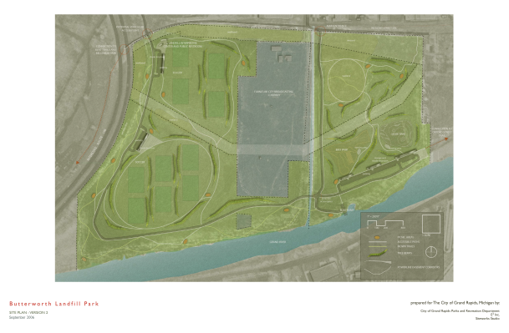
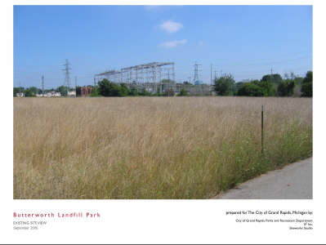
Early Reuse Assessments
City and EPA partner to complete visioning phase for future reuse

Slide 2
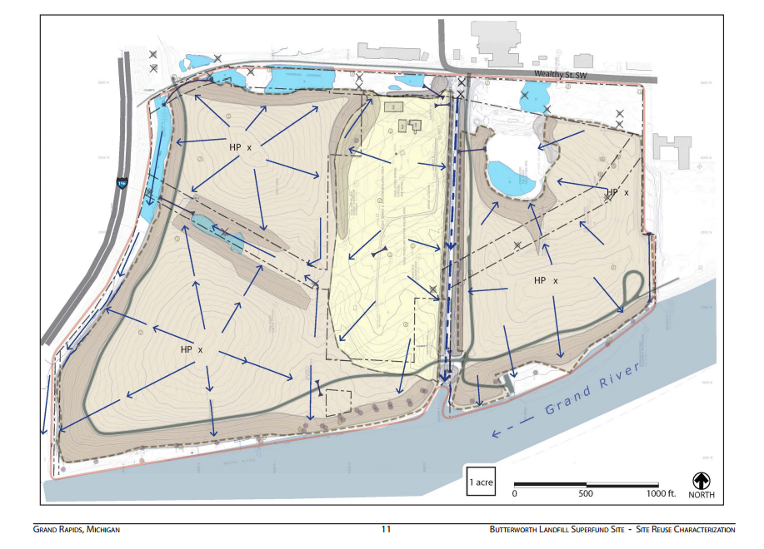
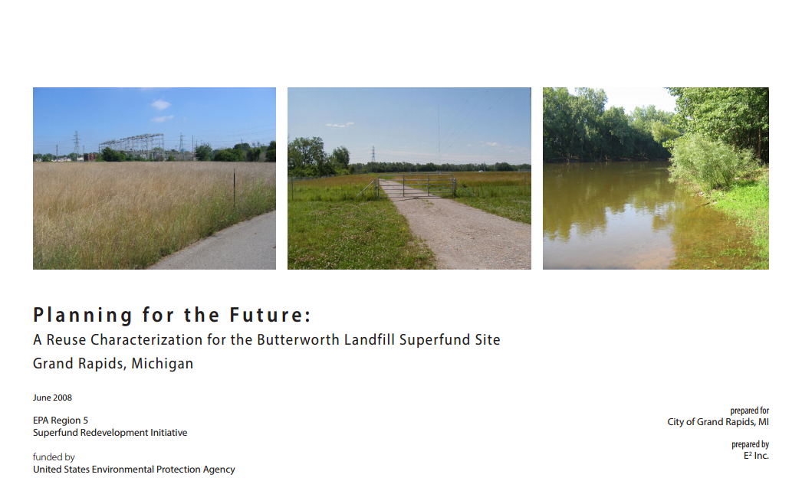
Refining Plans for the Future
Reuse Characterization project became the opportunities and constraints document used for the 2010 site master plan
http://www.epa.gov/superfund/programs/recycle/pdf/butterworthlandfill-reusereport.pdf

Slide 3
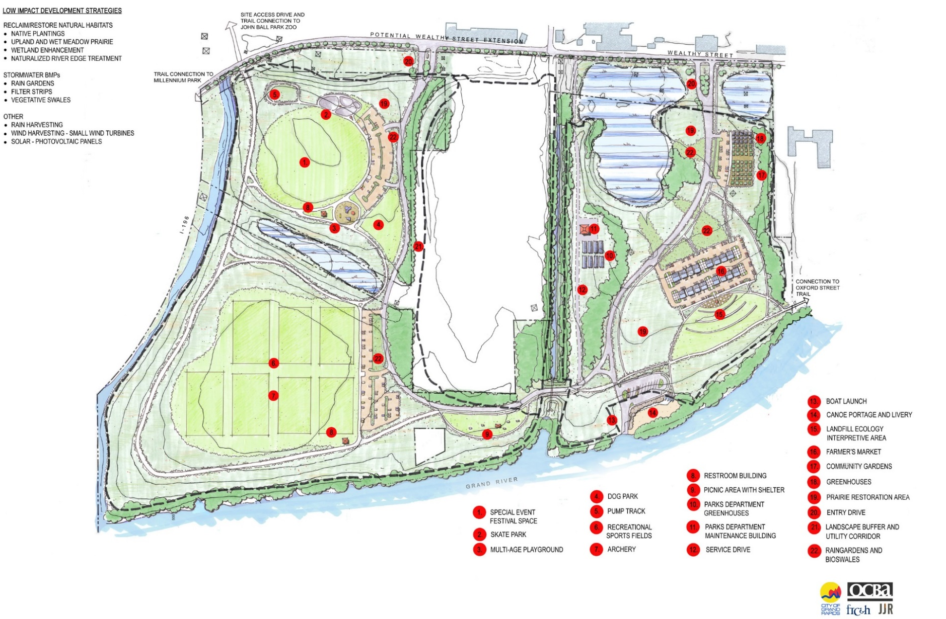
Green Grand Rapids Master Plan

Slide 4
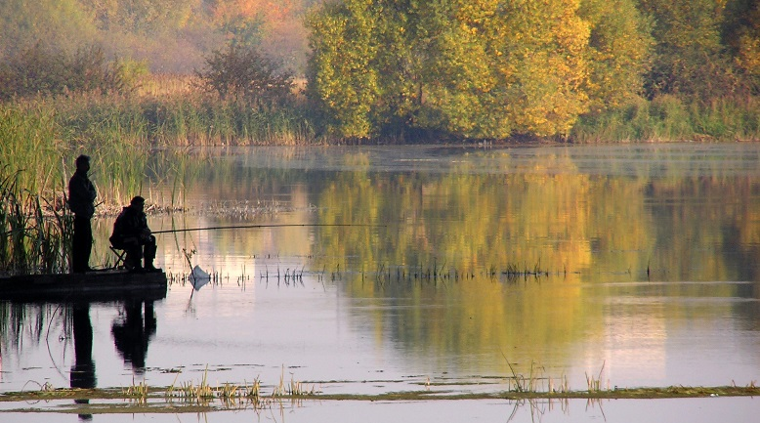
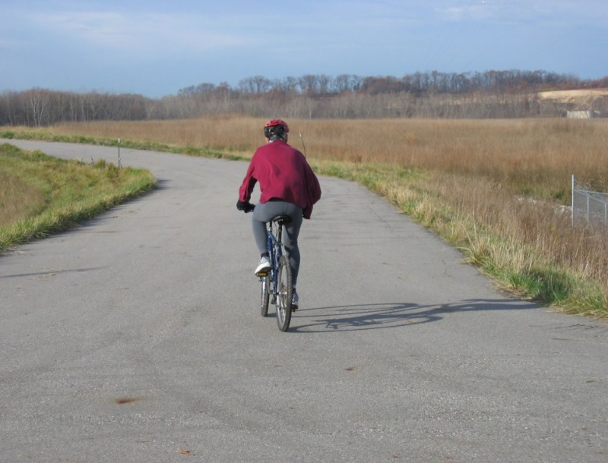
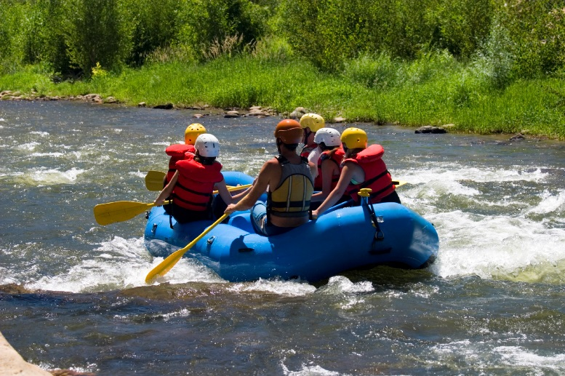
Creating Recreational Opportunities
Regional trail connector on site for bikes and races
Grant received for preliminary design of boat launch parking
Grand River rapids restoration; whitewater drop-off/ pickup at boat launch.

Slide 5
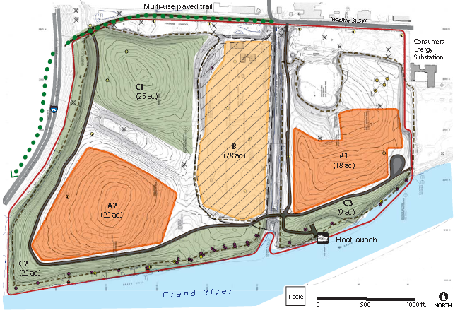
Looking Ahead
2011 – 2013 Solar Reuse Assessment
Preserving recreational spaces for future amenities (green areas)
Orange areas may be suitable for solar installation
Green infrastructure opportunities on 30 acres of on-site riparian corridor

Slide 6
For More Information, Contact
Tom Bloom
Region 5 Reuse Coordinator
bloom.thomas@epa.gov
Dion Novak
EPA Region 5, Site RPM
novak.dion@epa.gov
Jay Steffen
City of Grand Rapids
jsteffen@grcity.us

