Slide 1

Green Remediation and Green Infrastructure for a Cleaner and Safer Future
Carlos Pachon

Slide 2
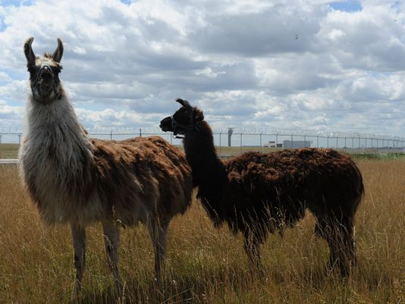
Photo credit: MIRA OBERMAN/AFP/Getty Images

Slide 3
Challenge: Lowering the Environmental Footprint of Site Cleanup Projects
Green Remediation
The practice of considering all
environmental effects of remedy
implementation and incorporating
options to minimize the environmental
footprints of cleanup actions.
*as defined by US EPA, a.k.a. greening response actions,
greener cleanups, etc.
Notes:
3
3
7/27/2015
3

Slide 4






Addressing the Environmental Leg of Sustainability:
Core Elements of Greener Cleanups
“Minimize, Reuse,
and Recycle…”
“Reduction, Efficiency,
and Renewables…”
“Conserve, Protect,
and Restore…”
“Protect Air Quality, Reduce Greenhouse Gases…”
“Improve Quality,
Decrease Quantity of Use…”

Slide 5
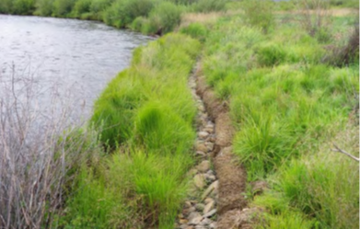
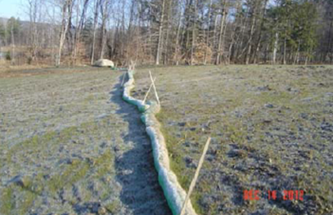
Greener Cleanup BMPs and Green Infrastructure
Use native grass species that can rapidly restore ground cover after remedial activities (California Gulch Superfund Site, Colorado EPA R8)
Use biobased and/or biodegradable rather than petroleum-based products , such as biodegradable seed matting or erosion control fabrics (Elizabeth Mine Superfund Site, Vermont, EPA R1)
5

Slide 6

The ASTM Guide for Greener Cleanups: A Common Language and Approach
ASTM Standard Guide for Greener Cleanups (E2893):
Codifies best practices and defines a process for reducing environmental footprint
Includes over 160 BMPs and outlines process for straight BMP application or use of quantification
A useful protocol for contracting purposes at any cleanup site
Results in a transparent documented process that is reported publicly
Small cleanup project, or standard cleanup approach
Cleanup project with Green Remediation goals (Client request, contract or regulatory requirement, etc)
Select and apply specific best management practices
Large complex projects
Quantify footprint, prioritize reduction targets

Slide 7
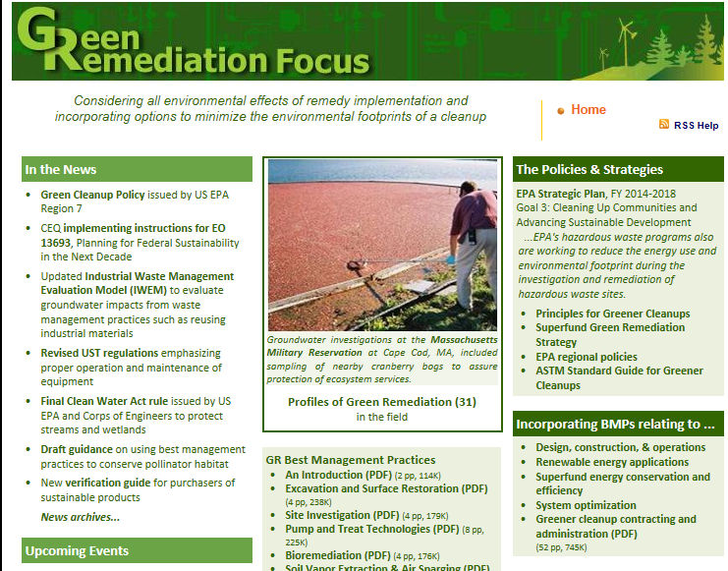
Greener Cleanups: Information and Resources
Implementation Guidance
Technical Webinars
Fact Sheets
Case Studies and Project Profiles
Policies and Strategies
News Updates
http://cluin.org/greenremediation

Slide 8
For More Information, Contact:
Carlos Pachon
EPA Superfund
Team Lead for Greener Cleanups
pachon.carlos@epa.gov
8

