Slide 1
Bringing Alternative Energy Projects to Superfund Sites
June 25, 2015
2:00 PM - 4:00 PM, EDT

Slide 2
Webinar Overview
Introduction to Reuse and SRI
    - Melissa Friedland, EPA SRI
Iron Horse Park (Solar)
- Robert Kirsch, WilmerHale
Martin-Marietta, Sodyeco, Inc. (Biofuel)
- Tom McKittrick, Forsite Development
4. Arsenic Trioxide (Geothermal) and Summitville Mine (Off-Site Solar)
  - Fran Costanzi, EPA Region 8
5. Pantex Plant (USDOE (Wind)
    - Camille Hueni, EPA Region 6; Kevin Long, Consolidated Nuclear Security, LLC, NNSA Pantex Plant
    6. How RE-Powering America’s Land Can Help
  - Marc Thomas, EPA RE-Powering America’s Land
  7. Resources, Contacts and Questions
- Melissa Friedland, EPA SRI

Slide 3
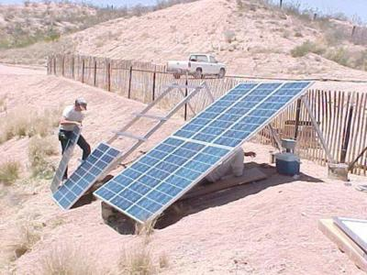
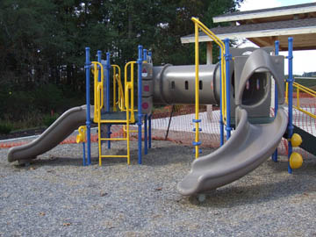
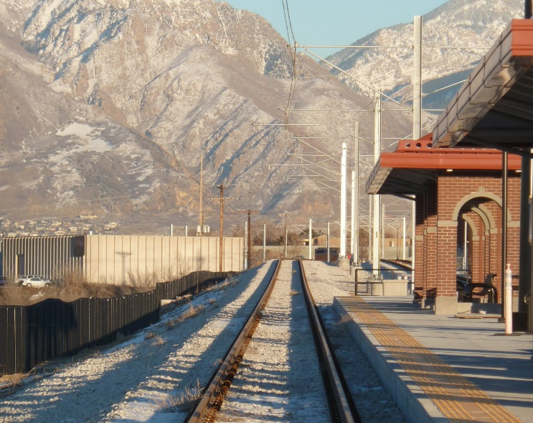
SRI: Superfund Redevelopment Initiative
Working with communities and other partners in considering future use opportunities and integrating appropriate reuse options into the cleanup process
http://www.epa.gov/superfund/programs/recycle/

