Slide 1

Shaffer Landfill
Robert C. Kirsch

Slide 2
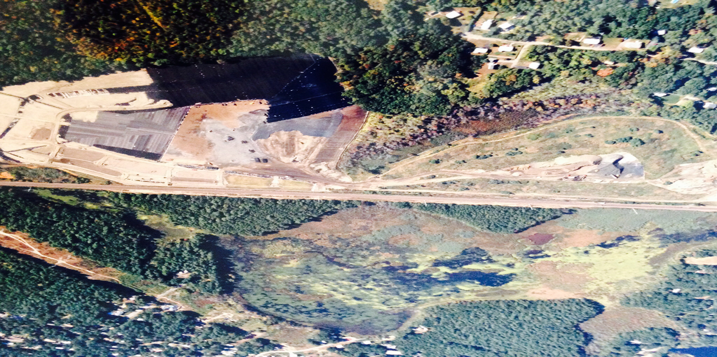
Shaffer Landfill OU - Before
2

Slide 3
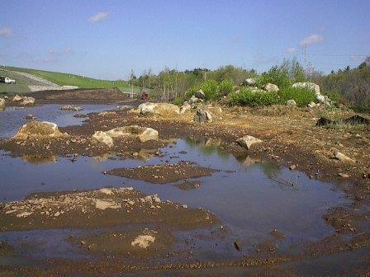
The landfill is bounded by wetlands
3

Slide 4
Shaffer Landfill CERCLA Solar Redevelopment
Ironhorse Park Site 550 acres
Shaffer Landfill OU 60 acres
Landfill operated 1950s to 1980s
State enforcement 1984
EPA lead 1991
PRP involvement 1993
Consent Decree 2000
Construction Complete 2003
4

Slide 5
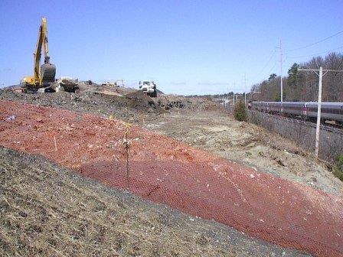
Re-grading North slope residential lobe
5

Slide 6
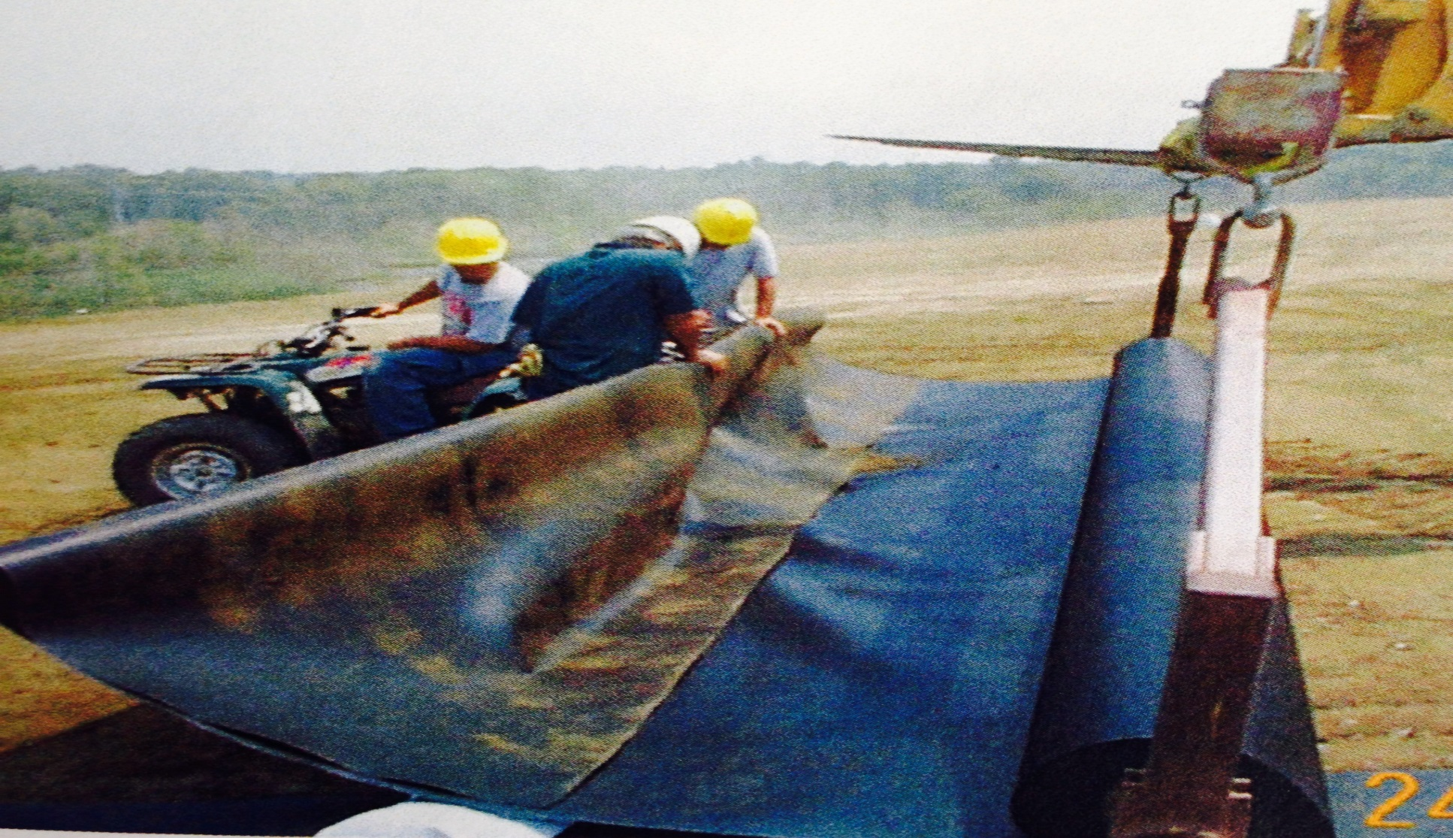
After re-grading, both lobes were capped
6

Slide 7
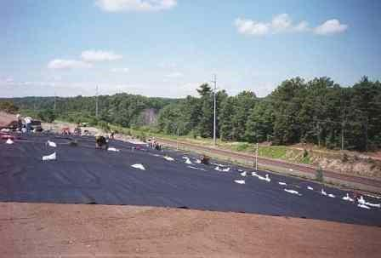
Liner welded over grading foundation layer
7

Slide 8
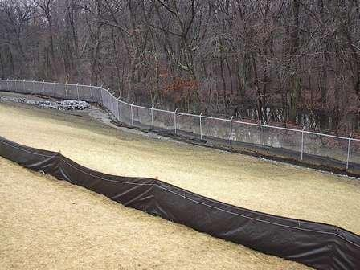
Temporary sedimentation measures
8

Slide 9
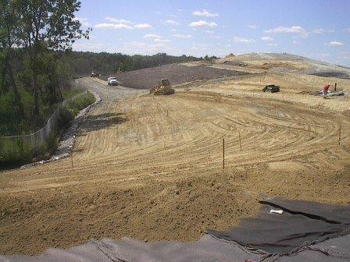
Topsoil over the cap (F) grading layer (R)
9

Slide 10
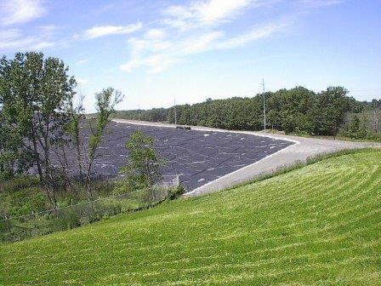
Vegetation (F) and Cap (R)
10

Slide 11
Landfill Redevelopment & CERCLA
Energy Rights Transferred to PRPs 1998
LFG effort 2000 – 2001
Possible Solar Developers Emerge 2009
Transform Energy Right to Financeable Interest 2011
11

Slide 12
Landfill Redevelopment & CERCLA
Development Lease 2011
Local Permitting 2011 – 2012
State Permitting 2012 – 2013
Project Financed – 2013
  PILOT
  Settlement
  Lease/Easement
12

Slide 13
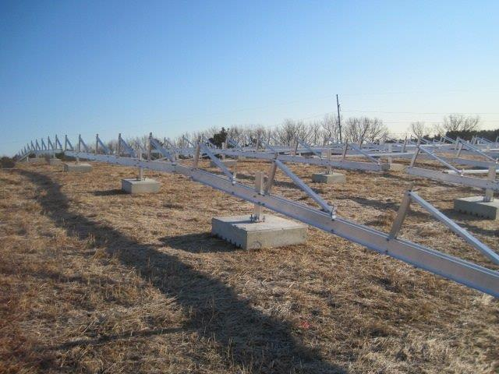
Construction 2014
13

Slide 14
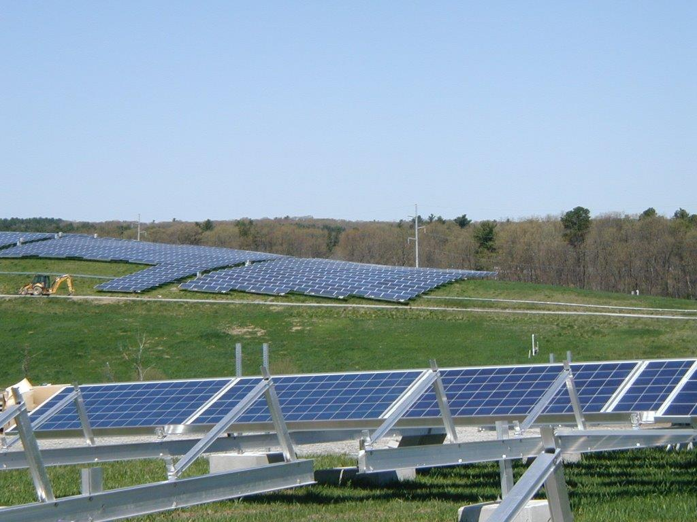
Construction 2014
14

Slide 15
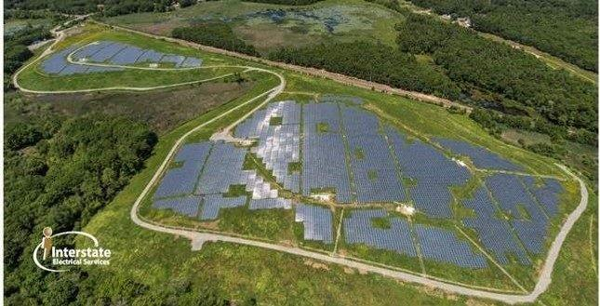
Shaffer Solar Project - After
15

Slide 16
Lessons Learned
Identify All Stakeholders
  Local Interests Can Be Complex and Time Consuming
Manage Expectations
Manage Risks – CERCLA Scares Financers
Enlist Agency(ies) Support
Questions?
16

Slide 17
For More Information, Contact:
Robert Kirsch
Partner, WilmerHale
rob.kirsch@wilmerhale.com
17

