Slide 1
RE-Powering America’s Land Initiative
Marc Thomas

Slide 2
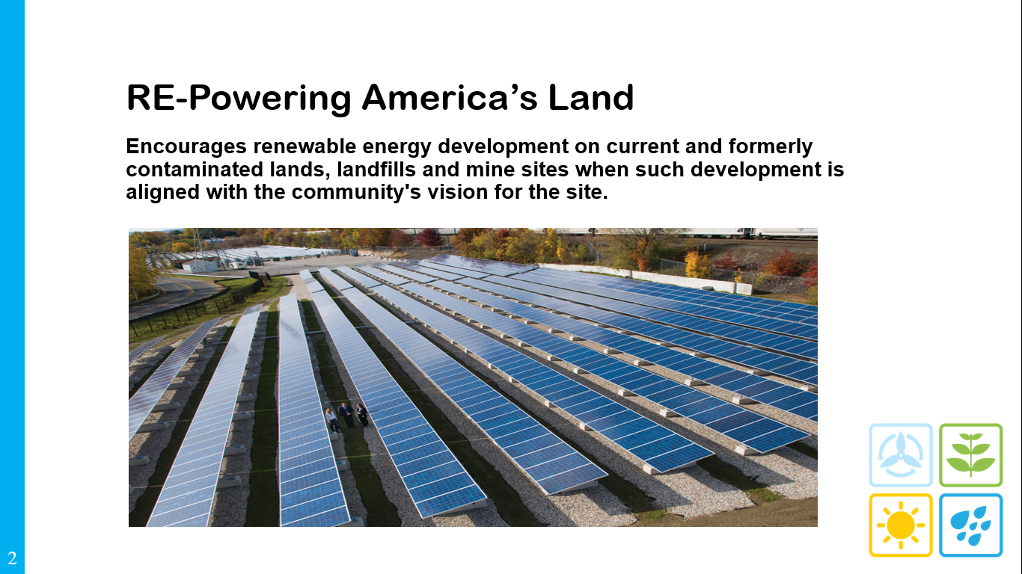

Slide 3
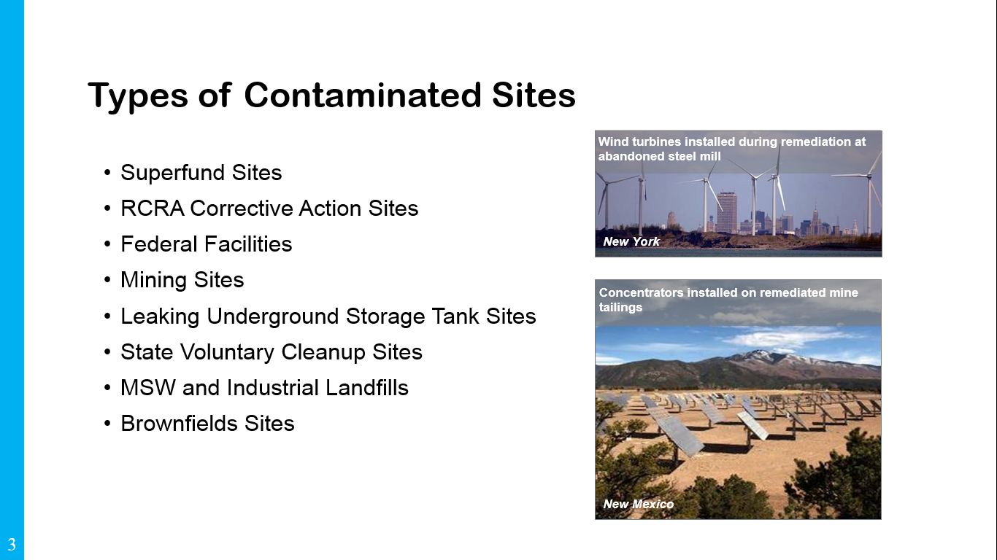

Slide 4
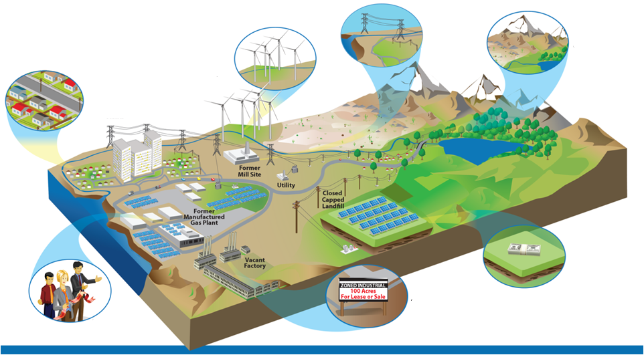
Why Renewables on Potentially Contaminated Lands?
Leverage existing
infrastructure
Build sustainable land development strategy
Protect open
space
Provide low-cost, clean power to communities
Improve project economics through reduced land costs & tax incentives
Reduce project cycle times with streamlined zoning and permitting
Gain community support
4

Slide 5

RE-Powering Tools and Resources
Mapping and Screening Tools
  RE-Powering Mapper
  Solar and Wind Decision Trees
Project Specific Technical Assistance
  RE-Powering Response Team (RRT)
  EPA/NREL Feasibility Studies
Communications and Outreach
  Newsletter, Tracking Matrix, Case studies, Webinars, etc.
Redevelopment Tools and Resources
  Liability Guidance and Model Comfort Letters
  Handbook on Siting Renewable Energy While Addressing Environmental Issues
  Best Practices for Siting Solar Photovoltaics on Municipal Solid Waste (MSW) Landfills
  RE-Powering Financing Fact Sheet and Other Resources
Pantex Renewable Energy Project
5

Slide 6
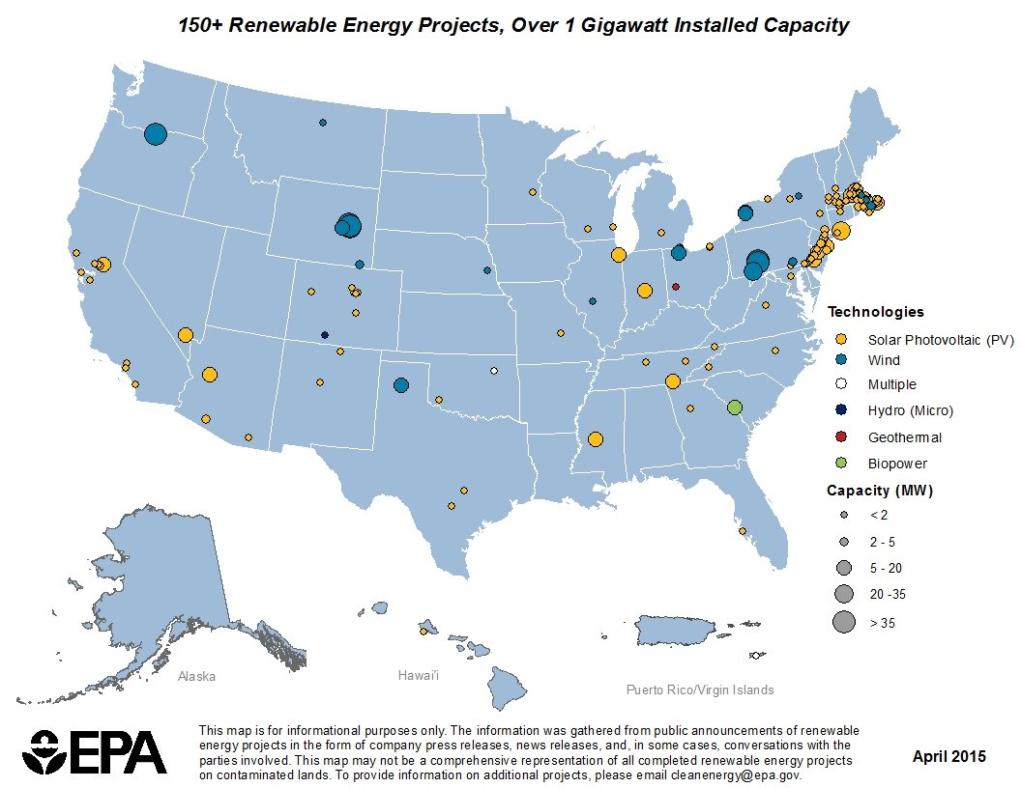
151 Installations Identified to Date
6

Slide 7
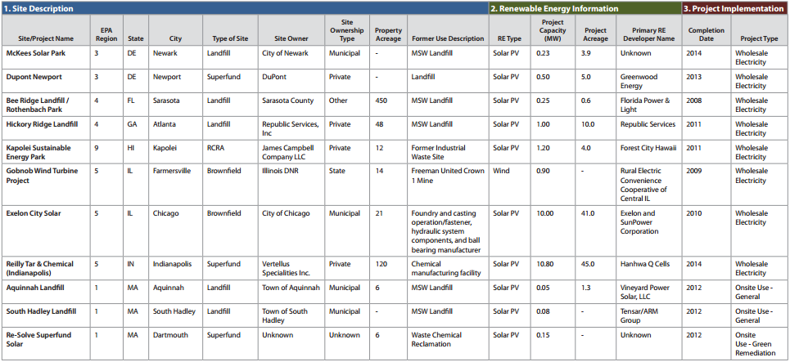
Tracking Matrix - Excerpt
7

Slide 8
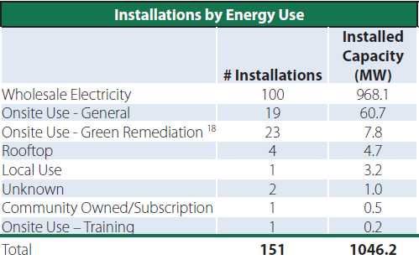
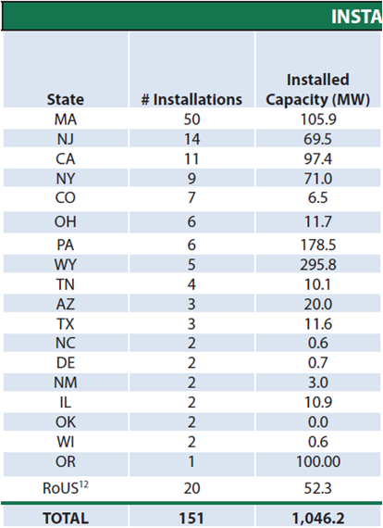
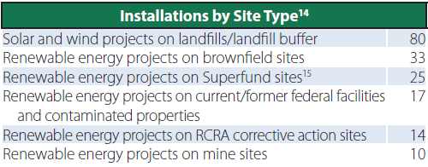
Trends: most installations sell wholesale electricity, are sited on landfills, and located in policy supportive states
8

Slide 9
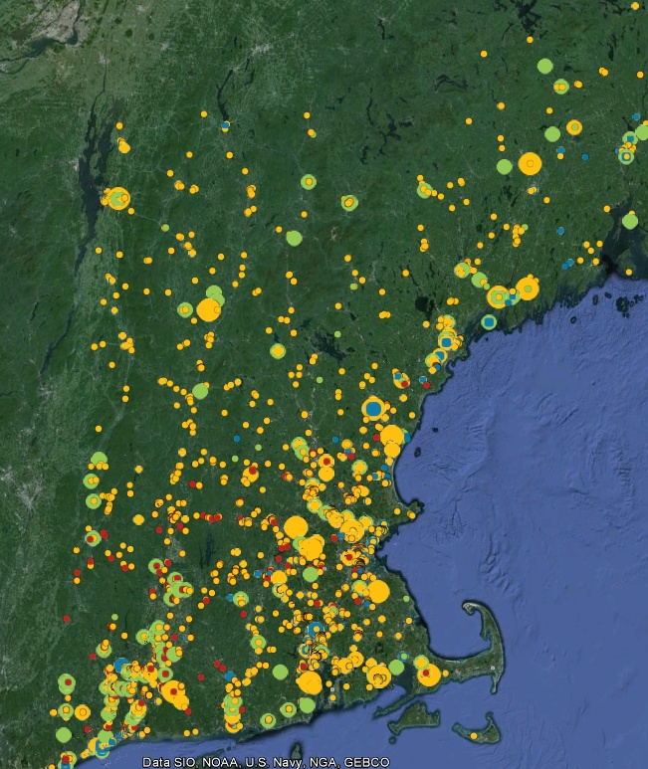
RE-Powering Mapper
Google Earth Overlay
Mapped inventory of 66,000+ EPA and select state tracked sites (over 35 million acres of land).
Identified potential renewable energy opportunities based on resource availability, acreage, and distance to infrastructure (roads and transmission lines)
Incorporates data from:
EPA Cleanup and Landfill Programs
National Renewable Energy Lab
  Wind, Solar, and Biomass Resources
Southern Methodist University and USGS
  Geothermal
Department of Homeland Security
  U.S. Highways
  Railroads
  Transmission Lines
  Substations
State Agencies from CA, HI, NJ, NY, OR, PA, VA, and WV
9

Slide 10
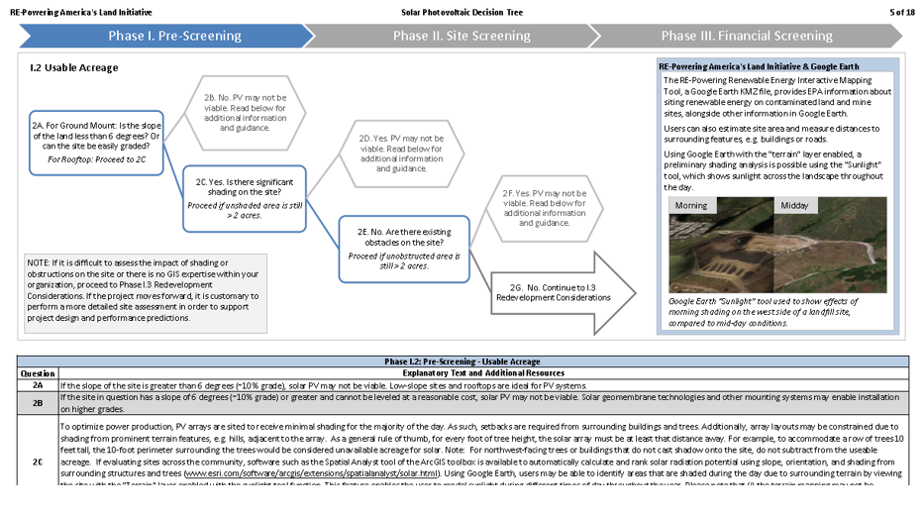
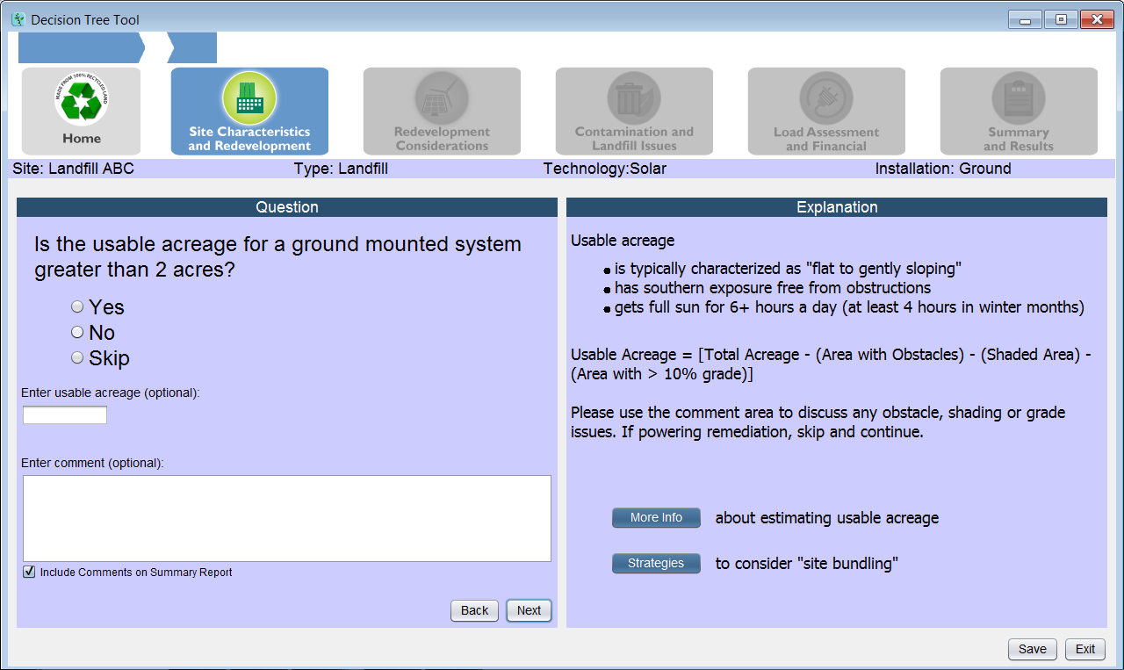
RE-Powering Decision Trees
10

Slide 11
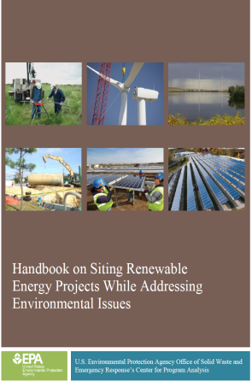
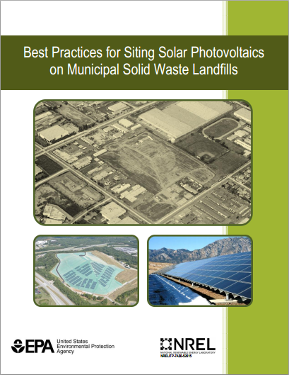
RE-Powering Tools and Resources
  Handbook on Siting Renewable Energy Projects While Addressing Environmental Issues
  Opportunities for siting renewable energy projects while addressing environmental site issues during all phases of cleanup
  Best Practices for Siting Solar Photovoltaics on Municipal Solid Waste Landfills
  Provides unique considerations, challenges, and best practices for siting solar PV on MSW landfills
  Provides information on power generation and deal structures
  Provides examples of solar PV on landfill projects
  Provides tools and resources to help facilitate solar PV on landfills
11

Slide 12
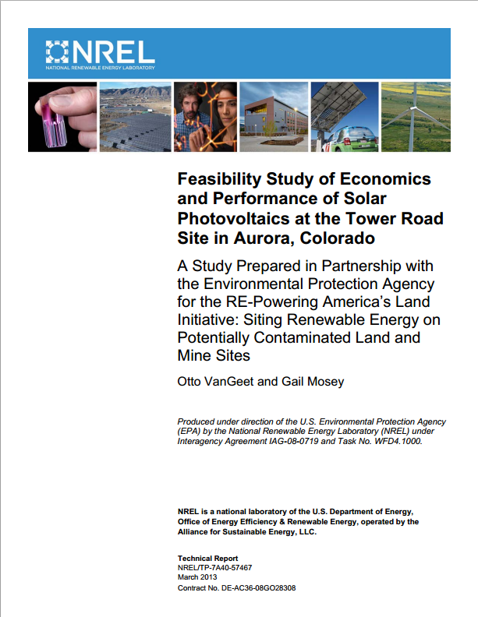
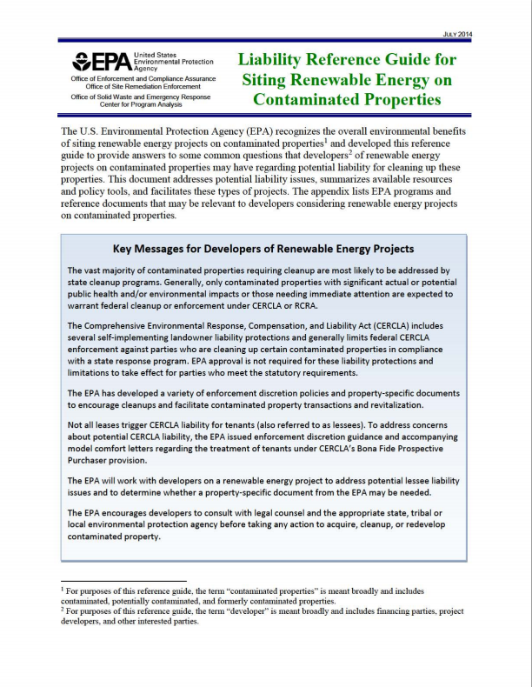
RE-Powering Tools and Resources
EPA/NREL Feasibility Studies
Pairs EPA’s expertise on contaminated sites with NREL’s renewable energy expertise
Assesses specific sites for renewable energy (RE) technologies
Estimates the cost, performance and site impacts of potential renewable energy project
Resources Regarding Potential Liability Issues
Revised Enforcement Guidance Regarding Tenants and CERCLA’s BFPP Provision
Model Comfort Letters
Liability Reference Guide for Siting Renewable Energy on Contaminated Properties
The Revitalization Handbook
12

Slide 13
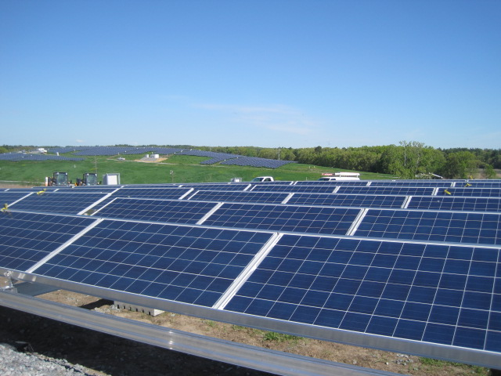
RE-Powering America’s Land
        Marc Thomas, RE-Powering Policy Analyst
        thomas.marc@epa.gov
        202-566-0791
        Adam Klinger, RE-Powering Team Lead
        klinger.adam@epa.gov
        202-566-0546
        General inquiries
        cleanenergy@epa.gov
Shaffer Landfill (Iron Horse Park)
        www.epa.gov/renewableenergyland
13

