Slide 1

Potentially Responsible Party (PRP) Perspectives on Superfund
Site Reuse
Superfund
Redevelopment
Initiative
August 2015

Slide 2
Webinar Overview
Welcome, Introduction to Reuse and SRI
  Melissa Friedland, EPA SRI
EPA Perspectives on PRP Reuse
  Hollis Luzecky, EPA OSRE
Calhoun Park Area Site Case Study
  Thomas Effinger, SCANA Corporation
Chemical Commodities, Inc. Site Case Study
  David Dassler, The Boeing Company
Midvale Slag Site Case Study
  Kevin Murray, Holland & Hart LLP
Resources, Contacts and Questions
  Melissa Friedland, EPA SRI

Slide 3
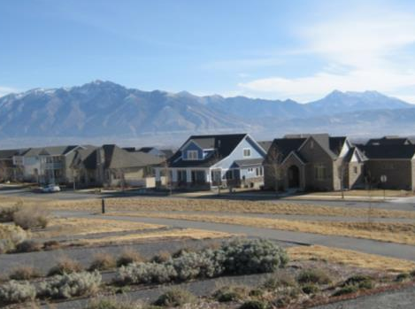
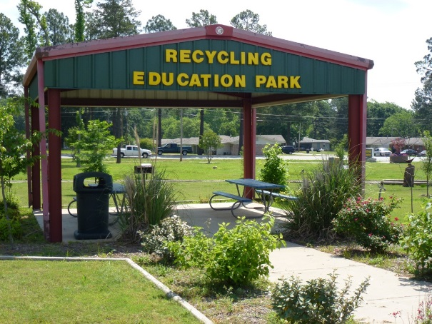
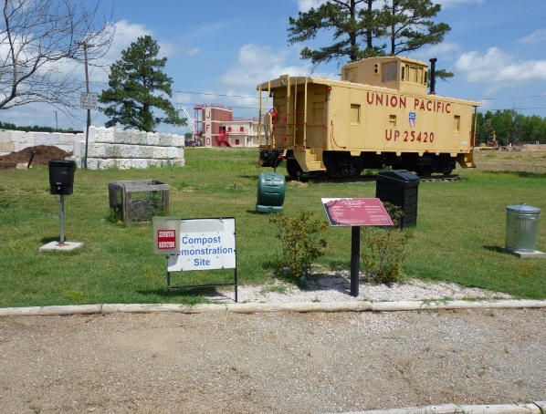
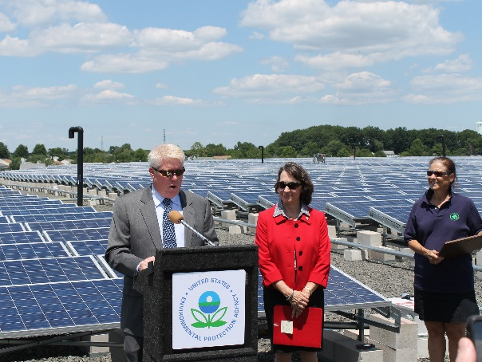
SRI: Superfund Redevelopment Initiative
Working with communities and other partners in considering future use opportunities and integrating appropriate reuse options into the cleanup process
http://www.epa.gov/superfund/programs/recycle/

