Slide 1

Calhoun Park Area Site Case Study
Tom Effinger

Slide 2
What is a Manufactured Gas Plant (MGP)?
MGPs were facilities that heated coal (and sometimes oil) in a closed vessel to liberate a flammable gas that was subsequently processed and stored in on-site gasholders prior to being distributed to end users.
MGPs were utilized in the U.S. from the 1800s thru the 1950s to manufacture gas from coal and oil prior to the development of interstate natural gas pipeline systems.
Estimates of the number of MGPs in the U.S. range from 3,000 to 10,000.

Slide 3
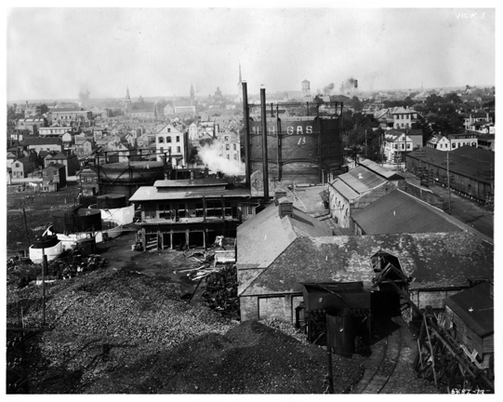
Charlotte Street Gas Works
1911

Slide 4
General Description of Site
  The CPA Site includes the SCE&G Charlotte Street electrical substation, former Calhoun Park, and former Ansonborough Homes.
  The electrical substation supplies electricity to majority of the southern portion of Charleston peninsula.
  Calhoun Park is currently site of an 1,100 car parking garage.

Slide 5
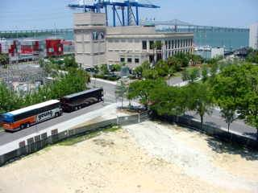
IMAX Theater

Slide 6
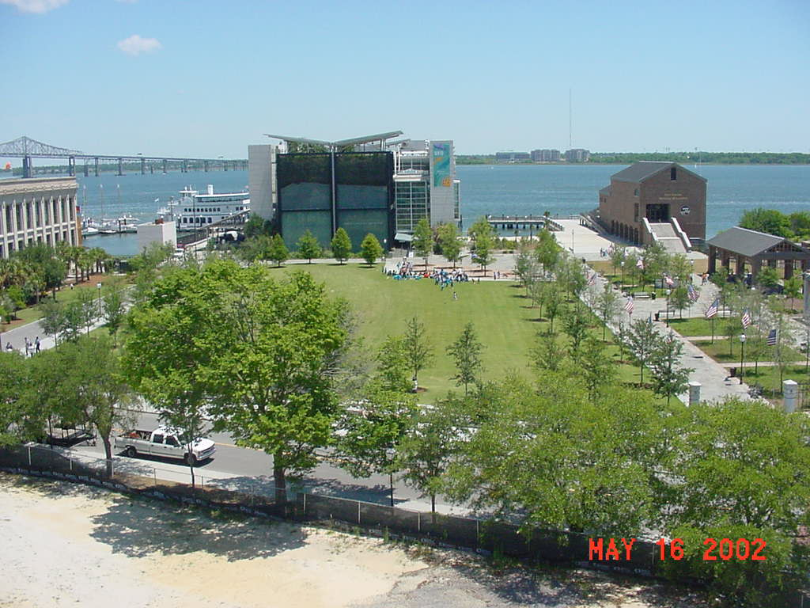
City Aquarium & Tour Boat Facility

Slide 7
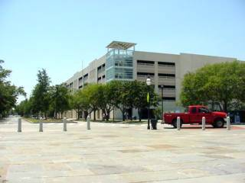
1,100 Car Parking Garage

Slide 8
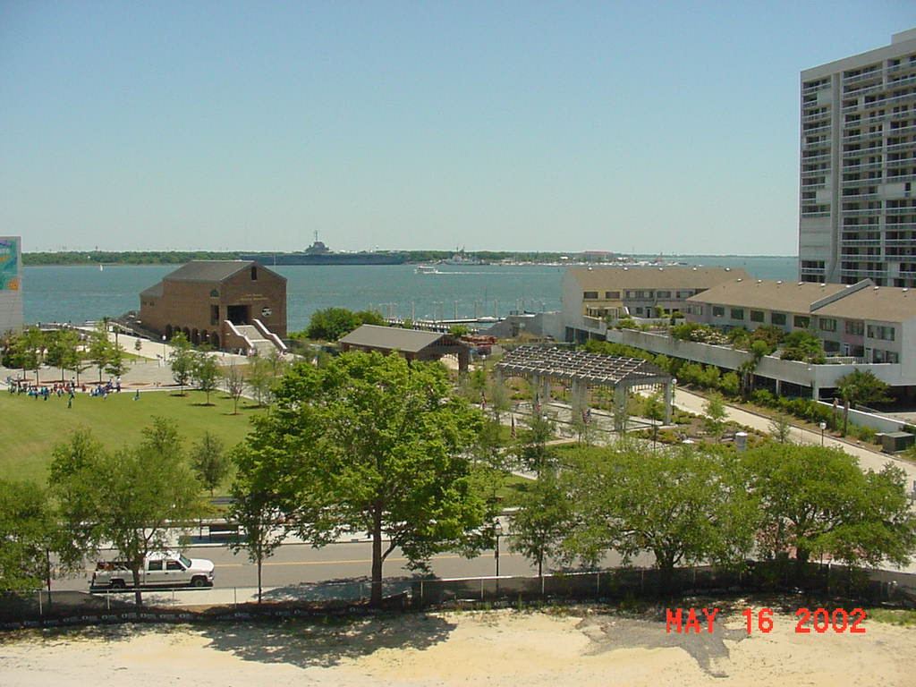
Dockside Condominiums

Slide 9
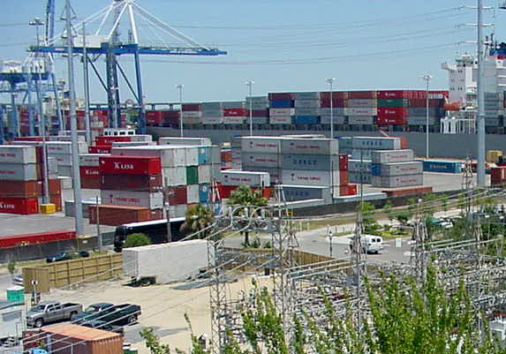
SC State Ports Authority

Slide 10
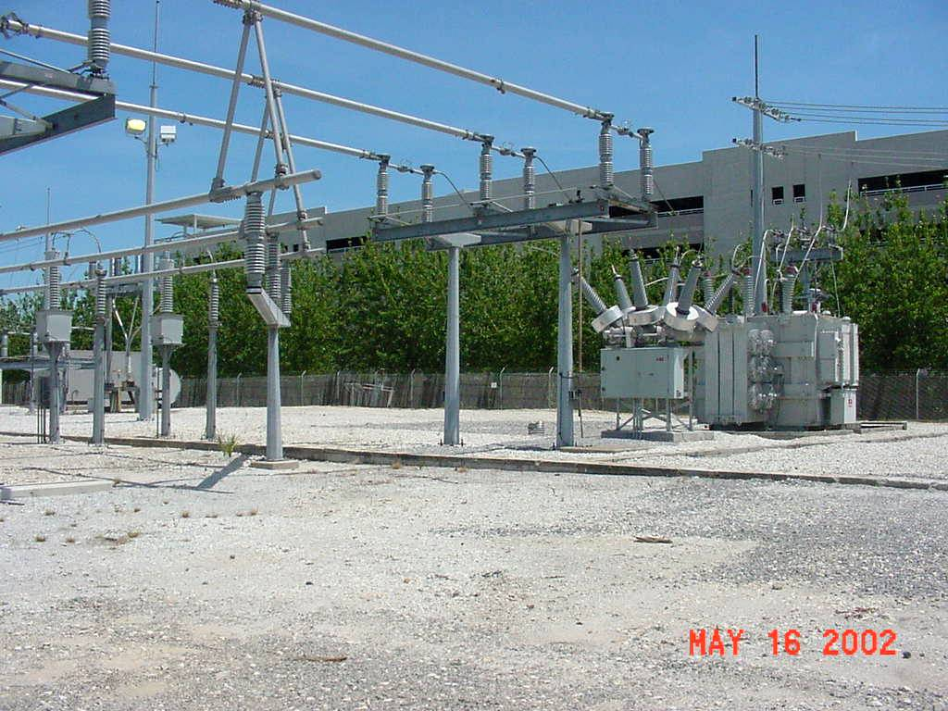
Photo of Substation

Slide 11
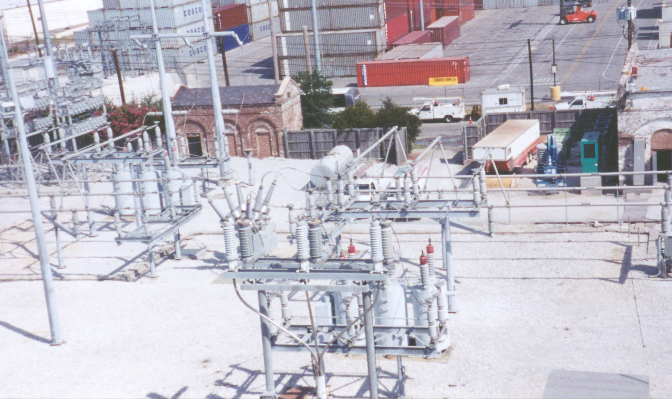
Substation Photo of Former MGP

Slide 12
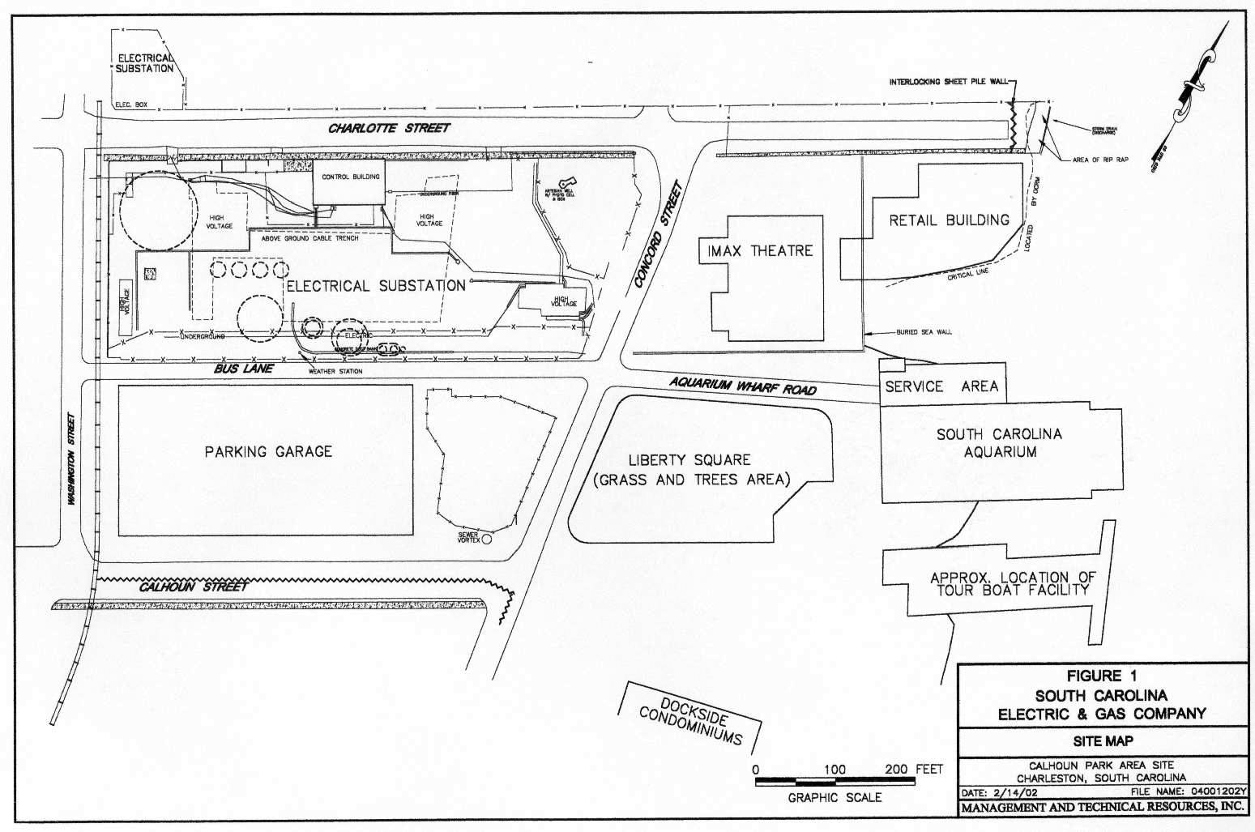

Slide 13

Project Stakeholders
Luden’s Developers
Regulators
Consultants
National Park Service
General Public
(Media)
City of Charleston

Slide 14
OK, So now what?
The mayor has an edict to open the Aquarium by May 2000.
The Developers need to get started.
The groundwater data doesn’t make sense.
CERCLA demands a rigorous protocol.
This ain’t no UST!

Slide 15
Regulatory Approach
Communications with all stakeholders
Phased approach to remedial work
Agency involvement in the preparation of Work Plans
Agency approval prior to implementing remedial work

Slide 16
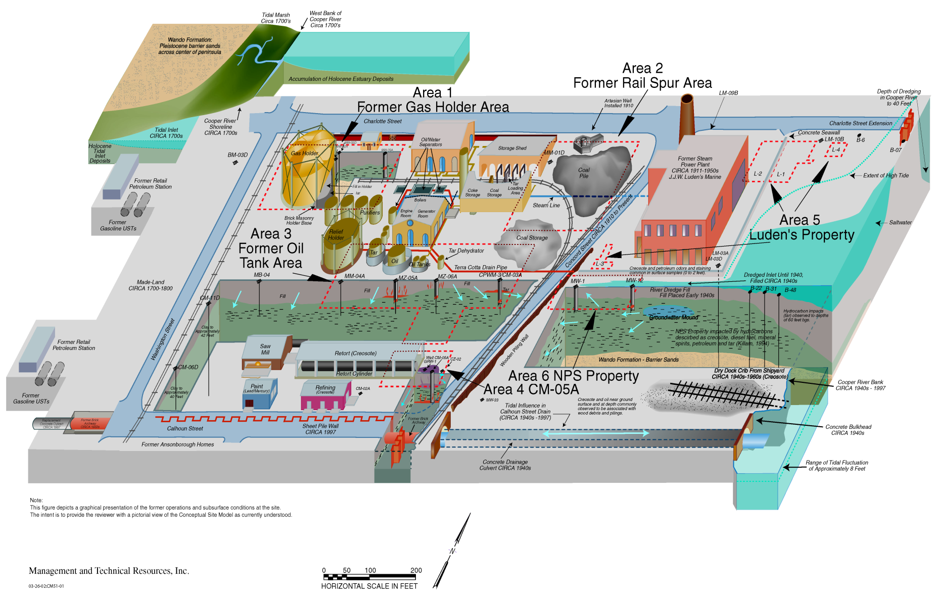
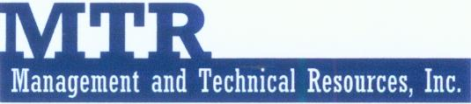
Conceptual Site Model

Slide 17
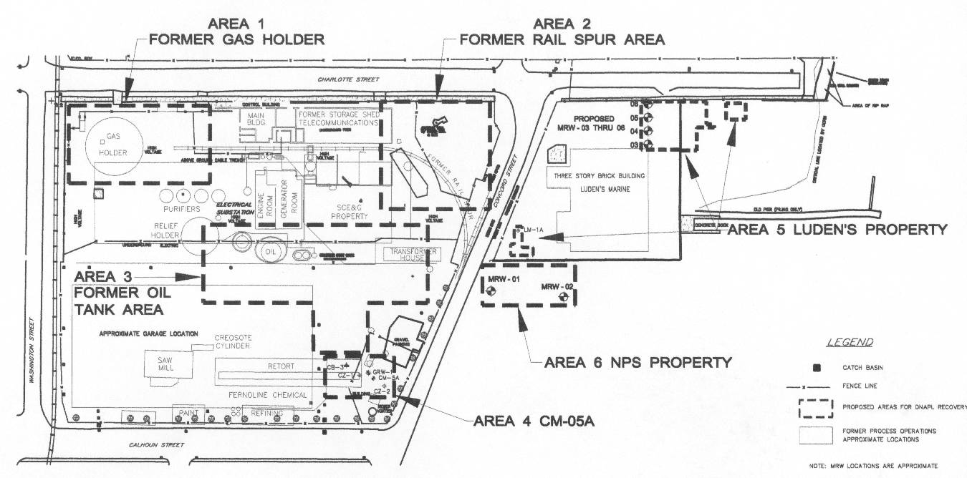
Remediation Areas

Slide 18
Summary of Remediation Activities
Excavation of DNAPL Impacted Material
Dewatering (in support of Excavation)
Installation of a DNAPL Recovery Trench
Recovery and Removal of Free-Phase DNAPL
Fenton’s Reagent Injection
ORC, PermeOx, EHC-O Injection
Phytoremediation

Slide 19
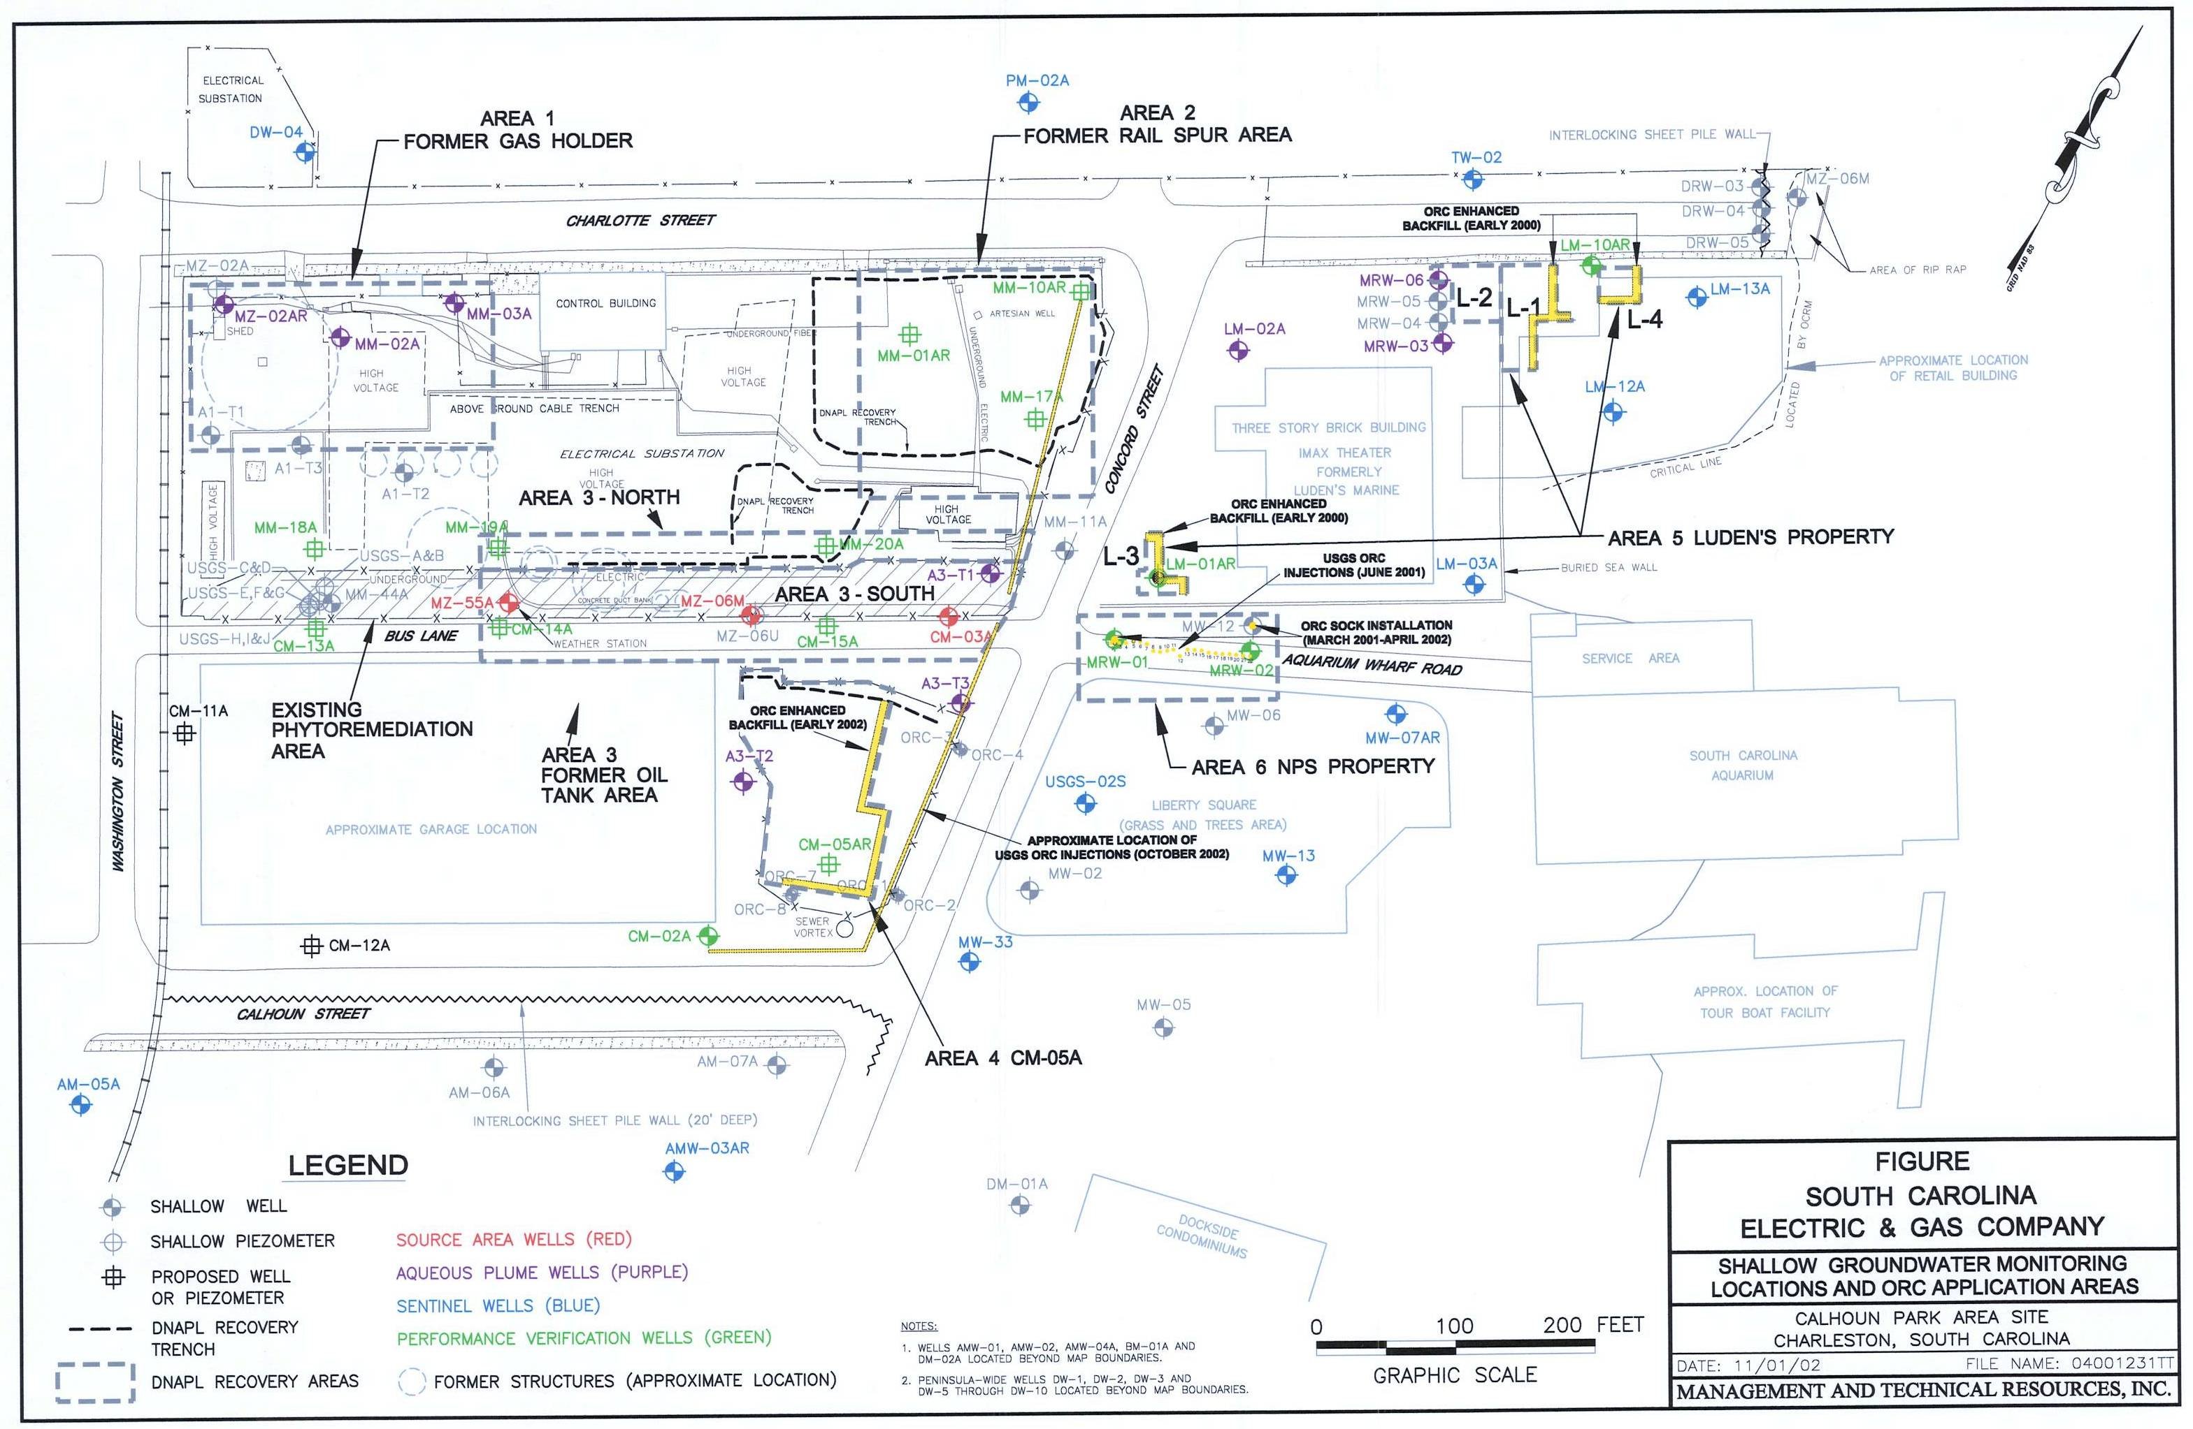
Example Title and Slide Text

Slide 20
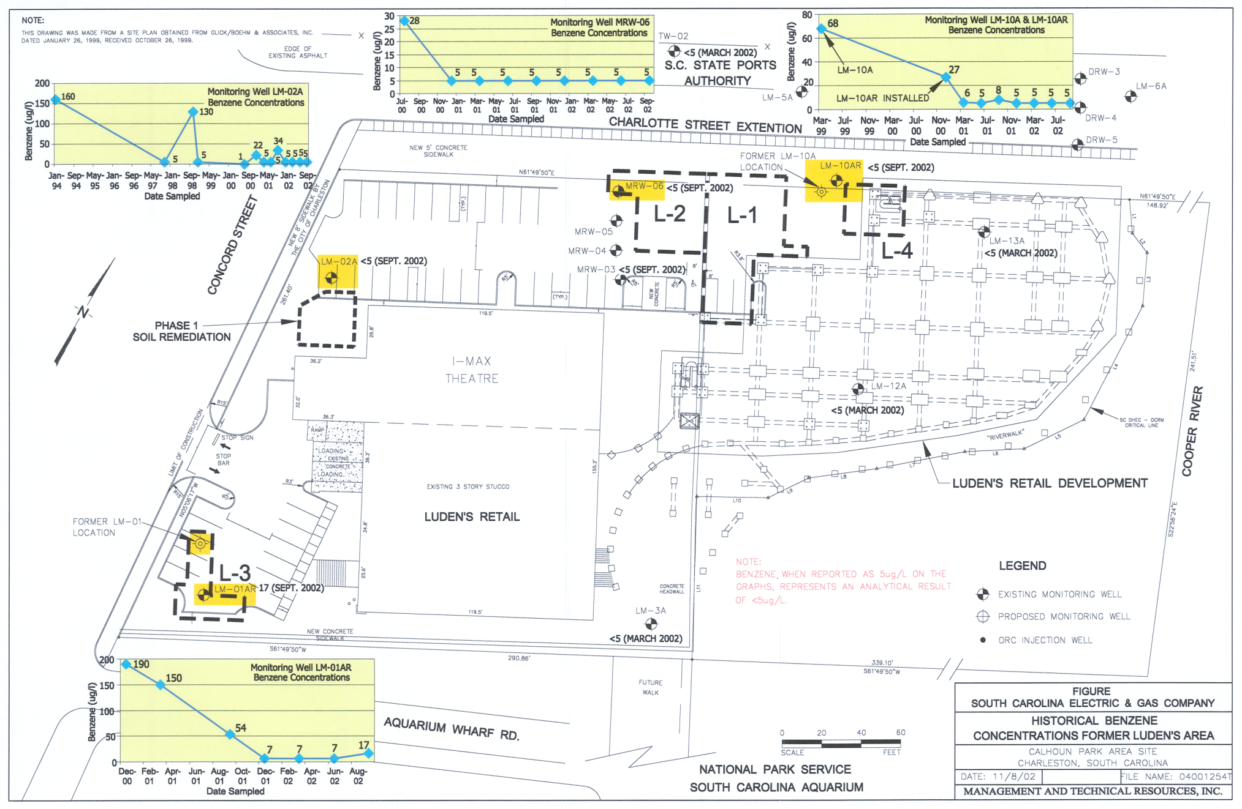
Example Title and Slide Text

Slide 21
Total Remediation Volumes Through March 2015
Media | Volumes
Impacted Material and Debris | Approximately 63k tons
Water/Groundwater | 3+ million gallons
Coal Tar Removed | 30,000 gallons

Slide 22
Remediation Areas

Slide 23
What about areas that could not be excavated?

Slide 24
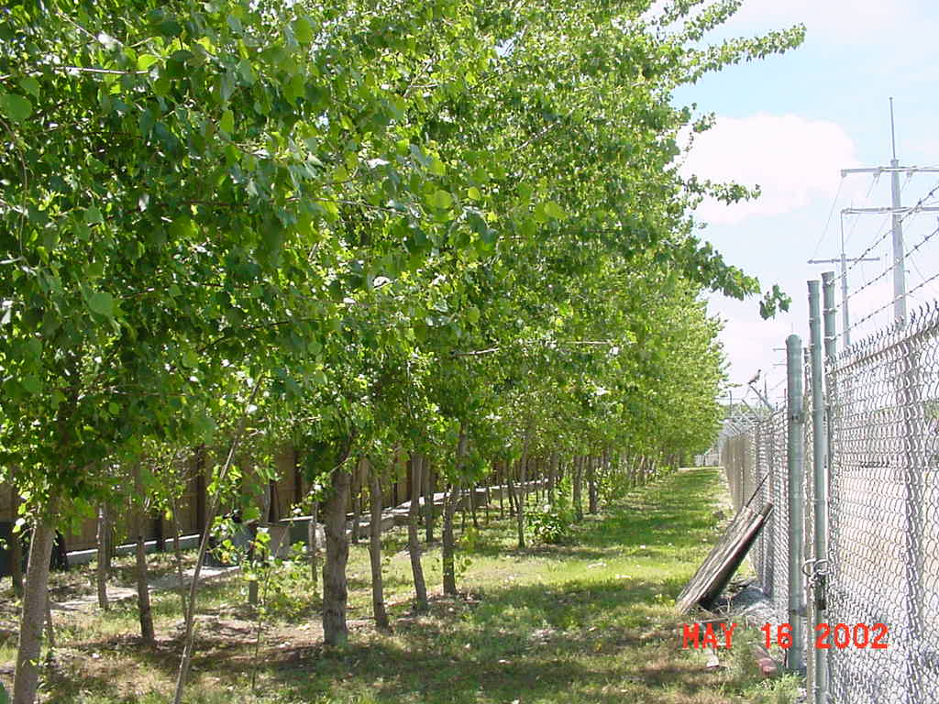
Phytoremediation Area

Slide 25
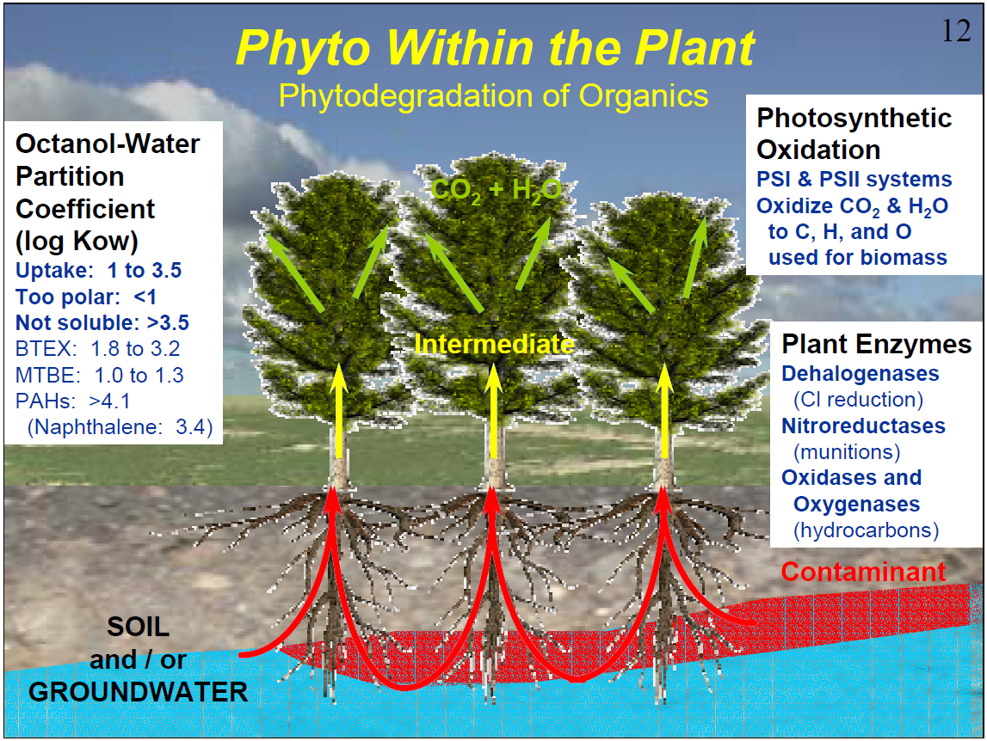
Source: 2003 ITRC Internet-based Training

Slide 26
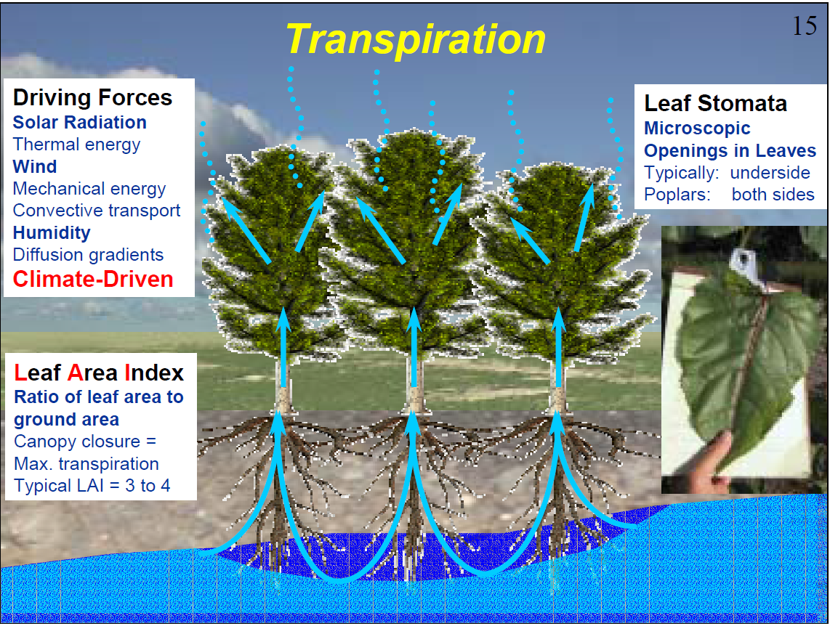
Source: 2003 ITRC Internet-based Training

Slide 27
What about Residual DNAPL Areas?

Slide 28
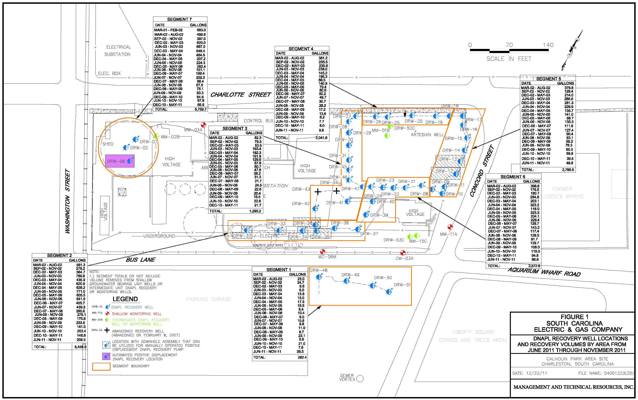
DNAPL Recovery Wells

Slide 29
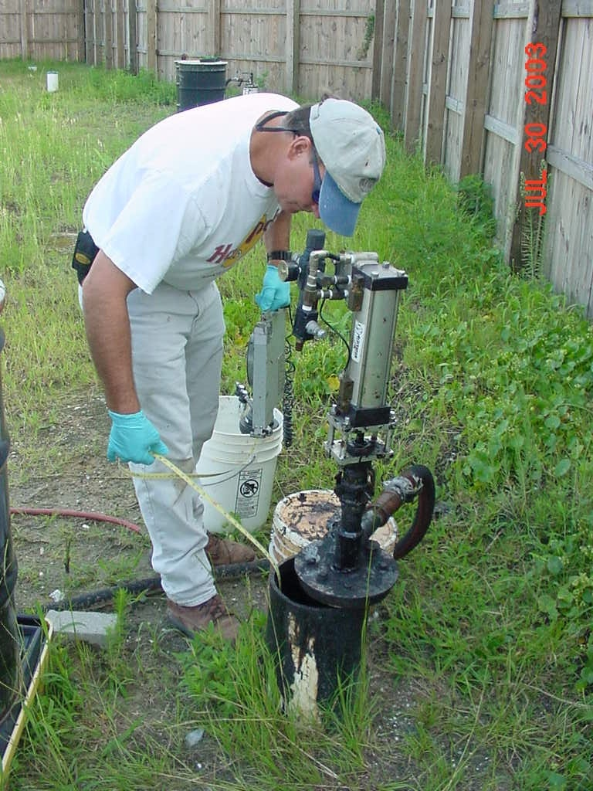
Measuring Depth to Tar in DRW 13

Slide 30
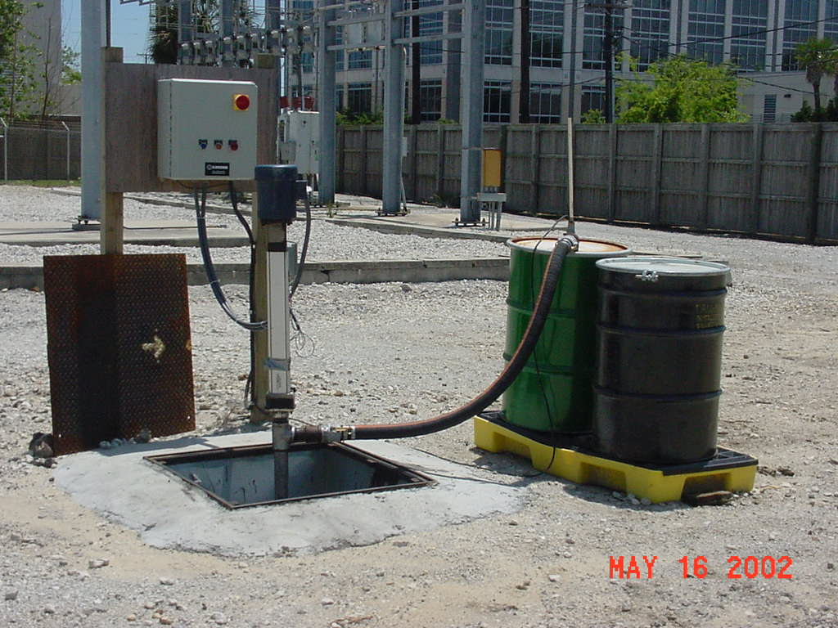
DNAPL pumping at Holder
Notes:
An 8-inch recovery well at the gas holder.

Slide 31
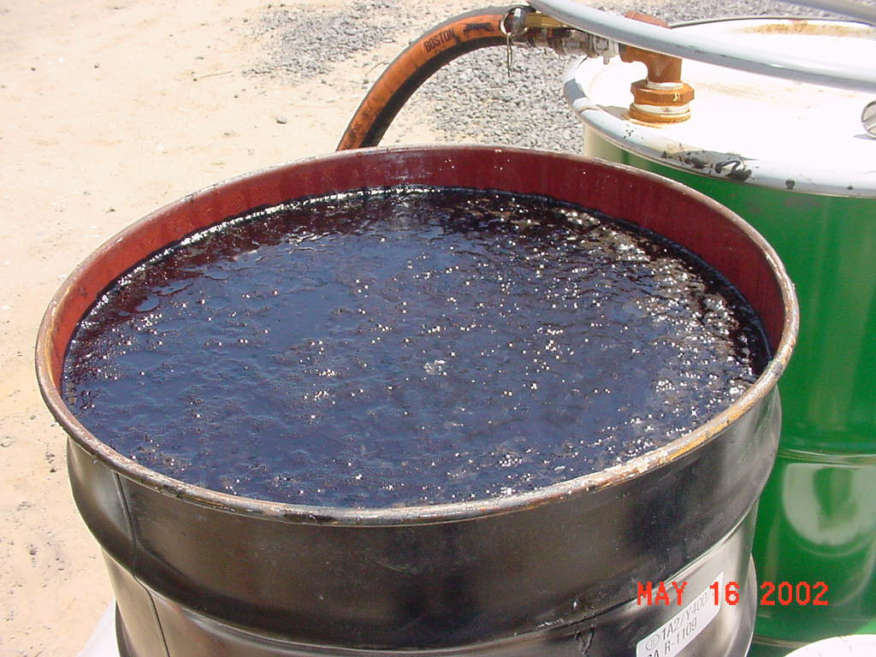
Recovered Tar/DNAPL

Slide 32
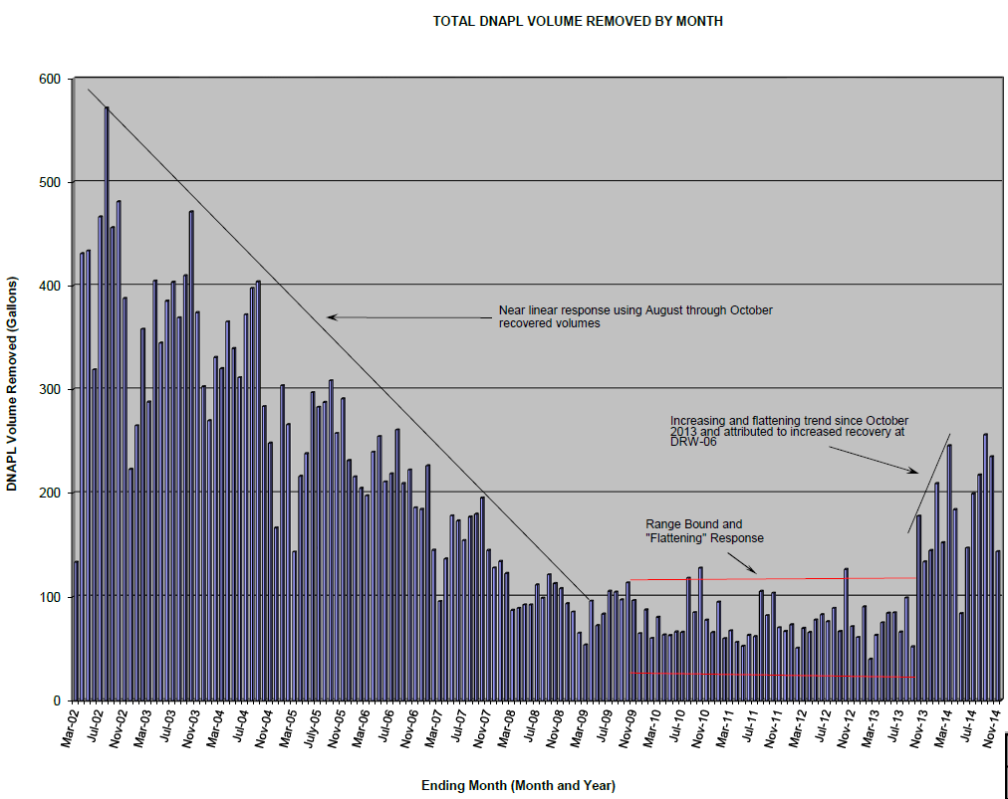
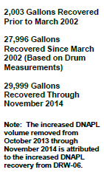

Slide 33
What about Sediment Areas in Cooper River?

Slide 34
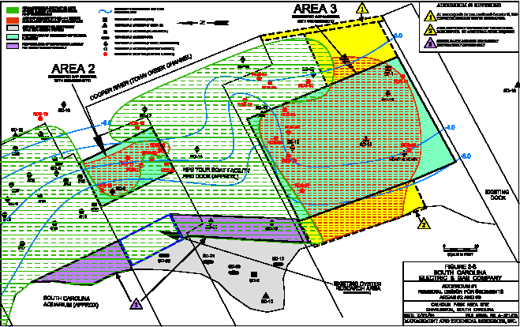
Sediment Cap and Habitat Restoration

Slide 35
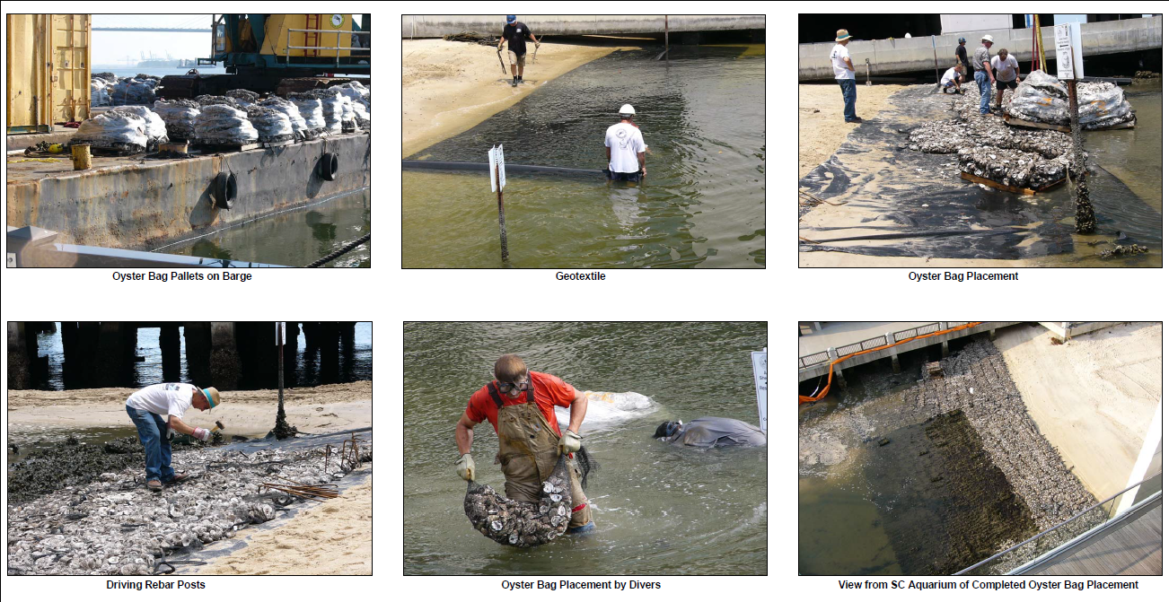

Slide 36
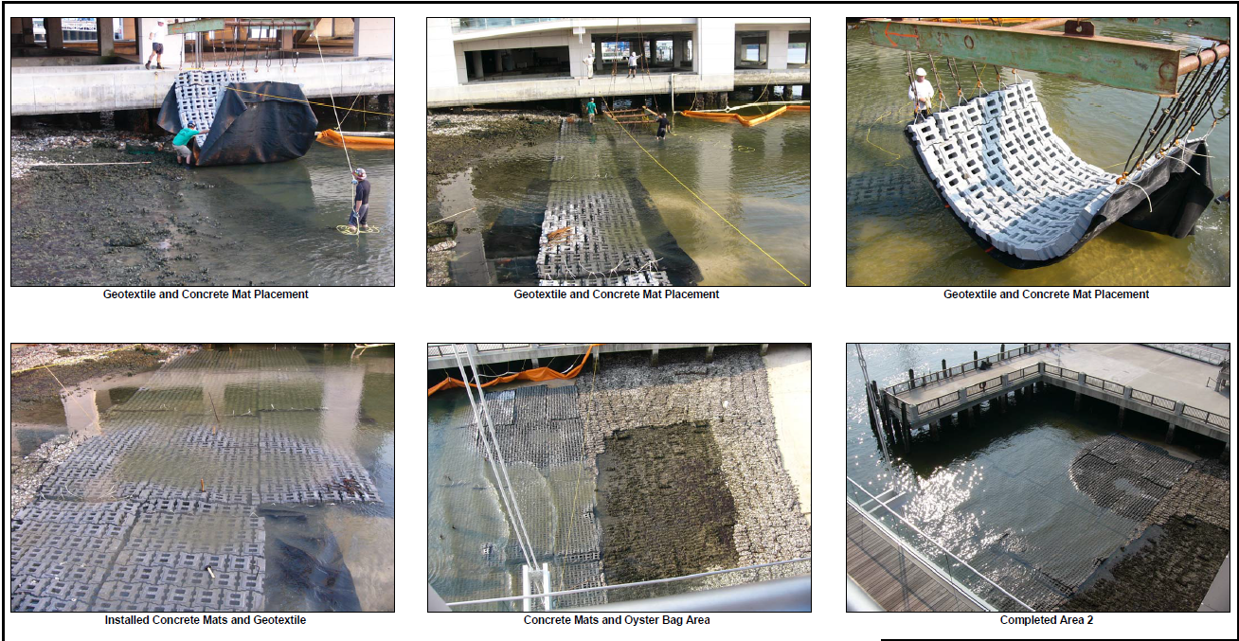

Slide 37
South Carolina Oyster Restoration and Enhancement Program (SCORE)
“The SCDNR’s Shellfish Research Section (SRS) appreciates SCE&G’s efforts to conduct its remedial activities along the shoreline adjacent to the SC Aquarium in a manner which will, hopefully, protect and enhance the existing SCORE project at the site.”
Loren D. Coen, Ph. D.
Senior Marine Scientist & Manager
Shellfish Research Section
MRRI, SC Department of Natural Resources

Slide 38
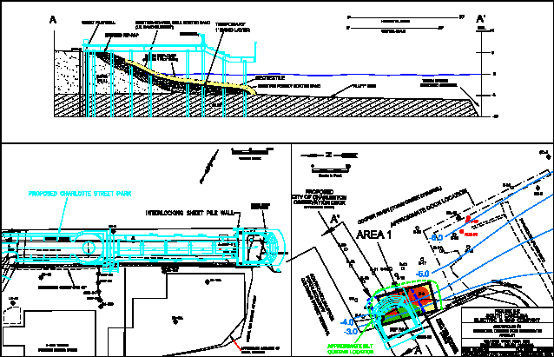
Charlotte Street Memorial Park

Slide 39
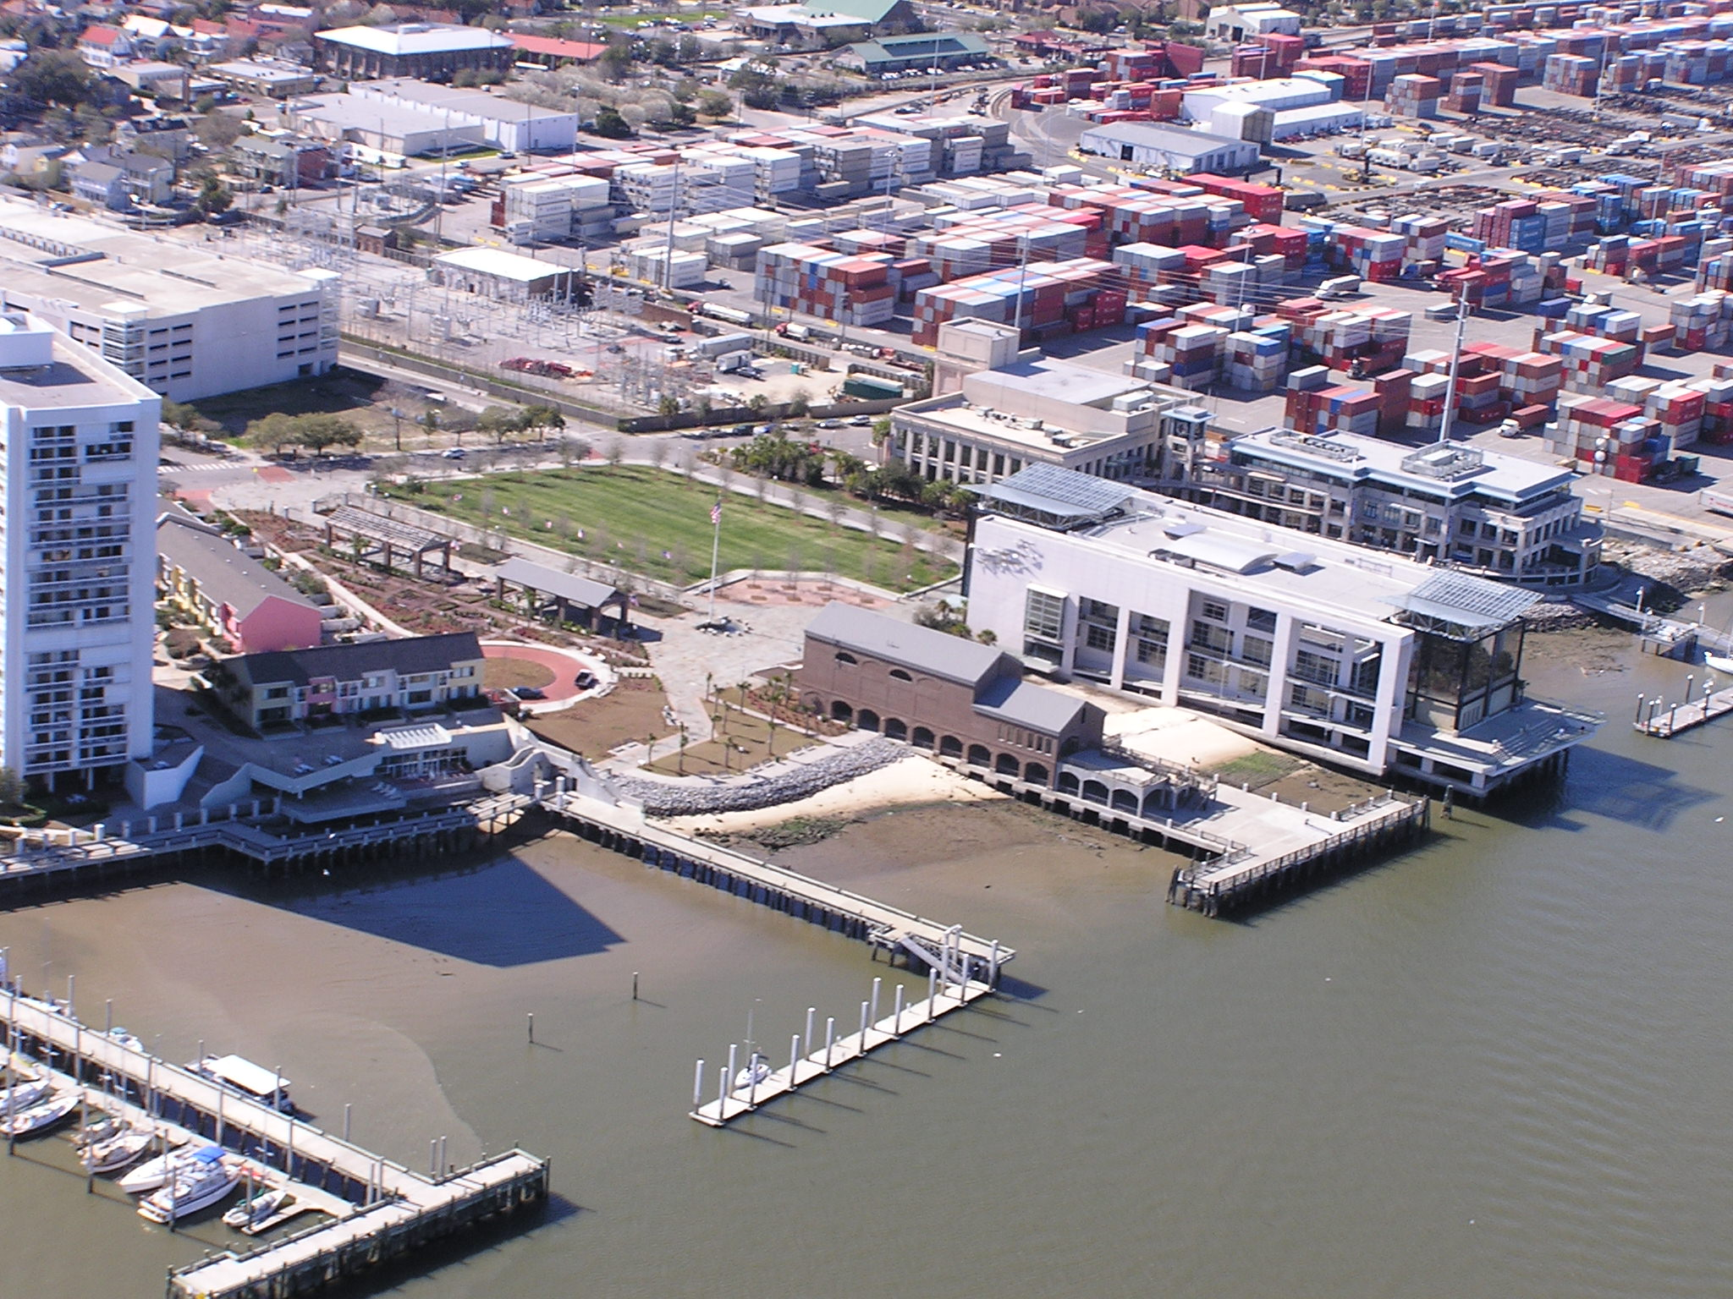

Slide 40
A Few Examples of the
“Integrated” CPA Site Wells

Slide 41
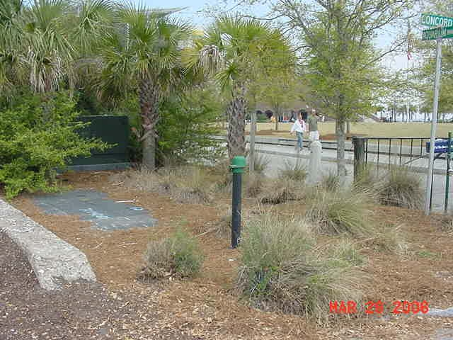
MW-12A Utility Corridor - View From Concord Street

Slide 42
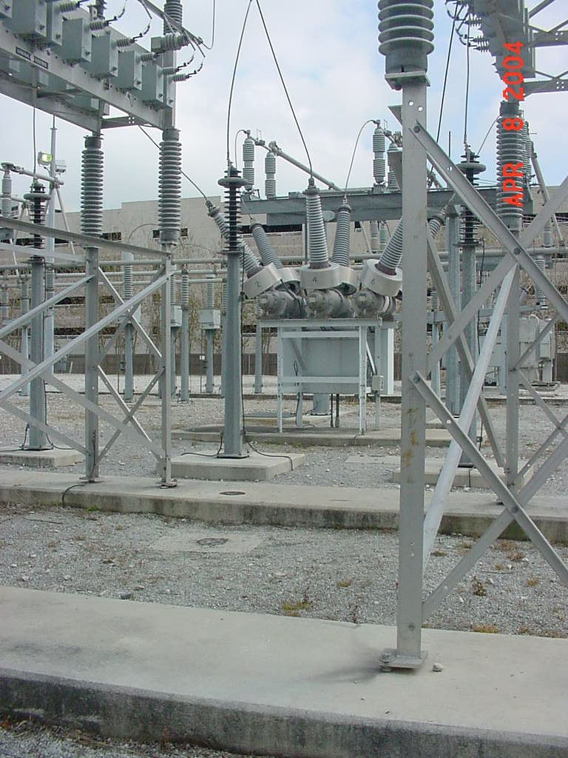
MM-02A, MM-02B – Incorporated into Electrical Equipment
MM-02A
MM-02B

Slide 43
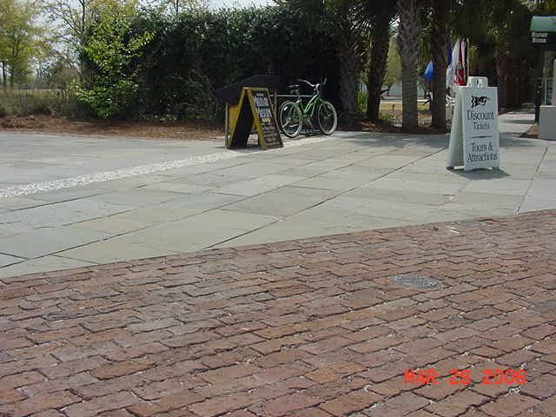
LM-03A – Incorporated into Brick Sidewalk

Slide 44
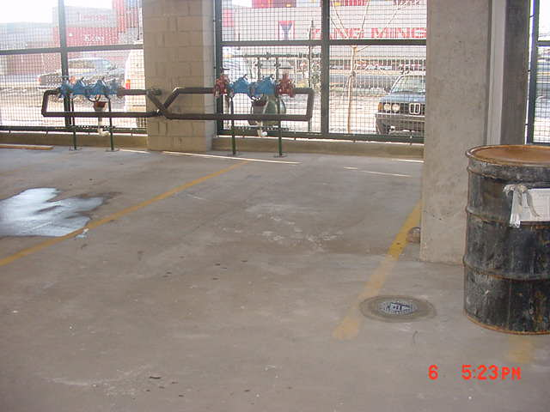
LM-13A - Installed in a Parking Garage

Slide 45
Phoenix Award
Successfully balancing redevelopment activities while striving to meet various regulatory requirements resulted in the SC Aquarium and CPA Site winning the nationally recognized Phoenix Award at the 2002 National Brownfield Association Conference.

Slide 46
Conclusions
Collaboration is critical.
  Neighbors/Developers
  Consultants
  Regulators
Be willing to take a phased approach and see the results.
  Risk/Rewards
  Adjust for lessons learned during remediation
  Adjust for results observed through monitoring
A sense of urgency ain’t a bad thing.

Slide 47
For More Information, Contact:
Tom Effinger
SCANA
teffinger@scana.com
Ken Mallary
EPA Region 4
mallary.ken@epa.gov

