Slide 1
Transformation of a Superfund Site to Ecological Habitat and an Outdoor Classroom
Dave Dassler
The Boeing Company

Slide 2
Boeing environmental strategy
Be the most environmentally progressive aerospace company.
Focus
Design in
Environmental Performance
Energy and Emissions
Materials and Waste
Community
Water
Innovate for
sustainable operations
Performance
Measures
Inspire Global Collaboration
Building a better planet

Slide 3
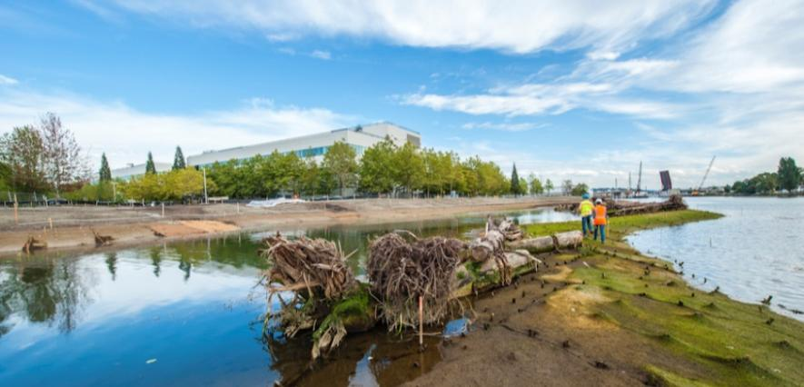
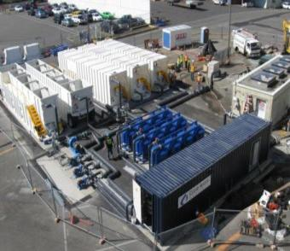
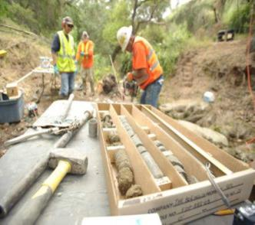
Leadership in Environmental Remediation
  Commitment
  to proactive solutions and technical excellence
  Collaborate
  with regulators
  and communities
  Clean
  locations affected
  by past practices
  Create
  safe environments and restore habitat

Slide 4
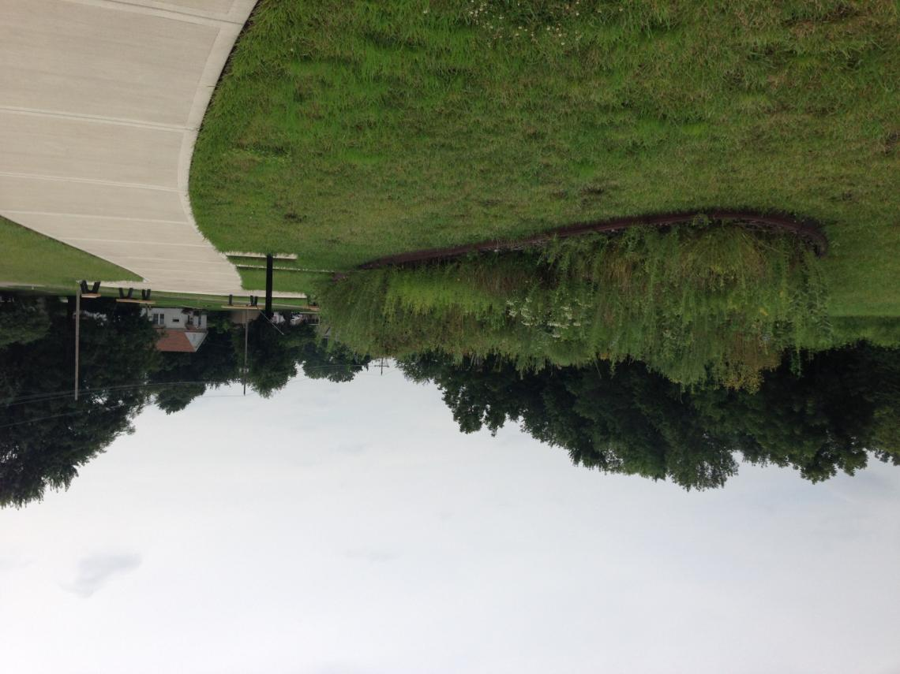

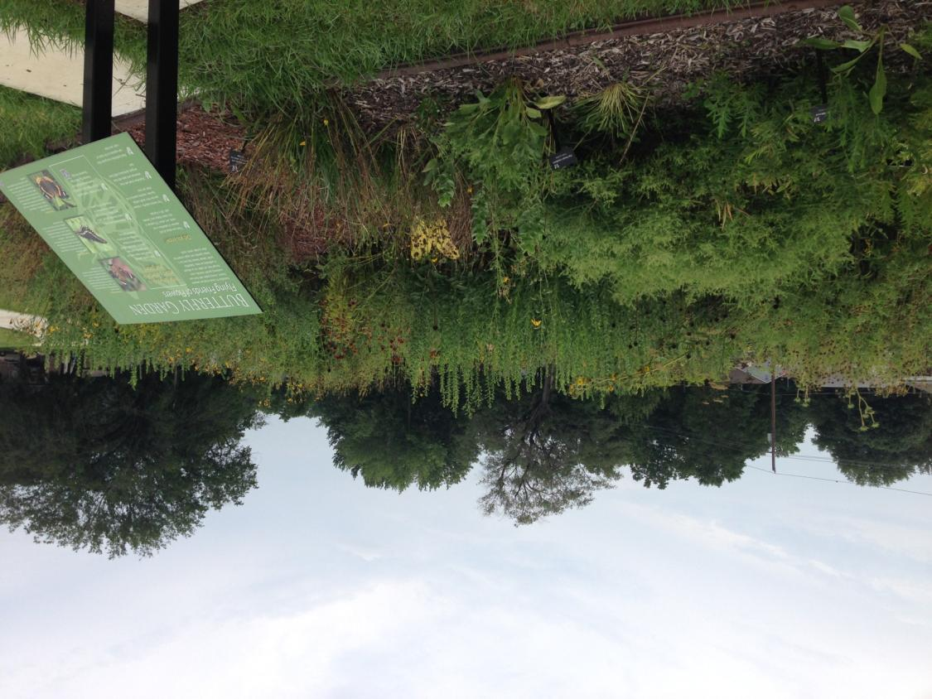
Pollinator Prairie, formerly CCI

Slide 5
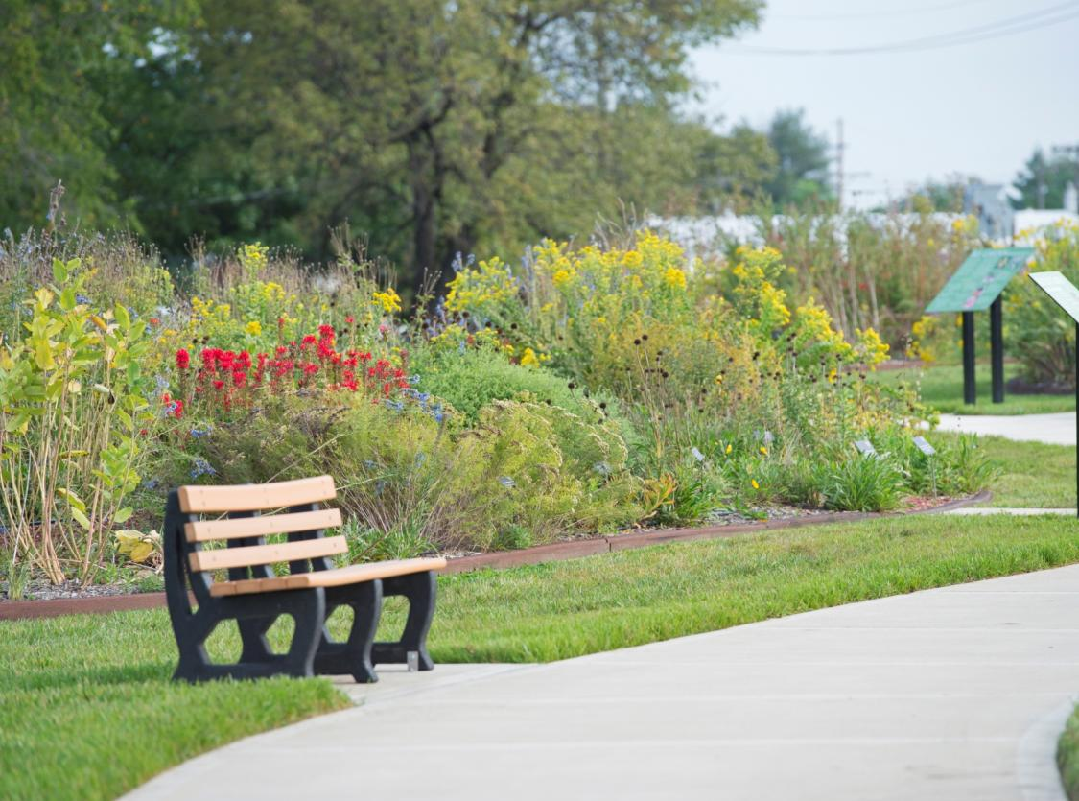
Pollinator Prairie

Slide 6
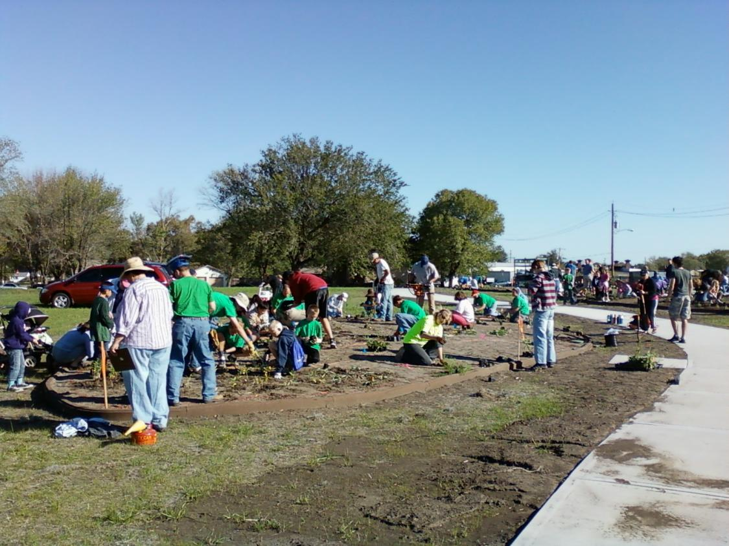
Community Involvement

Slide 7
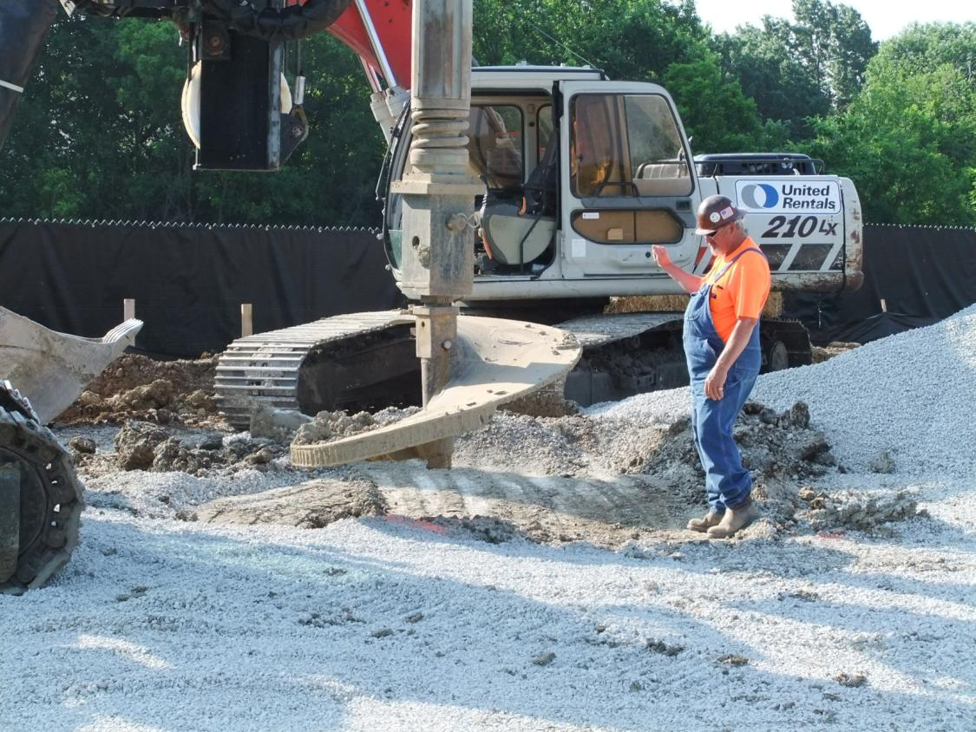
Remediation

Slide 8
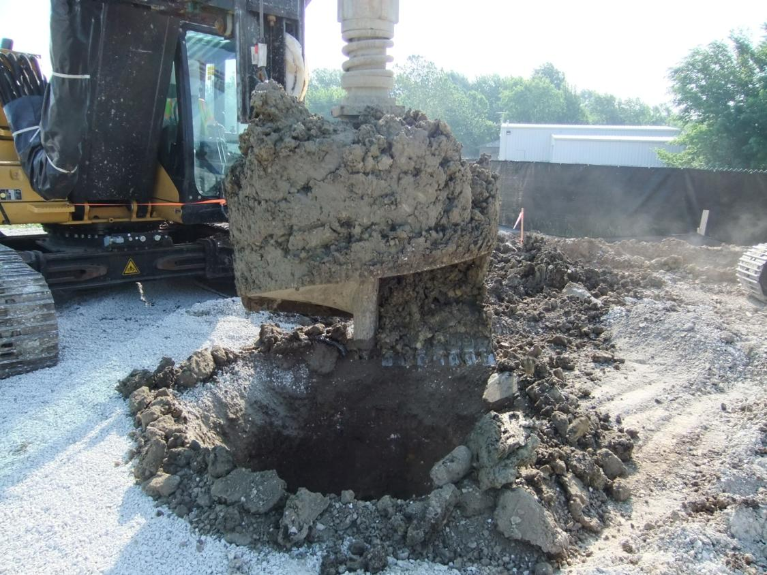
Remediation

Slide 9
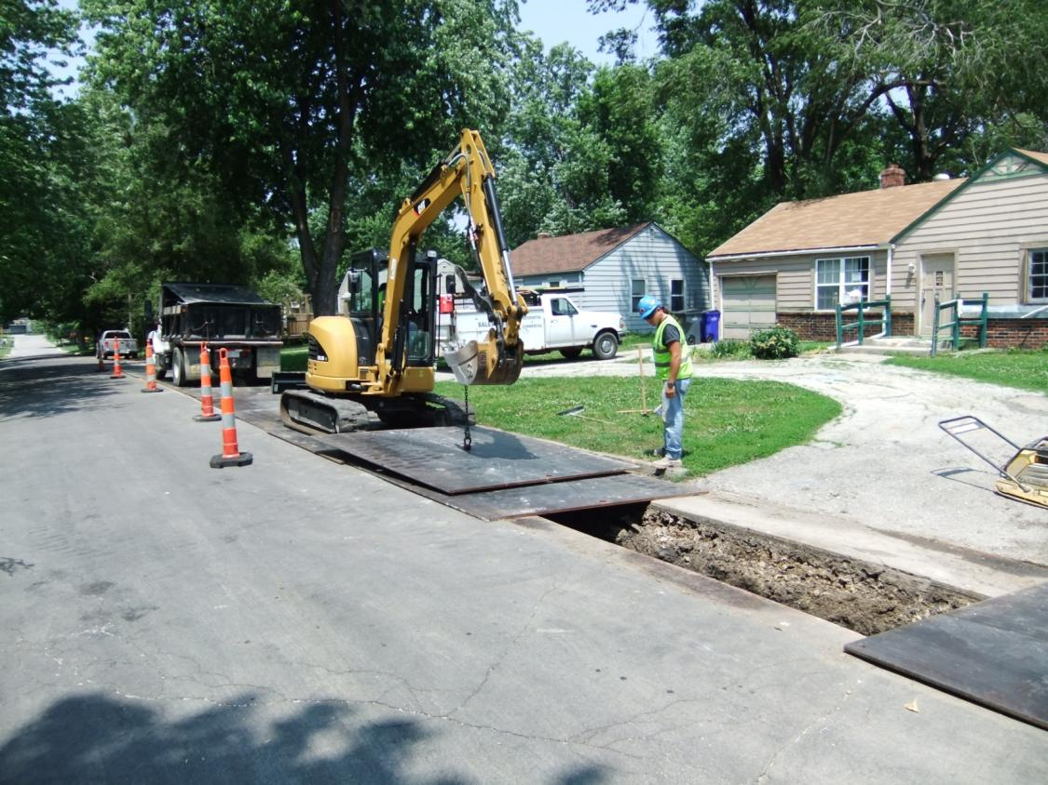
Remediation

Slide 10
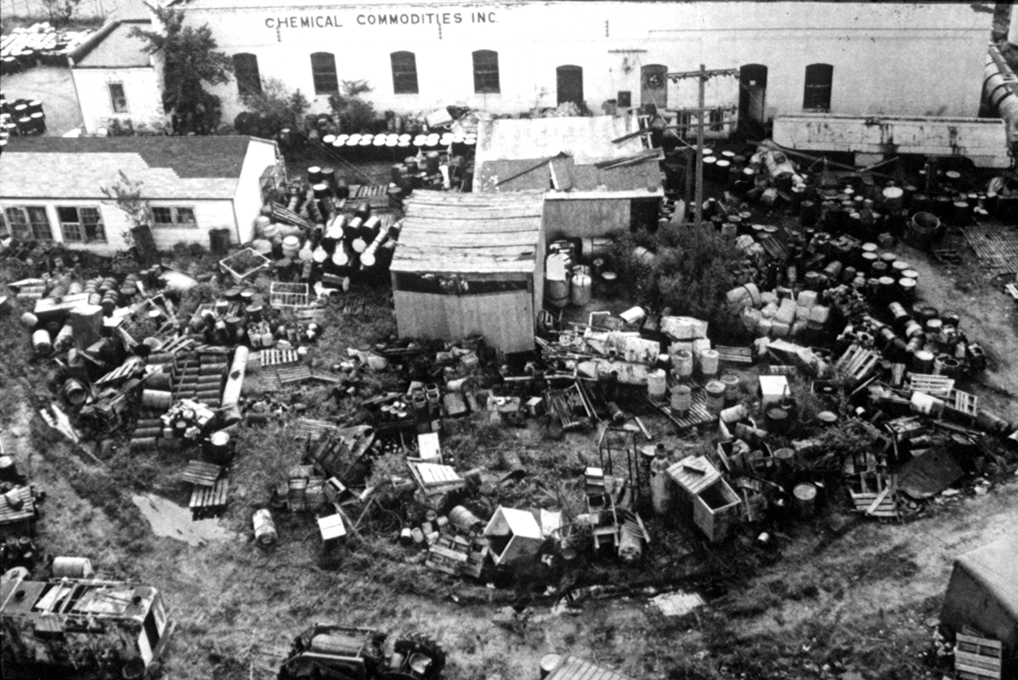
Early Site

Slide 11
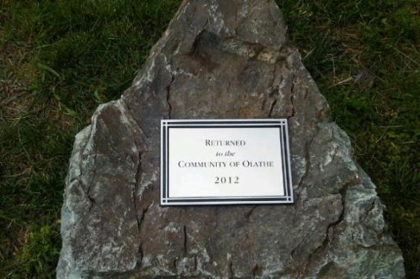
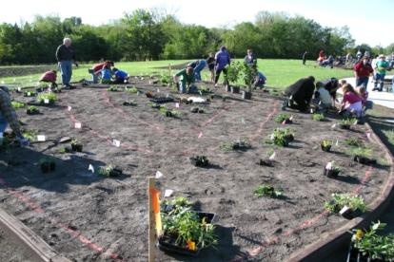
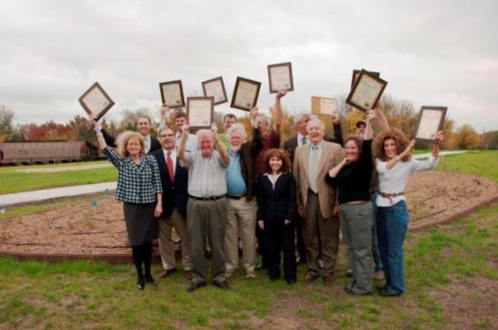
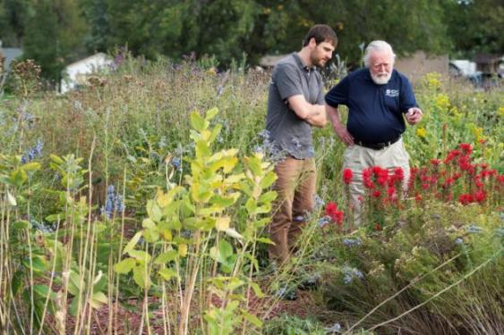
Transformation through Collaboration

Slide 12
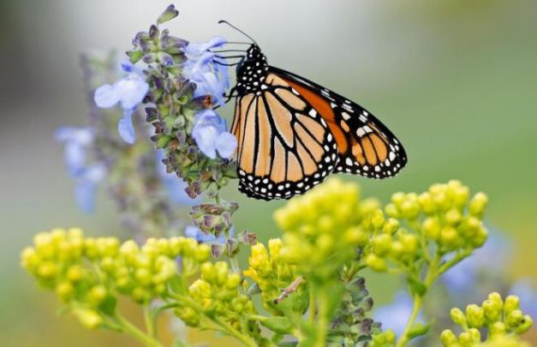
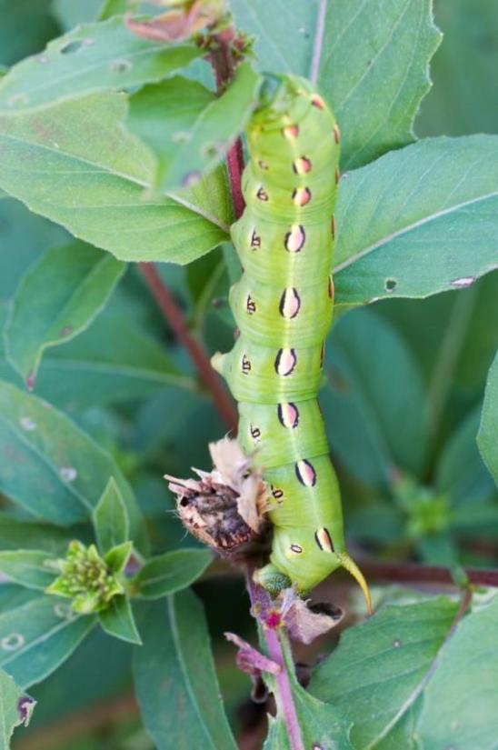
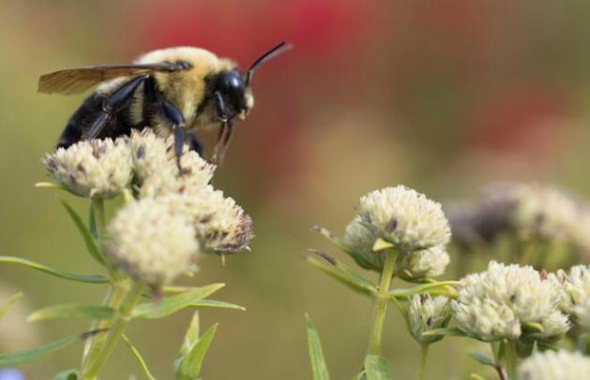
The Pollinator Prairie

Slide 13
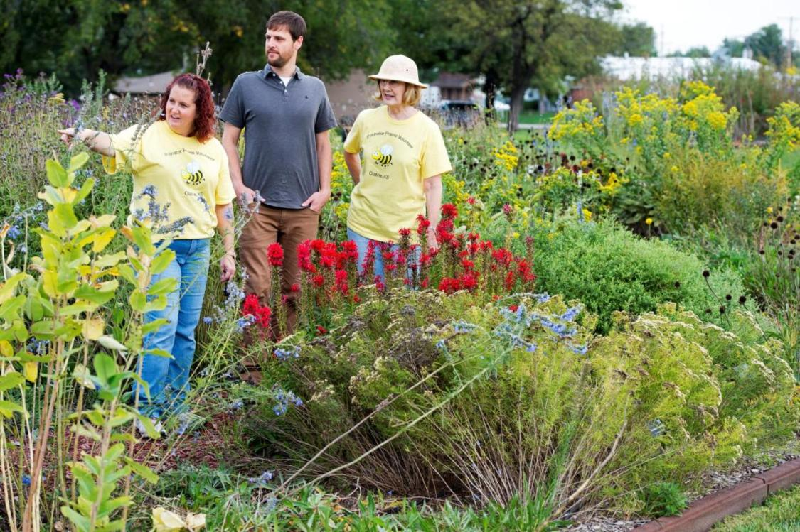
Engage. Educate. Celebrate.

Slide 14
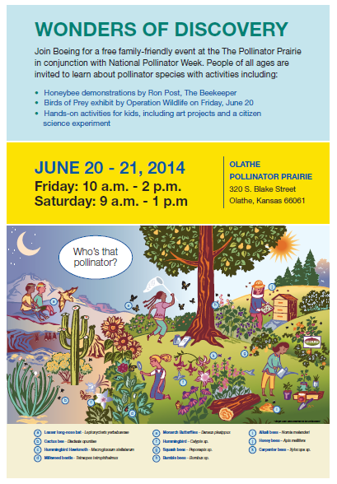

Engage. Educate. Celebrate.

Slide 15
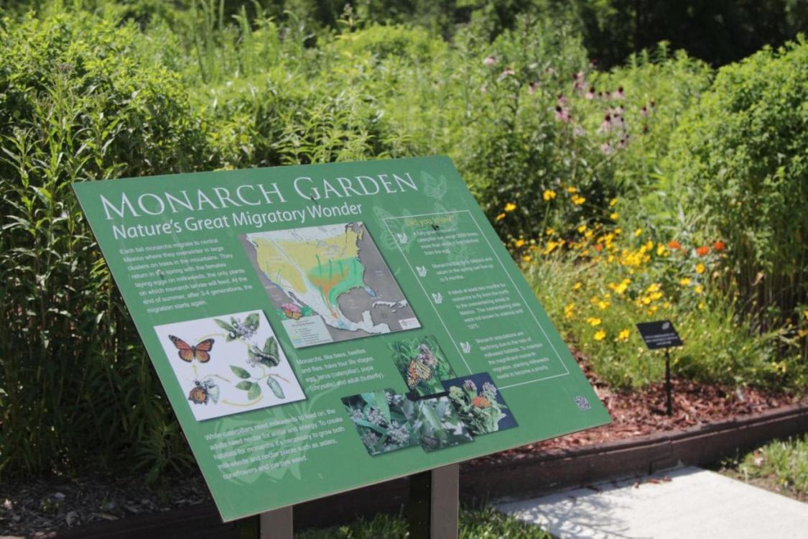
Engage. Educate. Celebrate.

Slide 16
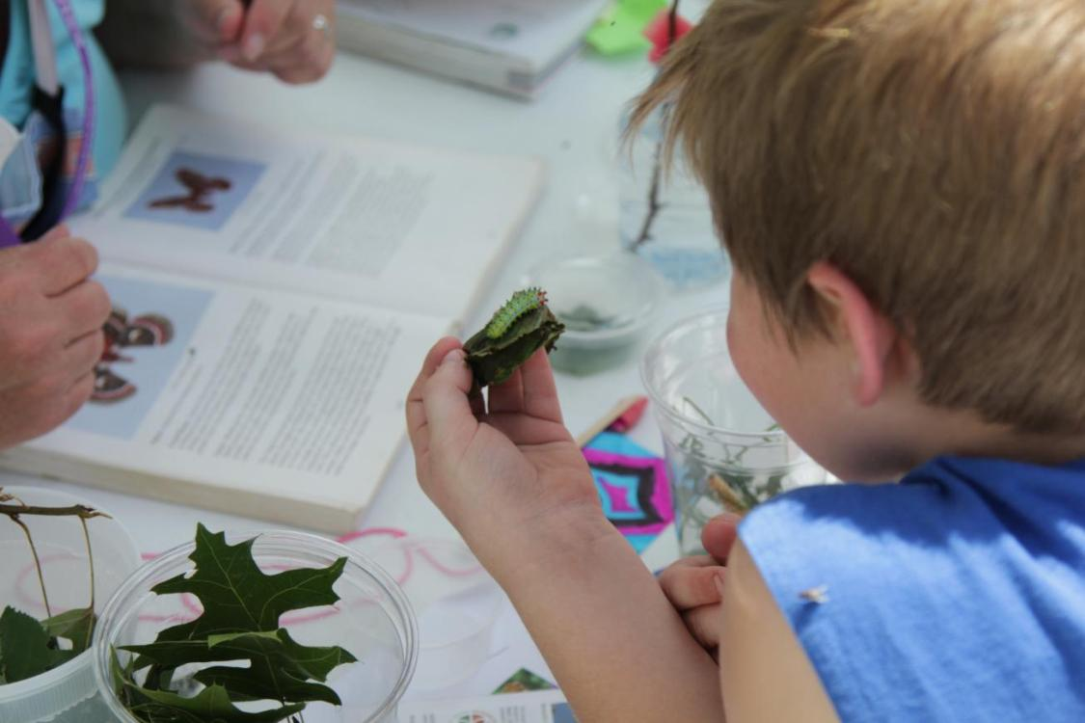
Engage. Educate. Celebrate.

Slide 17
For More Information:
David W. Dassler
The Boeing Company
david.w.dassler@boeing.com
Tonya Howell
EPA Region 7
howell.tonya@epa.gov
17

