Slide 1
TVA Kingston Ash Recovery Project Roane County, TN
Craig Zeller, Remedial Project Manager

Slide 2
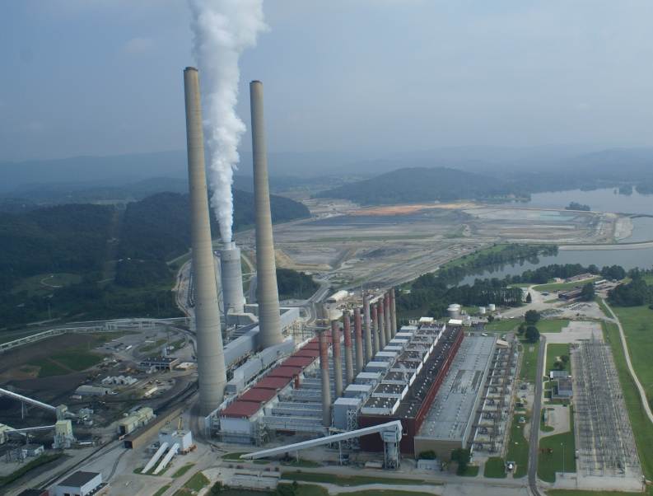
TVA Kingston Steam Plant
≈ 30 miles west of Knoxville off Interstate 40
Emory River Mile 2.0 (just above confluence with Clinch River)
Built 1951 to 1955 (initially for DOE Oak Ridge Reservation)
9 coal fired units
10 Billion KW-Hrs electricity year (670,000 homes in TN Valley)
14,000 tons of coal day (10% coal ash recovered)

Slide 3
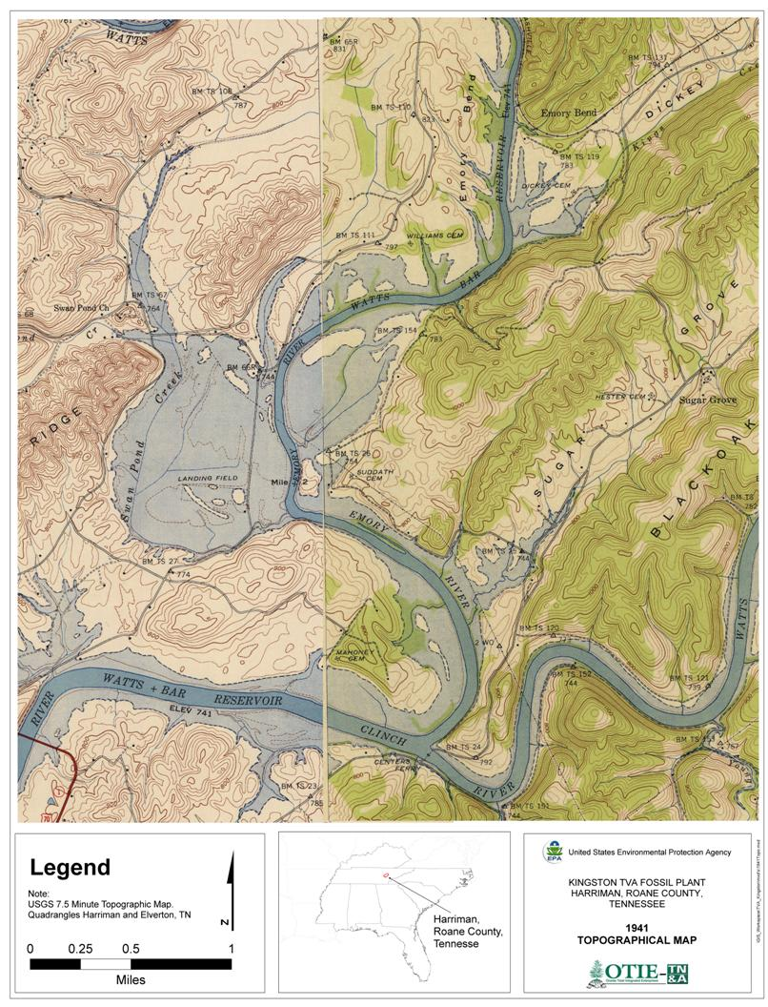
Swan Pond Embayment 1941

Slide 4
Dredge Cell Area Pre-Spill

Slide 5
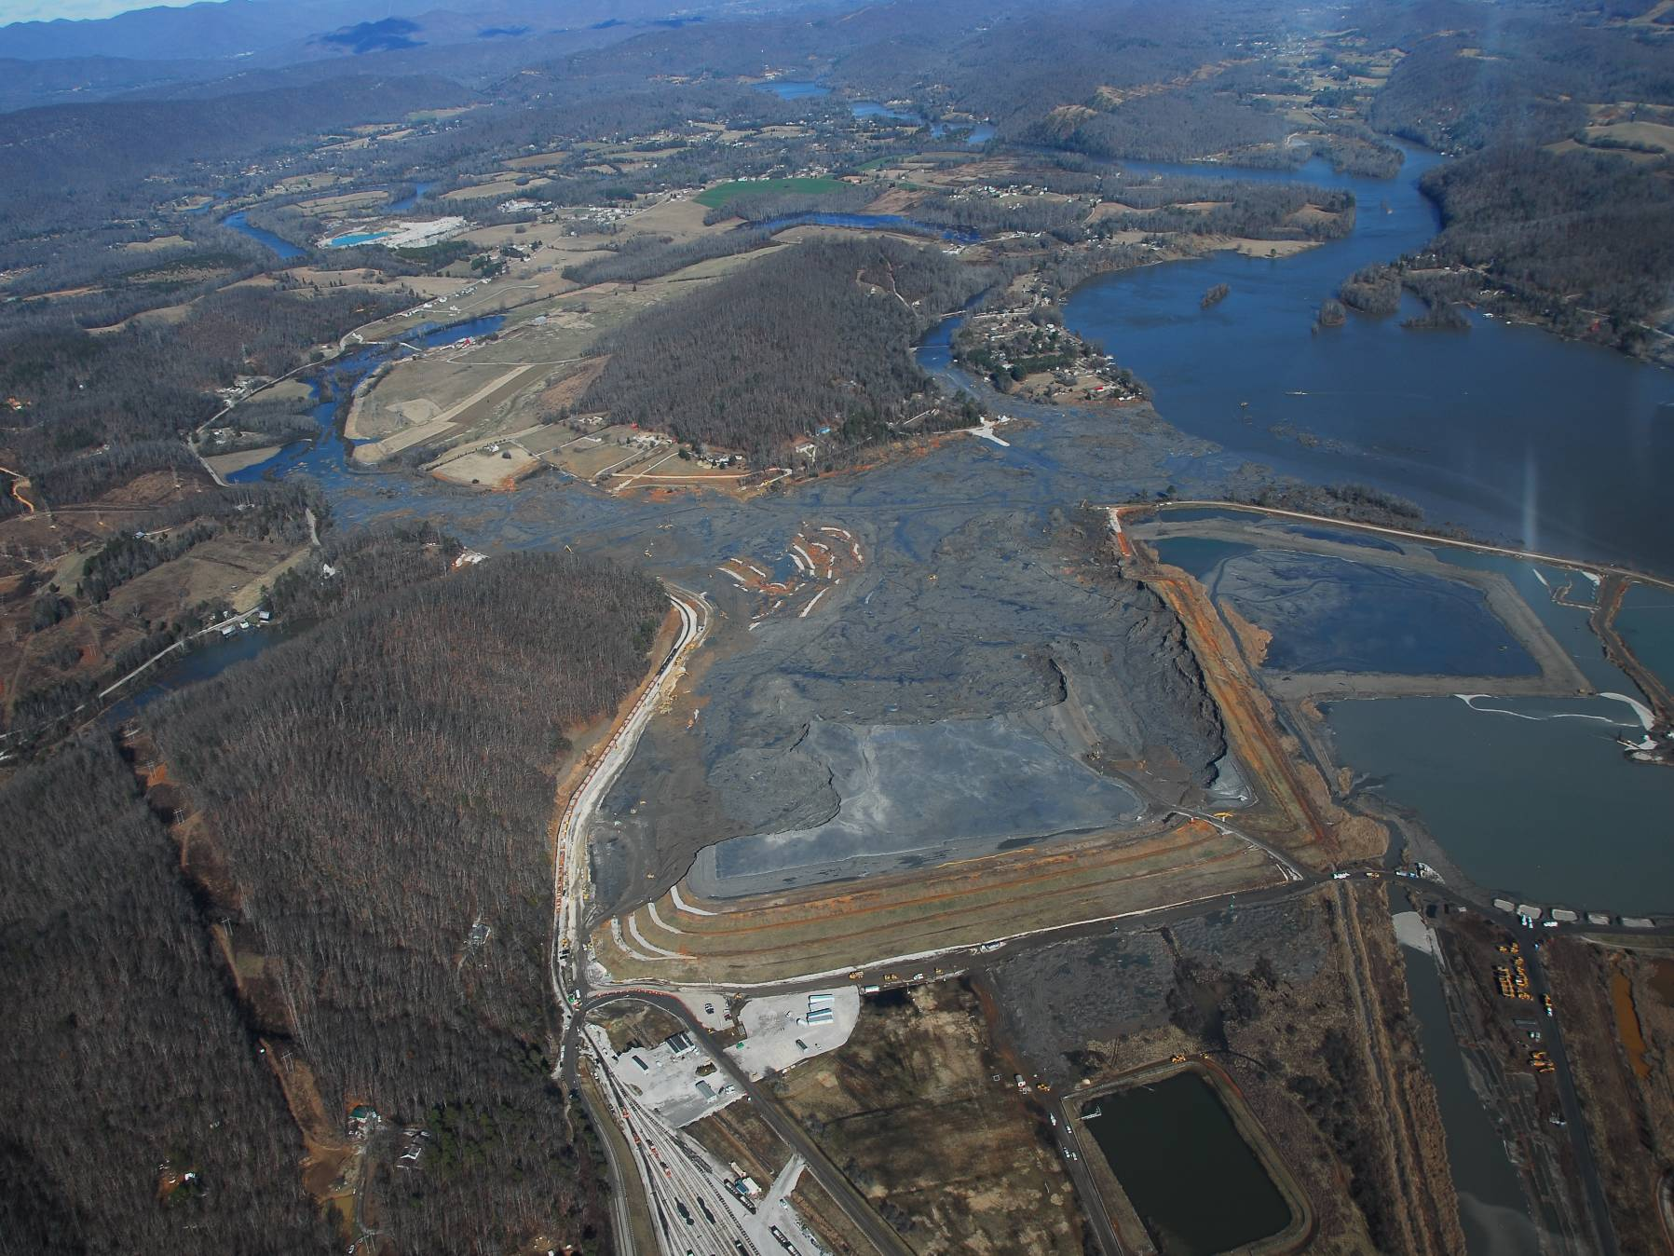
Spill Progression – 12/22/08
FILLS IN
SWAN POND
SLOUGH
EMPTIES INTO
EMORY RIVER
MAIN CHANNEL
FILLS IN
BERKSHIRE SLOUGH

Slide 6
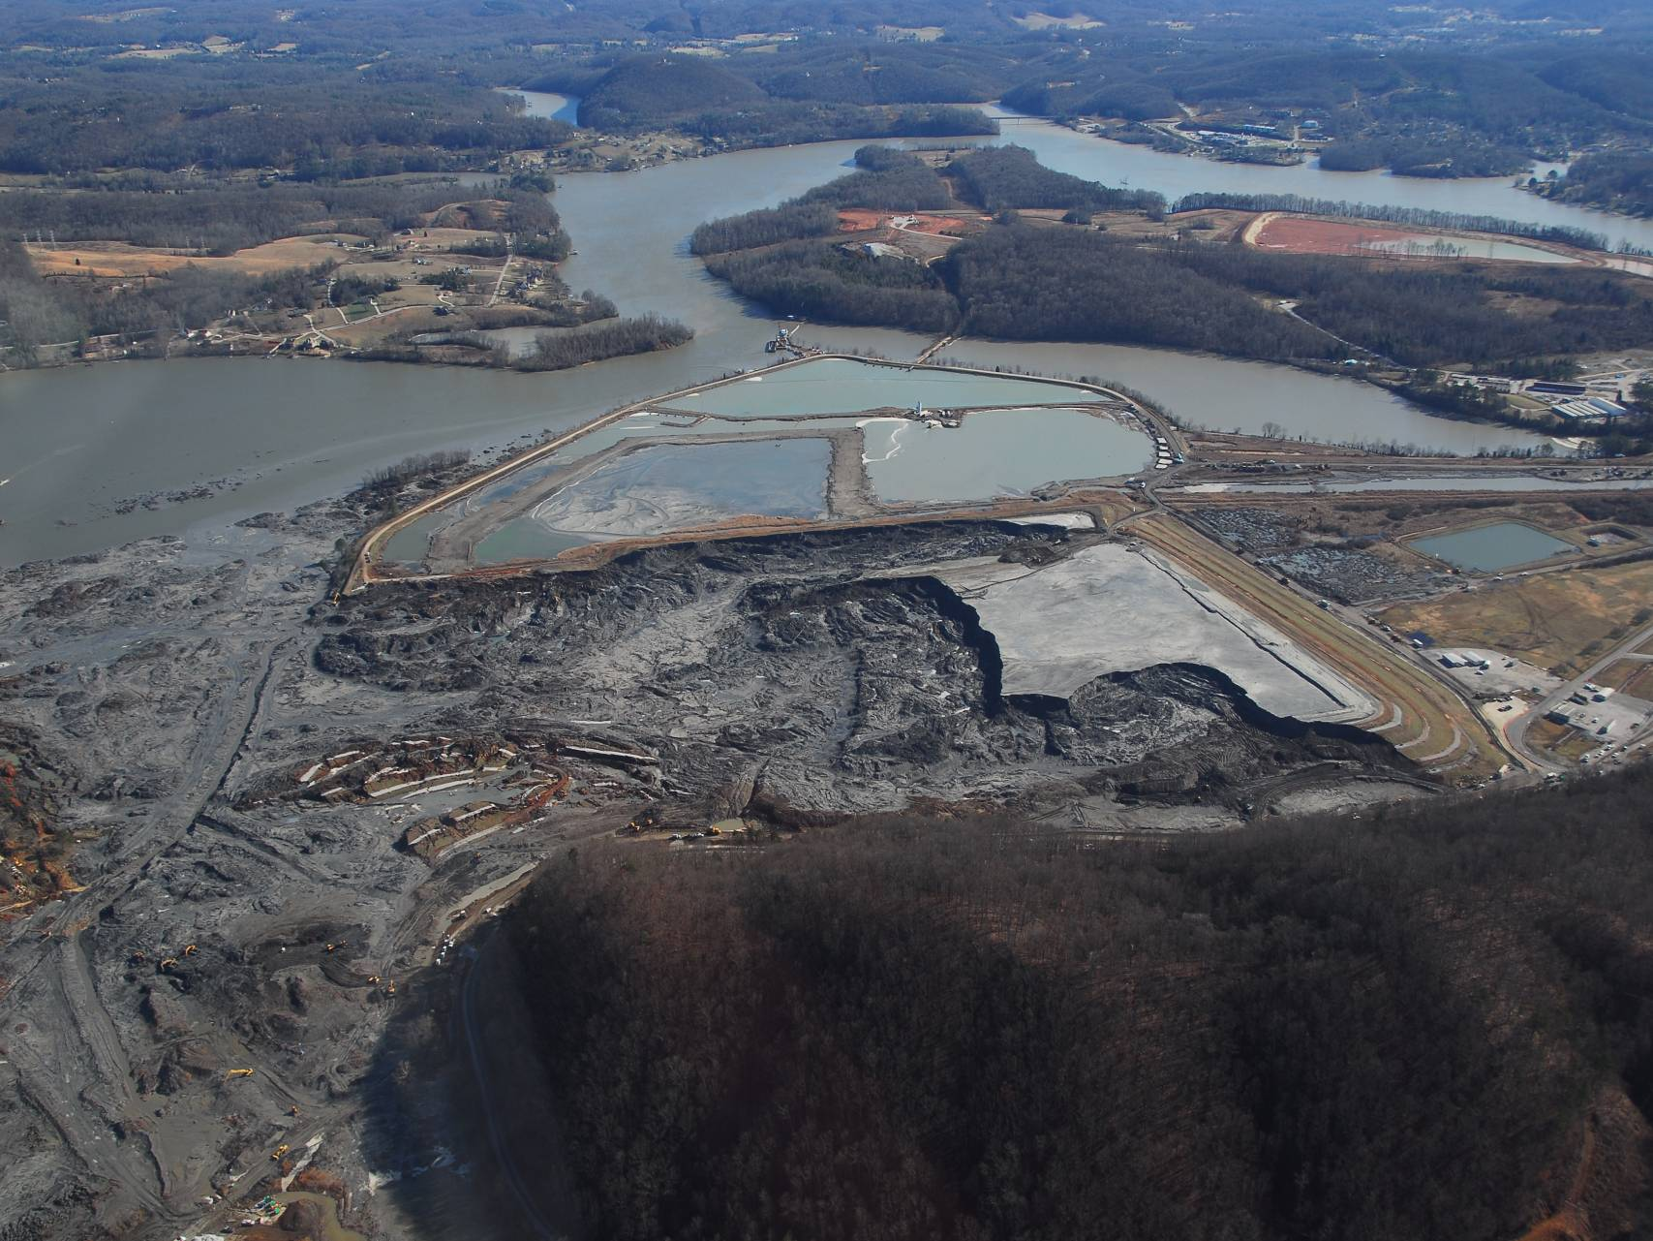
Dredge Cell Area Post-Spill

Slide 7
Root Cause Analysis

Slide 8
CERCLA Removal Action Strategy (May 12, 2009 AOC)
Phase 1 (Time-Critical Action Removal)
3.5 million CYS removed (excavated and dredged)
4.0 million tons disposed at Perry County, AL (completed 12/01/10)
May 29, 2010 Emory River reopened
Phase 2 (Non-Time Critical Action Removal)
2.3 million CYS removed from north and middle embayment
Consolidate in reinforced, on-site disposal area
Construct robust subsurface perimeter containment system to withstand earthquake loads
Phase 3 (Residual Ash Study)
River ecosystem and human health risk assessments
Long-term monitoring (5-year reviews)
Notes:
8

Slide 9
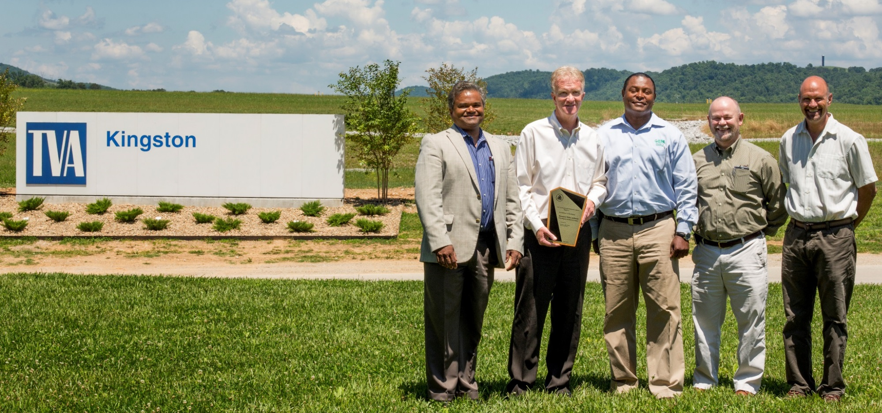
Region 4 Excellence in Site Re-Use Award
EPA Region 4 issued the award to TVA in June 2015 for community redevelopment and ecological restoration efforts that went above and beyond cleanup requirements.
From left to right, Mathy Stanislaus (EPA), Bob Deacy (TVA), Franklin Hill (EPA), Chuck Head (TVA) and Craig Zeller (EPA).

Slide 10
Project Costs Highlights
Time Critical Removal Action (Phase 1 Dredging)
$597.6 Million
$290.8 Million (≈50%) on Ash Dredging & Disposal
Non Time Critical Removal Actions (Phase 2/3)
$537.7 Million
$43 Million for Ash Stacking
$13 Million for Ash Processing/Stacking
$130 Million for Perimeter Wall
$34 Million for Ash Landfill
Total Project Costs
$1.134 Billion
≈$44 Million under $1.178 Billion Projection

Slide 11
For More Information, Contact
Craig Zeller, P.E.
EPA Region 4
(404) 562-8827
zeller.craig@epa.gov

