Slide 1
Restoration of the
Swan Pond Embayment
Michelle Cagley, Tennessee Valley Authority

Slide 2
Restoration Objectives
Protect and improve wildlife habitats
Protect and enhance wetlands
Stabilize embayment shorelines
Minimize erosion and sediment disposition
Provide recreation opportunities

Slide 3
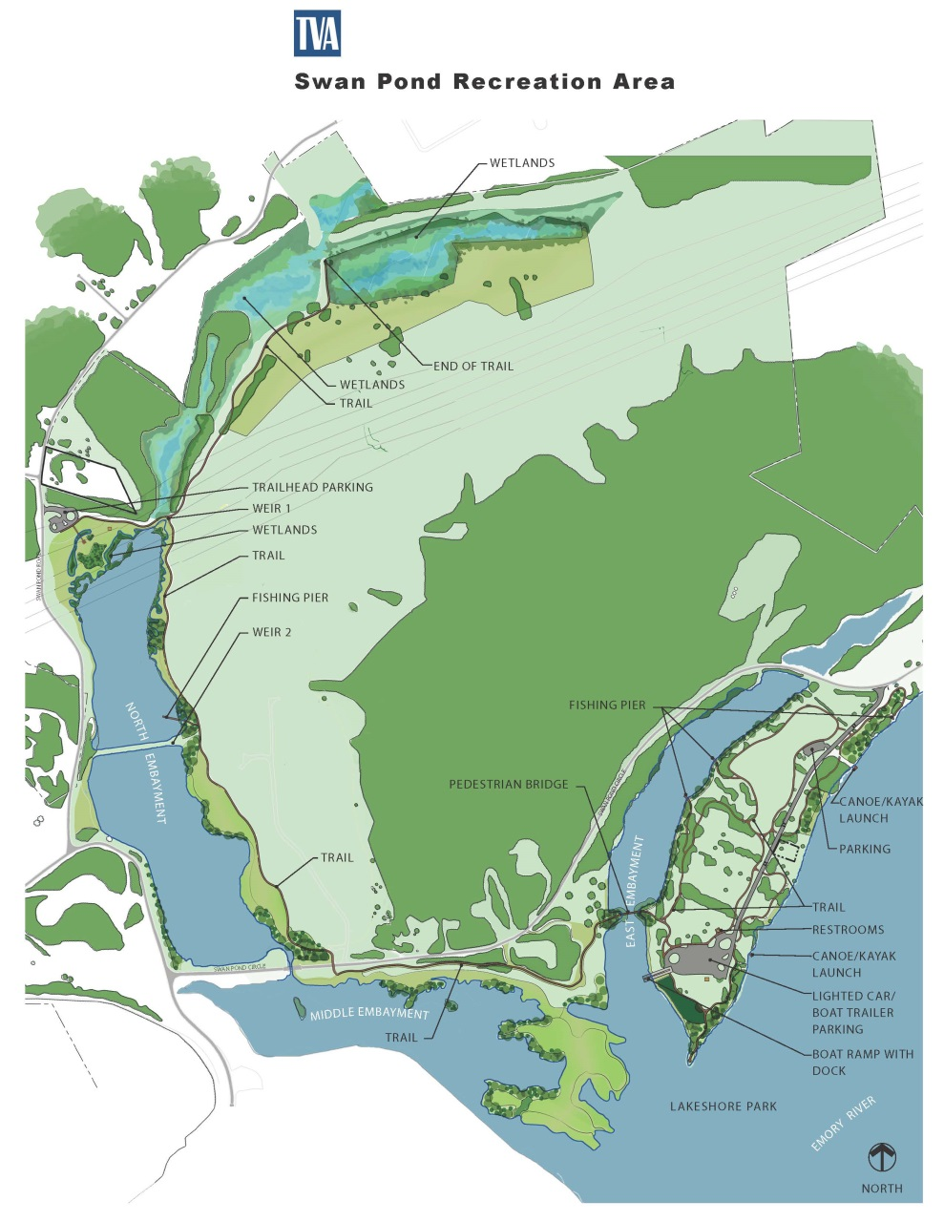
Swan Pond Restoration

Slide 4
Ecological Restoration
Re-vegetation of shoreline habitats
Installation of water control structures
Removal of invasive species
Creation of riparian buffers
Wetland preservation
Enhancement of upland habitat
Preservation of existing wetland habitat
Enhancement of aquatic habitat
Creation of new aquatic habitat

Slide 5
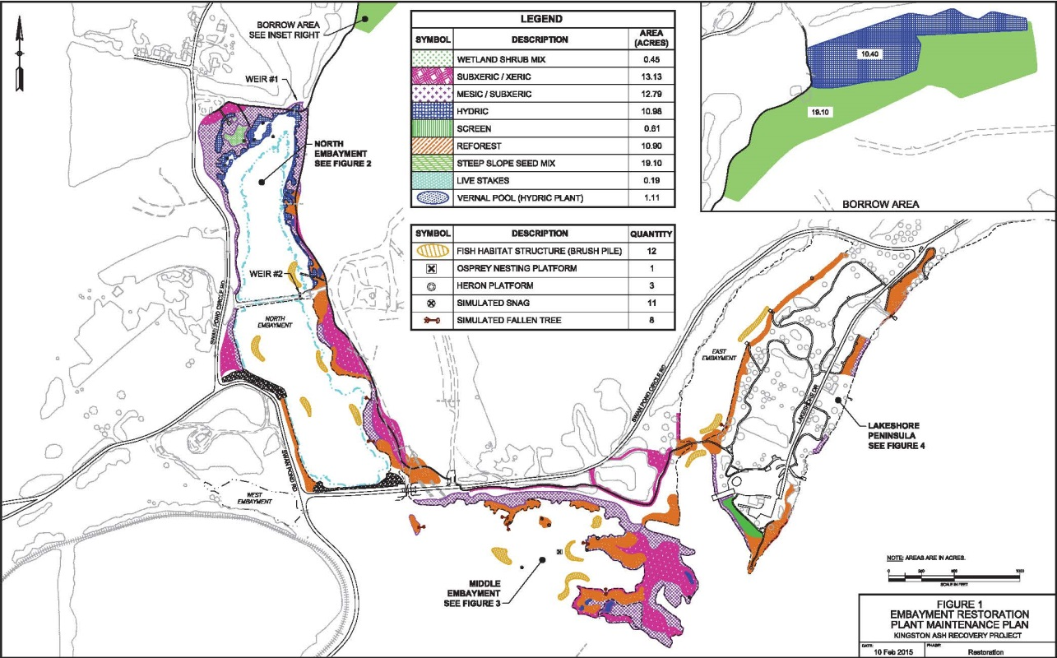
Plantings for Swan Pond Restoration

Slide 6
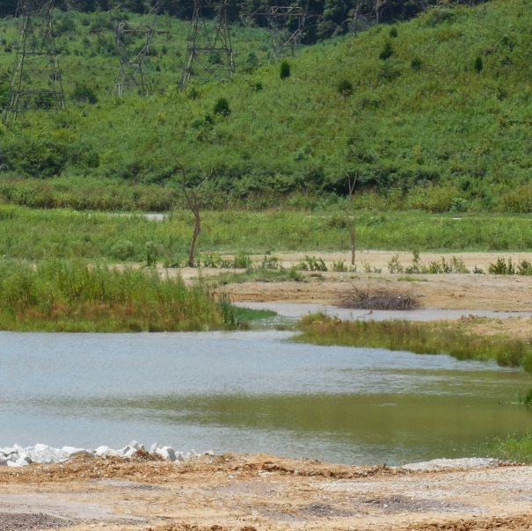
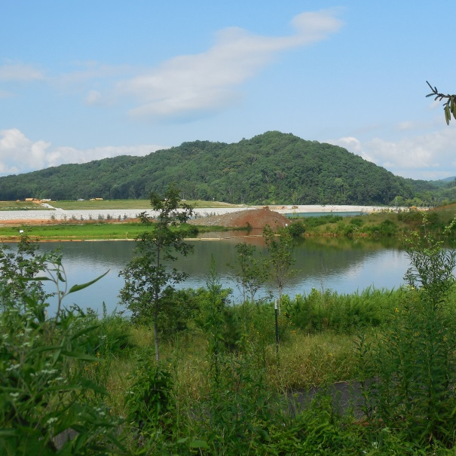
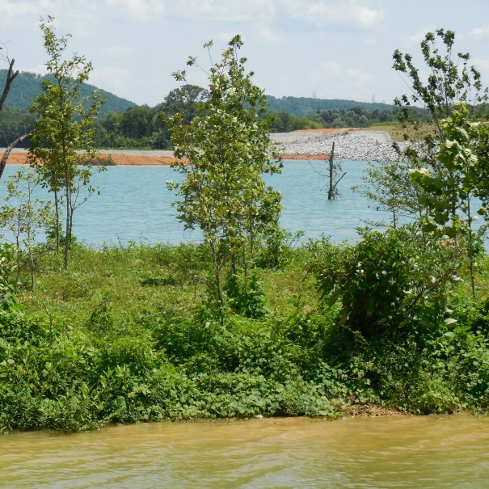
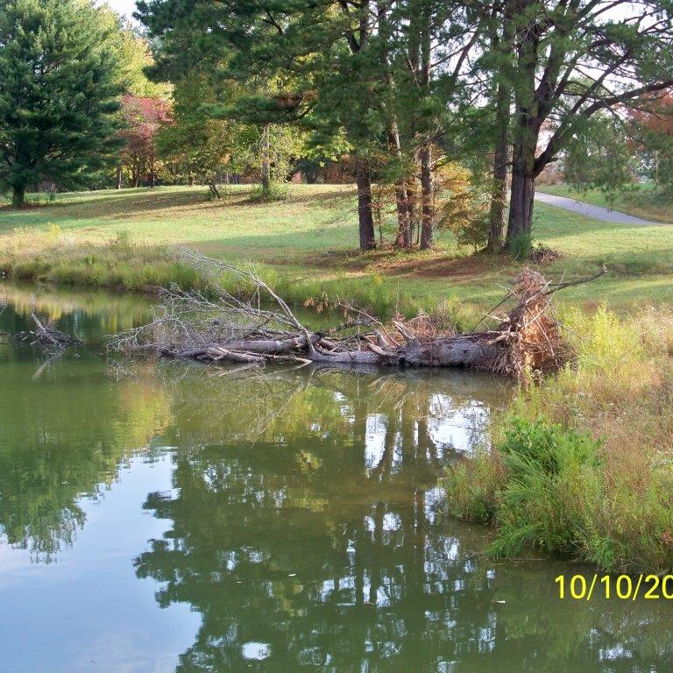
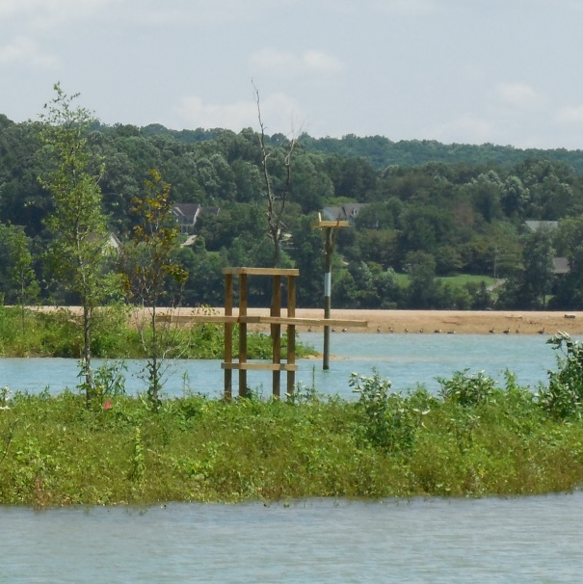
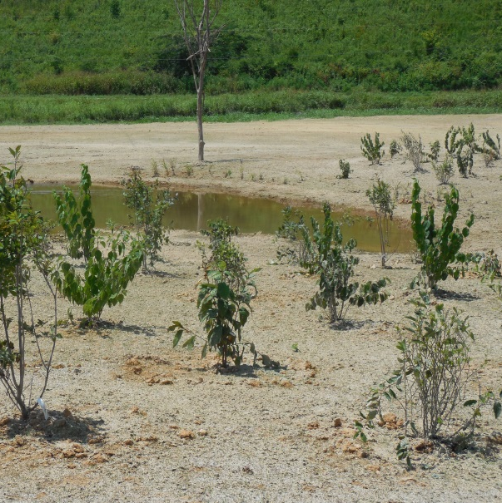
Ecological Restoration
Wetlands
Riparian Zone Plantings
Reforestation
Fish Attractors
Bird Attractors
Vernal Pools

Slide 7
Recreational Enhancements
4 miles of paved walking trails
2 Courtesy docks and 4 fishing piers
Boat ramp
Pedestrian bridge

Slide 8
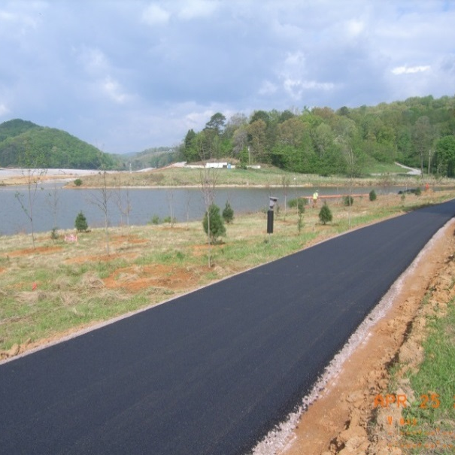
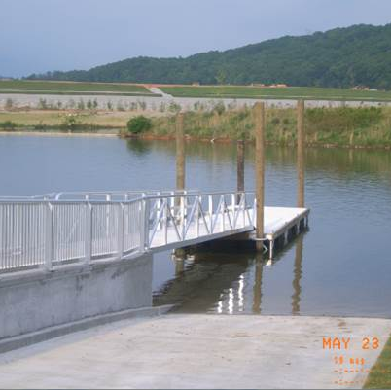
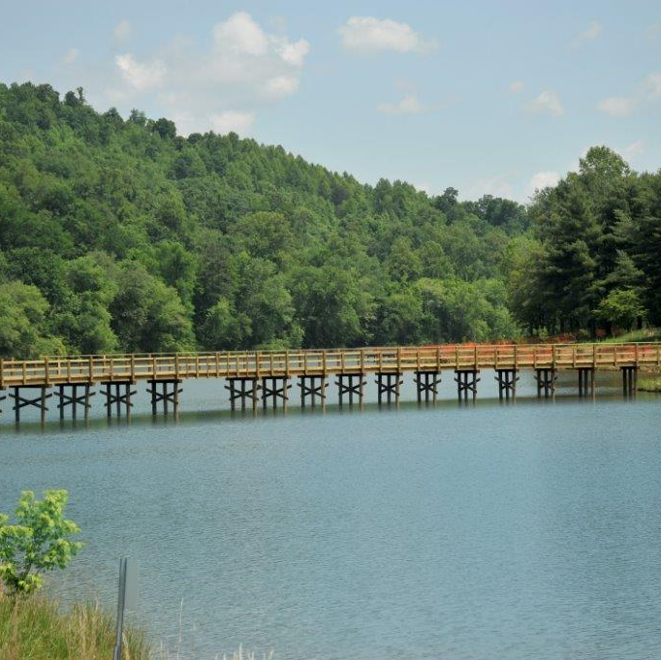
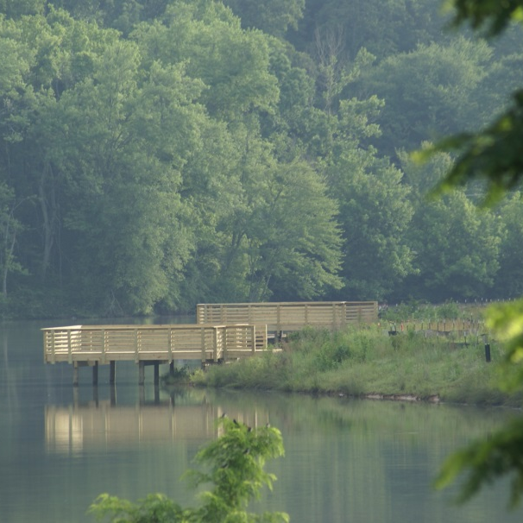
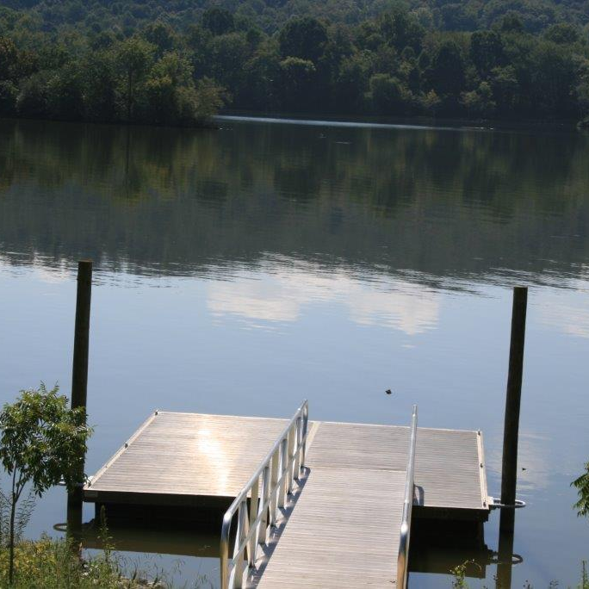
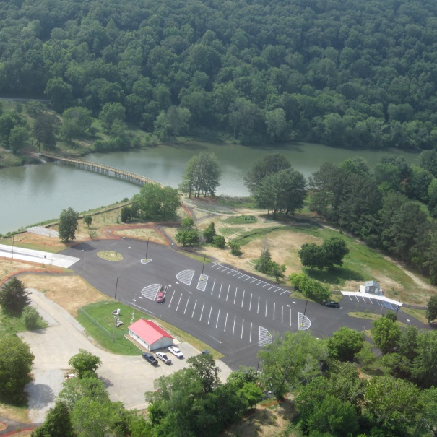
Recreational Enhancements
Walking Trails
Boat Ramp/Dock
Pedestrian Bridge
Fishing Piers
Canoe Launches
Parking Areas

Slide 9
For More Information, Contact
Michelle Cagley, P.E.
Tennessee Valley Authority
(865) 717-1636
amcagley@tva.gov

