Slide 1
Supporting Healthy Communities:
A Superfund Opportunity
EPA Superfund Redevelopment Initiative
Monday, March 20, 2017

Slide 2
Webinar Overview
Introduction to SRI
  Melissa Friedland, EPA Superfund Redevelopment Initiative
Supporting Healthy Communities: Jacksonville, Florida
  Tonya Spencer, U.S. EPA Region 4 Community Involvement Coordinator
Supporting Healthy Communities: Jacksonville Ash/ Brown’s Dump
  Joseph Alfano, U.S. EPA Region 4 Remedial Project Manager
Supporting Healthy Communities: Planning Tools
  Miranda Maupin, Skeo Program Manager

Slide 3
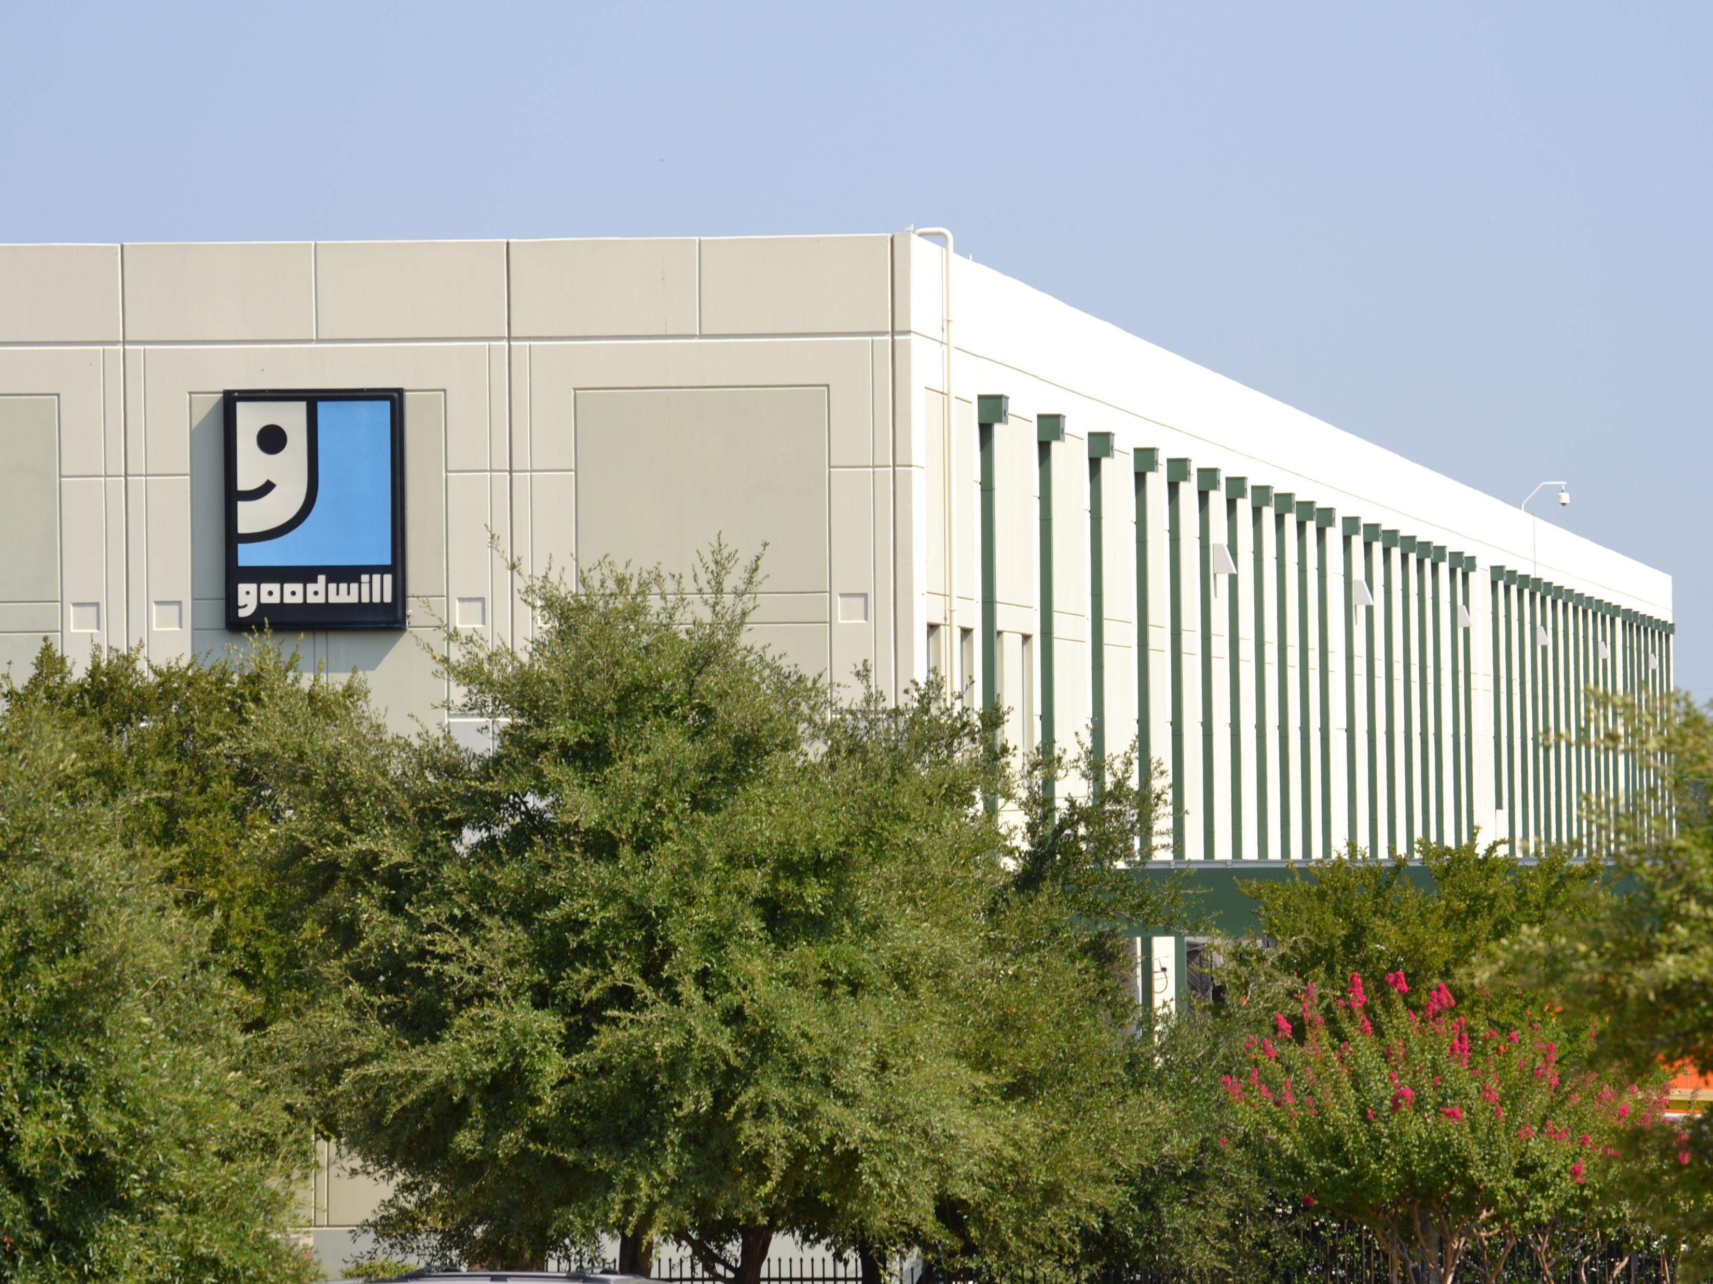
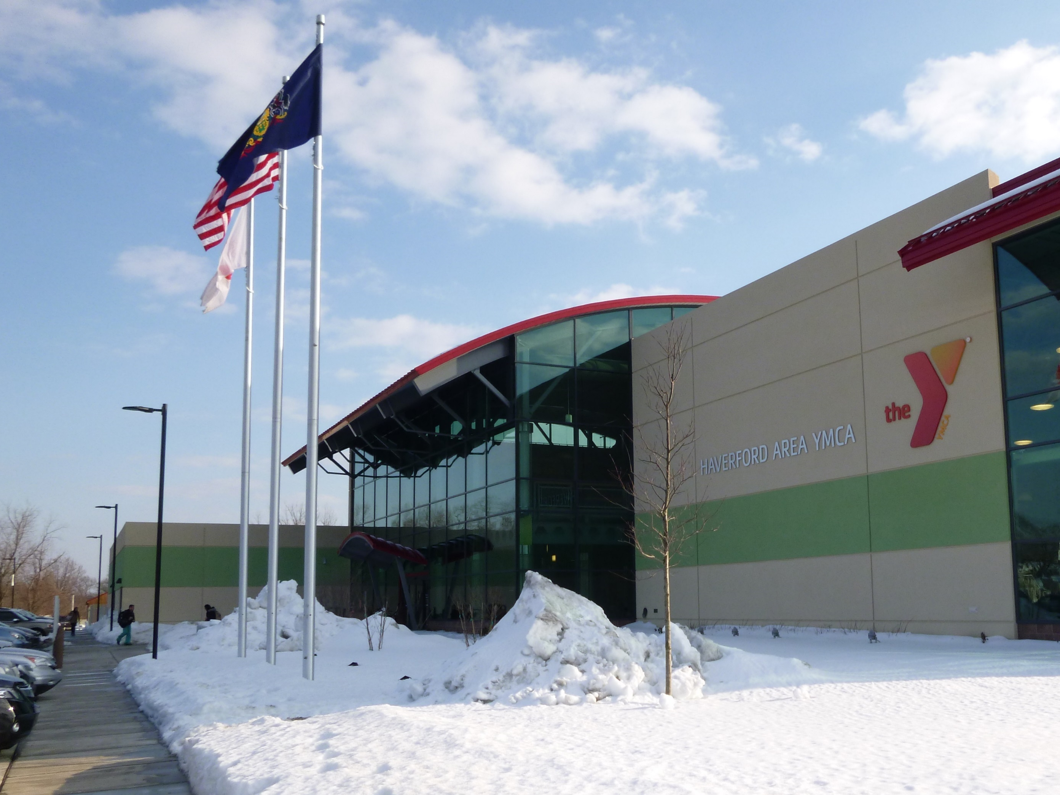
SRI: Superfund Redevelopment Initiative
Working with communities and other partners in considering future use opportunities and integrating appropriate reuse options into the cleanup process
https://www.epa.gov/superfund-redevelopment-initiative

Slide 4
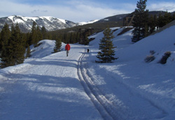
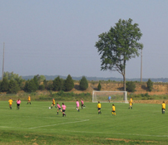
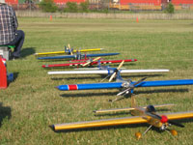
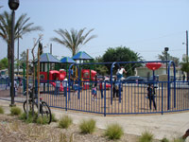
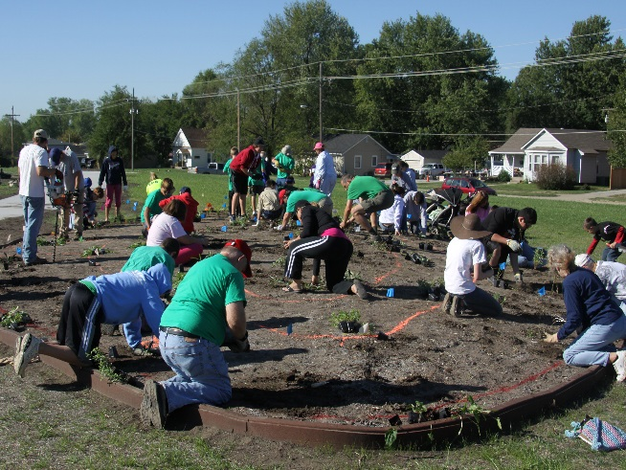
Redevelopment Partnerships
Rails-to-Trails Conservancy support at California Gulch Superfund site, Colorado
U.S. Soccer Foundation support at Avtex Fibers Superfund site, Virginia
Academy of Model Aeronautics support at Auburn Road Landfill Superfund site, New Hampshire
https://www.epa.gov/superfund-redevelopment-initiative/redevelopment-partnerships
The Trust for Public Land support at Pemaco Maywood Superfund site, California
Pollinator Partnership (P2) at Chemical Commodities Inc. Superfund site, Kansas

