Slide 1
Revitalizing contaminated lands:
ADDRESSING LIABILITY CONCERNS
Susan Kunst Boushell
EPA’s Office of Site Remediation Enforcement
March 25, 2015

Slide 2
Introduction
OSRE is part of EPA’s Office of Enforcement and Compliance Assurance (OECA)
Oversees the federal cleanup enforcement program for Superfund, RCRA corrective action, and leaking underground storage tanks
Works closely with the national program offices, Regions, and DOJ

Slide 3
EPA’s cleanup enforcement program
CERCLA and RCRA mandate that “polluters pay” for cleanups and provide strong enforcement tools to make this happen
EPA policies and subsequent CERCLA amendments have evolved to encourage the cleanup and reuse of contaminated properties

Slide 4
Enforcement’s approach to reuse
Develop enforcement guidance that addresses liability concerns so that EPA is not involved in most contaminated property transactions
Use site-specific tools when EPA involvement is critical to facilitate contaminated property transactions at sites of federal interest

Slide 5
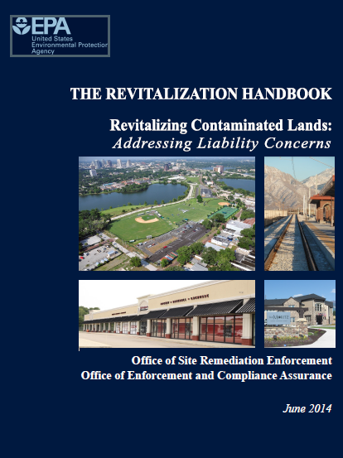
2014 revitalization handbook
Summarizes the federal statutory provisions and EPA enforcement guidance documents that address potential liability concerns of parties involved in reuse of contaminated sites
Provides an overview of the site-specific tools that may be used to address liability concerns
The Handbook can be found on EPA’s website at:
www2.epa.gov/enforcement/revitalization-handbook

Slide 6
federal laws addressing contaminated property cleanup
CERCLA, commonly known as Superfund
  Authorizes the federal government to assess and clean up properties contaminated with hazardous substances
  Provides authority for emergency response involving hazardous materials
  Establishes a comprehensive liability scheme to hold certain categories of parties liable to conduct and/or pay for cleanup of such releases
RCRA
  Regulates the management of solid wastes (both hazardous and non-hazardous) to protect human health and the environment
  Includes authorities for the investigation and cleanup of RCRA facilities

Slide 7
Parties potentially liable under cercla
The current owner or operator of a facility
The owner or operator at the time of disposal of hazardous substances
A person who arranged for the disposal or treatment of hazardous substances (“generator” or “arranger”)
A person who accepted hazardous substances for transport and selected the site to which the substances were transported (“transporter”)

Slide 8
2002 Brownfield amendments
Self-Implementing Landowner Liability Protections
  Bona Fide Prospective Purchasers (BFPPs)
  Contiguous Property Owners (CPOs)
  Innocent Landowners (ILOs)
Enforcement Bar/State Voluntary Cleanup Programs
Brownfield Grants Program
Small Business Exemptions

Slide 9
Bona fide prospective purchaser (BFPP) protection
Most widely applicable landowner liability protection
  Parties can purchase with knowledge
Key provisions include:
  Acquired ownership after January 11, 2002
  All disposal occurred prior to acquisition
  Conducts all appropriate inquiry (AAI) prior to acquisition
  Is not affiliated with a liable party
  Performs reasonable steps
Windfall Lien

Slide 10
Over a decade of implementation
Common Elements Guidance/Model Reasonable Steps Letter (2003)
Windfall Lien Guidance/Model Agreement (2003)
Contiguous Property Owner Guidance (2004)
BFPPs Doing Removal Work Agreement (2006)
Windfall Lien Resolution Procedures (2008)
Model CPO Assurance Letter (2009)
Affiliation Guidance (2011)
Tenants as BFPPs Guidance/Model Renewable Energy Letters (2012)

Slide 11
key fact sheets
Top 10 Questions to Ask When Buying a Superfund Site
Local Government Acquisition Fact Sheet
Renewable Energy Liability Concerns Fact Sheet
OSRE’s guidance, fact sheets and tools are available on EPA’s website: www2.epa.gov/enforcement/superfund-enforcement

Slide 12

Epa site-specific tools
Comfort/Status Letters
Agreements

Slide 13
Types of comfort/status letters
Superfund
  Comfort/Status Letter Policy and Sample Letters (1996)
  Letter for Federally Owned Properties (1996)
  BFPP Reasonable Steps Letter (2003)
  Windfall Lien Letter (2003)
  Good Samaritan Letter (2007)
  Letters for Renewable Energy Lessees (2012)
RCRA
  Letters for RCRA Brownfield Properties (2001)

Slide 14
Why does epa issue comfort/status letters?
To facilitate the clean up and reuse of contaminated or formerly contaminated properties when there is a realistic perception or probability of Superfund liability and no other private party mechanism adequately addresses a party’s concerns
To provide a party with information EPA currently has about their property and applicable Agency policies to help the party make informed decisions as they move forward with reuse of the property

Slide 15
What can a comfort/status letter do?
Provide information that EPA has about the property and the cleanup progress at the site
Share EPA’s present involvement at a property
Identify statutory protections and enforcement discretion guidance that may be potentially available at the property
Suggest “reasonable steps” that should be taken at a site
Provide links to additional resources and tools that may be useful or pertinent to the redevelopment effort

Slide 16
What does a comfort/status letter not do?
Does not include a determination of a party’s liability or provide the recipient with a no action assurance
Does not provide explicit approval for a project design or end use

Slide 17
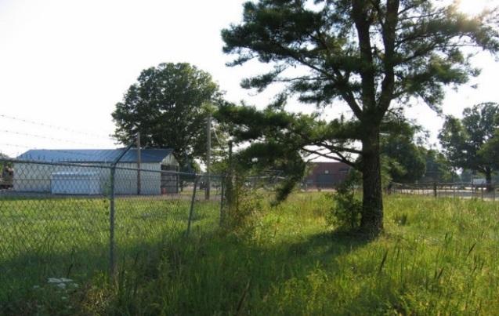
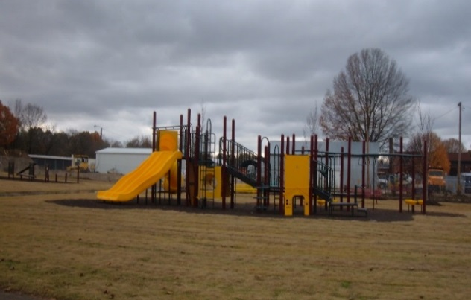
Arlington blending and packaging superfund site (EPA Region 4)
Arlington Blending and Packaging operated a pesticide processing and packaging facility which became a Superfund site in Arlington, Tennessee
As a result of EPA’s comfort/status letter to the Town of Arlington and a Ready for Reuse Determination, the Town opened the new Mary Alice Park in 2006

Slide 18
When does epa enter into site-specific agreements?
Given the self-implementing landowner liability protections, an agreement is not needed at most sites
At a site where a non-liable party is willing to perform cleanup work under EPA oversight, a site-specific agreement may be appropriate to address potential liability concerns
  Site of federal interest
  Work exceeds what would be required to maintain the liability protection (e.g., more than BFPP “reasonable steps”)

Slide 19
Sites of federal interest
Sites on the National Priorities List (NPL)
Sites where EPA is undertaking or has completed CERCLA cleanups, e.g., removal or remedial actions
Facilities subject to RCRA corrective action/post-closure
Contaminated sites in Indian country

Slide 20
Site-specific agreements
BFPP Doing Work
Contiguous Property Owner
Windfall Lien Resolution
Prospective Purchaser/Prospective Lessee

Slide 21
BFPp doing work agreements
Removal Work Agreement Model (2006)
  Sites of federal interest
  Work is more than obligations imposed by BFPP protection (e.g., more than reasonable steps)
  Federal covenant not to sue, contribution protection, and waiver of windfall lien
  EPA oversight
  Financial assurance
Remedial Work Agreement
  Based on removal model
  Include additional provisions appropriate for performance of remedial work

Slide 22
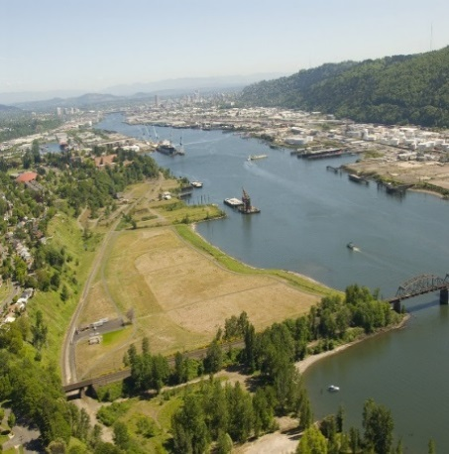
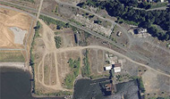
Portland harbor superfund site
(epa region 10)
The University of Portland wanted to purchase a portion of the site to meet their redevelopment needs but the anticipated timing of site investigation and cleanup was in line with its timeline
The University entered into a BFPP Doing Work Agreement for clean up of the Triangle Park portion of the site under EPA oversight

Slide 23
Other non-liable party agreements
Contiguous Property Owner (CPO) Agreements
  Explicit statutory authority under 107(q)
  No model, but similar to BFPP Doing Work Agreements
Windfall Lien Resolution Agreements
  Applicable to BFPPs
  Resolves EPA’s potential windfall lien on the property
  Does not involve performance of work so no federal covenant not to sue included

Slide 24
Prospective purchaser agreements
The statutory landowner liability protections have eliminated the need for PPAs at most sites
Where a party is willing to perform work, a BFPP work agreement typically is used
EPA will consider the use of a PPA or prospective lessee agreement (PLA) in limited circumstances
  Significant environmental benefits in terms of cleanup
  Unique, site-specific circumstances in the public interest
  Subject to regional resource constraints

Slide 25

Additional tools
CPO Assurance Letters
Ready for Reuse Determinations (RfRs)
Good Samaritans

Slide 26
Long-term stewardship and Institutional controls
Long-term stewardship activities are important to ensure the effectiveness of engineered and institutional controls during the reuse of properties, especially where some contamination remains
Institutional controls are intended to minimize the potential for human exposure to contamination by limiting land or resource use at a site
  Government Controls (e.g., permits, zoning)
  Informational Devices (e.g., deed notices)
  Proprietary Controls (e.g., easements, restrictive covenants)
  Enforcement Mechanisms (e.g., administrative orders, cleanup agreements)

Slide 27
Ic guidance
Institutional Controls: A Guide to Planning, Implementing, Maintaining, and Enforcing Institutional Controls at Contaminated Sites (PIME)
Institutional Controls: A Guide to Preparing Institutional Control Implementation and Assurance Plans at Contaminated Sites (ICIAP)

Slide 28
Additional information
Superfund Enforcement:
  www2.epa.gov/enforcement/superfund-enforcement
Brownfields and Land Revitalization Enforcement:
  www2.epa.gov/enforcement/brownfields-and-land-revitalization-cleanup-enforcement

Slide 29
Contact Information
Susan Kunst Boushell
EPA’s Office of Site Remediation Enforcement
202-564-2173
boushell.susan@epa.gov

