Slide 1
Cleanup Liability Concerns and Enforcement Tools at the Ecusta Mill Site
Jennifer Wendel, EPA
March 25, 2015

Slide 2
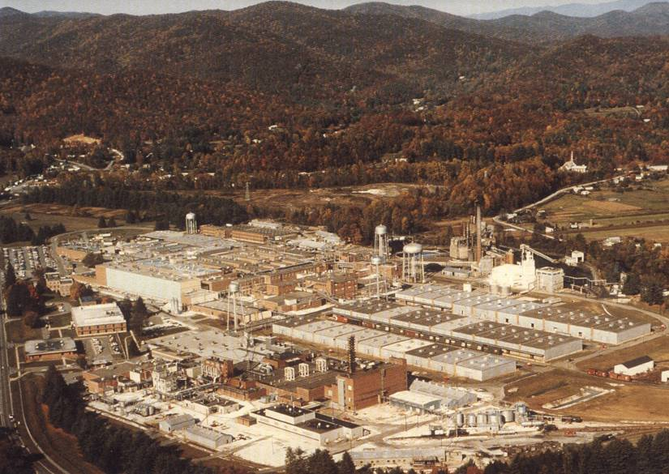
Former Ecusta Paper Mill
Brevard, N.C.

Slide 3
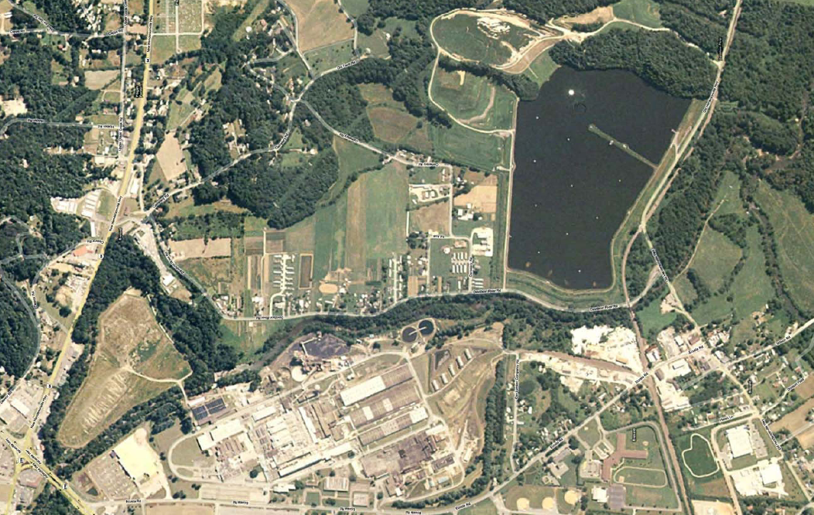
Landfills
ASB
Landfill
Main Plant Area

Slide 4
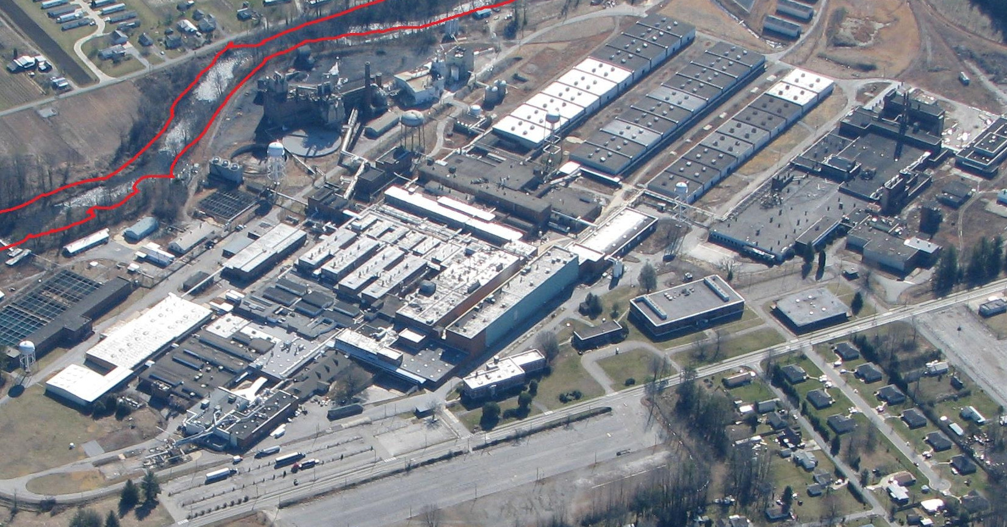
The Plant Site

Slide 5
Ownership History
Olin Corporation owned and operated the facility from 1949-1985.
P.H. Glatfelter owned and operated the facility from 1985-August 2001.
PURICO (IOM) purchased the site in 2001 from P.H. Glatfelter and operated the plant until they declared bankruptcy and shut down the plant in 2002.

Slide 6
Background for EPA and NC DENR Involvement
EPA and NC DENR responded to initial threats of contamination release after the plant closed in late 2002.
EPA conducted two investigations at the property, one initial inspection immediately following the shut down of operations and an Expanded Site Inspection in March, 2004.

Slide 7
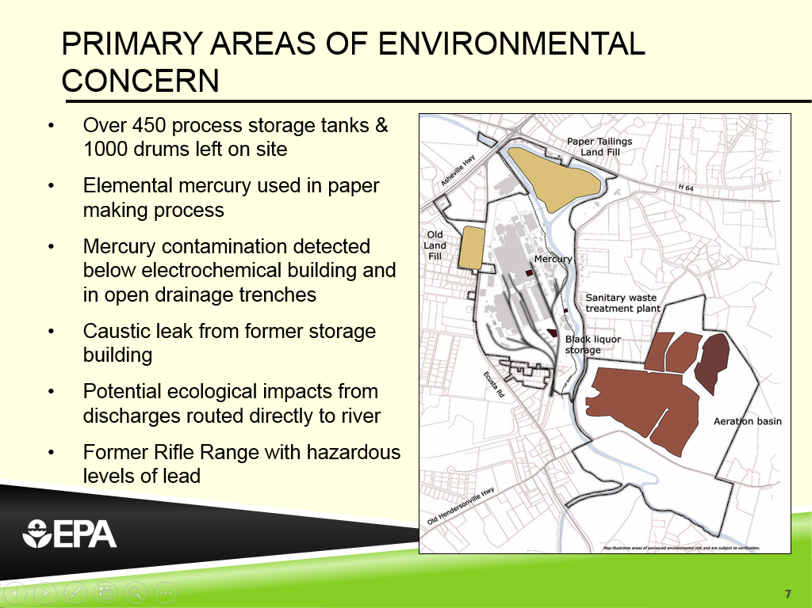
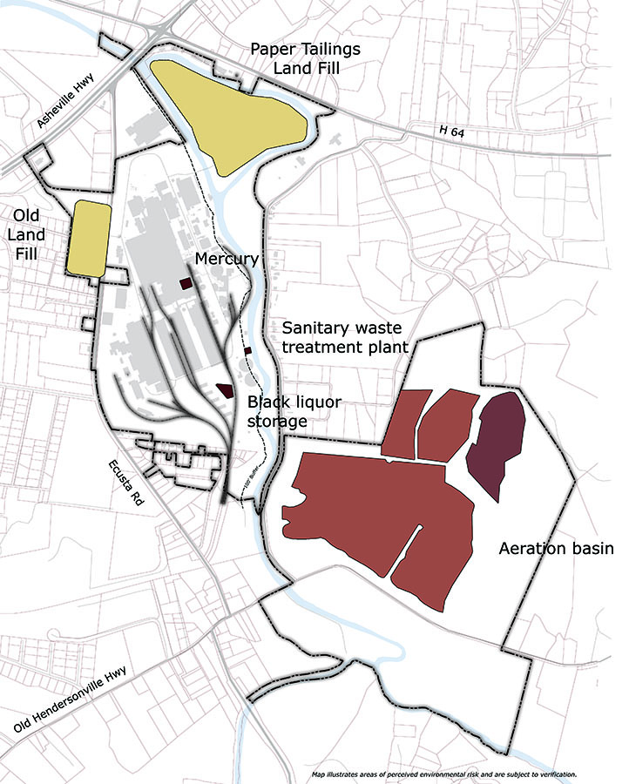
Primary Areas of Environmental Concern
Over 450 process storage tanks & 1000 drums left on site
Elemental mercury used in paper making process
Mercury contamination detected below electrochemical building and in open drainage trenches
Caustic leak from former storage building
Potential ecological impacts from discharges routed directly to river
Former Rifle Range with hazardous levels of lead

Slide 8
Redevelopment Proposal and Assumption of Liabilities
In August of 2006, EPA and NC DENR were approached by Renova Partners with a proposal to purchase the property for cleanup redevelopment, and to assume most of the environmental liabilities.
Renova Partners formed an LLC, Davidson River Village, to complete the acquisition.
Davidson River Village, LLC (DRV) purchased all of the properties defined in the agreements as the “Redevelopment Areas”

Slide 9
AOC with DRV
EPA entered into an Administrative Order on Consent with Davidson River Village, LLC. This AOC was in the form of a Bona-fide Prospective Purchaser Agreement (BFPP).
The BFPP agreement covered Time-Critical Removal activities during demolition as well as actions in other designated areas of concern.
The BFPP also required 2 Non-time Critical Removal actions:
  for the electrochemical building, and
  for all residual contamination not covered by the time-critical removal.

Slide 10
AOC with Glatfelter
EPA negotiated an agreement with P.H. Glatfelter for the performance of a Remedial Investigation/Feasibility Study (RI/FS) investigating the Davidson and French Broad Rivers.
Designated a Superfund Alternative Agreement (SAA), this AOC was signed using remedial authorities.

Slide 11
Meeting State Requirements for Cleanup and Long-term Stewardship
DRV has entered into Administrative Agreement (AA) with the State Inactive Hazardous Sites program.
DRV also entered into a Brownfields Agreement
Monitoring the operation and permitting of the ASB.
Post-closure monitoring and permits for landfills. Glatfelter retained State solid waste permits for closure of all landfills.

Slide 12
Memorandum of Understanding
Four party agreement which outlines and formalizes the strategy for the Site.
EPA, NC DENR, DRV and Glatfelter signatory.
Allows DRV and Glatfelter to meet EPA and NC DENR requirements in a coordinated way.

Slide 13
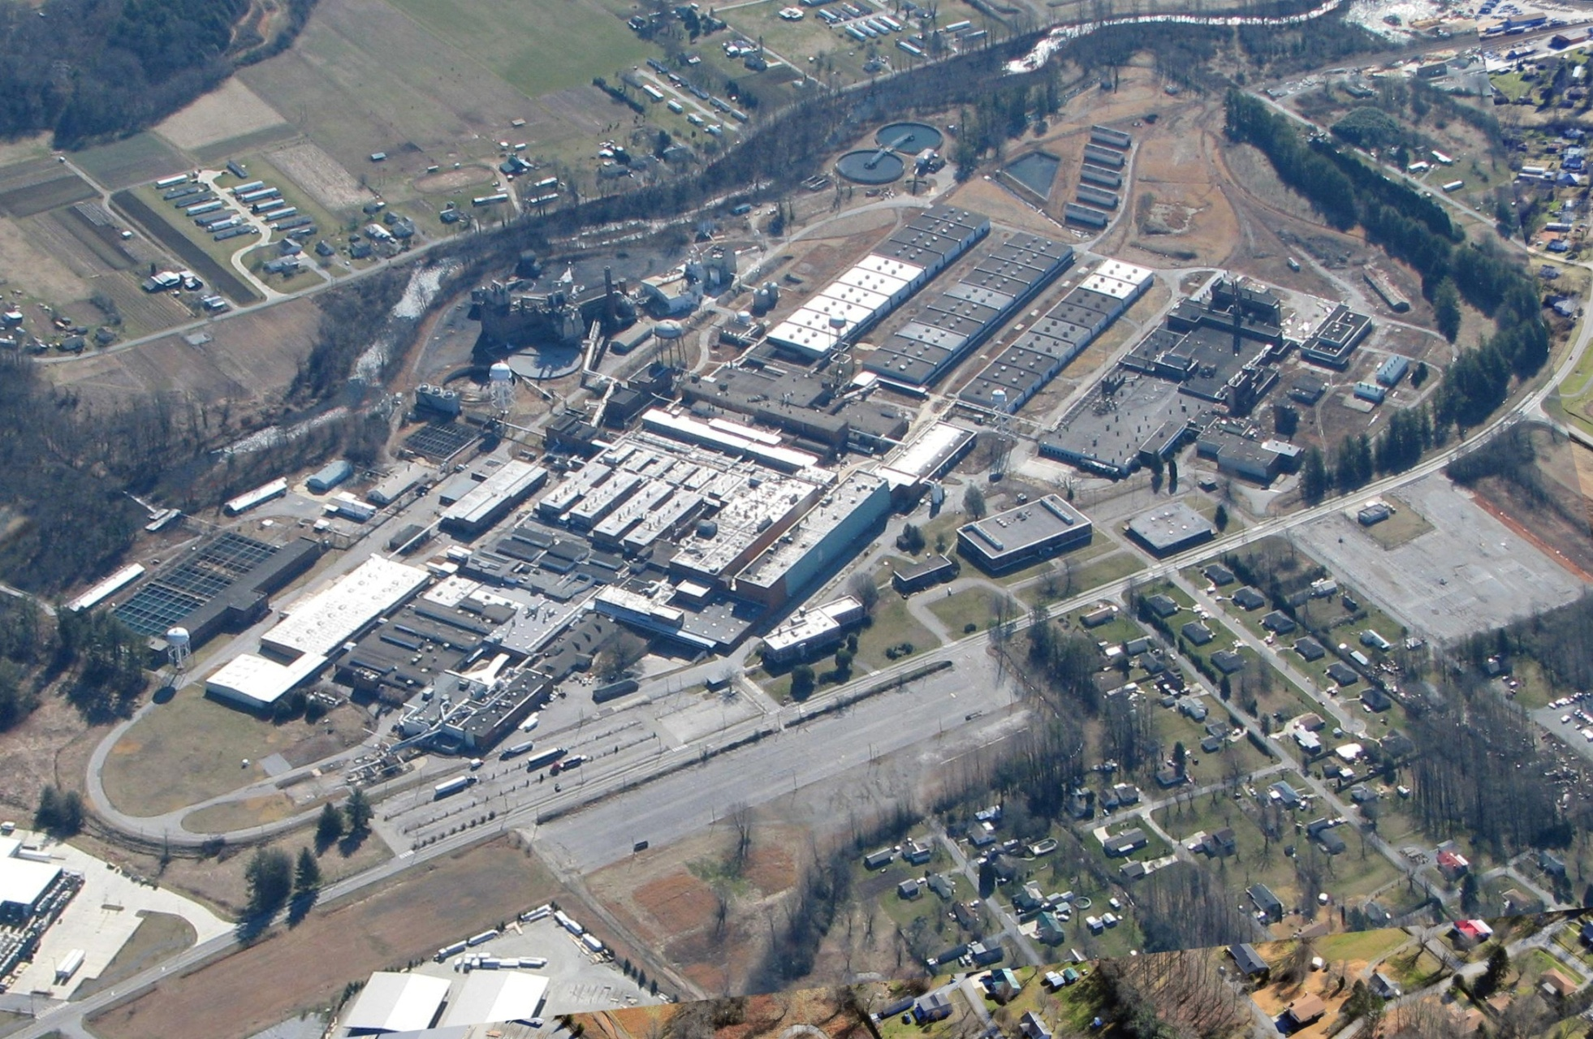
Ecusta Paper Mill – January, 2008

Slide 14
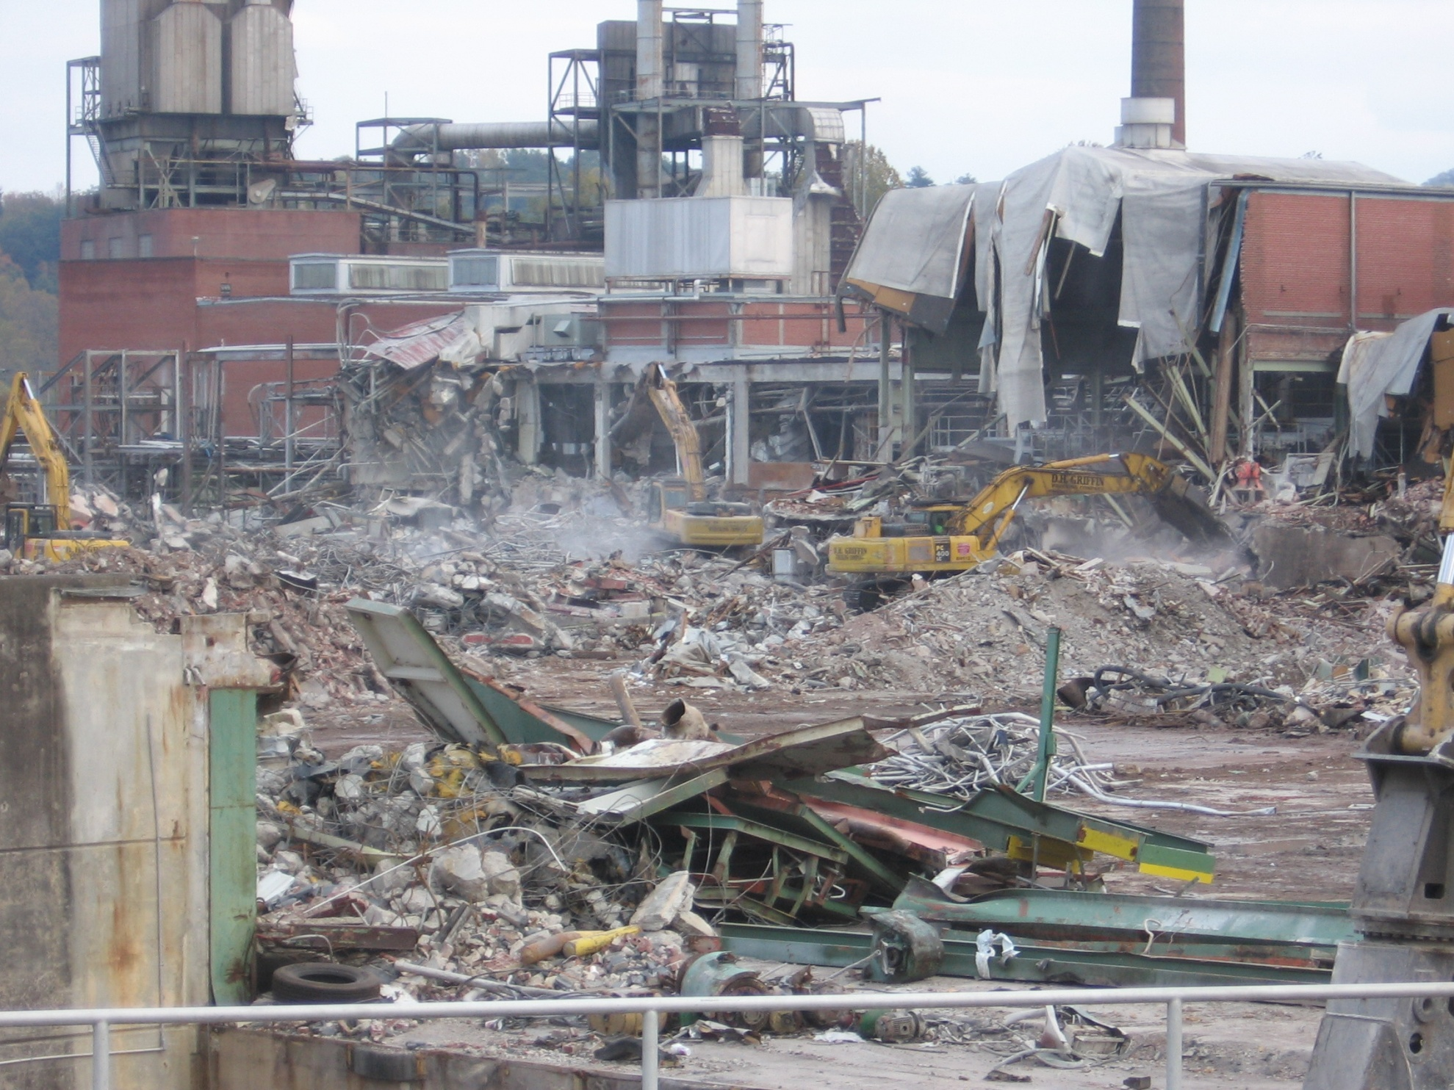

Slide 15
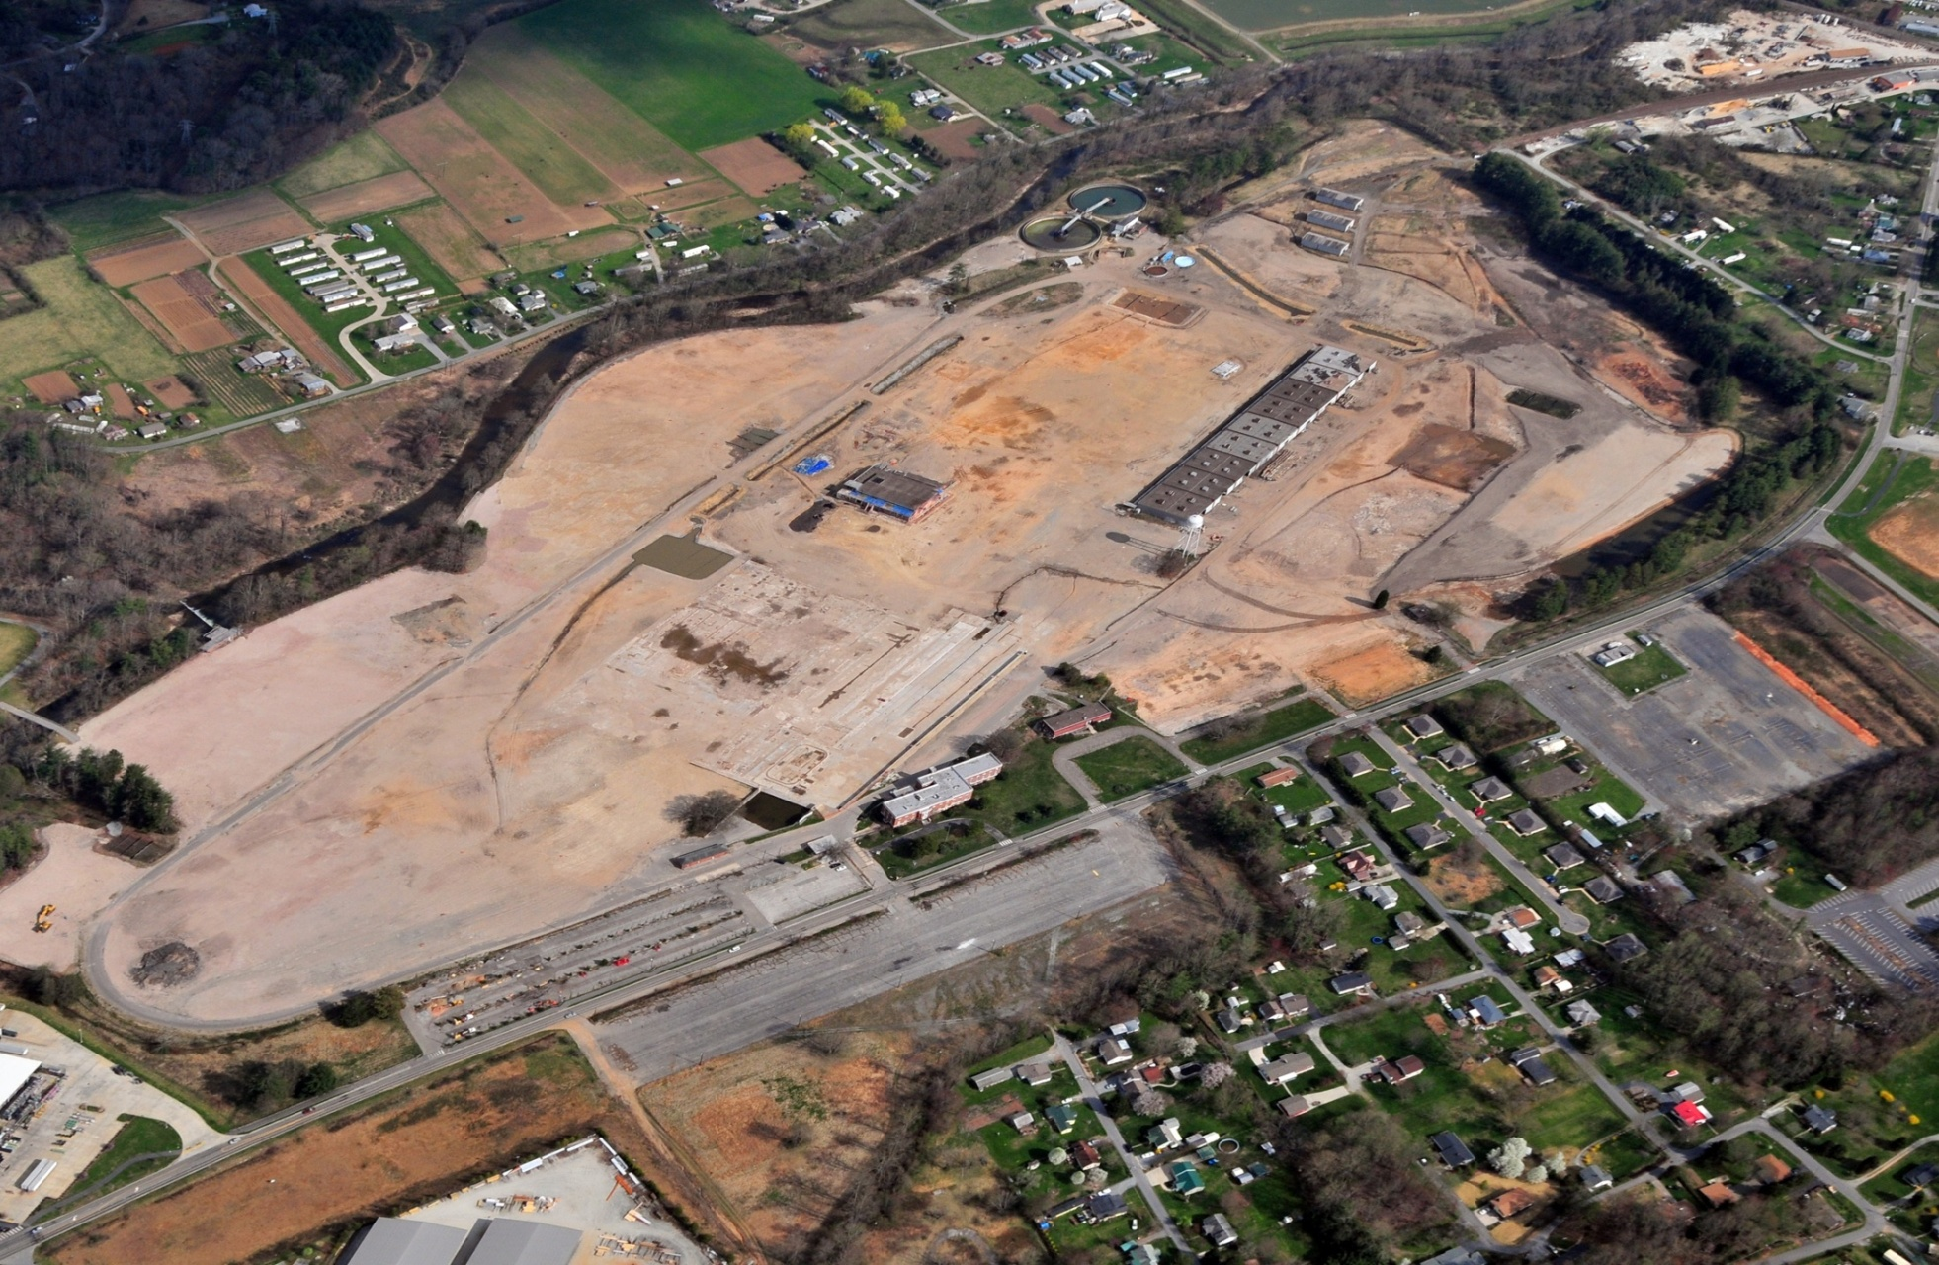
Ecusta Paper Mill – April, 2010

Slide 16
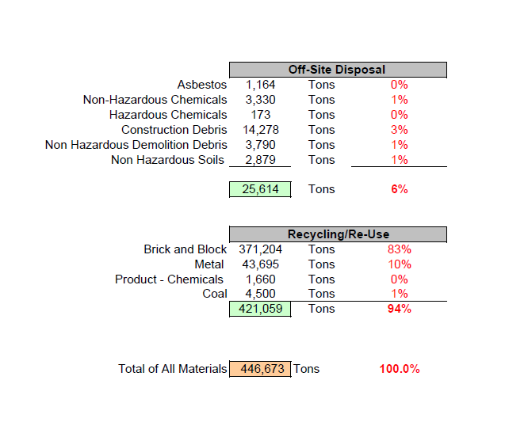
Recycling/Reuse = Smart Remediation
Notes:
16

Slide 17
Conceptual Master Plan

Slide 18

Create Pedestrian Friendly Streetscapes

Slide 19

Connect Open Space and Trails

Slide 20
Contact Information
Jennifer Wendel
EPA Region 4
404-562-8799
wendel.jennifer@epa.gov

