Slide 1
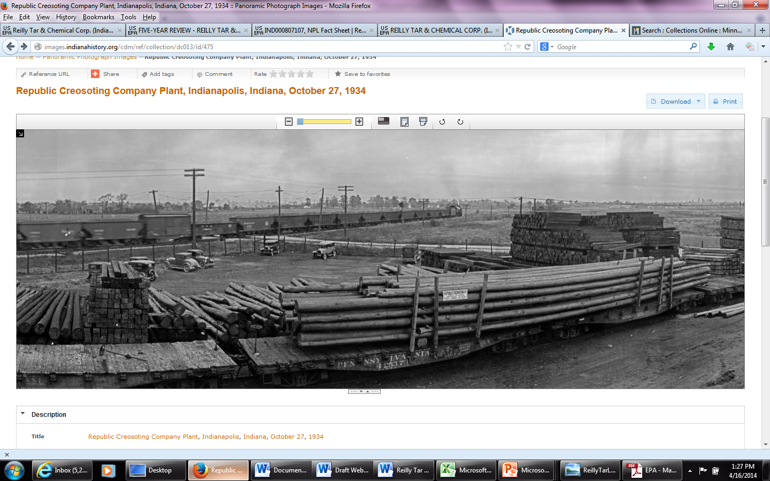
Site Background
Dion Novak, EPA Region 5 RPM

Slide 2
Site Background
120-acre site located on two parcels in Indianapolis.
Coal tar refinery and a wood treatment operations began on the southern part of the property in 1920s
Active chemical manufacturing facility on northern half of site that began operations in 1950s
On site management and disposal of creosote process wastes and specialty chemical operations resulted in ground water and soil contamination across site
Residential, industrial and commercial properties surround the site

Slide 3
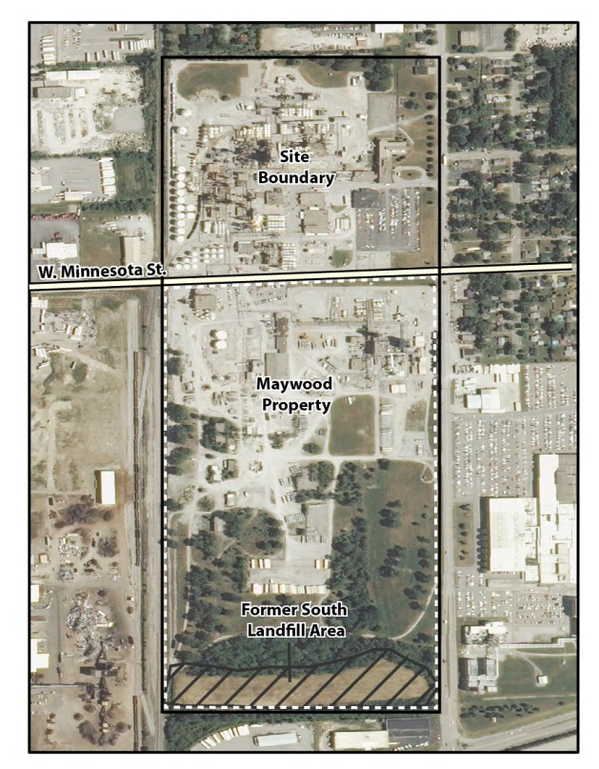
Site Aerial View

Slide 4
Site Cleanup Timeline
Activity | Date
Site Listed on National Priorities List | 1984
Reilly Tar begins remedial investigations | 1987
Record of Decision Signed (ROD) – OU-1 | 1992
ROD Signed – OU-2 | 1993
ROD Signed – OUs 3/ 4 | 1996
ROD Signed – OU-5 OU-2 remedy updated (ESD) | 1997
Off-site shipment of soil for thermal treatment for OU-2 completed | 1998
Restrictive covenant put in place by Reilly - limits use of southern portion of site to industrial use | 1998
Physical cleanup activities and PCOR completed for the site | 1999
Completion of SVE extraction in OU-4 | 2005
Biosparge pilot testing in OU-1 | 2008
Vertellus updated restrictive covenant | 2012

Slide 5
Selected Remedy Components
Ground water extraction and discharge to off-site POTW and ground water monitoring (OU-1)
In-situ solidification of sludge material in south landfill with soil cover and ICs (OU-2)
Thermal treatment of soils from other dumping areas on southern parcel (OU-2)
Permeable cover over wood treatment area (OU-3)
Concrete cover over parts of northern area. Soil vapor extraction for other parts of northern area (OU-4)
MNA of sitewide ground water (OU-5)

Slide 6
Key Site Reuse Remedy Considerations
Maintenance of cover soils
  Minimize/avoid soil excavation
  Minimize regrading and site contouring
  Repair new damage to cover soil
Minimize exposure to underground waste
Monitor for coal tar seeps
Ongoing periodic ground water monitoring
Compliance with conditions in restrictive covenant (e.g., no on-site excavation)
No impact on installed remedy, including surficial drainage patterns

Slide 7
Initial Maywood Project Discussions
2010-2011, Vertellus approached by solar developers interested in site
Spring 2012 – solar project took shape, Vertellus reached out to EPA
Early EPA/IDEM coordination on project site requirements
  Lay out Superfund remedy protectiveness requirements
  IDEM provided important local contact and project oversight

Slide 8
Project Coordination
Cooperative interaction between HQC, EPA, IDEM and Vertellus to coordinate project design
Willingness on part of HQC to be flexible and adapt project design on fly to meet EPA/IDEM requirements
Enabled entire project to be completed in less than 1 year

