Slide 1
Matthew McCullough, VP Development
Geoffrey S. Underwood, Project Developer
Maywood Solar Farm Development
From Brownfield to Greenfield

Slide 2

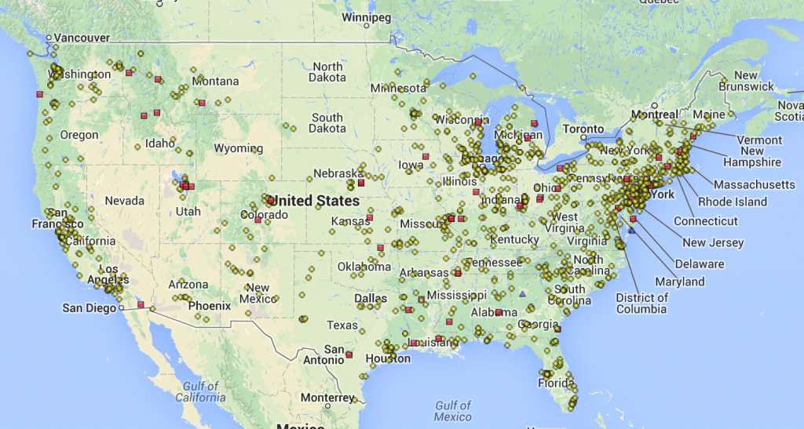

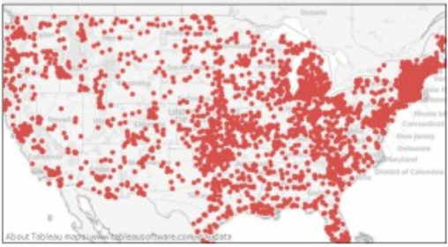
The Redevelopment Challenge
There is clear public value in revitalizing the more than 1,300 existing CERCLA (Superfund) National Priority Listed sites and and estimated 400,000+ CERCLIS (Brownfield) sites in the US. Conversion of sites to clean-tech renewable energy, generating long-term carbon emissions reductions, is a clear leveraged opportunity.
Given the clear value, what explains decades of failures in efforts to redevelop Superfund sites for renewable energy projects?

Slide 3
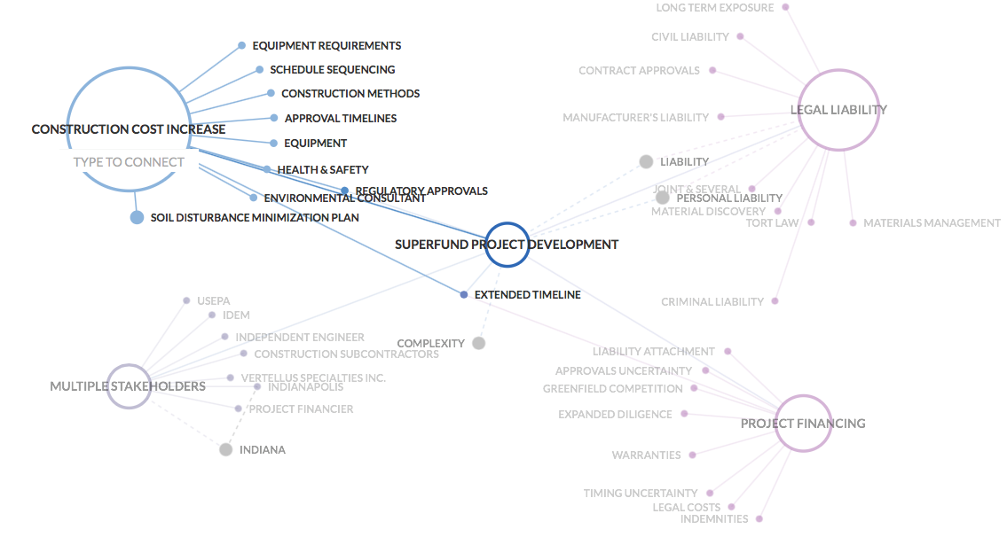
What Took So Long
To Make History?
PERCEPTION OF LIABILITY & INCREASED PROJECT COMPLEXITY
              - LEGAL LIABILITY - PROJECT FINANCING - PROJECT ECONOMICS

Slide 4
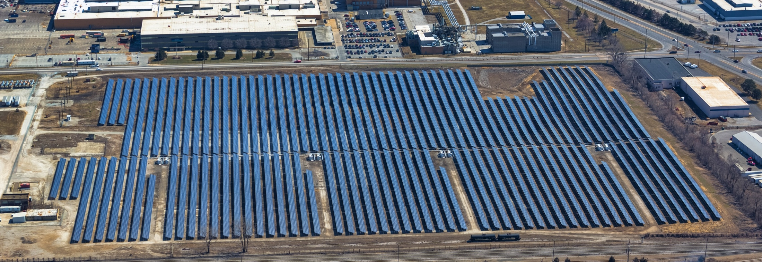
Given Dismal History –
Why This Project?
Hanwha Q CELLS was introduced to the project in November 2012 after the site owner – Vertellus Specialties Inc. (VSI) – had completed early development work and obtained IPL Rate REP Program award.
VSI experienced the failure of several solar development partners to demonstrate project financing. Vertellus sought out better capitalized firms – leading to an introduction to Hanwha Q CELLS which closed contracts within a 3 month period.
IPL Rate REP
Early Stage Development
Opportunity to Improve with Development Resources
Direct Dealing with Owner – No Third Parties
Owner/Partners Resources
Internal Resources
Site Status & History
Agencies’ Engagement
Project Economics Meet Commercial Criteria

Slide 5
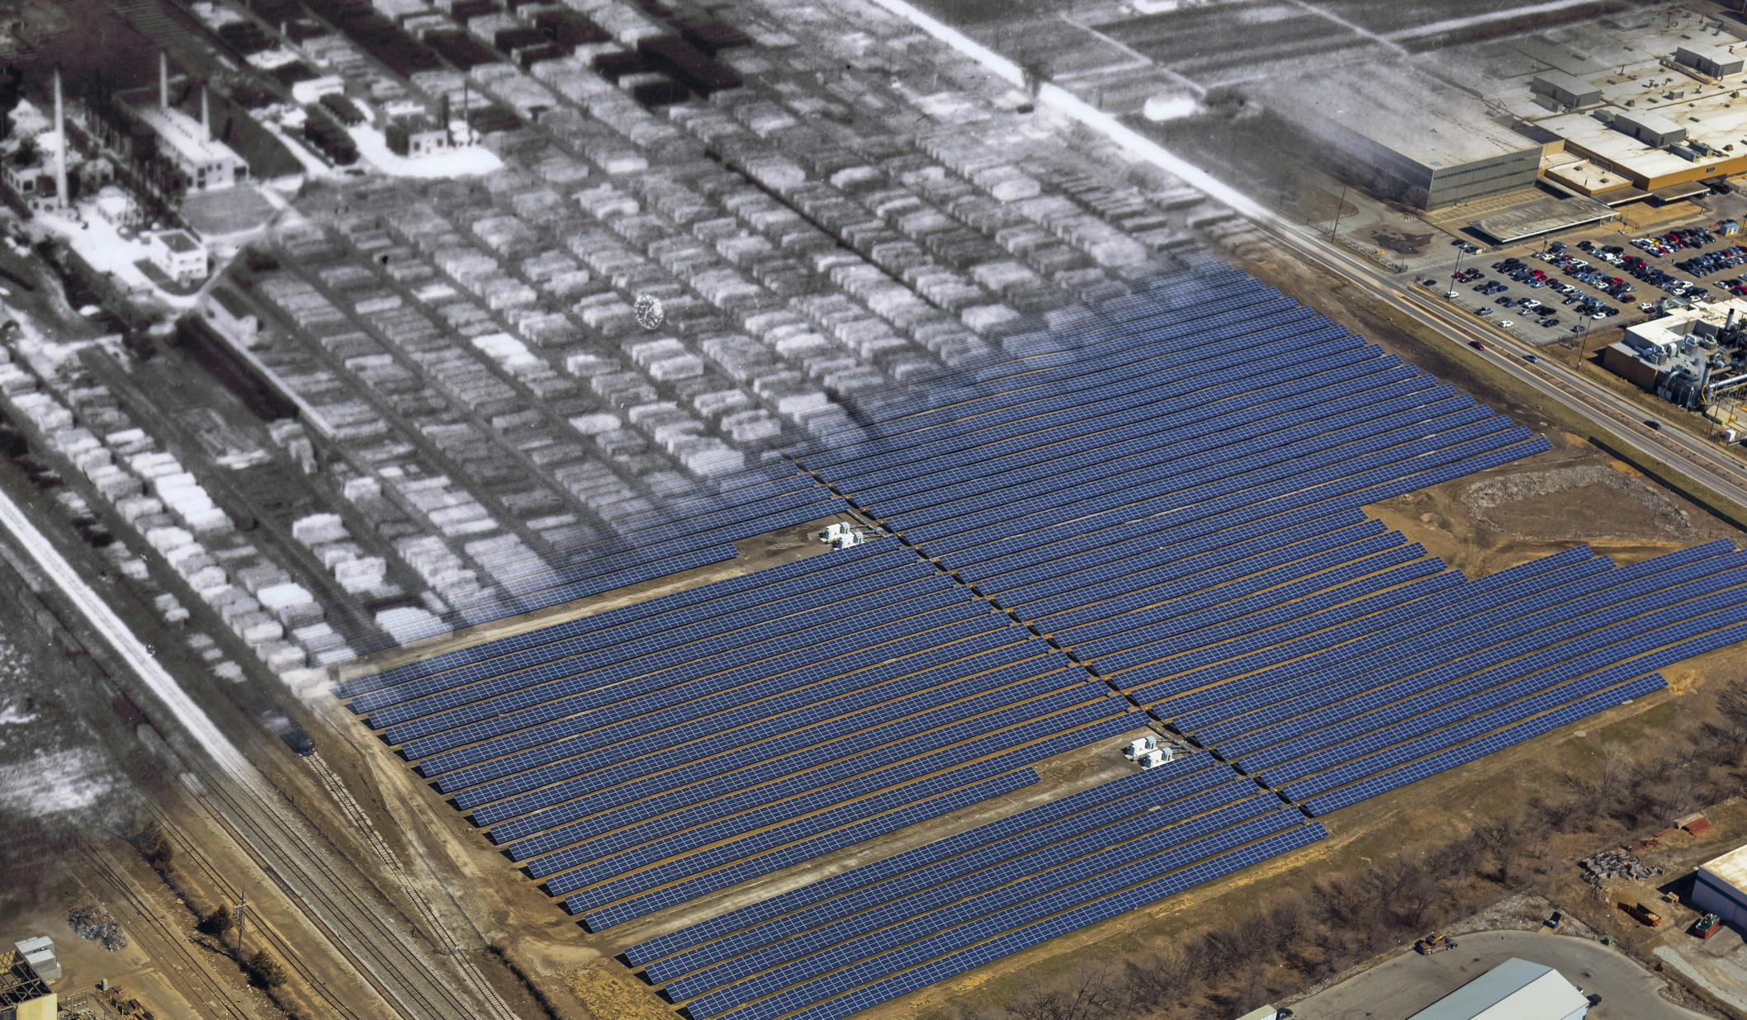
How Did Q Cells Make History?
  PROJECT PARTNERS - DILIGENCE
    VERTELLUS
    EPA
    IDEM
    AUGUST MACK
  INTERNAL EXPERTISE
  ADAPTIVE CONSTRUCTION
  IRRATIONAL PERSISTENCE

Slide 6
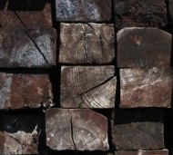
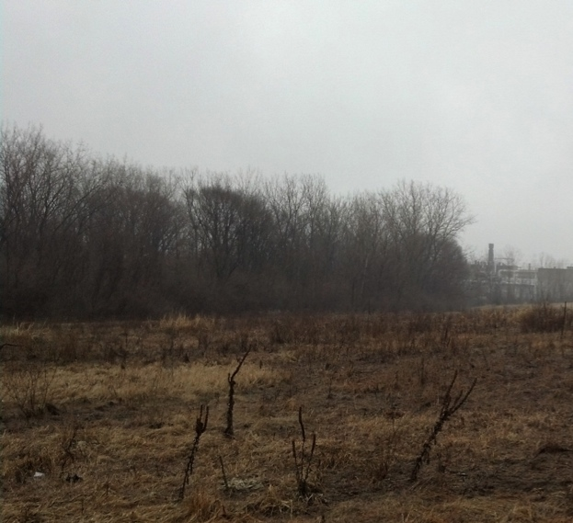

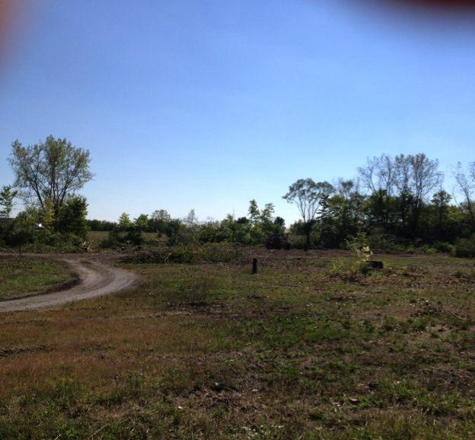
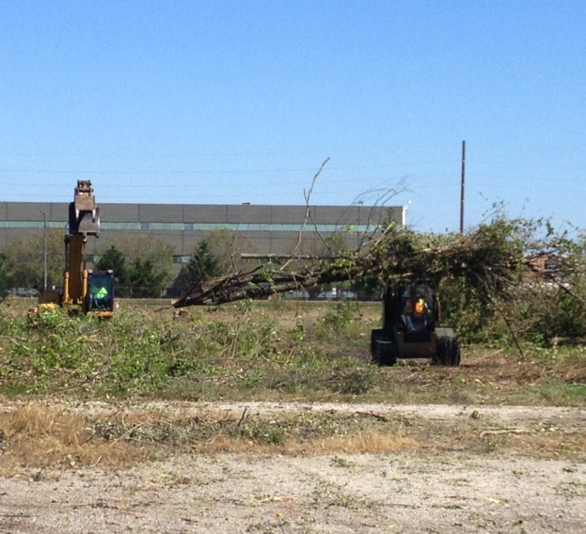
Project Partner: Vertellus
  PROJECT PARTNERS - DILIGENCE
    VERTELLUS
  INTERNAL EXPERTISE
  ADAPTIVE CONSTRUCTION
  IRRATIONAL PERSISTENCE

Slide 7
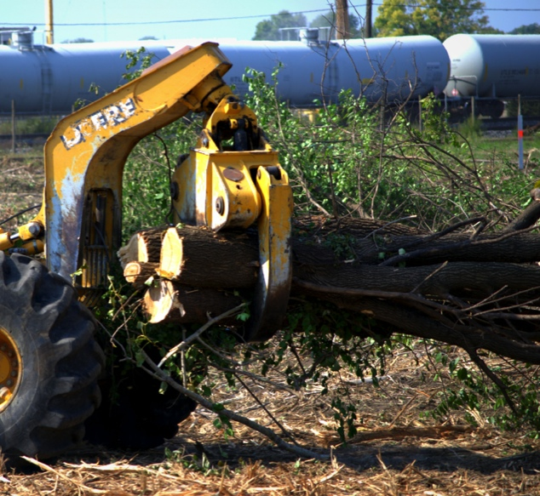
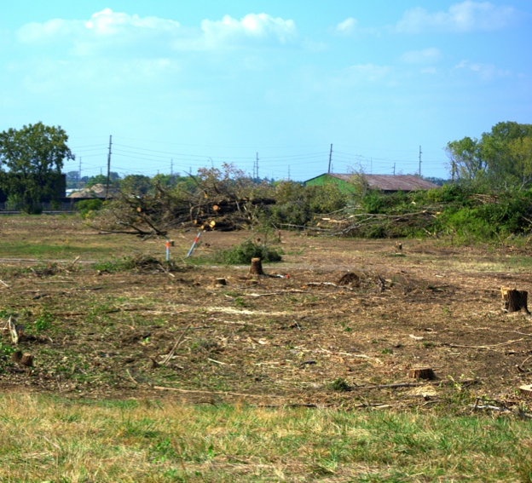
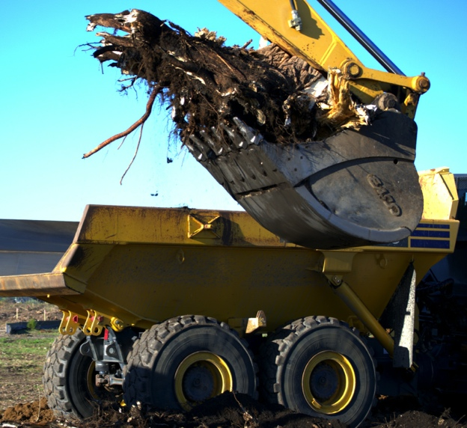
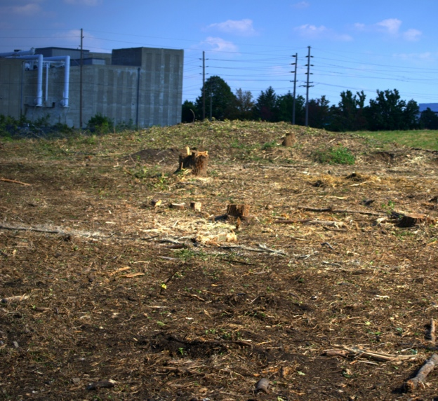
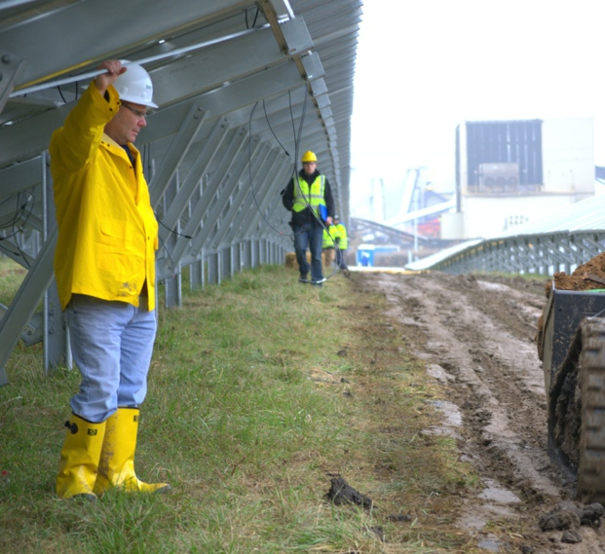
Project Partner: EPA
  PROJECT PARTNERS - DILIGENCE
    EPA
  INTERNAL EXPERTISE
  ADAPTIVE CONSTRUCTION
  IRRATIONAL PERSISTENCE

Slide 8
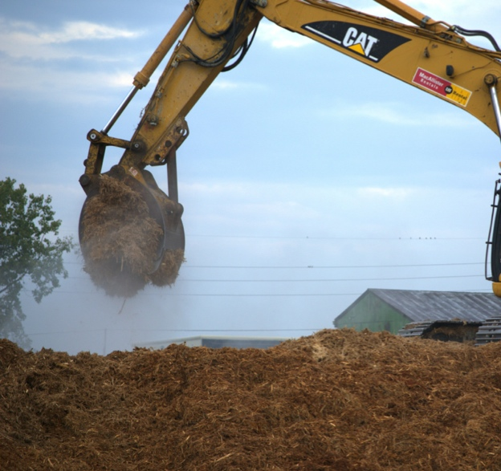
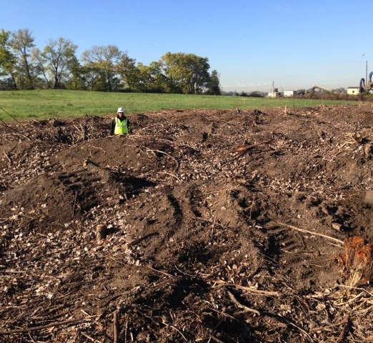

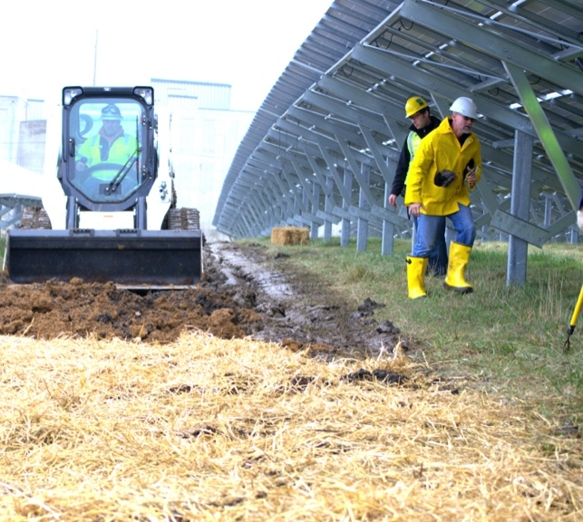
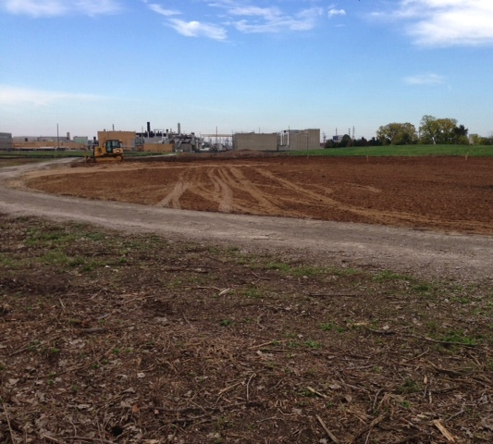
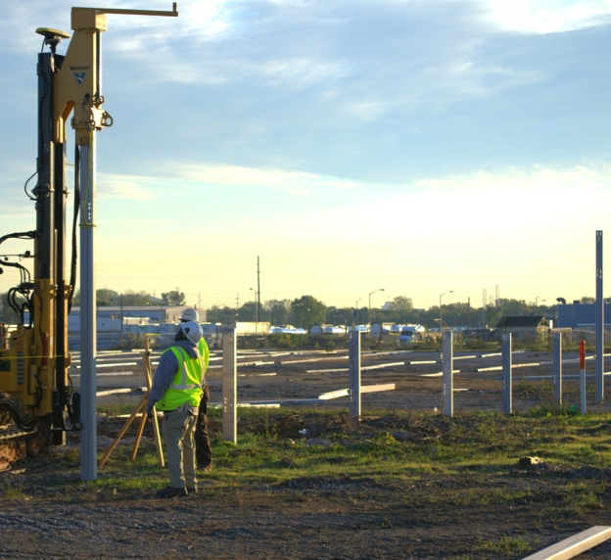
Project Partner: IDEM
  PROJECT PARTNERS - DILIGENCE
    IDEM
  INTERNAL EXPERTISE
  ADAPTIVE CONSTRUCTION
  IRRATIONAL PERSISTENCE

Slide 9
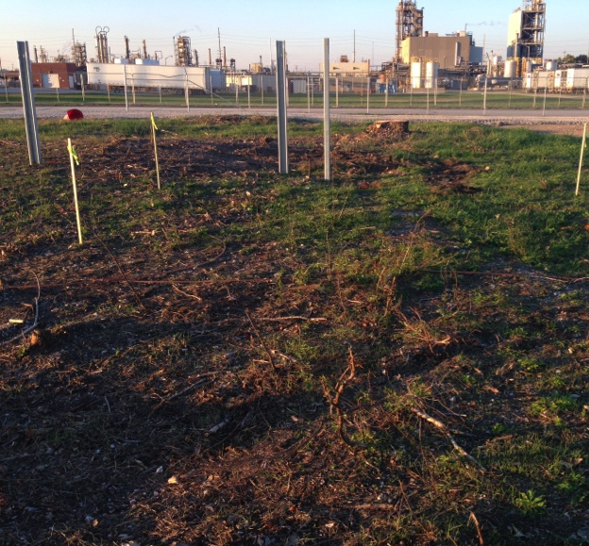
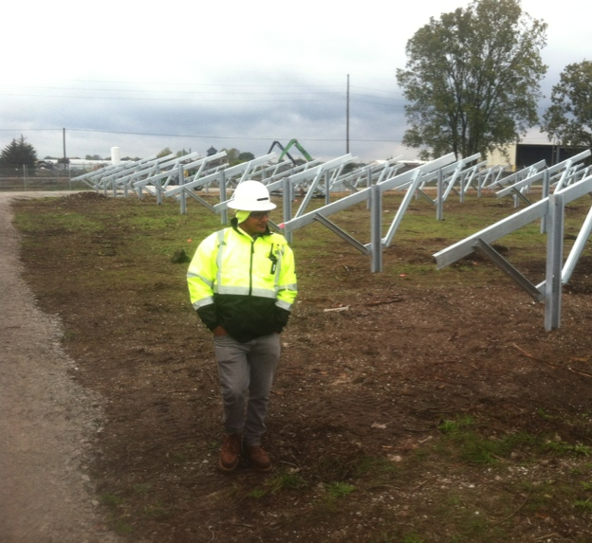

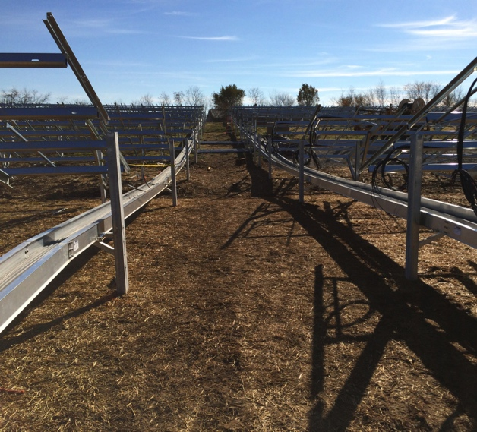
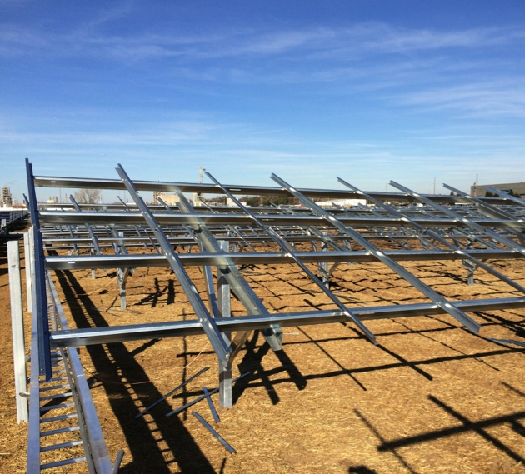
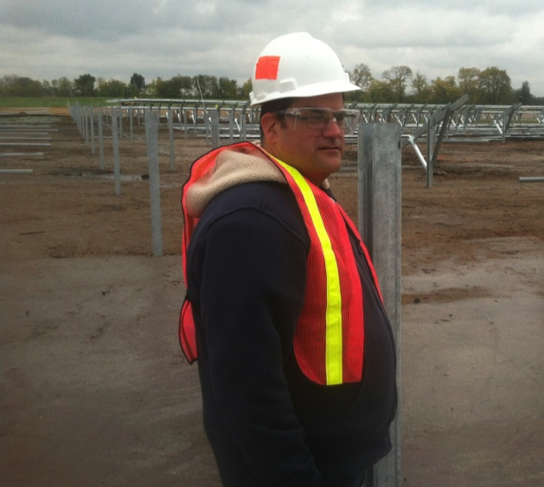
Project Partner: August Mack
  PROJECT PARTNERS - DILIGENCE
    AUGUST MACK
  INTERNAL EXPERTISE
  ADAPTIVE CONSTRUCTION
  IRRATIONAL PERSISTENCE

Slide 10
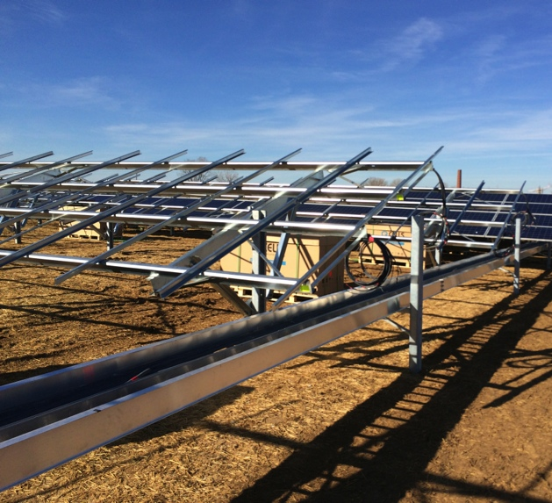
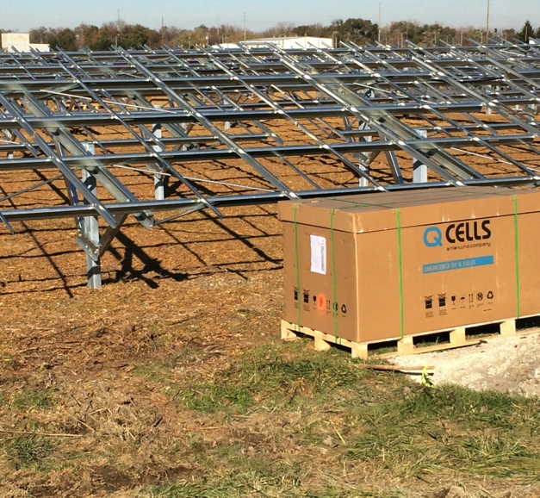
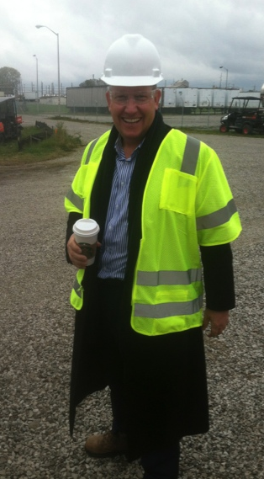
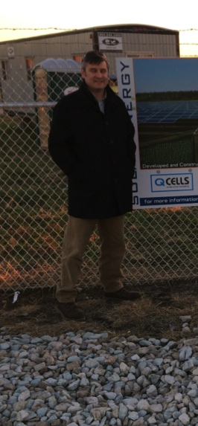
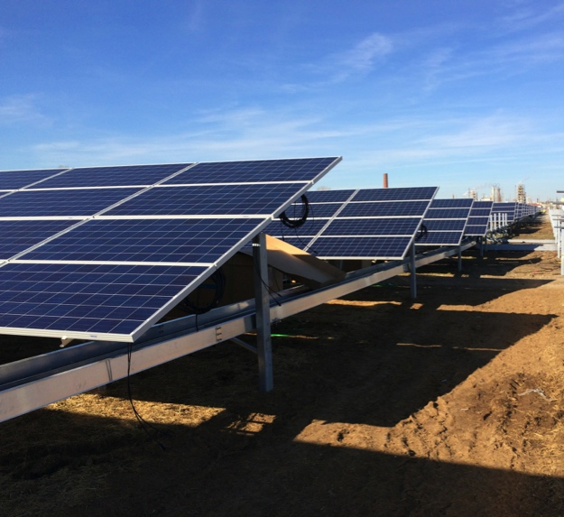
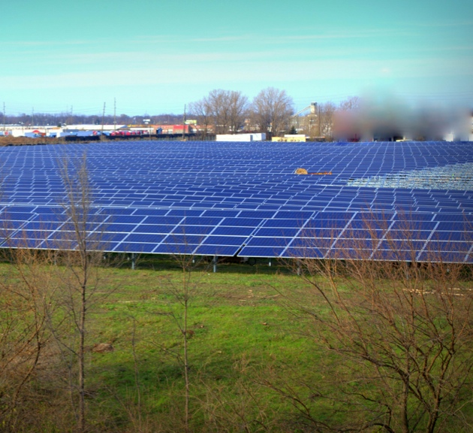
Hanwha Q Cells Internal Expertise
  PROJECT PARTNERS
    EPA
    VERTELLUS
    IDEM
    AUGUST MACK
  INTERNAL EXPERTISE
  IRRATIONAL PERSISTENCE

Slide 11
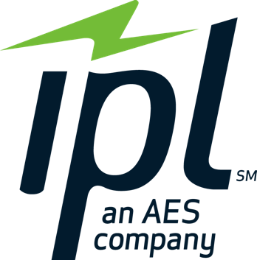
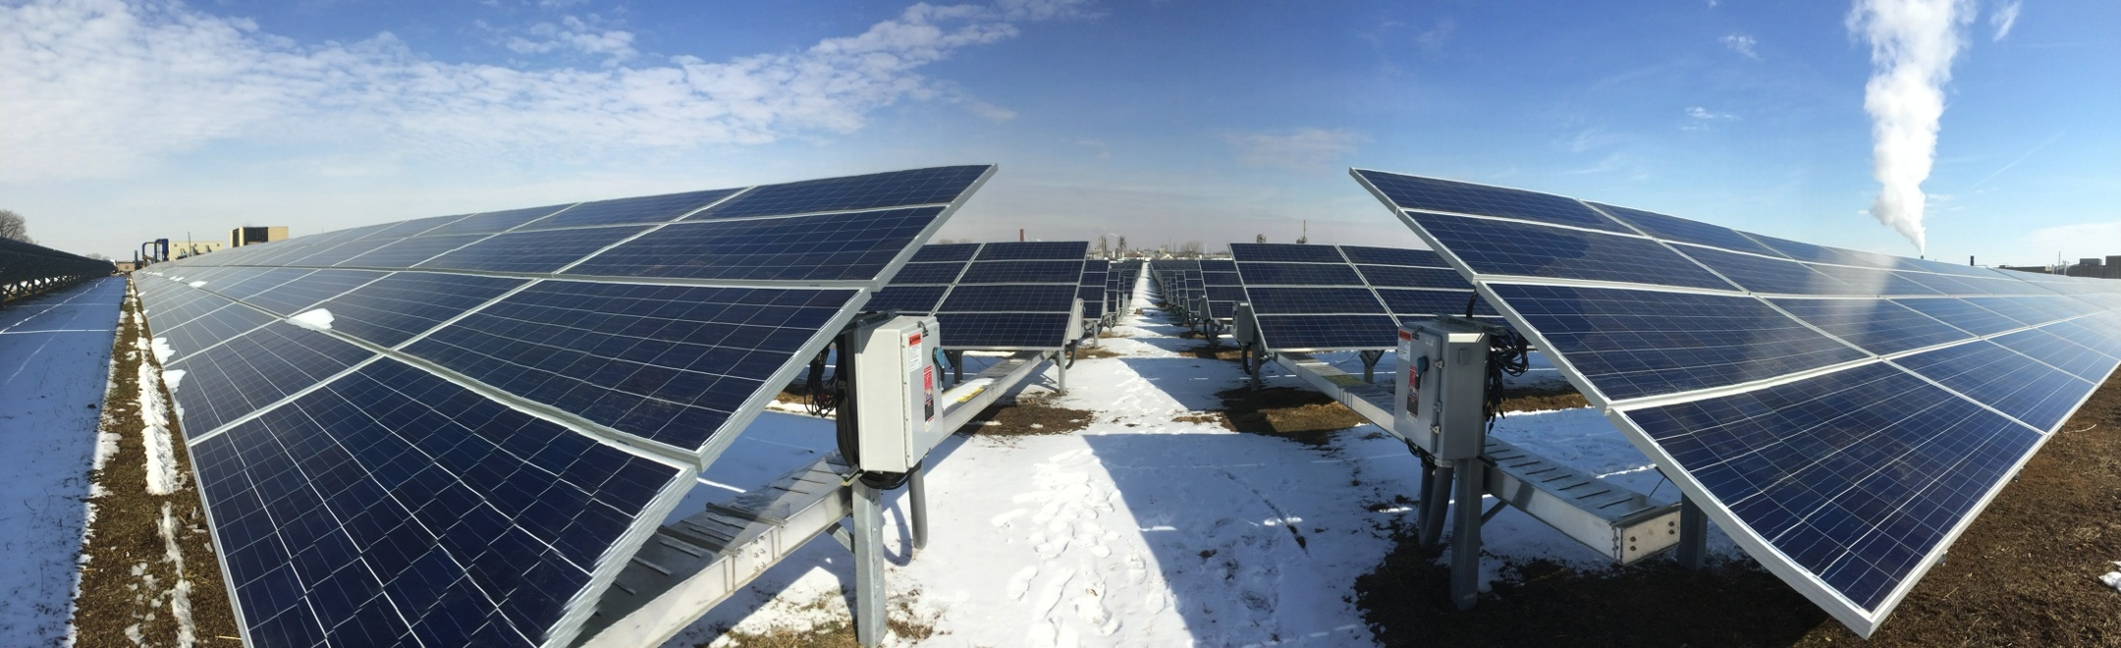
Project Partners:
Project Completion
  PROJECT PARTNERS - COMPLETION
    IPL
  IRRATIONAL PERSISTENCE

Slide 12

Project Partners:
Project Completion
  PROJECT PARTNERS - COMPLETION
    PNC ENERGY CAPITAL
  IRRATIONAL PERSISTENCE

Slide 13
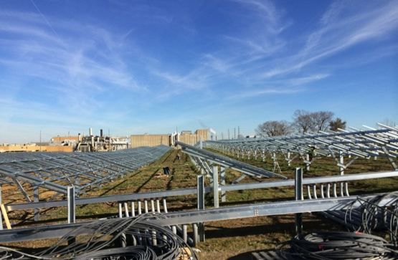
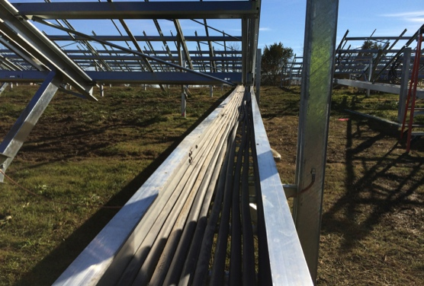
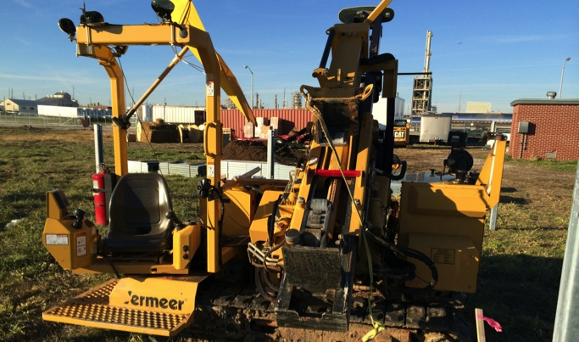
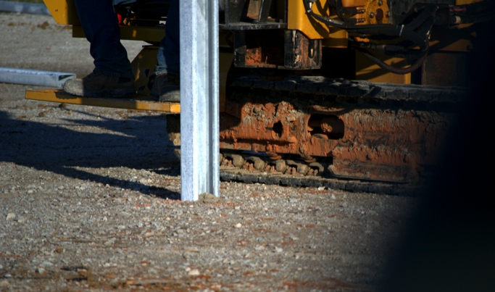
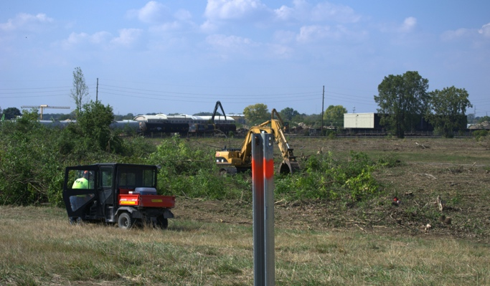
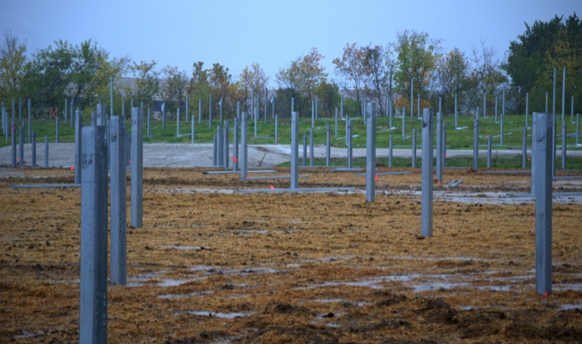
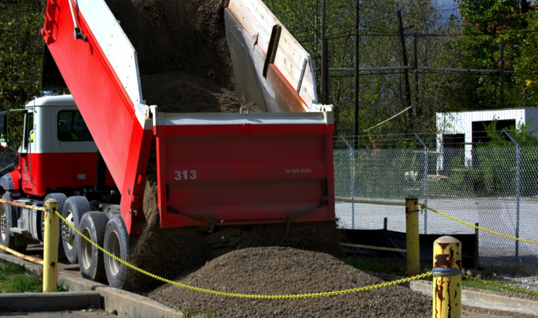
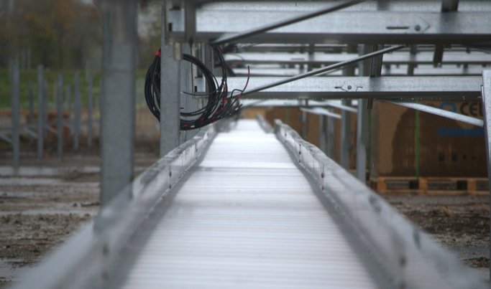
Hanwha Q Cells:
Innovative Thinking
  PROJECT TECHNICAL ELEMENTS
    CABLE TRAYS
    DRIVEN POSTS
    ADAPTIVE RACKING
    MINIMIZED GRADING
    SITE ELEMENTS IN SITU
  IRRATIONAL PERSISTENCE

Slide 14
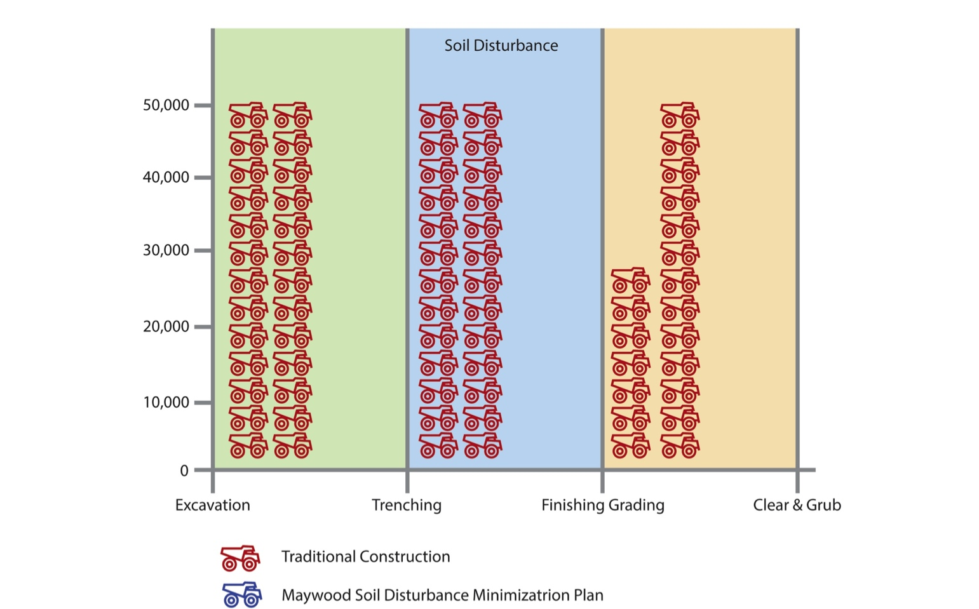
Hanwha Q Cells:
Innovative Thinking
Updating the Industry Standard
Traditional site construction for the Maywood sie would displace an estimated 171,000 cubic feet of soil - increasing the potential for impacting existing site remedy or exposing known underground hazards.

Slide 15
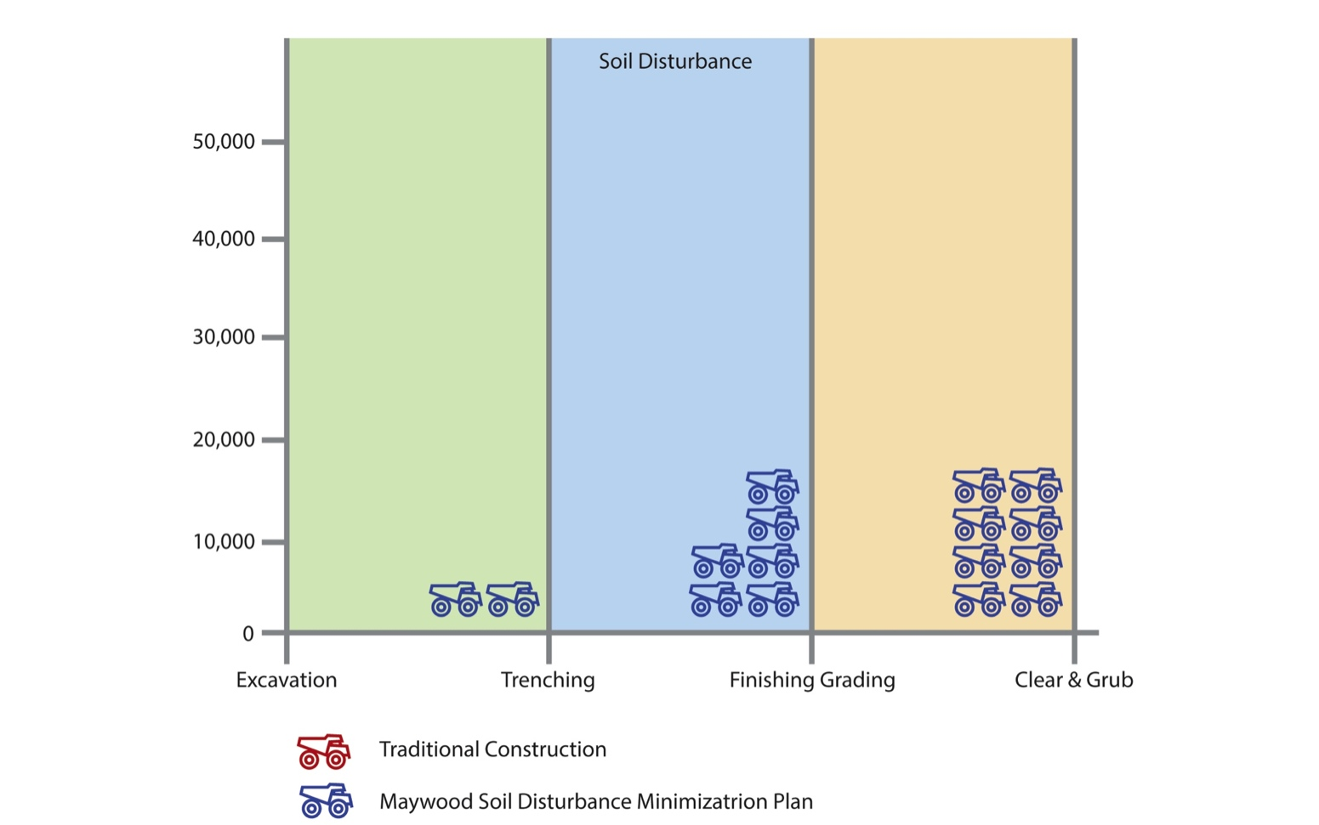
Hanwha Q Cells:
Innovative Thinking
Soil Disturbance Minimization Plan
Hanwha Q CELLS developed a proprietary construction approach – refined in close coordination with EPA – resulting in a total 11,000 cubic feet of soil displacement.

Slide 16
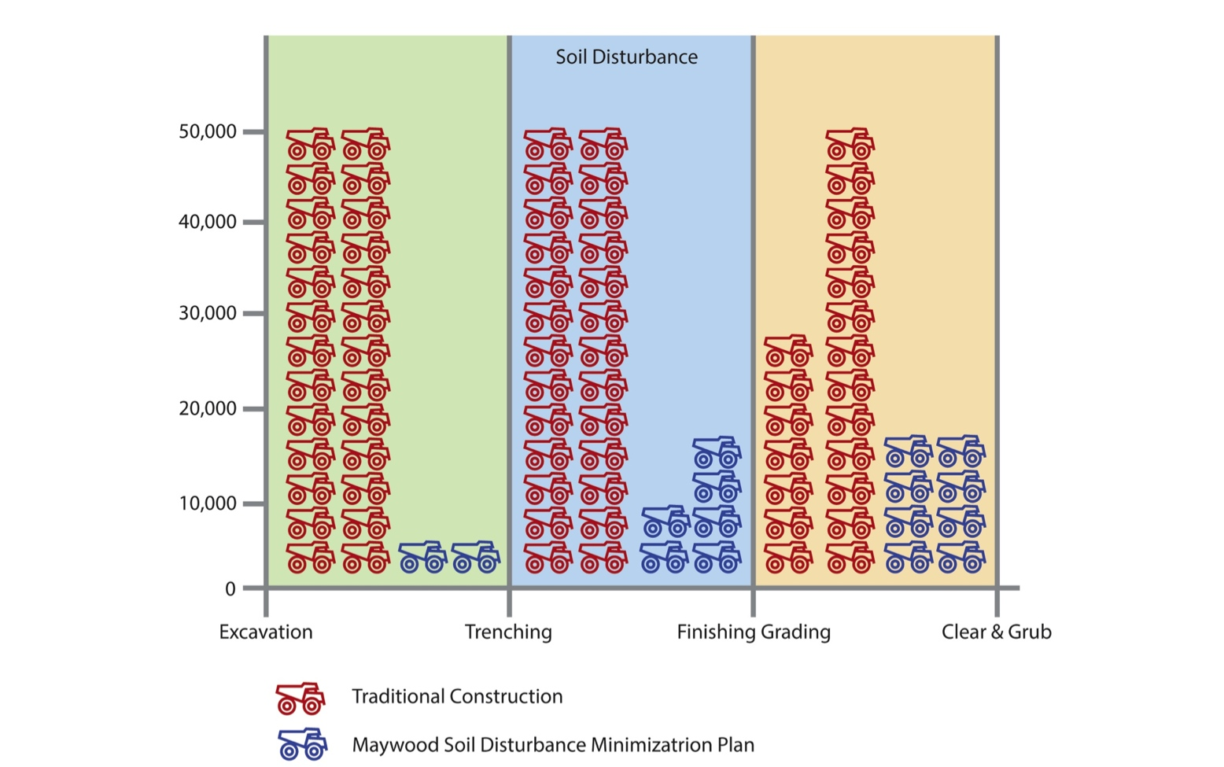
Hanwha Q Cells:
Innovative Thinking
Comparative Results
Q CELLS’ Soil Disturbance Minimization Plan resulted in a 93% decrease in project soil movement over conventional construction methods – significantly reducing the potential for impacting existing site remedy or exposing known underground hazards.

Slide 17
Project Criteria
  TECHNICAL/PHYSICAL CONDITIONS NEEDED FOR SUCCESSFUL BROWNFIELD PROJECT
    MARKET ECONOMICS/INCENTIVES
    MATURE BROWNFIELD SITE
    KNOWN/MANAGABLE HAZARDS
    SETTLED ENVIRONMENTAL PERMITTING
    WELL DOCUMENTED HISTORY
    SUPERFUND > BROWNFIELD
    REASONABLE LANDOWNER EXPECTATIONS
    CONTROLLING AGENCY BUY-IN
  IRRATIONAL PERSISTENCE

Slide 18

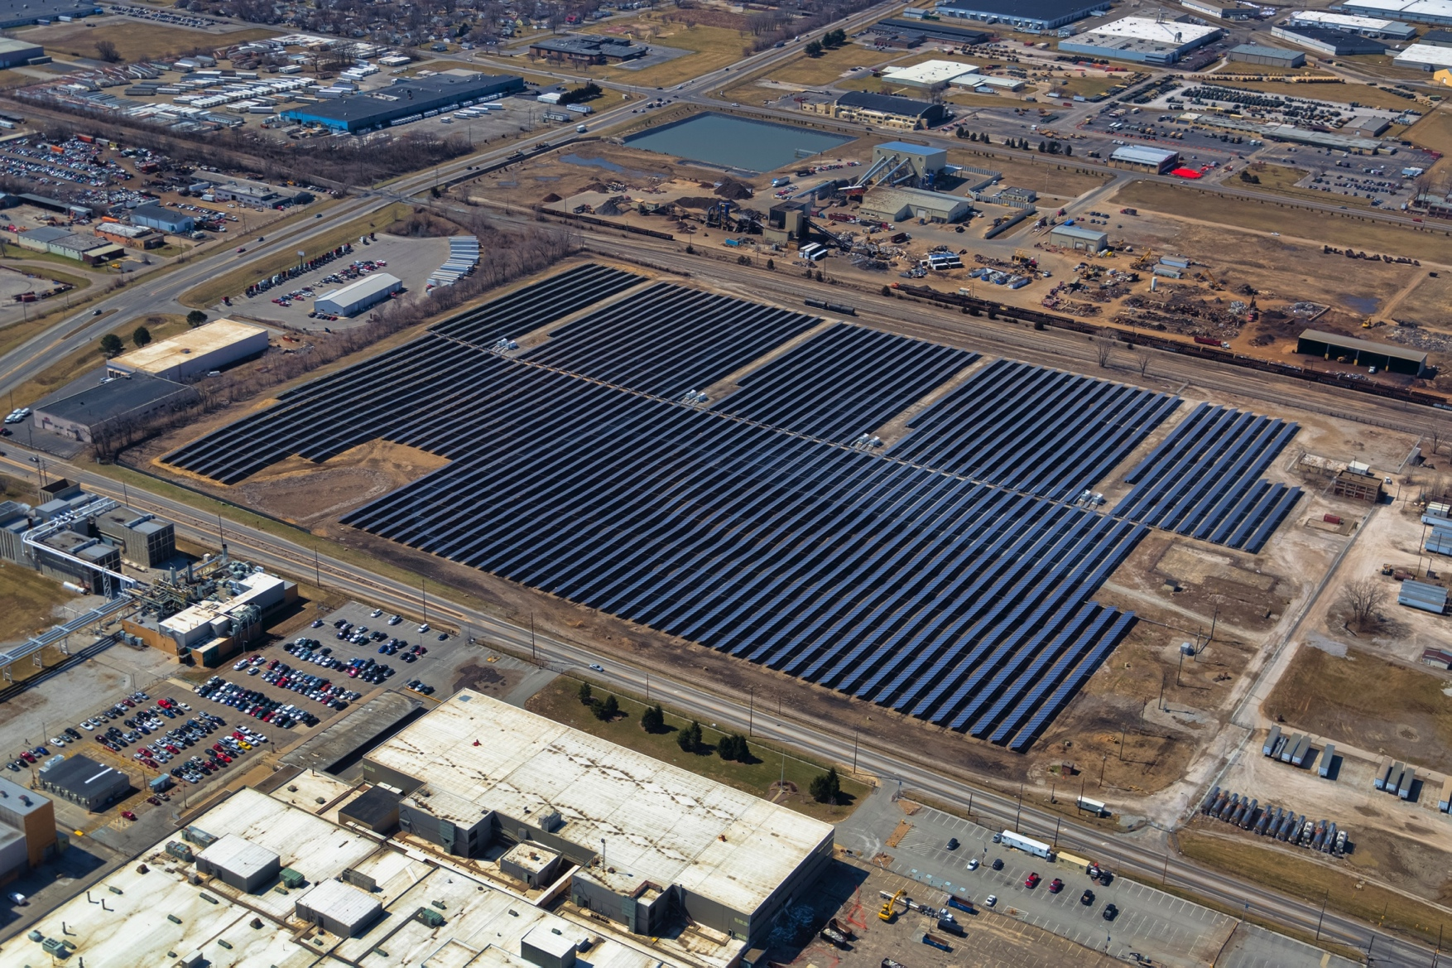
1st Utility Scale Solar
Superfund Plant

Slide 19
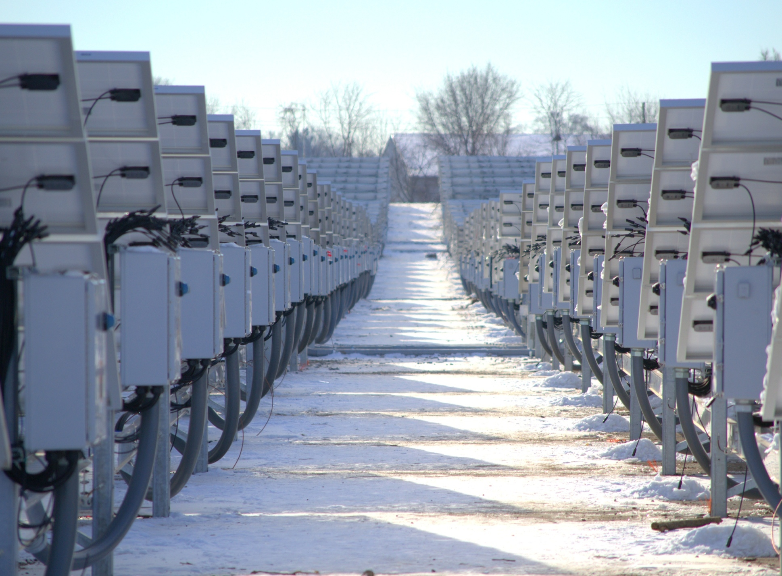
THANK YOU.

