Slide 1
Regional Seeds and
Renewable Energy
Frank Avvisato, SRI Project Officer

Slide 2
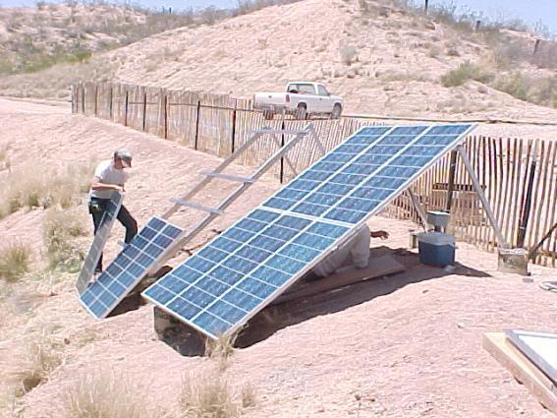
Renewable Energy
Assessment Support Activities
Regional seed activities have focused on two areas:
Renewable Energy Pre-Feasibility Assessments for Large Scale Projects
Green Remediation Site Evaluation
Notes:
2

Slide 3
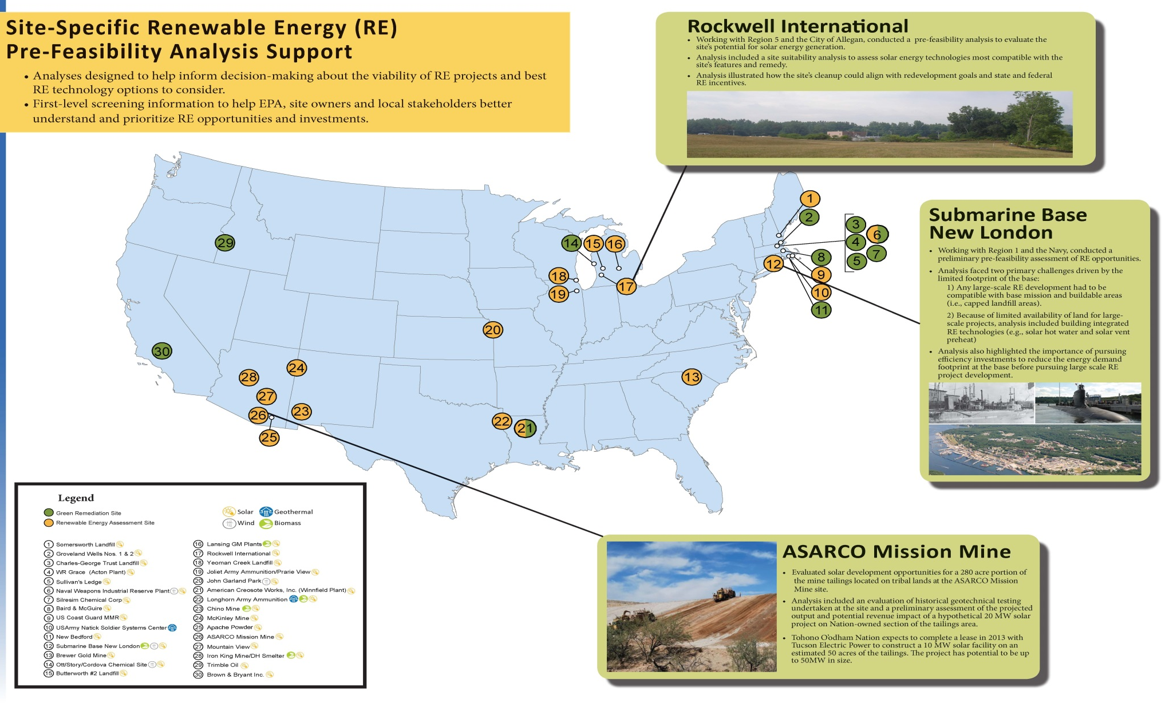
Sites Provided Technical and Community Support

Slide 4
Renewable Energy and Green Remediation Assessment Framework
General Assessment Approach
  Evaluate renewable energy resource.
  Assess site suitability.
  Review markets and incentives.
  Renewable energy technology overview.
  Estimate system size(s) and output projections.
  Collect/estimate site cleanup electricity demand (green remediation sites).
  Preliminary economic and financial analysis.
Notes:
4

Slide 5
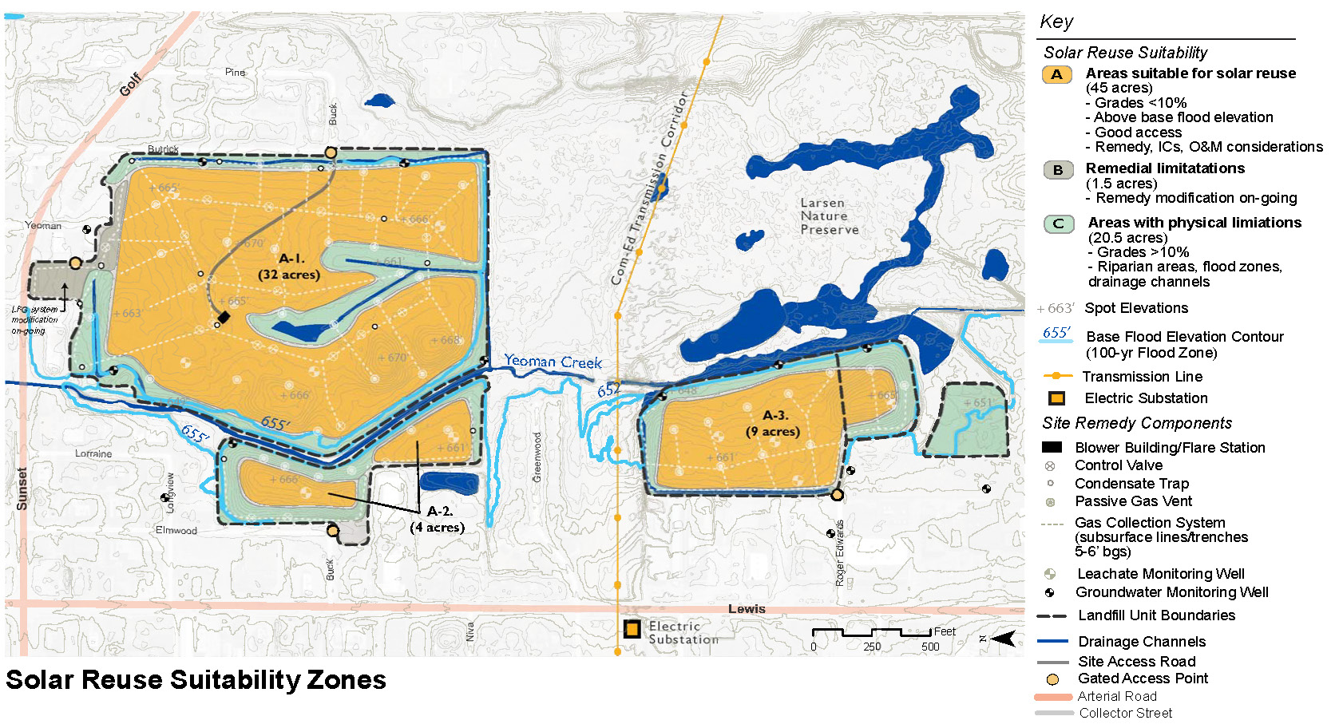
Renewable Energy
Assessments – Site Suitability

Slide 6
Renewable Energy
Assessments – Economic Evaluation
Reuse Zone | Available Acreage | Estimated Project Size | Estimated Output | Installed Costs | Annual O&M Costs
Non-Landfill Solar PV Potential
Zone N1 | 9.5 | 2 – 2.7 MW | 2370 – 3200 Mwah | $7 - $10.5 M | $40 – 54,000
Zone N2 | 19.5 | 4 – 5.5 MW | 4740 - 6500 Mwah | $14 – 22 M | $80 – 110,000
Zone N3 | 3.5 | 0.7 - 1 MW | 830 – 1185 Mwah | $2.4 - $4 M | $14 – 20,000
Landfill Solar PV Potential
Zone L1 | 20 | 4 – 5.6 MW | 4740 - 6640 Mwah | $14 – 22 M | $80 – 112,000
Zone L2 | 36.5 | 7.2 – 10.5 MW | 8530 - 12,450 Mwah | $14 – 22.4 M | $144 – 210,000
Assumptions System Costs: $3.30 - $4.00/Watt installed O&M Costs: $20/kW/year Area needed: 3.5 - 5 acres / MW MWh=1000 kilowatthours (kWh) Output estimate calculated with based on average crystalline silicon PV system tilted at latitude

Slide 7
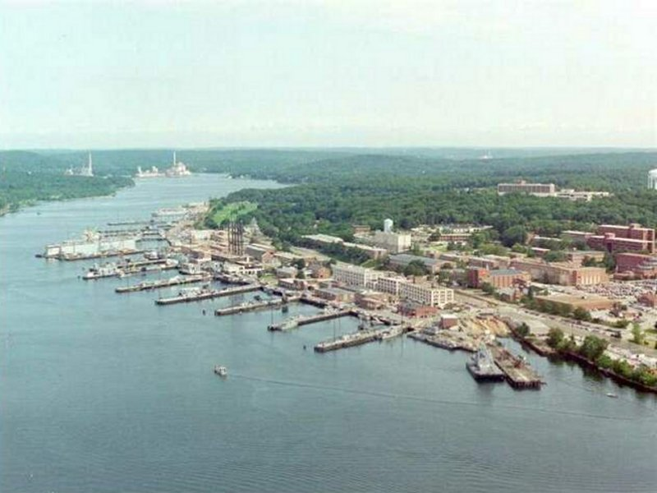
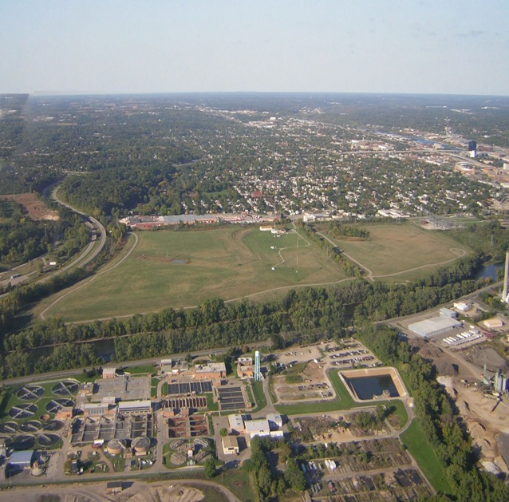
Renewable Energy Assessments:
Addressing Site-Specific Needs
SUBASE New London < (Groton, CT)
Butterworth Landfill (Grand Rapids, MI) >

Slide 8
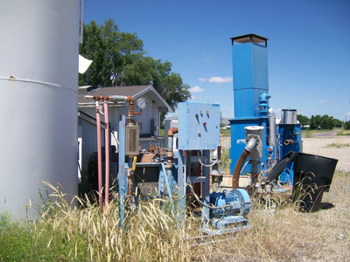
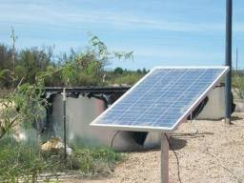
Green Remediation Assessments
Assessments undertaken for sites in CA, OR, SC, ID, MA.
Mix of Fund, PRP and Federal Facility sites.
Focus on use of renewable energy to power cleanup work.

Slide 9
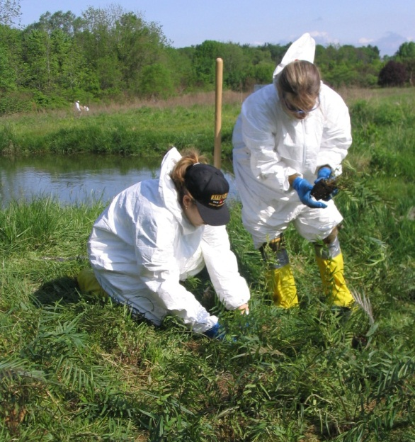
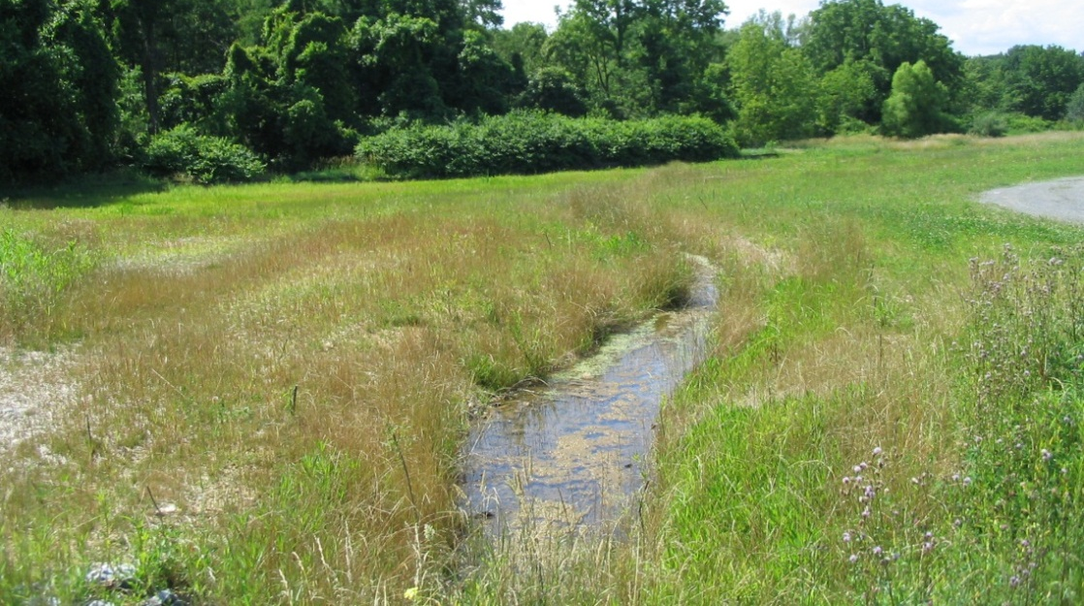
Green Remediation Assessments
Range of technologies evaluated including solar, wind and geothermal.
Similar assessment framework to utility-scale studies.

Slide 10
Lessons
Flexible framework
Stakeholder capacity-building

