Slide 1
Waterfront Reuse in EPA Region 2
Providing Riverfront Access

Slide 2
Webinar Overview
Introduction to Reuse and SRI
Melissa Friedland, EPA SRI
Roebling Steel Co. Case Study
Gloria Sosa, EPA Region 2
Marathon Battery Case Study
Pam Tames, EPA Region 2
Returning Waterfront Properties to the Public
Scott Dvorak, The Trust for Public Land
Elizabeth Butler, EPA Region 2
Resources, Contacts and Questions
Melissa Friedland, EPA SRI

Slide 3
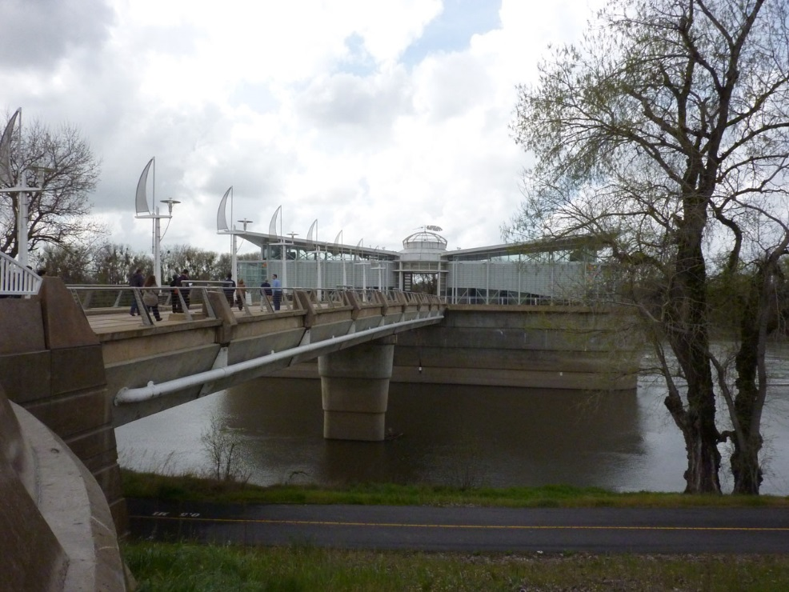
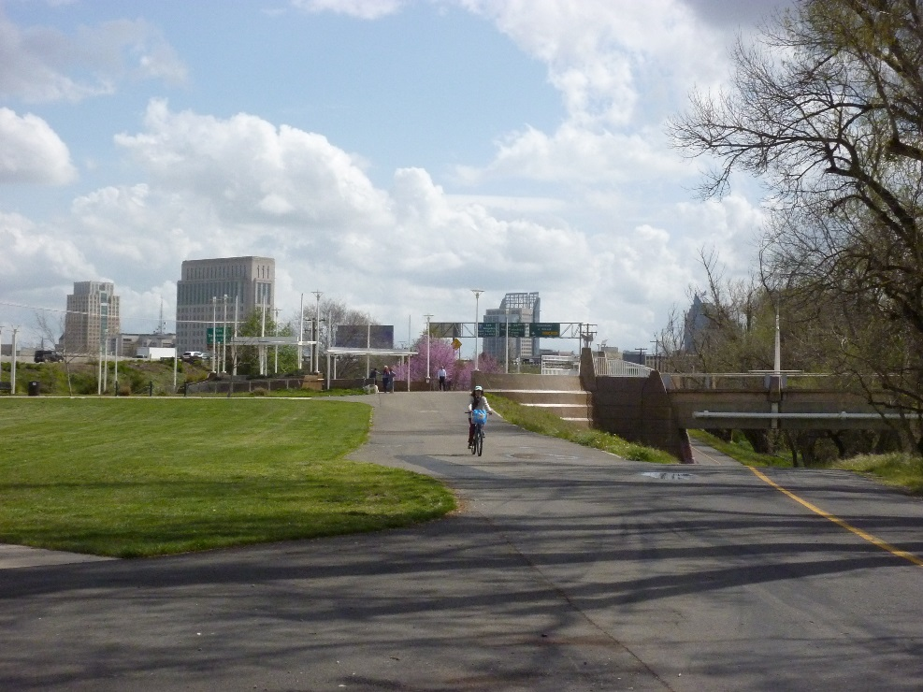
SRI: Superfund Redevelopment Initiative
Working with communities and other partners in considering future use opportunities and integrating appropriate reuse options into the cleanup process
https://www.epa.gov/superfund-redevelopment-initiative

Slide 4
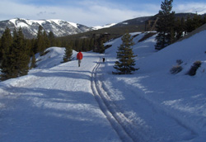
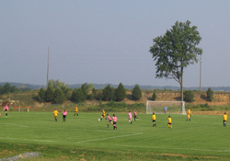
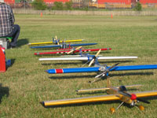
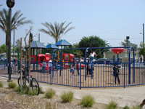
Redevelopment Partnerships
Rails-to-Trails Conservancy support at California Gulch Superfund site, Colorado
U.S. Soccer Foundation support at Avtex Fibers Superfund site, Virginia
Academy of Model Aeronautics support at Auburn Road Landfill Superfund site, New Hampshire
https://www.epa.gov/superfund-redevelopment-initiative/redevelopment-partnerships
The Trust for Public Land support at Pemaco Maywood Superfund site, California

