Slide 1
Marathon Battery Company Superfund Site Case Study
Pam Tames, P.E., Region 2

Slide 2
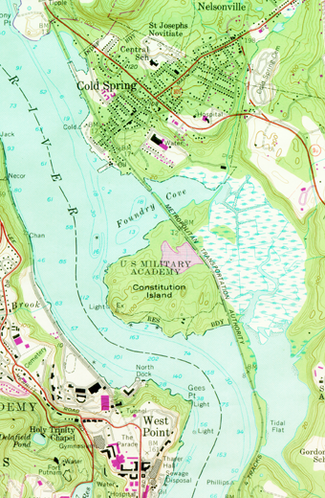
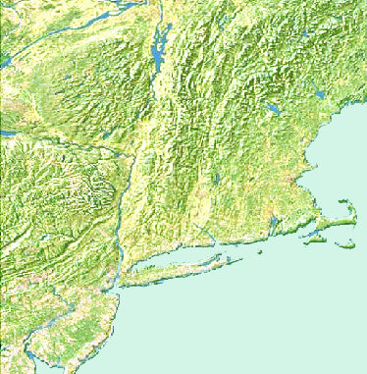
NORTH COVE
N
200 km
FOUNDRY COVE
FOUNDRY COVE
NEW YORK
CITY
The Site is on the east side of the Hudson River, near Cold Spring NY, across the river from West Point. It includes Foundry Cove and Marsh, the Cold Spring Pier area, and the former factory grounds.
SOUTH COVE
N
1.0 km

Slide 3
The Marathon Battery Company manufactured nickel-cadmium batteries for NIKE missile bases from the early 1950’s to 1978. Cadmium contaminated wastewater was discharged to the Hudson River and the Marsh.
Marathon Battery facility
East Foundry Cove Marsh

Slide 4
Factory Grounds
Here is another view of the former nickel cadmium battery factory. This photo was taken at the start of the remedial action. You can barely see the residential homes behind the facility.

Slide 5
Marathon Battery Company Superfund Site
Listed on the NPL in 1983
Cadmium is the main contaminant
Three Records of Decision, 1986, 1988 and 1989
Responsible Parties performed the Remedial Action in 1993-1995
Deleted from the NPL in 1996
Ongoing long term monitoring

Slide 6
The Selected Remedy for the Marsh, Cove and factory grounds
Excavated the marsh and removed all sediment containing cadmium above 100 ppm.
Capped the excavated marsh with clay (bentomat) and 2 feet of clean fill.
Restored the capped marsh with appropriate wetland plants
Dredged the cove and removed the top foot of sediment with the goal of removing 95% of the cadmium contaminated sediments.
Dredged hot spots in the Hudson River near the Village of Cold Spring Pier.
Excavated contaminated soils on the factory grounds and demolished the factory and all on-site buildings.

Slide 7
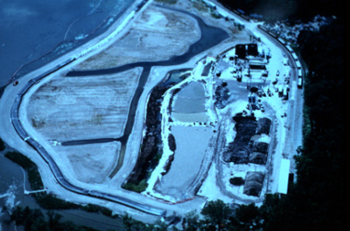
The Marsh Remedial Action
This photo was taken in 1995 before all the work was completed.
On the right, you can see piles of treated sediments and dirt curing prior to being transported by railcars to a landfill in Michigan.
On the top right, you can see the unused filter presses and hydro-cyclones.
In the middle, you can see the settling basins.

Slide 8
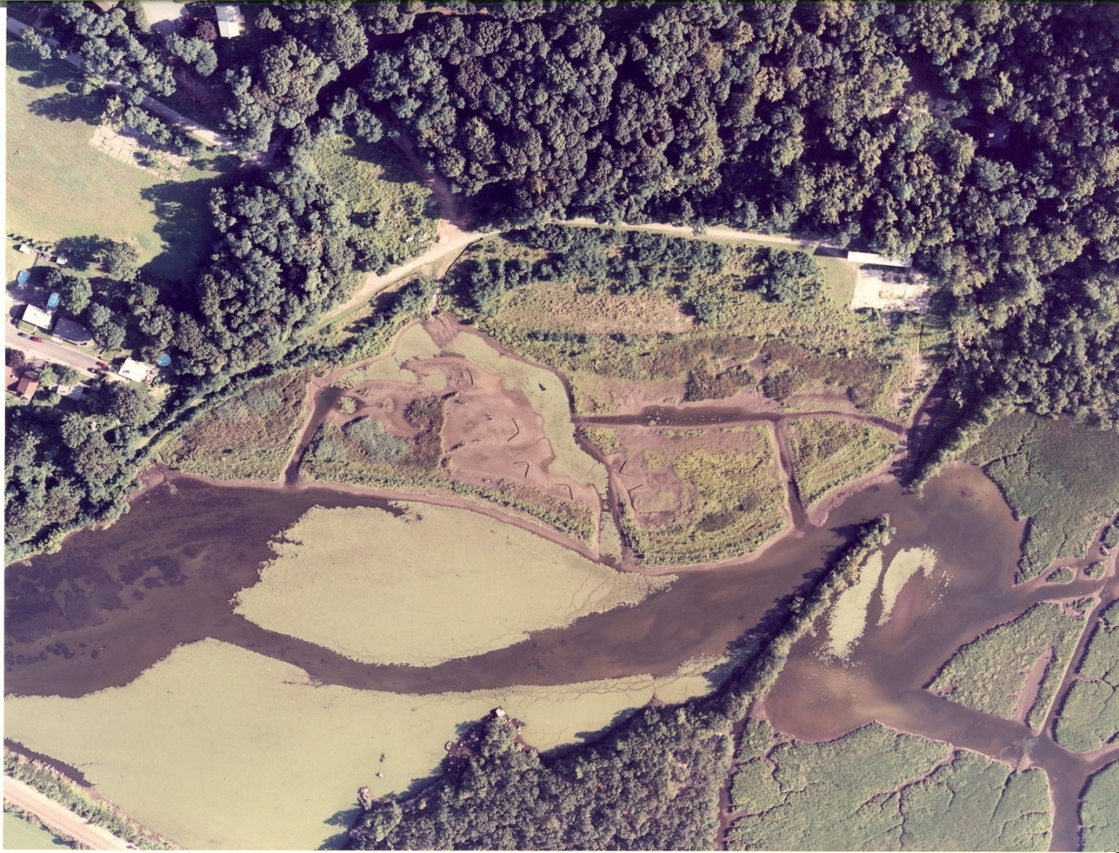
2002
The green area in the cove consists of water chestnuts, an invasive species.
The factory was located in the empty field in the upper left corner. This 12 acre field is currently owned by a developer and is awaiting redevelopment.

Slide 9
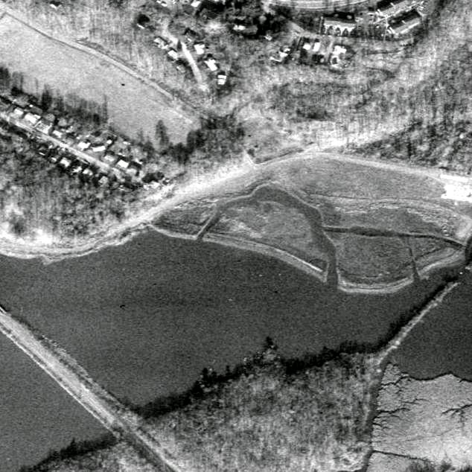
Another photo.
The rail trestle is on the left and the homes behind the factory are also on the left.

Slide 10
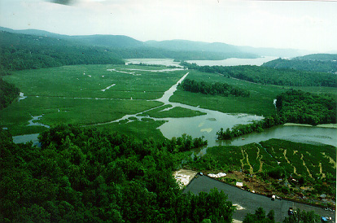
Constitution Marsh
East Foundry Cove and Marsh are located on the right side of the photo and Constitution Marsh is on the left. Kayakers enter the Cove by going beneath the Metro North rail trestle in East Foundry Cove and can go through both Marshes. Access to this area is also available through the Constitution Marsh visitors center located on Indian Brook off the South Cove.

Slide 11
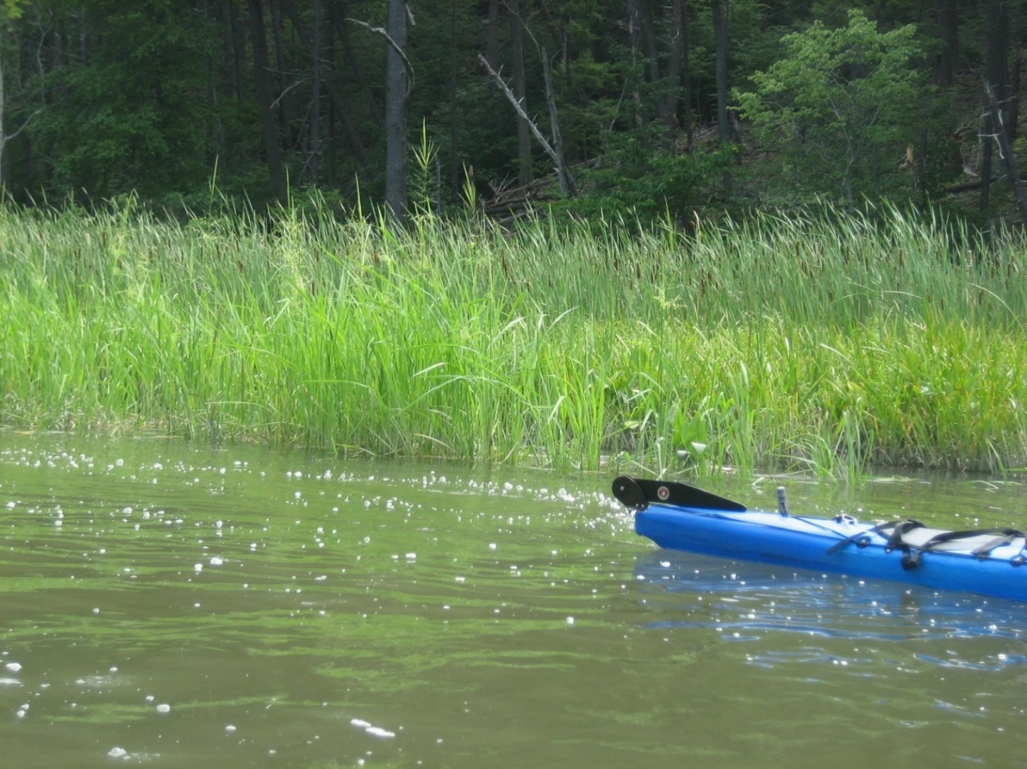
Kayaking in the Marsh

Slide 12
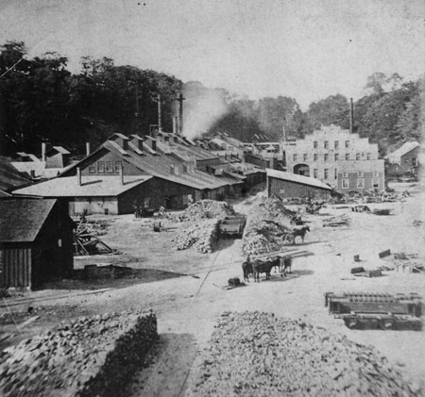
West Point Foundry
East Foundry Marsh and Cove are located within the West Point Foundry Historical site. The Parrott cannon, used in the Civil War by the Union Army, was manufactured here. An additional 2.5 upland acres of the Historical site were needed for the treatment and staging area and haul road.
Extensive archeological investigations were required in areas that would be impacted by the remedial action. Approximately $2 million was spent on this work. Over 10,000 artifacts were recovered. Several of the artifacts are on display at the Putnam County Historical Society located near the site.
This photo shows the original West Point Foundry in the 1800’s.

Slide 13
Magnetometer surveys were required as part of the archeological work. All the targets were investigated as part of the work. A gun platform was found in the marsh.

Slide 14
The archeologists investigated the basements of former workers homes which were located in the path of the haul road needed for the site remedial action.

Slide 15
Artifacts
This is an unmarked embossed whiteware creamer from the occupation component of Building 3. The embossed and blue painted decoration suggest a post 1830 date of initial manufacture.
Note the many cracks in the creamer. The individual pieces were put back together by the archeologists.
All shards of china and glassware found at the site were categorized and dated prior to being conserved. Many thousands of china fragments were found.
Other items found include coins, eyeglasses, a microscope, bottle stoppers, pipes, etc.

Slide 17
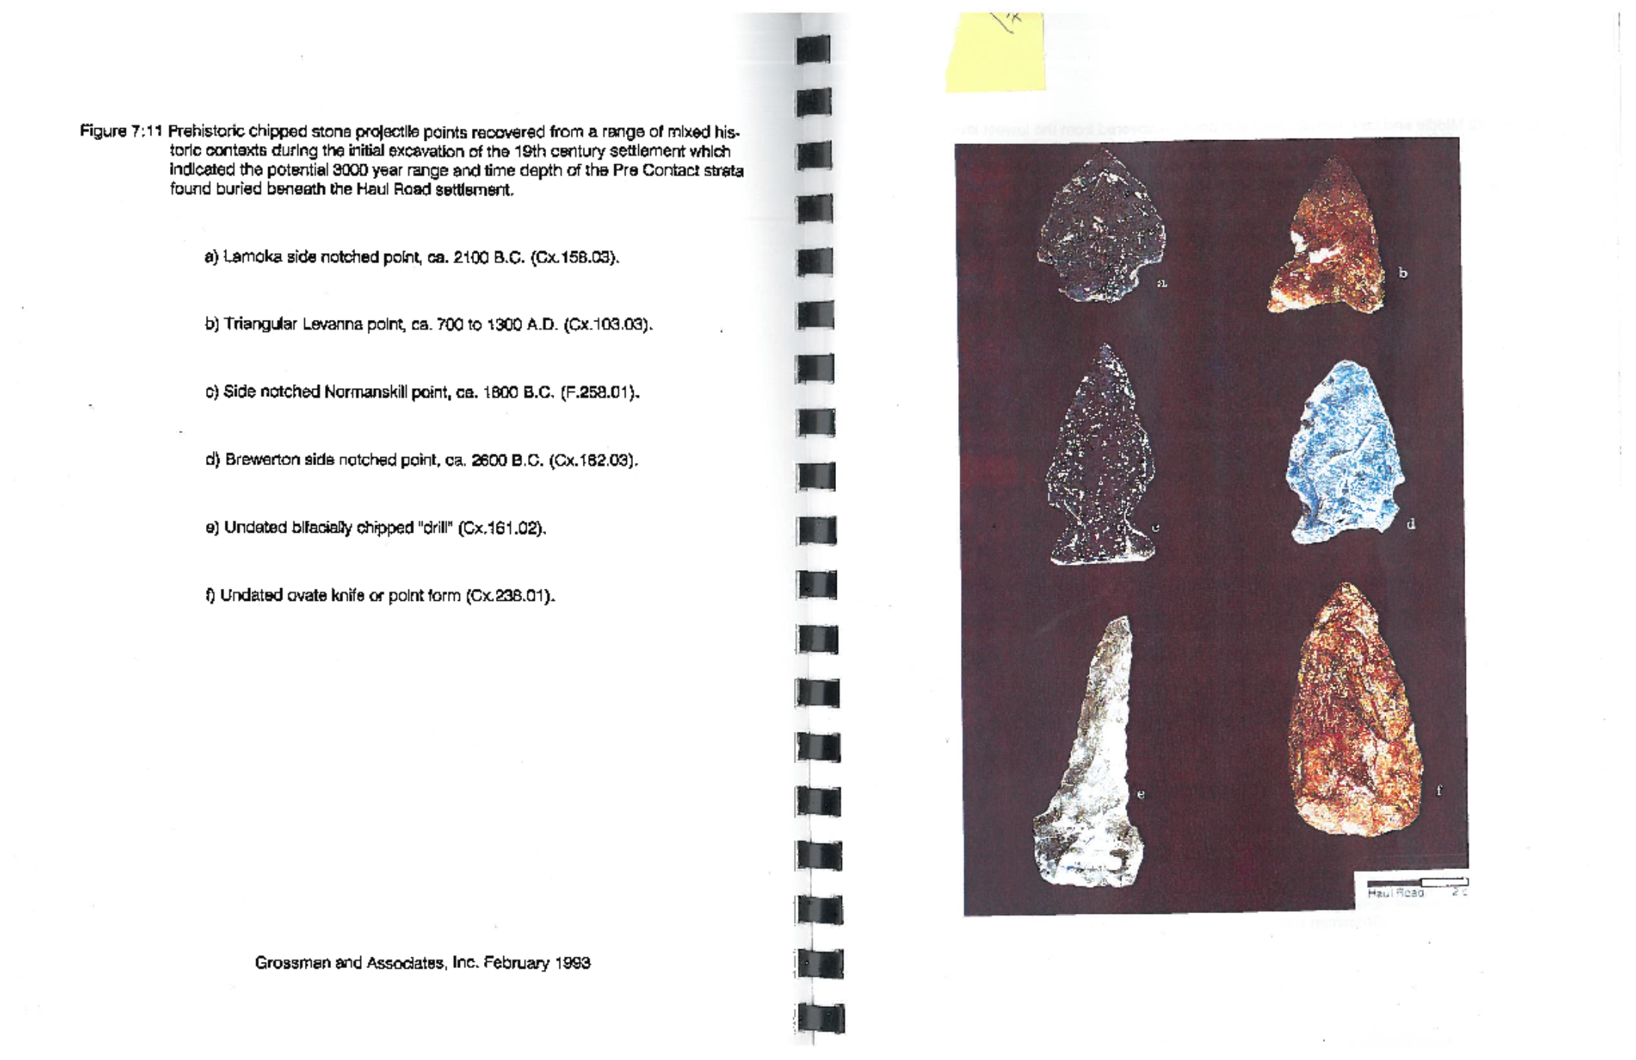
Prehistoric Artifacts

Slide 18
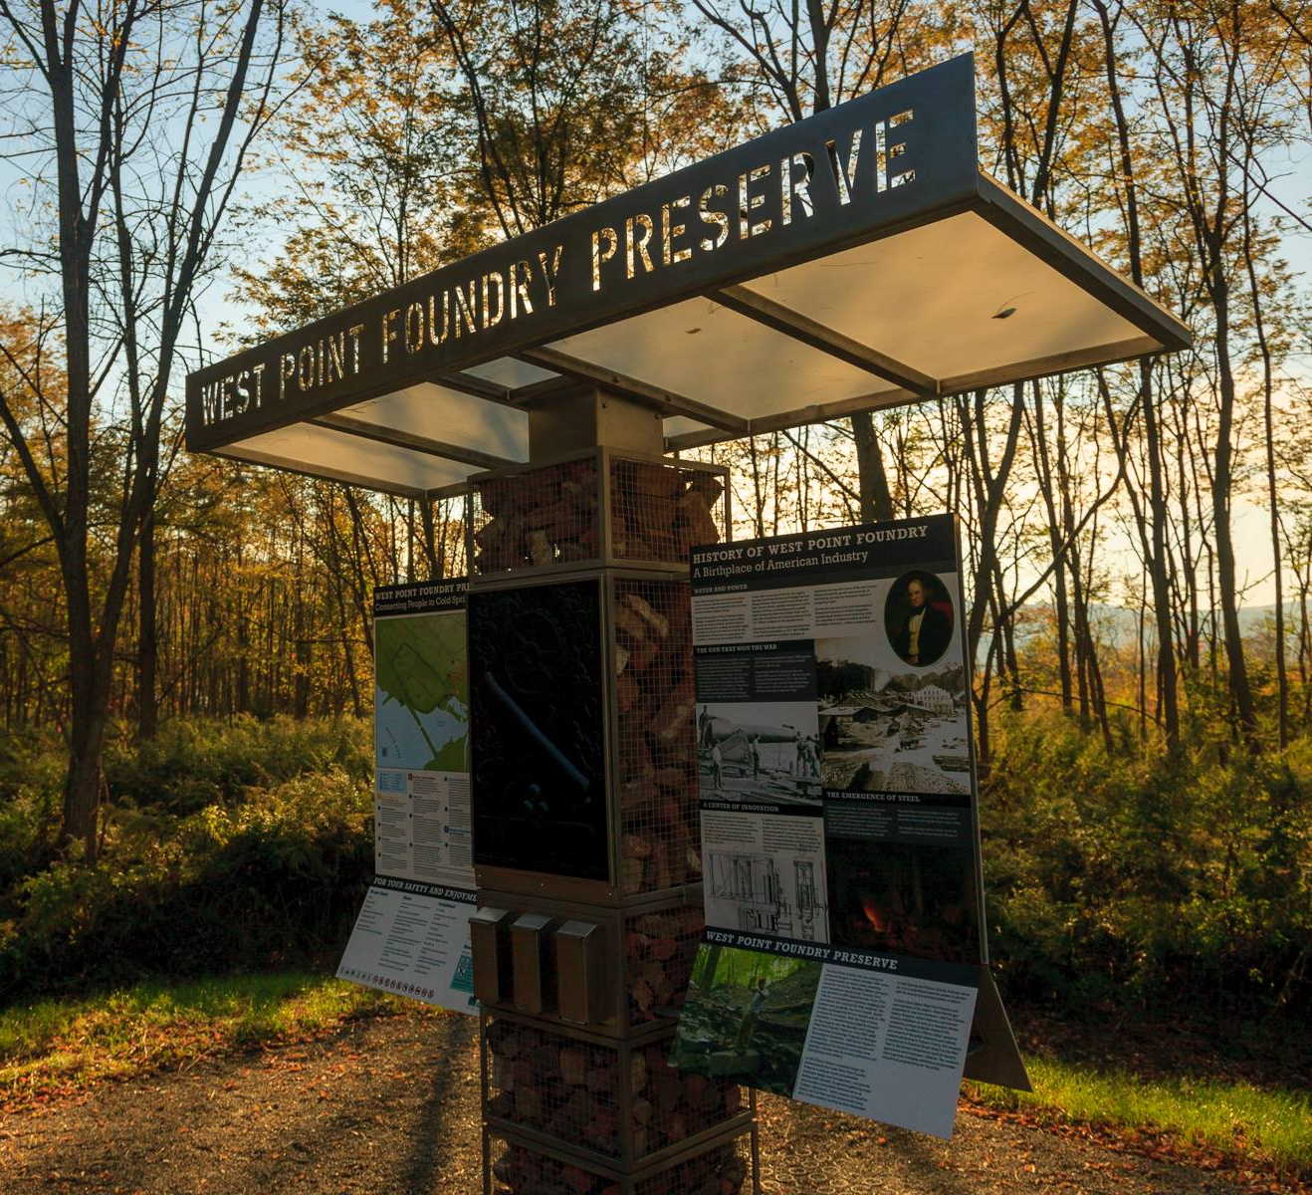
West Point Foundry Preserve
The West Point Historical site is 87 acres of which East Foundry Cove and Marsh and the 2.5 upland acres needed for the treatment and staging areas are a small part. After all remedial activities were completed, Scenic Hudson, a not-for-profit conservatory organization, bought the entire West Point Historical site. They spent an additional 7 years performing archeological studies on the areas which were not impacted by the remedial action. Industrial archeologists from Michigan Tech. performed this work. They also brought in landscape architects to design and construct a preserve which respected the history of the site. Approximately $4 million was spent on this work. All signage includes photos of the original West Point Foundry and the remediation of the Marathon Battery Site.

Slide 19
Plan for the West Point Foundry Preserve

Slide 20
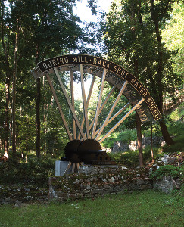
This sculpture recreates the size of the original water wheel used at the West Point Foundry.

Slide 21
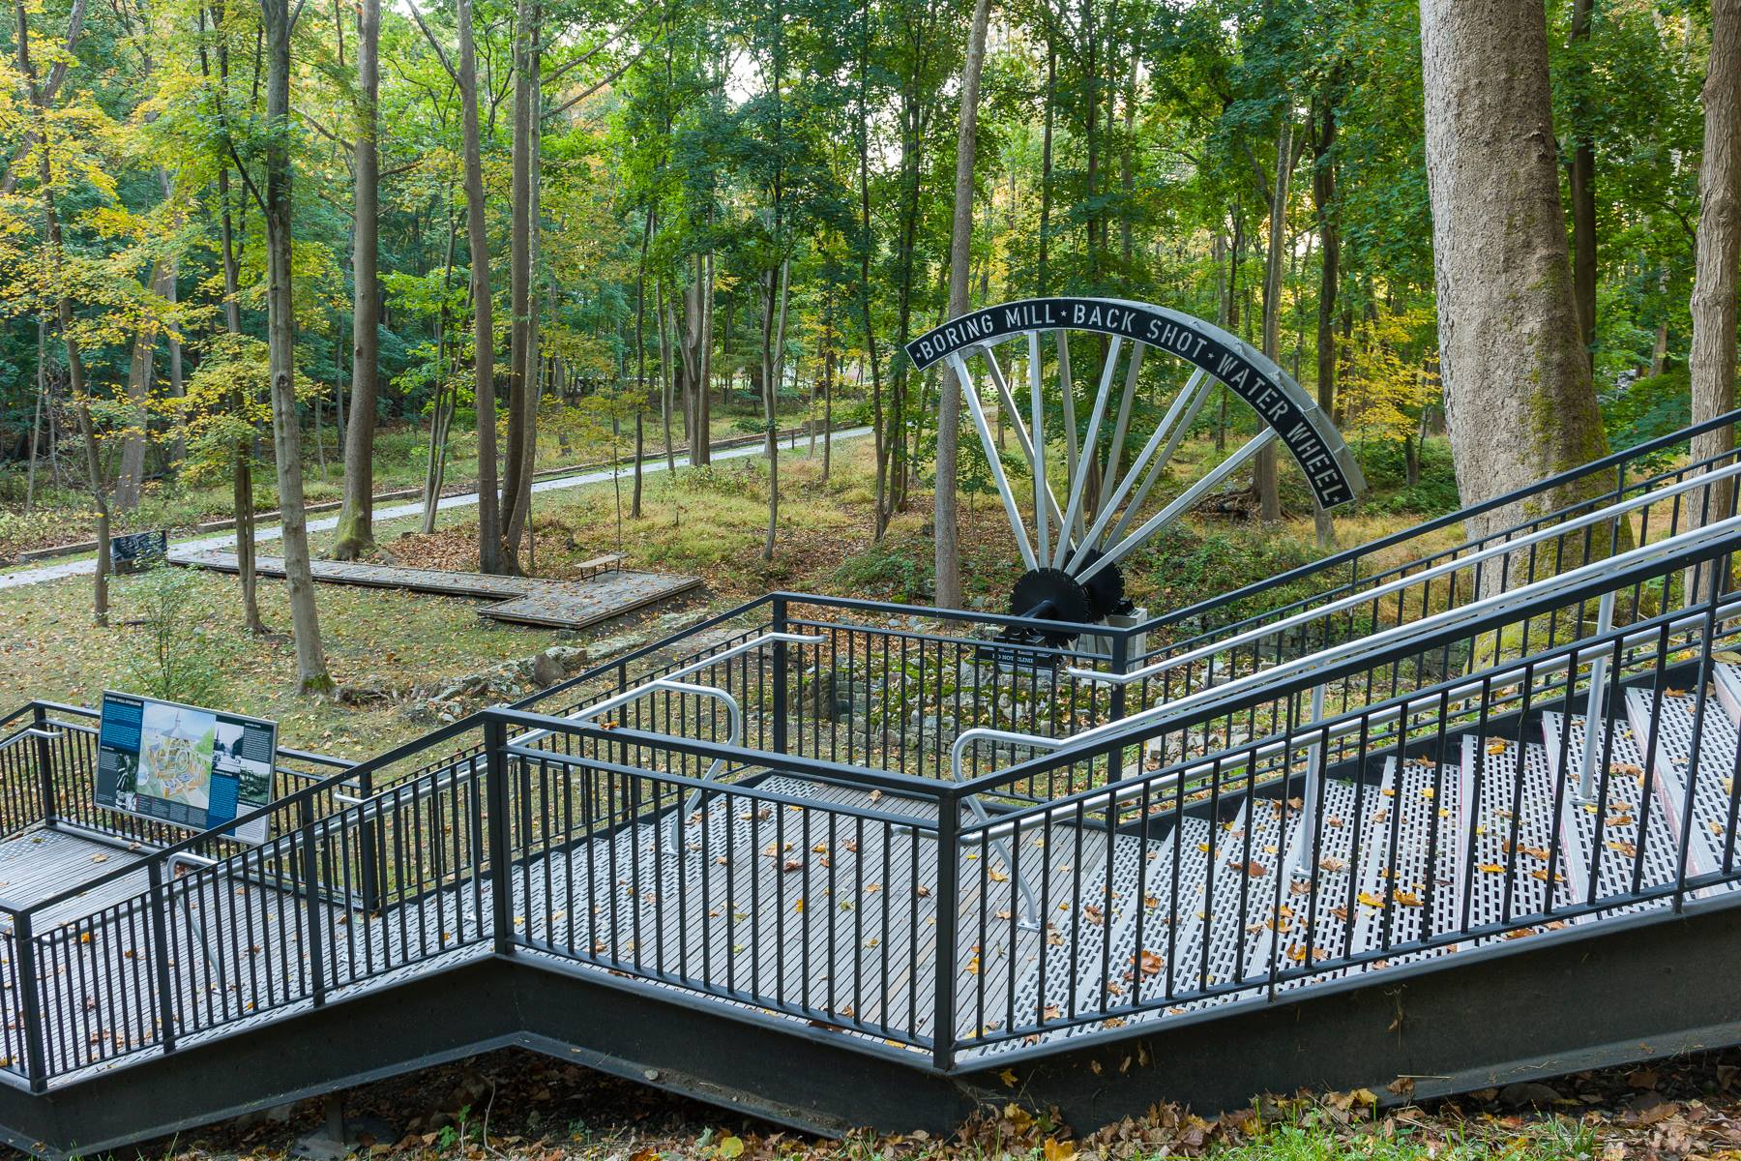
The walkway in the distance is located on the original rail line used to transport cannons and large items around the site. A reservoir located on the site provided the water which was channeled throughout the site providing power for machinery.
The Preserve is handicap accessible and has composting toilets.

Slide 22
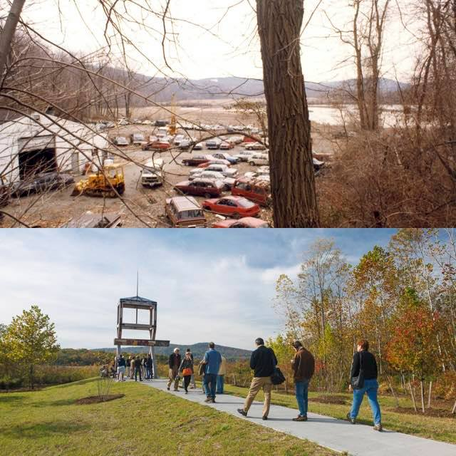
Before and After
This auto junk yard (top) was located adjacent to the treatment area and the Marsh. It was also purchased by Scenic Hudson after the site remediation was completed.
This walkway (bottom) is an extension of the walkway seen in the previous slide. The structure in the photo is a recreation of a viewing tower used when the cannons were tested. It has signage showing photos of its former use and also photos and descriptions of the 1990’s remediation.
Cannons were wheeled to the edge of the Marsh and tested by firing the cannon balls across the Hudson River.

Slide 23
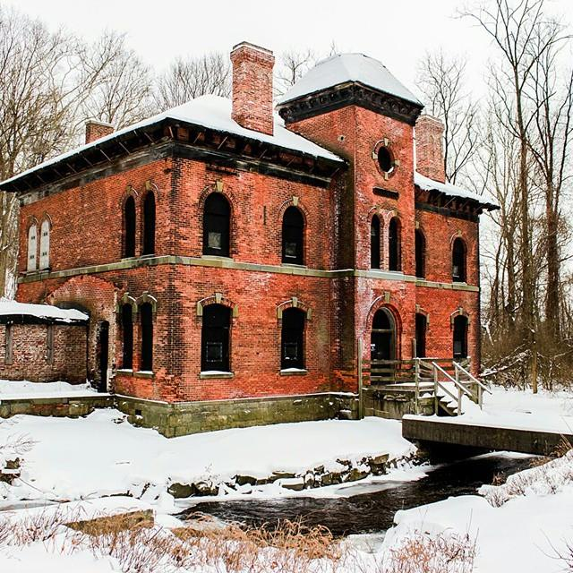
1865 Office Building
The office building is also located on the historical site. The interior is off limits to the public.

Slide 24
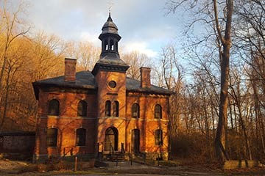
While Scenic Hudson does not have the funds to restore the building, they did stabilize it and they restored the cupola.
Abraham Lincoln visited the site in 1862 to view the manufacture of the cannons.

Slide 25
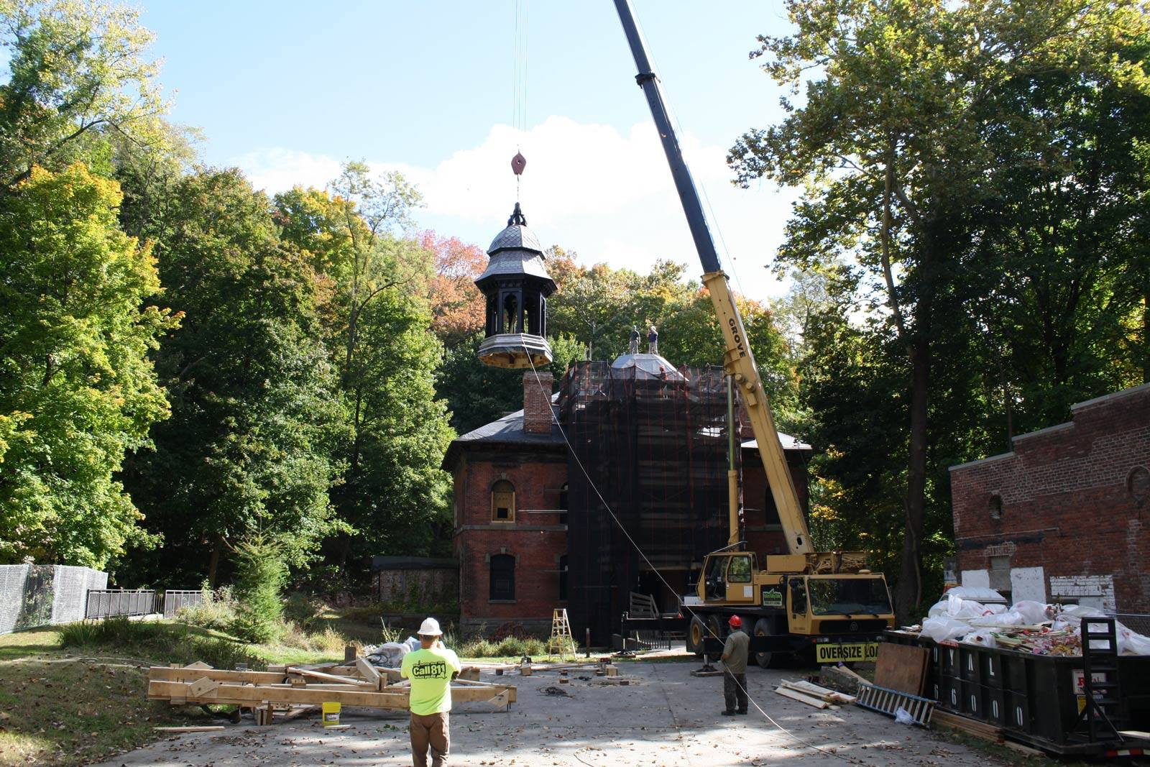
Restoring the Cupola to the 1865 Office Building
2015

Slide 26
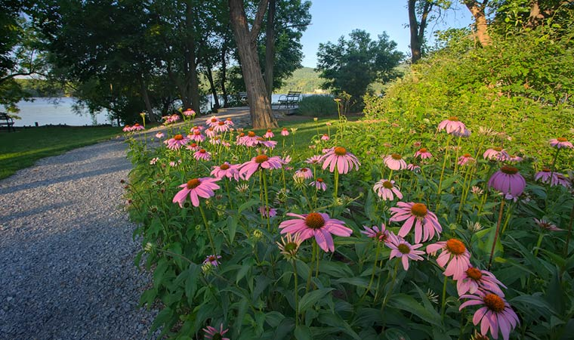
This small property was also part of Scenic Hudson’s purchase of the West Point Historical site. It is located directly on the Hudson River. The adjacent section of the river was dredged as part of the Marathon remediation. Scenic Hudson renovated the property to provide a boat ramp for kayaks and canoes and a portapotty for daytrippers. Parking is available at the adjacent Metro North train station. Scenic Hudson also constructed a walking trail from the train station to the West Point Foundry Preserve.

Slide 27
Village of Cold Spring Pier
This is a photo of the Village of Cold Spring Pier taken in the early 1990’s. Note the gazebo on the right. For many years, the Village had tried unsuccessfully to raise money to rehabilitate the Pier. Much of the cadmium contaminated wastewater was discharged to the Hudson River via a pipe beneath this Pier. As a result, the sediment surrounding the Pier was contaminated and required dredging. During the design, there was concern that dredging around the Pier would cause the Pier to deteriorate further. Therefore, as part of our remediation, we shored up the Pier with sheet piling and a cement base. As a goodwill gesture, the PRPs construction contractor, Sevenson, donated the labor to lay the brick on top of the cement.

Slide 28
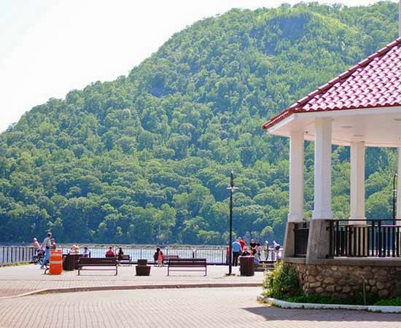
Village of Cold Spring Pier today
Now ferry boats are able to dock at the Pier bringing tourists from New York City to the Village where they can shop for antiques and enjoy the scenery.

Slide 29
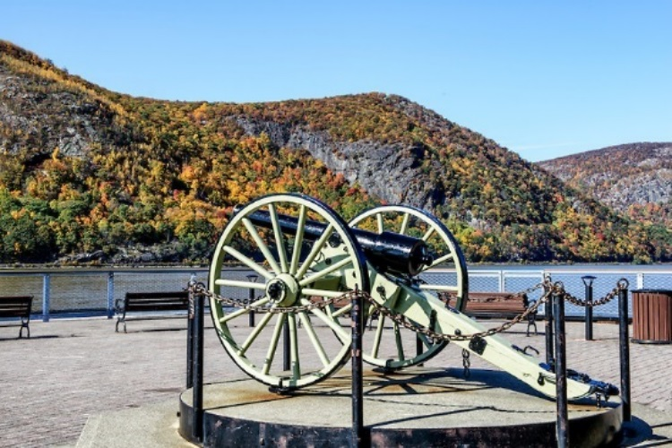
This is a Parrott cannon which was manufactured at the West Point foundry.

Slide 30
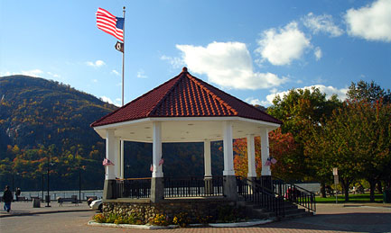
The End
Any questions?

Slide 31
Contact Information
Pam Tames
(212) 637-4255
Remedial Project Manager
Tames.Pam@epa.gov

