Slide 1
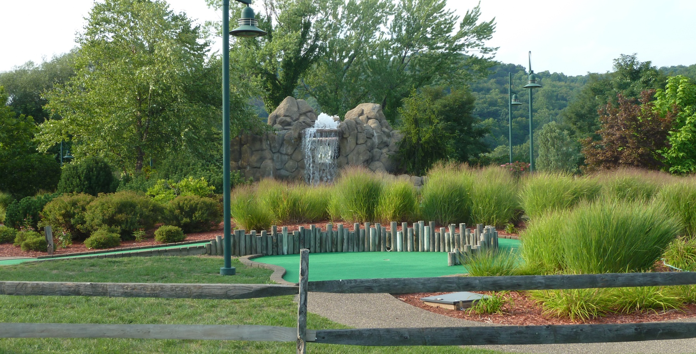
Reuse at the Ohio River Park Site
Chris Thomas, Region 3 Superfund Redevelopment Coordinator

Slide 2
Site Location and History
Ohio River Park Superfund Site
Neville Island, Pennsylvania
NPL: August 30, 1990

Slide 3
Early Days at the Site
Coraopolis Bridge
Olympic size indoor ice skating rink
Golf training facilities
Sports fields
Fitness center and restaurant

Slide 4
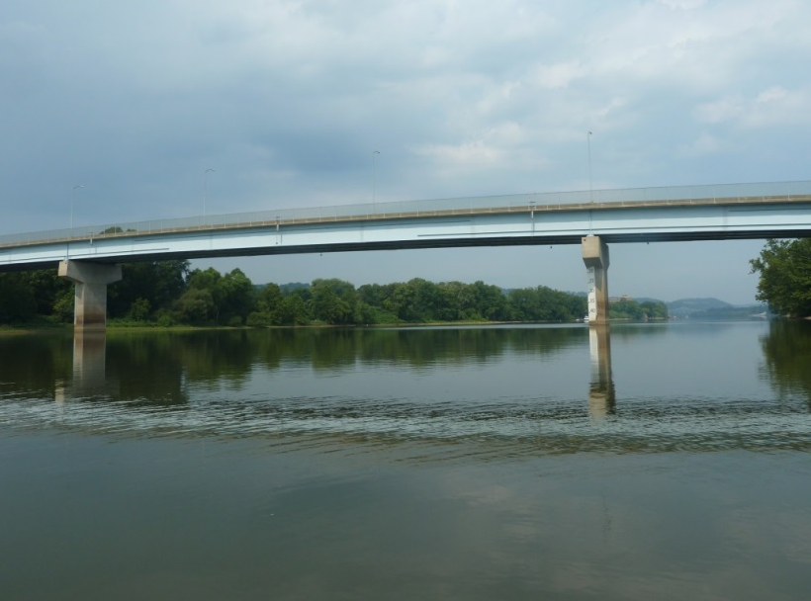
Remediation and Reuse
Separate Operable Unit
Expedited Baseline Risk Assessment
No-Action ROD
The Coraopolis Bridge, 2013
Neville Island Welcome Sign, 2013

Slide 5
Remedial Design cont.
Cement slurry wall barrier
Multi-layer cap
Vegetated soil cover
Drainage layers
Construction of the slurry wall
Crews installing a protective cover

Slide 6
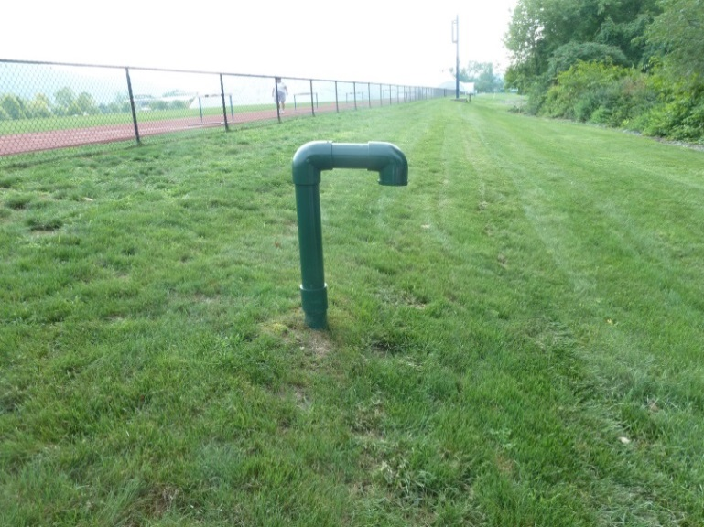
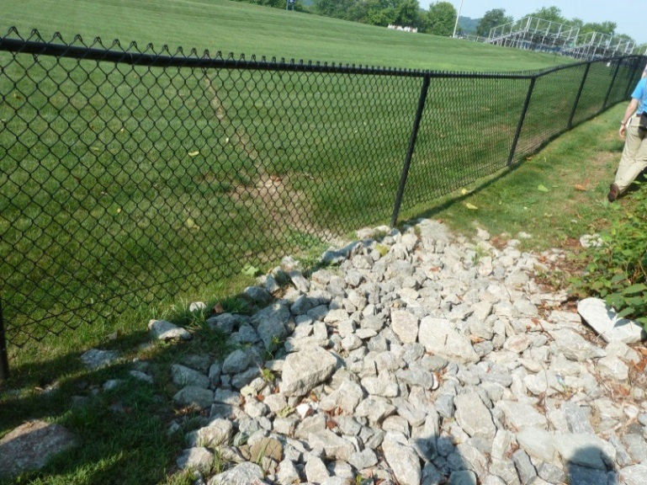
Remediation and Reuse
The Golf Dome at the Neville Island Sports Center, 2013
Gas vent and vegetated cap, 2013
Erosion control channels, 2013

Slide 7
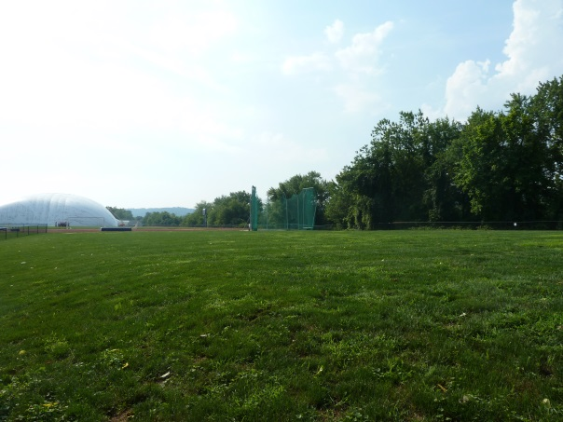
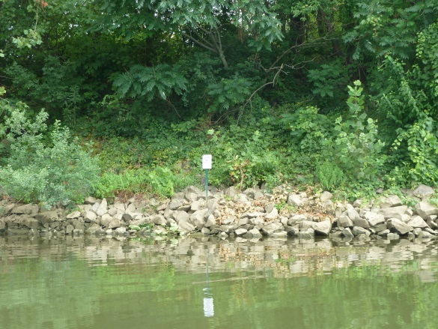
Key Lessons
Consider alternatives, such as phased cleanups, partial deletions or No-Action RODs, for portions of sites that meet human health and environmental risk baselines
Consider a combination of remediation techniques (multi-layer cap)
Structures that are part of the remedial design can be integrated into the landscape
Long-term protectiveness can be achieved through institutional controls, when appropriate

Slide 8
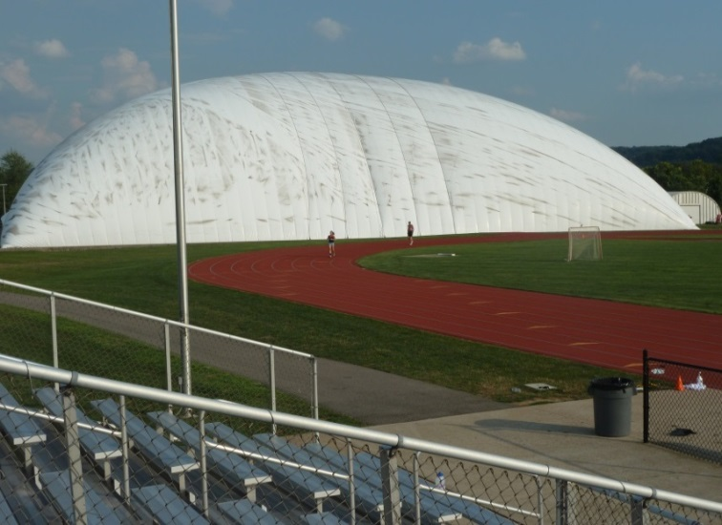
Site Today
Golf dome and outdoor track, 2013
Robert Morris University Island Sports Center, 2013
Indoor ice hockey rink

Slide 9
Contact Information
Chris Thomas
EPA Region 3
thomas.christopher@epa.gov
(215) 814-5555

