Slide 1
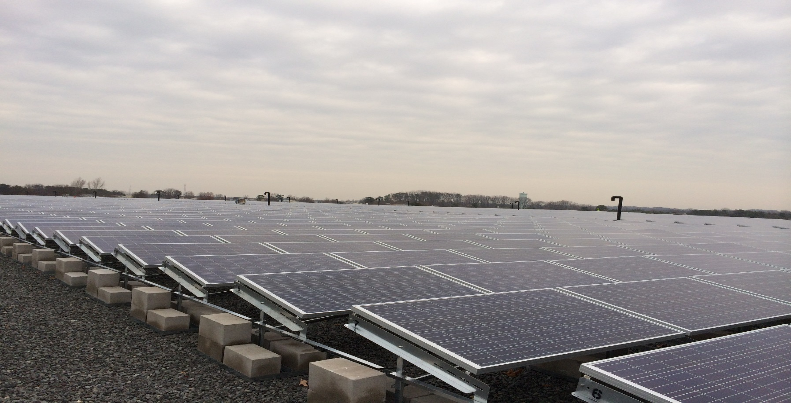
BRICK Township Landfill Superfund Site Solar panel field reuse
Jon Gorin – Region 2

Slide 2
Township of Brick
Ocean County, NJ

Slide 3
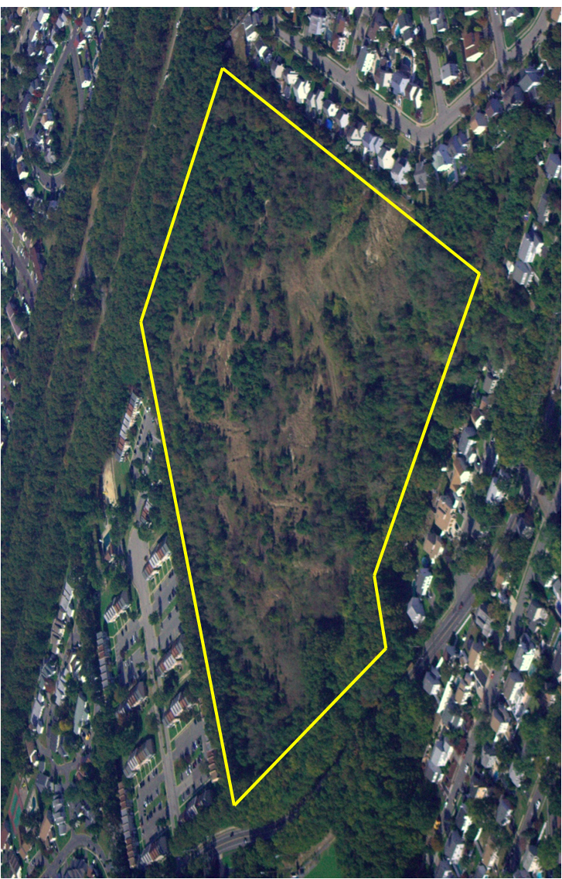
Brick Landfill Property Before

Slide 4
Route of Contamination

Slide 5
Background
The Potentially Responsible Party is Brick Township
EPA issued a 2008 Record of Decision Requiring:
Placement of institutional controls
Installation of an impermeable, layered landfill cap
Implementation of Long-term groundwater monitoring

Slide 6
Dual Objectives for Design
Comply with EPA’s Record of Decision
Installation of a NJDEP Compliant Landfill Cap
Development of the Groundwater Monitoring Program
Institutional Controls
Allow for Reuse and Revenue Generation
Commercial/Industrial Use
Executive Golf Course
Police Station
Wholesale Renewable Energy Generation (Photovoltaic - Solar)

Slide 7
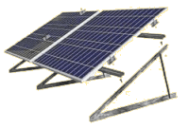
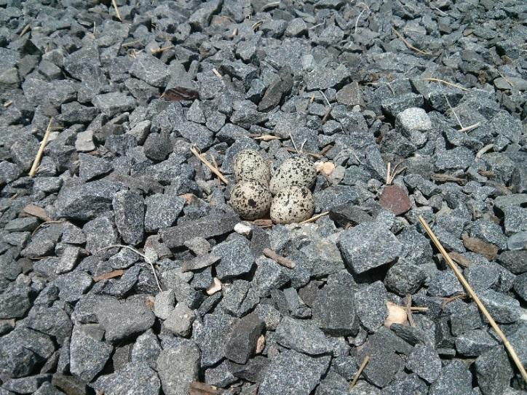
Additional Design Considerations
Requirements
Do not penetrate cap’s impermeable layer
Fit as many panels as possible
Aesthetically acceptable
Minimize maintenance
Design Elements
Skid mounted solar panels
Relatively steep sided
Slopes landscaped
Bluestone top layer

Slide 8
Alternate Cap Used at Brick
NJDEP REFERENCE CAP
Topsoil with Grass
Drainage Layer (sand)
Bedding and Cover Layer
60 mil HDPE
Leveling Course
Waste
Native Soil
BRICK CAP – SOLAR FIELD AREAS
Bluestone Layer
Drainage Layer (sand)
GCL
Leveling Course
Waste
Native Soil

Slide 9
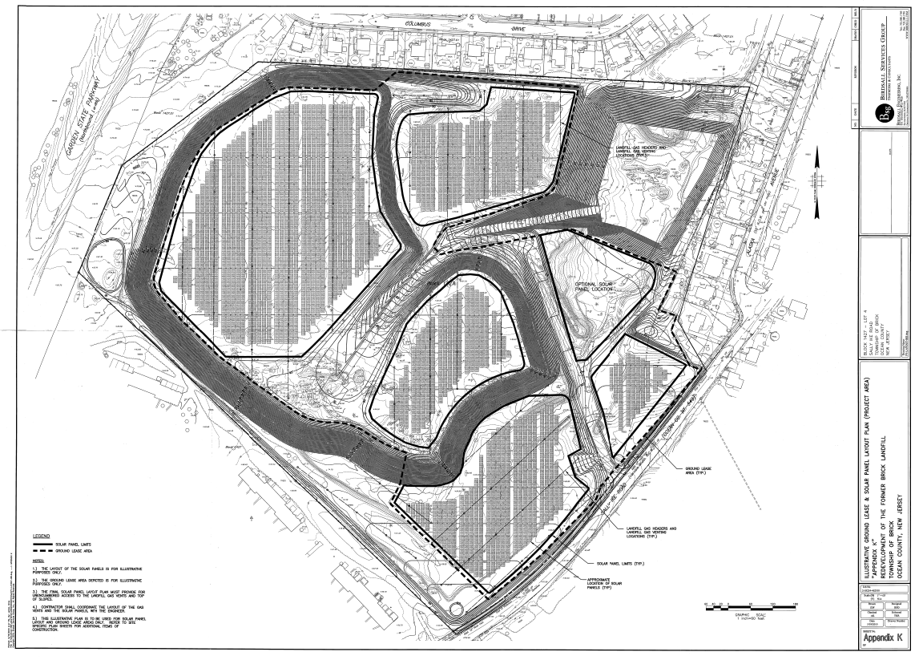
Final Remedial Design - Solar Farm
Infiltration Basin

Slide 11
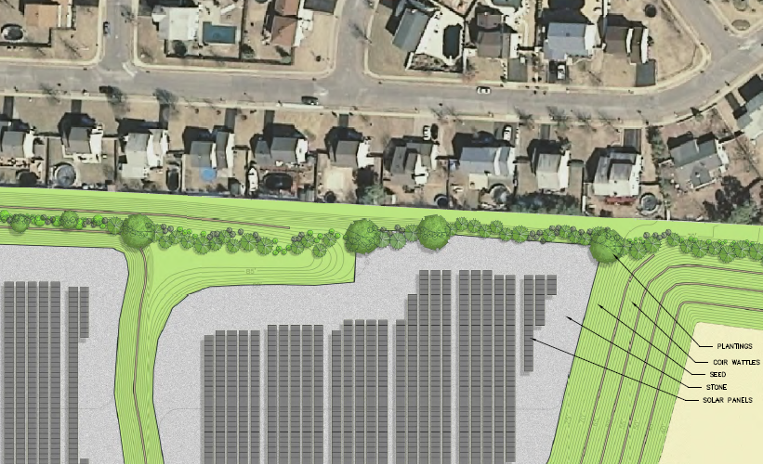

Slide 14
Solar Field
24,414 PV solar panels
Estimated annual production 7,400 MWh
Will begin operation this month

Slide 15
Brick Landfill Property After

Slide 16
Why Solar? Short Answer: SRECs
NJ has a Renewable Portfolio Standard (RPS) legislation with a “solar carve-out”
NJ Energy Suppliers Must Purchase Solar Renewable Energy Certificates (SRECs)
SRECs are sold through a spot market or through long term contracts

Slide 17
APPROXIMATE NJ SREC PRICES
(June – August 2011)

Slide 18
Solar Development Through a Public/Private Partnership
The Township provides low cost financing to the developer (~$30 million) through General Obligation Bonds
The Township profits by leasing the property to developer and getting discounted electricity for 15 years
The Township assumes ownership of the solar field after 15 years
The Developer acquires tax benefits, while earning revenue through the sale of electricity and SRECs

Slide 19
Summary
The Township installed an impermeable cap to interrupt the source of groundwater contamination
The Township formed a private/public partnership to use the capped area for a renewable energy project
Revenues and savings from the solar project are expected to eventually offset a large portion of the money the Township spent on the remedy

Slide 20
Contact Information
Jon Gorin
EPA Region 2
gorin.jonathan@epa.gov
(212)-637-4361
Related Resources
Brick Township Landfill Superfund Site Background Information/Design Documents: http://www.epa.gov/region2/superfund/npl/bricktownship/
EPA Information on Siting Renewable Energy on Contaminated Sites: http://www.epa.gov/renewableenergyland/
NJ SRECS Program: http://www.njcleanenergy.com/renewable-energy/programs/solar-renewable-energy-certificates-srec/new-jersey-solar-renewable-energy
Brick Township Video on the Landfill Reuse: https://www.youtube.com/watch?v=cTpXDM3gUYU&list=UUA5GssGDJb8jMoKHvoZnMBw

