Slide 1
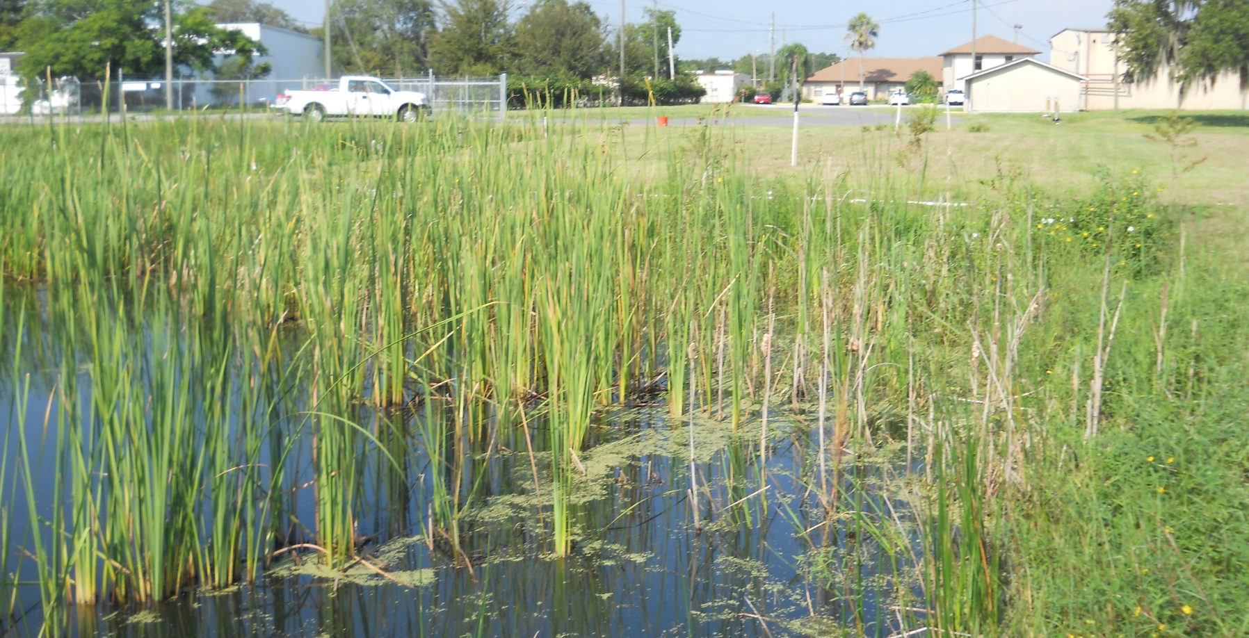
QUESTIONS and SURVEY

Slide 2
Resources

Slide 3
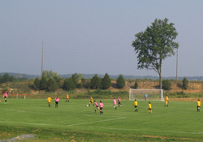
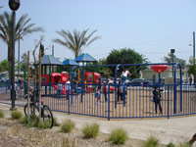
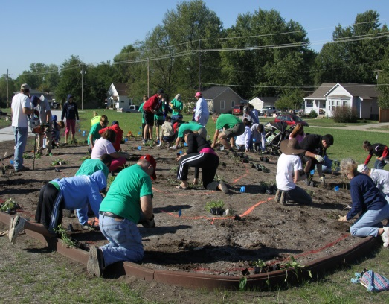
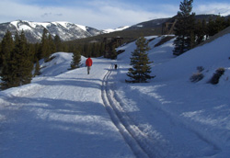
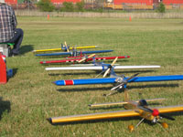
Partnerships
U.S. Soccer Foundation support at Avtex Fibers Superfund site, Virginia
The Trust for Public Land support at Pemaco Maywood Superfund site, California
Pollinator Partnership support at Chemical Commodities, Inc. Superfund site, Kansas
Rails-to-Trails Conservancy support at California Gulch Superfund site, Colorado
Academy of Model
Aeronautics support at Auburn Road Landfill Superfund site, New Hampshire
http://www.epa.gov/superfund/programs/recycle/activities/organizations.html

Slide 4
SRI Coordinators by Region
Region | Name | Phone | Email
1 | John Podgurski | 617-918-1296 | podgurski.john@epa.gov
2 | Gloria Sosa | 212-637-4283 | sosa.gloria@epa.gov
3 | Chris Thomas | 215-814-5555 | thomas.christopher@epa.gov
4 | Bill Denman | 404-562-8939 | denman.bill@epa.gov
5 | Thomas Bloom | 312-886-1967 | bloom.thomas@epa.gov
6 | Casey Luckett-Snyder | 214-665-7393 | luckett.casey@epa.gov
7 | Tonya Howell | 913-551-7589 | howell.tonya@epa.gov
8 | Fran Costanzi | 303-312-6571 | costanzi.frances@epa.gov
9 | Gary Riley | 415-972-3003 | riley.gary@epa.gov
10 | Kira Lynch | 206-553-2144 | lynch.kira@epa.gov

Slide 5
For More Information, Contact:
Melissa Friedland
Superfund Program Manager for Redevelopment
friedland.melissa@epa.gov
(703) 603-8864
Frank Avvisato
Superfund Redevelopment Initiative Project Officer
avvisato.frank@epa.gov
(703) 603-8949
http://www.epa.gov/superfund/programs/recycle/

