Slide 1
Pollinator Protection and National Policy
Dr. Larry Zaragoza
Acting Branch Chief, Community Involvement and Program Initiatives

Slide 2
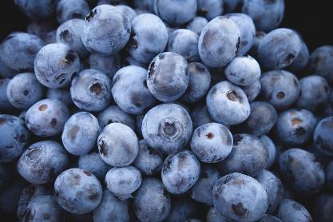
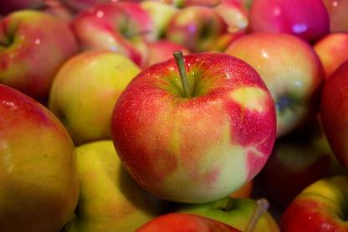

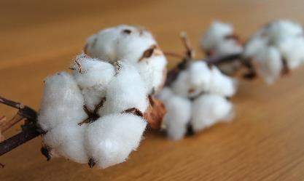
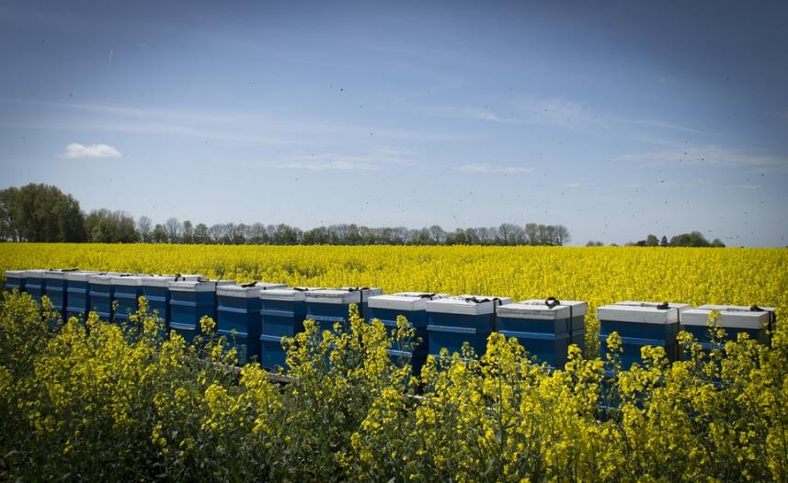
Pollinator Health – A National Need
Pollinators are important to food security
  Plants reproduction
  Plant productivity
Pollinators are important for the environment (biodiversity)
Efforts of the Federal Government to address Pollinator Health

Slide 3
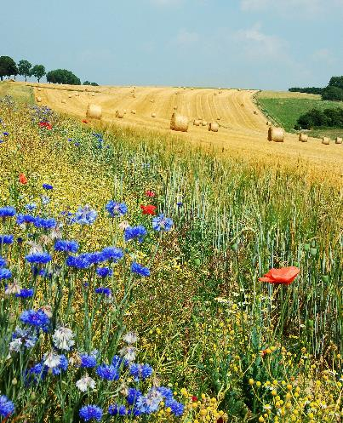
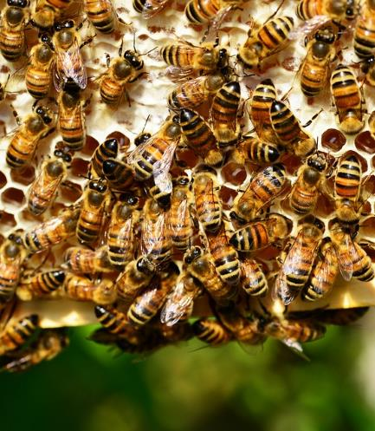
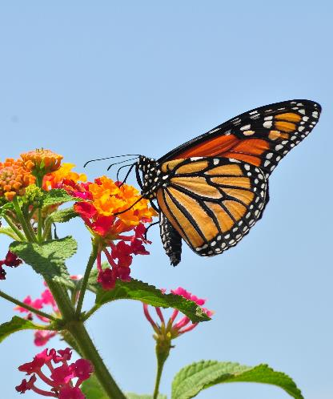
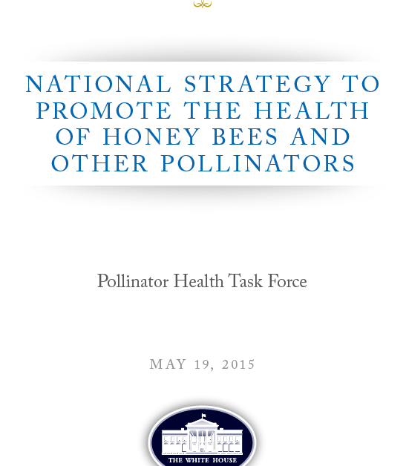
Call to Action - National Pollinator Health Strategy
I do care about bees — and we’re going to fix them! – President Obama
7 million acres
Healthy bee colonies
225 million Monarchs

Slide 4
The President’s Pollinator Task Force
In 2015, the White House announced the National Strategy to Promote the Health of Honey Bees and Other Pollinators
  The strategy creates the President’s Pollinator Task Force, which is co-chaired by the Secretary of Agriculture and the Administrator of the EPA.
  There are a number of federal commitments that are in the plan, including increasing the acres of pollinator habitat
  While the main area of focus for EPA is evaluating pesticides that can be harmful to pollinators and making adjustments so that pollinators will not be adversely impacted, Superfund and other cleanup programs also advocate consideration of pollinator habitat as a part of land use decisions as sites undergo cleanup
Superfund reports on pollinator habit acres at sites

Slide 5
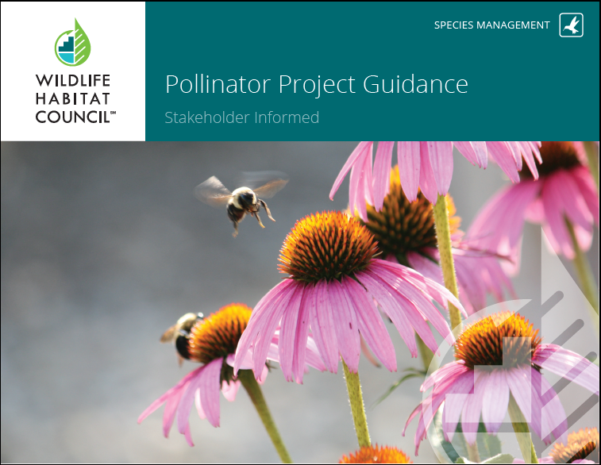
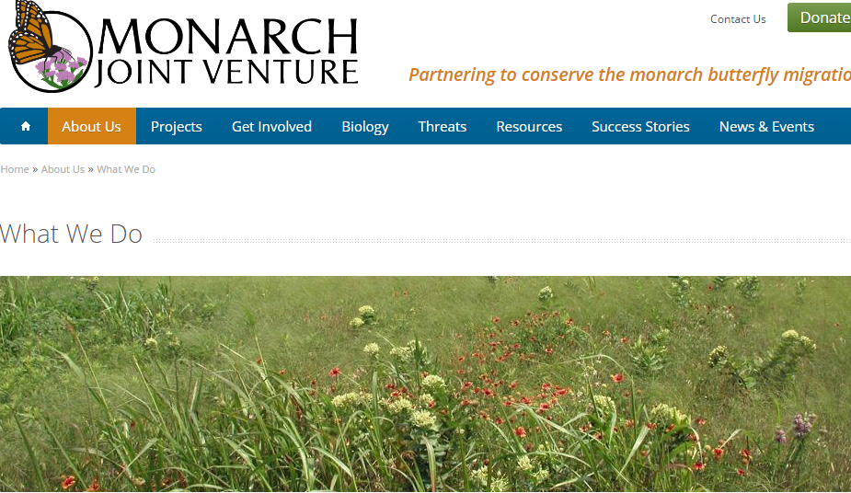
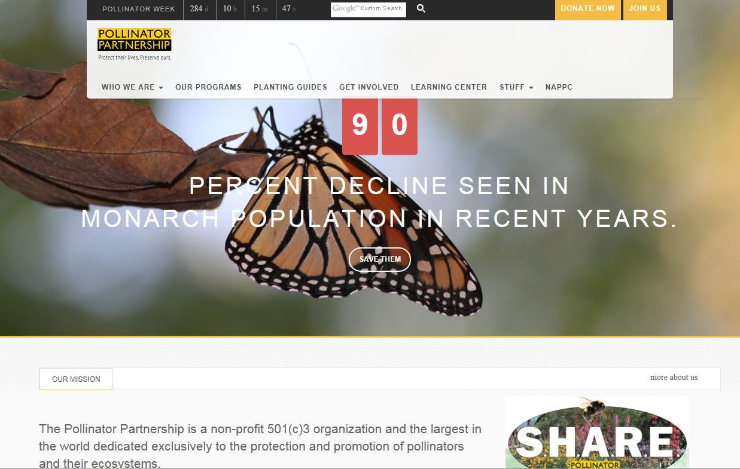
“All Hands on Deck” Approach to Partnerships

Slide 6
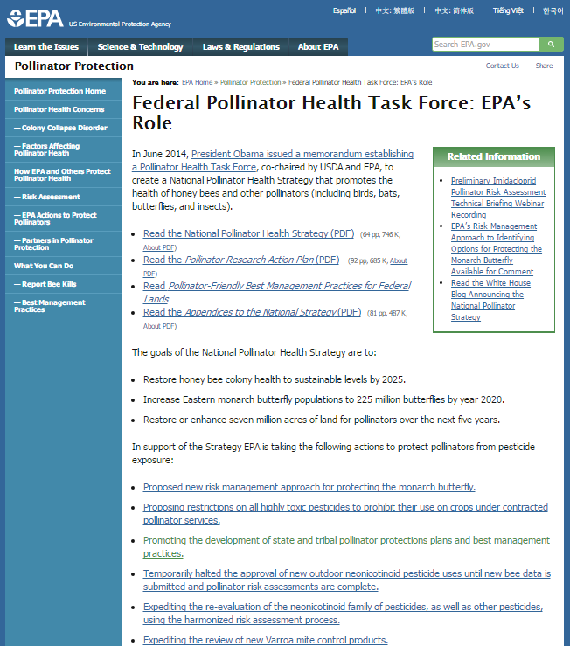
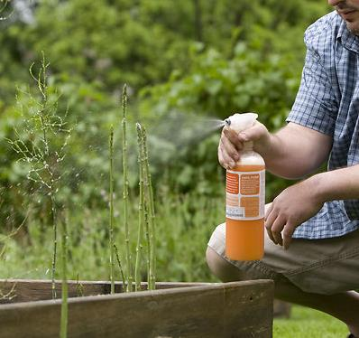
EPA’s Role in Protecting Pollinators
https://www.epa.gov/pollinator-protection/federal-pollinator-health-task-force-epas-role

Slide 7
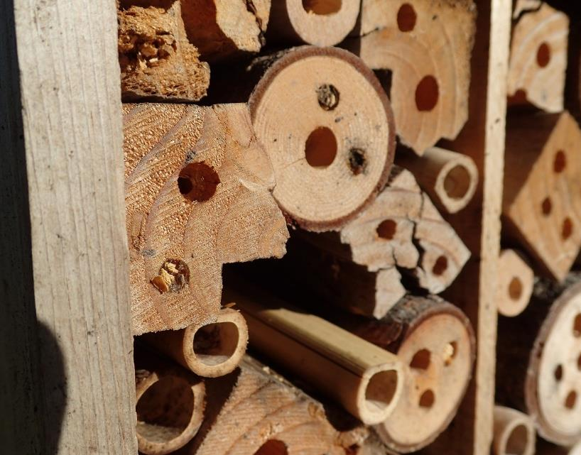
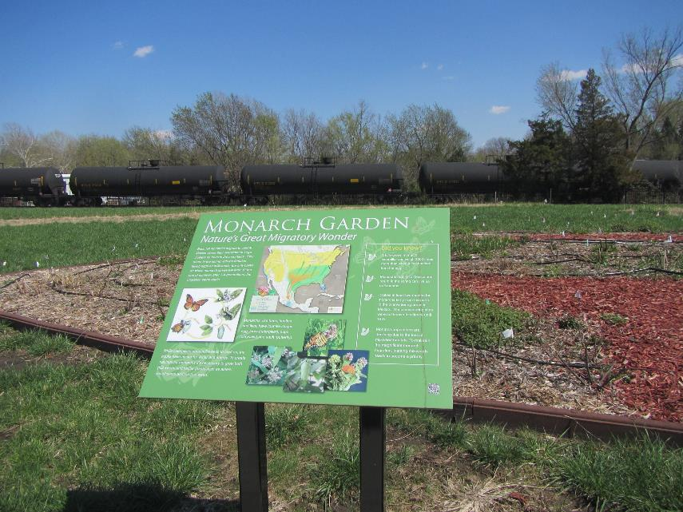
Leading by Example
Mason Bee House at
EPA Office in Oregon
Pollinator Prairie at Chemical Commodities Inc. Superfund Site

Slide 8
For More Information, Contact:
Dr. Larry Zaragoza
Acting Branch Chief,
Community Involvement and Program Initiatives
Office of Superfund Remediation & Technology Innovation
(703) 603-8867
zaragoza.larry@epa.gov

