Slide 1

The Role of Pollinators
Mary Galea
Plant Ecologist

Slide 2
Overview
Role of pollinators
Pollinator Partnership
Examples of where we work:
  Armstrong World Industries, Inc.
  Chemical Commodities, Inc.
Resources

Slide 3
Role of Pollinators
$217 Billion USD in global crop production
1 out of every 3 bites of food
Between 60 and 96% of ALL flowering plants depend on animal pollinators for reproduction.

Slide 4
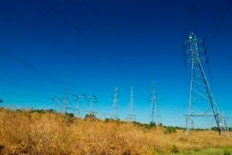
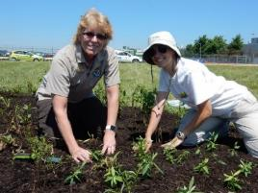
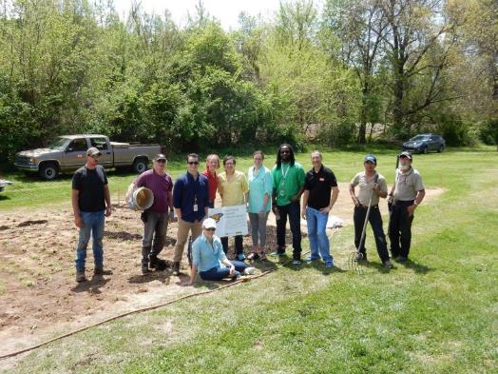

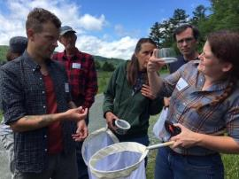

Pollinator Partnership
April 2011
June 2011
August 2011
September 2012
October 2011
Mission: The Pollinator Partnership’s mission is to promote the health of pollinators, critical to food and ecosystems, through conservation, education, and research.
4

Slide 5
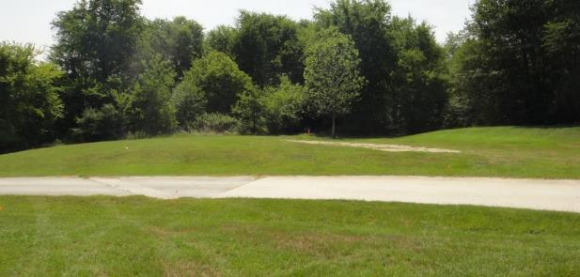
Armstrong World Industries
Seed mix consultation
Planting design consultation
Interpretive sign development
Website development and hosting
Before

Slide 6
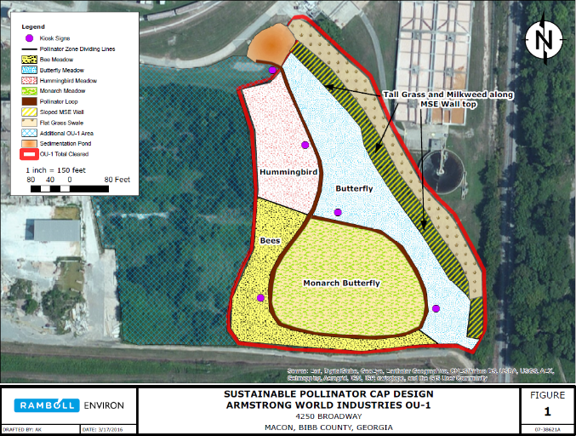
Armstrong Macon Meadow

Slide 7
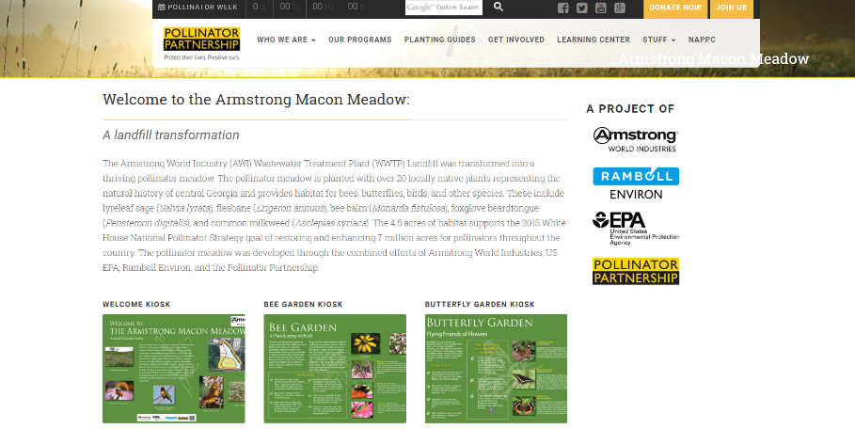
Armstrong Macon Meadow

Slide 8
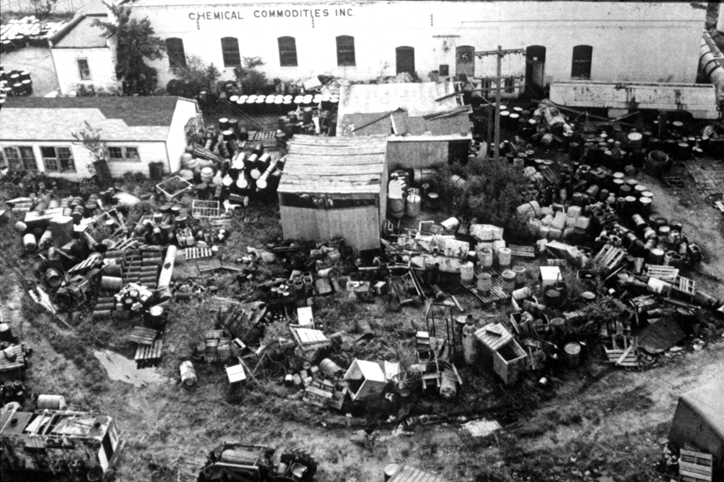
Chemical Commodities, Inc.
Planting design consultation
Plant selection
Interpretive sign development
Website development and hosting

Slide 9
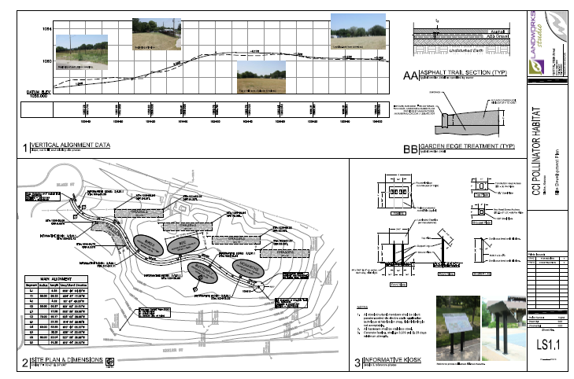
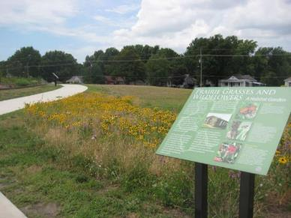
Pollinator Prairie

Slide 10
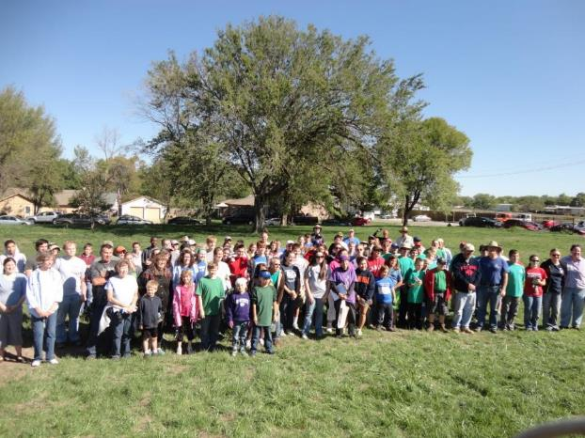
Pollinator Prairie

Slide 11
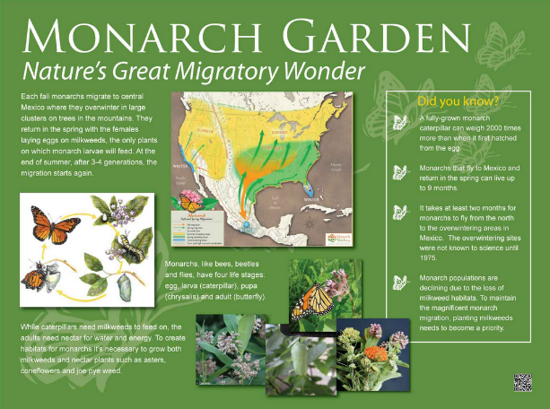
Pollinator Prairie

Slide 12
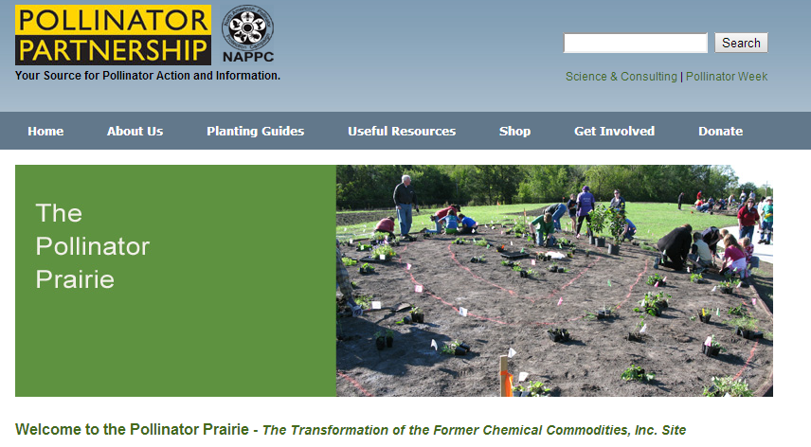
Pollinator Prairie

Slide 13
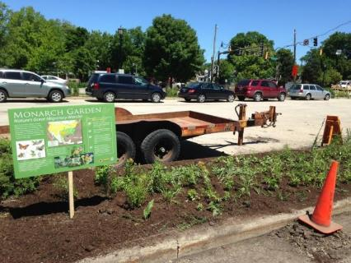
Pollinator Resources
Join an existing project or start your own!
P2 provides technical support, research, and outreach.
Use what’s already out there.

Slide 14
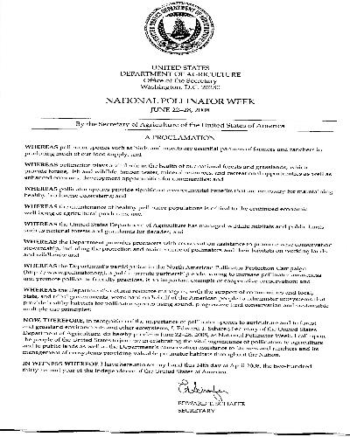
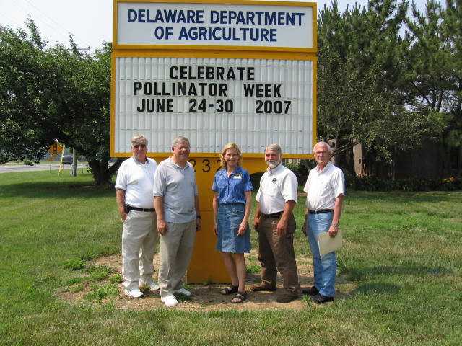
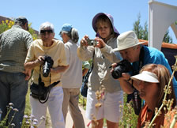
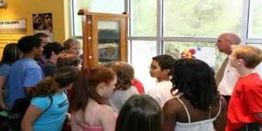
National Pollinator Week
June 18-24, 2017

Slide 15
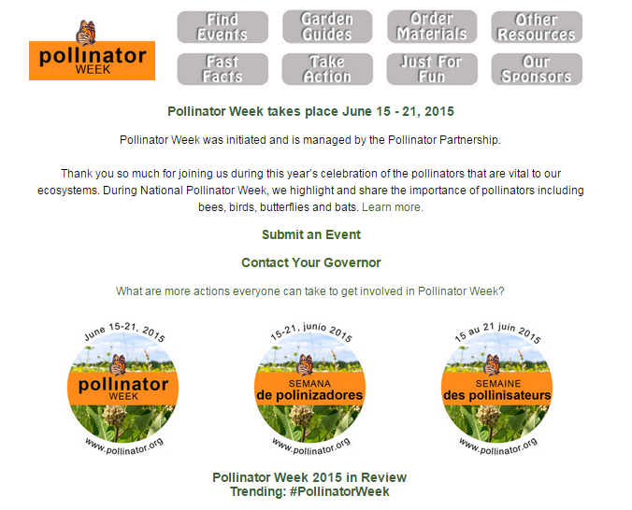
National Pollinator Week
June 18-24, 2017

Slide 16
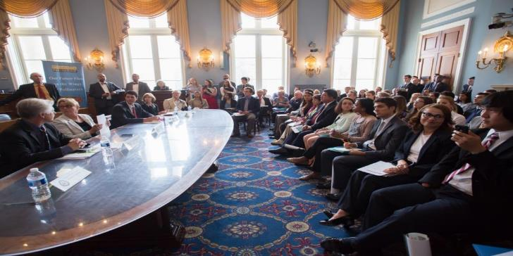



Million Pollinator Garden Challenge

Slide 17
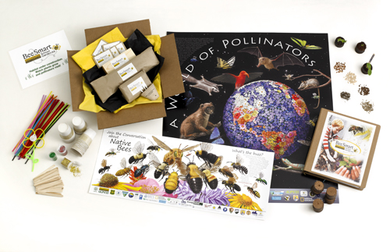

BeeSmart School Garden Kit
10 Lesson Plans
California State Standards
Teacher Resource Centers

Slide 18

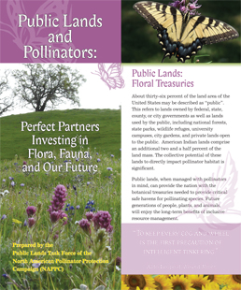
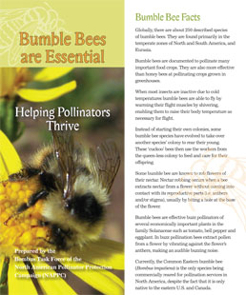
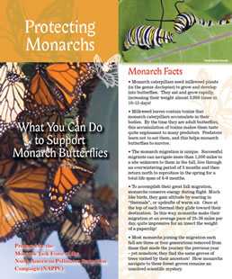

Brochures

Slide 19
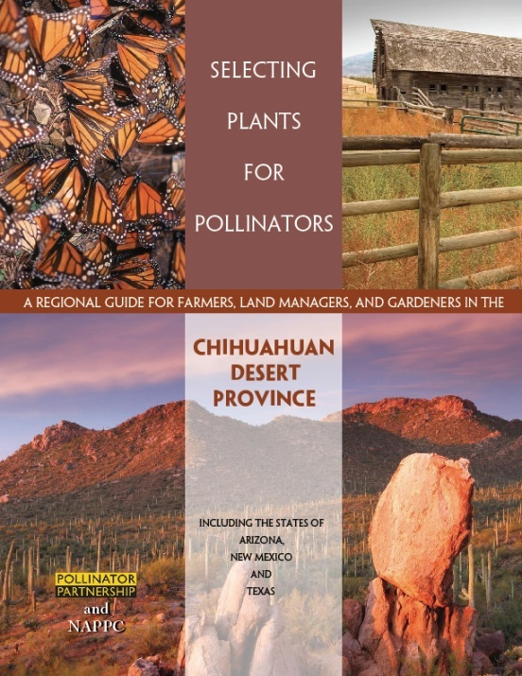
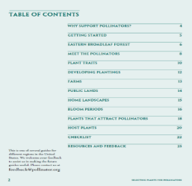

Slide 20

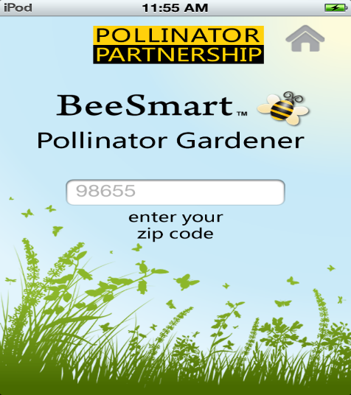
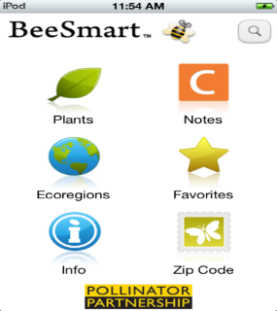
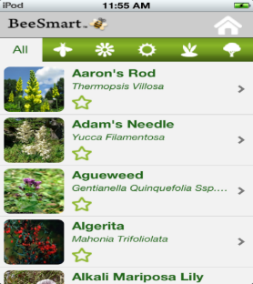
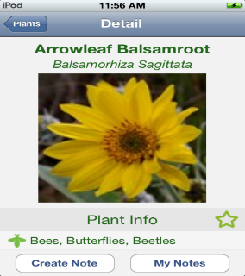

Slide 21

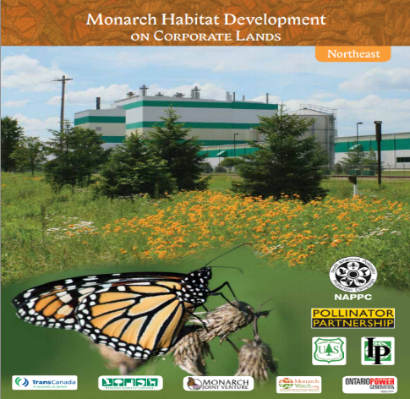
Monarch Habitat Development Guides

Slide 22

For More Information, Contact
Mary B. Galea
Plant Ecologist
Director, Great Lakes Regional Office
Pollinator Partnership
415-362-1137
mg@pollinator.org

