Slide 1
Ecological Revitalization –
Tools to Promote Pollinator Protection
Michele Mahoney
Ecological Land Use Coordinator

Slide 2
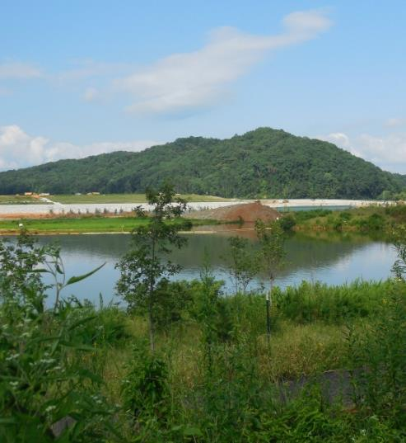
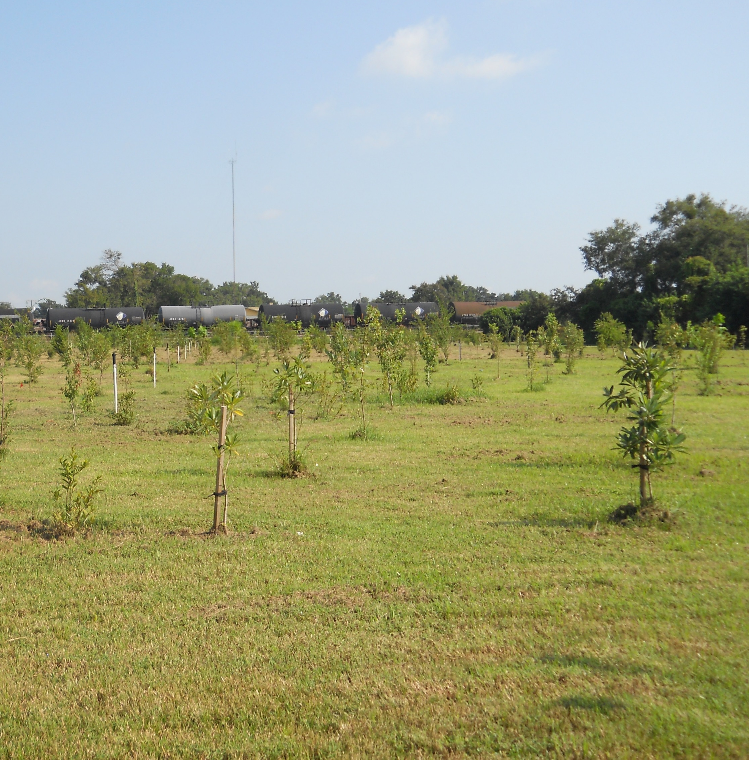
Ecological Revitalization Supports Pollinator Health
TVA Kingston site in Kingston, Tennessee
Improves soil health
Protects air & water quality
Provides habitat
Increases biodiversity
Creates sustainability
Landia Chemical Company site in Lakeland, Florida

Slide 3

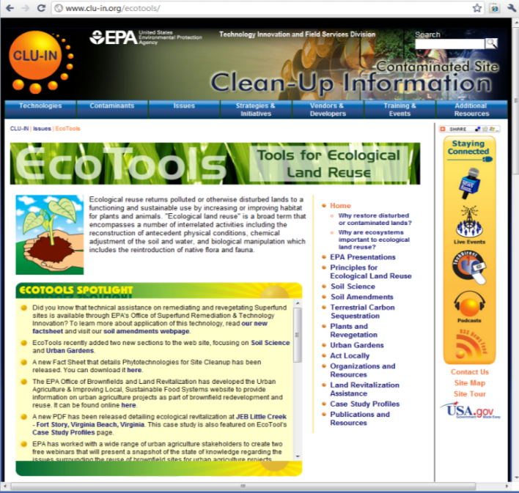
http://www.cluin.org/ecotools
https://clu-in.org/ecotools/presentations.cfm

Slide 4
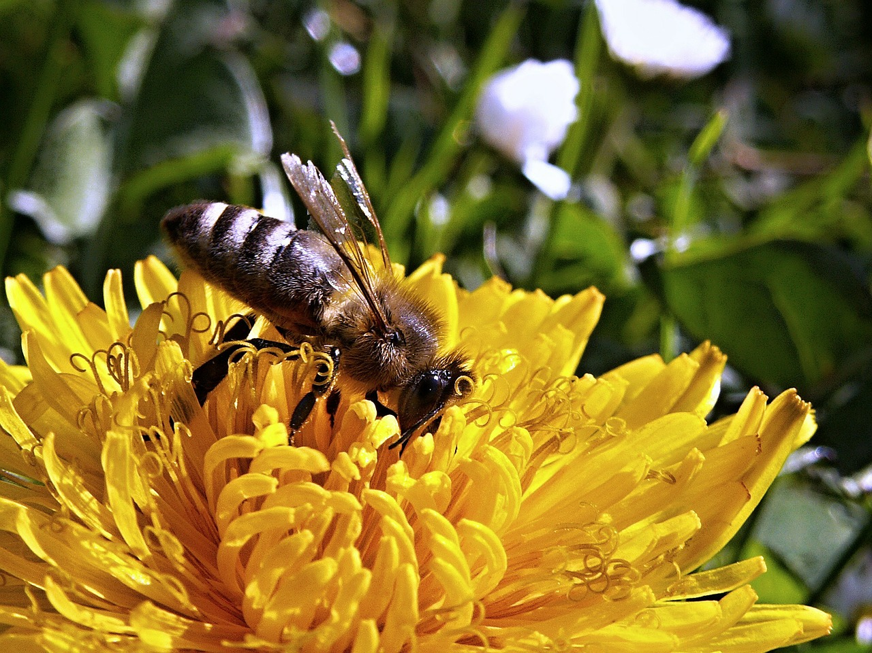
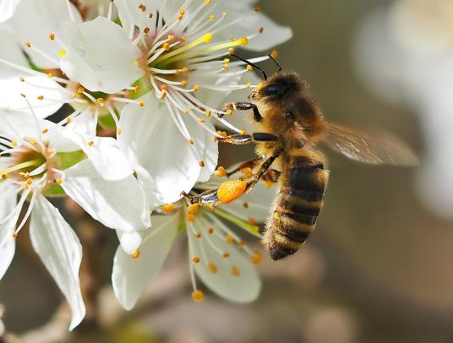
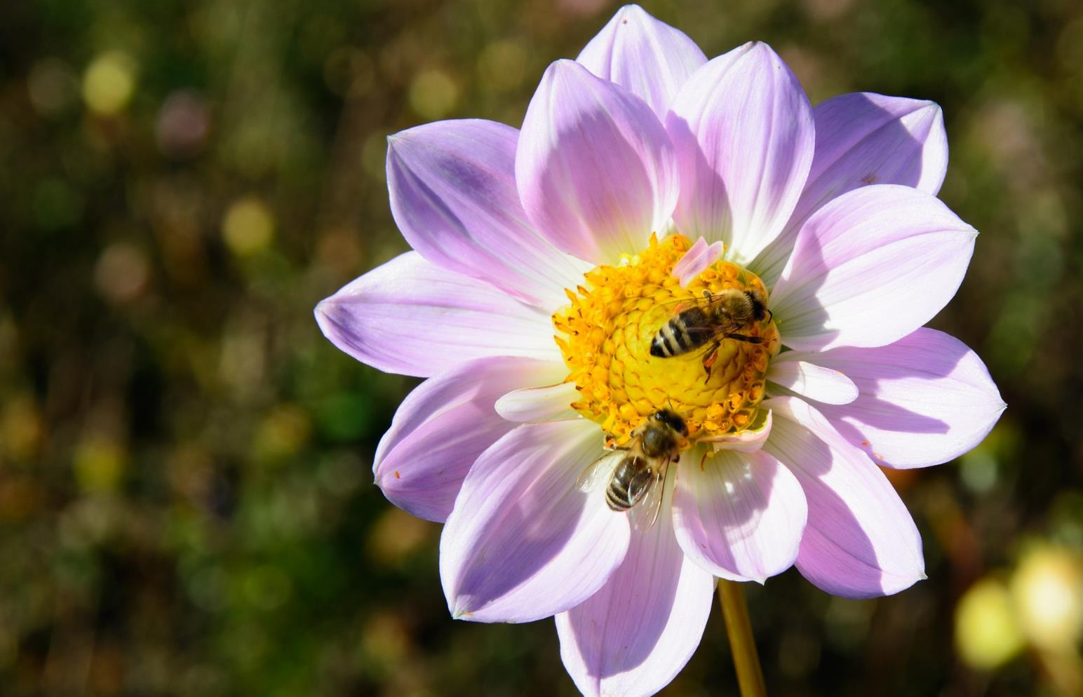
Regional Pollinator Support
Examples of successful pollinator habitat creation
Habitat creation at regional offices
Internal and external programs
Partnerships

Slide 5
For More Information, Contact
Michele Mahoney
Ecological Land Use Coordinator
Technology Innovation and Field Services
(703) 603-9057
mahoney.michele@epa.gov

