Slide 1
Pollinator Protection in Region 7
Catherine Wooster-Brown
Environmental Scientist

Slide 2
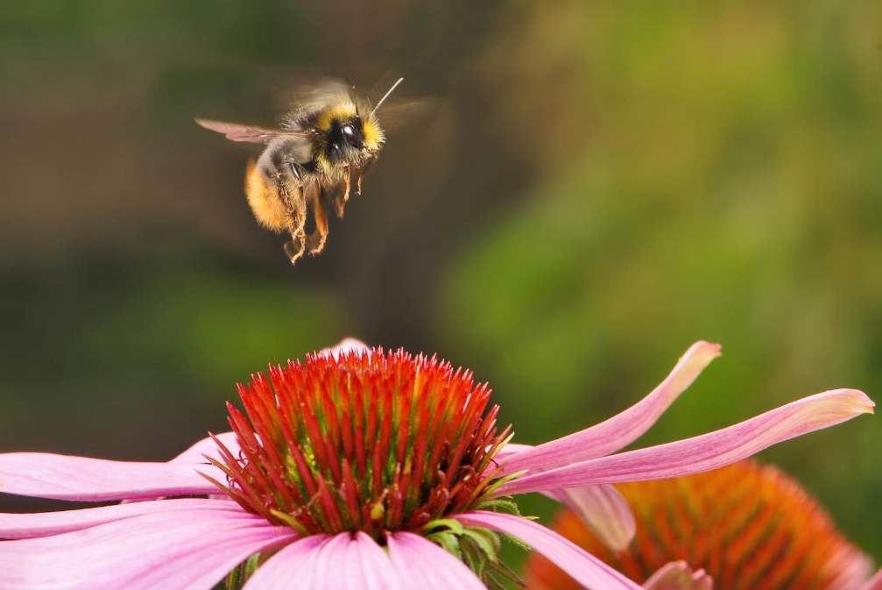
Region 7 Pollinator Workgroup
Our Purpose: Identify regional programmatic opportunities to facilitate pollinator protection and pollinator habitat opportunities within R7 as directed by the Regional Administrator and the Presidential Memorandum.
Pollinator Habitat at the Regional Office
External Programs
Internal Programs

Slide 3
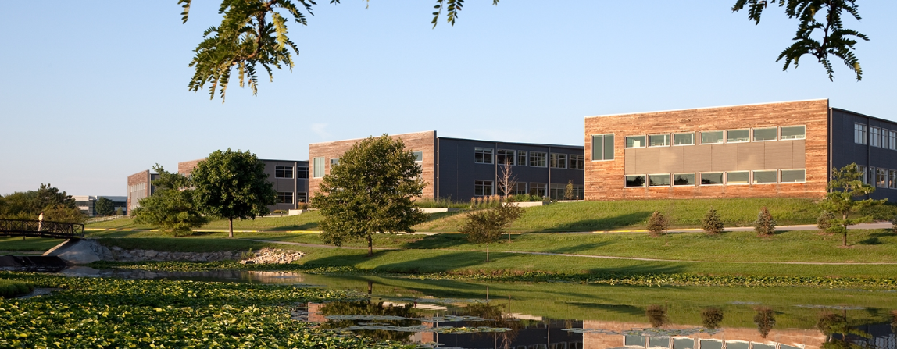
Pollinator Habitat at the Region 7 Office

Slide 4
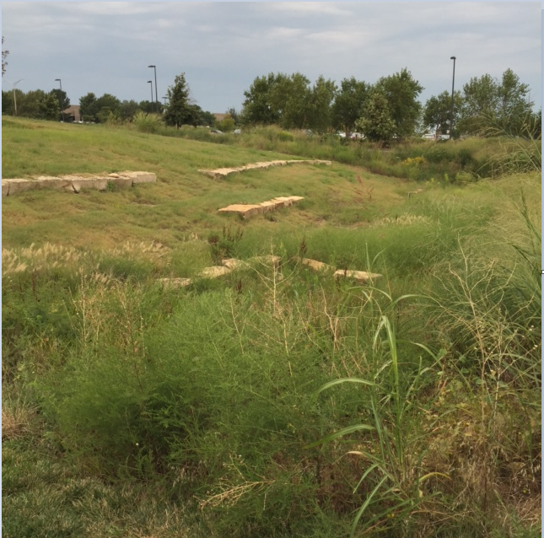
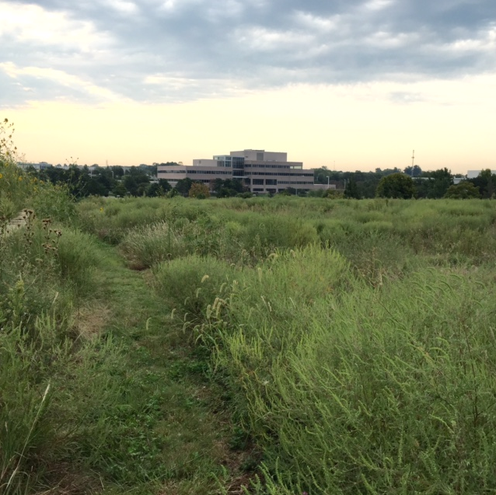
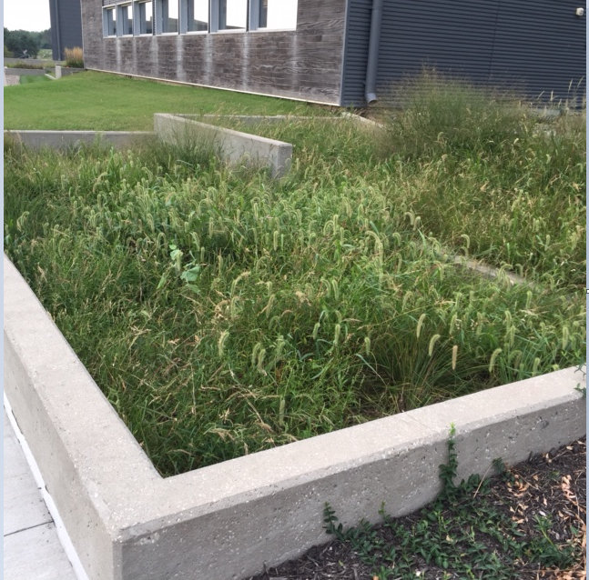
Pollinator Habitat at the R7 Office continued…

Slide 5

External Programs
Big Blue Thread in the Heartland (Public Blog).
Speakers at the RO.
Annual Pollinator Event during National Pollinator Week.
Healthy Schools Program.

Slide 6
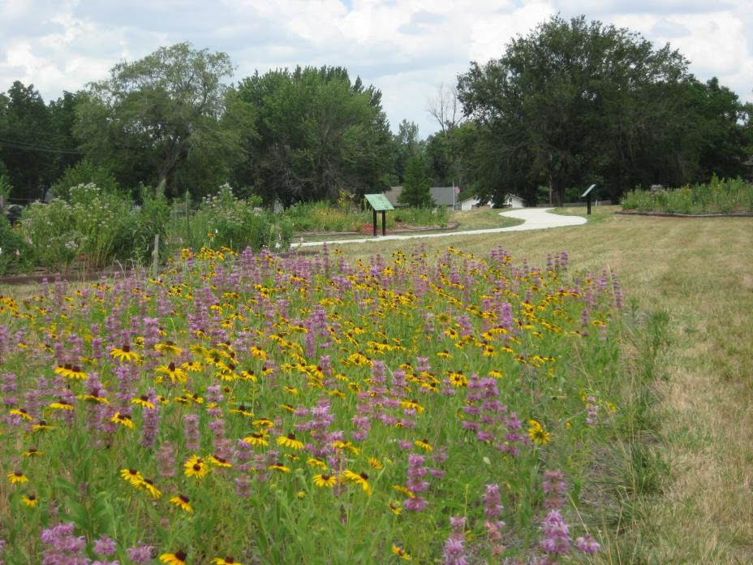
Internal Programs
Superfund and RCRA Pollinator Habitat as a Reuse Training
The Pollinator Problem.
The National Strategy.
EPA’s Pollinator Protection
Plan.
Metric: Acres of Pollinator
Friendly Habitat at Super-
fund Remedial Sites.
Chemical Commodities, Inc.

Slide 7
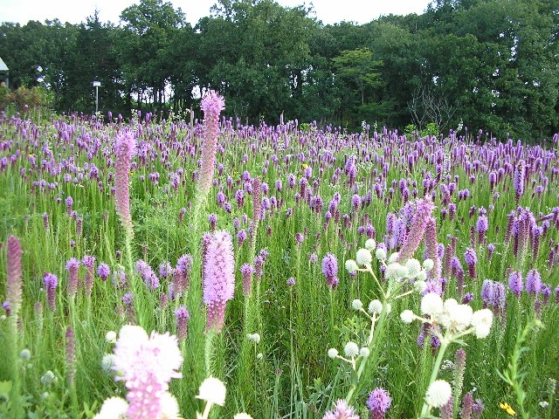
Superfund RPMs Can Start Documenting Possible Pollinator Habitat as a Reuse…
Record of Decision
Remedial Design/Remedial Action Plan
(Seed Mix in Specifications)
Performance Work Statement (Cost Estimate)
Kappelmann Century Farm, Gasconade County, MO

Slide 8
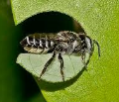
For RCRA Sites with PRPs, RPMs Could Have Reuse Discussions Which Include Pollinator Habitat.
Corrective Measures Study (including options and a cost estimate).
FIRST (Facility Investigation Remedy Selection Track) toolbox. In the FIRST process, there is a “Remedy Selection Process” (RSP) after the RCRA Facility Investigation (RFI) Report is completed.
The RSP would be the place to discuss the potential for Pollinator reuse. The potential for Pollinator reuse should be included on the agenda and provided to all parties before the RSP meeting. This allows time for the PRP to research options sufficiently to discuss the pros and cons during the meeting and decide whether it is an appropriate reuse at the site.
Leaf cutter bee

Slide 9
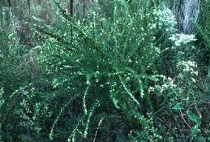
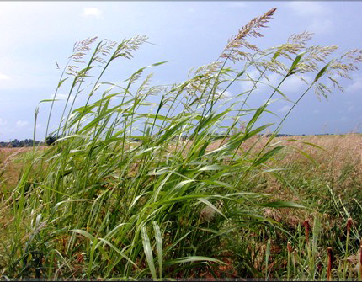
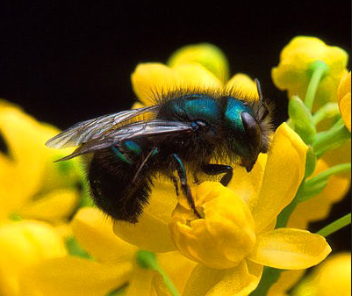
We Provide Details on Planting Pollinator Habitats
  Important Considerations;
      Surrounding Land Use.
      Identify Local Ecotypes.
      Identify Invasive Weeds/Plants.
      When to Seed.
      Cover Crops.
      Develop Short and Long Term Maintenance Plans.
Sericea Lespedeza
Johnson Grass
Mason Bee

Slide 10
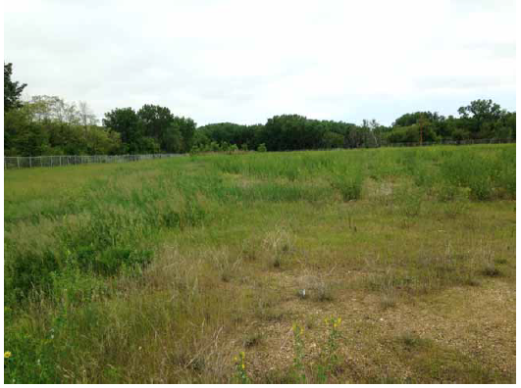
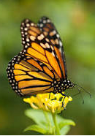
RCRA Site in Iowa
Monarch Butterfly

Slide 11
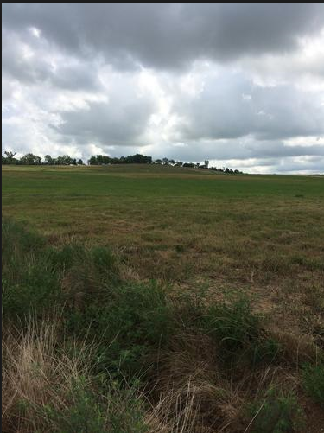
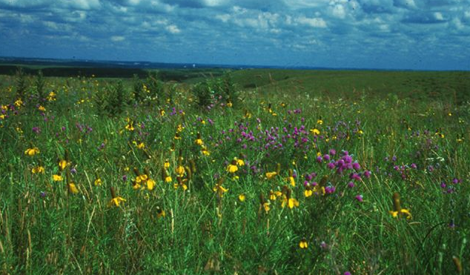
Superfund Site in Southeast Kansas, the Plan; Turn…
Fields of Grass
Fields of Flowers

Slide 12
For More Information, Contact
Catherine Wooster-Brown
Environmental Scientist
EPA Region 7
913-551-7425
wooster-brown.catherine@epa.gov

