Slide 1
September 10, 2014

Slide 2
Webinar Overview
Introduction to SRI
  Melissa Friedland, EPA SRI
Iron Horse Park/Shaffer Landfill
  Don McElroy, EPA Region 1
  Palmer Cameron and Nikola Krneta, Urban Green Technologies
  Robert Kirsch, WilmerHale
  David Bonnett, P.E., Geosyntec Consultants
Davie Landfill
  Bill Denman, EPA Region 4
  Richard Meyers, Broward County Solid Waste and Recycling Services
Resources and Contacts
  Melissa Friedland, EPA SRI

Slide 3
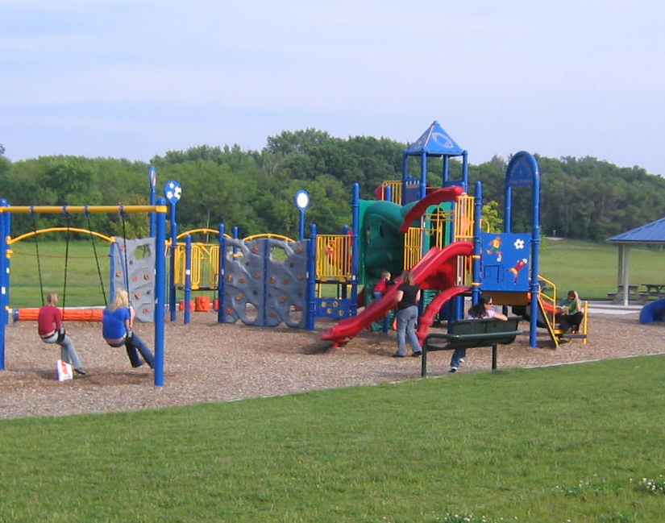
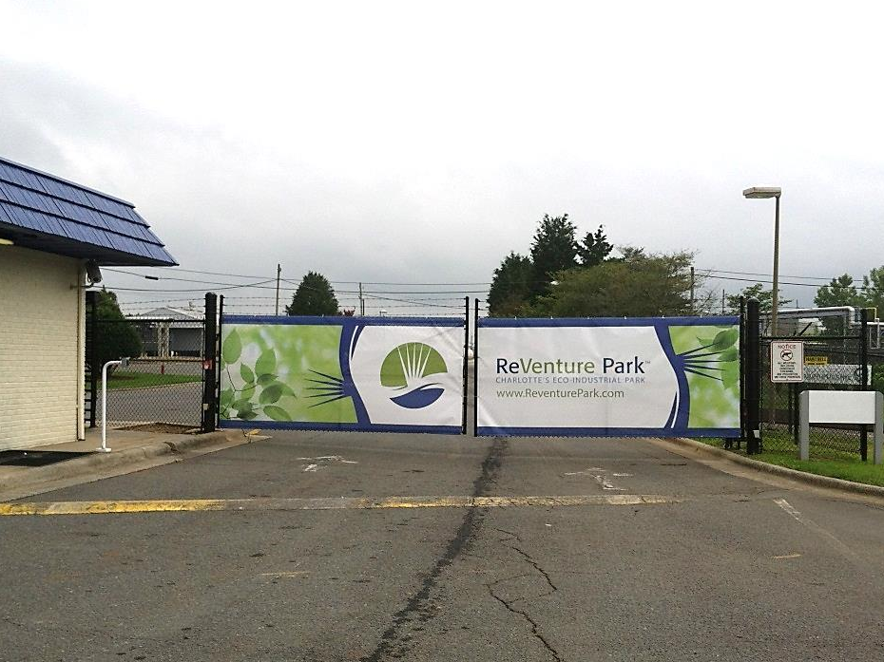
SRI: Superfund Redevelopment Initiative
Working with communities and other partners in considering future use opportunities and integrating appropriate reuse options into the cleanup process

Slide 4
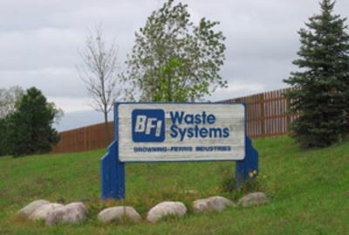
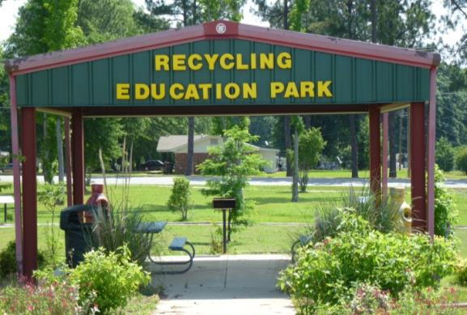
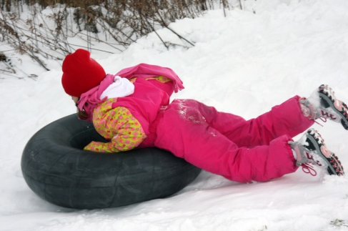
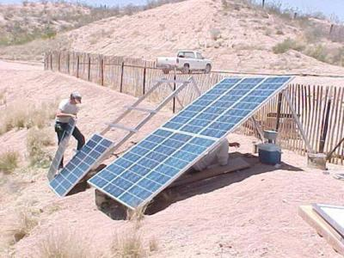
Reuse as a Priority
Source: Blackwell Forest Preserve District of DuPage County

Slide 5
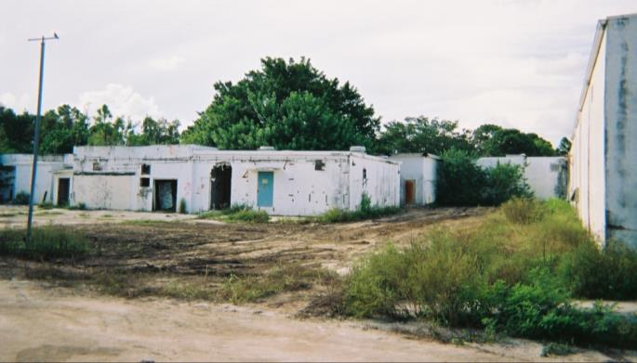
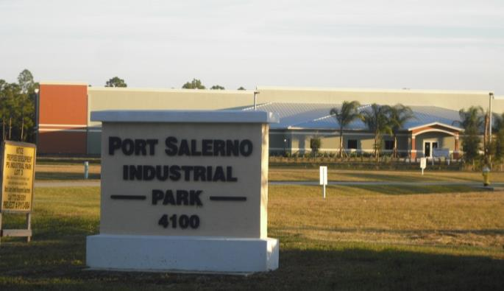
Benefits of Reuse
Economic
Environmental
Social
Protection of human health

