Slide 1
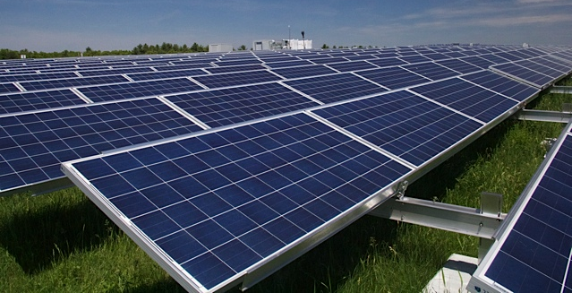
Shaffer Landfill Solar PRoject
Palmer W. Cameron, Urban Green Technologies
Nikola Krneta, Urban Green Technologies
Robert Kirsch, WilmerHale
David Bonnett, P.E., Geosyntec Consultants
Notes:
Greeting and brief introduction to each speaker and their relation to the project

Slide 2
Shaffer Landfill Solar Project
2
Notes:
Shaffer Landfill is a closed landfill located on approximately 100 acres of land in Billerica, Massachusetts.
Urban Green Technologies (UGT) was working closely with Capital Dynamics, our investor for this project.
We have built a 6.0 Megawatt (MW) solar renewable energy project on a portion of the site. This project is the largest solar development on a Superfund landfill site in the US.
The project had the strong support of the property owners, the Town of Billerica, the State of MA Department of Environmental Protection (DEP), U.S. EPA and National Grid (NG), the utility that services the site.

Slide 3
Why Solar? Why Here?
3
Notes:
Discuss:
How your organization became aware of the site
What attracted you to pursue solar here
Did you have any concerns about the Superfund site history?
If so, what did you do to overcome these concerns

Slide 4
Key Players
USEPA
Massachusetts Department of Environmental Protection
Town of Billerica, Massachusetts
Potentially Responsible Party Group
National Grid
Legal Team
Consultant Team
Site Owner
Investor
4
Notes:
Explain the roles and responsibilities of the various stakeholders in the project
Superfund Site overseen by the Federal Environmental Protection Agency (EPA)
Massachusetts Department of Environmental Protection (MDEP)
Town of Billerica, the town manager, planning board, building department
PRP Group the owners of the private landfill and their legal council
The electric utility, National Grid
Legal Team for lease, acquisition and negotiations
Consultant Team; environmental, surveyor, structural, civil, electrical, easements, engineering, procurement and construction (EPC)
Owner and Investor for equity position and who will take and use the tax benefits

Slide 5
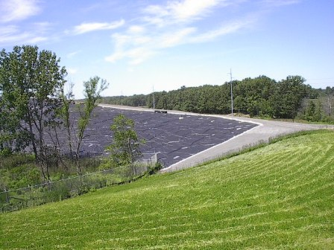
Project Design
5
Notes:
Pictures show the liner being placed over the graded foundation layer of the site and welding of seams (top), cap construction underway in background with completed cap and established vegetative cover in foreground (bottom)
UGT has performed extensive analysis and vetting of this site.
We have worked very closely with our consultants.
We worked hard to develop a site layout that will maximize the project size and output taking in account steep slopes (we utilized the land on up to 20% slope) as well as uneven terrain that forced us to create sub-arrays group as well as to level our micro grid racking to “level” the sub-array structure.

Slide 6
Project Design continued
6
Notes:
UGT received our Post Closure Use Permit from the MA Department of Environmental Protection on September 7, 2012.
The US EPA has reviewed the project and acknowledged that there will be no modification required to the landfill due to the solar project. Explain approval process, what was required.
Both EPA and DEP have been very supportive of the project.
Main concern was that the solar project should not affect the cap remedy implemented for the landfill.
We used a ballasted racking approach in order to avoid any possibility of piercing the cap.

Slide 7
Accessing a New Power Source
7
Notes:
Explain:
Connecting power to utility
How power is being used
Payment in lieu of taxes
Impact on community/area utility users?

Slide 8
Long-term Maintenance
8
Notes:
Discuss:
Construction and Operation of the Solar Array
Monitoring and maintaining the solar array and its electrical components
Maintaining the landfill relative grass cutting, erosion control, access for monitoring environmental requirements
Condition relative to monitoring natural gas generation if any
Secure the area with as security fence, lighting and cameras

Slide 9
Lessons Learned
9
Notes:
Several things can impact a project like this on a Superfund site. Some key lessons we’ve learned are:
Getting to know and working with EPA and understanding environmental issues, controls and limitations
Getting to know and working with the PRP group and investors that will have the last say in what you can and cannot do
Limitations regarding setbacks, wetlands, slopes, direction landfill faces
Climatic and weather conditions in the area

Slide 10
Contact Information
Palmer W. Cameron, Urban Green Technologies
palmer.cameron@urbangreentech.com
Nikola Krneta, Urban Green Technologies
nikola.krneta@urbangreentech.com
Robert Kirsch, WilmerHale
rob.kirsch@wilmerhale.com
David Bonnett, P.E., GeoSyntec
dbonnett@geosyntec.com
10

