Slide 1
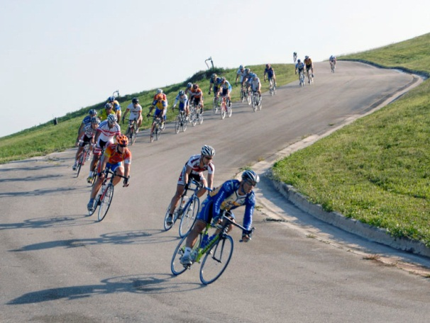
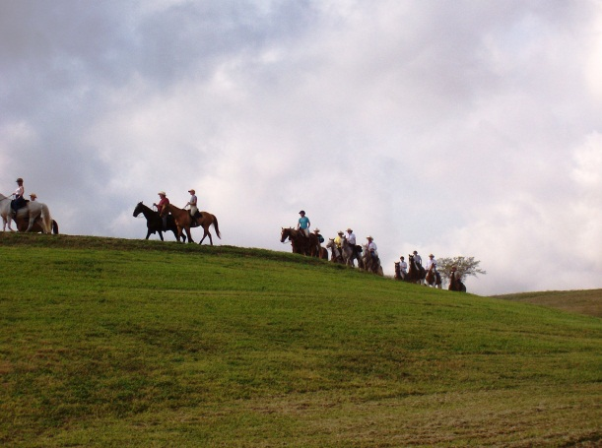
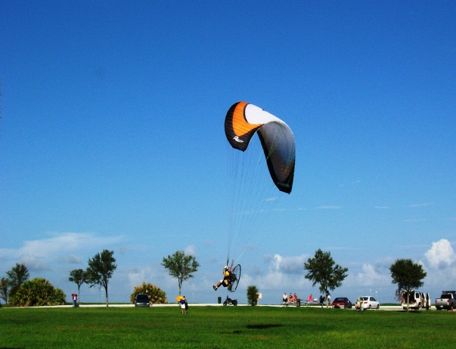
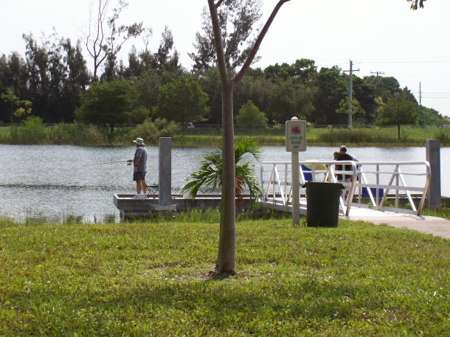
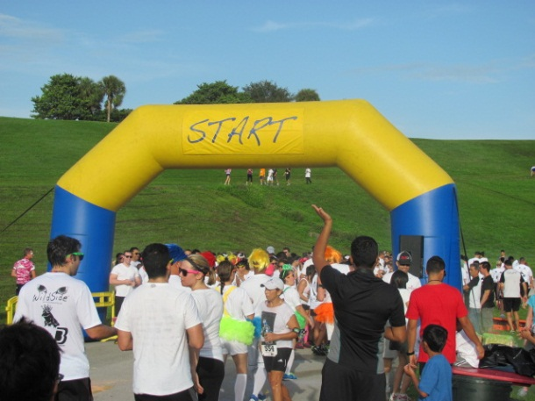
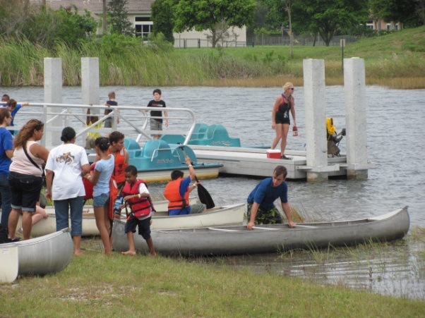
Capped superfund site reuse – davie landfill/Vista view park
Presented by Richard Meyers, Program Manager, Broward County Solid Waste and Recycling Services

Slide 2
Site Location
Florida
Davie Landfill – Vista View Park is located in the Town of Davie in Broward County, approximately 5 miles west of Fort Lauderdale, Florida

Slide 3
Historical Overview – Davie Landfill
Site Operations (1964 – 1987) - 210 Acre Site
Operations Included:
  Municipal Solid Waste Incinerator – 1964 to 1975
  Trash Landfill (68 acres) – 1964 to 1987
  Sanitary Landfill (48 acres) – 1975 to 1987
    Leachate Collection System
  Unlined Sludge Lagoon
Site Placed on National Priorities List (NPL) in 1983 due to concerns over potential groundwater contamination from on-site sludge lagoon

Slide 4
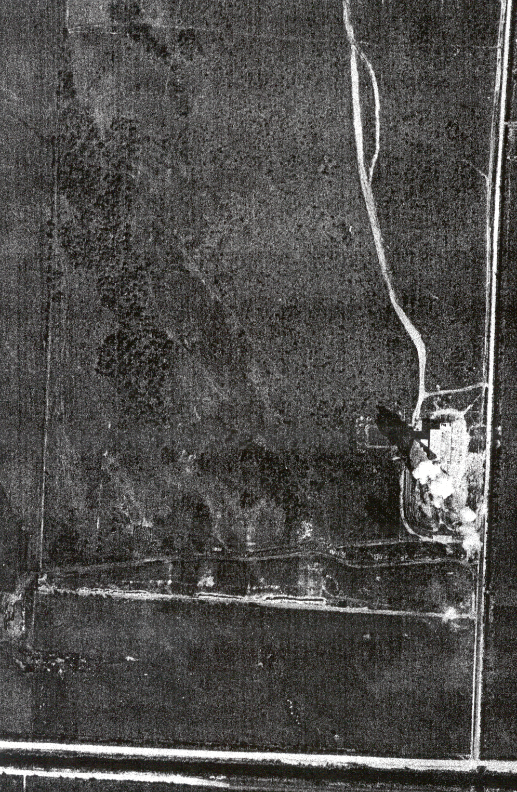
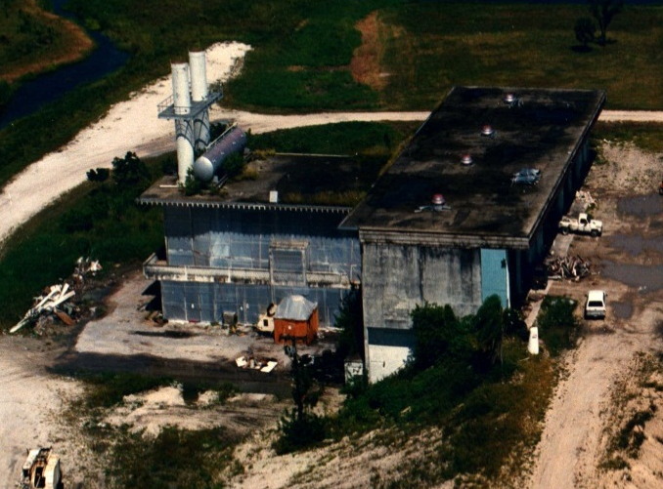
Site - 1965
1965 Aerial
Site commences operations
(1964) with an incinerator to burn municipal solid waste.
Trash landfill created to
accept ash from the incinerator, construction and demolition debris, bulk trash, and unburnable solid waste.
Incinerator
Trash Landfill

Slide 5
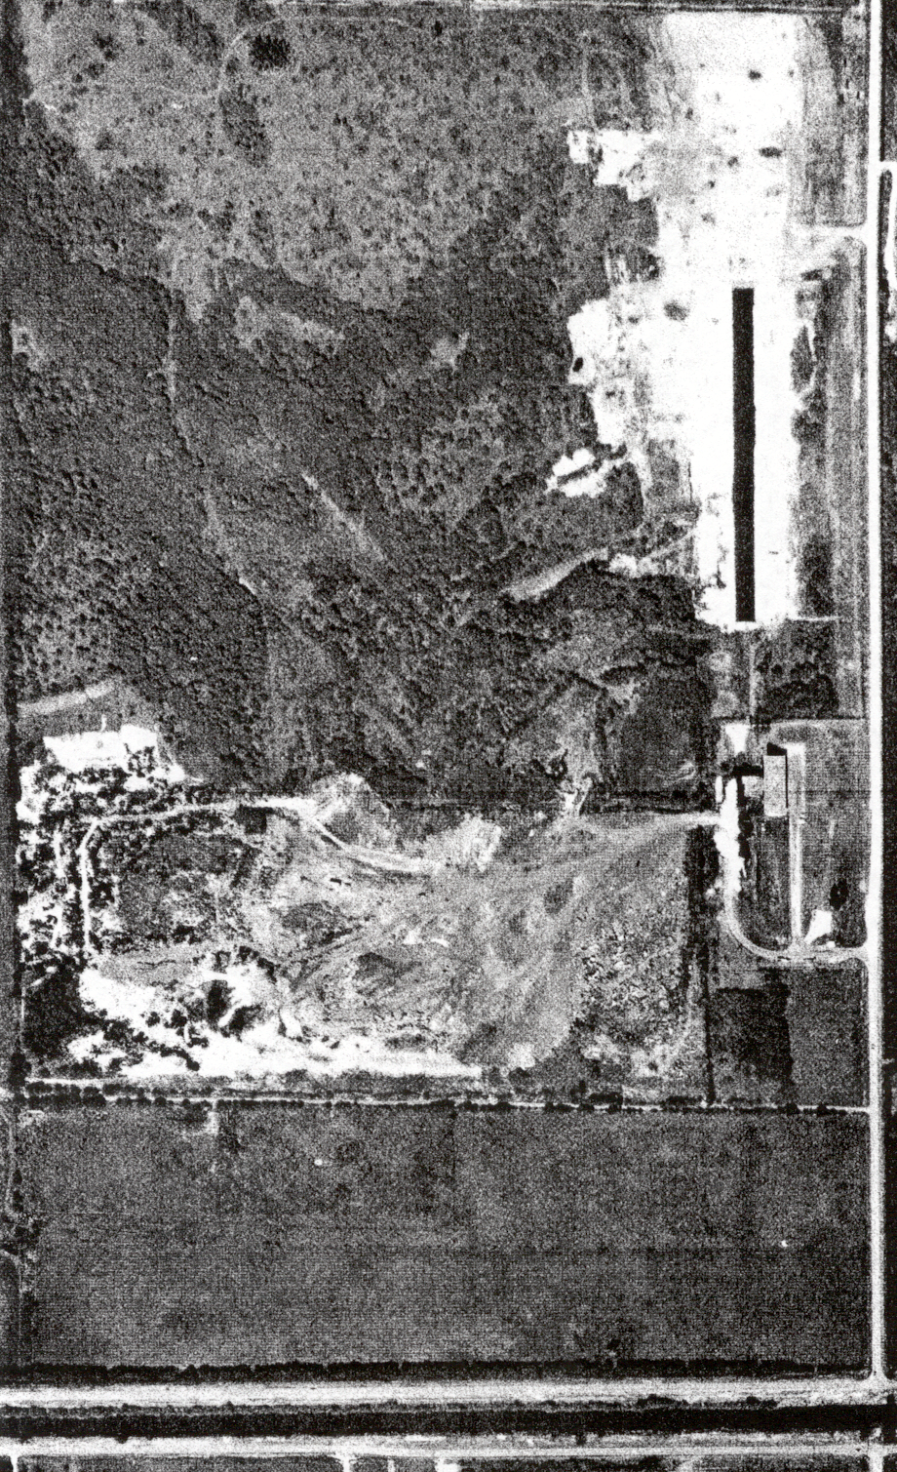
1973 Aerial
Site - 1971
Unlined sludge lagoon created in 1971 to dispose of grease trap waste, septic tank waste and municipal wastewater treatment plant sludge.
Sludge Lagoon
Incinerator
Trash Landfill

Slide 6
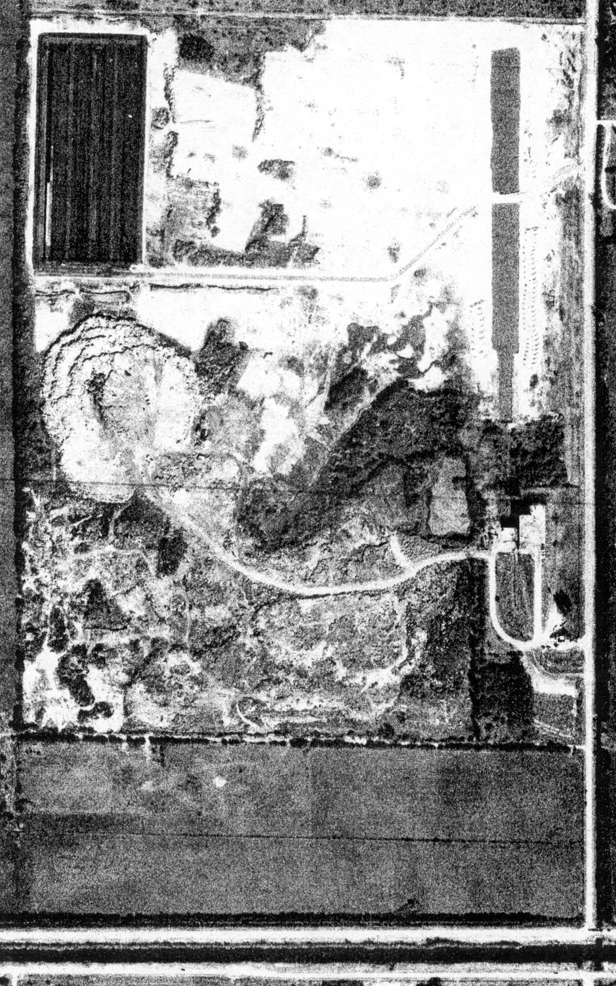
Site - 1975
1975 Aerial
Sanitary Landfill
By 1975, incinerator operations shut down due to change in air regulations.
Sanitary landfill commences operations.
Sludge Lagoon
Trash Landfill

Slide 7
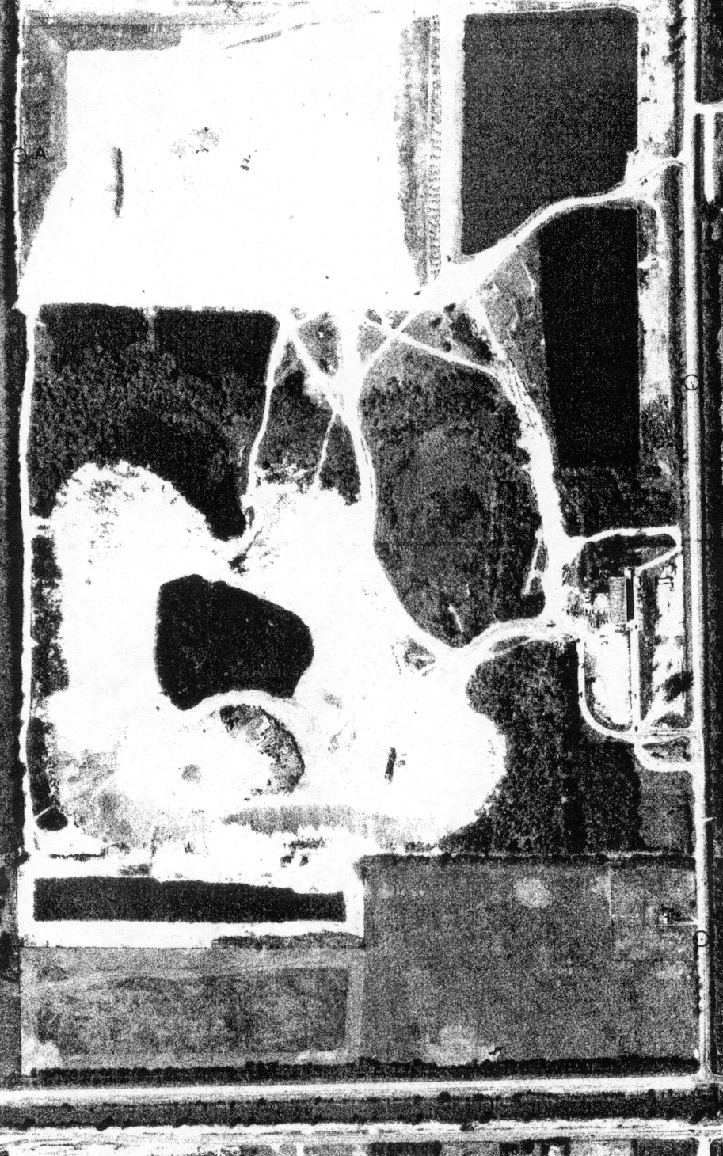
1984 Aerial
Site - 1984
Sanitary Landfill
Full-blown operations of trash landfill (south mound) and sanitary landfill (north mound).
In 1981, sludge lagoon operations shut down due to potential groundwater contamination concerns.
Landfill projected to cease operations by end of 1987.
Sludge Lagoon
Trash Landfill

Slide 8
Record of Decision - 1985
Record of Decision (ROD) - September 1985
Addressed contamination associated with the sludge lagoon (Operable Unit 1)
Broward County developed closure plan for sludge lagoon and the landfill
ROD authorized remedy for source control of contaminants
Remedy included:
  Dewatering and stabilization of sludge lagoon contents
  Placement of stabilized sludge in the sanitary landfill
  Installation of low permeability cap on landfill
  Note: The landfill was capped/closed in accordance with Resource Conservation and Recovery Act (RCRA) requirements under the authority of the Florida DEP.

Slide 9
Landfill Cap

Slide 10
Master End-Use Plan - 1987
Broward County and the Town of Davie realized that the landfill needed to be closed with the understanding that:
  Broward County was one of the fastest growing areas in Florida
  Growing demand for new park and recreational facilities
  A Master End Use Plan was developed - included detailed site analyses, an inventory of existing parks, and a consideration of county-wide recreational needs and goals
  Throughout the planning, design, and construction of the park, diverse stakeholders involvement included regulatory agencies, public ofﬁcials, local residents, and public interest groups.
  Ultimate End-Use Goals were to:
Increase Recreational Acreage
Provide More Open Space
Land Reuse
Site Protective of Human Health and the Environment

Slide 11
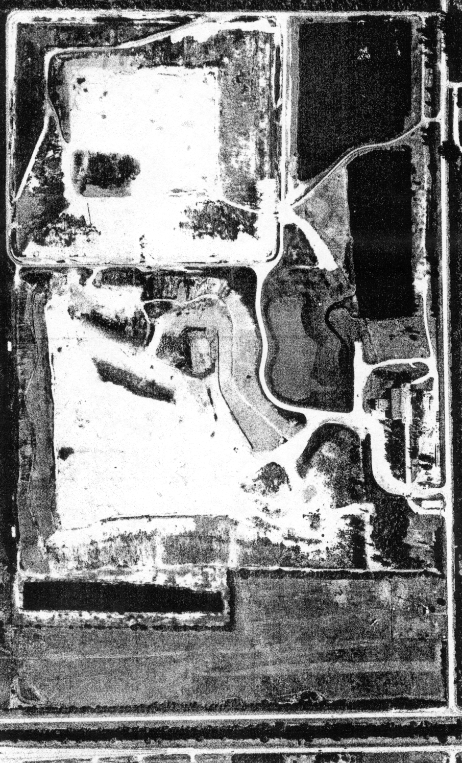
Site - 1990
1990 Aerial
Sanitary Landfill
Nature pond created following the remediation of the sludge lagoon.
Remediation involved the excavation, solidification and disposal of sludge in the sanitary landfill.
Landfill areas in process of being capped.
Other site closure features being incorporated.
Nature Pond (Former
Sludge Lagoon)
Trash Landfill

Slide 12
Other Site Assessment Activities
Evaluation of other potential sources of contamination and remediation (Operable Unit No. 2)
Remedial Investigation (RI) completed in October 1993
  Results showed sludge lagoon remediation effective
  Groundwater, surface water, sediment and soils at the site showed little to no contamination
  Risk Assessment completed in December 1993
    Determined only receptor/pathway was to residents through ingestion of groundwater
    Feasibility Study (FS) completed in April 1994
      Antimony and Vinyl Chloride most likely site contaminants

Slide 13
Site Remedy - 1994
      Major components of the selected remedy included:
        Natural attenuation of “antimony” and “vinyl chloride”
        Groundwater monitoring
        Monitoring of private wells in the surrounding area
        Connection to public water supply for affected residents
        Per the selected remedy, the following engineering, institutional and regulatory controls were implemented:
          Landfill capping
          Management of stormwater, leachate and landfill gas
          Groundwater and surface water monitoring
          Extension of public water supply lines
          Deed restrictions for the site
          Florida DEP regulatory control
ROD issued – August 1994
Required that performance of the selected remedy and established Performance Standards for antimony of 6 microgram per liter (μg/l) and vinyl chloride of 1 μg/l.

Slide 14
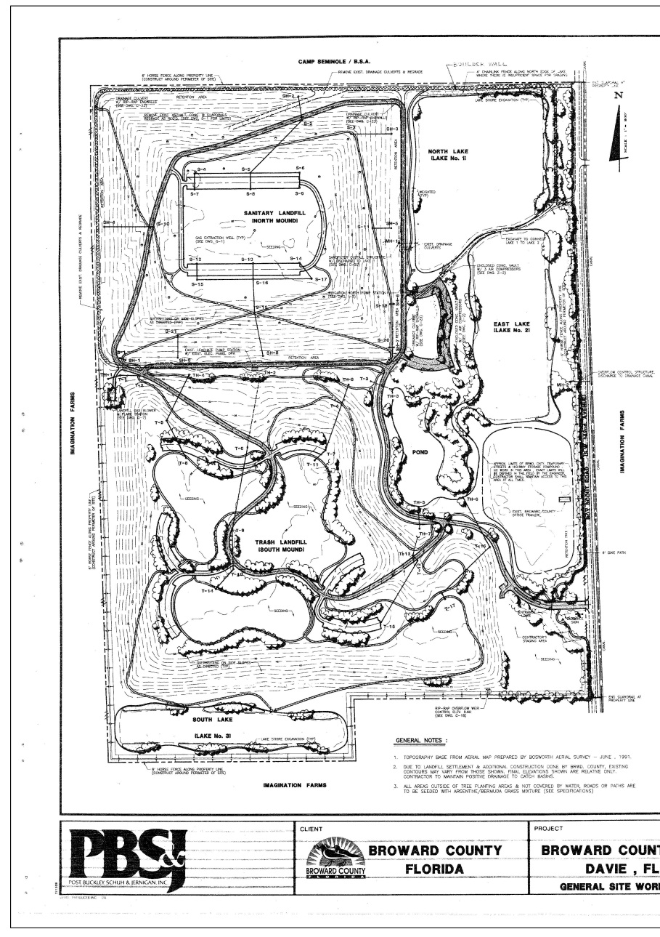
Davie Landfill - 1994
Broward County Solid Waste and Parks and Recreation worked together in meeting the future needs for park use.
By 1994, the capping of the landfill was complete and all of the initial park features had been incorporated.

Slide 15
Landscape Plan

Slide 16
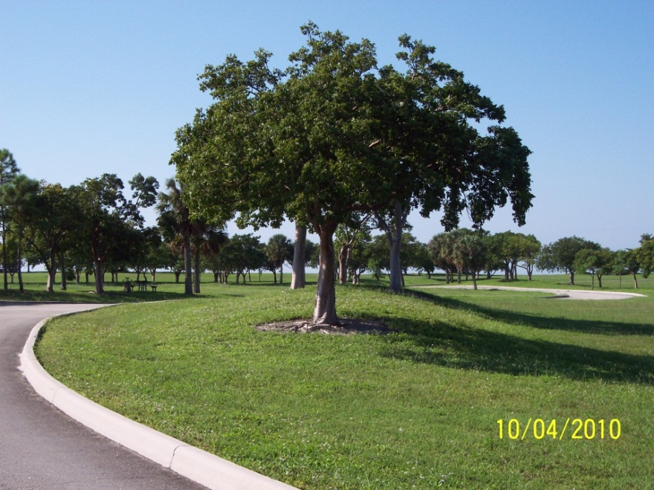
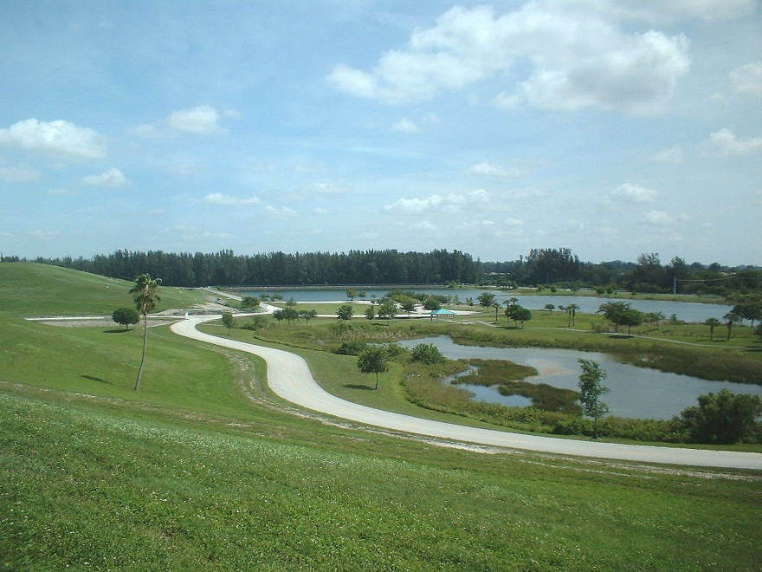
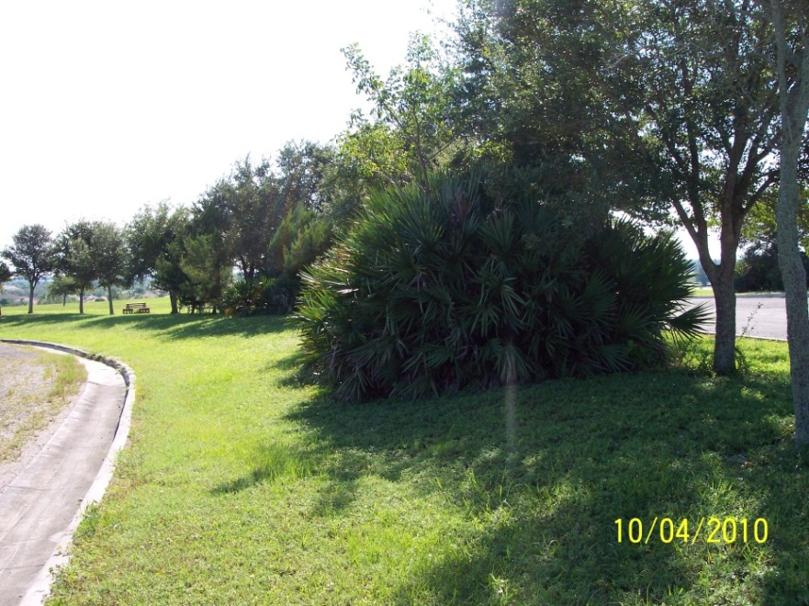
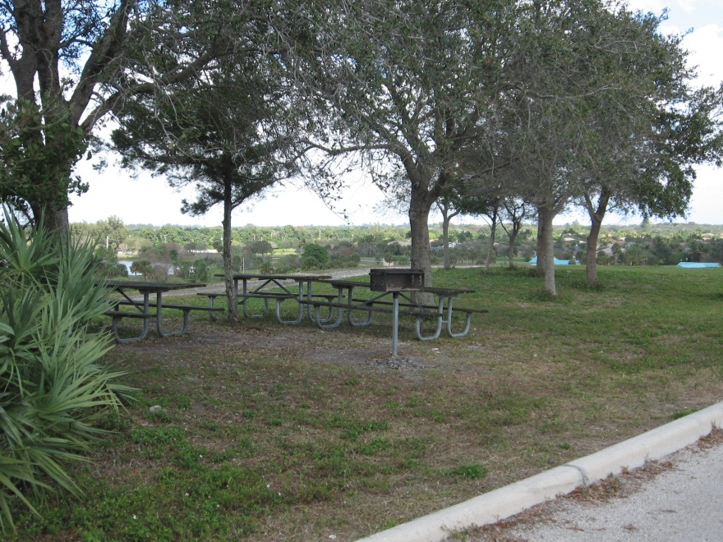
Landfill Landscape Photos

Slide 17
Regulatory Status – FDEP and EPA
Official Landfill Closure granted by Florida DEP in 1995
Post Closure Monitoring Permit issued by Florida DEP for 20 year period (1995-2015)
Process to delete site from NPL began in 2003-2004
  All remedial activities were completed, and the remedy continues to be protective of human health and the environment.
  Engineering/institutional/regulatory controls are in place, are effective and will continue to be diligently maintained
  Performance Standards for antimony and vinyl chloride had been met for a period of three years
  Site deleted from NPL in 2006

Slide 18
Initial Park Transformation
The transformation into a park was made possible through:
Initial funding from Broward County Office of Integrated Waste Management, now Solid Waste and Recycling Services.
Supplemental funding from the 2000 Safe Parks and Land Preservation Bond Referendum.
Prior to the park’s construction, natural communities were largely absent due to the site’s history. During the design phase, natural habitats were created through the use of natural plants/trees with the hope that animals naturally found in these habitats will make the park their home.
In 2002, an additional 61 acres were acquired at a cost of $12.8 million, half of which came from a Florida Communities Trust grant and the other half from the 2000 bond program.

Slide 19
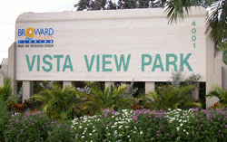
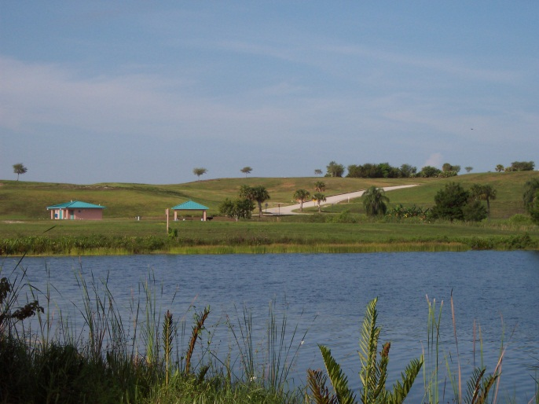
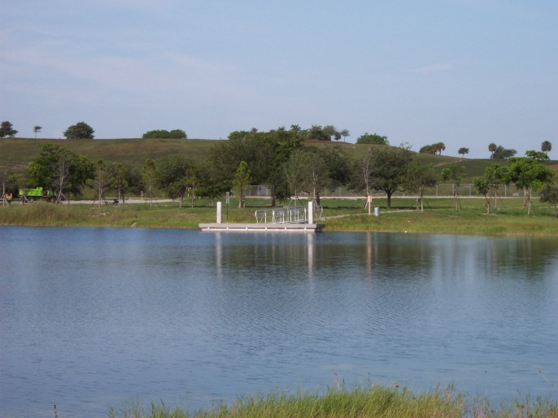
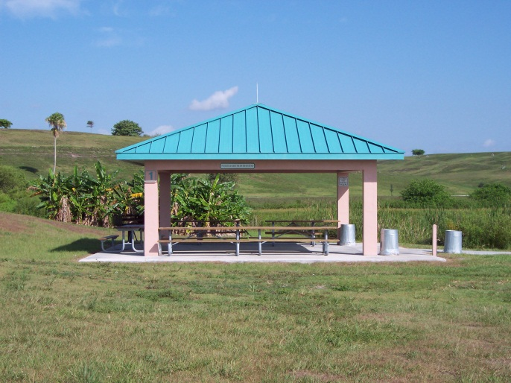
Vista View Park - 2003
The closed Davie Landfill opens in 2003 as Vista View Park (160 of the 210 acres available to the public) - amenities included 2 picnic shelters, fishing dock, paved trails, horse trails, restrooms, airstrip for model planes and paraglider pilots, lookout areas at top of landfill.

Slide 20
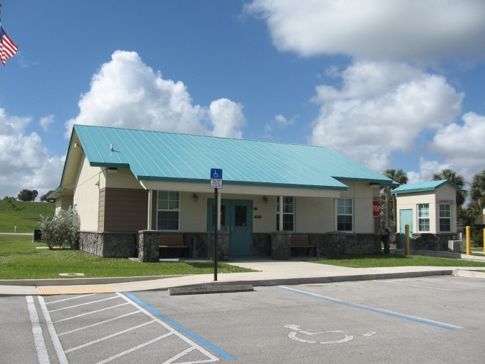
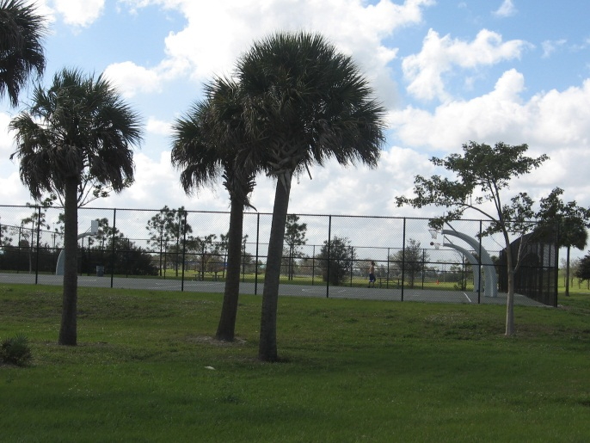
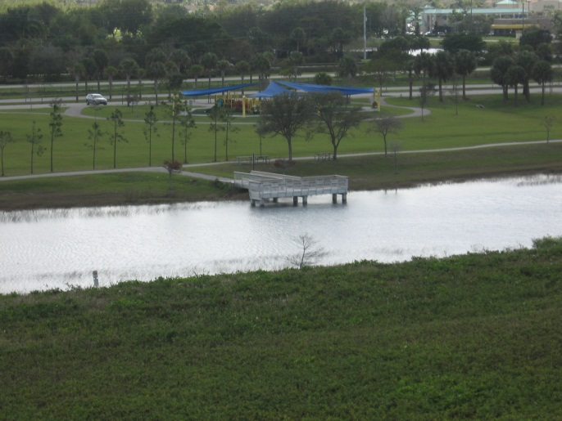
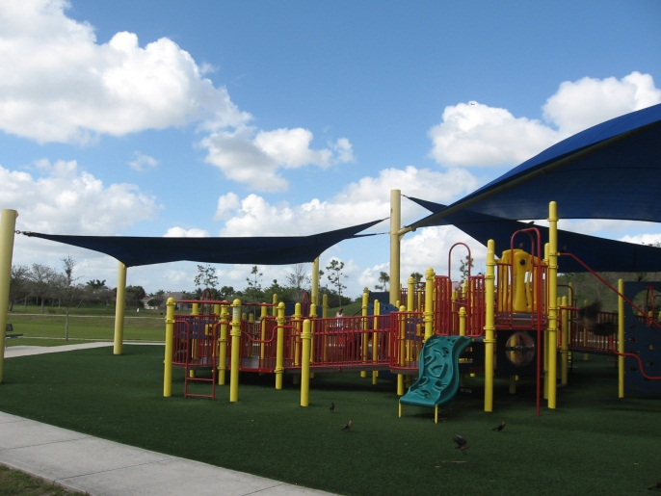
Vista View Park Expansion - 2009
In 2009/2010 – Vista View Park expands to the south adding an additional 61 acres – additional amenities included –2 playgrounds, basketball courts, 7 more picnic shelters, fitness stations, boat rentals, equestrian corral, primitive camping areas, additional parking.
The expansion cost an additional $7.2 million to construct.

Slide 21
Additional Park Expansion Features
Caitlyn’s Corral, a playground accessible to children of all levels of ability
  Awarded certification from Boundless Playgrounds for exceeding the minimum requirements of the Americans with Disabilities Act (ADA) and standards of the playground industry.
  Universal design practices and child development theories are incorporated into the Boundless standards.
An airstrip for radio-controlled planes and paraglider pilots, a 2nd fishing pier, an area for primitive group camping and two restrooms
1.2-mile loop trail offering several different fitness stations
A radio-controlled car track
2.1-mile horse trail loops around the park and connects to many miles of trails throughout the Town of Davie

Slide 22
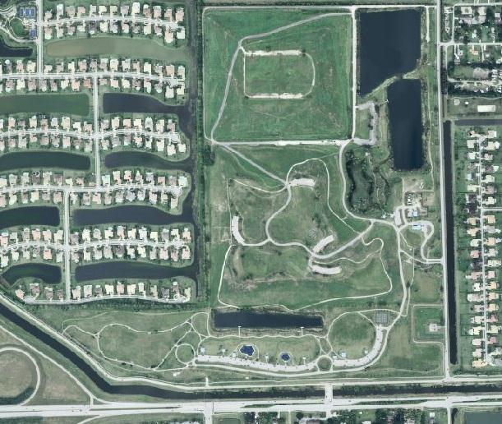
Vista View Park Expansion (Cont’d)
NOT PART OF PARK
(48 Acres)
Fishing Pier
Picnic Shelter
Equestrian Trail
Nature Pond
Picnic Shelter and Restroom
Paved Parking
Radio Controlled Car Track
Administrative Offices
Model Airplane Field
Paved Parking
Equestrian Trail
Equestrian Trail
Multi-purpose Trail with Exercise Stations
Basketball Courts
Boat Dock
Fishing Pier
Event Field
Picnic Shelters, Playgrounds and Restrooms
Equestrian Corral

Slide 23
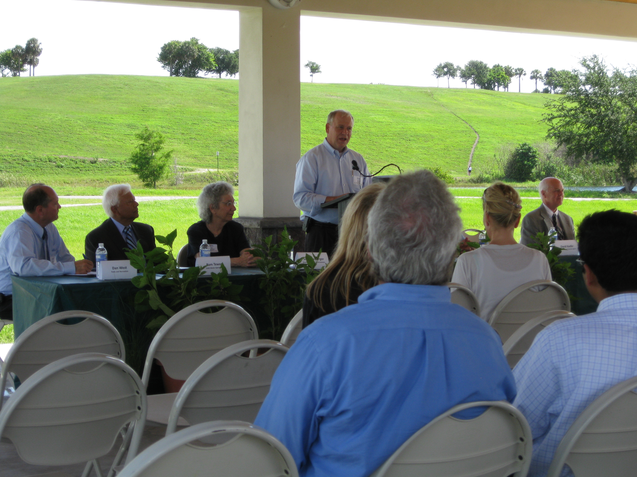
EPA Region 4 Excellence In Site Reuse Award
In June 2010, Broward County received EPA Region 4’s Excellence in Site Reuse award in recognition of its outstanding efforts in redeveloping Davie Landfill into Vista View Park.

Slide 24
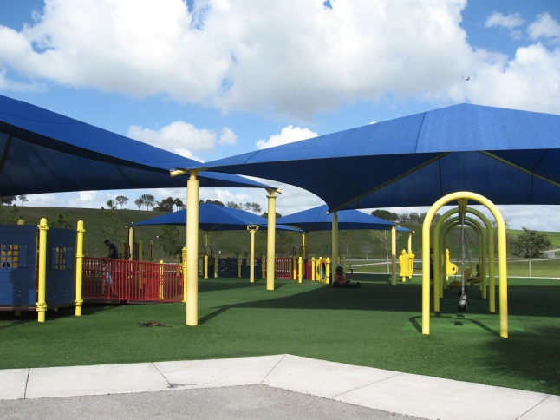
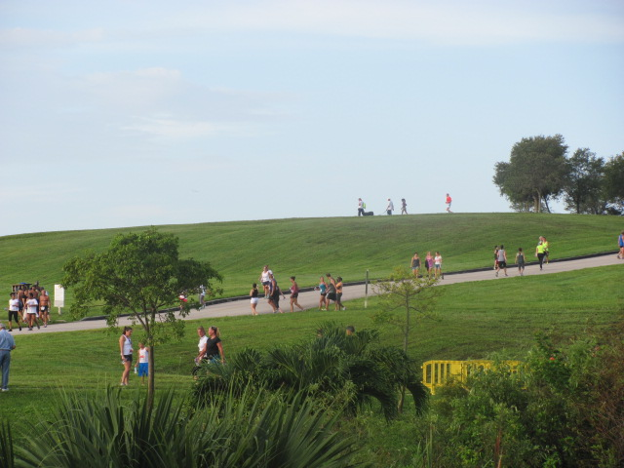
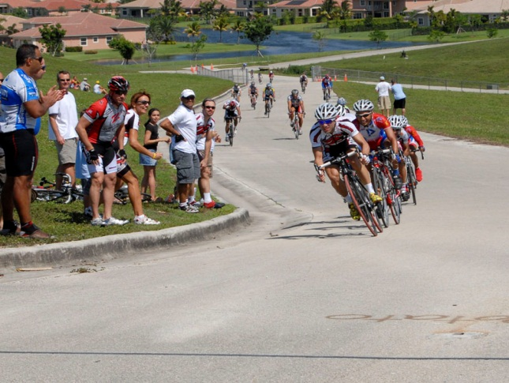
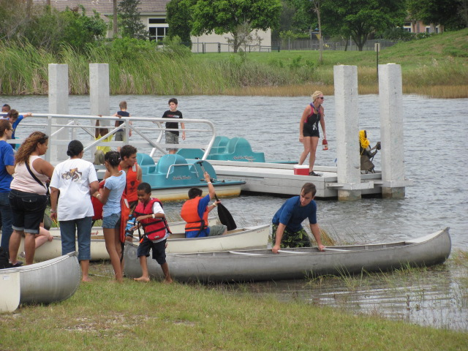
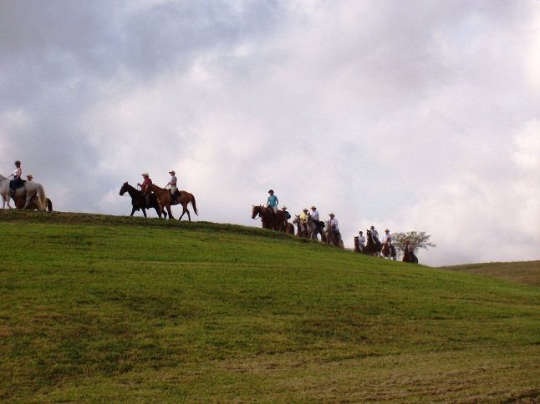

Vista View Park Today

Slide 25
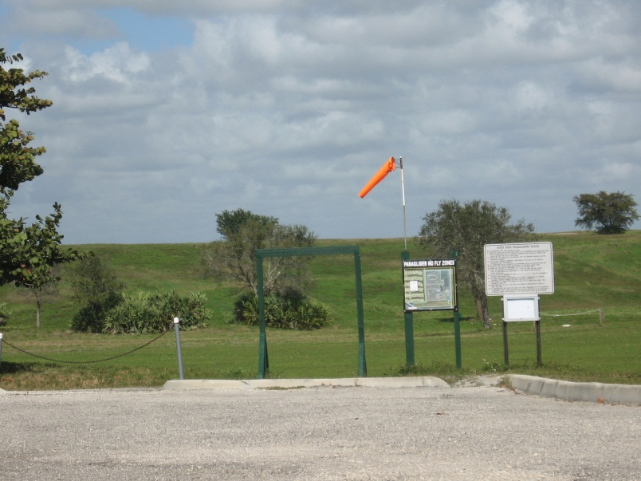
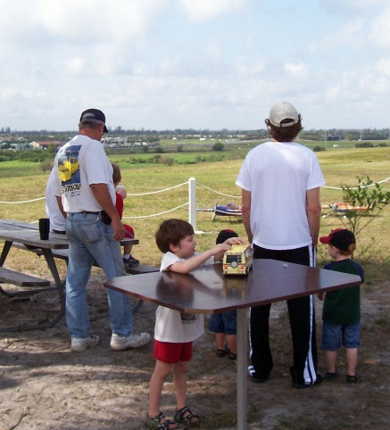
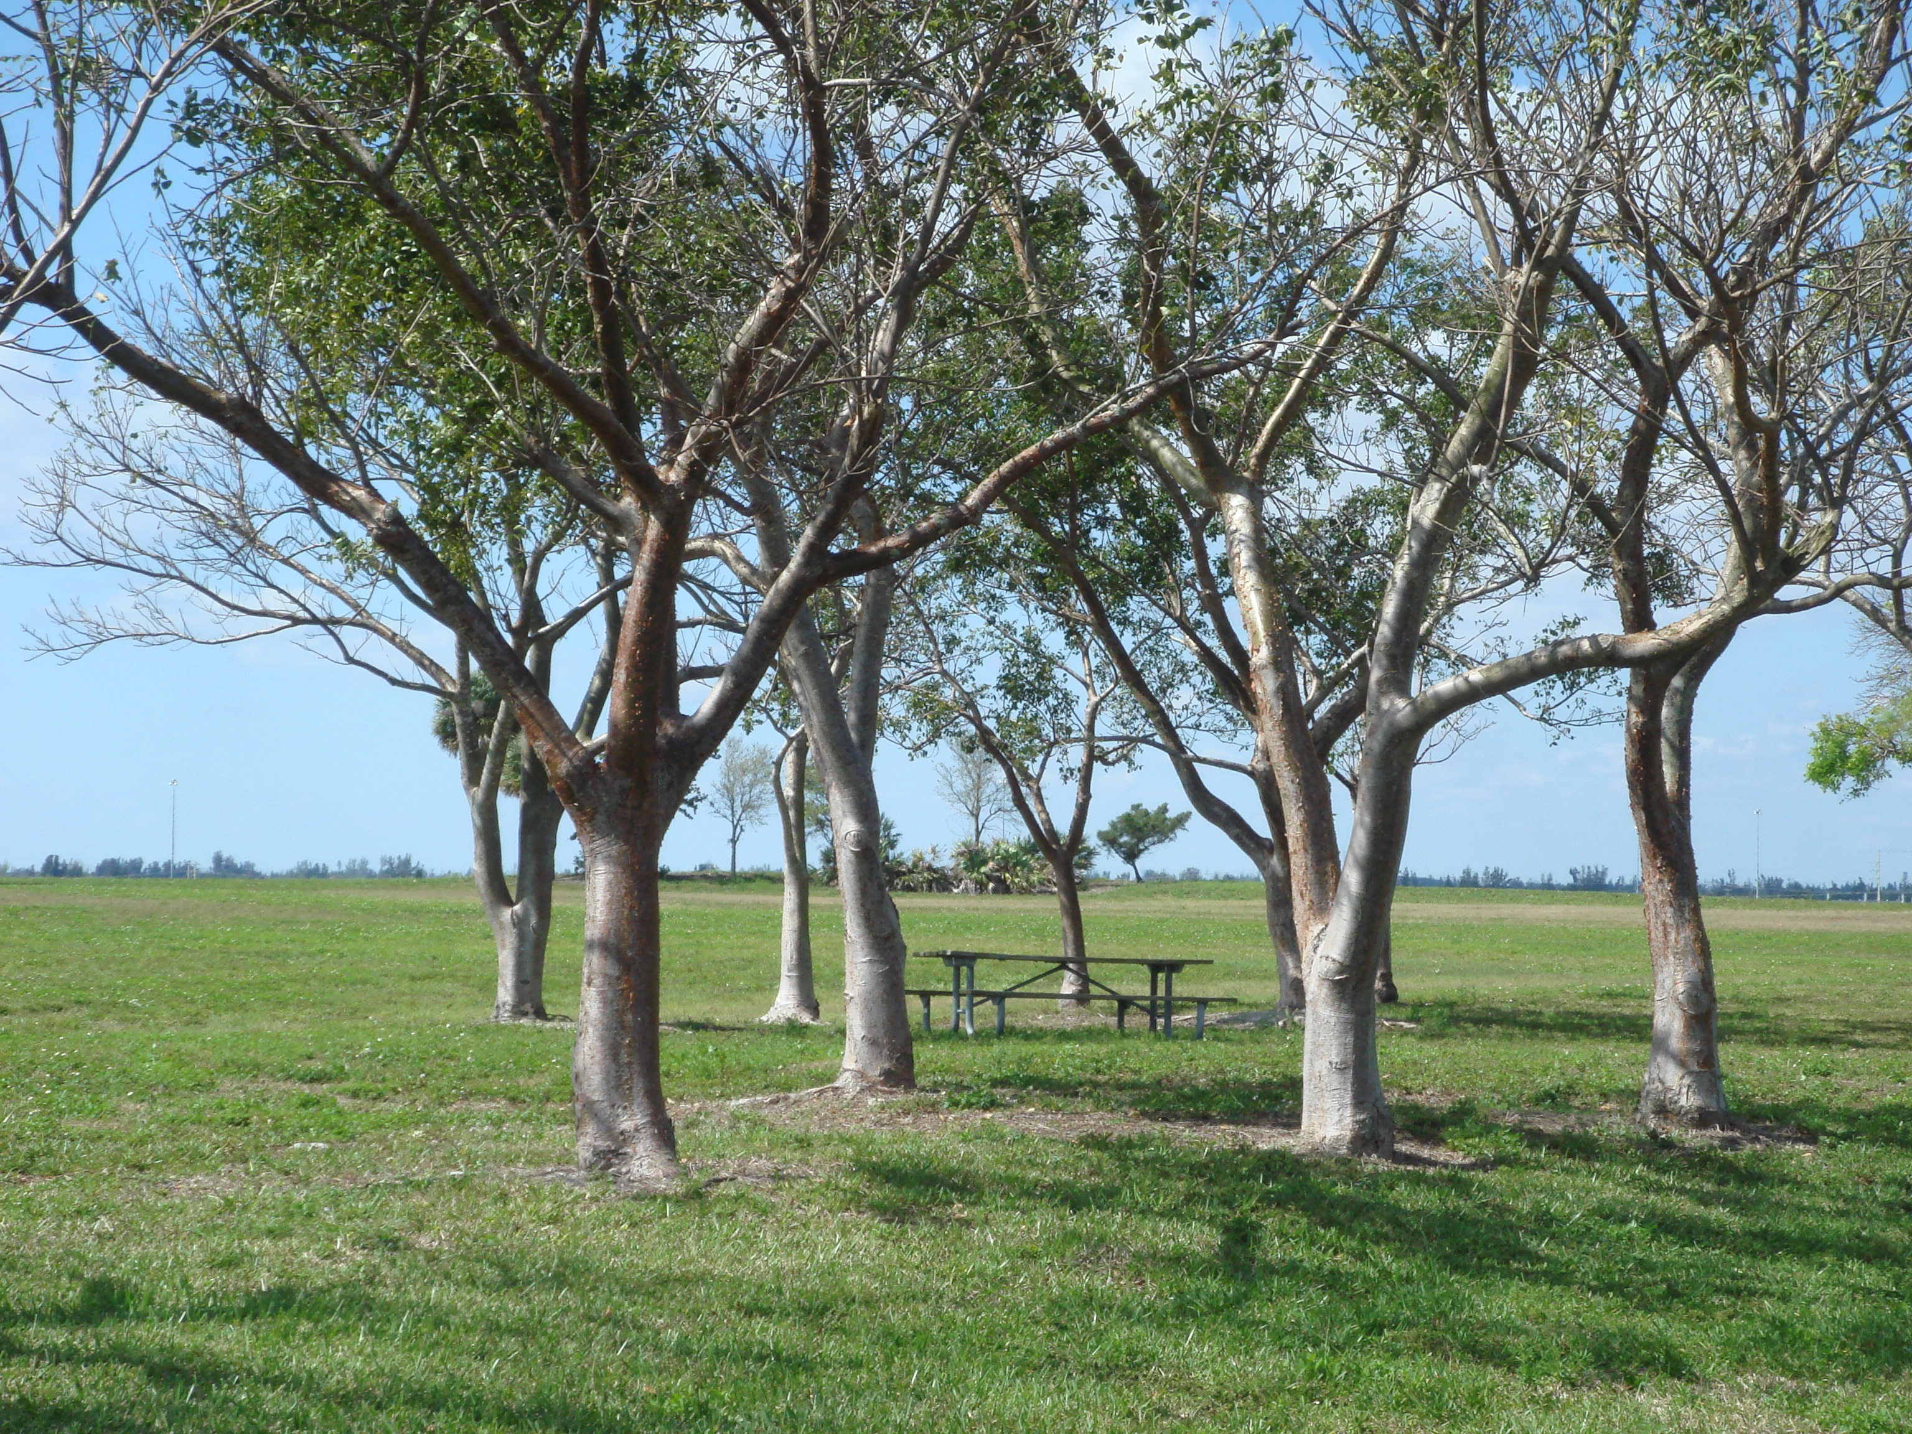
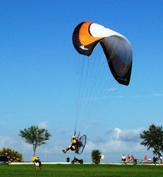
Vista View Park Today

Slide 26
Conclusion
Proactive thinking and action changed a negative stigma as a landfill facility to a beautiful regional park facility with continual increasing use.
Initial conversion of the site to park afforded opportunity to expand the park beyond original landfill site which created and opportunity to incorporate active components into the park use.
Brings great value to community.
Park features and use don’t compromise the landfill cap and the site continues to be protective of human health and the environment.

Slide 27
Contact Information
Richard Meyers
Program Manager,
Solid Waste and Recycling Services,
Broward County, Florida
rmeyers@broward.org
(954) 474-1848

