Slide 1
Frank Avvisato, EPA Superfund
Redevelopment Initiative
Reuse Planning and
Regional Seeds

Slide 2
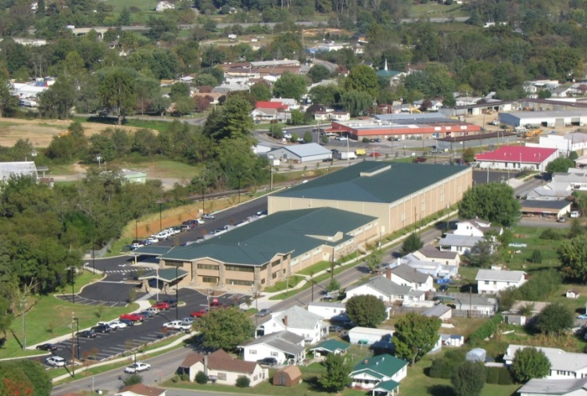
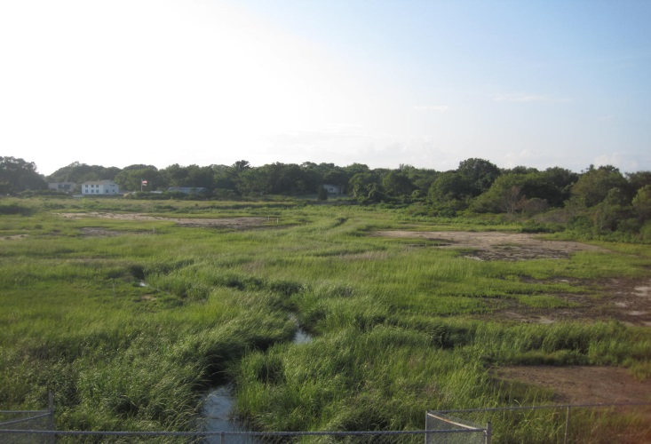
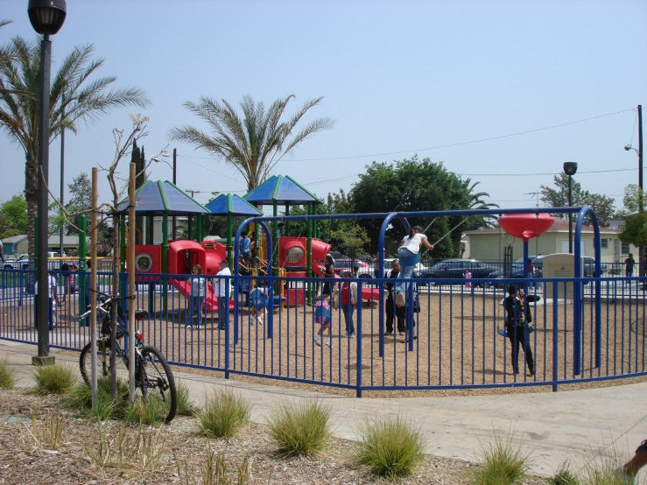
Benefits of Reuse
Economic
Environmental
Social

Slide 3
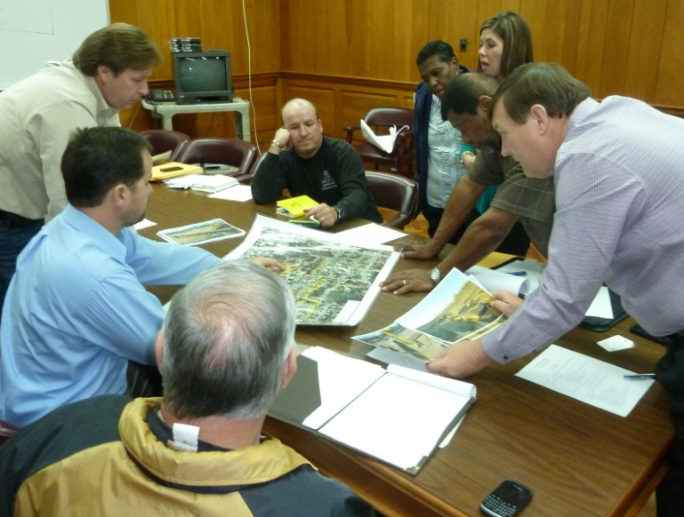
From Pilots to Regional Seeds
Avtex Fibers, one of SRI’s 10 initial Pilot Projects
Picayune Wood Treating, an SRI Regional Seed project

Slide 4
Regional Seeds
Bring the right stakeholders together
Provide site information
Clarify remedy and remedy components
Identify constraints and barriers
Outline goals and needs
Develop next steps

Slide 5
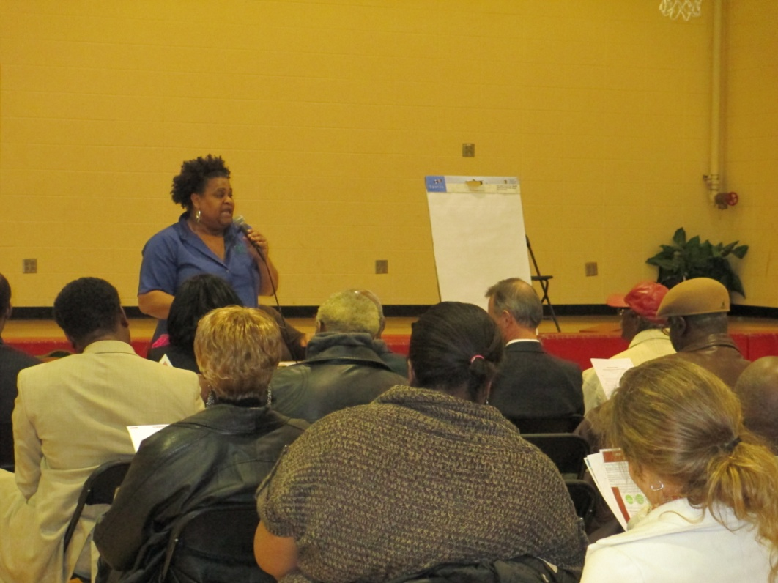
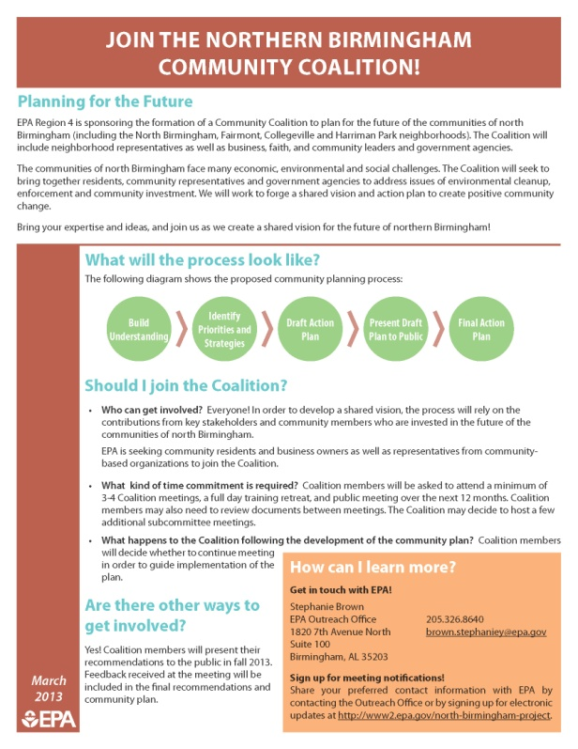
Benefits of Reuse Planning
Reuse planning can
Improve communication
Identify common goals
Establish partnerships
Clarify the site’s status and reuse potential
Ensure remedy protectiveness
Inform remedy selection
Reduce costs
Enhance long-term stewardship

Slide 6
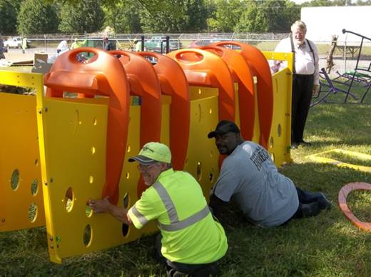
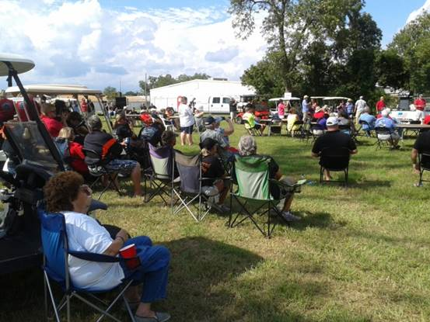
Community Benefits
Increased involvement
Support for existing community needs
Minimized impacts to local economy
New economic, recreational, public and industrial opportunities

Slide 7
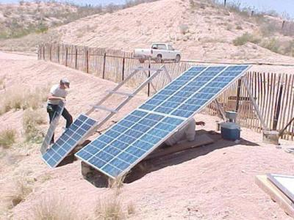
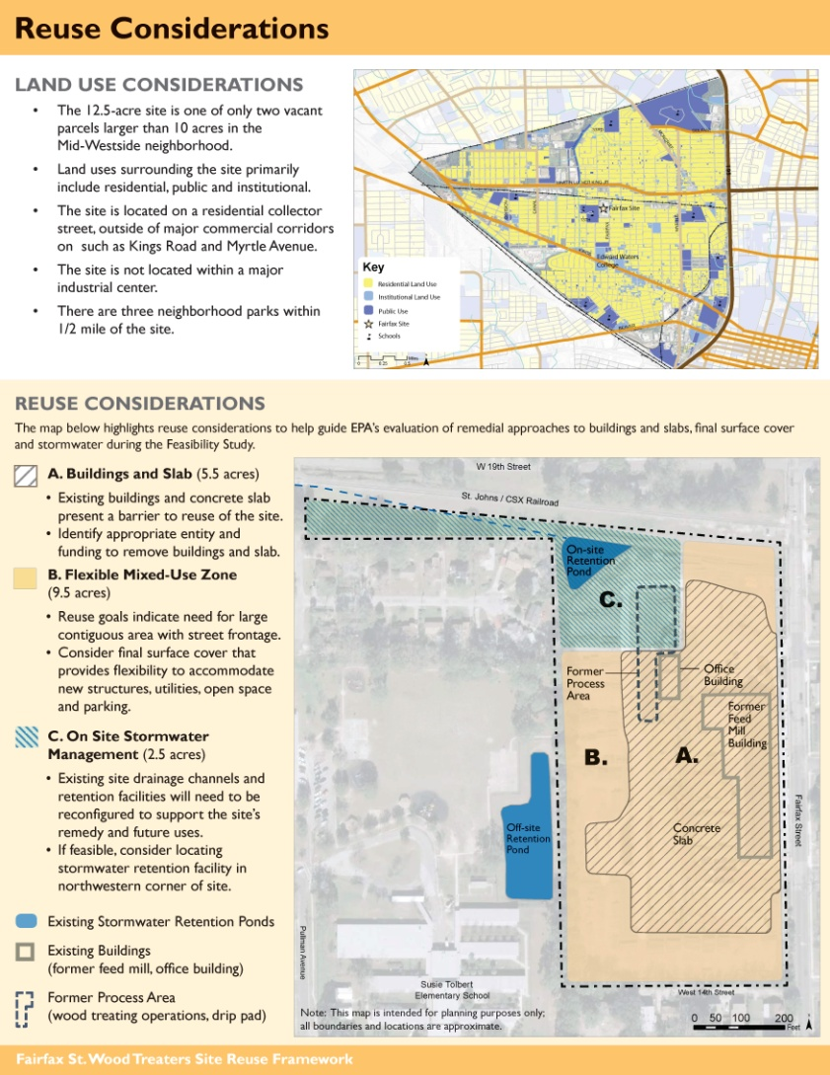
Reuse Planning Services
Situation Assessment
Reuse Assessment
Reuse Plan
Alternative Energy
Green Remediation
Area-wide Planning
Ready for Reuse Determinations

Slide 8
Case Studies
Bandera Road Ground Water Plume
  San Antonio, Texas
  Economic revitalization and green infrastructure
Waste, Inc.
  Michigan City, Indiana
  Community need for recreational space
East Helena
  East Helena, Montana
  Mining site and cultural heritage
Buckbee-Mears Co.
  Cortland, New York
  Factory closing and job loss

