Slide 1
Alisa Hefner, Skeo Solutions
Bandera Road
Leon Valley, Texas

Slide 2
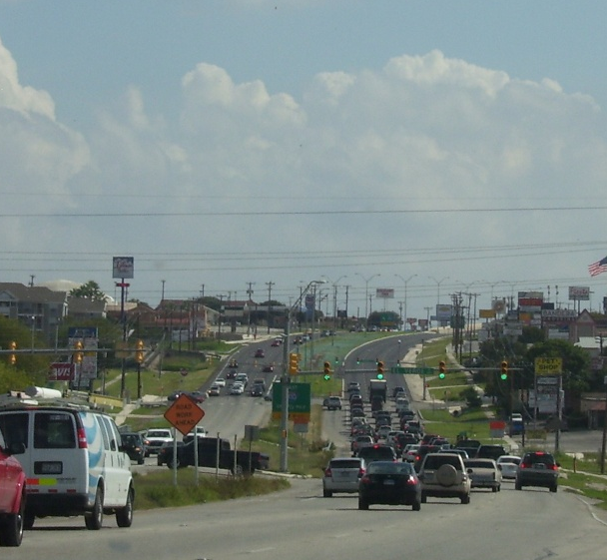
Context
Bandera Road is the central corridor of the City of Leon Valley and a major travel route between downtown San Antonio and surrounding centers.
This corridor would have development potential, if not for the mile long ground water plume containing TCE and PCE currently flowing underneath Bandera Road.

Slide 3
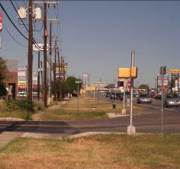
Situation
The City of Leon Valley was concerned that stigma related to the groundwater plume would deter community development.
The city was interested in promoting sustainability as a platform for economic development.

Slide 4
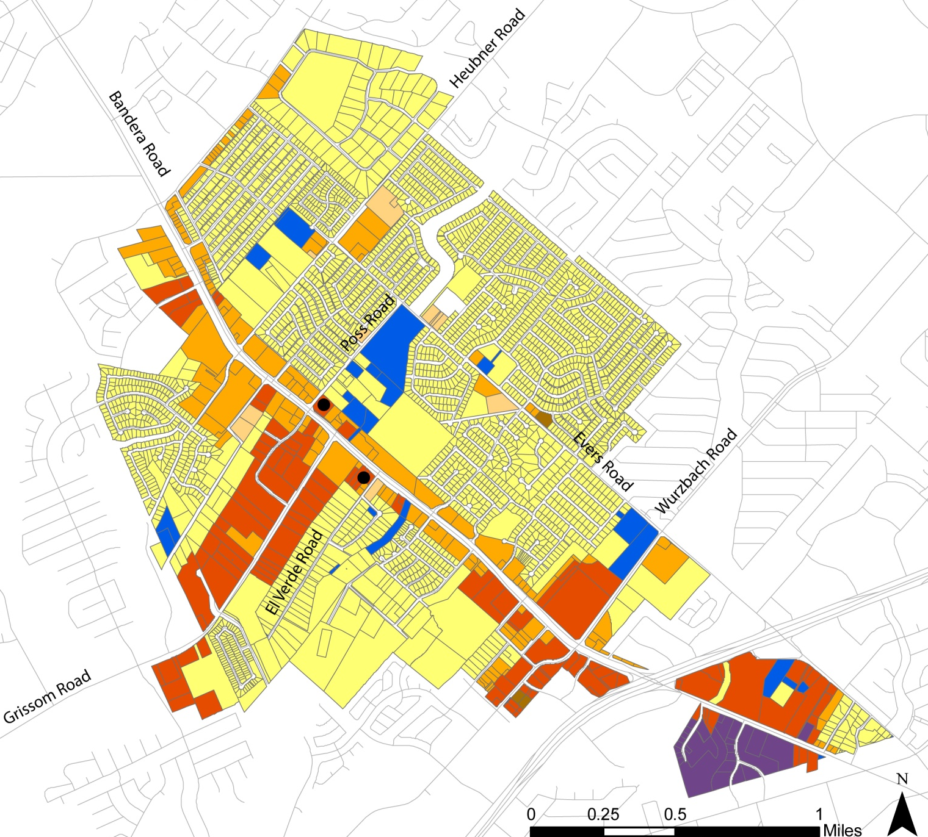
Community Reuse Goals
Identify interim sustainable revitalization strategies for the city given the long-term cleanup and possible negative publicity related to the Superfund site.

Slide 5
Process
SRI assistance leveraged existing planning efforts to develop a green infrastructure plan, including a greenway, green streets and connection to the regional trail system
Green Infrastructure Benefits
Property values increase
Green space near work places increase productivity and attract business
Reduce energy costs and provide means of natural stormwater management
Shoppers stay longer and hopefully spend more

Slide 6
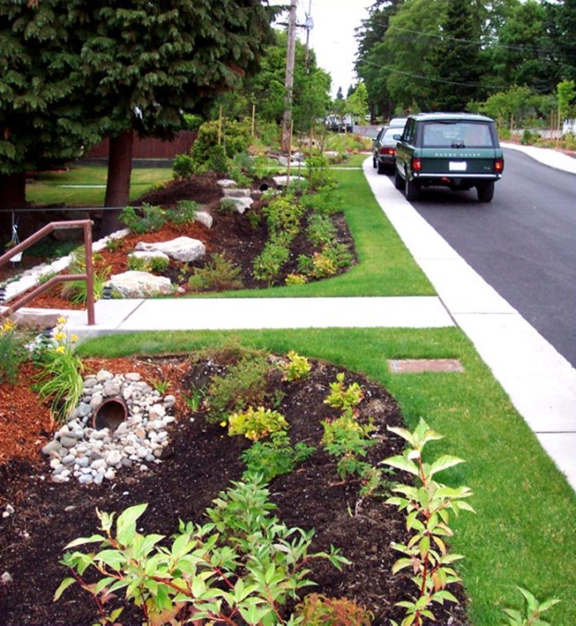
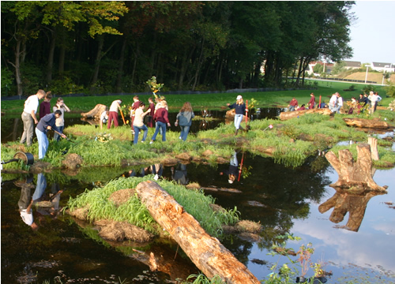
The Green Infrastructure Plan includes three strategies:
  A Creek Greenway
  A Green Streets Network
  Linking to the Regional Greenway
Source: http://www.djc.com/news/en/12001713
Source: http://www.dnrec.delaware.gov/GI/Pages/WhyNeedGI.aspx

Slide 7
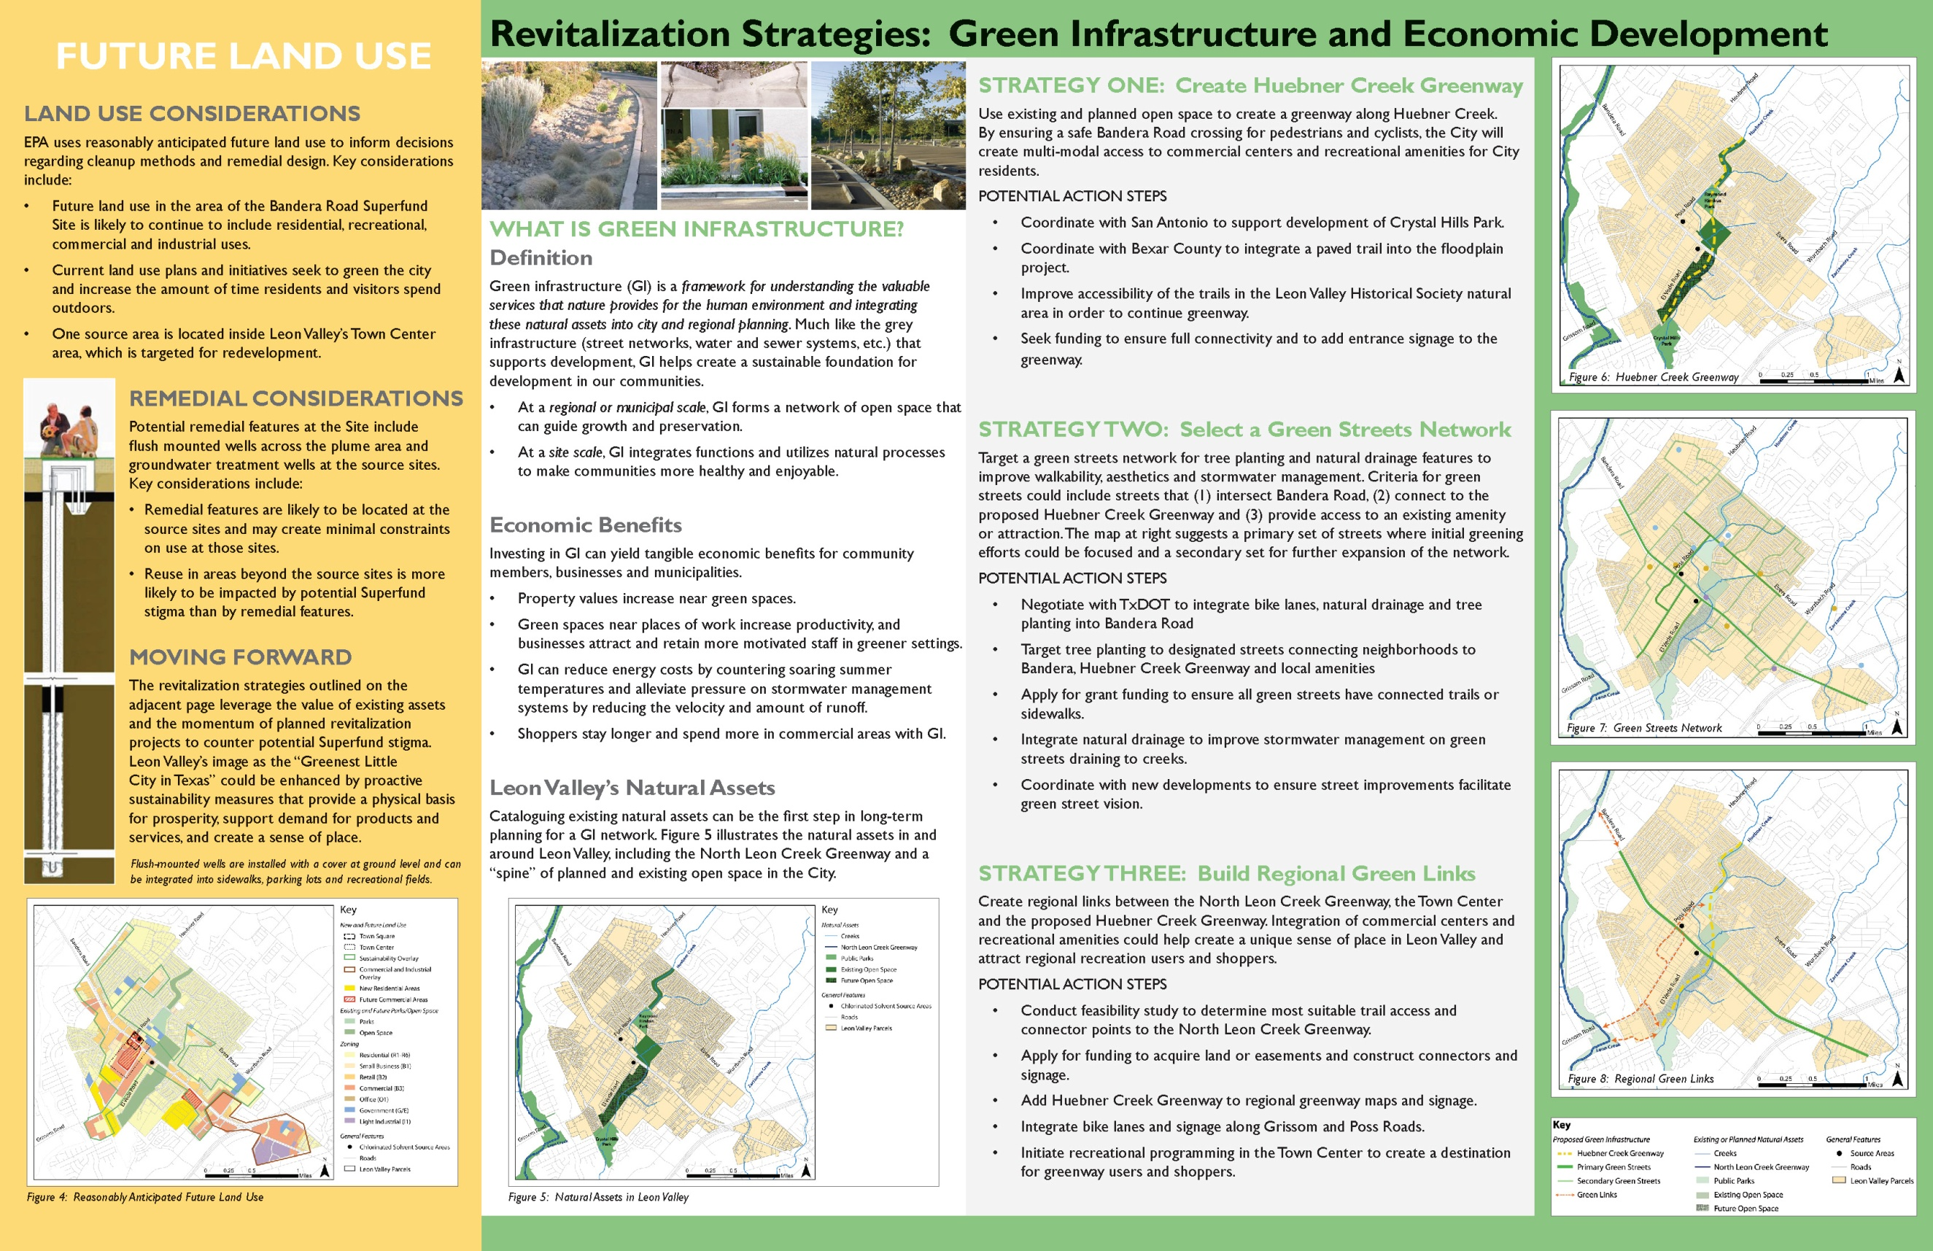
Strategy 1: Creek Greenway
Coordinate with County flood work and development projects to integrate trails
Improve accessibility of natural area owned by the Leon Valley Historical Society for access to greenway
Seek funding and add signage

Slide 8
Strategy 2: Green Streets Network
Target tree planting to designated streets connecting neighborhoods to greenway
Seek funding for trails and sidewalks
Integrate natural drainage for stormwater management
Coordinate street improvements with new developments

Slide 9
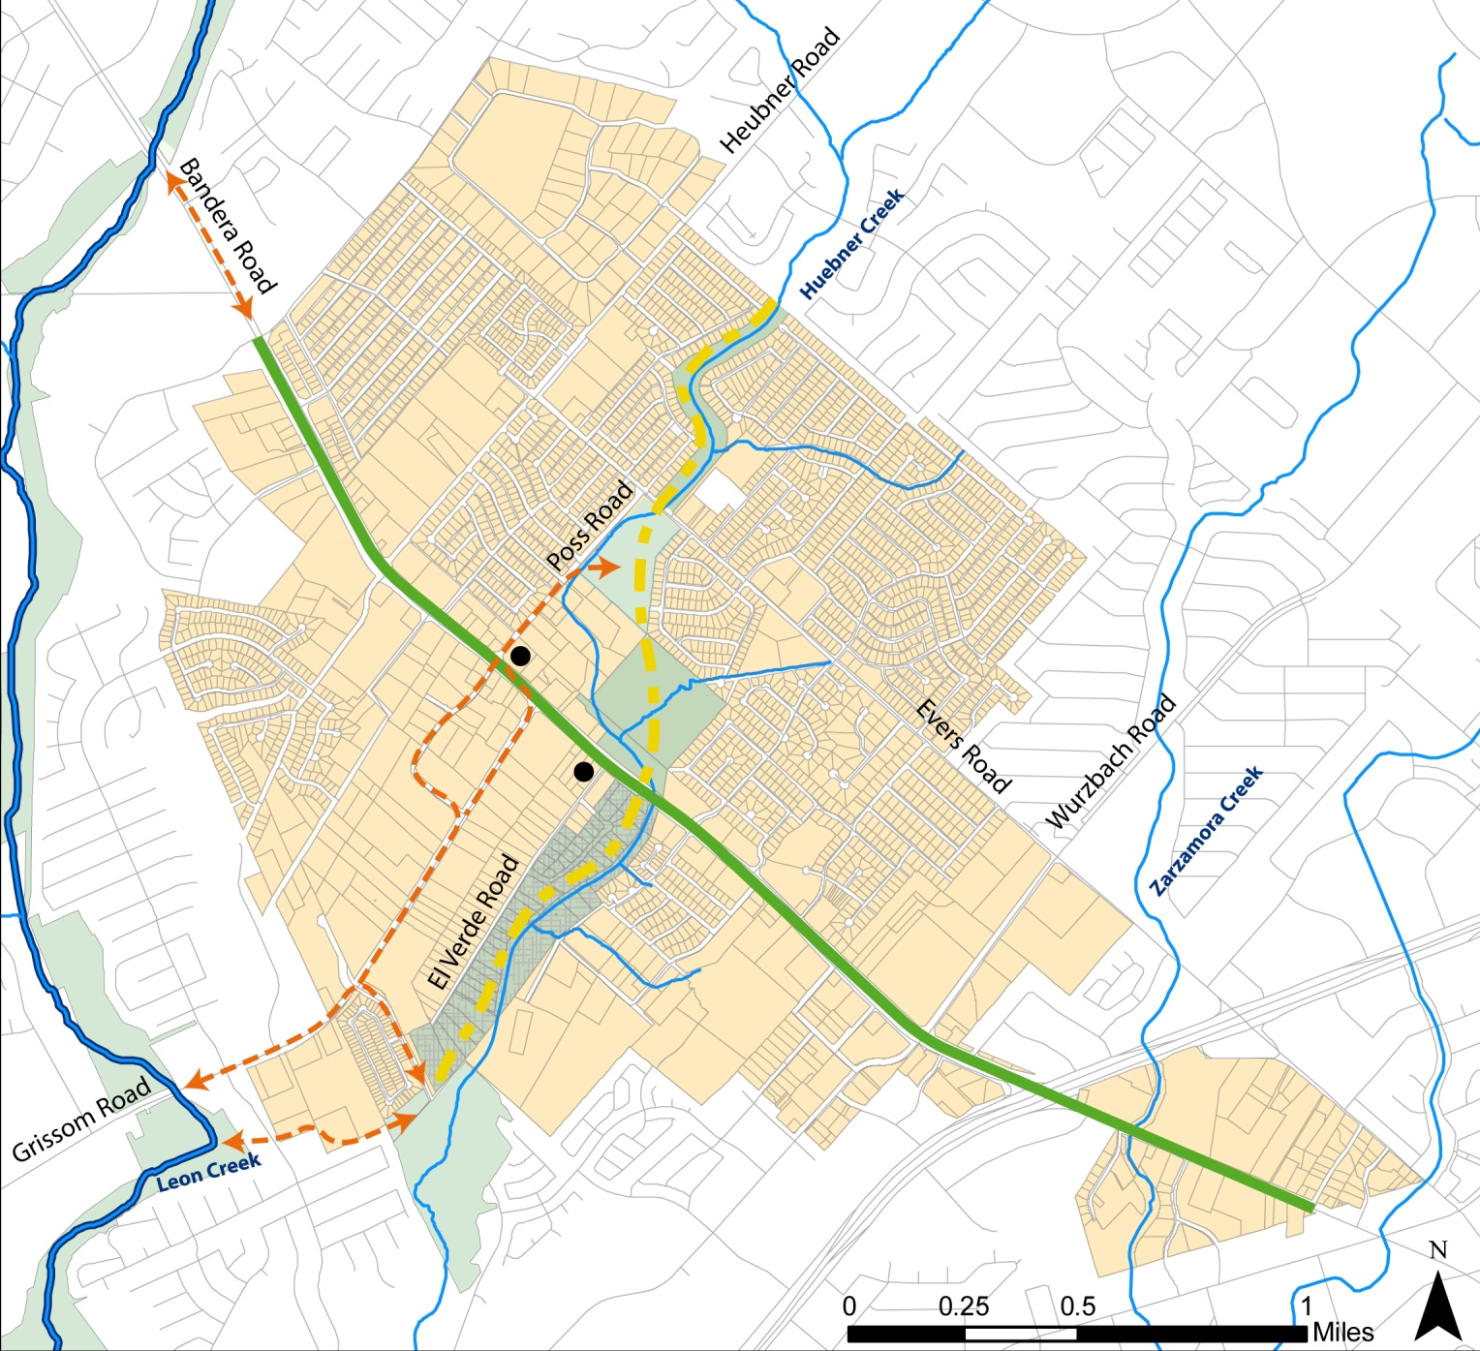
Strategy 3: Regional Green Links
Conduct a feasibility study to determine most suitable trail access to North Leon Creek Greenway
Apply for funding for land acquisition or easements and construct connectors and signage
Add Huebner Creek Greenway to regional greenway maps

Slide 10
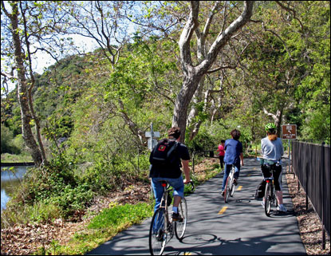
Implementation
Secured a mixed-use development agreement for a former abandoned auto site
Secured funding to implement gateway signage
Remedial action funded in part due to having a future use plan in place.
Bob Jones Trail, San Luis Obispo, CA
Source: Los Angeles Times

Slide 11
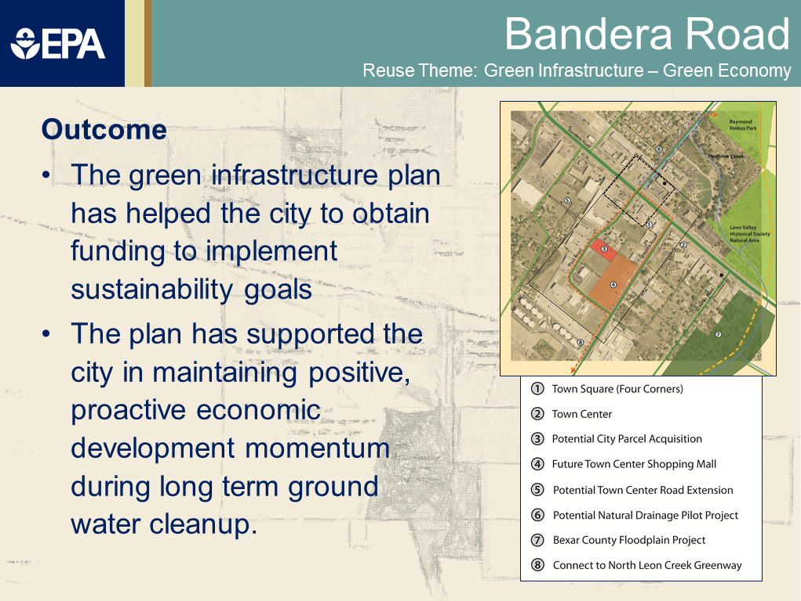
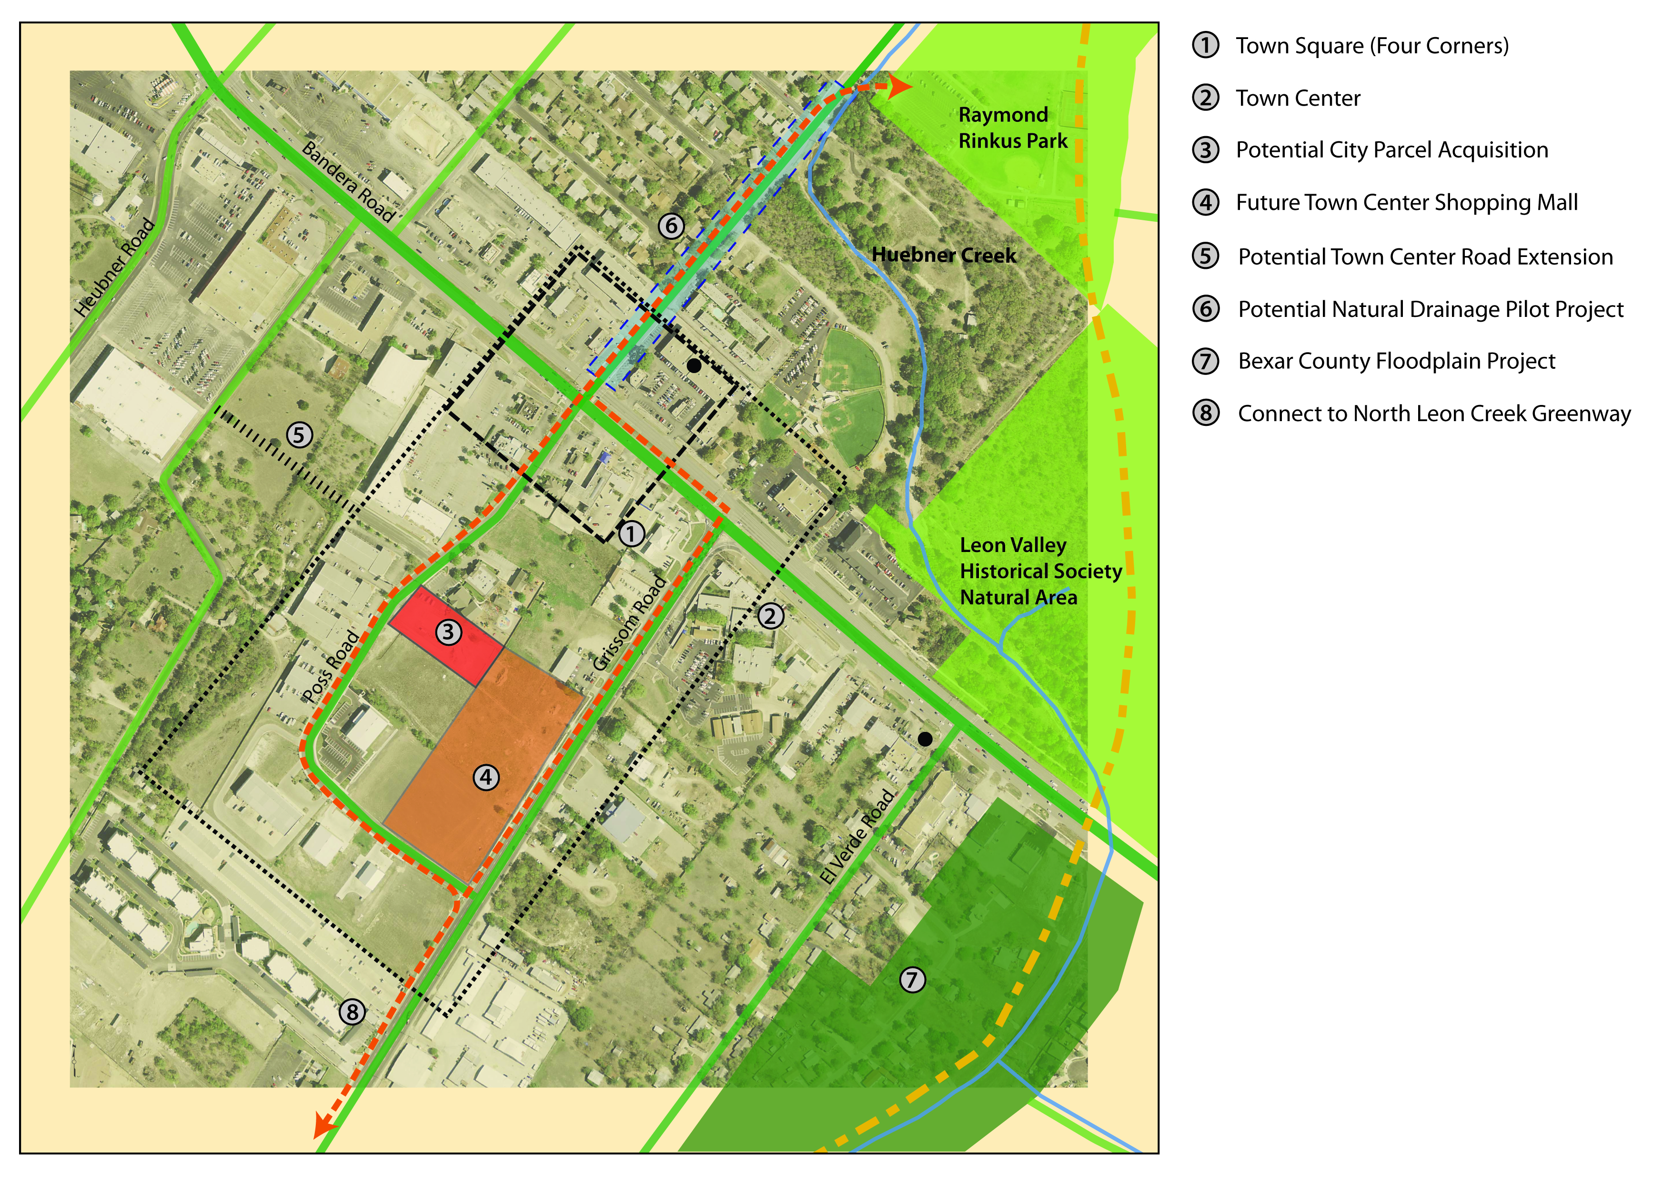
Outcome
The green infrastructure plan has helped the city to obtain funding to implement sustainability goals
The plan has supported the city in maintaining positive, proactive economic development momentum during long term ground water cleanup.

