Slide 1
Buckbee-Mears Co. Cortland, New York
Matt Robbie, Skeo Solutions

Slide 2
Buckbee-Mears Co. Reuse Theme: Site Repositioning
Context
Abandoned electronics plant required removal action
$25 million owed for cleanup, mortgage default and back taxes
Inter-agency effort to clarify reuse options, resolve liens, and re-position property for redevelopment

Slide 3
Buckbee-Mears Co. Reuse Theme: Site Repositioning

Slide 4
Buckbee-Mears Co. Reuse Theme: Site Repositioning
Process identified
Strategic redevelopment assets
Suitability for commercial/industrial reuse
Steps to position the property for sale at auction and redevelopment.

Slide 5
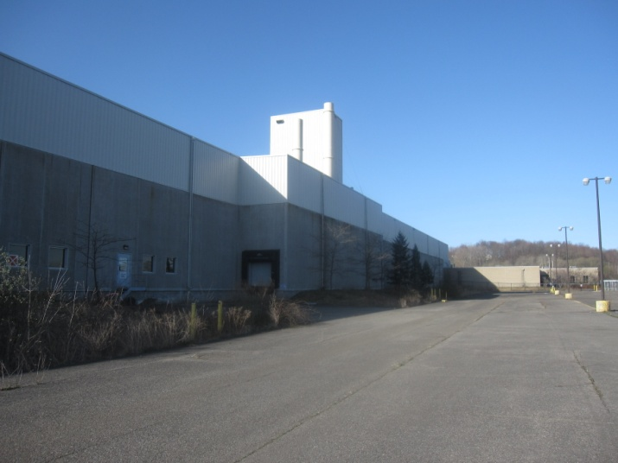
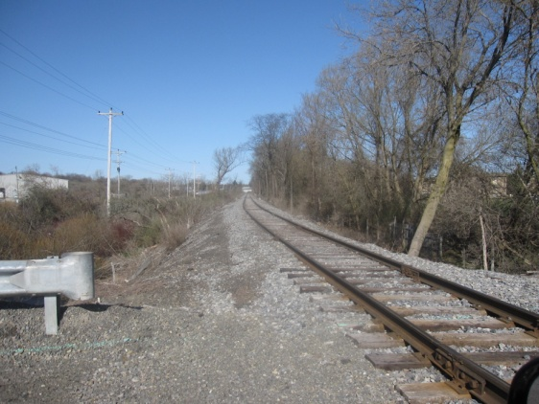
Buckbee-Mears Co. Reuse Theme: Site Repositioning
Assets
50-acre parcel zoned for industrial use
Potential Foreign Trade Zone designation
Access to I-81, the New York, Susquehanna and Western Railway
Structures
Supporting infrastructure

Slide 6
Buckbee-Mears Co. Reuse Theme: Site Repositioning
Suitability Analysis
Clarifies removal actions, residual contamination and use restrictions
Offers redevelopment considerations for structures and developable areas
Identifies potential barriers to reuse

Slide 7
Buckbee-Mears Co. Reuse Theme: Site Repositioning
Strategies to prepare for reuse
Barriers | Recommendations
Ownership | Administrative settlements and anticipated sale at auction to result in ownership transfer.
Liens | Administrative settlement to result in clear title to both parcels.
Contaminated slabs/subsurface soils | Concrete slab disturbance may result in exposure to residual chromium in concrete and sub-slab soils; any concrete demolition debris would have to be sampled and properly disposed of at a Solid or Hazardous Waste Landfill, depending on sampling results.
Building 5 mold contamination, size and configuration | Obtain cost estimate for partitioning Building 5 into 20,000-60,000 sq. ft. sections and removing mold from interior surfaces as per new configuration.
Inactive infrastructure | Obtain cost estimate and identify funding to repair rail spur, waste water treatment plant and re-energize electrical connection.
Potential re-zoning | Initiate discussions with Town of Cortlandville regarding potential for re-zoning 24-acre parcel for industrial use; clarify flood plain development approvals needed from the Town and NYSDEC.
Use Restrictions | Consider placing deed notices on the parcels to clarify slab removal/excavation considerations, existing local ground water use and withdrawal limitations and site zoning.
Liability | The 2002 Brownfield Amendments to CERCLA or Superfund provided important protections from liability to landowners who meet certain statutory criteria. See slides 38 and 39.
Ownership transfer
Remedial considerations
Adaptive reuse options
Liability protections

Slide 8
Buckbee-Mears Co. Reuse Theme: Site Repositioning
Repositioning Site Assets
Adaptive reuse to support multi-tenant manufacturing space
Available land suitable for structural development on slabs or natural ground

Slide 9
Buckbee-Mears Co. Reuse Theme: Site Repositioning
Outcomes
Attracted prospective purchaser with strong track record in adaptive reuse
Prospective purchaser inquiry process is underway
Targeting purchase during foreclosure auction anticipated in October 2013

