Slide 1
Waste Inc. Landfill Michigan City, Indiana
Matt Robbie, Skeo Solutions

Slide 2
Waste Inc. Landfill / Trail Creek Reuse Theme: Assessing Compatibility between Remedy and Proposed Reuse
Context
Michigan City, Indiana is developing the Trail Creek Greenway Corridor.
Waste Inc. Landfill site identified as a potential regional multi-use recreation destination.

Slide 3
Waste Inc. Landfill / Trail Creek Reuse Theme: Assessing Compatibility between Remedy and Proposed Reuse
Reuse Concept
Concept plan envisions year-round adventure park combined with creek access.
Region 5 SRI supported city in evaluating compatibility between reuse concept and landfill remedy.

Slide 4
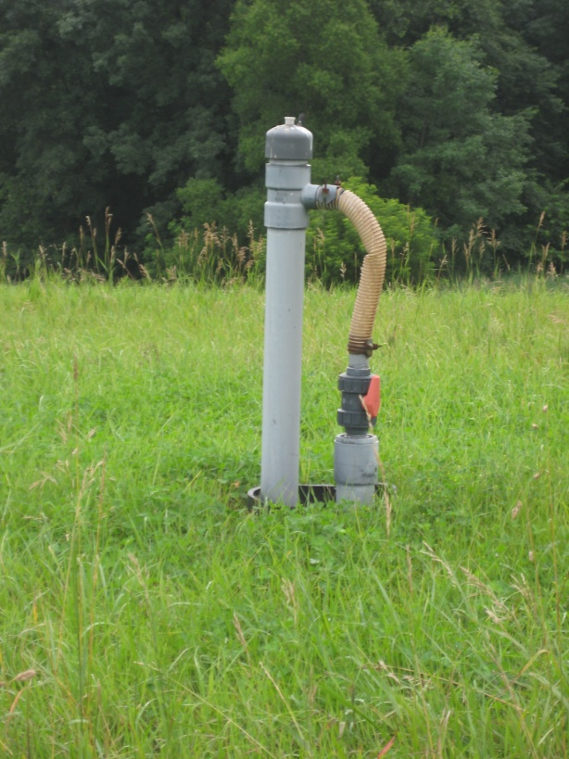
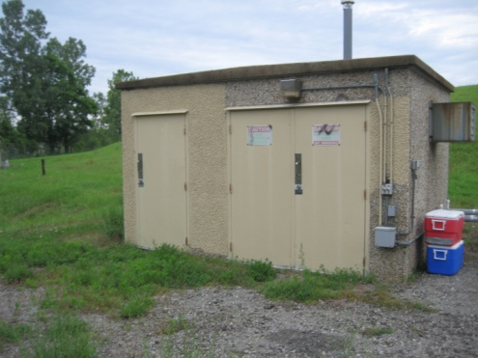
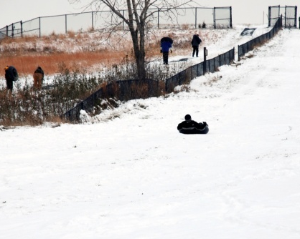
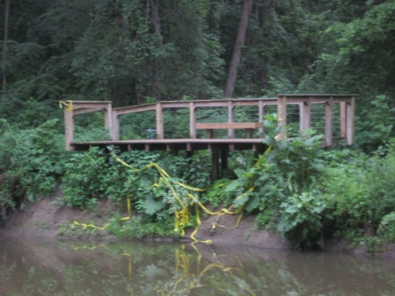
Waste Inc. Landfill / Trail Creek Reuse Theme: Assessing Compatibility between Remedy and Proposed Reuse
Suitability Analysis Evaluates
Physical features
Remedial features
Proposed recreational activities

Slide 5
Waste Inc. Landfill / Trail Creek Reuse Theme: Assessing Compatibility between Remedy and Proposed Reuse
Landfill Property
32-acre public open space bordering Trail Creek.
Proximity to high-value conservation lands.

Slide 6
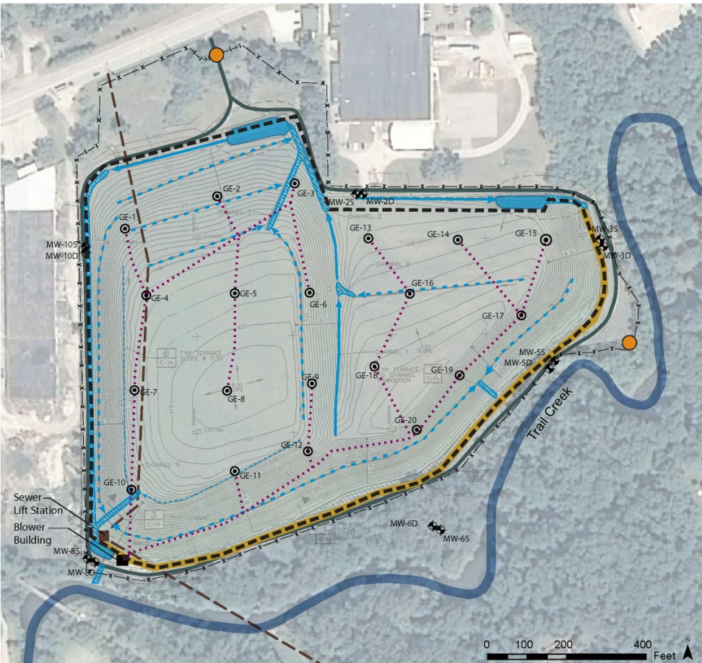
Waste Inc. Landfill / Trail Creek Reuse Theme: Assessing Compatibility between Remedy and Proposed Reuse
Physical Features
Remedy Components

Slide 7
Waste Inc. Landfill / Trail Creek Reuse Theme: Assessing Compatibility between Remedy and Proposed Reuse
Reuse Suitability Zones
Flat areas within capped area
Steep slopes within capped area
Areas suitable for structural development
Riparian areas

Slide 8
Waste Inc. Landfill / Trail Creek Reuse Theme: Assessing Compatibility between Remedy and Proposed Reuse

Slide 9
Waste Inc. Landfill / Trail Creek Reuse Theme: Assessing Compatibility between Remedy and Proposed Reuse
Lessons Learned
Tool to refine and groundtruth concept plan
Flexible reuse zones help refine recreation program
Compatibility analysis informs due diligence

