Slide 1



Welcome to the CLU-IN Internet Seminar
Superfund Research Program P42 RFA Briefing
(RFA ES 18-002)
Sponsored by:
National Institute of Environmental Health Sciences,
Superfund Research Program
Presenters:
William Suk, Director, Superfund Research Program (SRP), NIEHS (suk@niehs.nih.gov)
Danielle Carlin, Program Administrator, SRP NIEHS (danielle.carlin@nih.gov)
Michelle Heacock, Program Administrator, SRP NIEHS (HeacockM@niehs.nih.gov)
Heather Henry, Program Administrator, SRP NIEHS (henryh@niehs.nih.gov)
Brittany Trottier, Health Specialist, SRP NIEHS (Brittany.trottier@nih.gov)
Janice Allen, Scientific Review Officer, NIEHS (allen9@niehs.nih.gov)
Lisa Archer-Edwards, Grants Management Specialist, NIEHS (archer3@niehs.nih.gov)
Webinar Logistics:
Sara Amolegbe, MDB Inc., (samolegbe@michaeldbaker.com)
July 23, 2018 1:00 – 2:30 p.m. EST
Link to RFA: https://grants.nih.gov/grants/guide/rfa-files/RFA-ES-18-002.html
Link to RFA Information Page:
https://www.niehs.nih.gov/research/supported/centers/srp/funding/rfa/index.cfm

Slide 2
Funding Opportunity Webinar –
P42 Center RFA ES-18-002
Agenda
Welcome and Overview of P42 funding mechanism: William Suk (SRP Director)
P42 RFA
  General Information: Heather Henry, Danielle Carlin and Michelle Heacock, and Brittany Trottier
  Review Criteria: Janice Allen (Scientific Review Officer)
  Budget: Lisa Archer-Edwards (Grants Management Officer)
Question / Answer

Slide 3
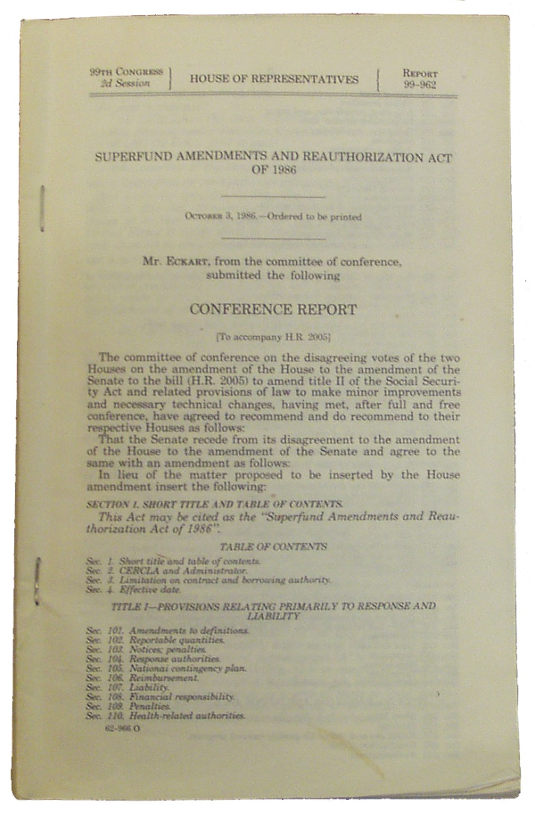
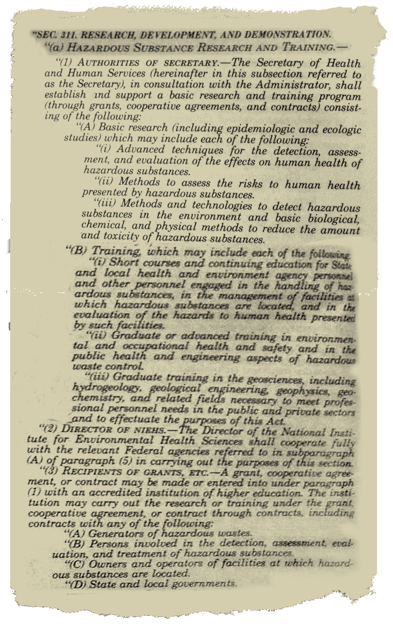
SRP Mandates under SARA
University-based basic research program established in 1986 under Superfund Amendments Reauthorization Act (SARA)
Development of:
    Advanced techniques for the detection, assessment, and evaluation of the human health effects of hazardous substances
    Methods to assess the risks to human health presented by hazardous substances
    Methods and technologies to detect hazardous substances in the environment
    Basic biological, chemical, and physical methods to reduce the amount and toxicity of hazardous substances
Health Effects
Assessing Risks
Detection
Remediation
SRP Mandates: https://www.niehs.nih.gov/research/supported/centers/srp/about/program/index.cfm

Slide 4

SRP Strategic Plan
Relevance
  Interaction with stakeholders
  Problem-based, solution-oriented research
  Critical research areas
Impact
Innovation
SRP Stakeholders
US Environmental Protection Agency (USEPA)
Agency for Toxic Substances and Disease Registry (ATSDR)
National Oceanic and Atmospheric Administration
U.S. Geological Survey
U.S. Department of Defense
U.S. Department of Energy
Other federal agencies, state, local, and tribal entities responsible for sites
Individuals and communities living near hazardous waste sites
SRP Strategic Plan: https://www.niehs.nih.gov/research/supported/centers/srp/about/register/index.cfm
SRP Website: https://www.niehs.nih.gov/research/supported/centers/srp/index.cfm

Slide 5
RFA-ES-18-002
Superfund Hazardous Substance Research and Training Program (P42)
P42 Multi-Project Centers
Provide sound science, data, information, and knowledge to inform the risk assessment and remediation management processes.
  Improve public health by supporting integrative, multi-disciplinary research.
Bring expertise of multiple biomedical and environmental science and engineering disciplines to address scientific uncertainties facing the National Superfund Program.
P42 RFA Website: https://www.niehs.nih.gov/research/supported/centers/srp/funding/rfa/index.cfm
RFA-ES-18-002: https://grants.nih.gov/grants/guide/rfa-files/RFA-ES-18-002.html
Suggested Research and Activities Document: https://www.niehs.nih.gov/research/supported/centers/srp/assets/docs/srp_funding_opps_suggested_research_and_activities_508.pdf
Tips for Applicants: https://www.niehs.nih.gov/research/supported/centers/srp/funding/rfa/rfa_tips/index.cfm
Additional Resources: https://www.niehs.nih.gov/research/supported/centers/srp/funding/rfa/rfa_resources/index.cfm

Slide 6
Key Dates
Open Date (Earliest Submission Date): November 19, 2018
Letter of Intent Due Date(s): November 19, 2018
Application Due Date(s): December 19, 2018, by 5:00 PM Eastern Time
Scientific Merit Review: May 2019
Advisory Council Review: October 2019
Earliest Start Date: December 1, 2019

Slide 7

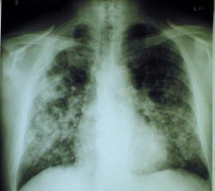

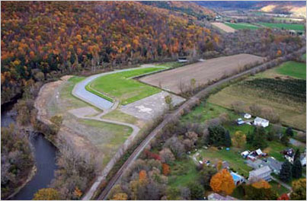



P42 Multi-Project Centers
Research and Training
Biomedical Science
Environmental Science and Engineering
Administrative (includes research translation)
Data Management and Analysis
Community
Engagement
Problem
Superfund Stakeholders
Stakeholder Communities
Solution

Slide 8
P42 Multi-Project Centers
Scope of the SRP Center Grant
SRP Mandates
Advanced techniques for the detection, assessment, and evaluation of the effect of hazardous substances on human health
Methods to assess the risks to human health presented by hazardous substances
Methods and technologies to detect hazardous substances in the environment
Basic biological, chemical, and physical methods to reduce the amount and toxicity of hazardous substances
SRP’s Strategic Plan
Relevance: to Superfund
Impact: to Stakeholders
Innovation: Trans-disciplinary/Paradigm-shifting
Not Required: Superfund Site
CERCLA Substances/Hazardous Substances: https://www.atsdr.cdc.gov/SPL/index.html;
https://www.niehs.nih.gov/research/supported/centers/srp/funding/rfa/rfa_resources/index.cfm
Programmatic Balance
See Current Grantees: http://tools.niehs.nih.gov/srp/programs/index267.cfm
Suggested Research Topics and Activities
High priority areas for SRP Stakeholders
https://www.niehs.nih.gov/research/supported/centers/srp/assets/docs/srp_funding_opps_suggested_research_and_activities_508.pdf
Broad Scope –
Ultimately should be a clear link to Superfund.

Slide 9
P42 Multi-Project Centers
All Components Interacting, Addressing Problem
Administrative Core (includes research translation)
Data Management and Analysis Core (DMAC)
Biomedical
(≥ 2 Projects)
Community Engagement Core (CEC)
Research Experience Training Coordination Core (RETCC)
Environmental Science and Engineering
(≥ 2 Projects)
Research Support Core(s)
optional
Total: 8 - 11 Components
  New, Renewal Proposals, and Resubmissions: up to $1.75M/year direct costs for 5 years

Slide 10
Cost Limitations (Direct)
    Cores Sum ≤ 20% Total Center
    Administrative
    Community Engagement
    Research Experience and Training Coordination
80%
Research Projects, Research Support Cores, DMAC
20%
AC, CEC, RETCC
Core Limitations (Direct):
Administrative - $150K
Community Engagement - $100K
Research Experience and Training Coordination- $100K
Data Management and Analysis – no set budget
Research Support Core (Optional) – no set budget
Center:
New and Renewal Applicants: up to $1.75M/year direct costs for 5 years

Slide 11
Overall Component
Administrative Core (includes research translation)
Data Management and Analysis Core (DMAC)
Biomedical
(≥ 2 Projects)
Community Engagement Core (CEC)
Overall
Research Experience Training Coordination Core (RETCC)
Environmental Science and Engineering
(≥ 2 Projects)
Research Support Core(s)
optional
Total: 8 - 11 Components
Recommended Subsections: Significance and Relevance to SRP Mandates and Superfund; Research Team; Innovation, Approach; Environment; and Center Integration

Slide 12
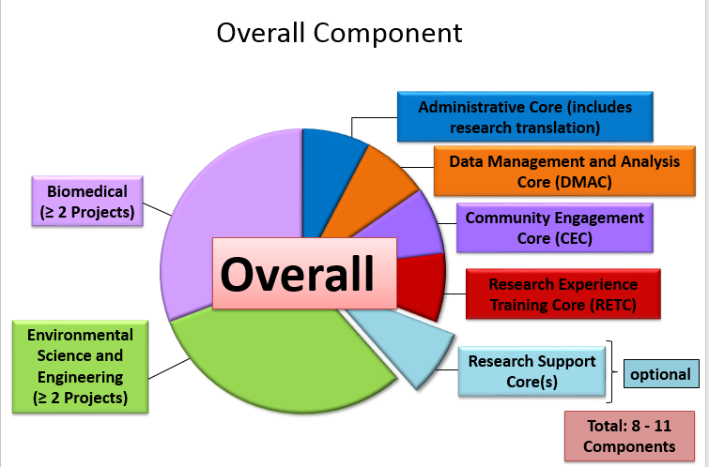
Overall Component
Other Attachments
  Center Organizational Structure
  Table of Research Support and Data Management and Analysis Core Utilization
  Table of Changes to Projects and Cores (renewal/resubmission applications)
  Table of Research Approaches
  Table of Integration with Center
Resource Sharing Plan
  Summary of Center Data Management and Analysis
NEW!
NEW!
Tips for Applicants: https://www.niehs.nih.gov/research/supported/centers/srp/funding/rfa/rfa_tips/index.cfm

Slide 13
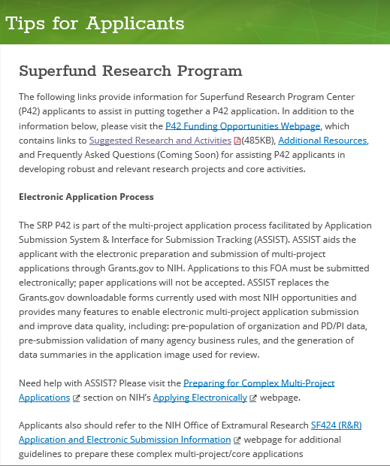
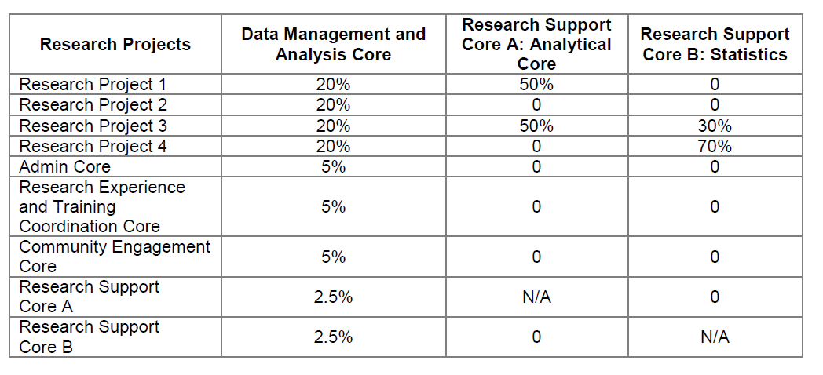
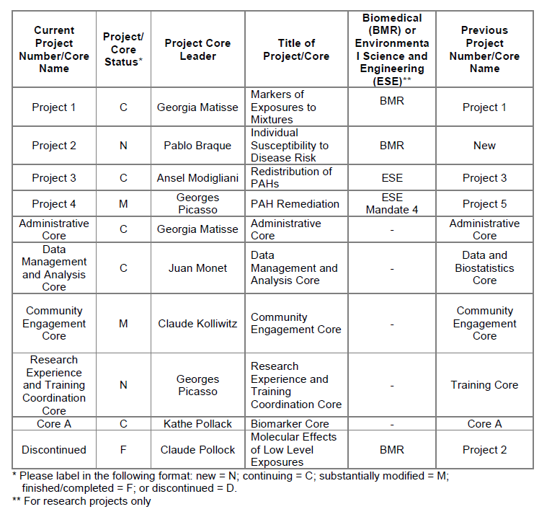
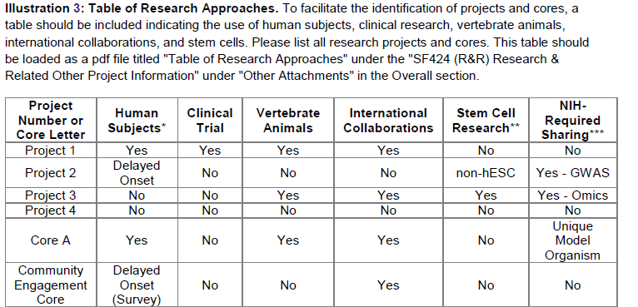
Table Examples for Overall Section
Table of RSC and DMAC Utilization
Table of Changes
Table of Research Approaches
Tips for Applicants: https://www.niehs.nih.gov/research/supported/centers/srp/funding/rfa/rfa_tips/index.cfm

Slide 14
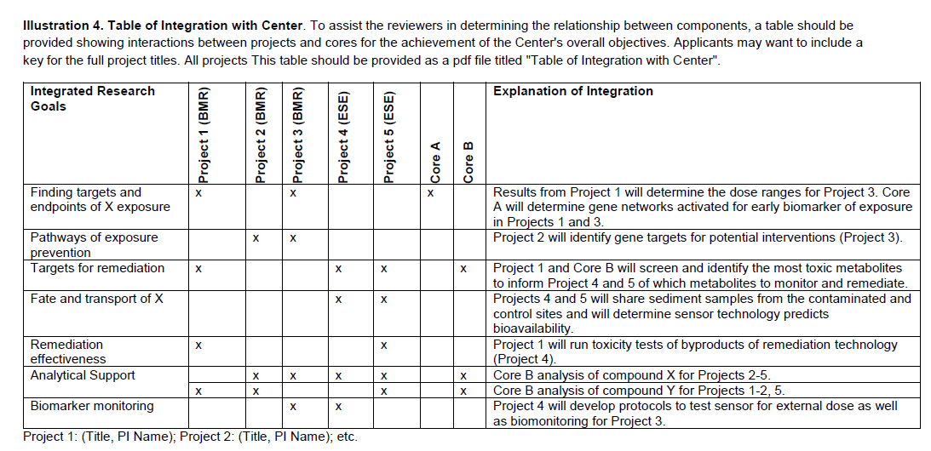
New: Table of Integration with Center
Table Examples for Overall Section
NEW!
Tips for Applicants: https://www.niehs.nih.gov/research/supported/centers/srp/funding/rfa/rfa_tips/index.cfm

Slide 15
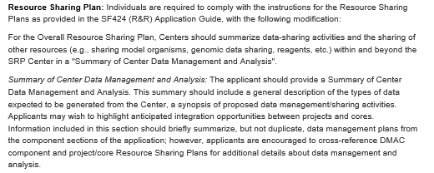
Overall Resource Sharing Plan
Current RFA: include a “Summary of Center Data Management and Analysis”
Resource Sharing Plan
  Summary of Center Data Management and Analysis
NEW!

Slide 16
P42 Projects
Mechanistic Toxicology
Health Effects
      Each project is reviewed as stand-alone
      Basic to application oriented
      Has an independent testable hypothesis or a logical progression of tasks
      Relation to SRP mandate(s)
      Relation to Overall Center
      Integration with other projects and Cores
      Resource Sharing Plan
        Sharing: data, specimens, technology
        Data Management Plan (1 paragraph) NEW!
        Investigator-initiated research translation (1 paragraph)
Epidemiology
Biomedical
(≥ 2 Projects)
Environmental Science
and Engineering
(≥ 2 Projects)
Hydrogeology
Fate and Transport
Remediation Engineering
Suggested Research and Activities: https://www.niehs.nih.gov/research/supported/centers/srp/assets/docs/srp_funding_opps_suggested_research_and_activities_508.pdf
Maximum of 6 projects

Slide 17
P42 Projects
NEW to ESE Projects!
Mechanistic Toxicology
      Applications should include at least one ESE project that supports SRP's fourth mandate "basic biological, chemical, and physical methods to reduce the amount and toxicity of hazardous substances”
      Review RFA section titled “Scope of the SRP Center Grant”
      Questions if a Project qualifies? Please contact SRP staff.
Health Effects
Epidemiology
Biomedical
(≥ 2 Projects)
Environmental Science
and Engineering
(≥ 2 Projects)
Hydrogeology
Fate and Transport
Remediation Engineering
Suggested Research and Activities: https://www.niehs.nih.gov/research/supported/centers/srp/assets/docs/srp_funding_opps_suggested_research_and_activities_508.pdf
Maximum of 6 projects

Slide 18
P42 Projects
Important Tips!
FOCUS!!!!
Centers should be VERY judicious in assembling research projects. Center should, with projects, keep a clear focus and not try to do too much!!
Include projects with most solid connection to the Center’s problem-solving theme.
Lean Times: Not too big! Consider coming in under budget and well under 11-component limit.
Interactions:
Cross-reference interactions between projects and cores. Should be consistent throughout.
Refer to "Table of Integration with Center“ (Overall Section)
Avoid Jargon!
P42 Reviewers have broad expertise
Write abstracts/titles for a general audience
Write Specific Aims for technical experts
Define Abbreviations
Use Plain Language: http://grants.nih.gov/grants/plain_language.htm

Slide 19
P42 Administrative Core (Required)
Consists (at minimum) of Center Director, Research Translation Coordinator, and Center Administrator
NEW to Admin Core!
Functions
Planning and coordination
Promote cross-discipline interaction among projects and cores
Oversee fiscal and quality management
Ensures research translation
Research Translation
1. Communication within SRP and to SRP staff
2. Partnerships with Government Agencies
3. Technology Transfer
4. Information Dissemination to Other End-Users
Administrative Core identifies Points of Contact (on behalf of the whole Center):
Data Collection Tool
NIH/NIEHS CareerTrac
SRP-hosted conference calls/webinars on research translation, community engagement, and data management
Suggested Research and Activities: https://www.niehs.nih.gov/research/supported/centers/srp/assets/docs/srp_funding_opps_suggested_research_and_activities_508.pdf
SRP Data Collection Tool: https://tools.niehs.nih.gov/srp/rtc/index.cfm
NIH CareerTrac database: https://careertrac.niehs.nih.gov/auth/login

Slide 20
P42 Administrative Core (Required)
External Advisory Committee (EAC)
Provides Guidance to Director
  Scientific Merit
  Relevance, sharing of data, integration
  Effectiveness of research translation, community engagement, training activities
  Discussion of projects that should be continued, modified, or discontinued
Anticipated EAC Members*
Academics (biomedical AND environmental science and engineering), Stakeholders, EPA/ATSDR, Industry, Community
*New Applicants: include expertise of potential EAC members, not names
Administrative Core not to exceed $150,000 Direct Costs; Center Director must commit a minimum of 1.8 person months

Slide 21
P42 Research Experience and Training Coordination Core (Required)
Graduate and Post-doctoral level cross-disciplinary training
NEW title BUT similar functions!
Activities: tailored curricula development, selected coursework, cross-disciplinary lab experiences, seminar series, journal clubs, workshops/conferences related to professional development, and travel to scientific meetings, etc.
Functions
Promote interactions between biomedical and environmental science and engineering trainees
Professional development
Promote involvement in Community Engagement and research translation, etc. (not mandatory but encouraged)
Promote interaction with Data Management and Analysis Core
Provide information about trainees and their activities to the SRP
For renewals, inquiring Reviewers want to know about past trainee successes (i.e., Trainee List)
NIH CareerTrac database: https://careertrac.niehs.nih.gov/auth/login
SPAN Leadership Committee: https://www.niehs.nih.gov/research/supported/centers/srp/training/spa/committee/index.cfm
Not to exceed $100,000 Direct Costs

Slide 22
P42 Research Support Core (Optional)
Provides centralized services
Shared by at least 2 projects
How Core is a resource to the Center as a whole.
How the Core's centralized services will produce an economy of effort and/or savings in overall costs compared to their inclusion as part of each project in the Center.
Research Support Cores that provide analytical and quantitative services to the applicant's Center should include a Quality Assurance Section (https://www.epa.gov/quality)
Laboratory facilities, analytical chemistry, '-omics' support, or analytical equipment and services; does not typically include research
Pros and Cons of RSC
  Pros:
    Excellent Interactions/Integration
    Opportunities for Training
    Assurance of Quality
  Cons:
    May not be critical (if facilities already available)
    11 component limit
Reference "Table of Research Support and Data Management and Analysis Core Utilization," described in the Overall component
RSCs do not have a set budget.

Slide 23
P42 Community Engagement Core (Required)
Functions:
Ensure bidirectional communication between the CEC and the community
Direct best practices and activities in community engagement for prevention and/or intervention
Provide potential solutions to communities to reduce or mitigate the impact of hazardous substance exposure (SRP Mandate #4)
Include:
Description of the proposed intervention and prevention activities with communities
Description of how CEC fits into Center theme
Timeline with milestones
Plan to measure and verify outcomes (e.g., a logic model)
Approach/methodology for surveys and/or sample collection
Process to guarantee effective bi-directional exchange of needs, recommendations, and results
Target communities
SRP defines target communities as those impacted by hazardous substances
Examples: local government groups, Tribal councils/communities, community service groups, non-governmental organizations working closely with a community, economically disadvantaged, and environmental justice communities
Provide Point of Contact
SRP-hosted conference calls/webinars on community engagement
Core not to exceed $100,000 Direct Costs
Suggested Research and Activities: https://www.niehs.nih.gov/research/supported/centers/srp/assets/docs/srp_funding_opps_suggested_research_and_activities_508.pdf

Slide 24
P42 Data Management and Analysis Core (Required)
NEW CORE!
Purposes
Support the management and integration of data assets across the Center, irrespective of dataset size
Establish, coordinate, and monitor processes for data analysis
Work with project/core leaders to ensure high data quality through lifecycle of data
Identify opportunities for integrating project/core-generated data with other existing datasets
Foster and enable interoperability of data between BMR and ESE projects to accelerate impact of Center's research
May also include additional functionalities of biostatistics, bioinformatics, geographical information systems, and computational modeling, etc.
Note: Not required to create a repository for the Center’s data
Comprehensive data management plan
coordination with projects and cores
fostering data sharing and interoperability
data quality assurance and quality control.
Provides Points of Contact (in Relation to Overall Center)
Data Collection Tool
SRP-hosted conference calls/webinars data management and analysis
DMAC does not have set budget
Data sharing policies: https://grants.nih.gov/policy/sharing.htm; https://fairsharing.org/
SRP Data Collection Tool: https://tools.niehs.nih.gov/srp/rtc/index.cfm

Slide 25

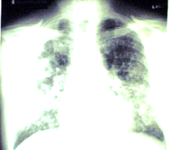

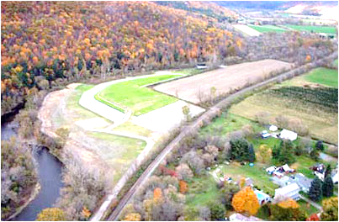


P42 Multi-Project Centers
* Projects and Cores Uniformly Meritorious
Research and Training
Environmental Science and Engineering
Biomedical Science
* Integration, Interaction, Synergy:
Biomedical and Environmental Science & Engineering
Projects and Cores
Administrative (includes research translation)
Data Management and Analysis
Community
Engagement
* Addressing Important Problem
Problem
Superfund Stakeholders
Stakeholder Communities
* Aids Stakeholders in Effective Decision-Making
Solution

Slide 26

“NIEHS SCIENTIFIC PEER REVIEW”
JANICE ALLEN, PHD – SRO (984-287-3232)
LAURA THOMAS, PHD – SRO (984-287-3328)
DEBORAH JONES – ESA (984-287-3275)
2019 P42 REVIEW

Slide 27
The Peer Review Process
Letters of Intent
NOVEMBER 19, 2018
Receive Applications
DECEMBER 19, 2018
Administrative Review
Responsive
Non-responsive
(return to applicant)
Review Committee
Peer Review Meeting (MAY, 2019)
Discussed
Not - Discussed
Summary
Statements
NAEHS Council
(OCT 2019)
Funding decisions
and awards
(DECEMBER, 2019)
Summary
Statements

Slide 28
Pre-Submission of P42 Application
Submission of Letter of Intent (LOI):
  Assists in review planning
  Email to Dr. Janice Allen at allen9@niehs.nih.gov Requested by NOVEMBER 19, 2018 (not required, but HIGHLY recommended)
Include in the LOI:
  Descriptive title of the Overall Center
    Brief description of the research proposed in the Center
    Include the title of each Research Project and Core
  Name, address, and telephone number of the PD(s)/PI(s)
  Names of key personnel (Project and Core Leaders)
  Names of any participating institutions

Slide 29
P42 Peer Review Process
Review Criteria are in the solicitation: http://grants.nih.gov/grants/guide/rfa-files/RFA-ES-15-019.html
Review of the Individual Research Projects, Cores
Review the Overall Center

Slide 30
Research Projects
Significance
Investigator(s)
Innovation
Approach
Environment
Contribution to SRP Center
Other Specific Criteria*
NIH’s Five Review Criteria
(criterion scores 10-90)
Impact Score
(10-90)
Each Project is reviewed.
Each Receives Criterion Scores and written critiques. Note-Applications not discussed will NOT receive an overall impact score (e.g Center , individual Projects, and Cores).
*Note: Human Subjects, Animal Care, and Biohazards can be considered in the overall score. Budget Concerns are not considered in score.

Slide 31
Cores
Contribution to SRP Center
Other Criteria Specific to Each Core
  Administrative
  Data Management and Analysis
  Community Engagement
  Research Experience and Training Coordination
  Research Support
  (see RFA for specific criteria)
Impact Score
(10-90)

Slide 32
Overall Center
Addresses a critical problem relevant to the SRP
Relevance/Merit of Projects and Cores (scientific gain)
Collaboration/Integration/Synergy
Leadership
Final Score (Range: 10-90)

Slide 33
Helpful Hints
Read and understand the Funding Announcement
Contact Program Staff for clarification of scientific matters and Grants Management Staff for budget issues.
Follow the guidelines: page limits, font size, and so forth
Start early………because:
  Any mistakes made with electronic submission (i.e., ASSIST) may cause your application to be returned without further deliberation by NIEHS Review staff.

Slide 34
Grantsmanship Issues
Be clear and concise….don’t expect reviewers to “know what you mean.”
All the components are important. One weak research project will impact the overall score. Extraneous or unnecessary cores will reduce cohesiveness of the center.
Too many projects…application sinks under its own weight.
Inadequate time allowed to prepare application.

Slide 35
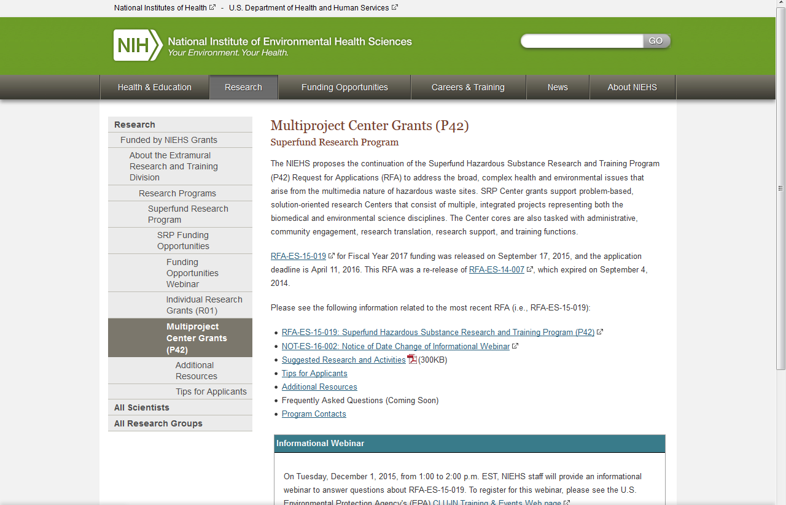
P42 Resources
RFA Webpage
  Suggested Research and Activities - Numerous areas of general interest as well as specific needs identified by stakeholders
  Tips for Applicants – electronic submission, what to include, etc.
  Additional Resources – Links to EPA, ATSDR, information to aid in community engagement activities, and other helpful websites
  Program Contacts
  RFA Webpage: http://www.niehs.nih.gov/research/supported/srp/funding/rfa/index.cfm
Also see “Current P42 Grantees:” http://tools.niehs.nih.gov/srp/programs/index267.cfm

Slide 36
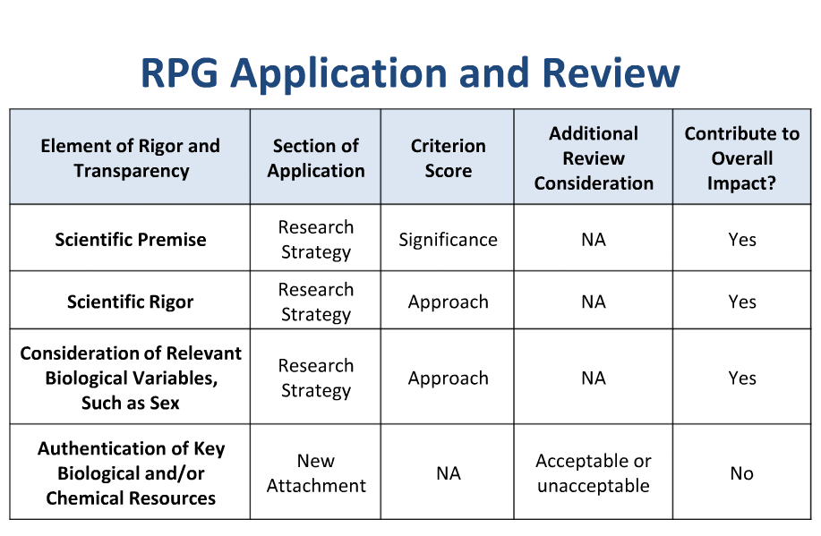

Slide 37
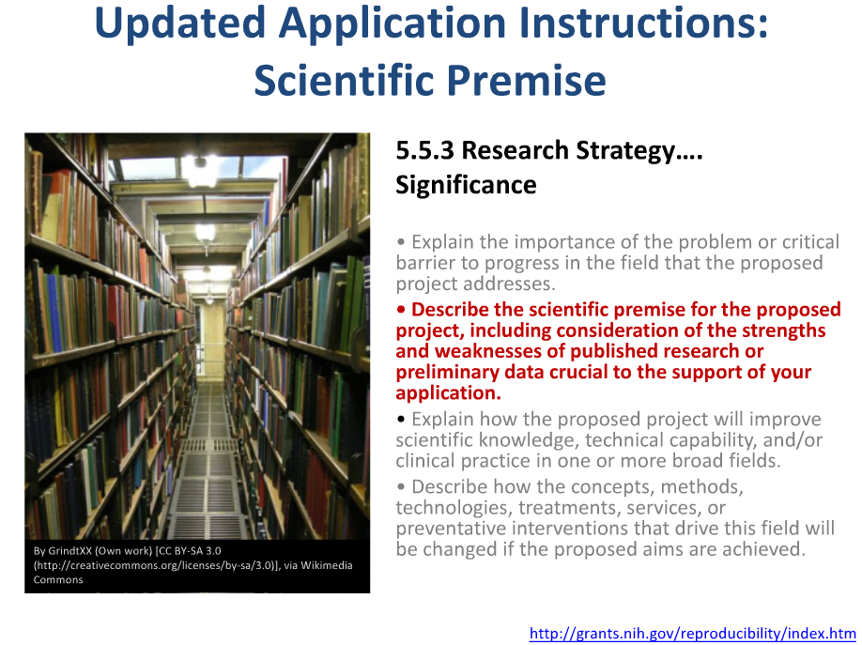

Slide 38
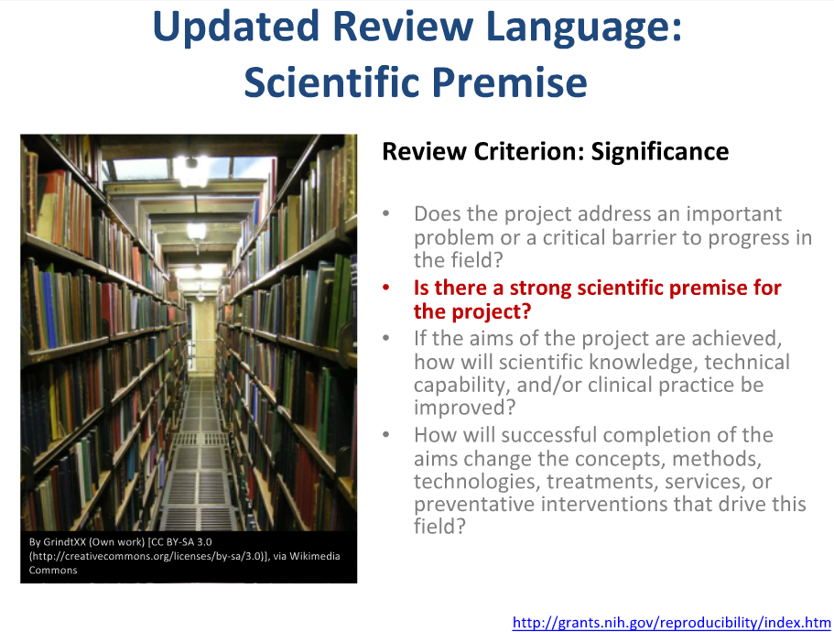

Slide 39
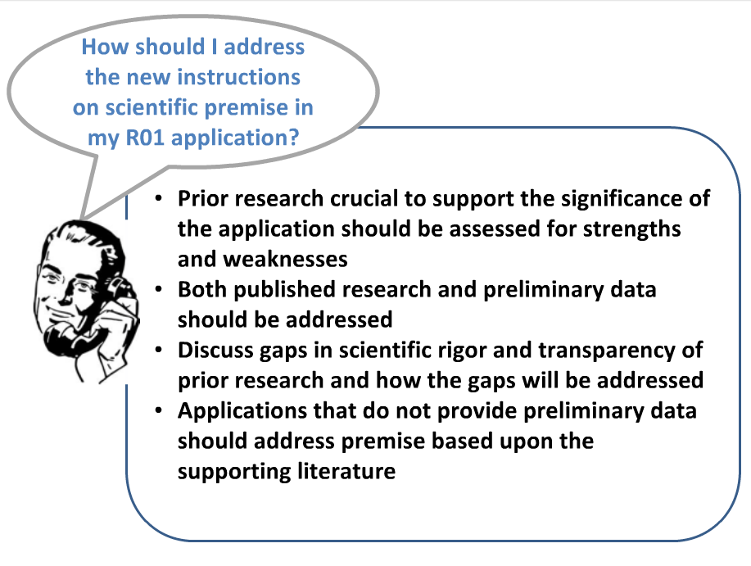
P42

Slide 40
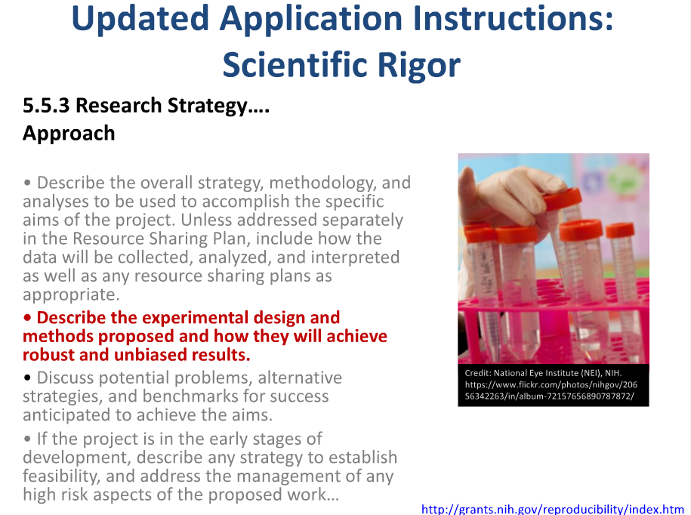

Slide 41
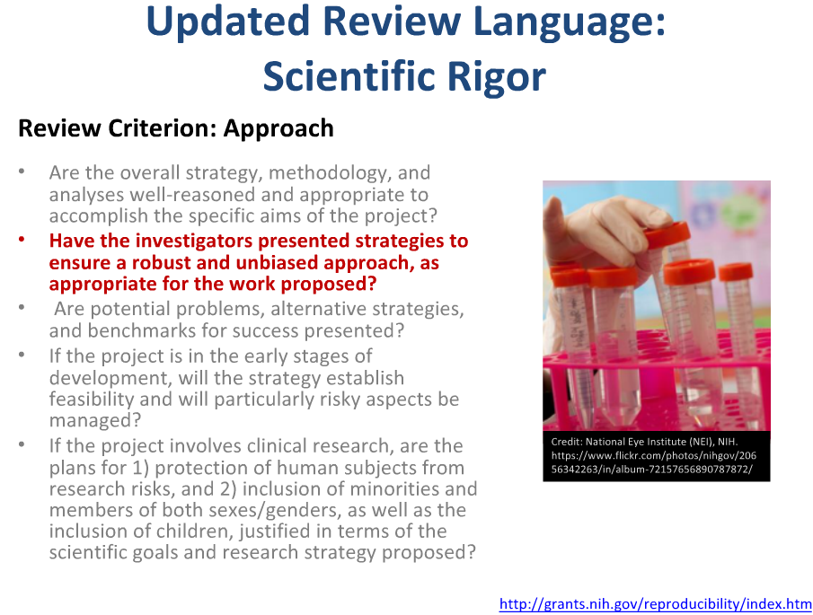

Slide 42
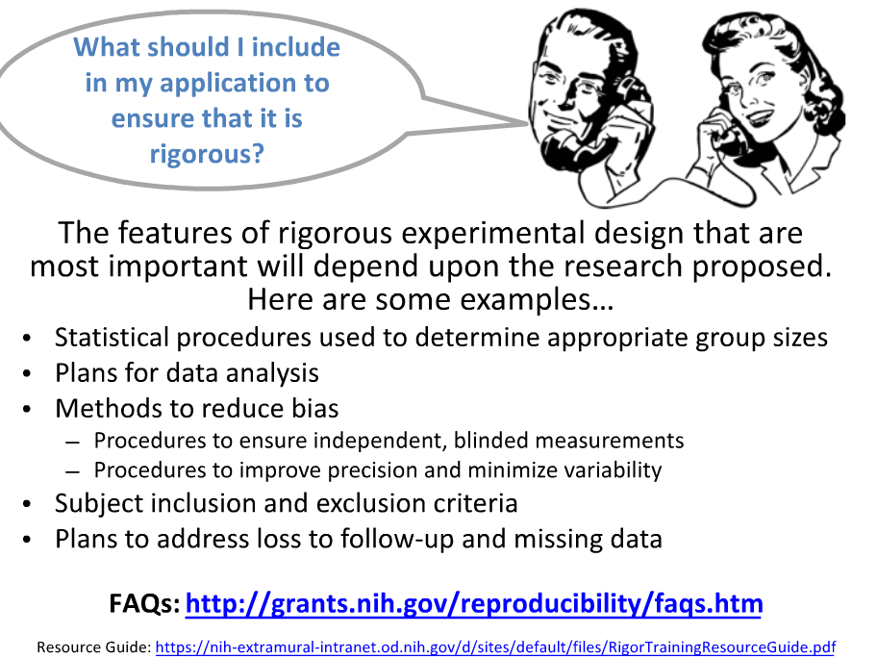

Slide 43
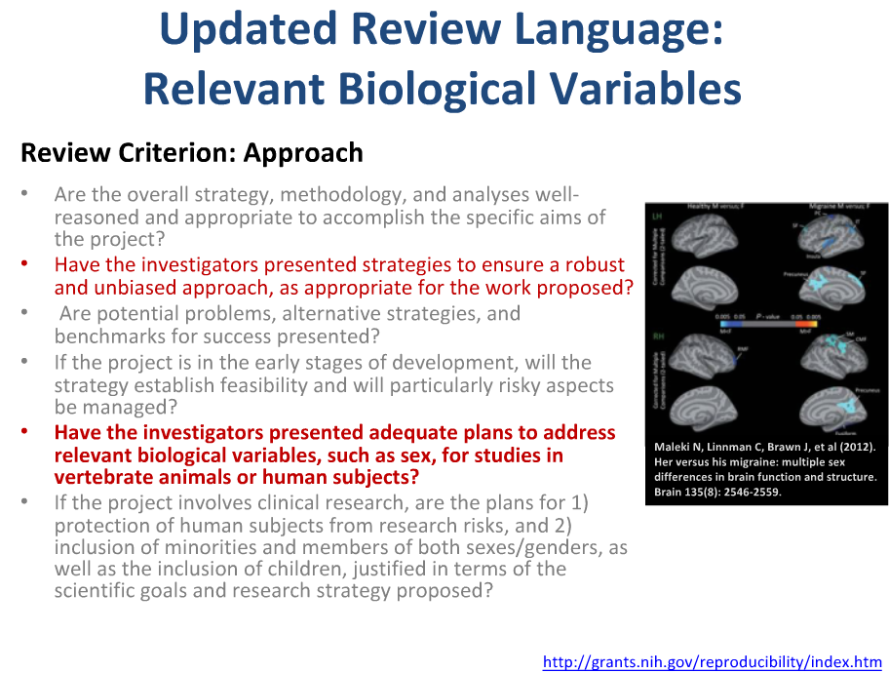

Slide 44
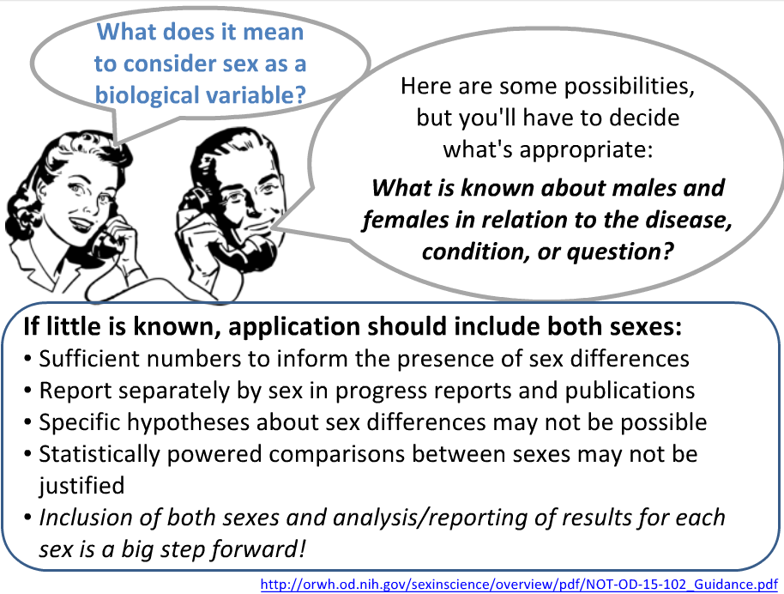

Slide 45
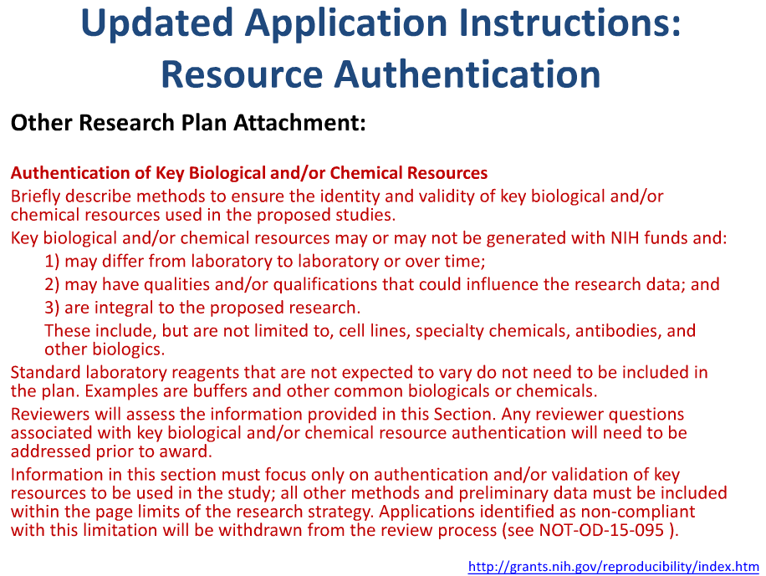

Slide 46
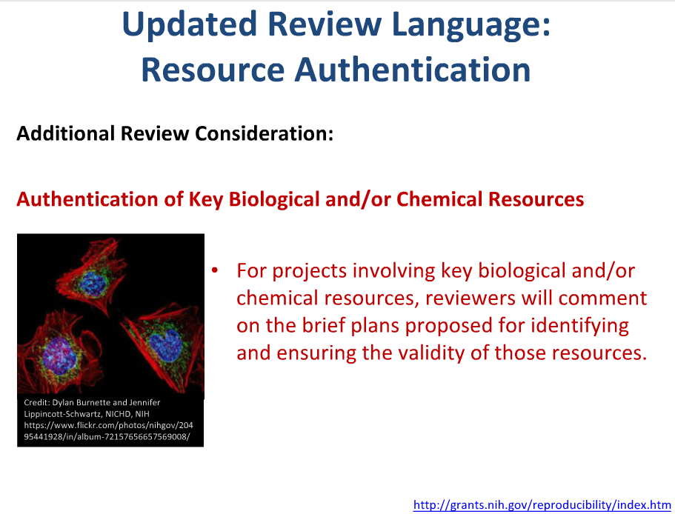

Slide 47
“QUESTIONS?”
JANICE ALLEN, PHD – SRO (984-287-3232)
allen9@niehs.nih.gov
LAURA THOMAS, PHD – SRO (984-287-3328)
Laura.Thomas@nih.gov
DEBORAH JONES – ESA (984-287-3275)
jonesdebo@mail.nih.gov
Alfonso R. Latoni – Chief of SRB (984-287-3279)
Alfonso.Latoni@nih.gov
2019 P42 REVIEW

Slide 48
NIEHS Grants Management
Lisa edwards, mBa
Budget

Slide 49
Electronic Budget
  Prepare the Application using ASSIST: https://grants.nih.gov/grants/how-to-apply-application-guide/prepare-to-apply-and-register/submission-options/assist.htm
  Webinar for Applicants: Electronic Submission Process of Multi-Project Applications https://grants.nih.gov/grants/webinar_docs/webinar_20130813.htm
SF424 (R&R) Detailed Budget forms
Budget data collected at component and subaward levels only
  Component and subaward budget data used to auto-calculate “Cumulative” (Composite) budget
Budget pages required for parent site and all consortium sites

Slide 50
Budget Preparation
Form Pages, Approvals, Other Support, Notices
Forms (http://grants.nih.gov/grants/forms.htm)
  SF424 (R&R) electronic submission
Approvals
  IACUC Approval (Vertebrate Animals)
  IRB Approval (Human Subjects)
  Begin process at time of application, but final approval will be requested for Just In Time*
Other Support
  “0%”, “Varies”, “As Needed”, etc., are not acceptable
  Total time commitment cannot exceed 12 calendar months
Important Notices
Revised Grants Policy Statement: https://grants.nih.gov/policy/nihgps/index.htm
Salary caps: NOT-OD-18-137
http://grants1.nih.gov/grants/policy/salcap_summary.htm.
*Just in Time: Request for information required prior to award.

Slide 51
Budget Preparation
Non-Modular
Provide detailed categorical budgets
Each Project
Each Core (Note – RETCC (training core) uses a “Core” component budget, not the NRSA form used in the past)
Each Subaward/Consortium (Note: SF424 will not allow Subawards on Subawards)
  Escalation
  Budgets submitted in subsequent years may request an escalation on recurring direct costs. (Note: Currently NIH does provide an escalation in subsequent years)
  Must be justified:
  Is the amount of escalation requested supported by institutional policies?
  Is the amount clearly stated?
Travel to Annual Meeting
Administrative Core Budget: Funds for travel by appropriate staff (i.e., Center Director, Center Administrator, and four trainees) to attend the Superfund Research Program three-day annual meeting shall be included in the Administrative Core’s budget for each year.
Escalation in outyears will be removed at the time of award.

Slide 52
Budget Preparation
Parent Grant Direct Costs
  Consideration of equipment in the out-years will be based upon justification and availability of funds
Subawards/Consortium
  must follow same guidelines as parent; budget pages required and should follow associated project or core
  Subawards/consortium direct costs are included in the parent grant Subtotal Direct Costs, which may be subject to budget caps
  F&A of subawards/consortium is included in Total direct Costs of parent grant, but will not count against budget cap
Budget Justifications (Be detailed and specific)
    Are all costs itemized?
    Are all additions and changes in subsequent/future years fully justified and identified clearly; specifically changes in personnel effort?

Slide 53
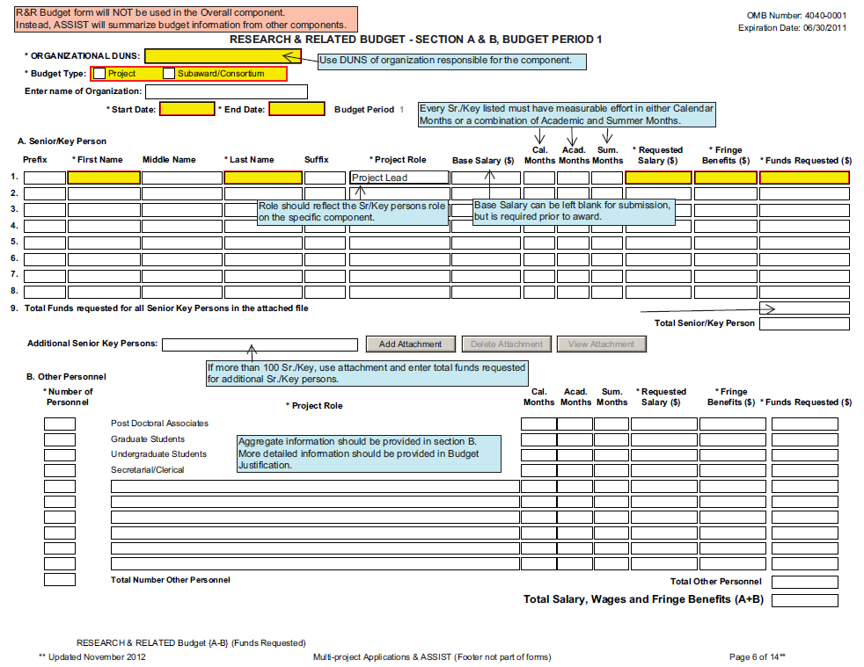

Slide 54
R&R Budget Sections A & B
Personnel separated into 2 sections:
A. Senior/Key Person
  First field must be completed, even if person on a component given role of “Project Leader” and not PD/PI
B. Other Personnel
  Postdocs, Grad Students, Undergrads: Only number of personnel required (not specific names)
  *Include only personnel employed by (e.g., receiving salary from) your organization.

Slide 55
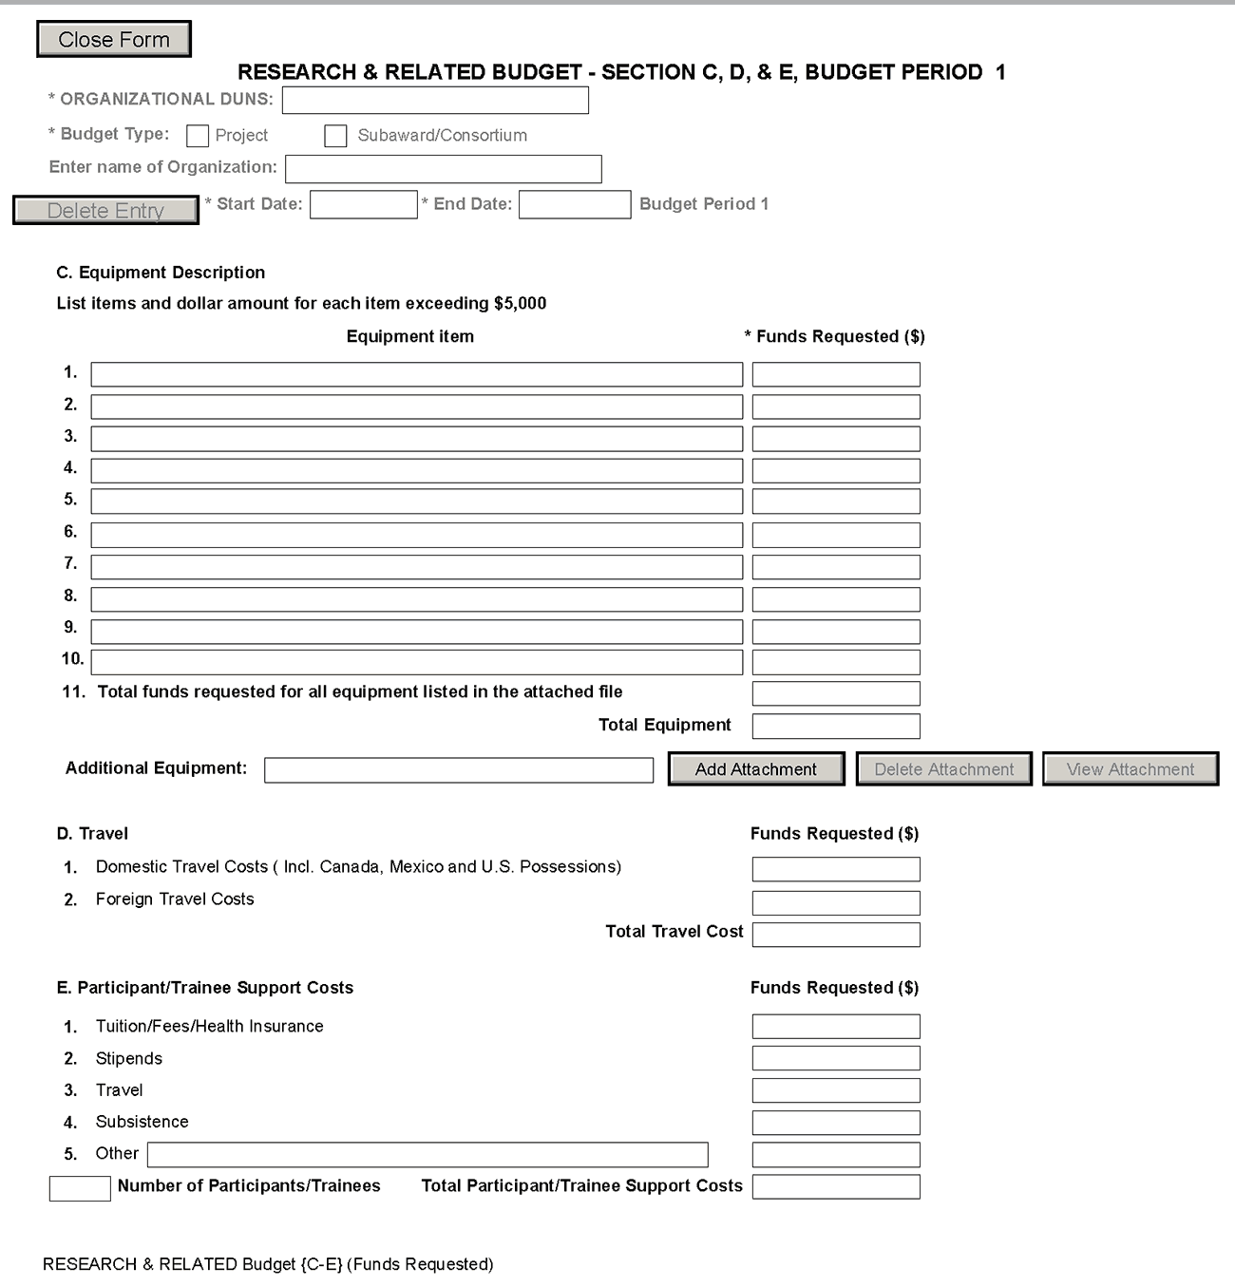
R&R Budget
Sections C - E
Itemize up to 100 pieces of equipment. If more, include total dollars in line 11 and provide details in the Additional Equipment attachment
Not required for P42

Slide 56
R&R Budget Sections C - E
Item D, Travel
  424 form differentiates between foreign and domestic travel

Slide 57
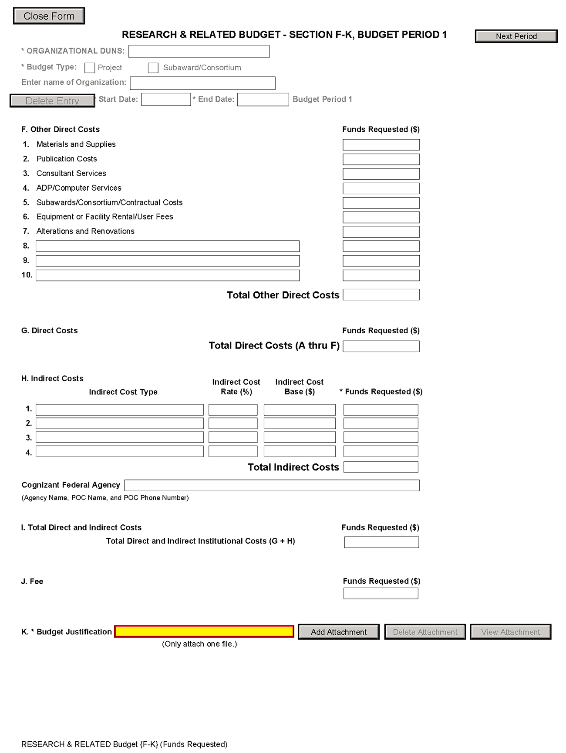
R&R Budget
Sections F - K
Subaward/Consortium/Contractual Cost not pre-populated. Include both Total Direct and Indirect cost

Slide 58
R&R Budget Sections F-K
Tuition remission
  Include in Item F, Other Direct Costs (boxes 8, 9 or 10)
Supplies
  Not a major line item on 424 budgets
  Included as line F.1 (Other Direct Costs: Materials and Supplies)
Alteration and Renovations
  Not a major line item on 424 budgets
  Included as line F.7 (Other Direct Costs: Alterations and Renovations)
Inpatient and Outpatient Care Costs
  424 does not include as major / minor line item
  Current instructions require inserting in fields F.8-F.10 (Other Direct Costs: Other Costs)

Slide 59
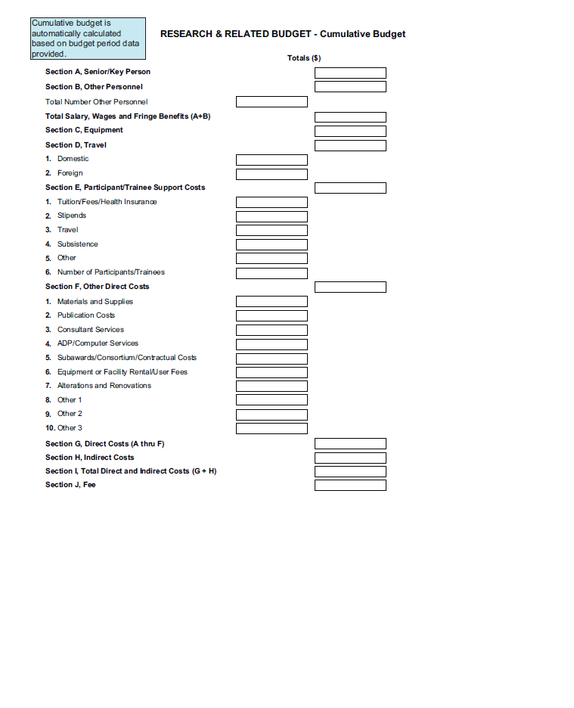

Slide 60
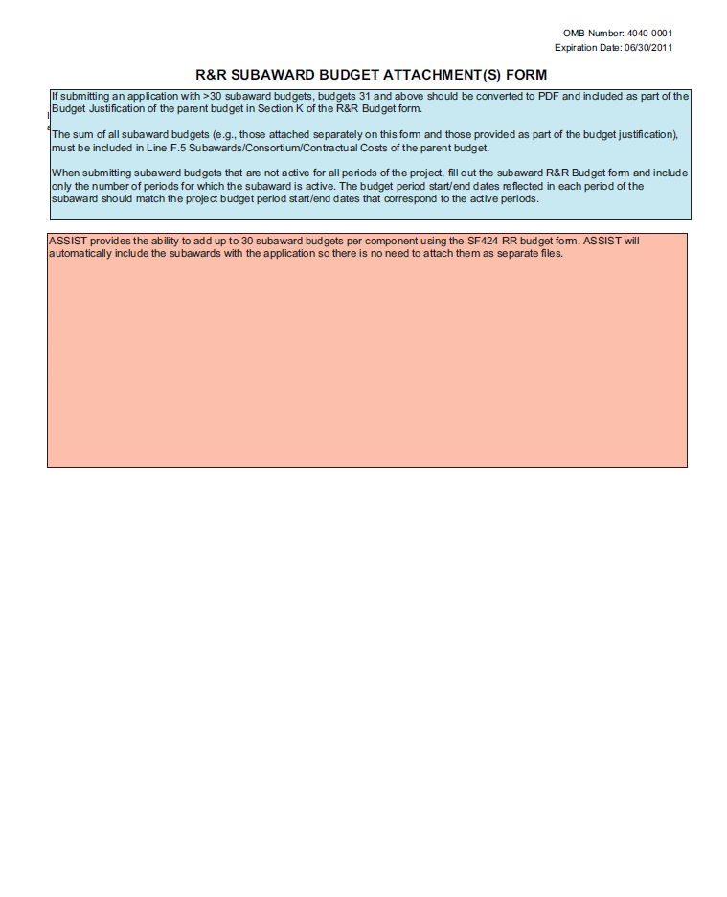

Slide 61
Resources
SF424 (R&R) Application and Electronic Submission Information” webpage:
  http://grants.nih.gov/grants/funding/424/index.htm#inst
Applying Electronically to Multi-project Applications:
  http://grants.nih.gov/grants/ElectronicReceipt/com_index.htm
Help with ASSIST
  http://grants.nih.gov/grants/ElectronicReceipt/assist.htm
“New” NIH Biographical Sketch Format: https://grants.nih.gov/grants/guide/notice-files/not-od-16-080.html
NIH Guidance on Rigor and Reproducibility: http://grants.nih.gov/reproducibility/index.htm
eRA Commons - https://commons.era.nih.gov/commons/index.jsp
Registered PD/PIs can check assignment/contact information, review outcome, and other important information.
eRA Commons Help Desk:
Hours: Mon-Fri, 7AM-8PM EDT/EST; Web: http://grants.nih.gov/support/; Toll-free: 1-866-504-9552. Phone: 301-402-7469

Slide 62
P42 Multi-Project Centers
Submit Application EARLY!!!
NIEHS Contacts on RFA
  Program Officers (contacts for initial consultation):
  Danielle Carlin (danielle.carlin@nih.gov)
  Michelle Heacock (HeacockM@niehs.nih.gov)
  Heather Henry (henryh@niehs.nih.gov)
  SRP Director William Suk (suk@niehs.nih.gov)
  SRP Health Specialist, Brittany Trottier (brittany.trottier@nih.gov)
  Scientific Review Officer, Janice Allen (allen9@niehs.nih.gov)
  Grants Management Officer, Lisa Archer-Edwards (archer3@niehs.nih.gov)
Link to RFA: https://grants.nih.gov/grants/guide/rfa-files/RFA-ES-18-002.html
Link to RFA Information Page:
https://www.niehs.nih.gov/research/supported/centers/srp/funding/rfa/index.cfm

Slide 63

Thank You!
QUESTIONS??
Acknowledgements:
EPA’s CLU-In.org
Jean Balent, EPA TIFSD
Sara Amolegbe, MDB Inc.
  Questions not covered during seminar will be answered off-line and posted on P42 Funding Opportunity Webpage:
  http://www.niehs.nih.gov/research/supported/dert/programs/srp/funding/rfa/index.cfm
Audio Archive will be available in approximately 4 weeks and are accessible from the above website.

Slide 64
Administrative Core’s research translation function
Community Engagement
Research Products
Theme of Center
ITERATIVE
Appropriate Application
bidirectional
End-users
Impacted Community
Partnership-driven
Bidirectional with impacted community(ies)
Finite/Defined Activities focuses on Prevention/Intervention
Activities should have the goal of reducing exposures
Initiated by the research translation coordinator or Project Leader
Based on research “product”
Opportunistic and rapid response
Critical role reporting successes

