Slide 1



Slide 2
Four Funding Cycles
2000 – 2005: Superfund Chemicals Impact on
Reproduction and Development
2005 – 2009: Superfund Chemicals Impact on Development
2011 – 2017: Developmental Toxicants: Mechanisms,
Consequences and Remediation
2017 – 2022: Developmental Exposures: Mechanisms,
Consequences and Remediation

Slide 3
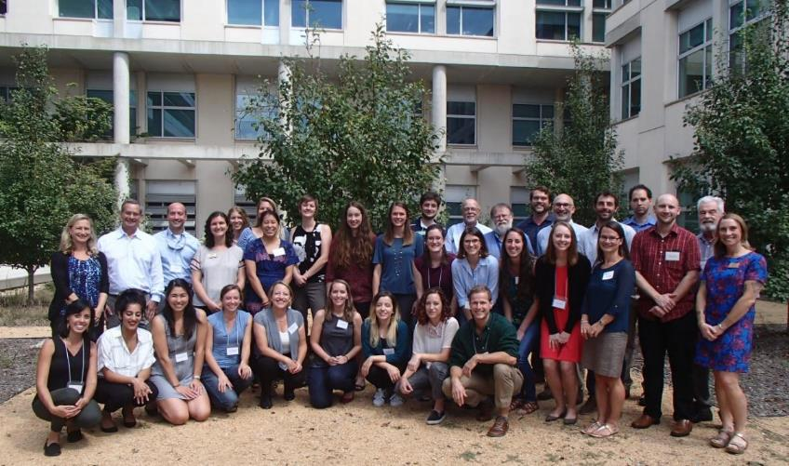

Duke Superfund Research Center
“early life exposures, later life consequences”
(DOHaD: Developmental Origins
of Health and Disease)
Five Research Projects
Three Biomedical
Two Non-biomedical
Six Research Support Cores

Slide 4
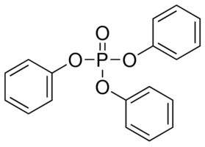

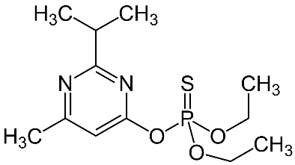
Project 1: Developmental neurotoxicants:
Sensitization, Consequences, and Mechanisms
PIs: Ted Slotkin, Ed Levin, Fred Seidler
Questions:
What happens to the brain when it is exposed to a chemical during development?
Do different chemicals that act by different mechanisms converge on the same pathways?
Triphenyl Phosphate
Benzo[a]pyrene
Diazinon

Slide 5
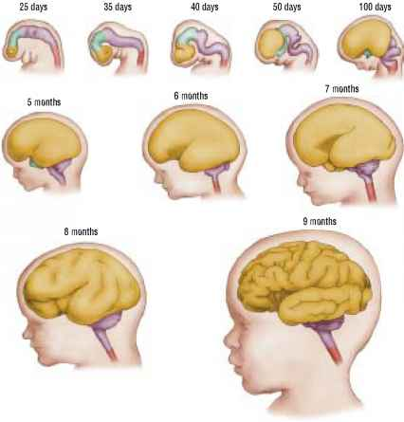
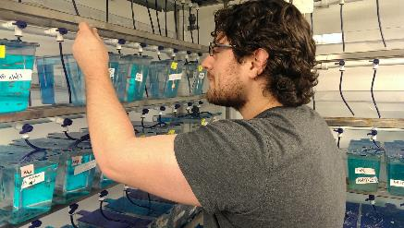
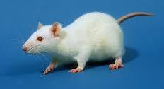
Project 1: Developmental neurotoxicants
Questions:
How does brain development change because of chemical exposures?
How do those changes lead to behavioral problems?
What therapies may help?
To what extent can we study these processes in simpler organisms?

Slide 6
Project 2: ALTERING THE BALANCE OF ADIPOGENIC AND OSTEOGENIC REGULATORY PATHWAYS FROM EARLY LIFE EXPOSURE TO ENVIRONMENTAL CHEMICALS
PIs: Heather Stapleton, Seth Kullman, Lee Ferguson
Examining pathways through which environmental chemicals might perturb the development of fat cells.
WHY?
~40% of the US population now obese, ~20% of adolescents; increasing health care burden
Caloric intake, activity, genetics insufficient to account for magnitude/speed of trend
Increasing data on pharmaceuticals and other environmental chemicals as metabolic disruptors

Slide 7
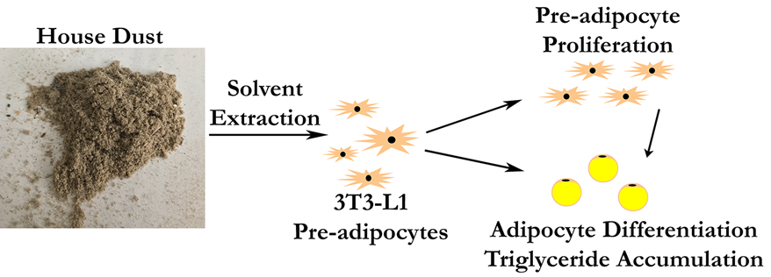
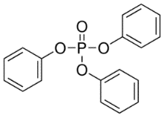
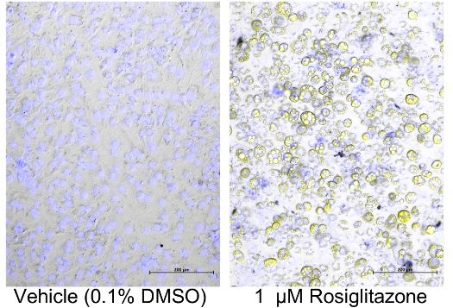
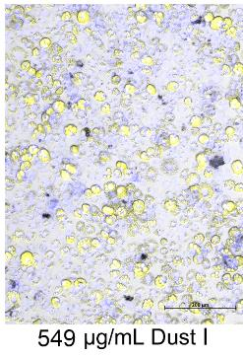
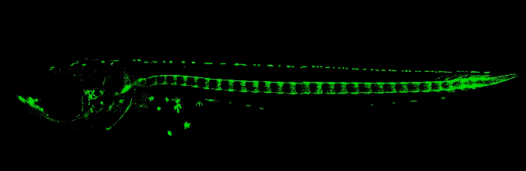
Project 2: How do indoor chemicals and mixtures (house dust) alter the development of fat cells
Tetrabromobisphenol A
Triphenyl Phosphate
3-OH-BDE-47
6-OH-BDE-47

Slide 8
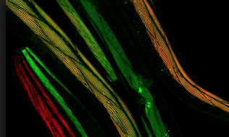

Project 3: Persistent mitochondrial and epigenetic effects of early-life toxicant exposure
PIs: Joel Meyer, Susan Murphy
Exposing C. elegans to “mitotoxicant” chemicals and measuring effects in their great-grand progeny.
Benzo[a]pyrene, arsenic, mercury, pentachlorophenol, triphenylphosphate, diazinon, Superfund (creosote) mixture
Mitochondrial function
Chemical exposure
No chemical exposure for 2 generations (only 8 days)

Slide 9

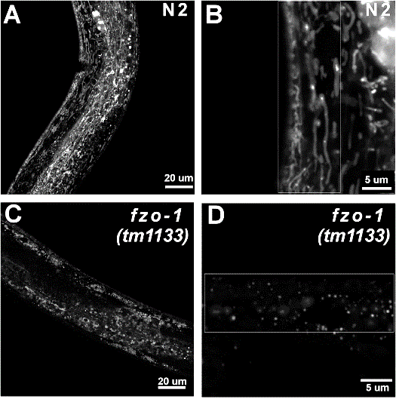
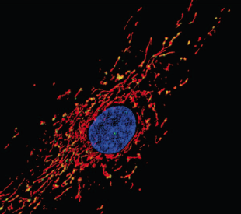
Project 3: Role of genetic differences in sensitivity
Nuclear DNA
Mitochondria
Mitochondrial DNA

Slide 10
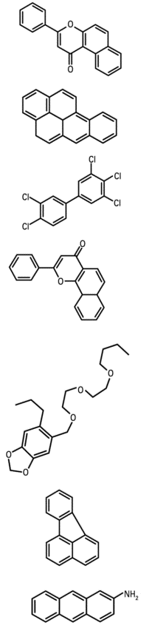
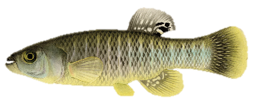
Project 4: Mechanisms and Consequences of Evolved Adaptation to Environmental Pollution
PI – Di Giulio, Co-PI- Hinton
Trainees - Jordan Kozal and Casey Lindberg
The phenomenon pollution driving evolution has implications for environmental health and management in terms of genetic diversity, organisms’ abilities to adapt to environmental changes such as warming, and understanding future risks posed by contamination.
Linking effects of specific chemicals and mixtures to cardiovascular and nervous systems, yields great relevance to human and ecological health.

Slide 11
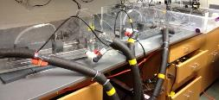
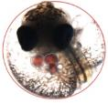
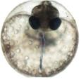
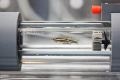
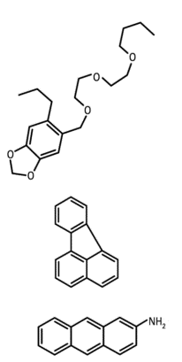
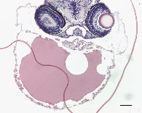
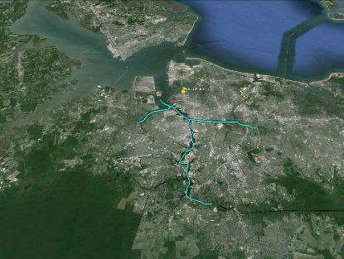
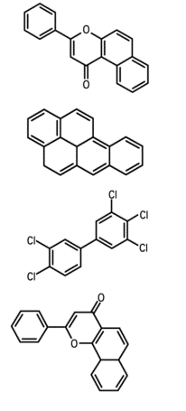
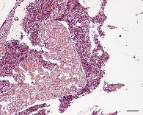
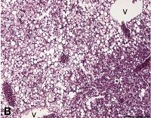

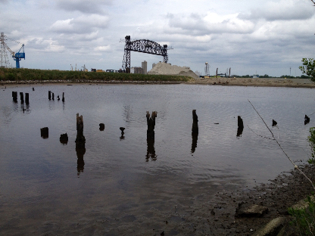



swim tunnel
morphology
Polycyclic Aromatic Hydrocarbons (PAHs)
The Elizabeth River, VA
Organismal
Fish collections
Organ/Tissue
Atlantic killifish
(Fundulus heteroclitus)
Southern branch
Atlantic Wood Industries
Cellular
PAH resistance
ERSE
Molecular
Bioenergetics: Extracellular
flux analyzer
Zebrafish
(Danio rerio)
Behavioral
creosote
Neurotoxicity

Slide 12
swim tunnel
morphology
The Elizabeth River, VA
Organismal
Fish collections
Organ/Tissue
Atlantic killifish
(Fundulus heteroclitus)
Southern branch
Atlantic Wood Industries
Cellular
PAH resistance
ERSE
Molecular
Bioenergetics: Extracellular
flux analyzer
Zebrafish
(Danio rerio)
Behavioral
creosote
Neurotoxicity

Slide 13
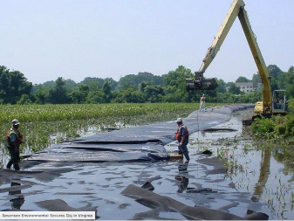
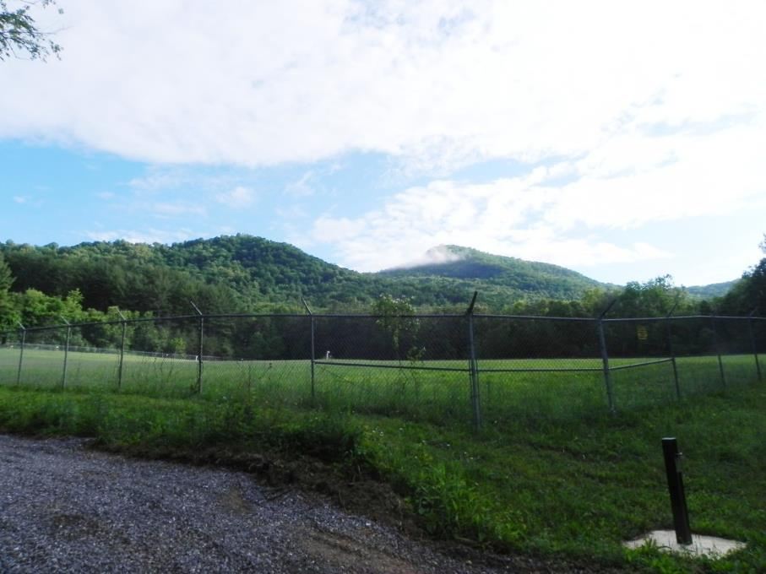
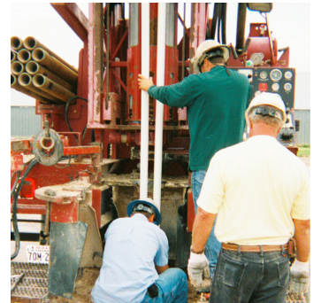
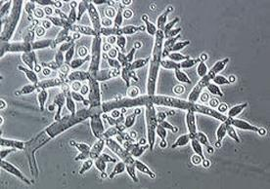
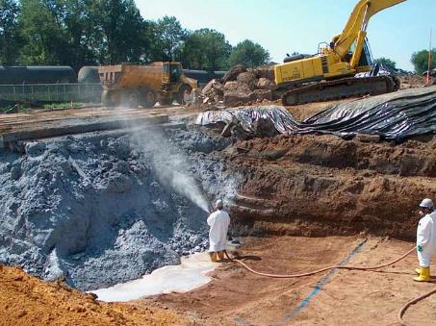
Project 5: Engineering the Physico-Chemical Environment to Enhance Polycyclic Aromatic Hydrocarbon (PAH) Bioremediation
PIs: Gunsch, Hsu-Kim, Wiesner and Vilgalys
Trainees: Volkoff, Bippus, Rodriguez and Crittenden
Challenge: Low PAH bioavailability to bacteria
Fungi: An Underused Resource in Bioremediation
Trichoderma harzanium
How can we improve fungal-bacterial cooperation for enhancing PAH biodegradation?

Slide 14
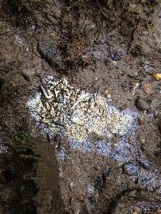
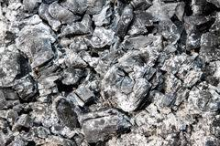
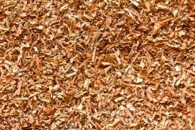
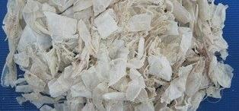
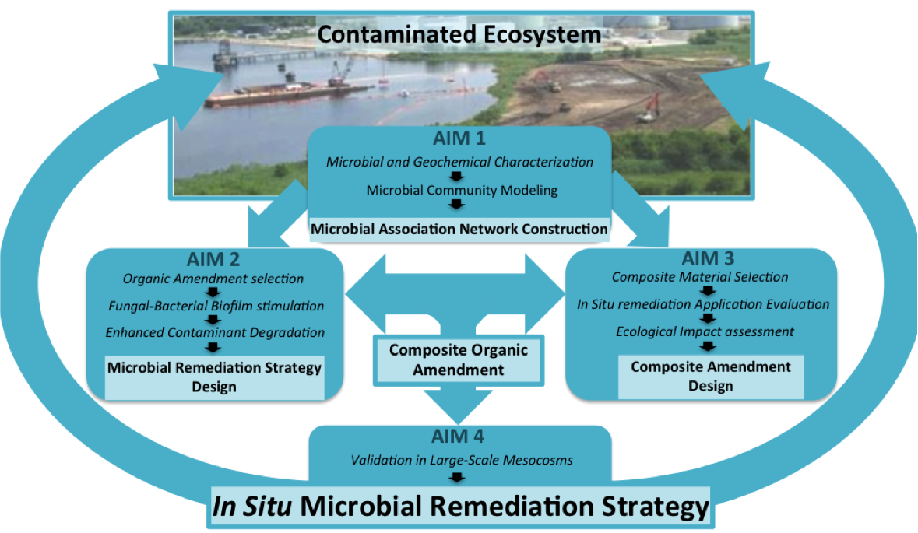

Slide 15
Research Support Cores
Administrative Core
Director: Richard Di Giulio; Deputy Director: Heather Stapleton
Training Core PI: Joel Meyer
Neurobehavioral Toxicity Core PI: Edward Levin
Analytical Chemistry Core PI: Lee Ferguson
Community Engagement Core PI: Elizabeth Shapiro-Garza
Research Translation Core PI: Charlotte Clark

Slide 16

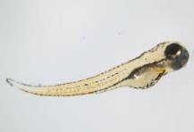
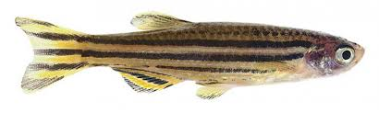
Neurobehavioral toxicity core
Principal Investigator: Edward Levin
Goal: To provide assessments of neurobehavioral impairments resulting
from developmental toxicant exposure
Behavioral tests to assess:
Activity
Emotional Health
Learning
Cognition

Slide 17
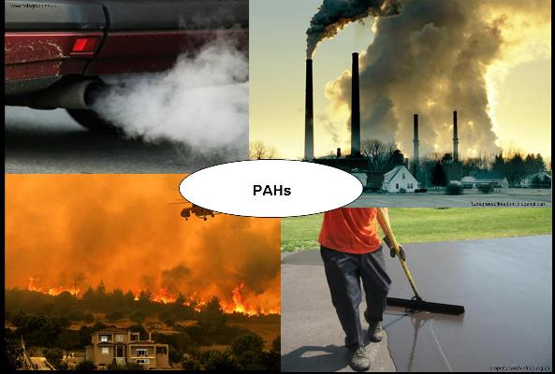
Analytical Chemistry Core
PI: Lee Ferguson, Co-PIs: Heather Stapleton & Helen Hsu-Kim
Goal: Provide routine analysis of organic and inorganic contaminants on a routine basis to investigators in support of the SRC research projects.
Examples of services by the ACC –
Quantify hormones in biological tissues.
Analysis of flame retardants and emerging contaminants (GenX) in environmental and biological samples.
Analysis of PAHs (polycyclic aromatic hydrocarbons) in sediment, water and fish tissues.
Analysis of trace metals in sediment, water and tissues.

Slide 18
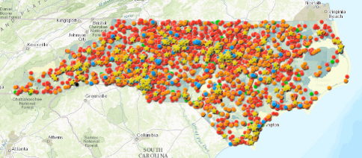
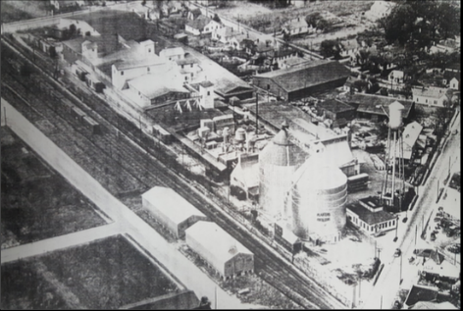
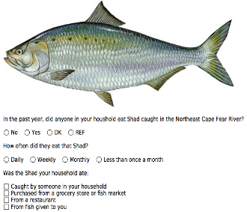
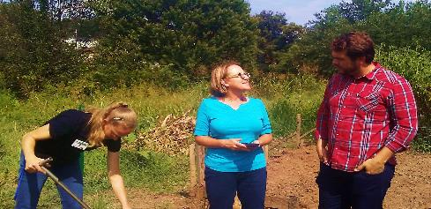
Community Engagement Core
PI: Dr. Elizabeth Shapiro-Garza
Core Projects:
Community Gardens
Communities near former industrial sites
Subsistence fish consumers
GIS Mapping Tool
Former Planter’s Oil Mill Site, Rocky Mount, NC

Slide 19
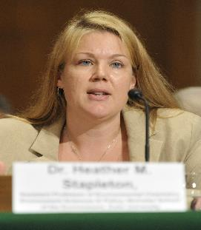
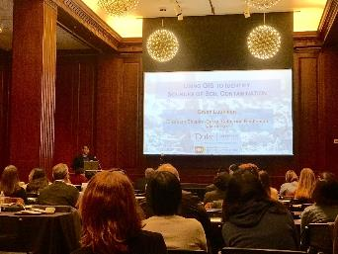
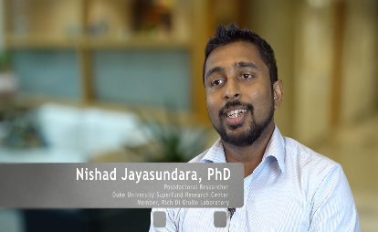



Research Translation Core
PI: Charlotte Clark
PI-initiated Research Translation
Center-wide Formal Training
Trainee Communication Skills
On-line networks – children’s health
Communications, Social Media etc.
Stakeholder, Partnership Engagement

Slide 20
Finally: To the NIEHS Superfund Research Program
THANKS!!!!!
Dr. William Suk Dr. Heather Henry

