Slide 1
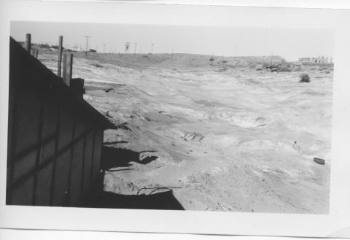
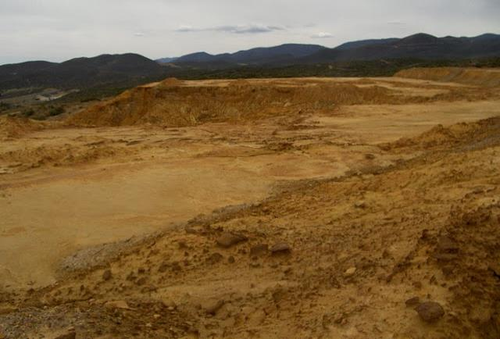


University of Arizona Superfund Research Program
“Risk and Remediation of Metal-Mining Wastes”
Director: Raina Maier
Associate Director: Clark Lantz
https://superfund.arizona.edu/
1950 2018
ADMMR Photo Archive, Arizona Geological Survey

Slide 2
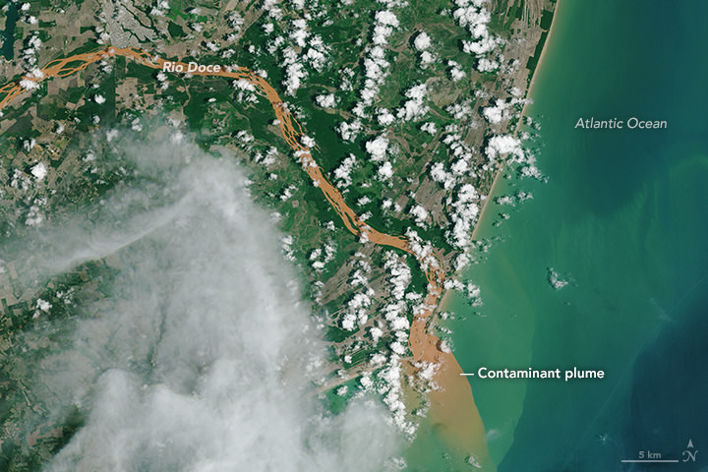
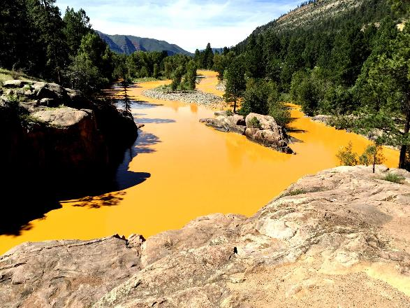
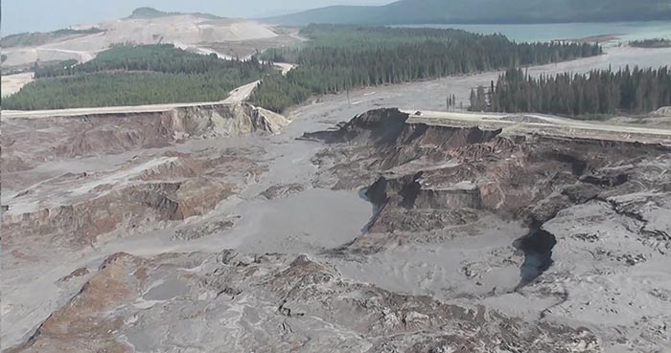
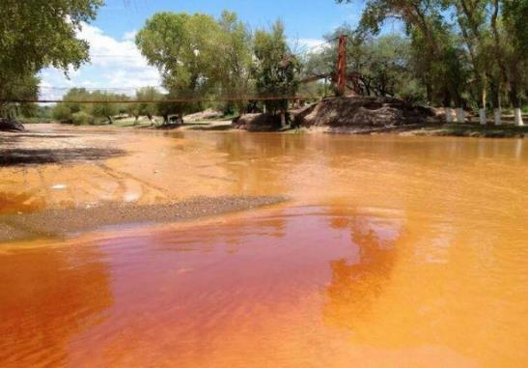
Residual mine waste is one of the largest waste streams in the world
https://durangoherald.com/articles/100800
The Gold King Mine spill, 2015
The Samarco iron ore mine dam collapse, 2015
https://en.wikipedia.org/wiki/Bento_Rodrigues_dam_disaster
The Cananea Mine spill, 2014
http://www.northernminer.com/regulatory-issues/tailings-dam-failures-expected-to-increase-experts-say/1003703723/
The Mt. Polley tailings dam break, 2015
http://www.watersecuritynetwork.org/learning-from-the-cananea-mining-spill-in-sonora-mexico/
Mt Polley tailing dam break, 2014

Slide 3
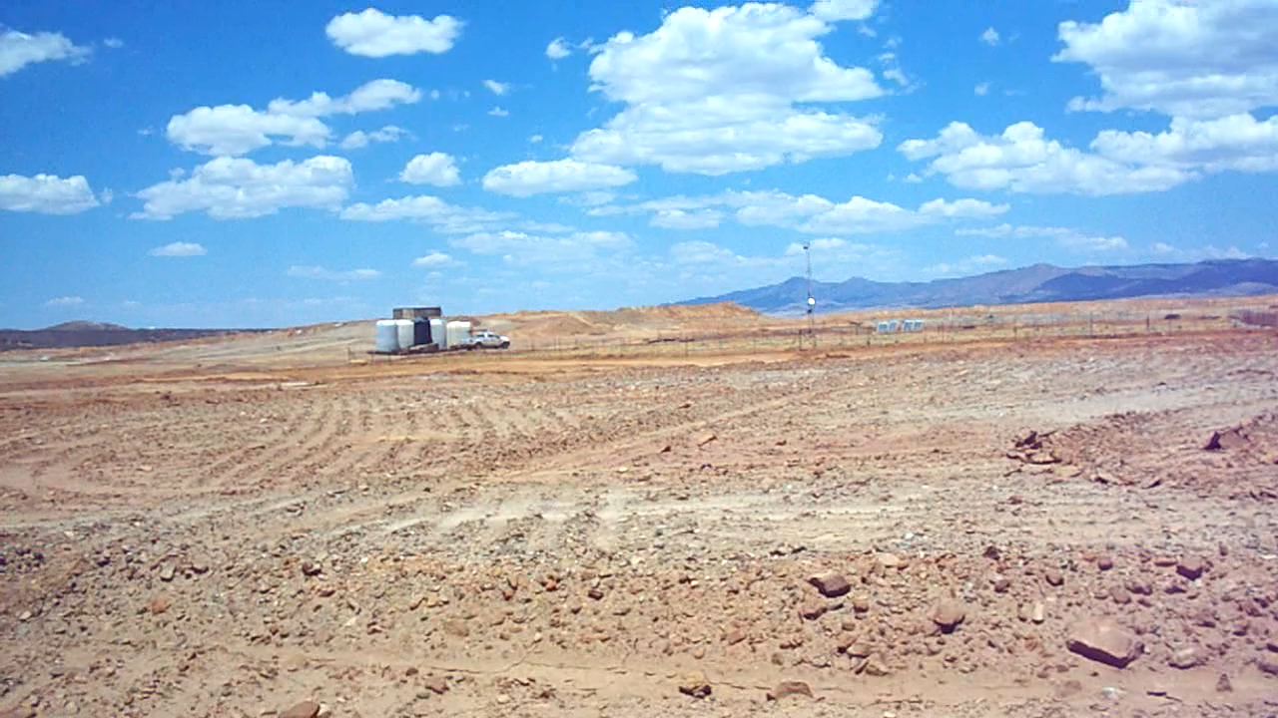
Dust Emission at the Iron King Mine and Humboldt Smelter Superfund Site
Video: Mackenzie Russell
Atmospheric Science

Slide 4
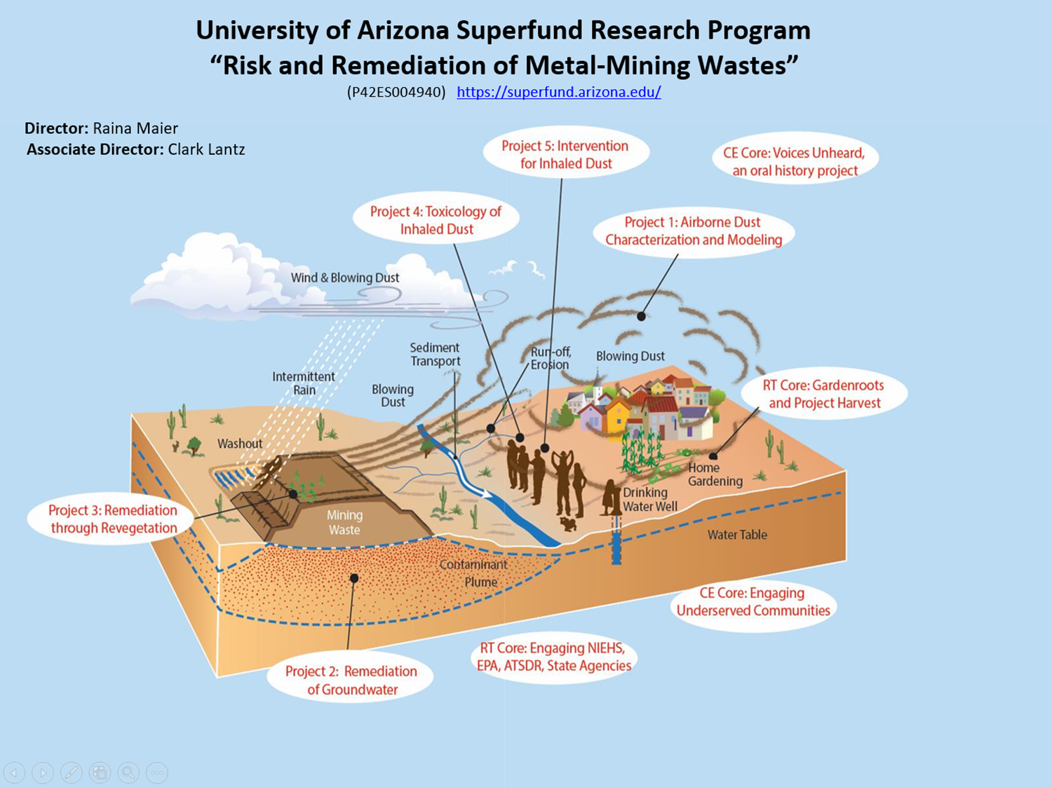
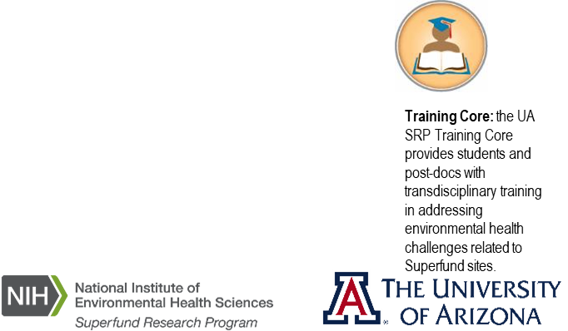

Slide 5
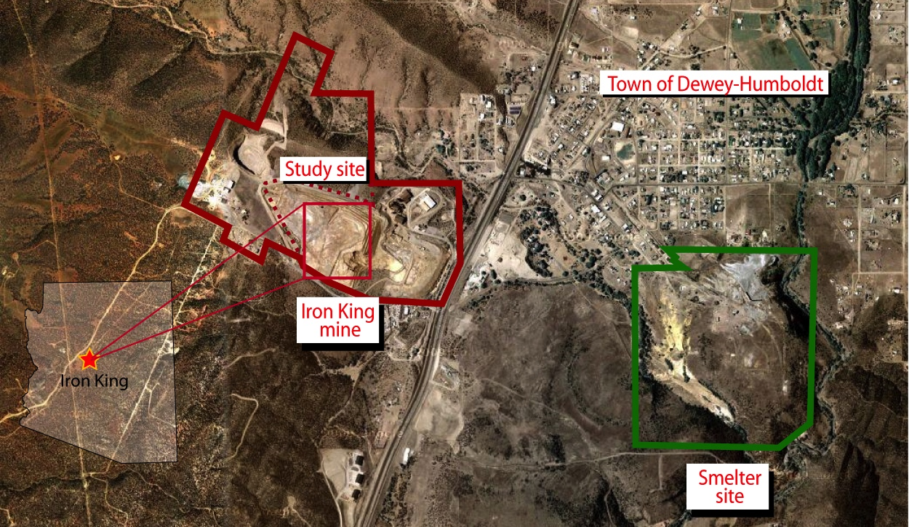
Iron King Mine and Humboldt Smelter Superfund Site
  PROBLEMS
  pH = 2-3
  Arsenic, Lead, Zinc ≥ 3000 mg/kg
Tucson

Slide 6
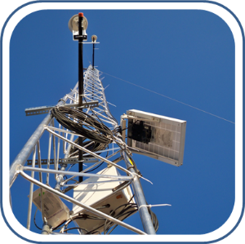
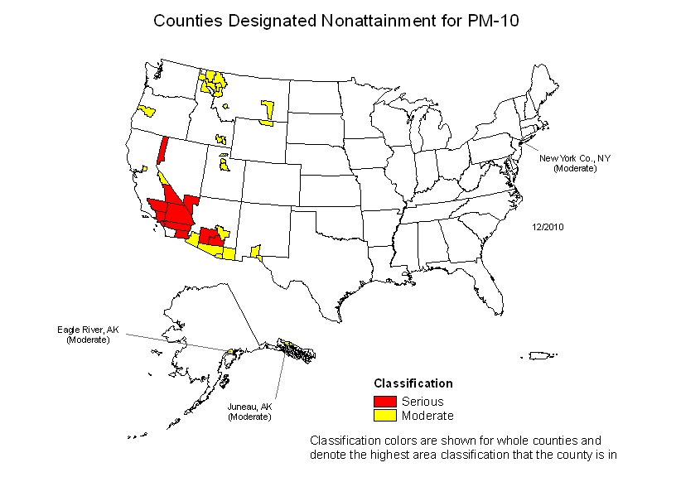
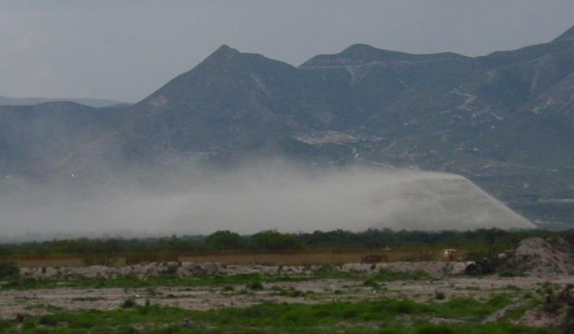
Project 1 - Dust Emission and Weather Forecasting
Dr. Eduardo Saez, Dr. Eric Betterton, Dr. Armin Sorooshian
Arid climate in US Southwest makes dust an important exposure route
Assessing aerosol movement and deposition in conjunction with source apportionment
Combining aerosol modeling with weather forecasting to predict dust movement
Hygroscopic properties may enhance respiratory deposition for mining dusts!
Youn et al., 2016. Environ. Sci. Technol., 50:11706
Counties designated as
nonattainment for PM10

Slide 7
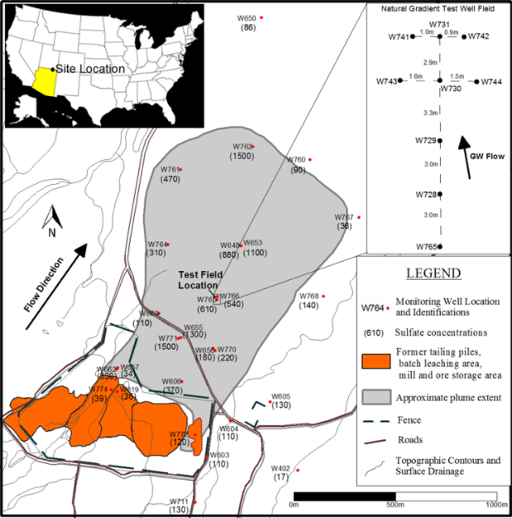
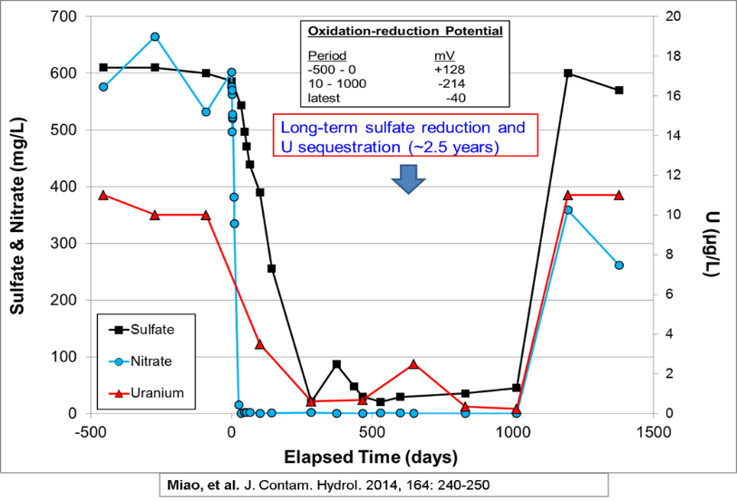
Project 2 - Bioremediation of Uranium Plumes
Dr. Mark Brusseau, Dr. Jim Field
Monument Valley UMTRA Site
1% ethanol injection
One ethanol injection sequestered nitrate and uranium for 2.5 years!

Slide 8
Project 3 - Phytoremediation of Mine Tailings
Dr. Raina Maier, Dr. Julie Neilson, Dr. Jon Chorover, Dr. Mark Barton
Scaling from greenhouse to field works!
Gil-Loaiza et al., 2016, Sci. Total Environ.
Vegetation reduces dust off-site dust transport!
Gil-Loaiza et al., 2018, Environ. Sci. Technol.

Slide 9
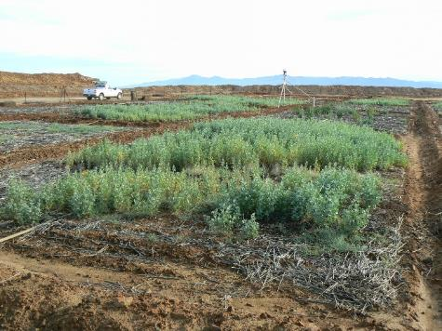
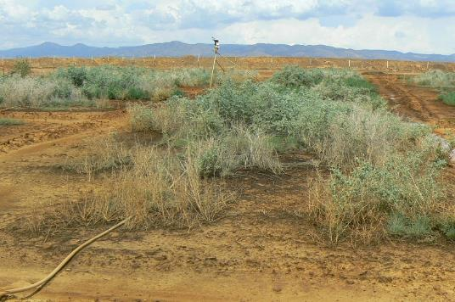
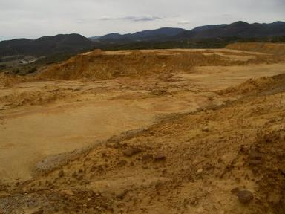
Warring Microbes
Iron King Mine tailings field study 2010 to 2017
Time zero 1 year 3 years
After compost amendment
Adds C, N, and other nutrients
Adds plant growth promoting microbes
But…….. difficult to establish sustained plant growth

Slide 10
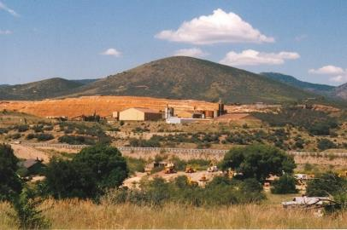
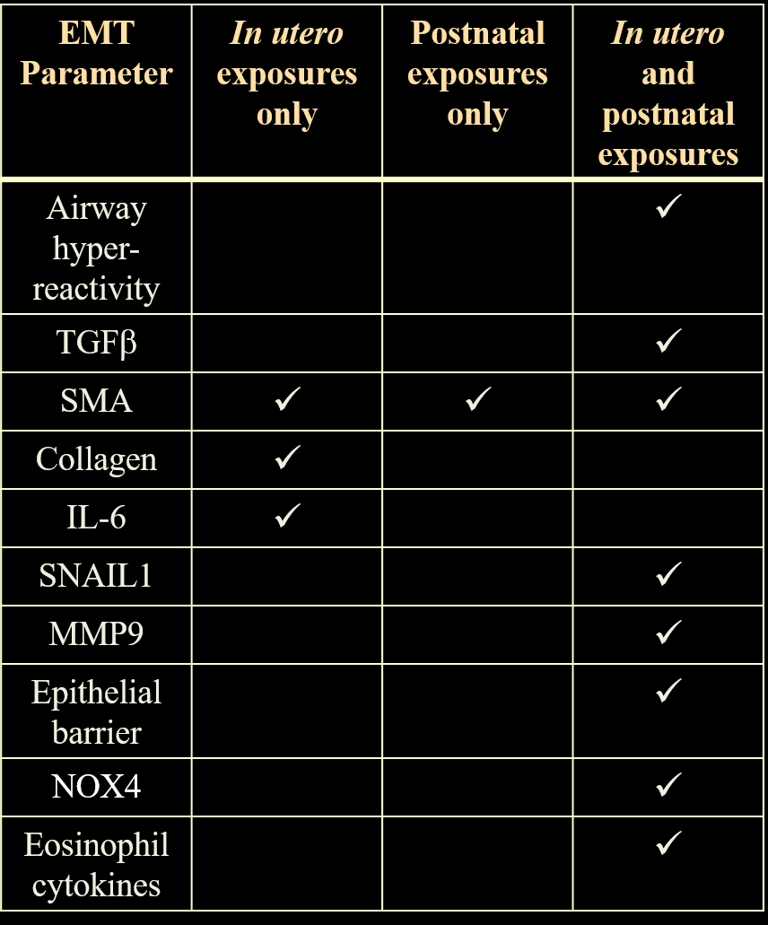
Project 4 - Toxicology of Inhaled Dust
Dr. Clark Lantz, Dr. Scott Boitano, Dr. Donna Zhang
Animals were exposed through inhalation to real world dusts collected from the Iron King mine tailings at various developmental times.
Exposures altered a number of Epithelial to Mesenchymal Transition (EMT) markers.
Continuous in utero and postnatal exposures produced the most significant effects.
In utero exposures may prime the lung for responding to subsequent postnatal exposures

Slide 11
Project 5 – Intervention for Dust Inhalation
Dr. Donna Zhang, Dr. Clark Lantz, Dr. Scott Boitano

Slide 12
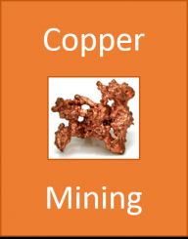
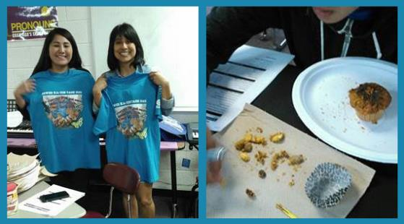
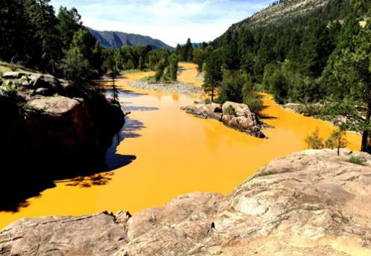
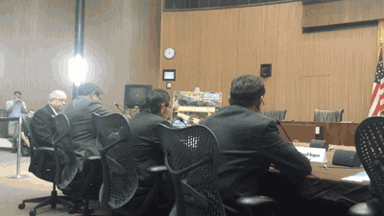
Education and Reaching Out to Stakeholders
Dr. Karletta Chief
Muffin Mining at Earth Day with Tribal students
Mining Modules: Mining and Environmental Education for Tribal Community Colleges
Testifying at Congressional hearing on Gold King Mine spill
Understanding the Gold King Mine spill

Slide 13
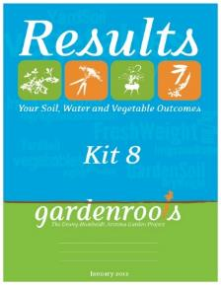
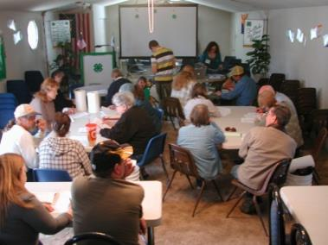

Gardenroots: A Citizen Science Program to Empower Communities Neighboring Contamination
Dr. Monica Ramirez
https://www.superfund.arizona.edu/projects/community-engaged-research/gardenroots/home
Now an Arizona-wide program called Project Harvest
Engaging community members through citizen science about the health of their harvested rainwater, soil, and plants.
https://projectharvest.arizona.edu/

Slide 14
An Outgrowth of this Work:
Center for Environmentally Sustainable Mining
Mission Statement
To develop educational and research initiatives that address environmental issues related to mining activities in arid and semi-arid environments.
Developed as a research translation vehicle to support Arizona communities, industry, and policy-makers
Environmental and engagement pillar for mining research at UA
Supports the Superfund Research Program and various other projects

Slide 15
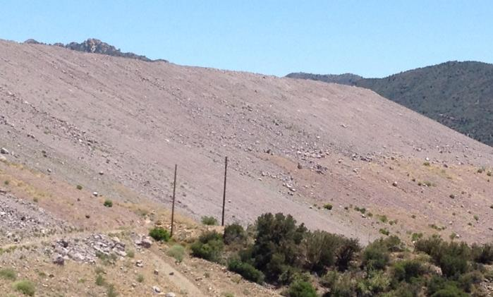
CESM Industry-Academic Cooperative for Reclamation
Dr. Julie Neilson and Dr. Raina Maier
Reclamation of Mine Tailings
Partnership
Grupo Mexico + KGHM Intl. + Rio Tinto + UA
Together addressing a critical component of active mining operations
Shared information
Shared expertise
Goal is to both protect environment and reduce operating costs

Slide 16

Questions
https://superfund.arizona.edu/

