Slide 1
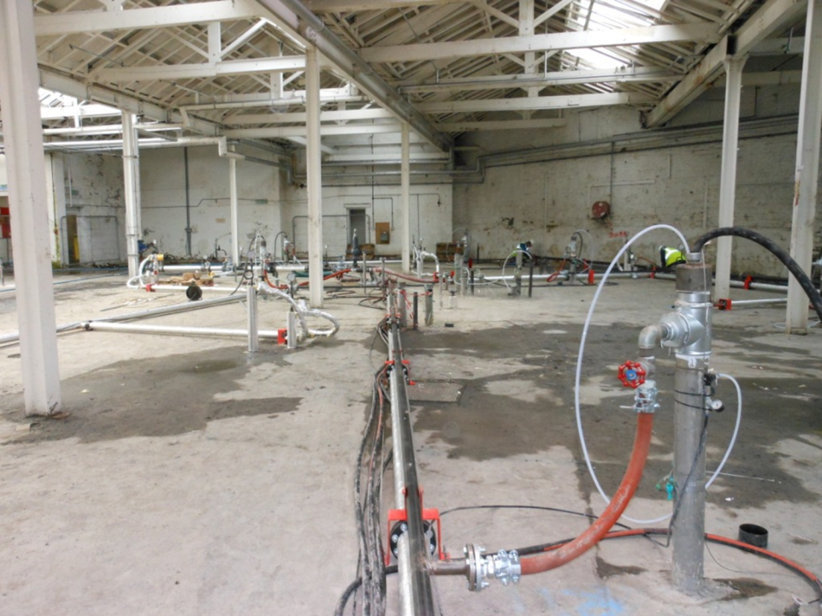


High resolution site characterisation coupled with in situ thermal as a means of sustainable remediation
The world’s leading sustainability consultancy

Slide 2
Case Study Overview
European (UK) case study
Complex site – chlorinated solvents in fractured bedrock
Pump & Treat originally envisaged as solution - thermally enhanced DPVE selected as an alternative
Application of sustainability through life cycle of project

Slide 3
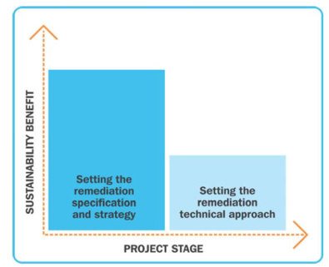
The NICOLE Roadmap - overview
NICOLE defines sustainable remediation as:
“a framework to embed balanced decision making in the selection of the strategy to address land [and/or water contamination] as an integral part of sustainable land use”; and
“a sustainable remediation project is one that represents the best solution when considering environmental, social and economic factors – as agreed by the stakeholders”.
The NICOLE road map sets out broad framework for incorporation of sustainability management and assessment principles into contaminated land management.

Slide 4
Translating NICOLE Road Map into Practice
ERM has integrated the NICOLE framework with key stages in project delivery as indicated below
Setting the remediation
specification and strategy
Setting the remediation
technical approach
CLIENT
End State Vision
PROJECT DEFINITION
PLANNING
(brownfield)
SITE
INVESTIGATION
RISK
ASSESSMENT
REMEDIAL OPTIONS
APPRAISAL
REMEDIATION
CONSTRUCTION
REMEDIATION
OPTIMISATION
End State Vision
ACHIEVED
Community & stakeholder engagement
Sustainable Procurement
Notes:
4

Slide 5
Project Definition
Environmental
Site specific sustainability indicators identified and metrics agreed
Predominantly Environmental, Economic – reflecting nature of site
Protection of human health key social metric
Overall boundaries of project set by corporate policies, timescale and business objectives
Social
Economic
Project Boundaries

Slide 6

Site Investigation
Primary benefits
Mass distribution
Contaminant Flux
Geochemistry
Risks refined & reduced
Refined area of treatment (reduced by 40%)
Areas of greatest mass identified and remediation targeted to those areas
Robust Conceptual Model
Underpins Sustainable Solutions
Secondary benefits
Minimised Waste generated
Eliminated Multiple Mobilisations
Reduced time on site, manual handling and multiple journeys
Minimised carbon footprint of works 13.5 tonnes CO2e cf 33 tonnes CO2e estimated
High Resolution Site
Characterisation Approach
Passive soil gas survey
Waterloo Profiler
Discrete Fracture Network

Slide 7
Remediation
Steam injection undertaken within challenging geological/hydrogeological scenario (confined, fractured rock aquifer)
Contaminants of concern: TCE, cis 1,2-DCE and vinyl chloride
Over 1,000kg of contaminant mass was recovered in less than three months
Post thermal treatment EVO injection to treat residual plume outside thermally treatment footprint
Sustainability considered in design and operation
  Utilisation of surplus steam as heating source
  Extensive instrumentation, real time monitoring and optimisation
  Combination of in situ thermal and bioremediation

Slide 8
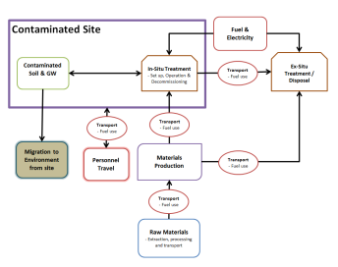
Life Cycle Assessment
As one of environmental indicators in the LCA ERM calculated carbon footprint of initially proposed pump and treat works and compared this to the thermal project actually undertaken
Modelling of the carbon footprint was carried out using the Life Cycle Assessment (LCA) software package Simapro and Life Cycle Inventory (LCI) data from the Ecoinvent 2.2 database for all materials, fuels and processes
Only considered set up and operation of the system and not decommissioning as this has not yet been completed and is unlikely to have a large effect on the results.

Slide 9
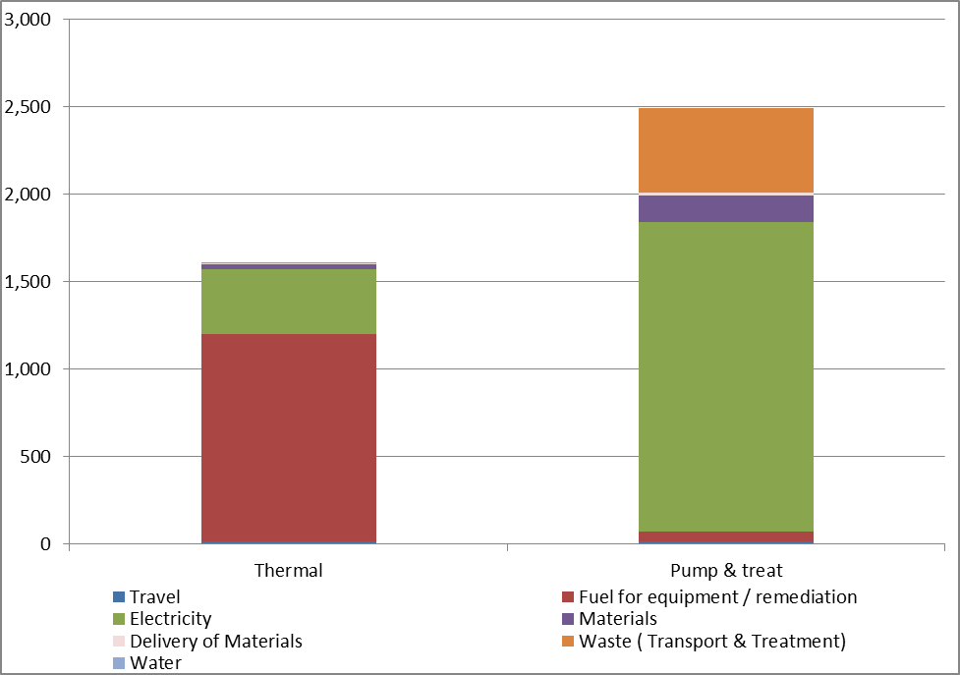
Results – GHG emissions
tons CO_{2-eq}
2496 tons
CO_{2-eq}
_{(+ 54%)}
1611 tons
CO_{2-eq}
Notes:
In implementation – site steam was insufficient / unreliable in supply so much of energy was derived from a dedicated boiler system- had a major influence on energy use
Energy requirement for pump & treat included operation of catalytic oxidiser – probably unrealistic and would have significantly reduced
Nature of electricity generation – also significant influence
Demonstrates importance of detailed site specific appraisal of issues and insights that may be gained from LCA
easier geo/hydro – less steam

Slide 10
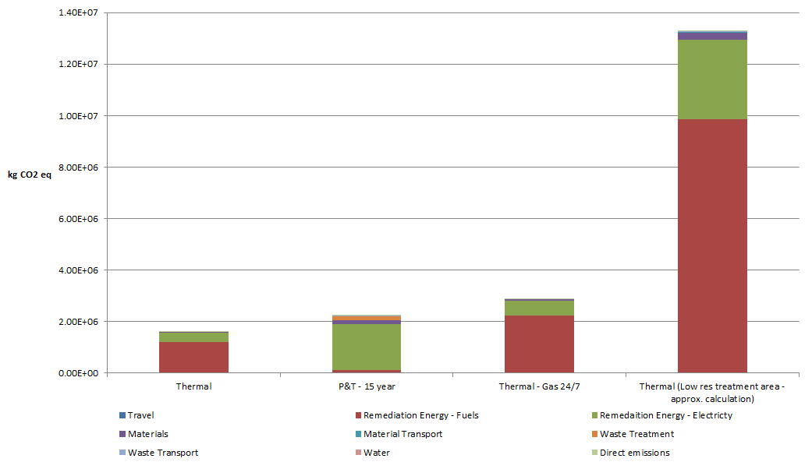
Results – Thermal vs P&T & No Optimisation
System(2) Performance - Steam
10

Slide 11
Conclusions
    Environmental Footprint significantly reduced compared to original approach
      underpinned by robust conceptual site model and understanding of risks
      accurate source zone delineation
      use of existing energy as available (if steam)
      optimised heat control and delivery
      polished residual with in situ bioremediation
    Future Innovation
      alternative energy supplies
      links with other technologies
      energy recovery
      ‘Low’ temperature thermal
    Broader business benefit – significant reduction of lifecycle costs
11

Slide 12
Acknowledgments
James Baldock, Donald Reid, Simon Tillotson & Jay Dablow ERM
http://www.nicole.org/
http://www.nicole.org/uploadedfiles/2013%20NICOLE-Common-Forum-Joint-Position-Sustainable-Remediation.pdf
http://www.claire.co.uk/index.php?option=com_content&view=article&id=738:surf-uk-indicator-report&catid=966:framework-and-guidance&Itemid=78

