Slide 1
Insight on themes for upcoming Sustainable Remediation Conference: Agenda and Host Country Goals
Marco Falconi (SuRF Italy / ISPRA)
Claudio Albano (SuRF Italy /CH2M HILL)

Slide 2
Agenda
Indroduction to SustRem2014
  Organization
  Topics
  Program & Venue
  Host Country Goals

Slide 3
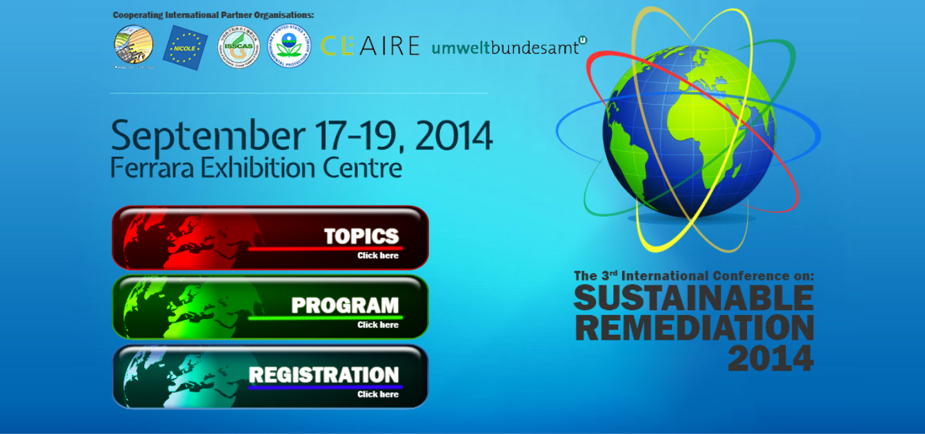
Introduction to SustRem2014
After Copenhagen 2009 and Vienna 2012…Italy will host
“The 3rd International Conference on
Sustainable Remediation 2014”
September 17 – 19, 2014 in Ferrara!
www.sustrem2014.com

Slide 4





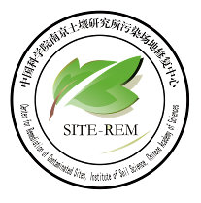


SustRem2014 - Organization
Organized by:
SuRF Italy – RECONnet
REMTECH - Ferrara Fiere
US EPA
CLAIRE
Austrian EPA
Cooperating International Partner Organizations

Slide 5
SustRem2014 - Themes
Conceptual Framing – new developments and learnings since 2012, visioning and experiences on policy development incentives and regulatory support
Tools, Metrics and Indicators – characterization and analysis to better understand ‘green’, ‘eco-efficient’, ‘sustainable’ and ‘socio-economical’ aspects
“Greening” Remediation, eco-efficient Technologies and Opportunities from Synergy – lowering the environmental footprint and increasing cost-effectiveness, developing technology demonstration, promoting renewables and combined benefit approaches
Case-studies – brownfield redevelopment; environmental footprint; increased cost-effectiveness, environmental & social improvement, renewables, combined benefit approaches (e.g. heat storage and groundwater remediation)
Stakeholder involvement and participative / collaborative approaches

Slide 6
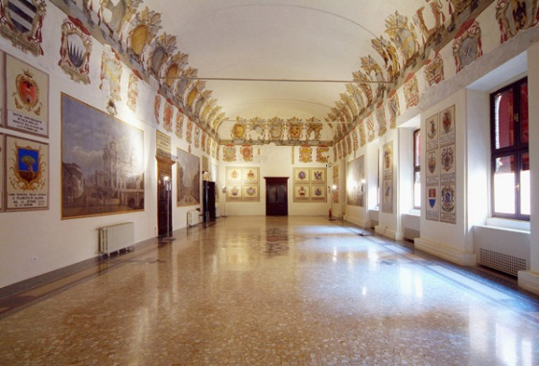
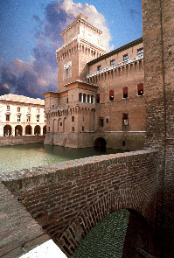
  SustRem2014 - Program & Venue
Registration dates
Registration - January 6th till September 3rd (30th June Deadline early bird).
Abstract submittal deadline – April 25th
Abstract acceptance confirmation - May
Conference
Wednesday, September, 17th (afternoon) – Ferrara Castle downtown
Conference opening
Thursday, September 18th - Fiera district
Technical & Scientific Sessions
Thematic and Project Workshops
Conference Dinner
Friday, September 19th 2014 - Fiera district
Plenary Session
Poster Session
Roundtable Discussion and Summary

Slide 7
  Host Country Goals
Promote SR experience from lessons learnt, case studies and governance at International Level
Witness and support the continuous improvement in SR practice
Spread the concepts of Green and Sustainable Remediation among Italian stakeholders (regulators, authorities, industries, service providers, territory)
Support the development of GSR framework tools for addressing and promoting the sustainability in remediation practice in Italy and Internationally

Slide 8
  Italian Environmental Regulation
Very clear statements in Environmental Act (Decree 152/06): remediation should…
  …tend to treat soil on site and reuse it as filling material
  …reduce risks related to transport
  …avoid any troubles related to noises and odors
  …adapt to morphological, vegetation and landscape characteristics of the surrounding area
  …ensure for each site the achievement of the objectives minimizing the environmental impacts

Slide 9
  Italian Environmental Regulation
Reuse of excavated soil (Decree 161/2012 and Law 98/2013) Excavated soil from a contaminated sites…
  …if reused on site for construction activity
    …is not waste if it’s not contaminated (C_{soil} < Screen. Level)
    …is not waste if after leaching test, the concentration is lower than a certain threshold (C_{leachate} < Threshold level)
  …can be considered as a by-product and reused off site
    …if (C_{soil} < Screen. Level) and it will be used in the same exposure scenario
    …if the risk assessment determines an acceptable risk for the future destination
  …if the site is a worked-out mine, can be reused on site (e.g. nourishment of slopes)

Slide 10
  Italian Environmental Regulation
Water Saving (Law 98/2013): In presence of contaminated groundwater…
  …you should identify and use the BAT to treat the plume
  …if you use P&T, you should evaluate the use of the extracted groundwater in the industrial cycle
  …treated GW are considered as industrial waters (e.g. they can go in sewage)
  …reinjection of treated GW can be authorized if
    the water will not contain harmful substances
    additional measures and monitoring controls are implemented
  …physical barriers are allowed only in few cases

Slide 11
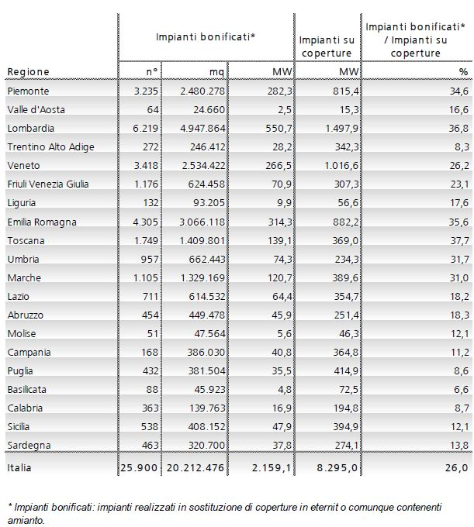
  National Incentives to GSR
Region | Cleanup sites | PV | % On total
Example push to Greening remediation represented by PhotoVoltaic (PV) incentives schemes on clean up sites
10% Incentives for PV installed in replacement of ACM covers
5% Incentives for ground-mounted PV on remediated sites
In 11 regions, mandatory to install PV systems on service stations roofs
Incentives ended July 2013
More than 20 Km² PV installed Source: GSE.it (2012)

Slide 12
  Soil Remediation Status in Italy
Source: Risk reduction measures in NPL sites (EIONET 2012)

Slide 13
  GW Remediation Status in Italy
Source: Risk reduction measures in NPL sites (EIONET 2012)

Slide 14
  Conclusions
Environmental regulations in Italy (and globally) includes provisions for green practices.
Currently remediations occur mainly via traditional, more impacting technogies.
Sustainable Remediation frameworks, strategies and tools can support the enhancement of environmental cleanup activities, via increasing culture and consensus from project Stakeholders.
SustRem2014 represents a great opportunity for remediation practitioners and industry to learn and share best practices, challenges and success stories to support sustainability at international level.

Slide 15
Looking forward seeing you in Ferrara! Thank you !
M. Falconi (ISPRA) marco.falconi@isprambiente.it
C. Albano (CH2MHILL) claudio.albano@ch2m.com
www.surfitaly.it
www.sustrem2014.com

