Slide 1
Using Quantitation to Develop
Sustainable Solutions

Slide 2
Why consider quantitation?
Main purpose is to provide information on the most significant contributions to environmental footprint
Helps to identify opportunities to reduce contributions
Can also be used to estimate benefits of potential Best Management Practices
Can be used in any step of the cleanup life cycle, but most application in the following steps
  Remedy selection
  Design
  Optimization of O&M
Reduction in environmental footprint often results in lower costs as well
SURF supported the ASTM Greener Cleanup Standard and ASTM Integration of Sustainable Cleanup Objectives Standard
Research into quantitation with economic and societal aspects ongoing
We will focus on environmental footprint quantitation in these examples

Slide 3
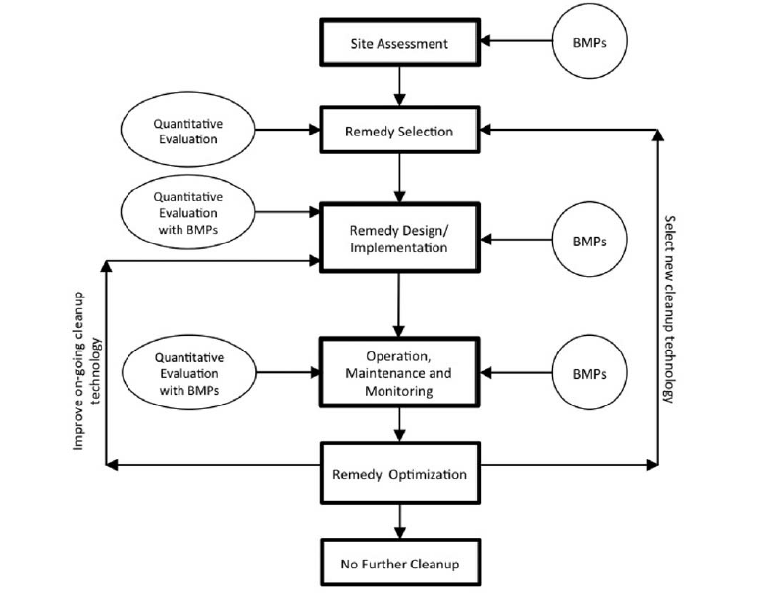
ASTM Greener Cleanup Overview (2013)

Slide 4
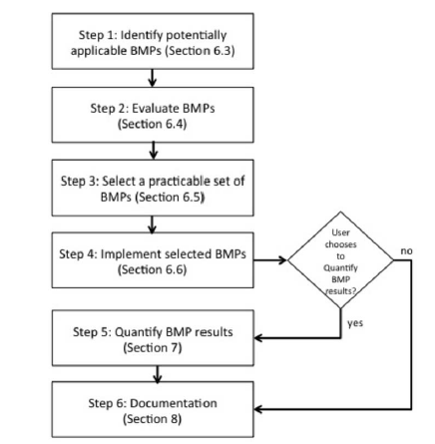
Integration of Sustainable Cleanup Objectives (ASTM 2013)

Slide 5
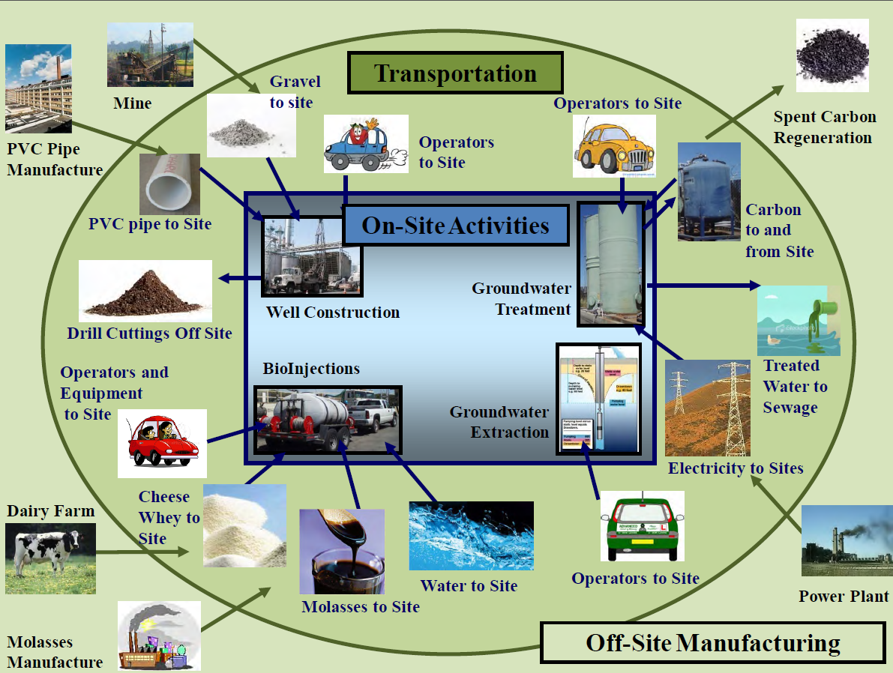
From Greener Cleanups Presentation (EPA 2012, K Scheuermann)

Slide 6
Tools to Support Quantitation
Footprint Analysis
Life Cycle Assessment
Footprint analysis tools are free, easy to learn and utilize
Focus primarily on CO₂ emissions, NO_{x}, SO_{x}, PM, and energy
Some tools go further and provide water use and optimization modules
Most common tools:
  AFCEC SRT™
  SiteWise™
  EPA SEFA
Relatively expensive per license; significant knowledge of LCA and training on tool required
Reports results in terms of environmental impacts in addition to specific emissions
Robust analytical capabilities
Most common tool:
  SimaPro
  GaBi (though not widely used in remediation industry)

Slide 7
Travis AFB Site DP39 Summary
TCE plume 2000 feet long
Source concentration of 8,000 ug/L
Aquifer thickness 20 to 60 feet
Interbedded silty-sands and clays
Eight-year interim pump and treat remedy failed to reduce source area TCE
Focused FS proposes green remediation alternative (bioreactor, phytoremediation, biobarrier oil injection)
Compared to groundwater pumping and GAC treatment

Slide 8
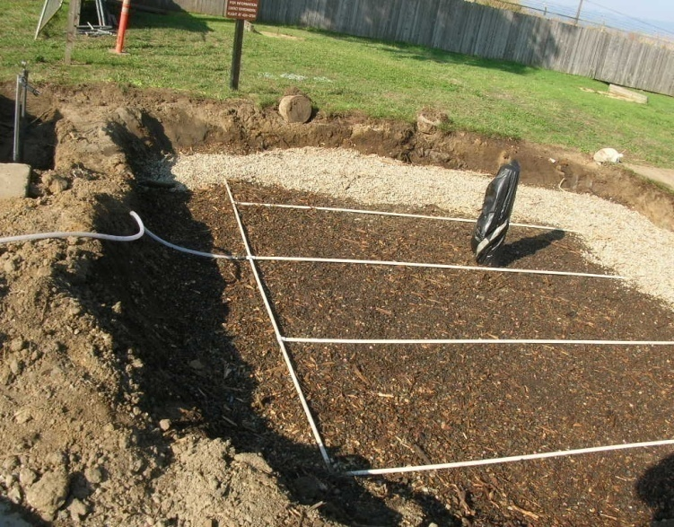
Green Remedy Alternative
Solar powered Insitu bioreactor
Deep plume Biobarrier
Shallow plume -
Phytoremediation
Long-term monitoring using passive bag diffusion samplers
EPA Region 9 case study for sustainable remediation

Slide 9
Quantitation Comparison
30-Yr Life-cycle Impacts | Alt 1 – Existing Pump and Treatment with GAC | Alt 2 – Green Remedy Bioreactor/ Phytoremediation/ Bio-barrier/ MNA
GHG as CO2 (tons ) | 1500 | 453
Energy Used (kw-hr equiv) | 6,700,000 | 93,500

Slide 10
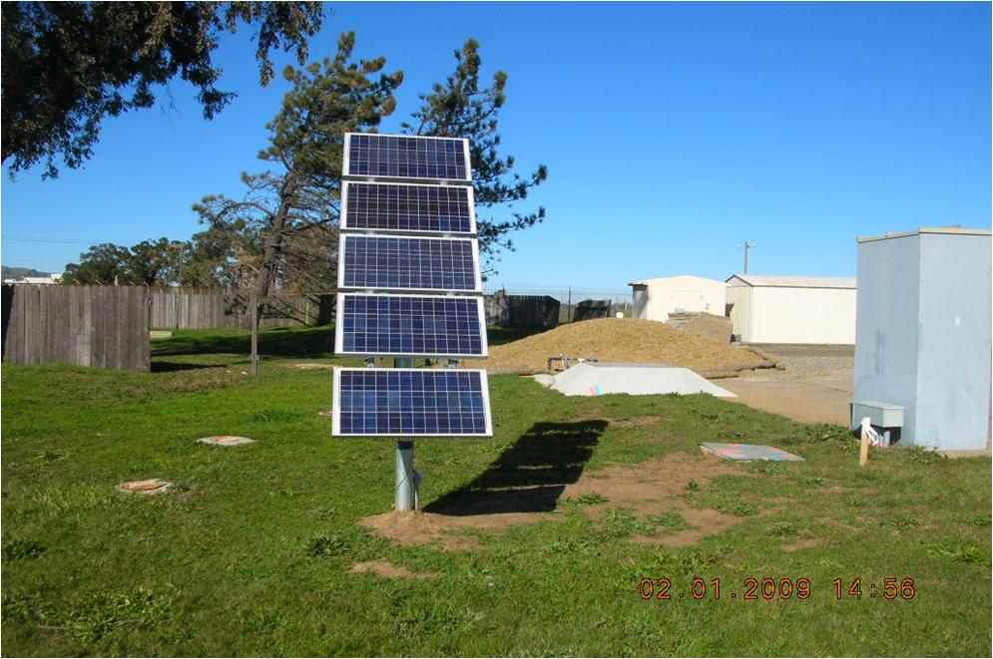
Solar-Powered Bioreactor
10

Slide 11
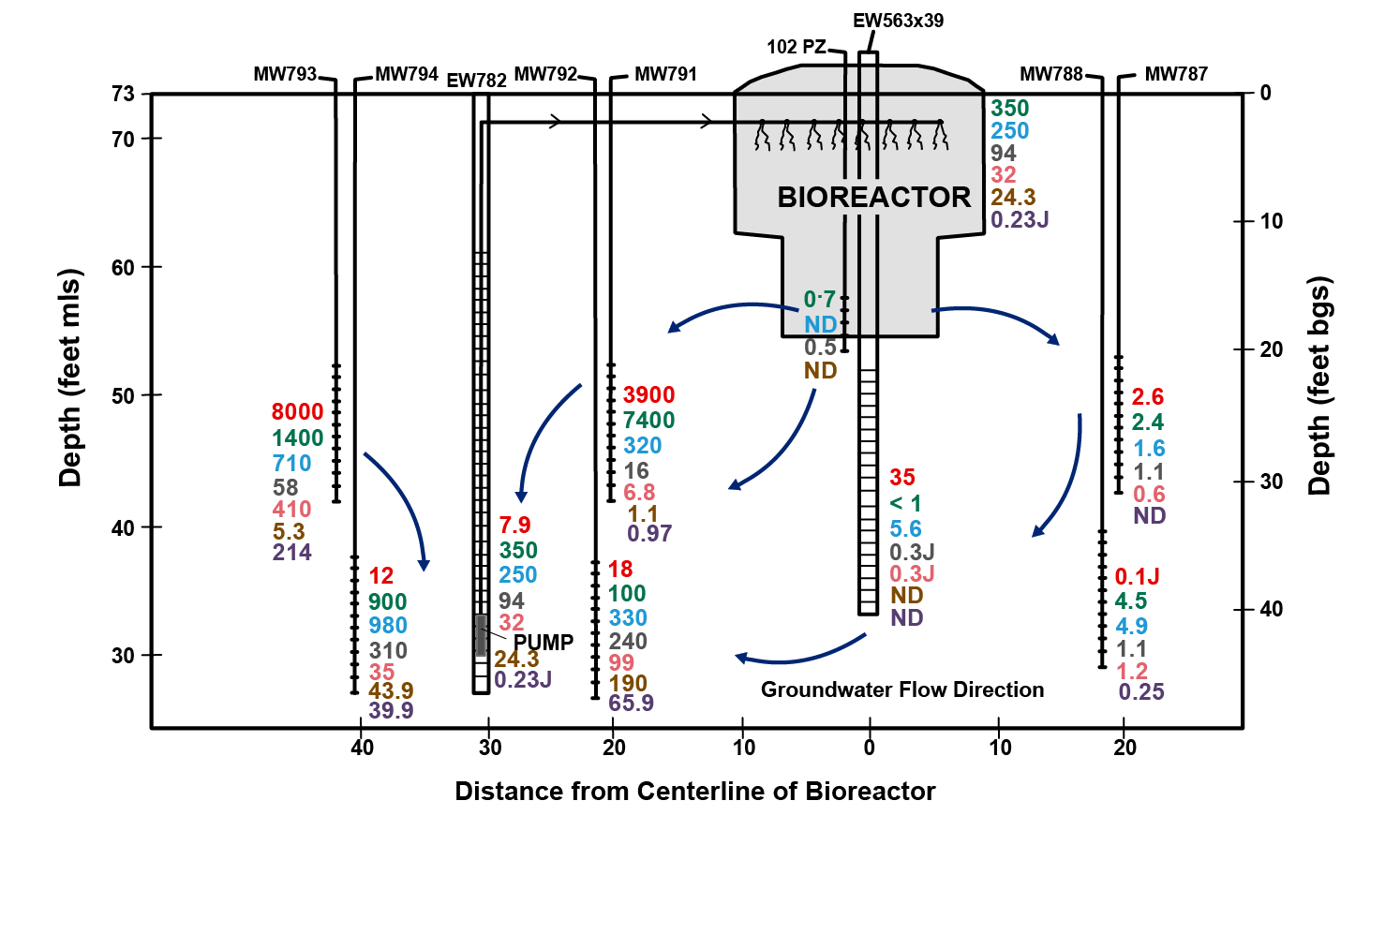
TCE in Groundwater
Would not have considered this approach unless we asked
“can we make it greener?”

Slide 12
Material Substitution
Alternative analysis considered:
  Onsite solidification with cap - traditional
  Onsite solidification with cap - sustainable
Footprint analysis was performed to identify components of the onsite remedy that could be modified to make the closure more sustainable
Portland cement identified as key contributor to the green house gas footprint
Raised awareness of potential to use green pozzolans to reduce the footprint

Slide 13
Sustainable Remediation Case Study
Material Substitution
Team evaluated sources and effectiveness of green pozzolans and selected an alternate solidification agent
GHG avoidance – 6400 metric tons
Design estimated cost savings for material substitution $125,000
Would not have recognized material substitution if we did not ask “how can we make this greener?”

Slide 14
New SURF Technical Initiative
Compilation of case studies
Will be shared freely on SURF website
Use of a simple standard template to report information
Show depth and breadth of successful applications of sustainable remediation
Email CSI@sustainableremediation.org if you would like to contribute

