Slide 1
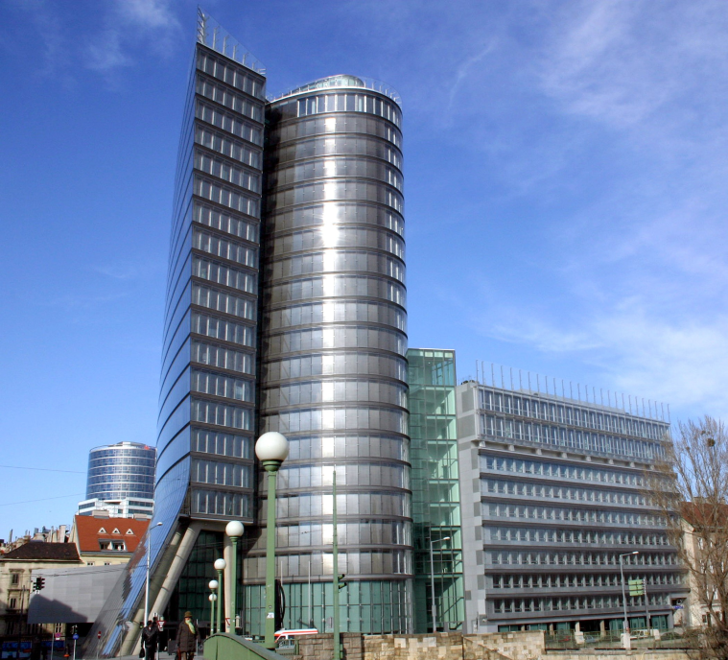
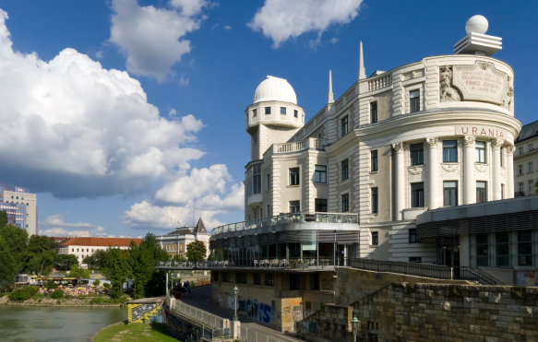
concepts for designing diversity & future
smart & visible projects
Entities leading green & sustainable remediation
GLOBAL UPDATE
Dietmar MÜLLER-GRABHERR
Sustainable Remediation Webinar – April, 15, 2014
Notes:
1

Slide 2
Agenda
Global round up of initiatives
    Asia and Australia
    Europe
    North & South America
      Further International Efforts
Achievements and resources (highlights* since 2012)
*illustrative
Sustainable Remediation – April, 15, 2014

Slide 3
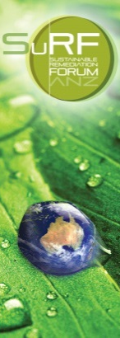
Asia & Australia
SurF ANZ (Australia & New Zealand, 2009)
  collaborative stakeholder forum (within ALGA)
SuRF China (to be established 2014)
  E3 (engineering centres) platform & SiteRem
SuRF Taiwan (since 2012)
    working group within TASGEP (LOOK OUT: Los Angeles Environmental Forum, 7 – 14 August 2014)
Sustainable Remediation Webinar – April, 15, 2014

Slide 4
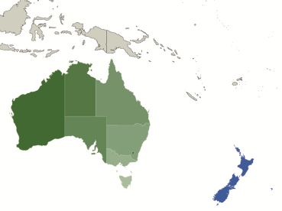
SuRF ANZ - achievements
Ongoing development of a Framework for SR.
Organizing meetings and forums for SR dialogue
  CleanUp 2013 (15 – 18 September 2013, Melbourne)
Establishing SuRF ANZ policy in consultation with members (e.g. March 2014 Internet Bulletin):
  The Sustainable Remediation On-line Dialogue
Providing website-based SR tools
Contributing to a national remediation framework (NRF) - being developed through CRC CARE.
Sustainable Remediation Webinar – April, 15, 2014

Slide 5


Europe (1)
COMMON FORUM (regulators and policy-makers network)
NICOLE (industry and business network)
SuRF-UK (since 2007)
SuRF-NL (informal Dutch network, since 2011)
SuRF-Italy (since 2012)
Sustainable Remediation Webinar – April, 15, 2014

Slide 6
Europe (2) - achievements
NICOLE:
NICOLE-Workshop Green Remediation (Lisbon, Portugal; June 12 - 14, 2013)
NICOLE & COMMON FORUM:
Risk-Informed and Sustainable Remediation (Joint Position Statement, June 2013)
    available also: Dutch, French, German & Italian translation
COMMON FORUM:
Public procurement as a further key for SR
  submitted a project proposal to the European Commission
Sustainable Remediation Webinar – April, 15, 2014

Slide 7
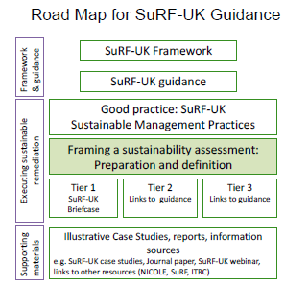
SuRF-UK - achievements
Phase 3 results (2013)
  see: SuRF-UK Bulletin 4
  Sustainable Management Practices (report & excel spreadsheet)
  Project Framing Guidance
  Tier 1 – Qualitative Assessment
first Case studies (October 2013)
Sustainable Remediation Webinar – April, 15, 2014

Slide 8
North America & South America
US EPA
ITRC (Interstate Technology & Regulatory Council)
Environment Canada
SURF (since 2006)
SuRF Brazil (since 2010)
SuRF-Canada (since 2011)
ASTM International
  [formerly: American Society for Testing and Materials (ASTM)]
Sustainable Remediation Webinar – April, 15, 2014

Slide 9
North America - achievements
SURF (publications 2013):
Integrating Remediation and Reuse to Achieve Whole-System Sustainability Benefits
Groundwater Conservation And Reuse At Remediation Sites. Published December 2013.
ASTM (publications 2013):
E2876 Standard Guide for Integrating Sustainable Objectives into Cleanup
E2893 Standard Guide for Greener Cleanups
Sustainable Remediation Webinar – April, 15, 2014

Slide 10
Other International Efforts
CL:AIRE (UK) organizing
    International SuRF network
ISO (International Organization for Standardization)
    WG drafting: Guidance on sustainable remediation (under ISO TC 190 SC “Soil and site assessment”; lead: Paul Nathanial, Univ. Nottingham & LQM)

Slide 11
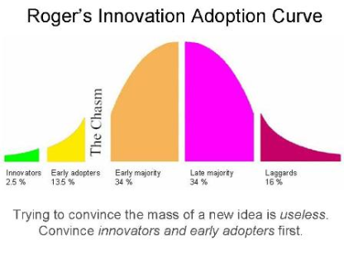
SustRem2012 - supported:
strengthened global exchange
NICOLE & CF Joint Position
SuRF Italy
from conceptual discussions to practice: Case studies
TO PREPARE INNOVATION
It’s a process - and it’s about PEOPLE
THANKS FOR LISTENING !
Sustainable Remediation Webinar – April, 15, 2014
Notes:
11

Slide 12
SOURCES
  SuRF ANZ www.surfanz.com.au/
  SuRF Taiwan www.tasgep.org.tw/
  Common Forum www.commonforum.eu
  NICOLE www.nicole.org
  SuRF-UK www.claire.co.uk/surfuk
  SuRF-NL www.surf–nl.com
  SuRF-Italy www.surfitaly.it
  US EPA www.cluin.org/greenremediation/
  ITRC www.itrcweb.org
  Environment Canada www.ec.gc.ca
  SURF www.sustainableremediation.org
  SuRF Canada www.surfcanada.org
  SuRF International www.claire.co.uk/surfinternational
  ASTM International www.astm.org
ALSO LOOK OUT FOR: “The Rise and Future of Green and Sustainable Remediation“ DOWNLOAD: www.thehorinkogroup.org
Notes:
12

