Slide 1

Green Remediation
An Overview of the State of the Practice
Carlos Pachon
USEPA
Washington, DC
April 15, 2014
1

Slide 2
Agenda
Trends in technology selection in Superfund: Implications for green remediation practices
Developments in technical tools and guidance
Examples of what is happening in the field
Summary

Slide 3
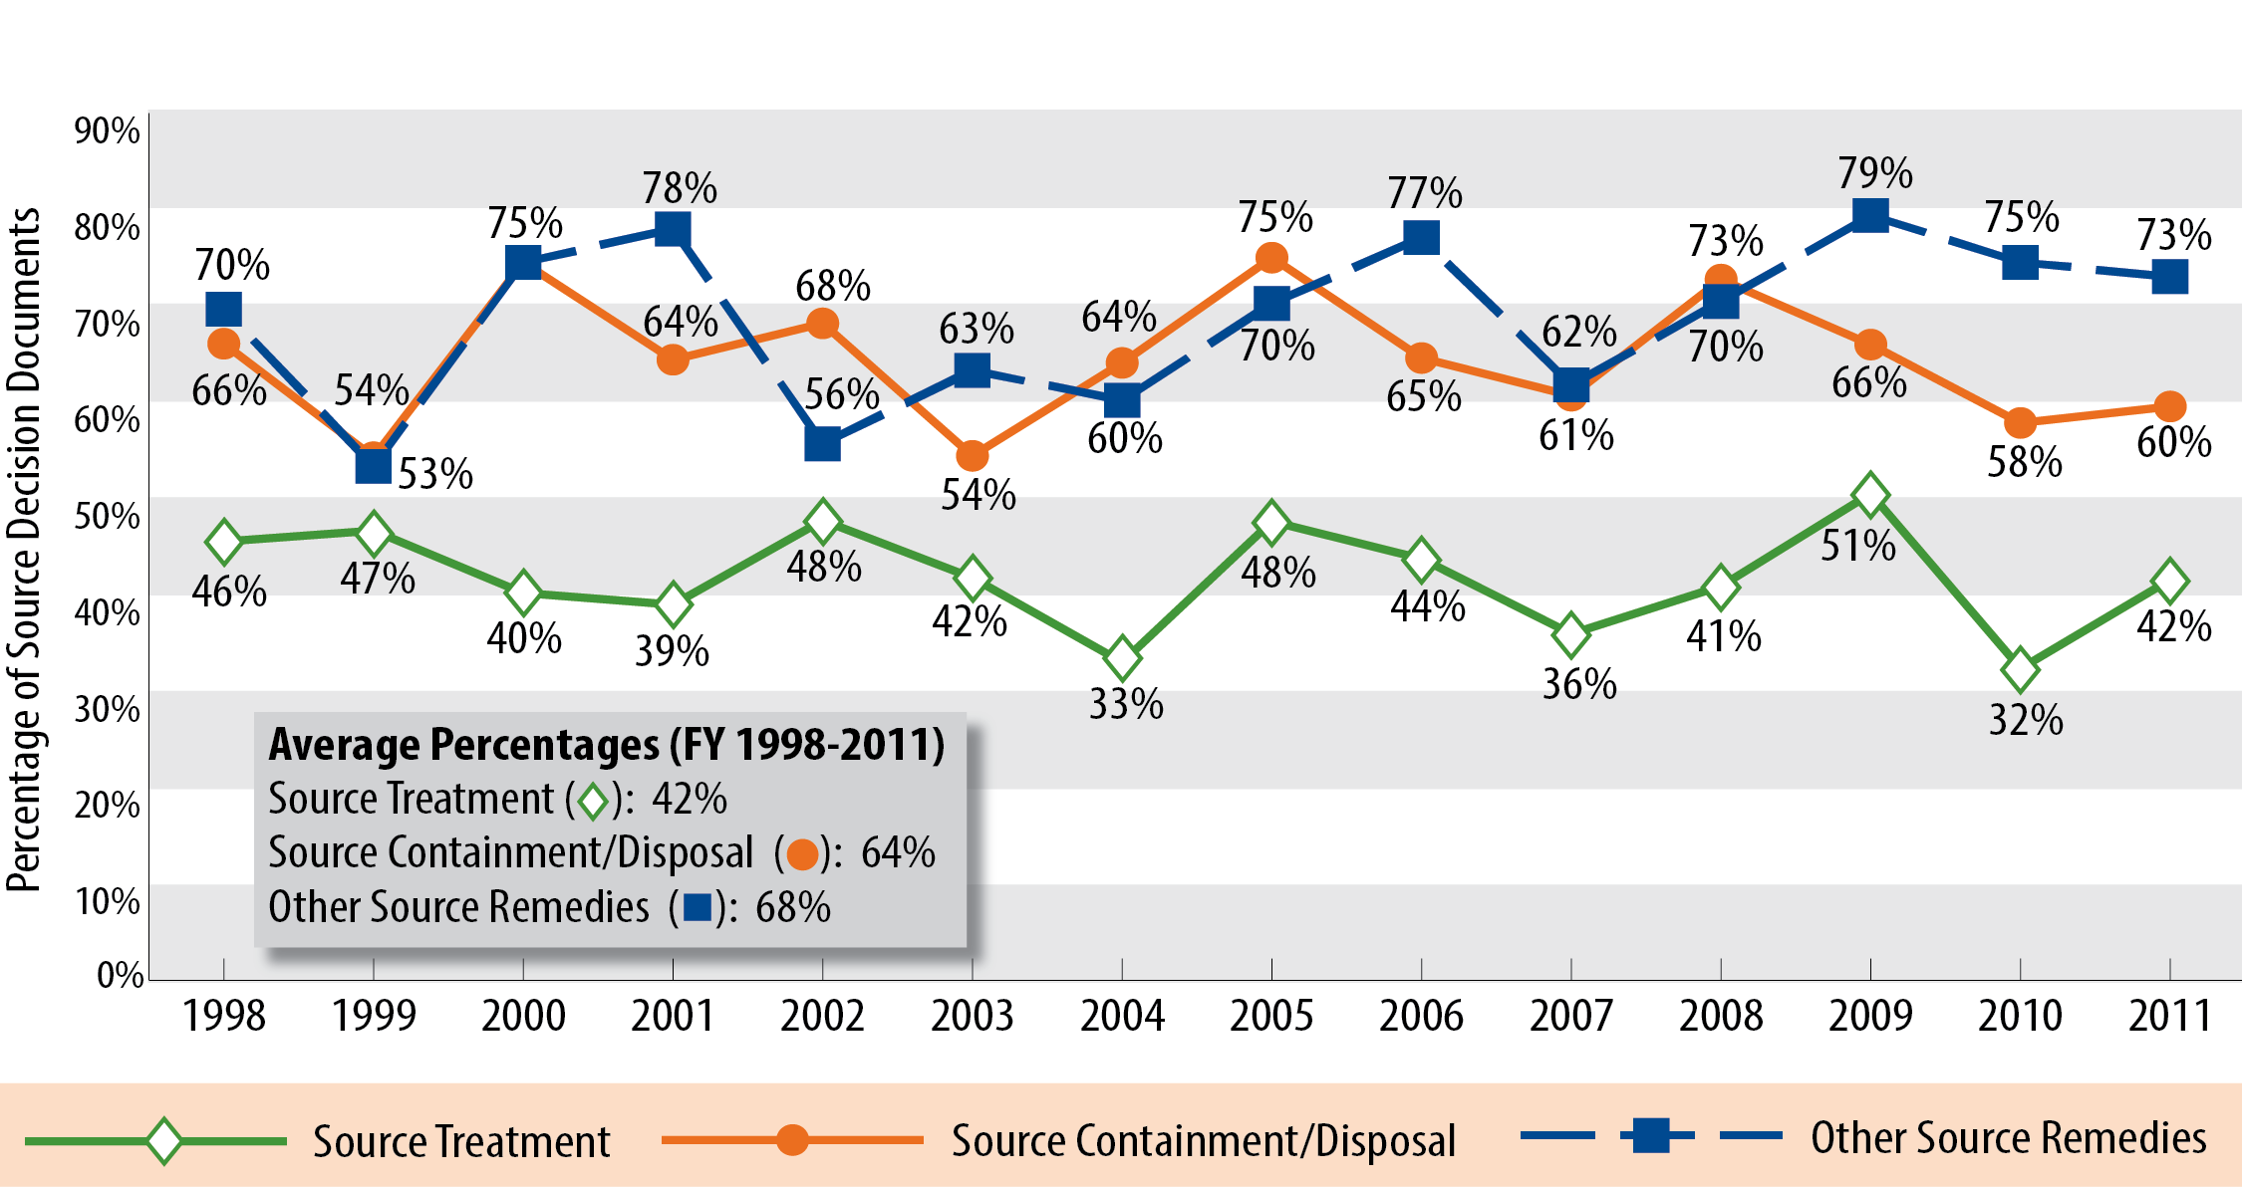
Continuity in Remedies for Site Cleanup (1/2)
Trends in Superfund Remedy Decisions for Contaminant Sources*
* Figure 8: Superfund Remedy Report http://cluin.org/asr

Slide 4
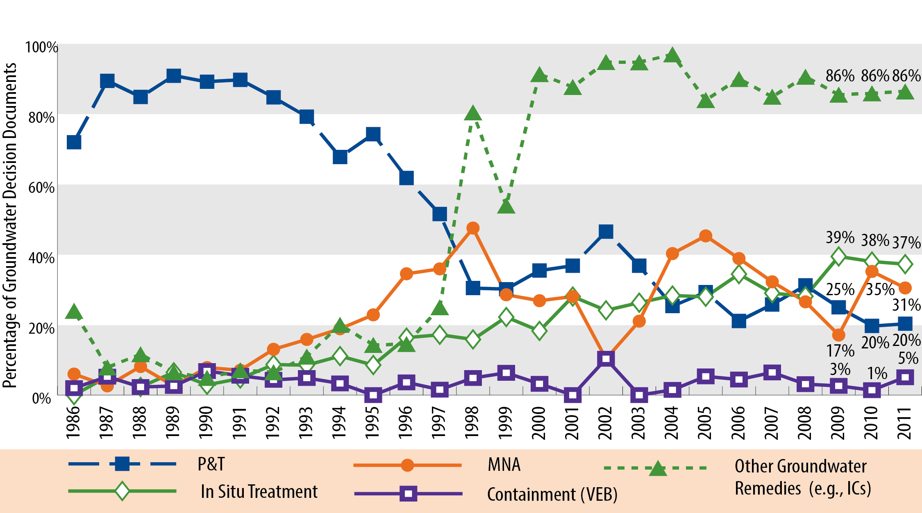
Continuity in Remedies for Site Cleanup (2/2)
Trends in Superfund Remedy Decisions for Ground Water*
* Figure 11: Superfund Remedy Report http://cluin.org/asr
Notes:
5 main points: mix of remedies, ICs high now, in situ continues to go up, p&t continues to stay low (does not distinguish between restoration & contain RAOs); containment of gw low; doesn’t include hydraulic containment
RODs and decision documents may be counted in more than one category.
RODs from FY 1986 - 2004 include only RODs and ROD amendments.
Other remedies selected prior to 1998 may be under represented in figure. [WHY?] LF: I don’t remember why!
Values shown for last 3 years
Groundwater Other mostly ICs; left monitoring out this time (used at every site even if not in decision doc)
Main msgs: In situ GW continues up; P&T for GW has leveled out; MNA is up & down; ICs constant

Slide 5
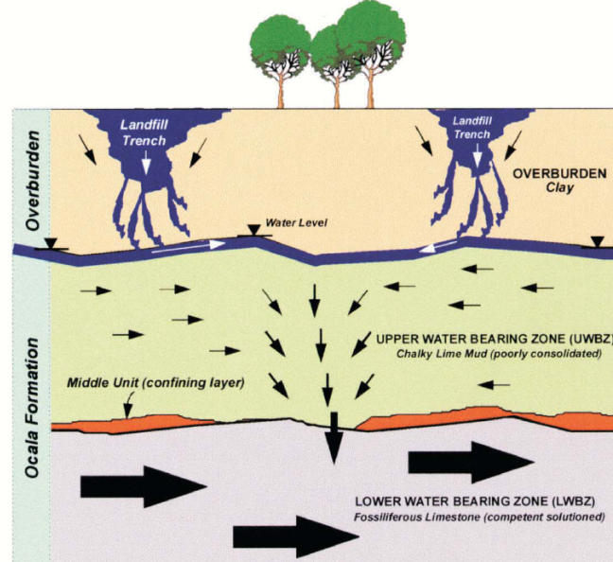
Footprint Reduction in Remedies
Consistent with science and engineering principles and lessons learned to date
Large reductions in footprints come from…
  Accurate and continuously updated
  conceptual site model (CSM)
  Well-characterized source areas and contaminant plumes
  Optimal remedial strategy
  Sound engineering in design
  Streamlined performance monitoring
  Adaptive management
…then, focus on greening the resulting remedy

Slide 6
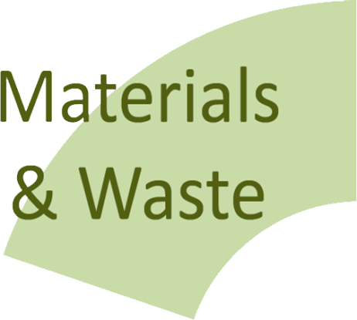





Robust BMPs Addressing all Core Elements of Green Remediation
“Minimize, Reuse,
and Recycle…”
“Reduction, Efficiency,
and Renewables…”
“Conserve, Protect,
and Restore…”
“Protect Air Quality, Reduce Greenhouse Gases…”
“Improve Quality,
Decrease Quantity of Use…”

Slide 7
Technical Guidance and Tools for Implementation
ASTM Standard Guide for Greener Cleanups
  Voluntary guide
    Approach for selecting BMPs, including use of quantitative methods
    Specifies documentation of actions taken
  Use encouraged at EPA Cleanup Programs
  Webinar April 25 (see cluin.org)
Environmental Footprint tools
  Updated EPA Methodology Spreadsheets
  Battelle Sitewise Tool (In use by US Navy and Army)
  US Air Force Sustainable Remediation Tool (SRT)
  Proprietary tools on the market and developed by Consulting and Engineering firms
Contracting language
Notes:
SRT – technology specific tools, excell based.
SEFA is activity based, provides flexibility
Sitewise is also activity based.

Slide 8
In the Field
Conducting environmental footprint quantification helps target BMPs to address key contributors
Green remediation is being embedded into existing project management processes
For new remedies; Footprint reductions achieved through focused system design and a robust remedial strategy with adaptive management responding to continuously updated CSM
Existing remedies: System optimization analyses provide a good opportunity to identify and implement footprint reduction measures
Protecting human health and the environment are still key drivers in remedy decisions

Slide 9















GSR: An Expanding Practice and Expectation*
* Companies identified based on an Internet search for ‘green remediation”. Their inclusion does not constitute an endorsement and the list is not comprehensive.

Slide 10
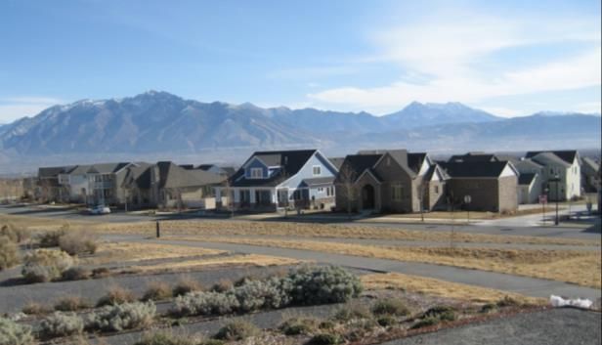
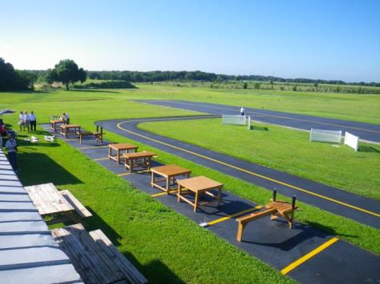
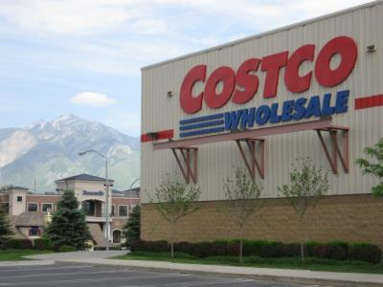
SRI: the Superfund Redevelopment Initiative
Working with communities and other partners in considering future use opportunities and integrating appropriate reuse options into the cleanup process
http://www.epa.gov/superfund/programs/recycle/index.html
Reuse as a Priority
Integrated planning of cleanup and reuse
Tools and Resources
Redevelopment Partnerships
Training and Education
Site-specific Support
Performance Measurement
15th Anniversary of SRI this year
Notes:
Restoring, revitalizing, and bringing economically productive new uses to Superfund sites is a vital part of EPA’s work. Communities have been reusing cleaned up sites for many years and for a wide variety of purposes. During the past 15 years, SRI has directly supported efforts to return Superfund sites to productive use.
Our mission at SRI is to work with communities and other partners in considering future use opportunities and integrating appropriate reuse options into the cleanup process.
EPA has always been supportive of site reuse but our thinking regarding when to consider reuse in the remedial process has evolved over time. In recent years, reuse has become an integral part of the Agency’s strategic plans and goals. The 1995 Land Use Directive, titled “Land Use in the CERCLA Remedy Selection Process,” emphasizes the need to consider future land uses while making remedy selection decisions at Superfund sites. EPA further reinforced this Agency-wide mandate with the 2010 Reuse Directive, formally called “Considering Reasonably Anticipated Future Land Use and Reusing Barriers to Reuse at EPA-lead Superfund Remedial Sites.” This 2010 directive is designed to guide continued reuse support at Superfund sites throughout the cleanup pipeline and specifically speaks to addressing reuse opportunities at later cleanup stages, such as when remedy construction is underway or even complete. EPA’s Superfund program actively seeks out the reuse or return to use of Superfund sites in ways that are compatible with the site remedy, ensure the long-term protection of human health and the environment, and support the productive use of the site for years to come.
The tools and resources available through SRI are critical to supporting the Agency’s strategic plans and goals.
SRI’s Return to Use Initiative aims to remove barriers to reuse that are not necessary for the protection of human health, the environment, or the remedy at those sites where remedies are already in place. We work with the Regions to find ways for Headquarters to potentially help address barriers on a site by site basis. We then share those journeys in demonstration project fact sheets with the hopes of reaching other communities and site teams looking for inspiration or solutions for reuse questions at a Superfund site.
Ready for Reuse determinations, or RfRs, provide a single summary document outlining that a site “ready for reuse”. It documents that a contaminated site has been characterized and cleaned up to the extent necessary for specified current or future types of uses as long as the use limitations identified continue to be met. Use of RfR Determinations has proven to be valuable for dealing with confusion over what future uses are appropriate at a site and helpful in facilitating the public and private reuse of sites.
Another excellent resource that SRI has is our partnerships. Currently we are partnering with the Academy of Model Aeronautics, the U.S. Soccer Foundation, the Rails to Trails Conservancy, the Pollinator Partnership and The Trust for Public Land. We have worked with these partners on several successful projects and can provide you with additional information if you are interested in a specific type of site reuse. These partnerships are a great way to open the door to exploring reuse opportunities and available resources. All of these organizations are familiar with Superfund and are willing to work with interested communities. I encourage you all to visit the Redevelopment Partnerships page on our website to learn more about our partners and the unique skills, tools and resources they can bring to the table.
SRI hosts a quarterly webinar series focusing on reuse questions, types and topics raised by communities and EPA Regional staff. In addition, SRI participates in national conferences to help share more information with communities about reuse opportunities and share available tools and resources with EPA staff to support reuse efforts.
There is no one-size-fits-all approach to Superfund reuse. SRI understands that each site and community present a unique situation with unique needs. However, regardless of the type of site or cleanup status, Regional Seeds provide an important catalyst for communities to begin the reuse process. While Regional Seeds can support other reuse activities, the majority of Regional Seed funding directly supports site reuse planning.
Many sites have reuse potential but remain vacant or idle because stakeholders lack understanding of the remedy components, the types of potential future uses, and the key steps and players needed to return a site to beneficial use. The seed concept kick starts the process by bringing the right stakeholders to the table, clarifying the remedy and any constraints on reuse, and outlining the community’s goals and suitable reuse options to pursue.
SRI also uses the Sitewide Ready for Anticipated Use, or SWRAU, performance measure to report the Superfund program’s accomplishments in making land ready for reuse at construction complete sites. The measure reflects EPA’s priority on reuse as an integral part of the Agency’s cleanup mission for the Superfund program.
And, last but not least, we are celebrating the Superfund Redevelopment Initiative’s 15th anniversary this year! Over the past 15 years, SRI has been involved in the reuse process at many sites. In 1999, we faced the question of how to return cleaned up, vacant Superfund sites to beneficial use in their communities – today we can proudly say that there are more than 700 Superfund sites in actual, continued or planned reuse. We have found that sharing the stories of successful reuse projects is one of SRI’s most valuable tools. We will be celebrating with events and projects all year long. I would urge you to visit the SRI website often as we continue to post new tools, resources and reuse success stories.
Pictured: Residential reuse including Energy Star® certified homes in the Daybreak Community at the Kennecott (South Zone) site in Salt Lake County, Utah; commercial reuse at the Murray Smelter site in Murray City, Utah; recreational reuse as a model airplane park at the Taylor Road Landfill site in Hillsborough County, Florida

Slide 11
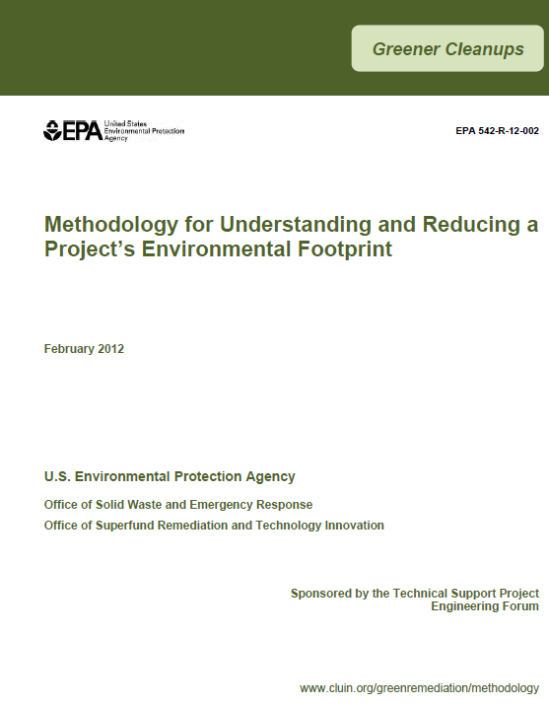
Options for Implementing Green Remediation
Direct Use of Best Management Practices (BMPs)
  Excavation and Surface Restoration
  Site Investigation
  Pump and Treat Technologies
  Bioremediation
  Soil Vapor Extraction & Air Sparging
  Clean Fuel & Emission Technologies for Site Cleanup
  Integrating Renewable Energy into Site Cleanup
  Sites with Leaking Underground Storage Tank Systems
  Landfill Cover Systems & Energy Production
  Mining Sites
  Implementing In Situ Thermal Technologies
  Overview of EPA's Methodology to Address the Environmental Footprint of Site Cleanup
For Complex Projects – Apply Footprint Quantification
  Analyses key remedy components that are contributors to footprint
  Information form footprint analysis can help define priority footprint reduction actions
  USEPA produced a methodology for in-house use, but open to all
www.cluin.org/greenremediation/

Slide 12
In Summary
Green remediation is not a “new technology” but an improvement to the existing portfolio or remediation technologies
Awareness and use of GR best management practices is expanding in most cleanup programs, at large and small sites
GR is not regulatory requirement, but a practice many entities pursue in line with sustainability objectives
Consulting and engineering firms are increasingly incorporating GR BMPs into their standard operations
A large body of GR technical resources is available, and multiple groups are engaged in advancing the practice

