Slide 1
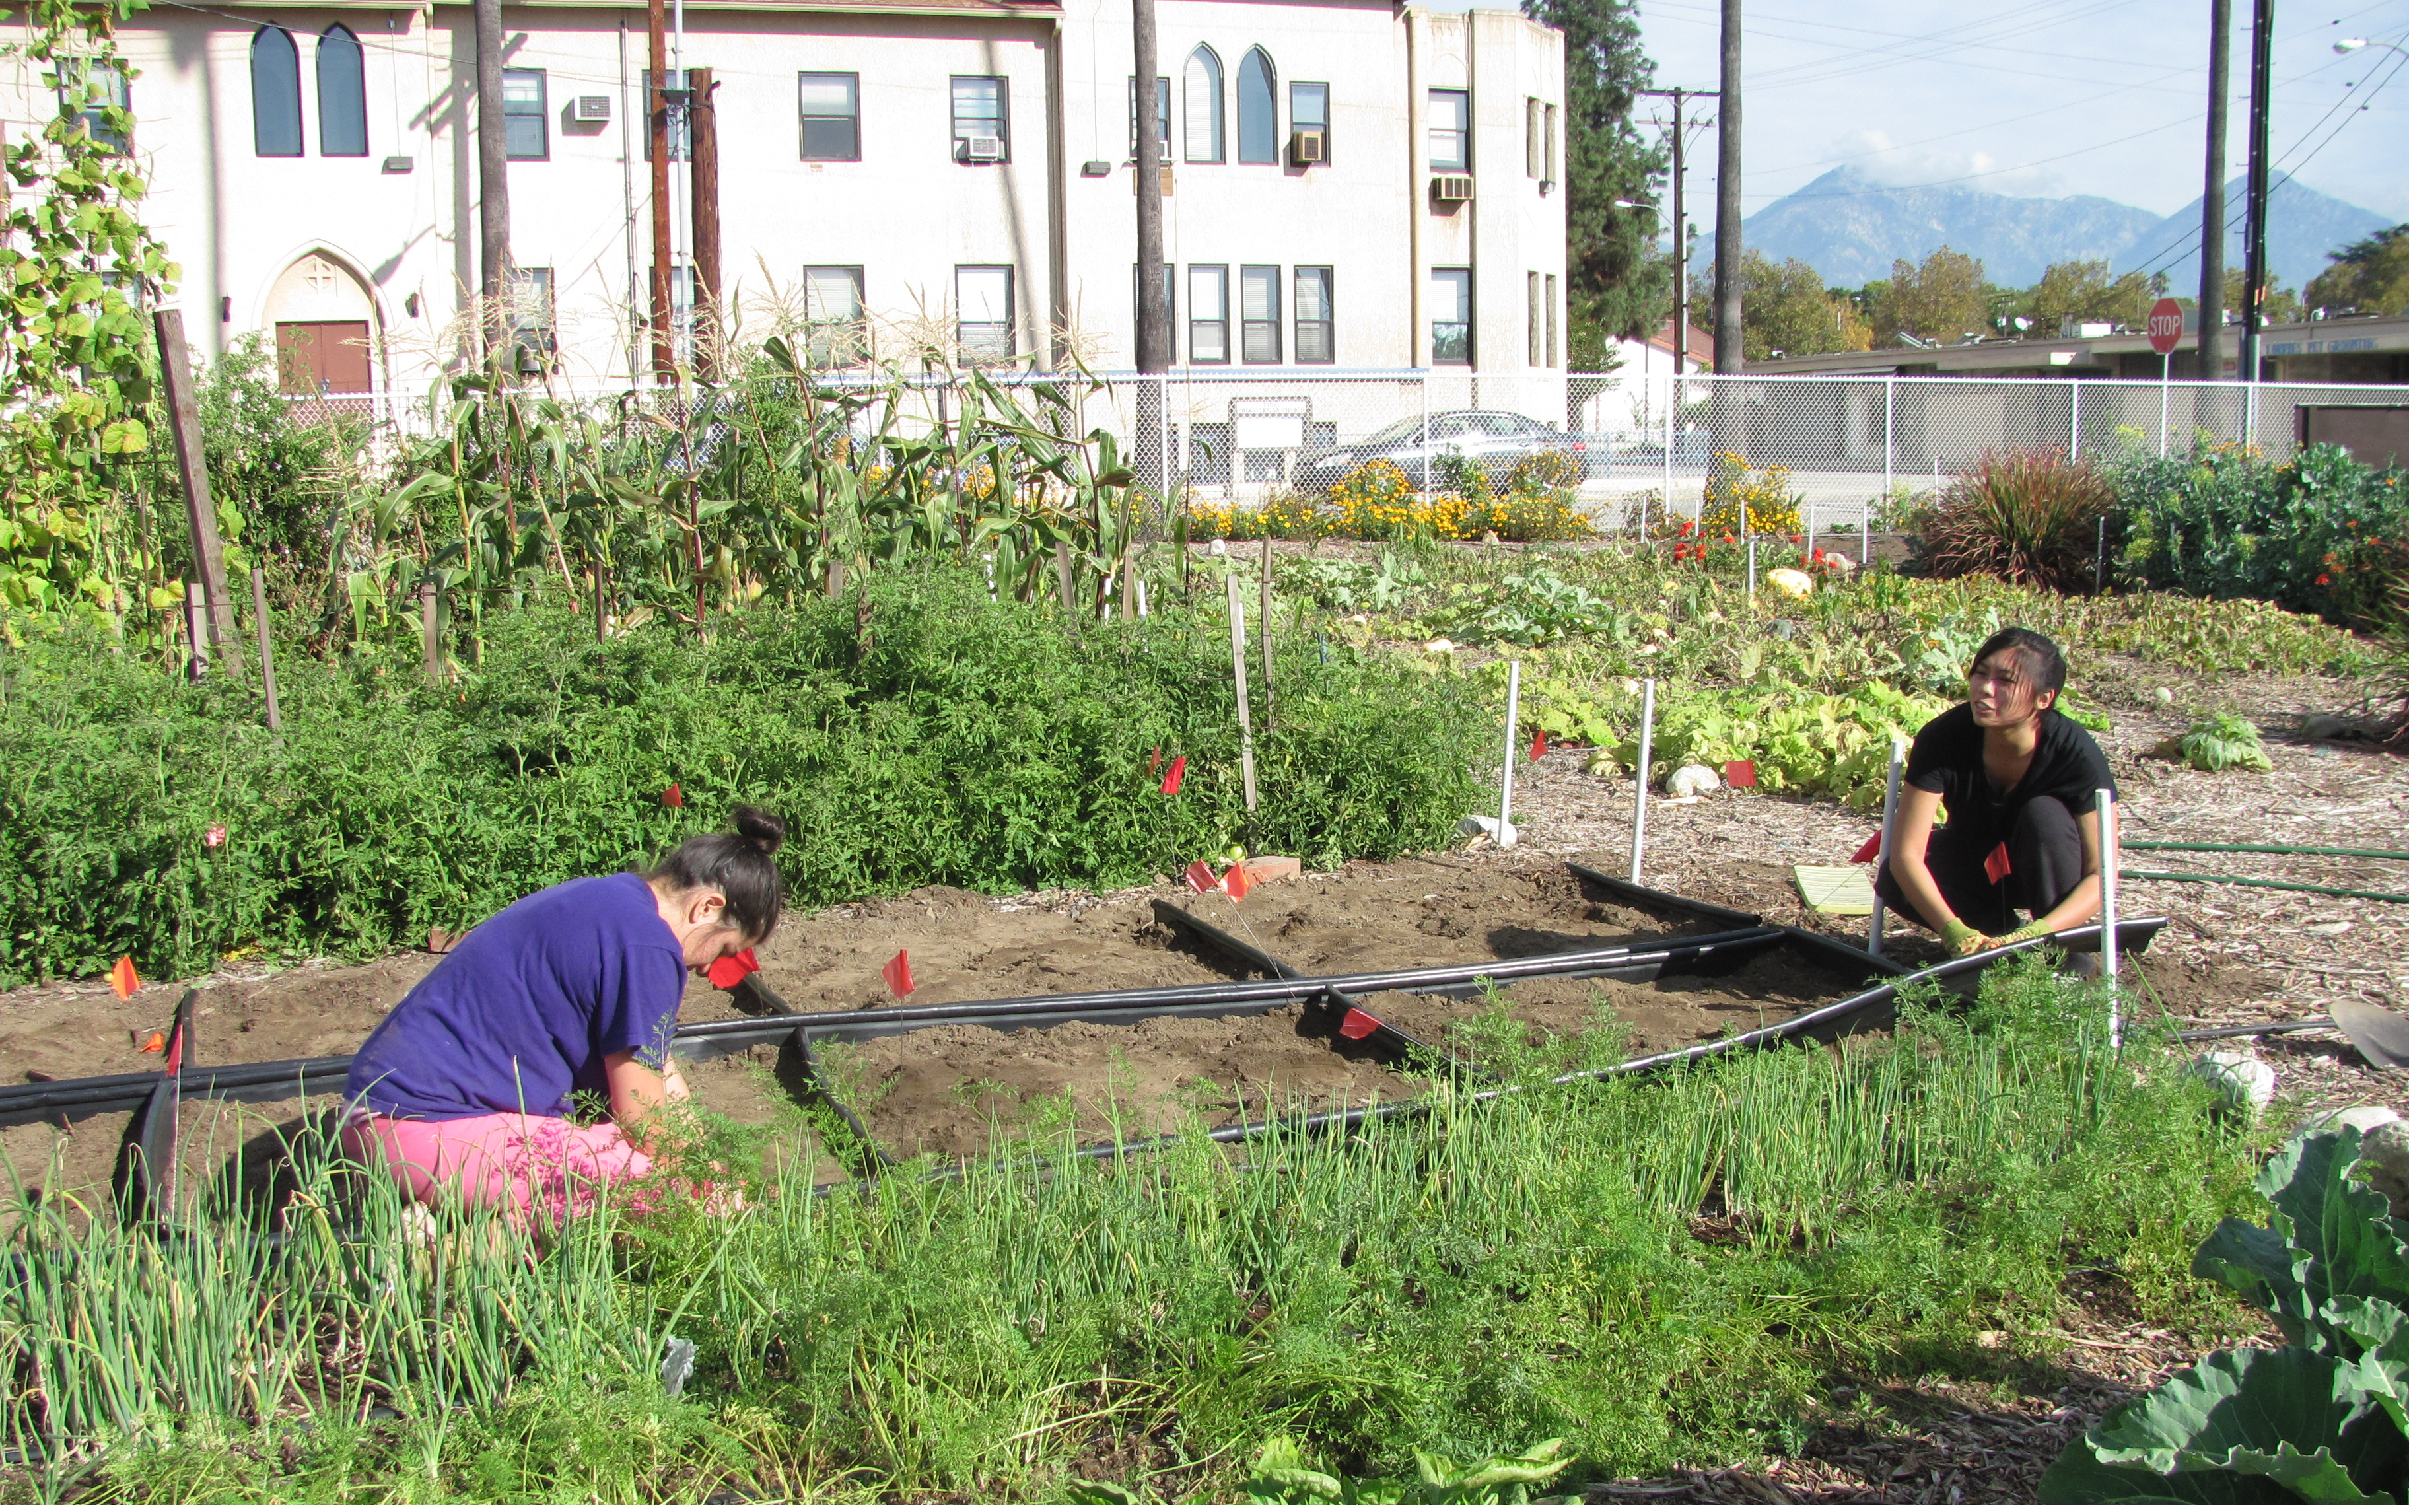
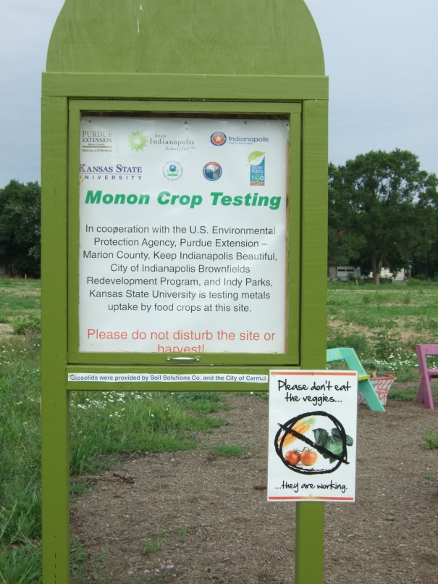
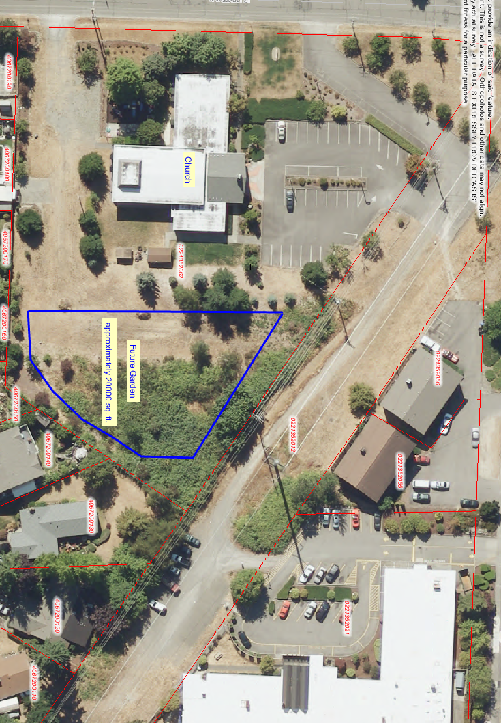
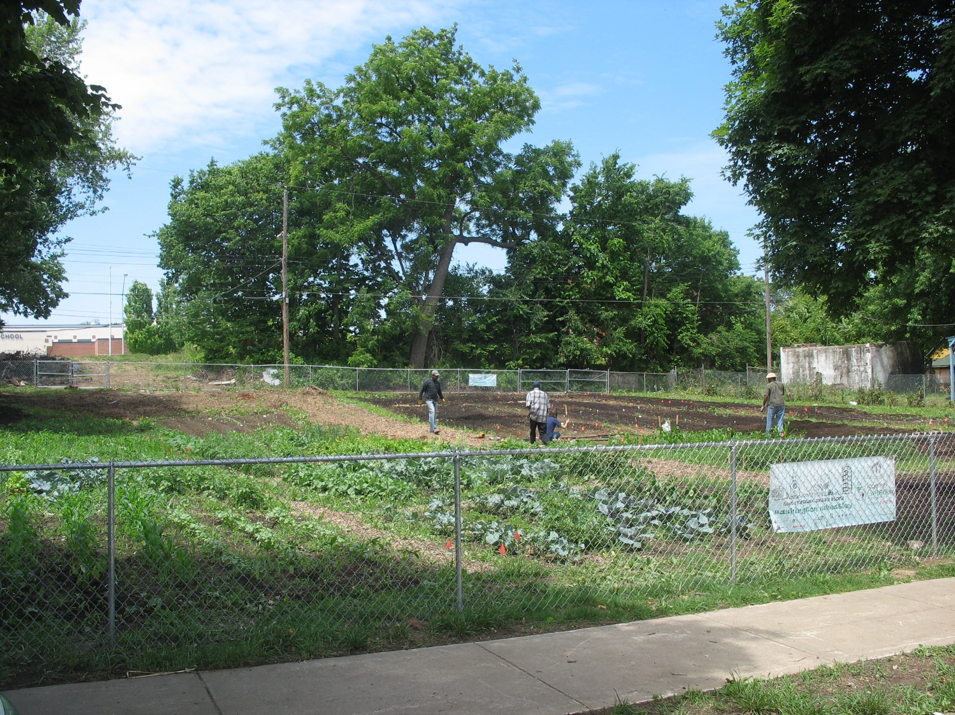
Managing Contaminants in Urban Vegetable Gardens to Minimize Human Exposure
Ganga Hettiarachchi
Department of Agronomy
CLU-IN Webinar
10/15/2014

Slide 2
Common Contaminants and Human Exposure Risks of Urban Gardening

Slide 3
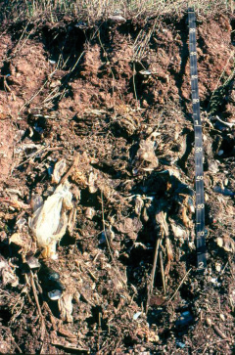
Urban Soils
Natural soil profile
with major horizons
Urban Soil Profile
A horizon
B horizon
C horizon
(human
artifact)
Source: Urban Soil Primer, 2005. USDA, NRCS Publication.
http://soils.usda.gov/use/urban/downloads/primer(screen).pdf

Slide 4
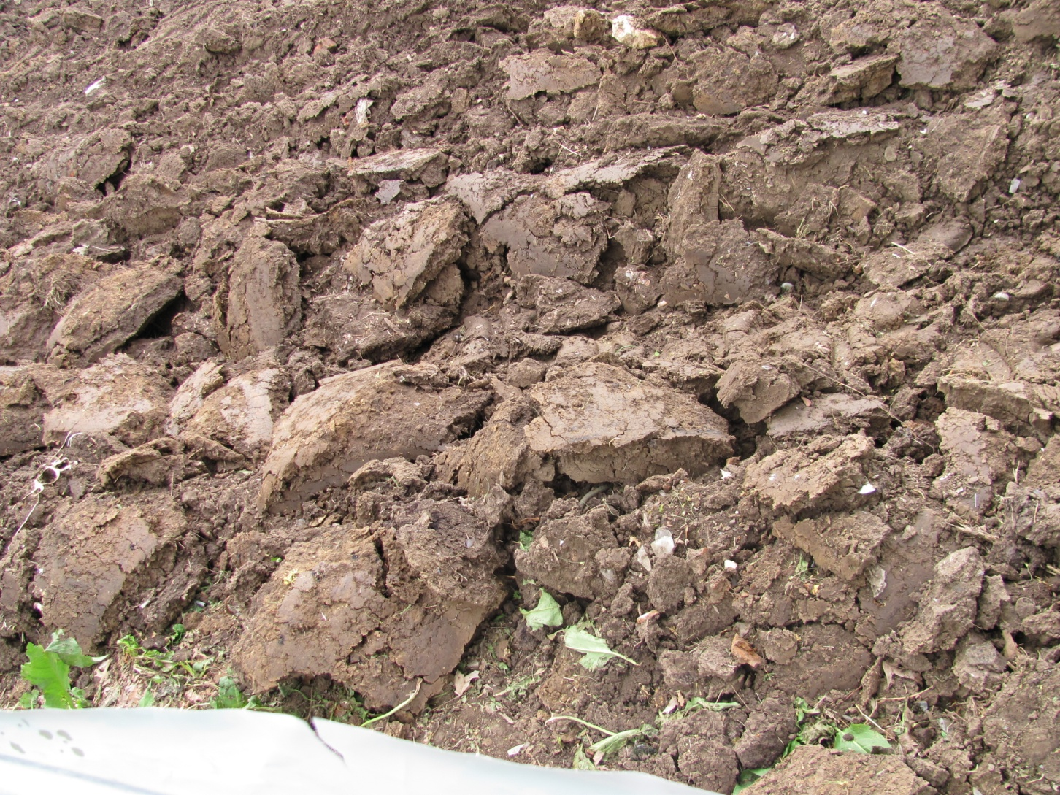
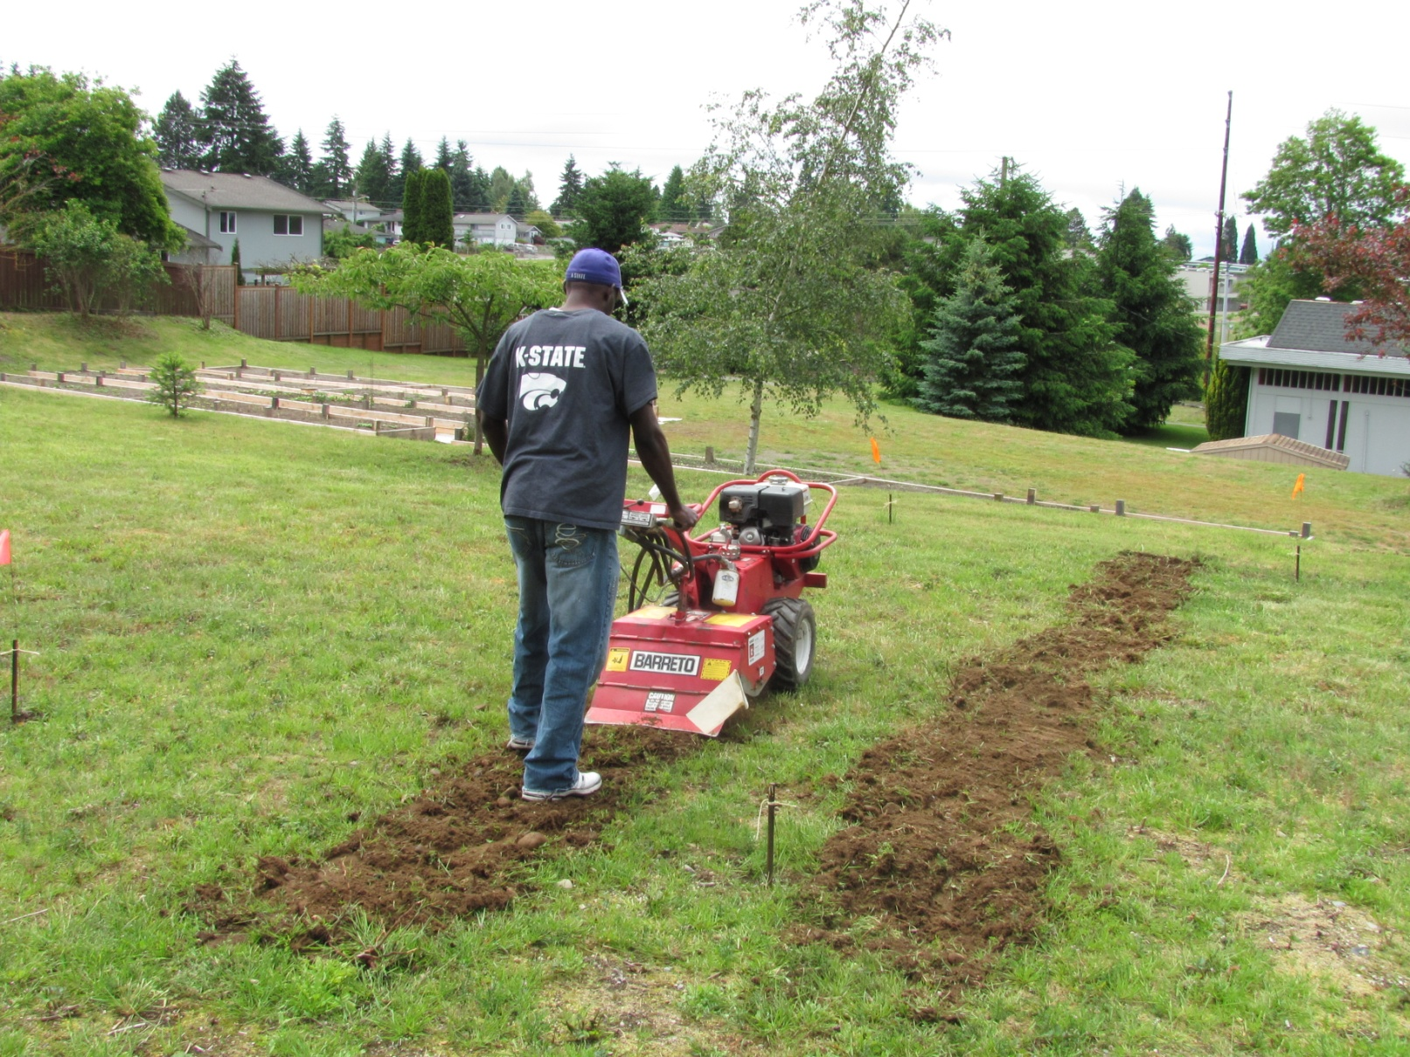
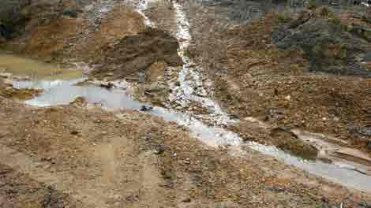
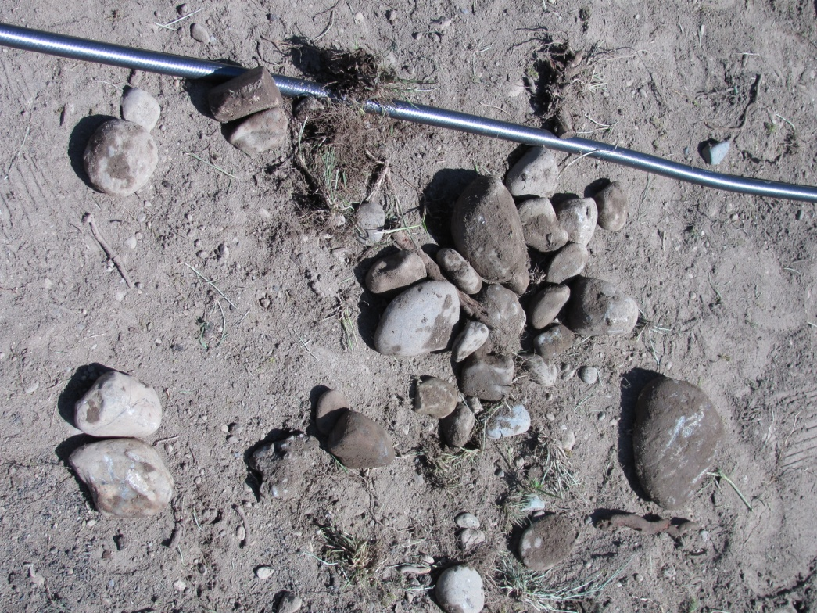
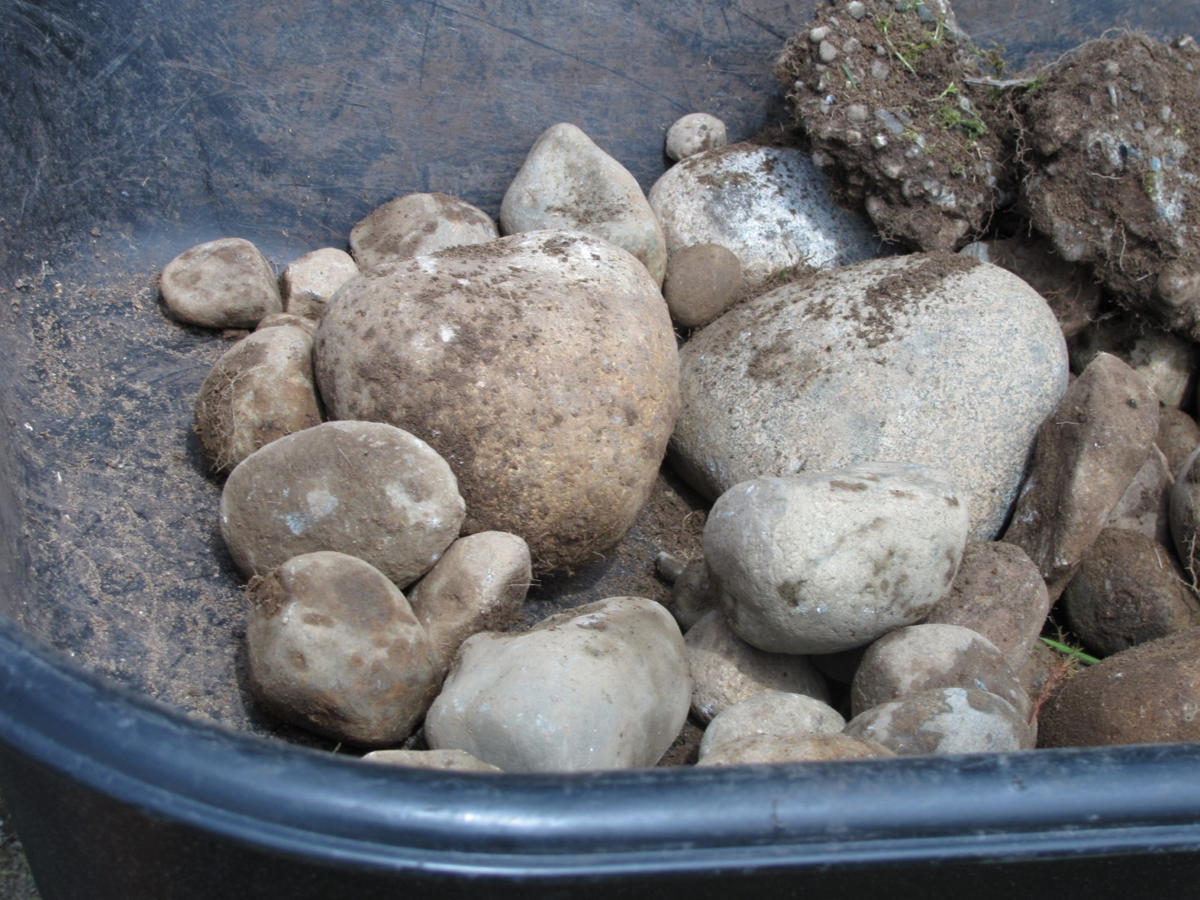
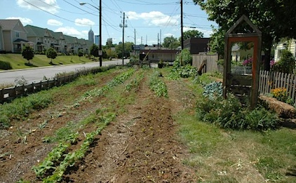
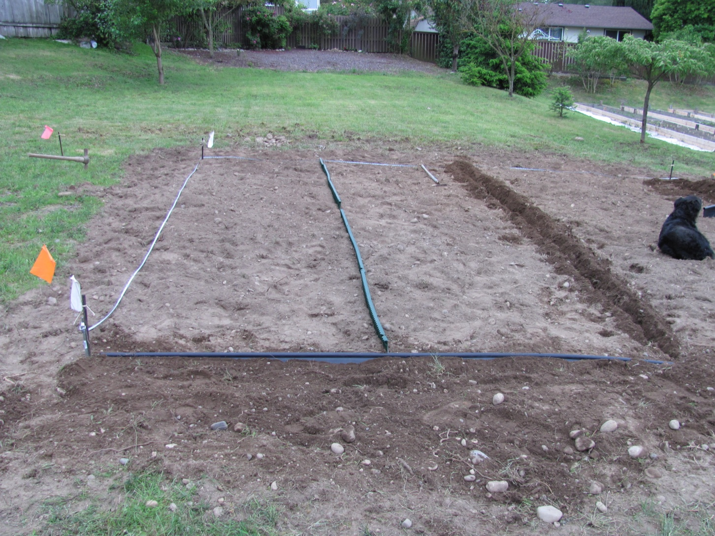
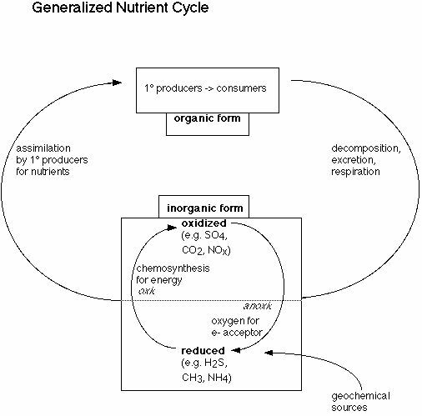
Soil compaction
Common Soil Quality Issues: Urban Soils
Shallow soil, stones and other debris
Poor Drainage
Low organic matter, low nutrient concentrations
Interrupted nutrient cycling, modified soil organism activity, poor nutrient availability
Soil contamination:
Road side soils, previous buildings, affected by industrial fallout, etc.

Slide 5
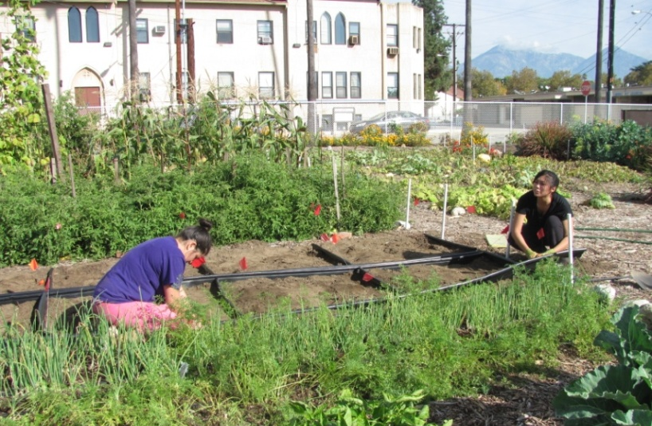
Contaminants in Urban Soil
One of the major challenges of growing vegetables in an urban environment is the possibility of soil contamination.
Examples: lead from paint and leaded gasoline; arsenic, DDT, and chlordane as pesticides; polycyclic aromatic hydrocarbons from incomplete burning of C-containing materials

Slide 6
Potential Exposure Pathways
Direct exposure (Ingestion of soil and dust)
Soil → Human
Direct exposure (Inhalation, Dermal)
Soil → Human
Indirect Exposure
Soil → Plant → Human
The concentrations of these contaminants in the above-ground portions of the plants would be very low

Slide 7
Bioavailability
A measure of the fraction of the chemical(s) of concern in environmental media that is accessible to an organism for absorption
American Society for Testing and Materials, 1998
An essential or toxic element is bioavailable
if it is present as, or can be transformed readily to, the free ion species, if it can move to plant roots on a time scale that is relevant to plant growth and development, and if, once absorbed, it affects the life cycle of the plants
Sposito, 1989

Slide 8
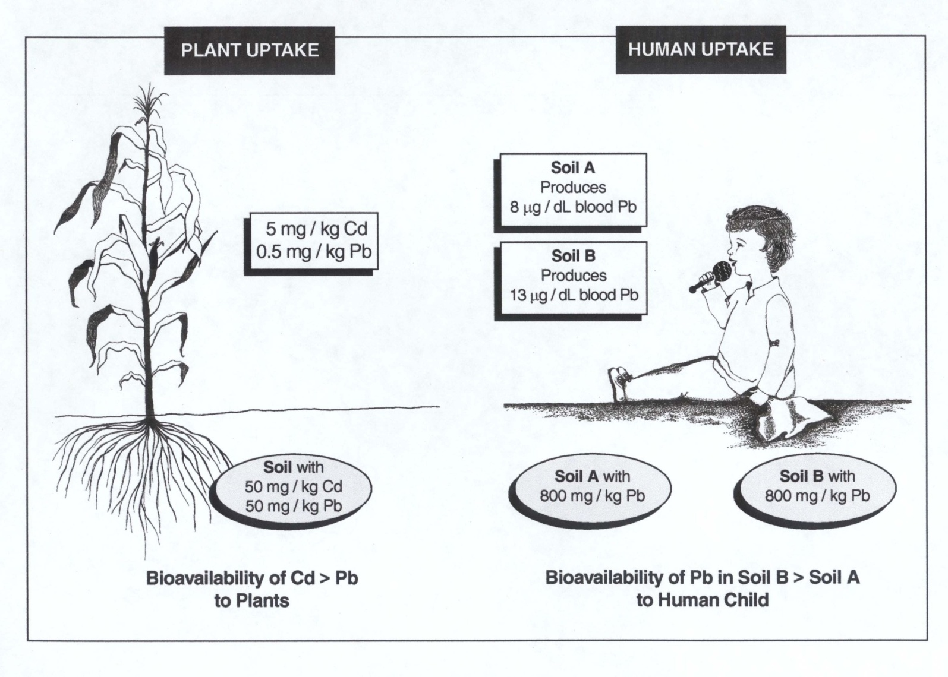
Bioavailability
Describes the fraction of the chemical(s) of concern in soil that is accessible to an organism (human or plants) for absorption.

Slide 9
Bioavailability of soil contaminants depends on
The solubility and/or availability of different pools of contaminant in soil
Soil properties

Slide 10
What are these pools? Speciation
Form | Example
A. Free metal | Pb²⁺ (lead ion)
B. Soluble complexes | Pb(OH)¹⁺ ; Pb(OH)₂⁰; PbCO₃⁰, PbCl⁺ Pb-citrate
C. Polymeric organic complexes | Pb – humic acid
D. Adsorbed or incorporated metal onto soil minerals | Pb bound on, or in, microparticulate oxides or aluminosilicates
F. Precipitated metal form | Pb phosphate, Pb carbonate, Pb sulphate, Pb sulfide
High
Low
Availability

Slide 11
Soil properties: pH
Concentrations (mg/kg) of selected elements in Alfalfa tissue as influenced by soil pH
pH | Cd | Cu | Ni | Mo
6.0 | 0.8 | 17.7 | 1.9 | 193
7.0 | 0.6 | 16.8 | 0.8 | 342
7.7 | 0.4 | 16.0 | 0.8 | 370
Source: Pierzynski et al., 2005

Slide 12
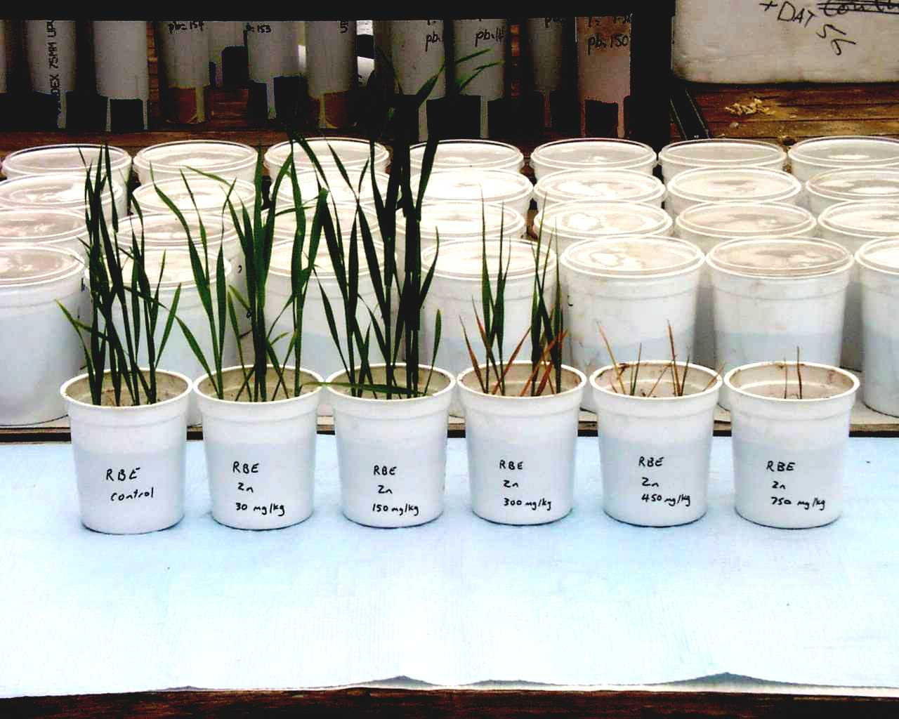
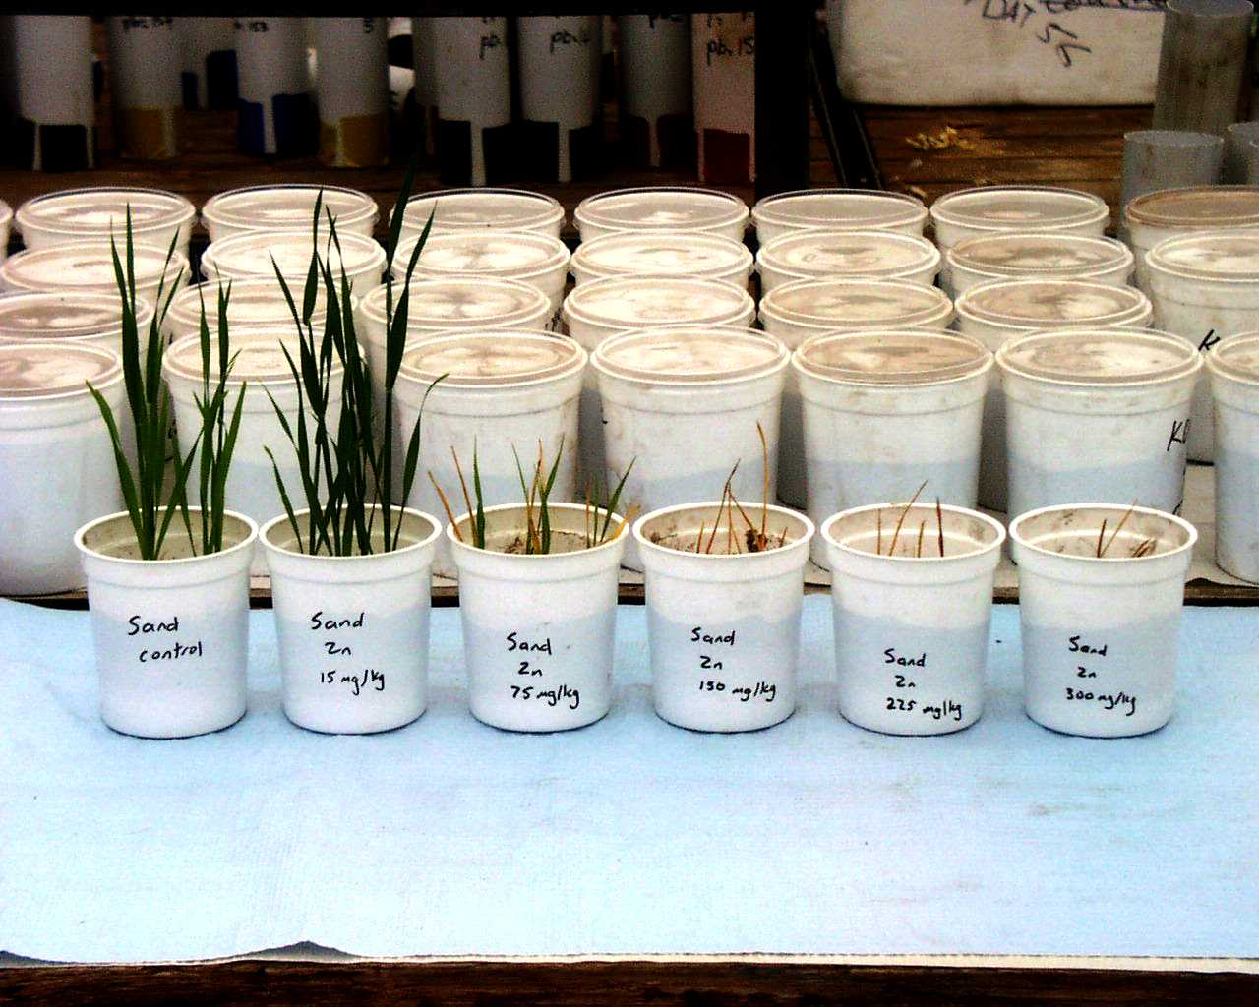
Soil Type
Clayey Soil
Control
30 ppm
150 ppm
300 ppm
450 ppm
750 ppm
Sand
Control
15 ppm
75 ppm
150 ppm
225 ppm
300 ppm
Courtesy of CSIRO, Land & Water, Australia
Courtesy of CSIRO, Land & Water, Australia

Slide 13
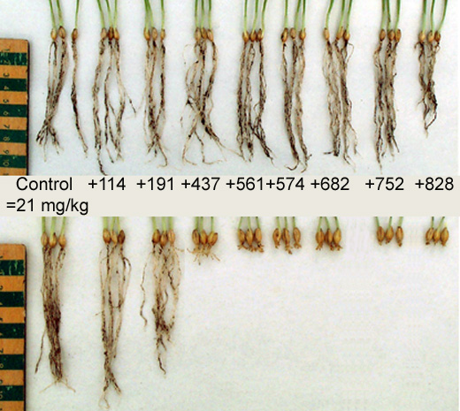
Natural attenuation (ageing) in soil
Example: root elongation on soil contaminated by Cu
Field transect
Fresh spike
Courtesy of CSIRO, Land & Water, Australia

Slide 14
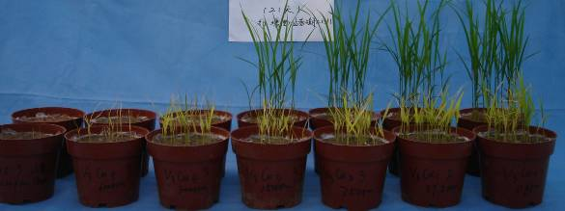
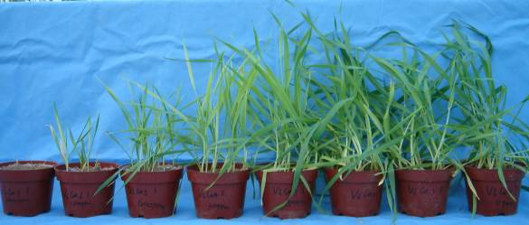
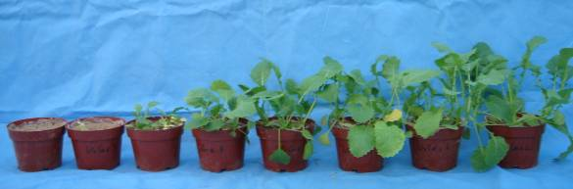
Species difference in tolerance/uptake
Rice
Barley
Mustard
Courtesy of CSIRO, Land & Water, Australia

Slide 15
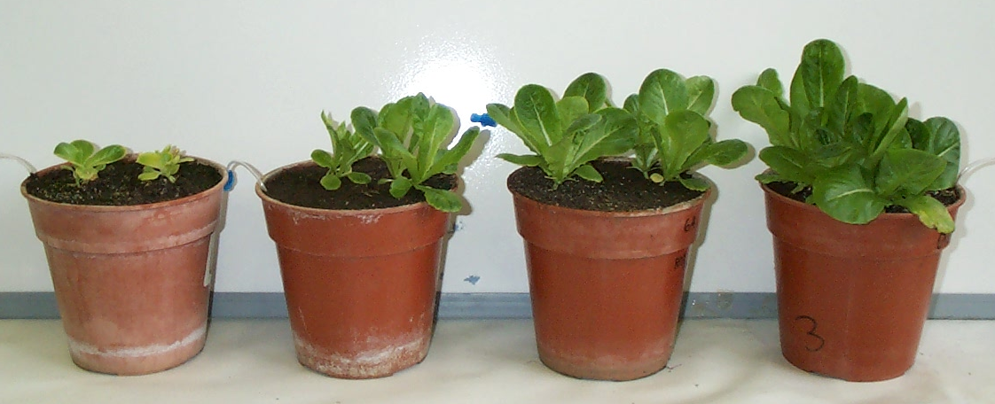
Addition of Soil Amendments Can Reduce Contaminant Bioavailability
Bioavailability: the fraction of the chemical(s) of concern in soil that is accessible to an organism (human or plants) for absorption
Same contaminated soil, different soil amendments, different effects
Metal
contaminated
soils- unamended
With Lime
With Beringite-
modified aluminosilicate
With Red Mud
Fe oxide rich residue
Courtesy of CSIRO, Land & Water, Australia

Slide 16
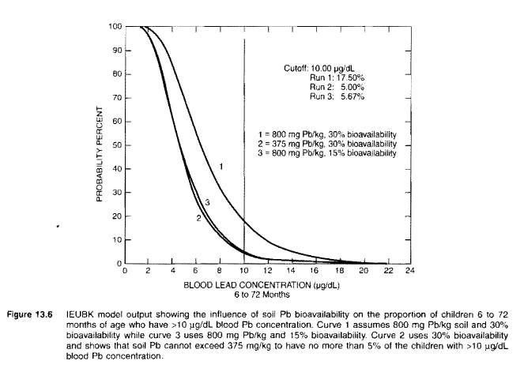
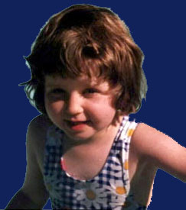

Slide 17
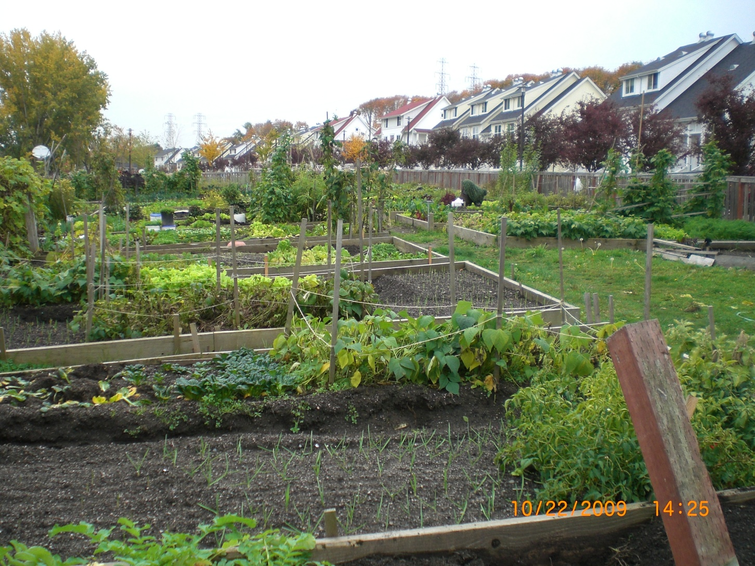
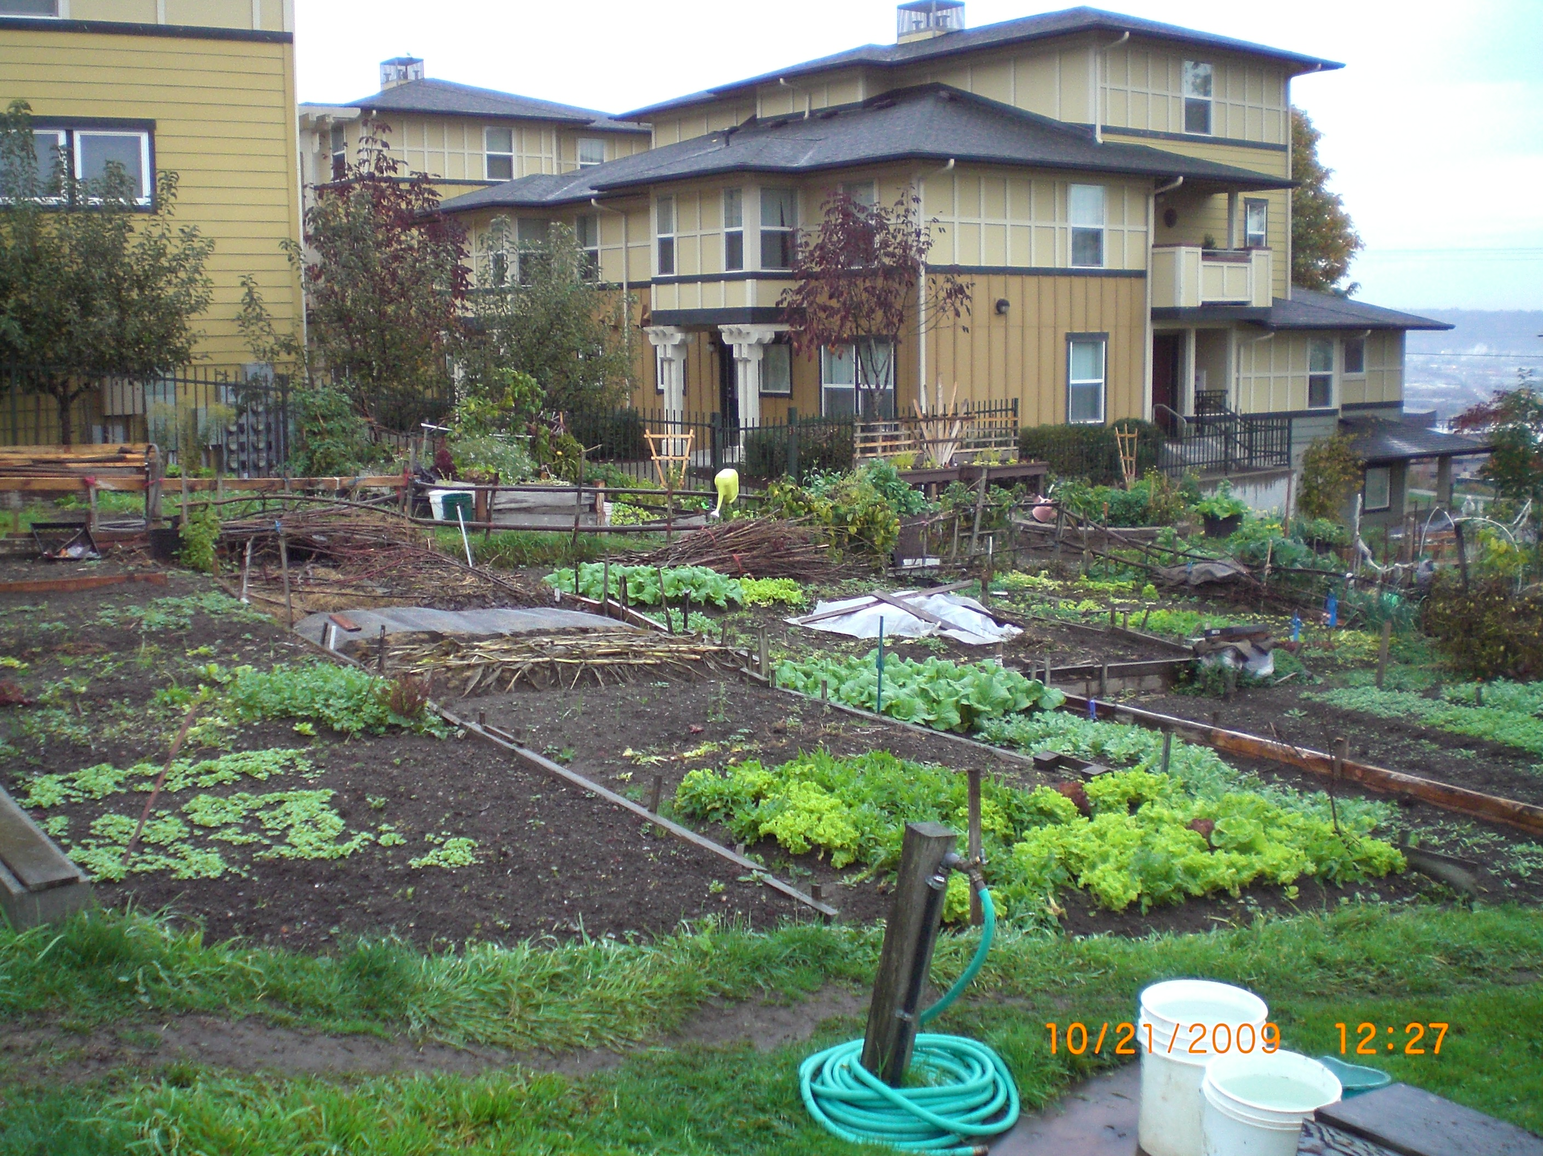
Using Soil Amendments to Reduce Human Exposure to Contaminants

Slide 18
Questions
Is there contamination?
If so, what is it and how much?
Does the site require environmental cleanup?
Growing in-ground or above ground?
Who will work in the garden (adults, kids, ADA)?
What are the general soil conditions?
What crops will be grown?

Slide 19
Growing In-Ground vs Above Ground
Decision-making drivers
  Liability
  Comfort level of gardeners re. residual contamination
  Soil conditions
  Accessibility
  Cost
  Space

Slide 20
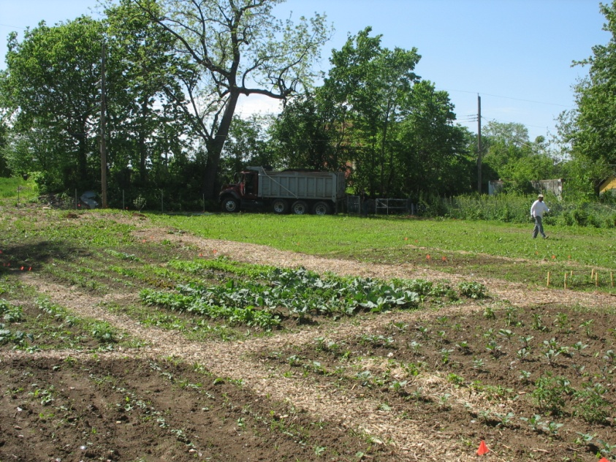
Growing In-Situ
May need to take
some precautions
Add amendments

Slide 21
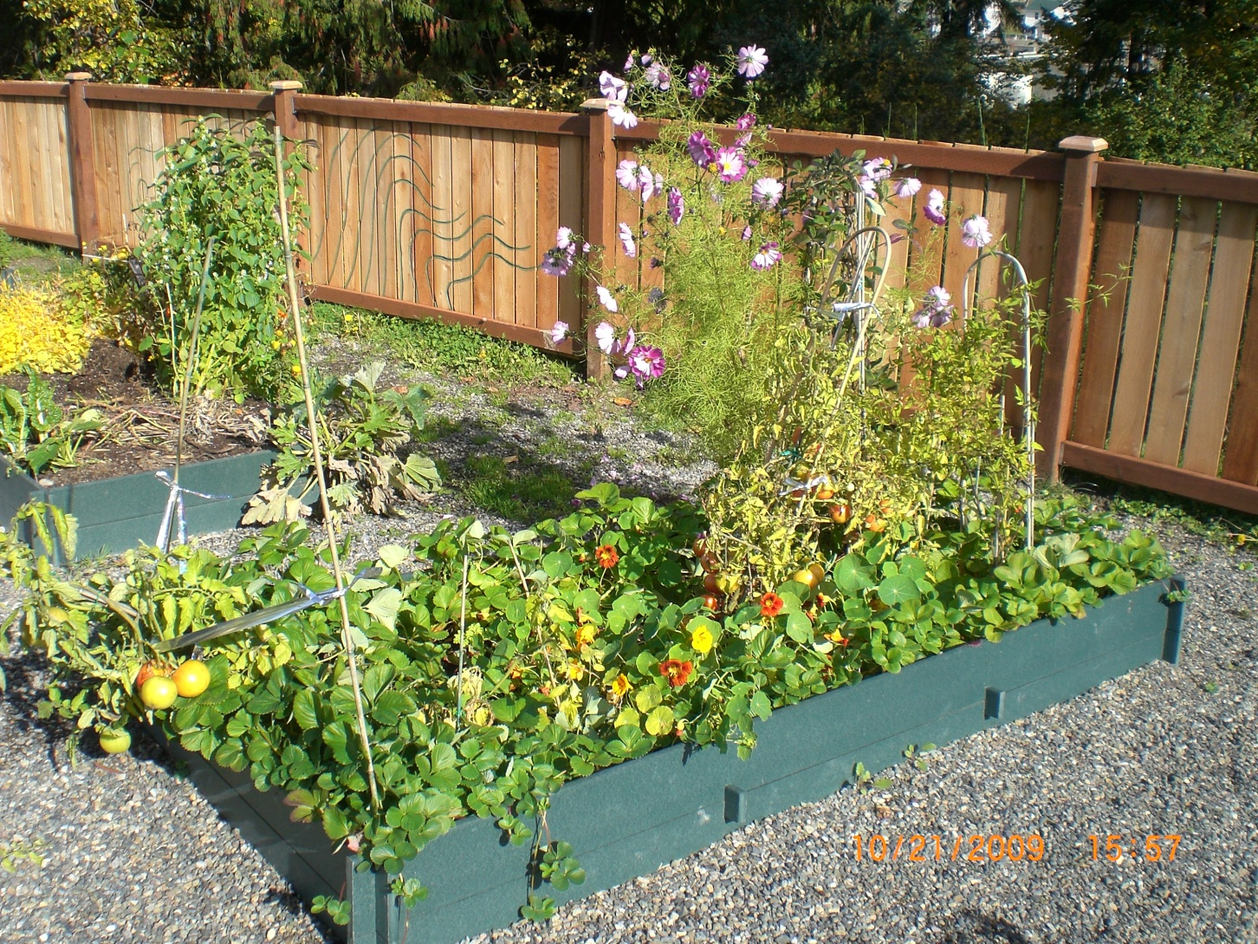
Raised Beds

Slide 22
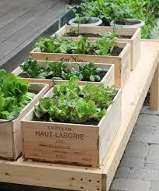
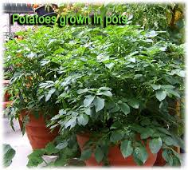
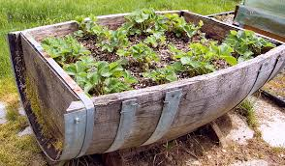
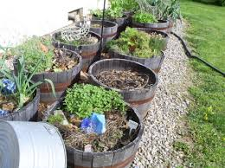
Container Gardening
Source: www.google.com

Slide 23
Soil Quality Issues in Urban Soils
Nutrient Status inadequate in urban soils
Soil pH
Organic matter content low in urban soils
Soil type (clayey vs sandy soils)
Soil Compaction yes
Soil Chemistry an issue in urban soils
  Toxicity of soil contaminants (some metals)
  Excess Na (phyotoxic)
  Excess salts (phytotoxic)

Slide 24
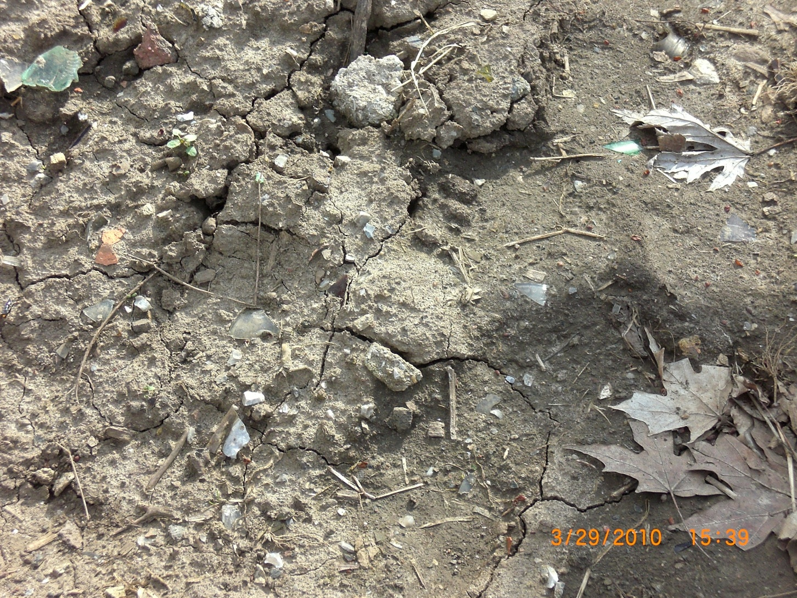

Slide 25
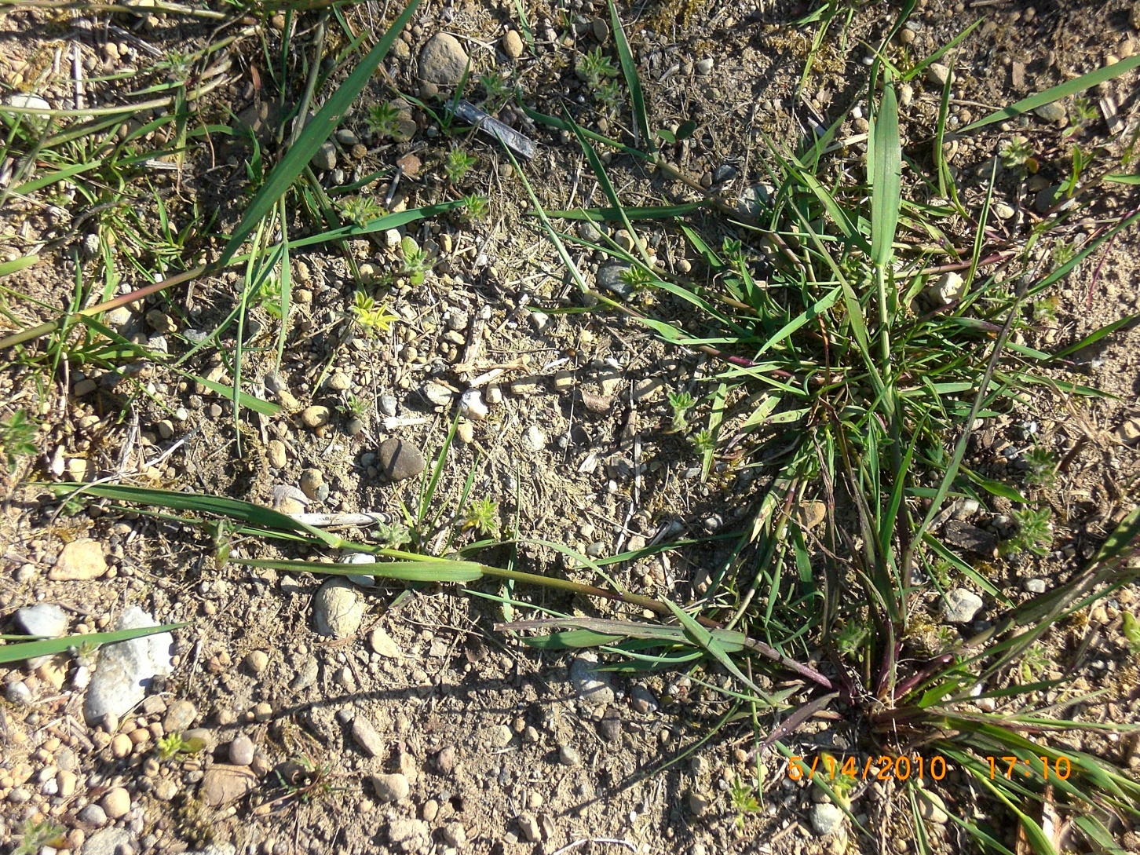

Slide 26
Compaction
Reduces soil porosity
Air movement and root penetration are restricted
Water runs off or ponds instead of infiltrating
Roots grow sideways instead of downward
Remedies: Tilling and addition of compost (Improving soil organic matter content will help binding contaminants (reduces their bioavailability))

Slide 27
Nutrient Status
Nutrient status: N, P, K
Nitrogen: healthy leaf and stem growth
Phosphorus: important for root growth, flower production, binds metals (reduces bioavailability)
Potassium: overall plant health

Slide 28
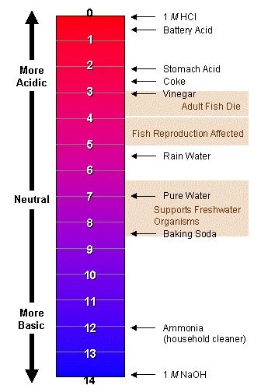
pH
Typical pH values
Measure of soil acidity
or basicity/alkalinity
Has a great impact on
numerous soil chemical
reactions
Examples: adsorption
Low soil pH means:
higher mobility of cationic metals
lower mobility of anions
Extreme
range in
pH for
most
mineral
soils

Slide 29


pH Adjustment
Adding lime to increase alkalinity
Select fertilizer to increase acidity: ammonium sulfate, sulfur-coated urea
Add elemental sulfur or aluminum sulfate
to acidify soils

Slide 30
Organic Matter
Enhances soil color
Improves soil structure
Improves soil drainage and aeration (clayey soils)
Retains Water (sandy soils)
Provides soil nutrients
Encourages microbial activity
Binds contaminants, reduces bioavailability
Ideal OM content depends on soil type
Below 1-3 % OM can be considered as low

Slide 31
Contaminant Dilution through Compost Addition
Washington Wheatley Site, Kansas City, MO

Slide 32
Differences in growth between amended and non-amended plots
Further dilution of contaminants through enhanced growth

Slide 33
Swiss Chard Pb versus available P in Soils (Wash. Wheatley, Kansas City, MO)
Swiss Chard Pb (µg/kg)
Mehlich-3 extractable P (mg/kg)

Slide 34
Biosolids
Nutrient rich organic material resulting from the treatment of domestic sewage in treatment facility
Tested (federal biosolids rule: 40CFR Part 503)
Biosolids can be applied as fertilizer and will improve soil structure
Very efficient use of organic N,P by crops because of slow release throughout the growing season

Slide 35

Cadmium Adsorption in amended soils
Ryan et al. (2003)

Slide 36
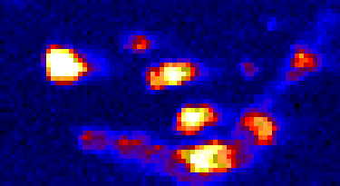
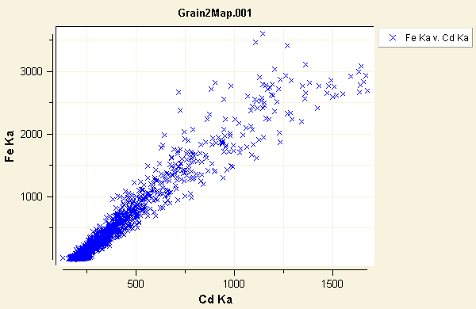
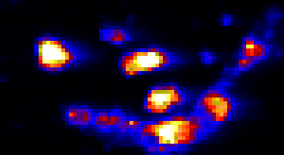
Biosolids μ-XRF Maps
Cd
Key point: Tight correlation between iron and metals
Fe
Hettiarachchi et al., 2005

Slide 37
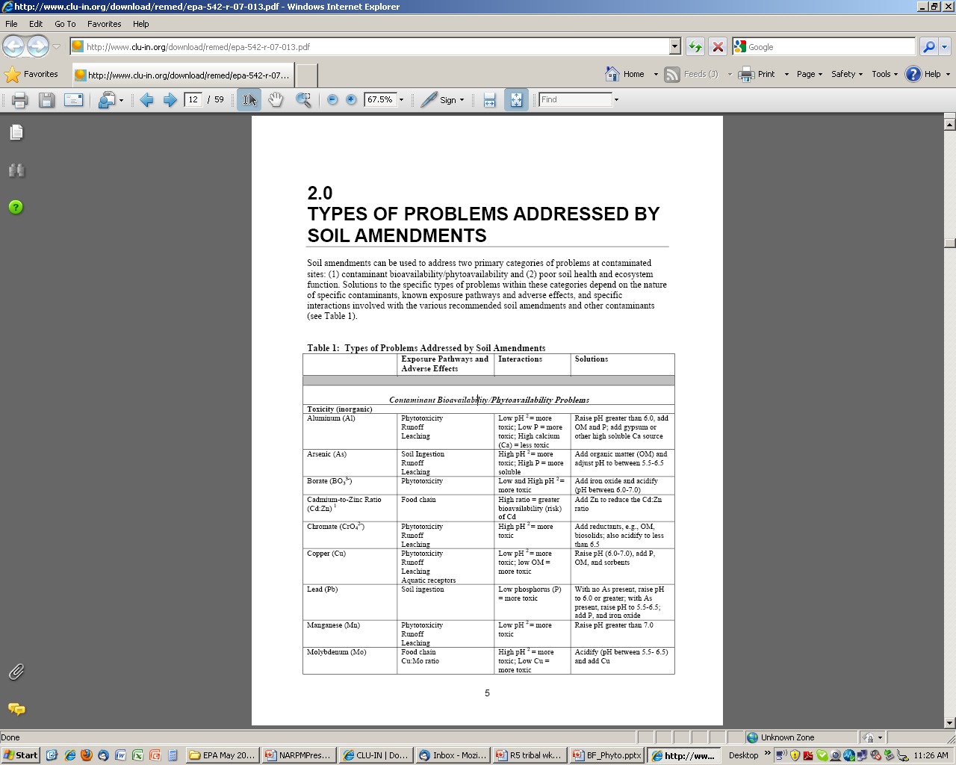
Use of Soil Amendments
The Use of Soil Amendments for Remediation, Revitalization, and Reuse, EPA 542-R-07-013, 2007

Slide 38
Crop Selection
Root crops vs leafy and fruit bearing vegetables
Root crops take up more metals compared to leafy and fruit bearing crops

Slide 39
Soil Amendments/BMPs - Summary
Till and add compost to mitigate compaction
Add compost/biosolids to improve soil structure, mitigate compaction, to provide nutrients and to reduce bioavailability of contaminants
Add lime or acidulating materials to adjust pH to reduce bioavailability of contaminants
Maintain optimum nutrient levels - provide P to reduce bioavailability of metals
Select suitable crop types

Slide 40
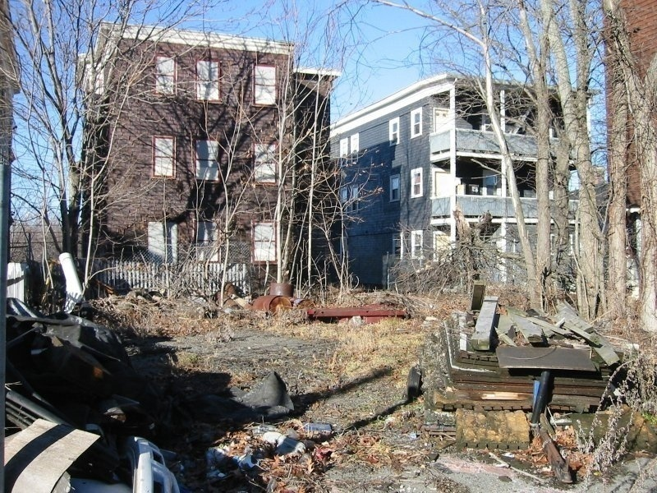
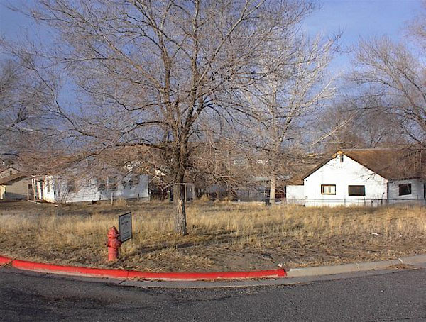
Gardening at Brownfield Sites

Slide 41
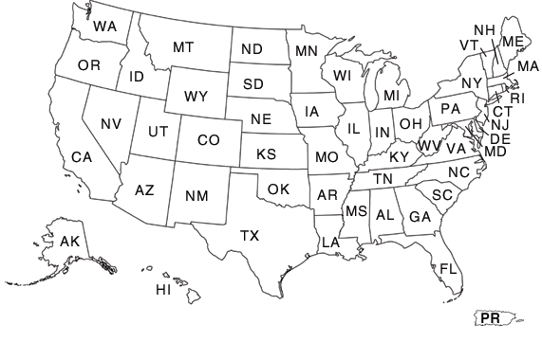
K-State Project: Gardening Initiatives at Brownfields sites
7 test sites across the USA: Kansas City, MO; Tacoma, WA, Seattle, WA; Indianapolis, IN; Pomona, CA; Philadelphia, PA; Toledo, OH
Funded by the EPA Brownfields Training, Research, and Technical Assistance Grants Program

Slide 42
Process
Establish site history
Collect soil samples and testing
Best management practices (adding soil amendments, raised beds)
Continuous monitoring, soil and produce sampling
Training and technical assistance to participating organizations throughout

Slide 43
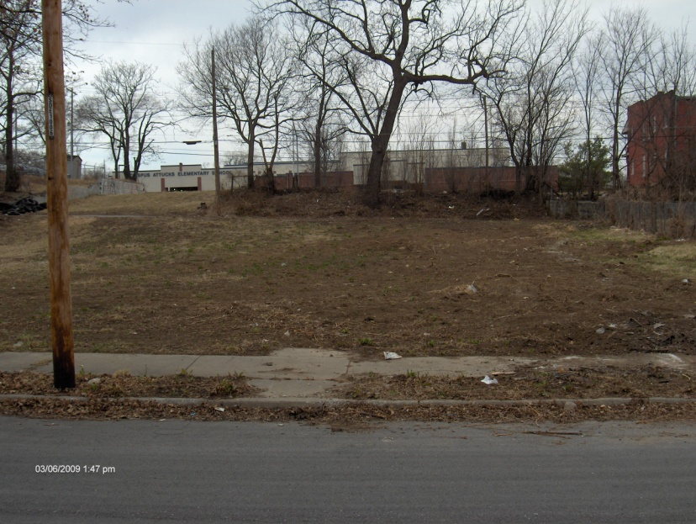
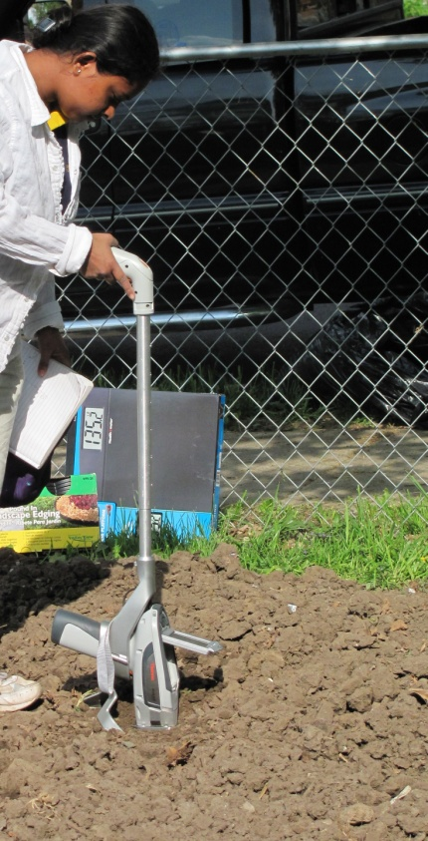
Example Site 1: Kansas city, MO
Size ~ 42m x 37m
Silt loam (Sand-4%, Silt-75%, Clay-21%)
The site was screened in situ, every ~6 m for trace elements using x-ray fluorescence spectrometer
Moderately elevated Pb
Soils were also tested for chlordane
Reference: Attanayake, C.P., G.M. Hettiarachchi, A. Harms, D. Presley, S. Martin, and G.M. Pierzynski. 2014. J. Environ. Qual. Vol. 43, 475-487

Slide 44
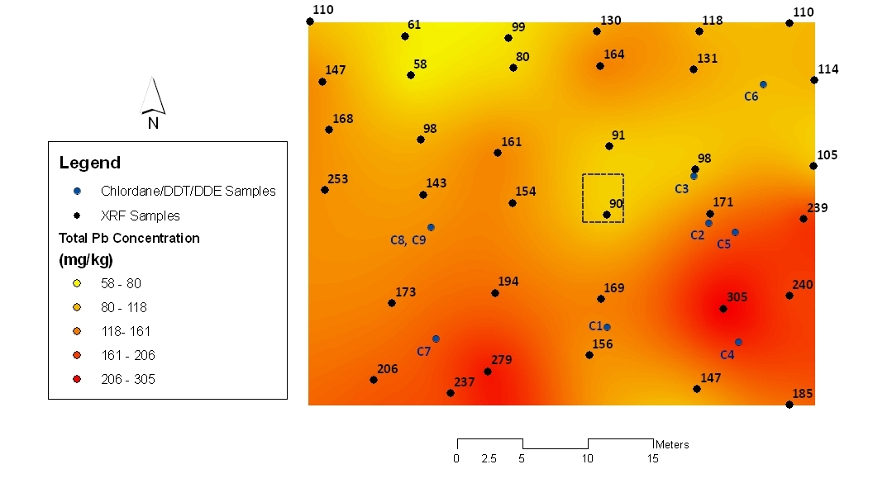
Soil Lead Distribution Map
Chlordane - n.d.
DDT- 0.04 mg/kg to1.3 mg/kg
DDE - only detected in two of the submitted samples (0.03, 0.04 mg/kg)

Slide 45
Selected Soil Properties
Sample ID | pH | Mehlich-3 P | Ext. K | NH₄-N | NO₃-N | OM
 |  | ---------------------- mg/kg ----------------------- |  |  |  | %
9S | 6.6 | 130 | 624 | 53.6 | 73.2 | 3.9
9D | 6.6 | 93 | 455 | 9.6 | 35.1 | 3.4
21S | 7.2 | 116 | 417 | 11.8 | 22.7 | 3.0
21D | 7.2 | 123 | 221 | 9.3 | 15.0 | 3.1
26S | 7.8 | 57 | 255 | 8.3 | 4.3 | 1.5
26D | 7.6 | 80 | 260 | 8.2 | 2.2 | 1.1
39S | 6.9 | 154 | 488 | 15.0 | 24.2 | 4.7
39D | 6.9 | 149 | 334 | 9.6 | 13.3 | 3.3
S = 0-15 cm D = 15-30 cm
Texture: Silt loam with 21% clay

Slide 46
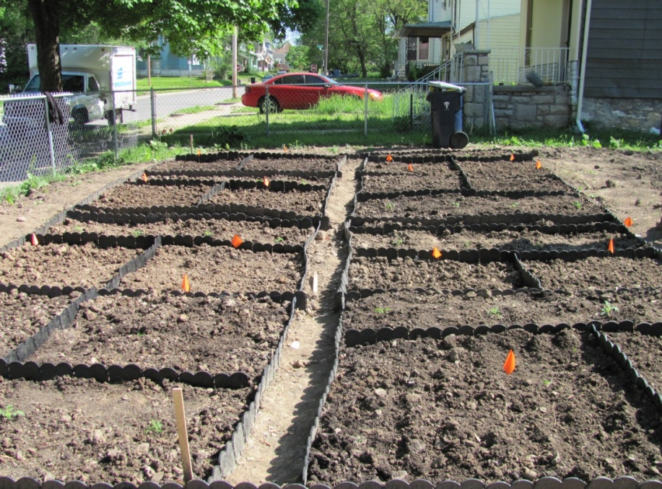
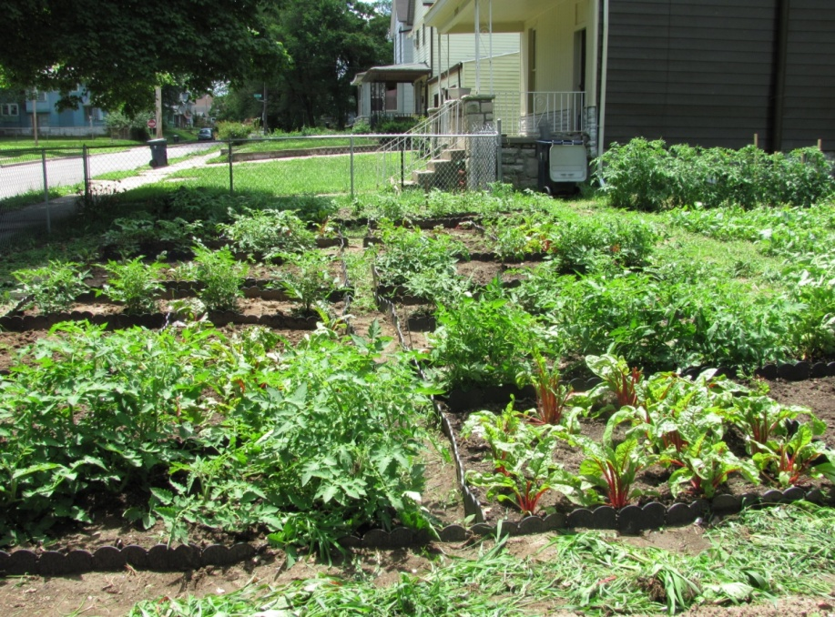
Test plot-2010
Treatments:
No compost and compost @
~25 kg/m²
Crops:
Swiss Chard
Carrots
Tomato
April 2010.
June 2010.

Slide 47
Kansas City, MO
Contaminant Dilution through Compost Addition
Plot # | Total Soil Pb (mg/kg) Prior to Compost Addition After Compost Addition
1 | 289 | 203
2 | 255 | 120
5 | 253 | 146
8 | 186 | 114
Average | 246 | 146

Slide 48
Lead Concentration in Swiss Chard
CODEX MCL – 5.0 mg/kg-DW #
Lab cleaned
Kitchen cleaned
a
Compost – 59 %
Pb concentration (mg/kg-DW)
Lab cleaning- ~ 67 %
a
b
b
Treatment | Soil Pb (mg/kg)
No compost | 128-348
Compost | 101-256
p<0.05 (split plot design, 4 blocks)
*,** between two categories a, b- within a category
# CODEX MCL (FAO/WHO) - 0.3 mg/kg fresh wt. basis (94% moisture)

Slide 49
Lead Concentration in Tomato
CODEX MCL – 1.6 mg/kg-DW #
Lab cleaned
kitchen cleaned
Pb concentration (mg/kg-DW)
Lab cleaning- ~ 61-78%
a
a
Treatment | Soil Pb (mg/kg)
No compost | 143-271
Compost | 122-193
b
b
p<0.05 (split plot design, 4 blocks)
*,** between two categories a, b- within a category
# CODEX (FAO, WHO) - 0.1 mg/kg fresh wt. (94% moisture)

Slide 50
Lead Concentration in Carrot
CODEX MCL- 1.5 mg/kg-DW #
Lab cleaned
a
Kitchen cleaned
a
Peeled
a
a
a
a
Pb concentration (mg/kg-DW)
Compost- ~ 20 %
Treatment | Soil Pb (mg/kg)
No compost | 154-388
Compost | 119-161
p<0.05 (split plot design, 4 blocks)
*,** between two categories a, b- within a category
# CODEX (FAO, WHO) - 0.1 mg/kg fresh wt. (93% moisture)

Slide 51
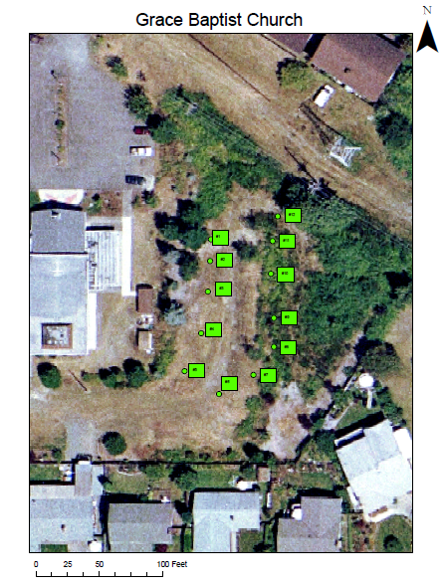
Tacoma, WA Example Site 2
Element | Concentration in soil (mg/kg)
As | 17- 162
Pb | 17- 427
Texture: Sandy loam
Reference: Defoe P.P., G.M. Hettiarachchi, C. Benedict, S. Martin. 2014. J. Environ. Qual. doi:10.2134/jeq2014.03.0099
Size: 43m x 24m

Slide 52
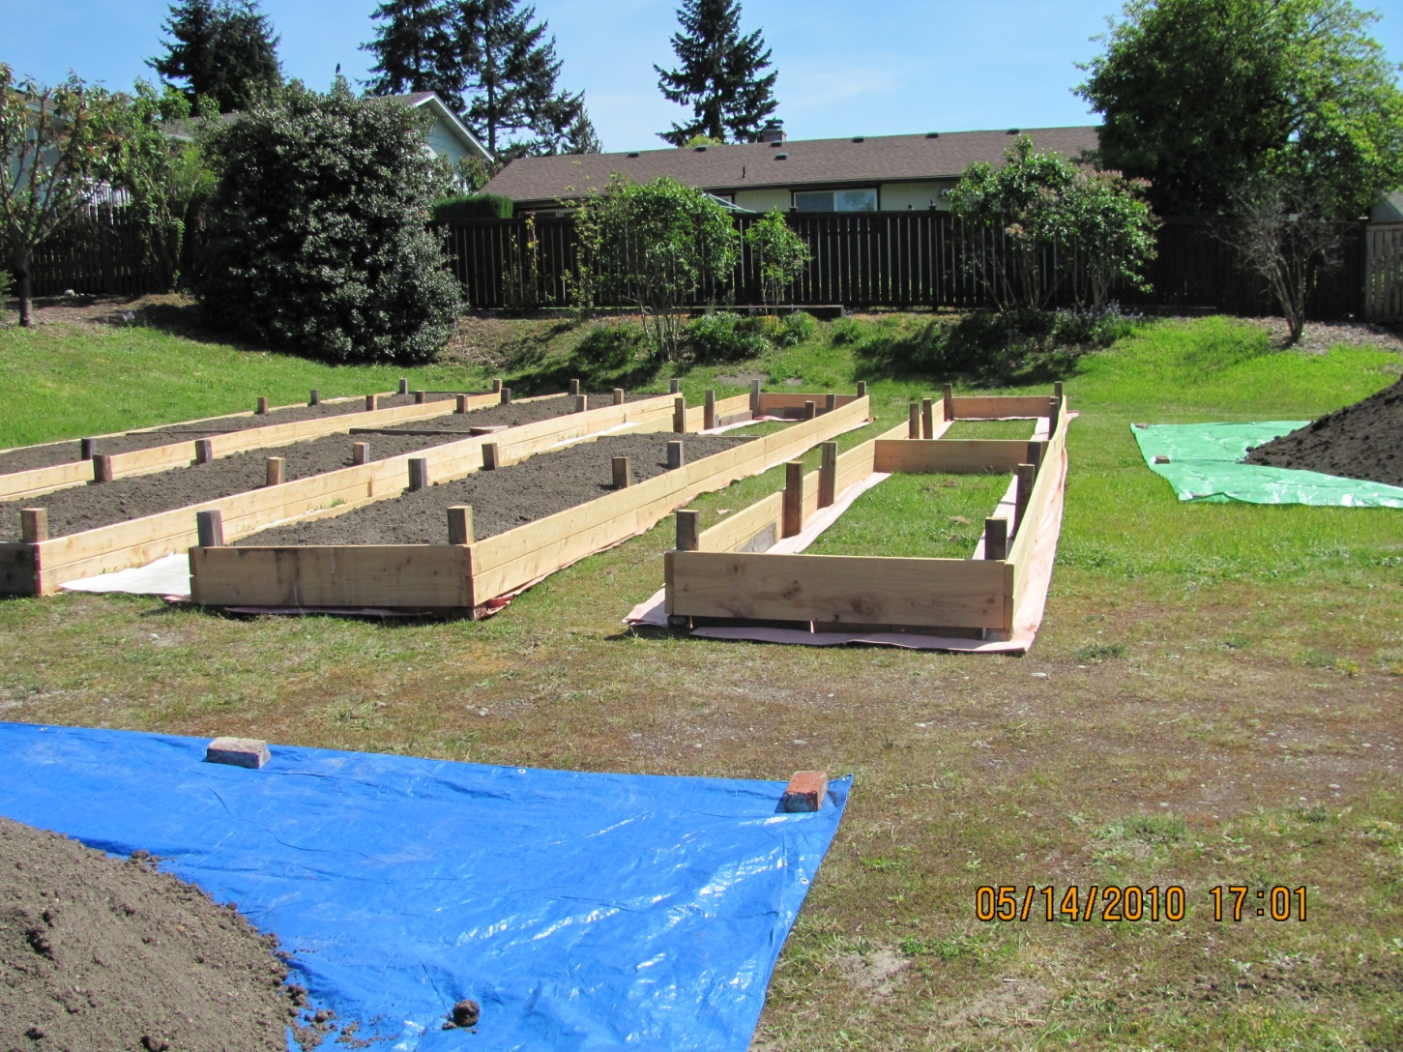
Tacoma, WA- Community Garden

Slide 53

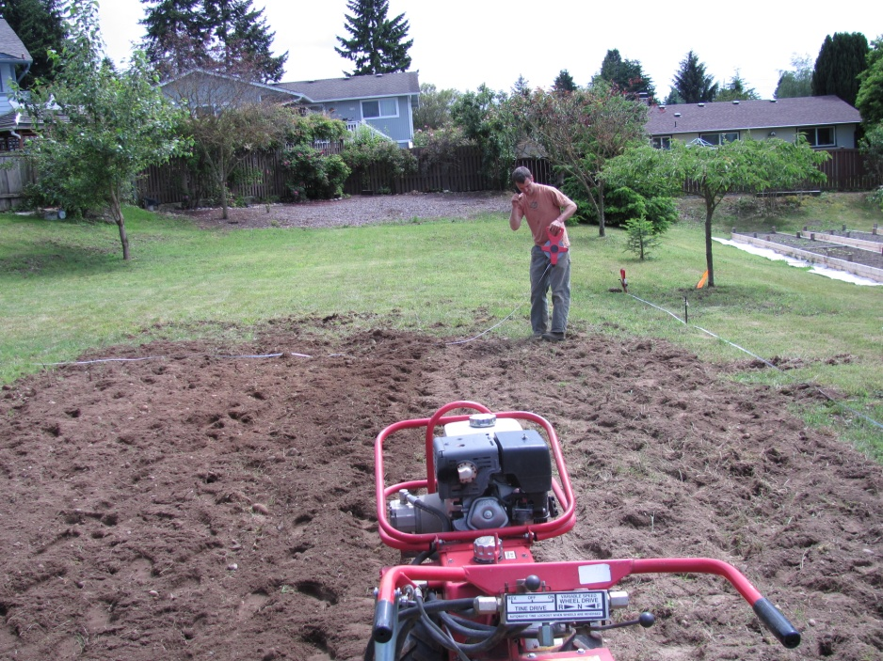

Test plots-Tacoma, WA- 2010
Low to medium available N, P and K in soils
Treatments:
No compost and compost @
~28 kg/m²
Crops:
Lettuce, Carrots, Tomato

Slide 54

Tacoma, WA- Test plots
Lime+
Tagro
added
Control
Lead uptake patterns by tested vegetable types were similar
Root > leafy > fruiting
Leafy and fruit crops – lead concentrations were below MCL

Slide 55
Arsenic in Lettuce
2010
2011
Vertical bars represents the means of four replicates
* MCL- Estimated using daily reference dose limit

Slide 56
Arsenic in Tomatoes
2010
2011
Vertical bars represents the means of four replicates

Slide 57
Arsenic in Carrots
2010
2011
Vertical bars represents the means of four replicates
MCL- Estimated using inorganic As daily reference dose limit listed in USEPA, 2003,
The Integrated Risk Information System

Slide 58




Lead = 437-513 mg/kg
Arsenic = 23-84 mg/kg
PAHs in test plots = 23- 50 mg/kg
May 2011
July 2011
Amendments (4 compost types): Leafy compost, mushroom compost, composted biosolids, non-composted biosolids
Monon site,
Indianapolis
Example site 3

Slide 59
PAHs in Soils and Vegetables- 2011
# of rings | PAH | Range in test plots (ppm) | Tomato and Carrot (ppm)
2 | Naphthalene | <0.4-1.4 | < 0.01
3 | Acenaphthylene | <0.4-2.4 | < 0.01
3 | Acenaphthene | <0.4-0.8 | < 0.01
3 | Fluorene | <0.4-0.8 | < 0.01
3 | Phenanthrene | 6.8-5.6 | < 0.01
3 | Anthracene | 0.5-4.5 | < 0.01
4 | Fluoranthene | 1.6-1.4 | < 0.01
4 | Pyrene | 1.5-1.2 | < 0.01
4 | Chrysene | 1.4-10.4 | < 0.01
4 | Benzo (a) anthracene | 1.1-8.2 | < 0.01
5 | Benzo(b)fluoranthene | 2.6-18.7 | < 0.04
5 | Benzo(k)fluoranthene | <0.4-6.0 | < 0.04
6 | Indeno(1,2,3-cd)pyrene | 1.1-6.8 | < 0.04
6 | Benzo(g,h,i)perylene | <2.2-7.2 | < 0.04
5 | Benzo(a)pyrene | 1.4-9.9 | < 0.10
5 | Dibenz(a,h)anthracene | <0.4-2.3 | < 0.10
Toxicity

Slide 60
Plant uptake of organic contaminants
Source: Wild. S.R. and K.C. Jones. 1992. Polynuclear hydrocarbon uptake by carrots grown in sludge-amended soils. J. Environ. Qual. 21: 217-225.

Slide 61

Trichloroethylene uptake into fruits and vegetables
Doucette et al., 2007. Trichloroethylene uptake into fruits and vegetables: Three year study. Environ. Sci. Technol. 41: 2505- 2509.

Slide 62
Plant uptake of chromium
Source: Chaney et al. 1996.

Slide 63

Testing gastrointestinal dissolution of soil As and Pb
At pH= 2.5
Physiologically Based Extraction Test-PBET
Percentage bioaccessible Pb at Kansas City garden test plots
†Bioaccessible Pb as a percentage of soil total Pb
NIST 2711a- 35.2% bioaccessible Pb

Slide 64
Summary
Soil → plant → Human “Non-significant”
In general, concentrations of contaminants in aboveground biomass are low
Root crops will be affected by elevated levels of Pb as well as some persistent organic contaminants in soils
Compost/biosolids addition reduces contaminant uptake as well as bioaccessibility of contaminants through dilution as well as improved binding capacity of soils
Thorough cleaning of vegetables further reduced the potential of transferring soil contaminants to humans via vegetable consumption

Slide 65
Summary, cont.
Use clean soil/compost raised beds or containers to grow root crops
Follow BMPs to minimize
  Soil → Human (mainly contaminated soil ingestion)
Bioaccessibilities of Pb, As and persistent organic chemicals in soils were low- detailed chemical analysis (Pb, As, PAHs) and in vitro/lab chemical extractions suggested that they are strongly bound

Slide 66
Acknowledgements
Graduate students- Chammi Attanayake, Phillip Defoe, Janelle Price, Ashley Harms, Jay Weeks
Co-PI, Sabine Martin and other Investigators (DeAnn Presley, Gary Pierzynski, Blasé Leven, Larry Erickson, Rhonda Janke)
Colleagues/collaborators- Rufus Chaney, Kirk Scheckel, Nick Basta, Sally Brown, Jason White

