Slide 1
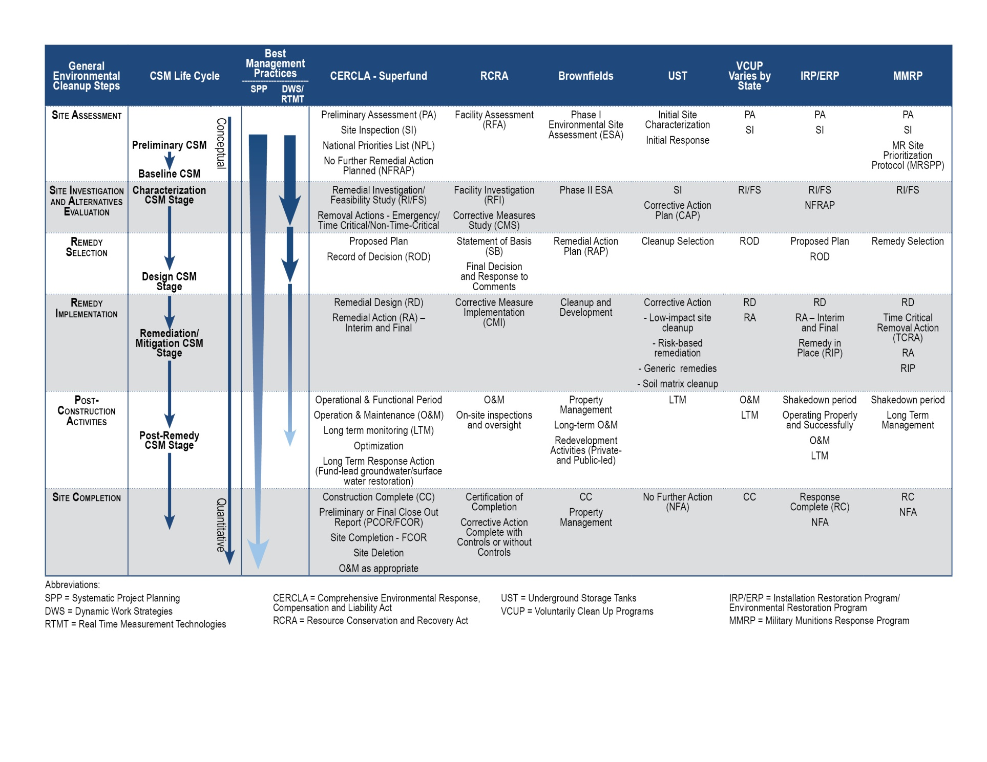
Project Life Cycle CSM Supports Project Phases
Environmental Cleanup Best Management Practices: Effective Use Of The Project Life Cycle Conceptual Site Model. EPA 542-F-11-011
Preliminary CSM
Developed after initial assessment but prior to systematic planning
Baseline CSM
Product of systematic planning; documents stakeholder consensus
Characterization CSM Stage
Used to guide investigation efforts and support decision-making
Design CSM Stage
Used to support basis for remedy and redevelopment design
Remediation/Mitigation CSM Stage
Used to guide efforts, meet objectives, and support optimization
Post-Remedy CSM Stage
Documents attainment of remediation objectives and goals
Resource Slide
1-14
Notes:
1

