Slide 1

Best Management Practices for Site Remediation

Slide 2
High-Resolution Site Characterization and Remediation http://www.clu-in.org/characterization/technologies/hrsc/
Increases sampling density
  Delineates hydrogeology; focus on heterogeneity
  Correlates contaminant mass locations to stratigraphy
Delineates zones of contamination (source mass)
  Targets application of remedies
  Reduces remedy footprint and cost of operation
Uses collaborative data sets to manage uncertainty
  Verifies screening results with fixed-based analytical confirmation
  Improves weight-of-evidence with multiple data types
Electronic databases and 3-D visualization of contaminant distribution
More effective treatment
  Higher confidence that site is fully characterized for design
  Tighter source identification and delineation
  More accurate mass and volume estimates
  Targeted vs. shotgun remedy design and implementation
  Improved monitoring of remedy performance
Reduced treatment costs
  Treatment focused on the problem area
  Reduced residual contamination
  Saving in treatment compounds and waste handling
  Reduced need for long-term O&M

Slide 3
Importance of CSM to Remedial Design
Challenge for investigations → advance CSM sufficiently for remedial design with limited available funds
CSM evolves and matures as additional data are acquired
  Use as a tool for stakeholder consensus
  Strike balance between costs of investigation and remedy
In situ treatment design and application is most effective when based on a mature CSM
Mature CSM gives more confidence in the remedy selection and design
CSM can be used to guide design changes during remediation

Slide 4
Use CSMs to Manage Remediation
Reach stakeholder consensus on remedial requirements
Negotiate remedial option with regulatory authorities
Benchmark remediation
  Determine what data are required to achieve each CSM version
Refine understanding of source area dimensions
Demonstrate site no longer poses risk or unacceptable risk
Use updated CSM to document “revised baseline” for future use

Slide 5
Comprehensive Exit Strategy Design
Project Type
Strategy Levels
Strategy Gap
Assessment
Organizational
Programmatic
What specific elements are
needed from each level?
Multiple Sites
Comprehensive
Exit Strategy
Plan
Site-Specific / Stakeholder
=
Technical / Media
Single Sites
Administrative

Slide 6
Components of an Exit Strategy

Slide 7
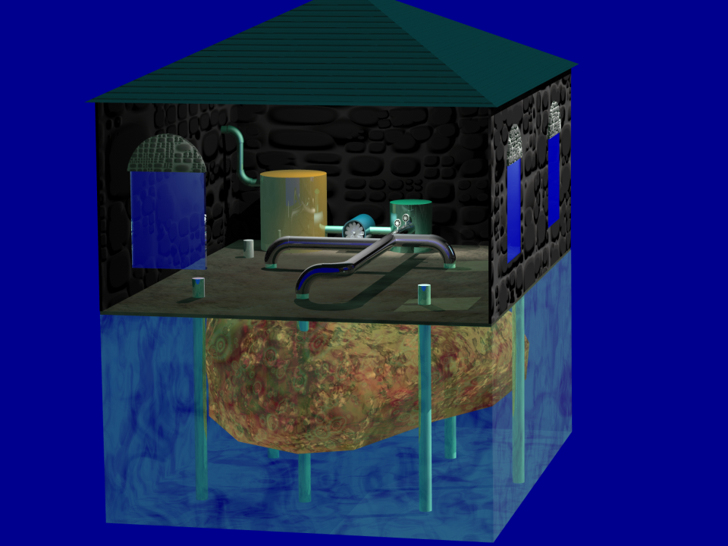
Soil Vapor Extraction
Process applies a subsurface vacuum that:
  draws fresh air through the unsaturated zone
  inducing flux, mass transfer, and removal of VOCs in soil above water table

Slide 8
SVE System Extraction Wells
Typically 2 to 4 inches in diameter, with a screen length of 10 to 15 feet
Ideally spaced to achieve an overlapping of the ROI and adequate pore volume exchange
Determine well spacing and configuration through pilot test or modeling
May involve air injection in combination with air extraction
ROI
Extraction well
Area of contamination

Slide 9
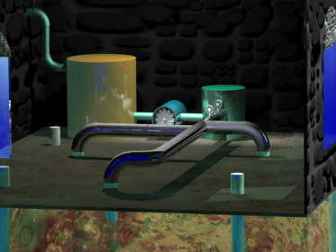
SVE: Factors Affecting Success - - Performance Considerations
Vapor
Treatment
Preferential flow
  Air will preferentially flow through higher permeability zones, providing less remediation to lower permeability zones
Asymptotic mass removal
  Remediation often limited by contaminant diffusion from lower to higher permeability zones where vapors are extracted
Short circuiting
  Short circuiting of air flow may occur in shallow or poorly constructed wells, reducing the ROI
High water table
  Rising water levels can blind screen intervals near the water table
Off-gas treatment
  Optimal method for off-gas treatment may vary over time as mass loading decreases
Aerobic degradation
  Increased air flow through subsurface can increase biodegradation of contaminants amenable to aerobic degradation
Condensate
Collection
Blower
Contaminant characteristics
Soil properties
Site conditions
System design
Performance affected by several factors

Slide 10
SVE Considerations to Avoid Overdesign
Recognize that majority of mass will be removed in a few months
Mass removal after first few months will be diffusion limited
All wells do not need to come online or be online at the same time
Mass contributions after first few months come from more focused source areas rather than broader soil vapor plumes (some wells will no longer need to operate)
Wells can be operated on a rotating basis to reduce costs while mass diffuses out of tighter parts of the formation

Slide 11
SVE Considerations to Avoid Overdesign
Off-gas treatment units (such as granular activated carbon [GAC] or thermal oxidizers) can be rented
A system designed for maximum flow and maximum contaminant loading will be oversized (overdesigned in a few months)
Pulsed operation of wells or operation of wells on a rotating schedule can be accomplished during weekly system checks
  Elaborate control systems and automated valves are often not needed
Fracking can increase flow rates, however, note that increased flow will be from preferential paths

Slide 12
SVE Operational Data Considerations for CSM
What is the trigger point for shutting down the system and transitioning to monitoring only?
What is the trigger point for changing off-gas treatment?
Based on operating wells and extracted vapors, can you determine the approximate location of previously known source and better target that remaining source material?
Would some existing vapor extraction wells serve as valuable vapor injection wells?

Slide 13
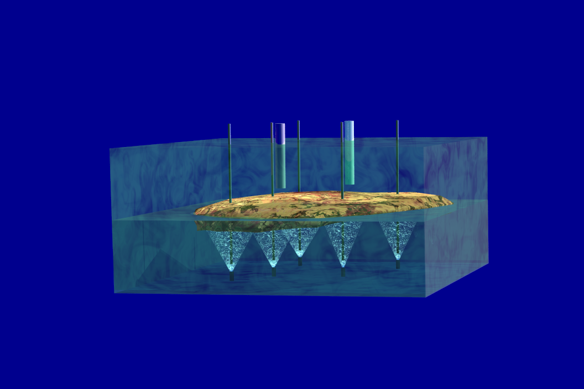
Air Sparging
Direct injection of air below the water table.
Must be operated in conjunction with an
SVE system to collect vapors
Air-injection
wells
SVE wells
Dissolved VOCs
in groundwater
transfer
to air bubbles
Dissolved phase
contamination

Slide 14
AS: Factors Affecting Success - - Performance Considerations
Contaminant characteristics
Soil properties (permeability)
System design, including:
  Air distribution (zone of influence)
  Air injection pressure and flow rates
In general, the ROI for AS wells is between
5 and 10 feet
Channeling
  Sparge bubbles will establish preferential pathways and leave some zones untreated
Aerobic degradation
  Aerobic degradation of contaminants amenable to aerobic degradation may occur but is difficult to quantify
Adequate characterization needed to treat entire target volume

Slide 15
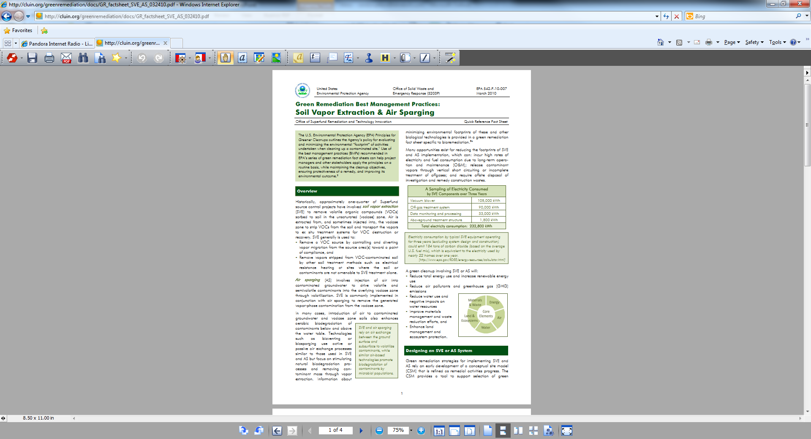
AS Design and Operational Considerations
Recognize potential for:
  Discontinuing operation of some sparge points
  Adding new sparge points during operation
Pulsed operation is beneficial but can be accomplished during weekly system checks
  Elaborate control systems and automated valves are often not needed
Recognize diminishing returns and reduced risk and transition to monitoring only or another remedial technology
Green considerations www.cluin.org/greenremediation

Slide 16
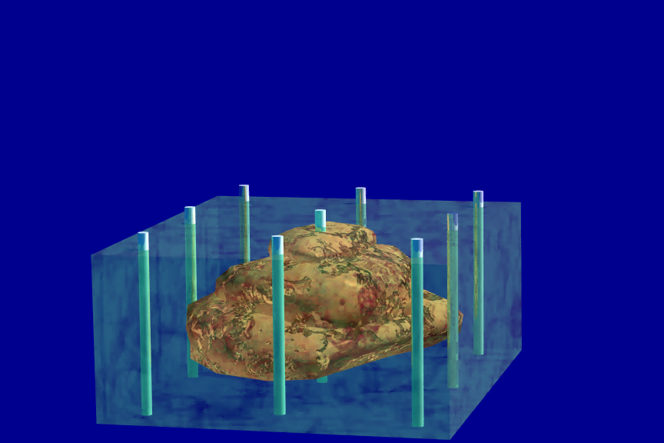
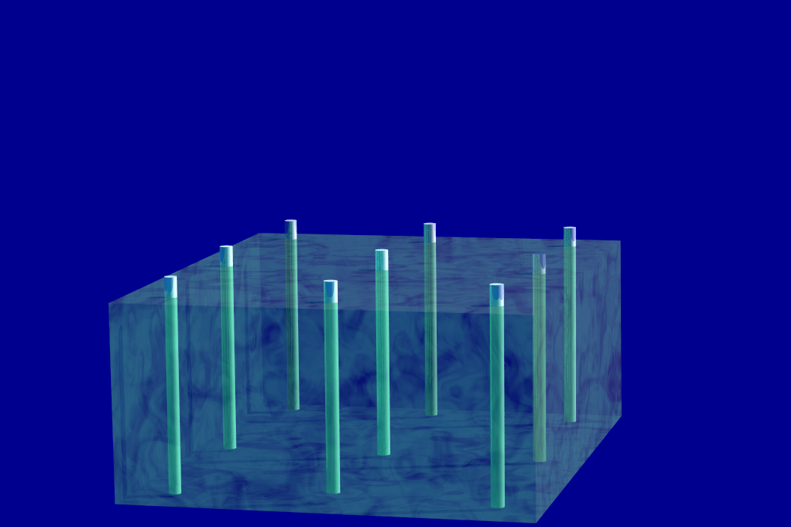
ISCO
Minimal waste generation
Targeted delivery
Minimal surface impact
Fast response
Flexibility
Treatment process in which oxidizing chemicals are placed in direct contact with the contaminant, destroying or immobilizing the contaminant.
Treatment of fuel, solvents, and pesticides in either the saturated or unsaturated zone.
More effective if design is based on high-resolution site characterization.

Slide 17
ISCO System: Factors Affecting Success
Optimal matching of oxidant and contaminants
  Treatability study may be necessary
  Some oxidation products can be purchased “off the shelf”
    Vendors will review site data for low or no cost
Level of definition of the contaminated zone
Contact between oxidant and contaminant
  Inject oxidant directly into contaminated zone
  Avoid “daylighting” reaction via multiple, smaller injections
  Preferential flow paths can adversely affect oxidant delivery
Ensuring oxidant not affected by natural material
  Naturally occurring organic carbon will consume oxidant
  Certain metals in soil and groundwater will impair performance

Slide 18
ISCO Design and Performance Considerations
Injected reagents will follow preferential paths, including along a direct-push drive rod to the surface or the next most permeable interval
Consider pros and cons of different delivery systems
 | Pros | Cons
Permanent Injection Wells | Available for multiple injection events Can carefully construct to target specific intervals Allows for recirculation systems Can be sampled Well-suited when injection is slow Fewer refusal issues than direct push | More costly to install each location/interval Increases site infrastructure
Direct-Push | Flexible with respect to locating new injection points/intervals Ability to collect data in new locations | Preferential flow along drive rods Potential false impressive of targeting specific injection intervals Potential for refusal Costly when injection is slow

Slide 19
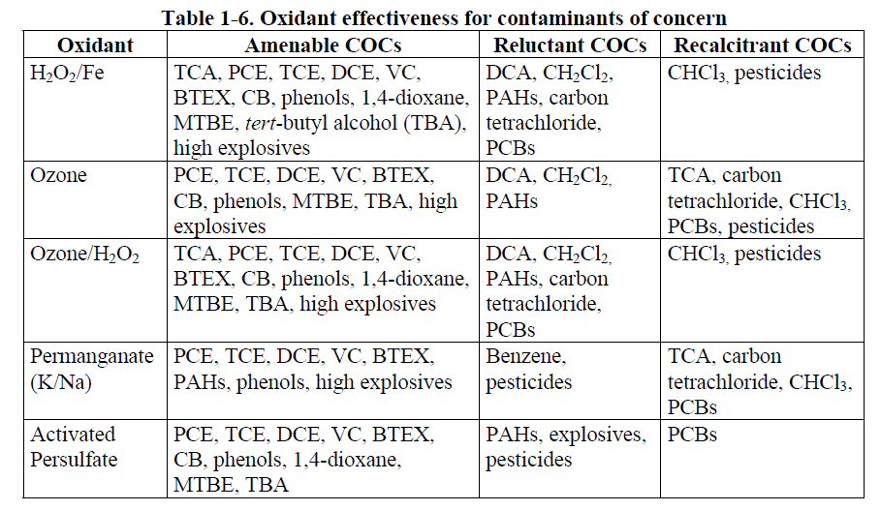
ISCO Design and Performance Considerations
Match the oxidant to the contaminant – engage multiple vendors for multiple products during design
Technical and Regulatory Guidance for In Situ Chemical Oxidation of Contaminated Soil and Groundwater Second Edition, ITRC – January 2005

Slide 20
ISCO Design and Performance Considerations
Use pilot testing to confirm natural oxidant demand and success of delivering reagents
Consider reactivity when selecting oxidant concentrations
  High peroxide concentrations will generate gas and backpressure
  Other oxidants may cause floc formation and fouling
  Some oxidants (such as permanganate) can be added as a slurry for longer-term activity
Consider oxidant persistence (implications for injection approach)
  Fenton’s reagent and ozone are consumed in minutes to hours
  Permanganate and persulfate last days to weeks to months

Slide 21
ISCO Design and Performance Considerations
Remediation after first one or two events will be diffusion limited (rebound)
Measure backpressure during injections and analyze results
  More permeable vs. less permeable zones
  Fracturing caused by injections
  Failure of seals
  Confirm reagent goes where you want it to go based on initial characterization
Additional safety precautions/procedures when treating LNAPL with ISCO due to heat generation and reactivity, temperatures can rise above flashpoint

Slide 22
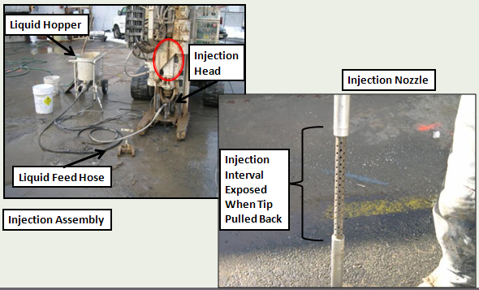
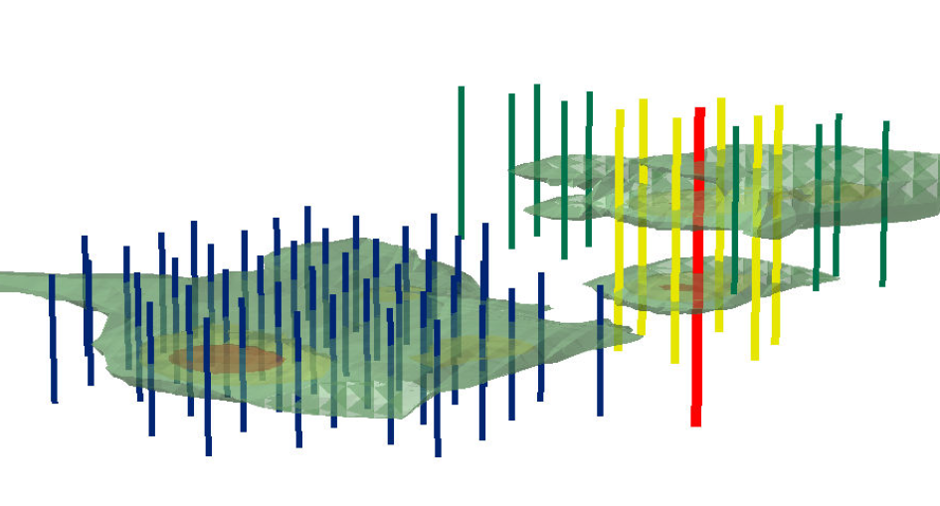
ISCO Remediation Designed Using High-Resolution
Site Characterization and 3-D Visualization
Injection Interval Pattern for the
Two Plumes
Plume B Injection Interval
Plume A Injection Interval
Plume B
8 ft injection
Interval to
Treat deeper
PHC contamination
Plume A
4 ft
Injection
Interval

Slide 23
Soil Excavation and Off-Site Disposal
Common refrain - “Just dig it up and get rid of it”
Not that easy - Must ask these questions first:
  Is contaminated area fully delineated?
  Is size and depth of the excavation clearly established?
  What is the depth to groundwater?
  Does remedy require excavation below the water table
    Is dewatering necessary to support redevelopment construction?
    Does UST removal or soil remediation require over-excavation, as is sometimes done in certain State programs?
  What are the consequences of leaving some contamination in place?
    Are the impediments to “getting it all” really that much greater than years of long-term remediation?
(continued)

Slide 24
Soil Excavation and Off-Site Disposal
Not that easy - must ask these questions first:
  Have cleanup standards and RAOs been clearly established?
  Has a method for determining completion been established?
  What are the disposal requirements for the contaminants?
  What are the acceptance criteria for the disposal facility; and how far away it is?
  Have site logistics such as contaminated/clean backfill soil staging and equipment storage been addressed?
Disposal of PHC soils easier/less expensive than CVOC-contaminated soils disposal
Be cognizant of State guidance to avoid over-excavation
  Accurately estimate soil volumes to limit scale of land-farming or disposal

Slide 25
Pre-Excavation Design Considerations

Slide 26
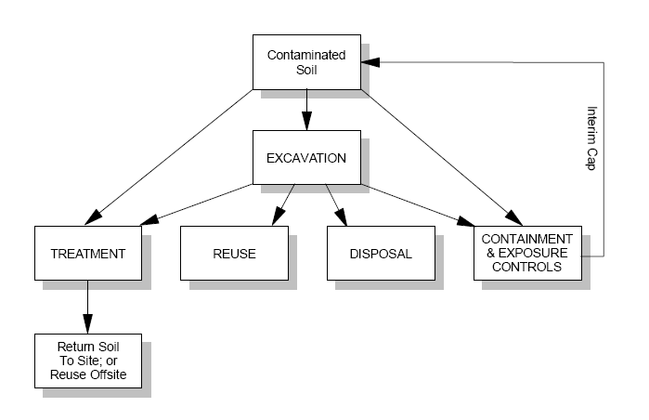
Post-Excavation Design Considerations

Slide 27
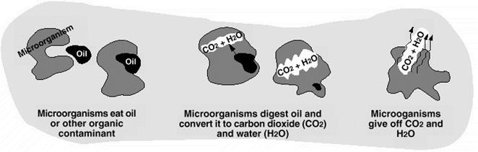
Bioremediation
Remediation of contaminants by enhancing microbial activity to degrade (or stabilize) contaminants by oxidation, reduction, or cometabolism…
  Oxidation (aerobic degradation of benzene)
  Reduction (reductive dehalogenation of TCE)
  Cometabolism – degradation of a variety of contaminants by enzymes produced by bacteria using other compounds for energy
Biostimulation – Amendments added to enhance microbial activity
Bioaugmentation – Addition of microbes for remediation
Various approaches
  Direct-push injections
  Discrete injections in permanent injection points
  Recirculation systems
  Source area treatment or biobarriers
Various amendment options

Slide 28
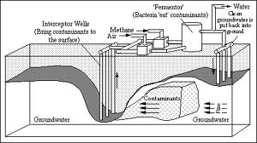
Bioremediation: Factors Affecting Success
Contaminated media
Aerobic or anaerobic conditions
Physical parameters
  pH
  Temperature
  Naturally occurring organic matter (carbon)
  ORP
  DO
Moisture content of unsaturated zone
Existing microbial populations
Mature CSM; impact area well-defined

Slide 29
Bioremediation Design and Performance Considerations
Different schools of thought on “fast-burn” vs. “slow-burn” substrate for treating chlorinated solvents
Different options for delivering oxygen for treating BTEX
  ORC injections
  ORC socks or in situ submerged oxygen curtain (iSOCs™)
  Air sparging with or without ozone or oxygen addition
  Nutrient addition may also be needed
Consider injection approaches (see ISCO discussion)
Recirculation help disperse reagents and reduce number of injection points
Design a robust performance monitoring program. Multiple events will likely be needed. Have the data to optimize the next event
  DO, ORP, Fe+2, NO₃⁻, SO₄²⁻, VOCs, pH, alkalinity
  Increase frequency of monitoring (such as monthly instead of quarterly), additional performance monitoring events…
    Help confirm results
    Provides additional insight
    Helps better distinguish between effects/results from consecutive injection events

Slide 30
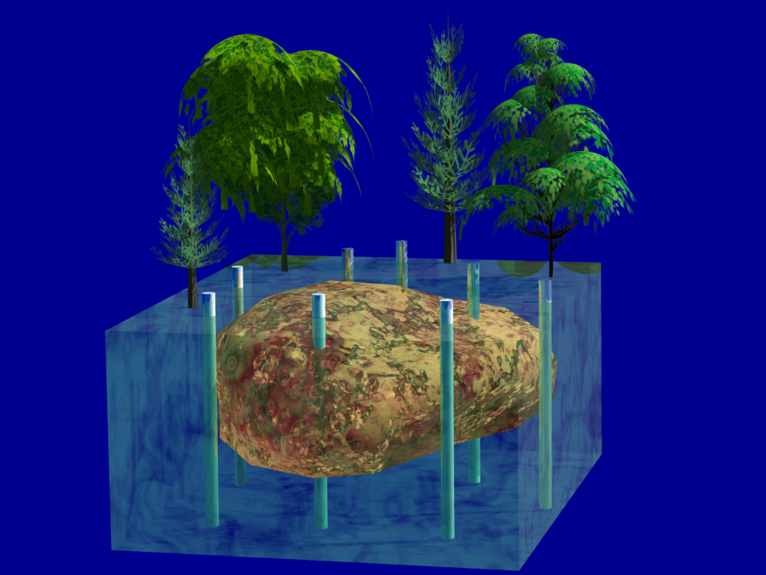
MNA
Relies on natural processes to remediate contamination.
Relies on:
Volatilization of contaminant
Biological processes
Chemical processes
Success depends on:
Type and amount of contaminant
Size and depth of contaminated area
Favorable soil and groundwater conditions
Sufficient time

Slide 31
General MNA Considerations
May require ICs
Usually applied to low-level groundwater impacts
1999 OSWER directive 9200.4-17P
  Requires rigorous site characterization
  Evaluate efficacy of MNA using “lines of evidence”
  Performance monitoring
Impose a stewardship obligation on property owner
Requires a groundwater monitoring system
  Upgradient monitoring wells
  In-plume monitoring wells
  Downgradient sentinel wells

Slide 32
Initial Screening of MNA Applicability
Do state regulations allow MNA as a remedial method?
  Many States require majority of source mass be removed
  Presence of mobile LNAPL may preclude consideration
  May be acceptable for limited non-mobile, residual phase LNAPL
Has the source been removed to the maximum extent practicable?
Is plume size and concentration reducing such that remediation will be achieved within a reasonable time?
Are there any receptors that could be affected?

Slide 33
Key Components of Typical MNA CAP
Documentation of adequate source control
Comprehensive site characterization
Showing lines of evidence to support MNA
Performance objectives
  Tools are available to support remedy evaluation
    remfuel http://www.epa.gov/ada/csmos/models/remfuel.html
Evaluation of timeframe for meeting remediation objectives
Long-term performance monitoring
Contingency plan

Slide 34
Pilot Studies
Before conducting a pilot test, confirm (to the degree possible) that full-scale application is practical and appropriate
  Don’t conduct unnecessary pilots
Collect too much rather than too little data
Several phases of successful pilot studies could actually be a successful full-scale remedy
Evaluate failed pilot study results to confirm implementation issues were not the reason for failure. Consider the benefit of redoing a pilot study before abandoning a technology
Increase the likelihood of success through sound research and bench-scale studies
Be sure the pilot test addresses the most critical parts of the remedy (such as reagent delivery to the tough locations)

Slide 35
Treatment Trains
Combination of remediation technologies usually applied in a “treatment train” via flexible record of decision/CAP
  Aggressive ISCO to treat source
  PRB or PRZ to treat plume
  MNA for “tail” of plume with low concentrations
  State requirements-“make every conceivable effort, utilizing every available technology”
Prepare a corrective action plan to outline the preferred cleanup option for the site
  Public has the opportunity to comment on preferred option
  Consider the comments and may revise final cleanup
  Determination of the final cleanup for a site is documented in its final site closure documents

Slide 36
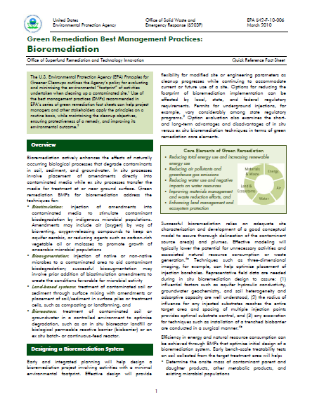
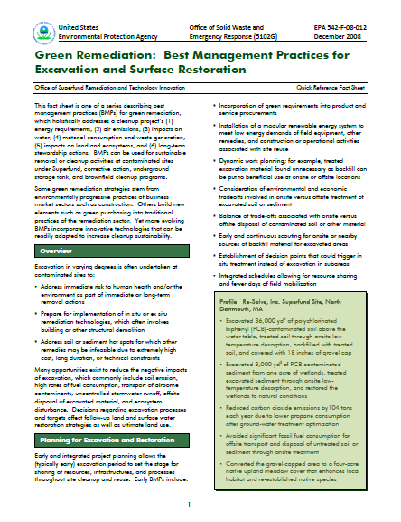
Green BMPs for Characterization and Remediation
For more information on Green BMPS for Bioremediation, refer to this fact sheet
www.cluin.org/greenremediation

Slide 37
Case Study: Fannon
Petroleum Site, Virginia

Slide 38
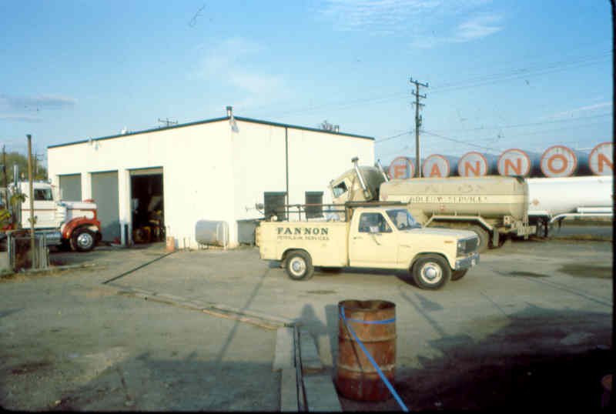
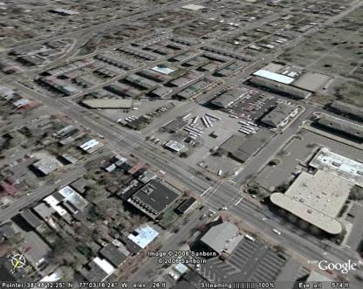
Case Study – Fannon Petroleum Site, Virginia
Fuel Depot since late 1800s
Most recent facility since 1962
ASTs and USTs
> 500,000 gallon capacity
Early 1980s release

Slide 39
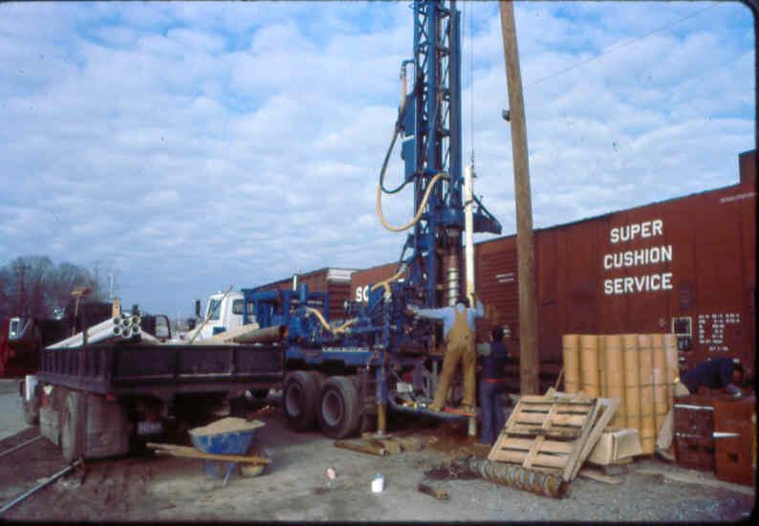
Systematic Planning Considerations
Unconsolidated geology (relatively uncomplicated)
  MIP with collection of soil samples for laboratory analysis
Developer with plan (residential)
Identify hot spots requiring remediation
Define threshold contamination level above which remediation was necessary
Stakeholder concurrence and acceptance
  City, owners, citizens
Identified receptors

Slide 40
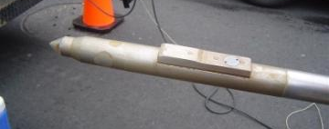
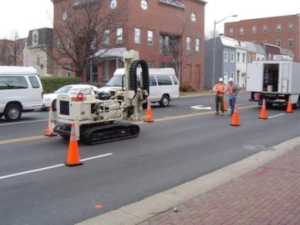
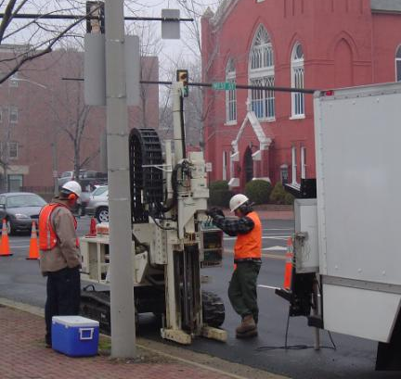
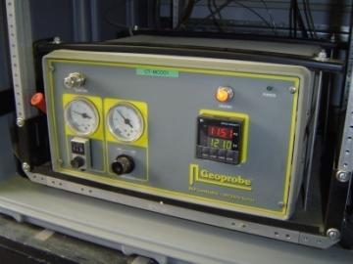
MIP Survey

Slide 41
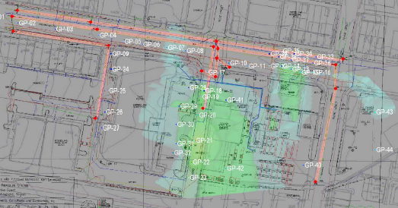
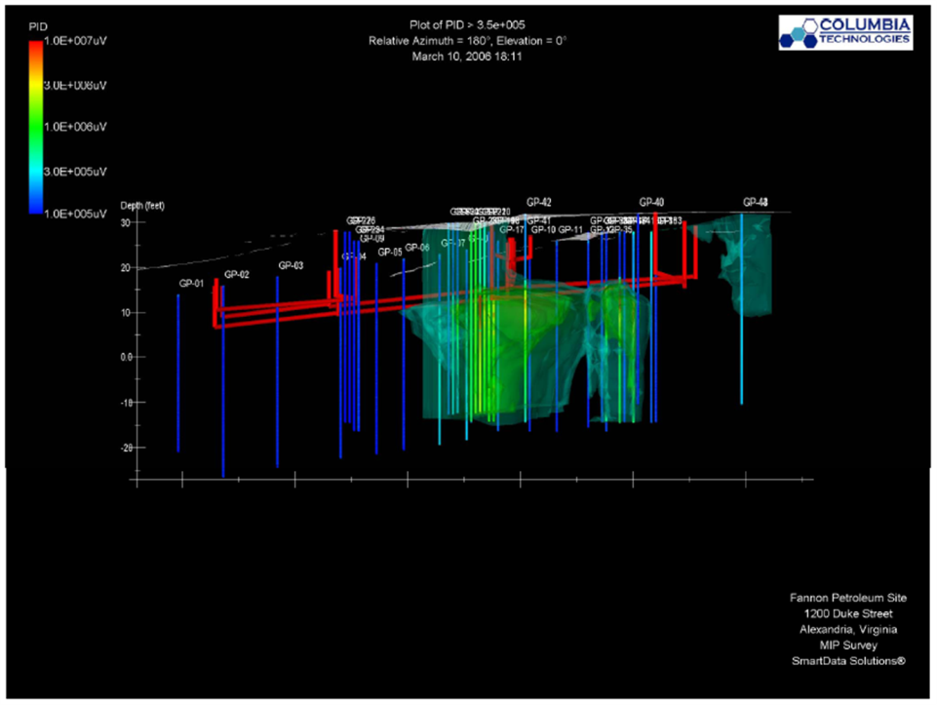

MIP Results
Closely correlated with plume
defined by conventional
investigation methods
MIP identified previously
unknown contamination
Plume appeared to intersect
sanitary/storm sewer system
Some adjustments to construction
plan (such as depth of structures)
Negotiated environmental
redevelopment actions which
could be potentially be reimbursed
under state UST fund

Slide 42
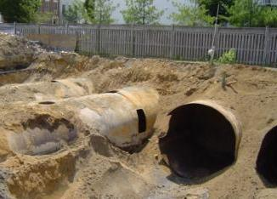
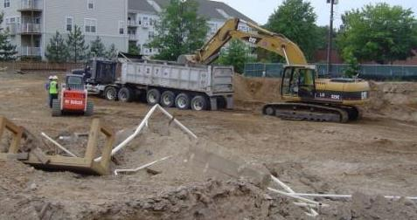
Remedial Actions
Excavation and removal of 28 USTs
Excavation and disposal of 35,317
tons of petroleum-impacted soil
Recovery and disposal of 1,000
gallons of free-phase petroleum
Ongoing subsurface remediation
at down-gradient adjacent
property
Continued reduction in amount
of subsurface contamination
Post-CAP monitoring in
near future

Slide 43
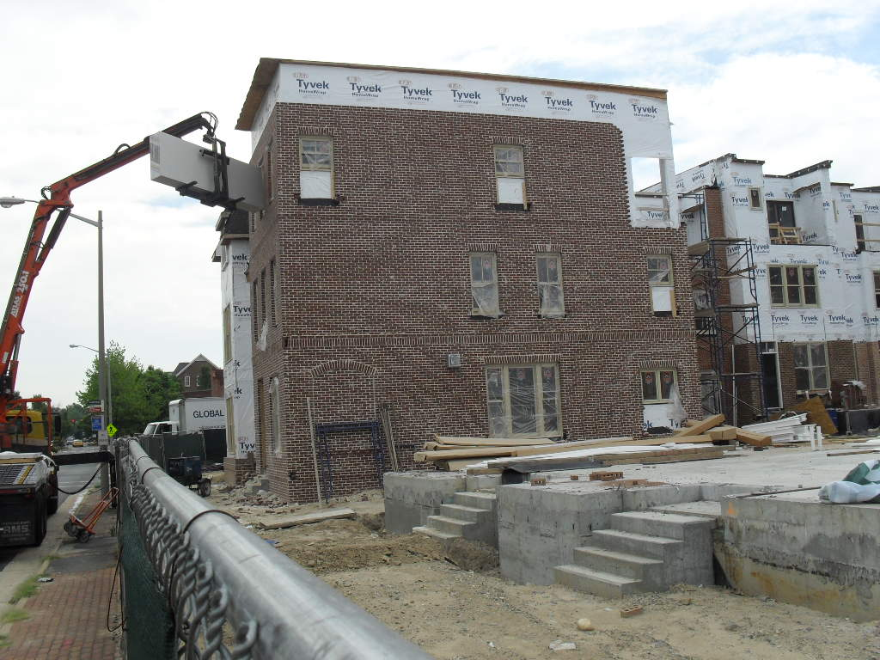
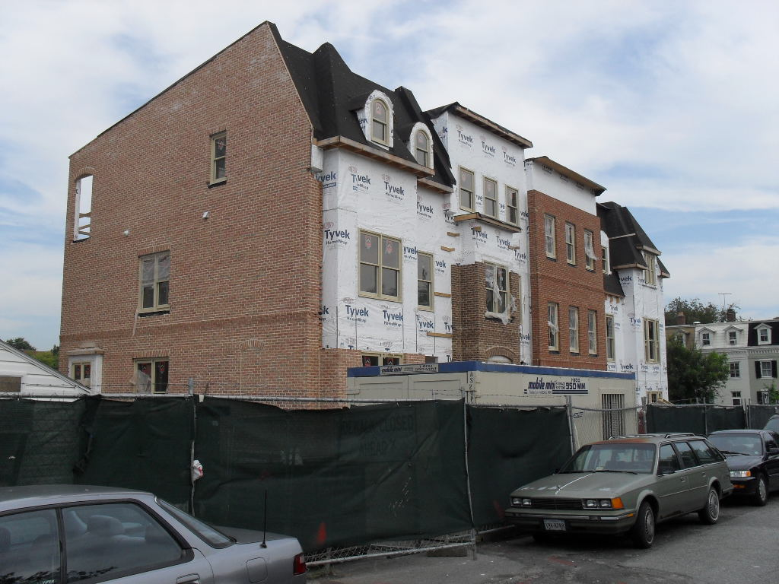
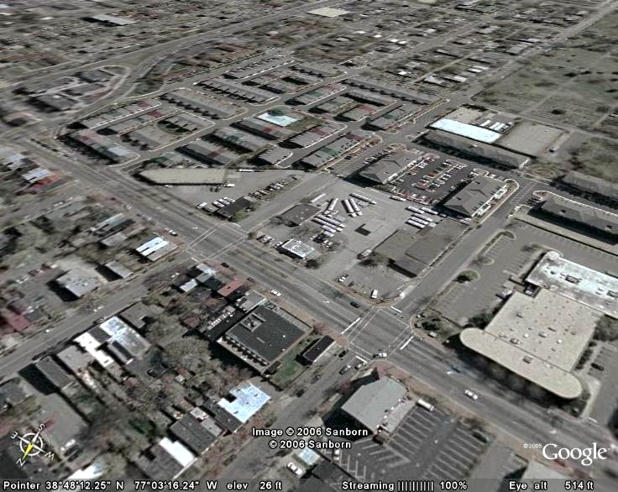
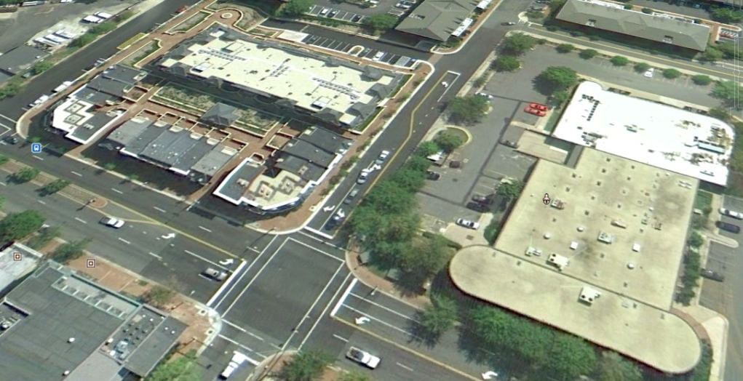
Redevelopment 2008/2009
Before After

Slide 44
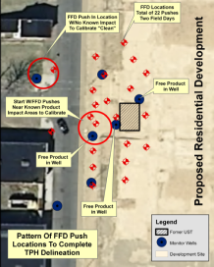
Case Study: Excavation of
TPH-Contaminated Soil – Removal

Slide 45
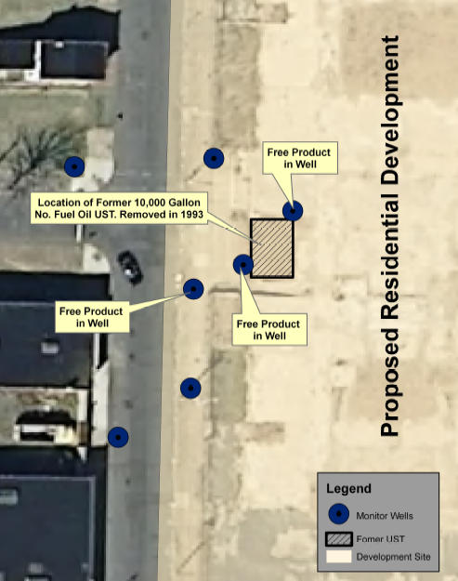
Case Example – Delineation of TPH Contamination from UST Release Using Collaborative Data Sets and Imaging
10,000 gallon heating oil UST leaked released No. 2 fuel oil
Limited site investigation consisted of monitoring wells
Proposed residential development on former school site
Delineate TPH contamination zone and define core impact area for the purposes of remediation

Slide 46
Delineation of PHC Contamination in Soil Caused By UST Release
PHC in soil delineated using an FFD
  Employs UV light source to locate TPH
Locations of depth-discrete soil and groundwater samples were selected based on FFD Logs
Data sets were imaged using ArcGIS 3-D Imaging Software to depict contaminated zone
To support remedial action design, visualization used to:
  Gain regulatory acceptance regarding completeness of delineation
  Decide on limits of excavation before construction
  Design the excavation project and estimate volumes

Slide 47

FFD Pushes Used to Delineate Extent of Contamination
Begin at locations of known highest TPH impact or free product in well
Test instrument response
Next “go to” location with little to no TPH impact
Perform dynamic field based “step outs” to instrument “flat line”
When FFD shows no response (“flat Line”) confident TPH below 100 ppm

Slide 48
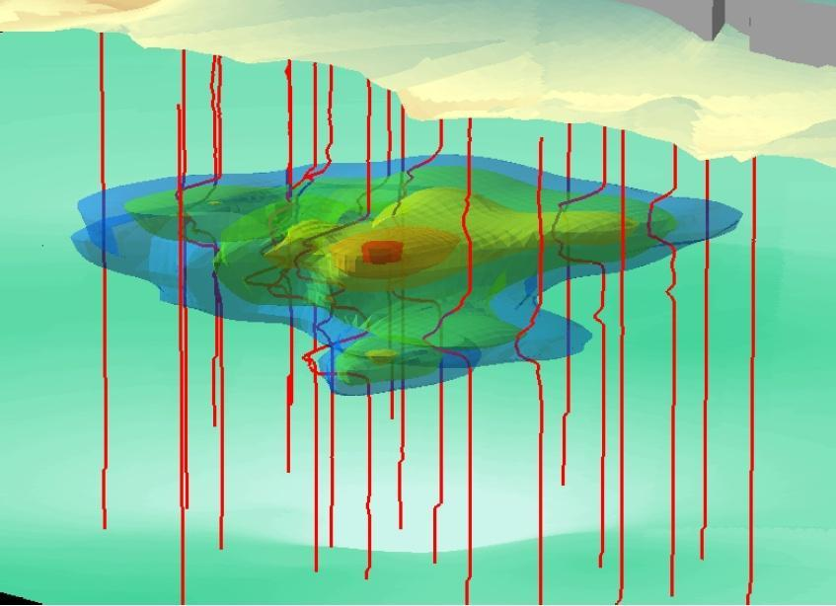
TPH Contamination Area 3-D Visualization Built From FFD Profiles
Core contaminated area
TPH contamination model
“Flat line”
FFD log
profiles
at edges
Area of increased
signal response
FFD Electronic Signal Profile
Shells represent
FFD signal strength
from 150 mv to
1200 mv
FFD logs “hung” from the
land surface raster.

Slide 49
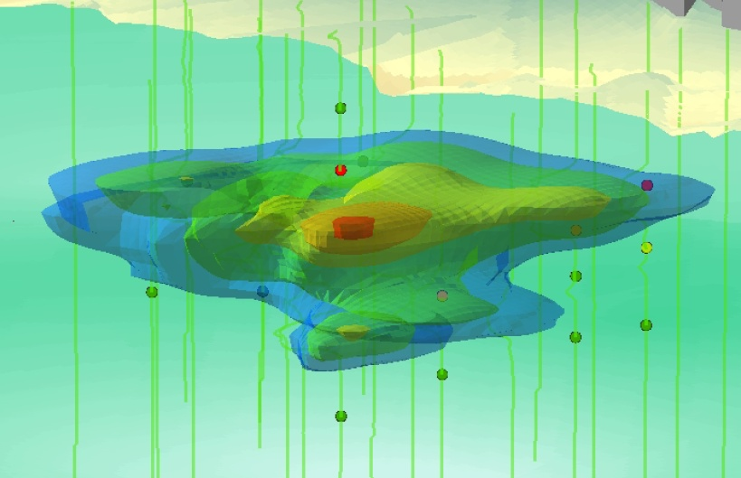
Collaborative Data Sets Demonstrate Delineation

Slide 50
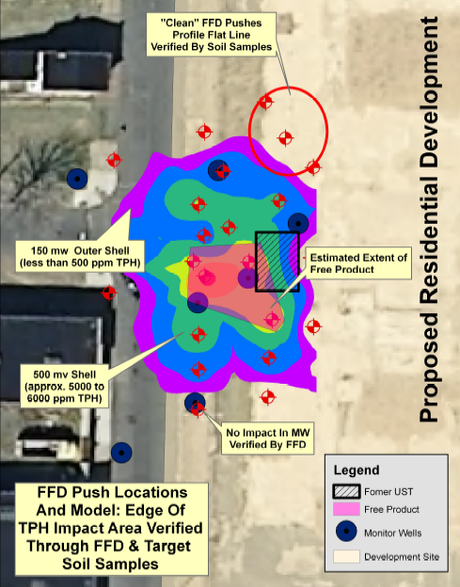
TPH-Contaminated Area Delineated
Extent of TPH-contamination verified through collaborative data set and visualization
Various cleanup options can be quickly evaluated:
  Total removal to beyond 150 mv shell
  Removal to extent of 500 mv shell which correlates with approximately 5 to 6,000 ppm TPH
  Free product and core contaminated area removal for maximum risk reduction benefit

Slide 51
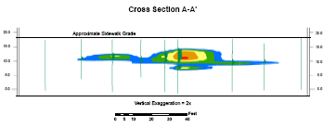
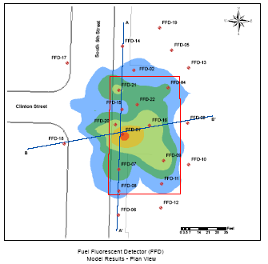
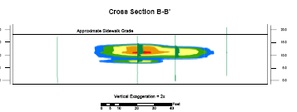
Engineering Analysis – Cross Sections Showing Distribution of Fuel Contamination and Location of Excavation
Excavation area

Slide 52
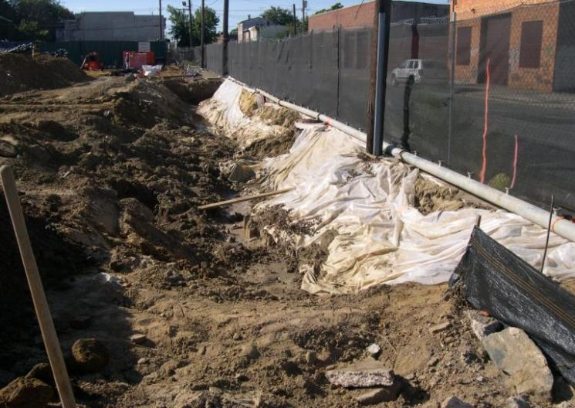
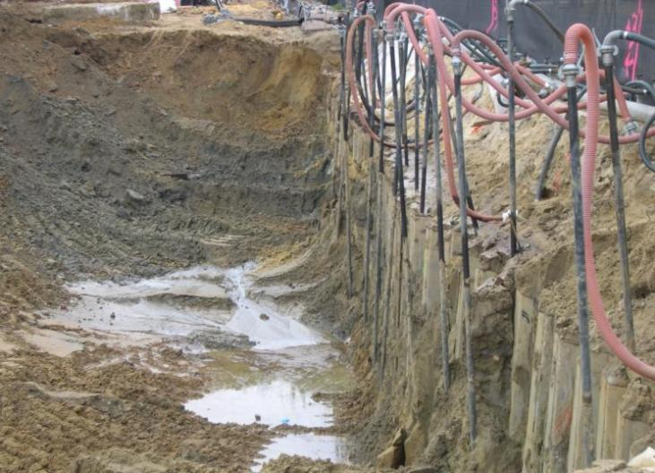
Sheet Piling Cutoff Wall Installed Along Edge of Roadway
TPH-contaminated area near a roadway excavated
Sheet piling installed along border between school site and roadway

Slide 53
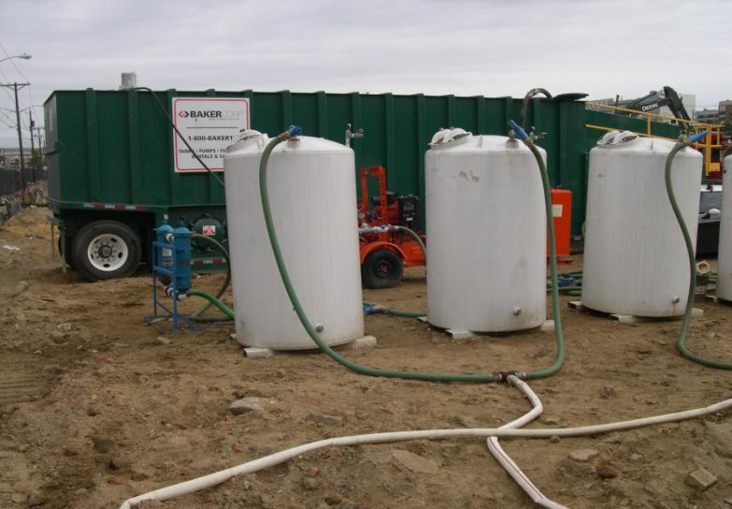
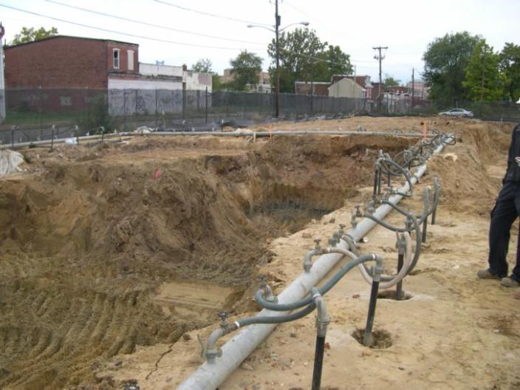
Well Point Dewatering System
TPH-contaminated soil extended below water table
Well point system installed to depress water table at location where TPH-contaminated soil was excavated
Activated carbon
water treatment
canisters

Slide 54
TPH-Contaminated Soil Removal
Soil contaminated with PHC from UST Release
Clean backfill staged on site prior to excavation to minimize open excavation time
Excavated with dewatering system support
Oxygen Release Compound spread in with backfill to promote biodegradation of residual TPH compounds
Backfill material spread and compacted

Slide 55
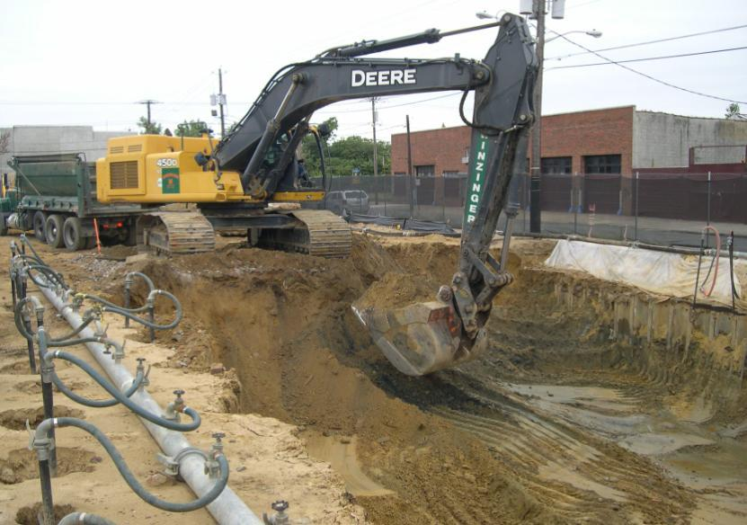
Excavation of TPH-contaminated Soil
Dewatering system

Slide 56
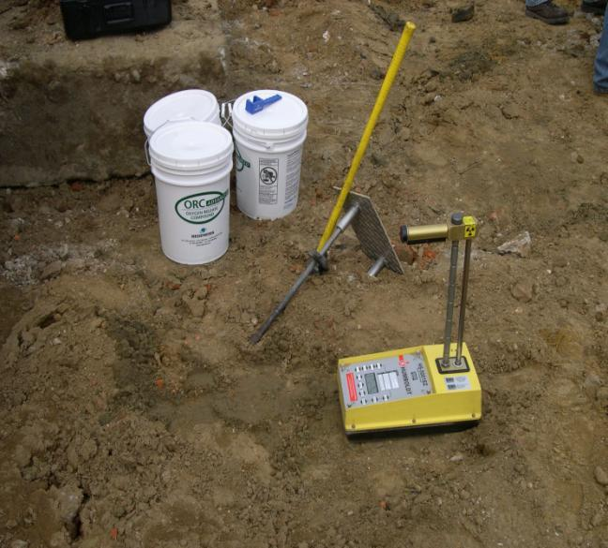
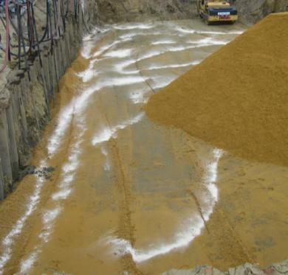
Oxygen Release Compound Added to Promote Biodegradation of Residual TPH
Oxygen Release Compound
spread in backfill
Soil density testing
instrument

Slide 57
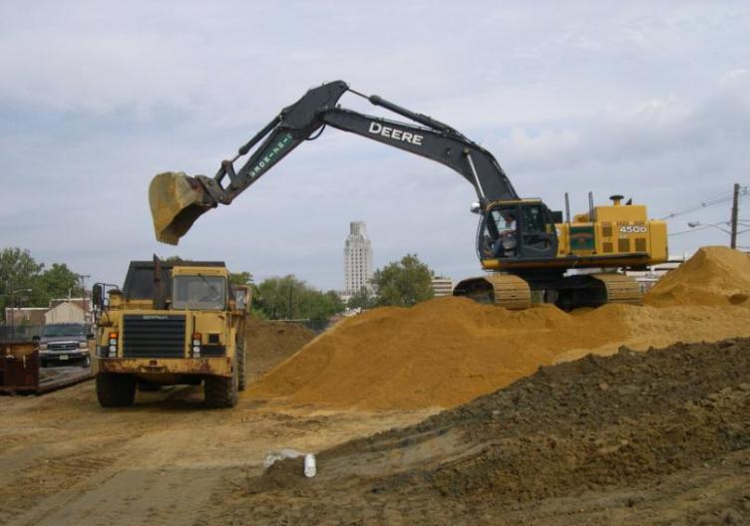
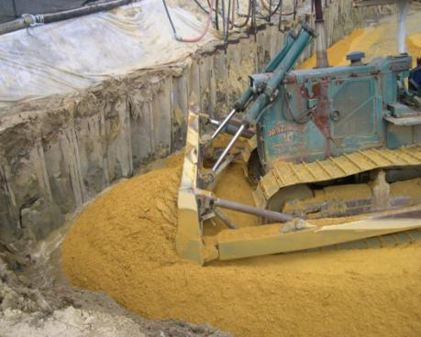
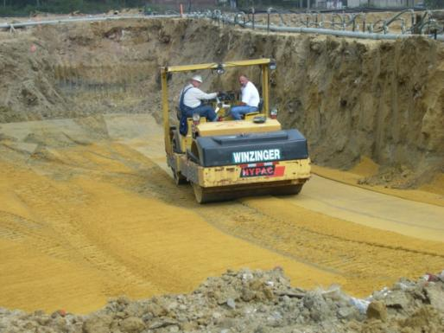
Stockpiling, Spreading, and Compacting Cleanup Backfill

Slide 58
Summary
Real-time measurement technologies can provide high-density data sets that can rapidly advance the CSM
Probe electronic signals are compatible with ArcGIS and other imaging software and can be easily visualized in 3-D
Sorting image by signal strength can provide indication of contaminant concentration distribution
Discrete sample soil and groundwater locations can be selected to verify signal strength, concentration correlation and confirm delineation
Image (the CSM) is recreated using collaborative data
  Electronic signals from probe
  Discrete sample analytical results
Mature CSM 3-D visualization can be used for selection and design of remedial action

Slide 59
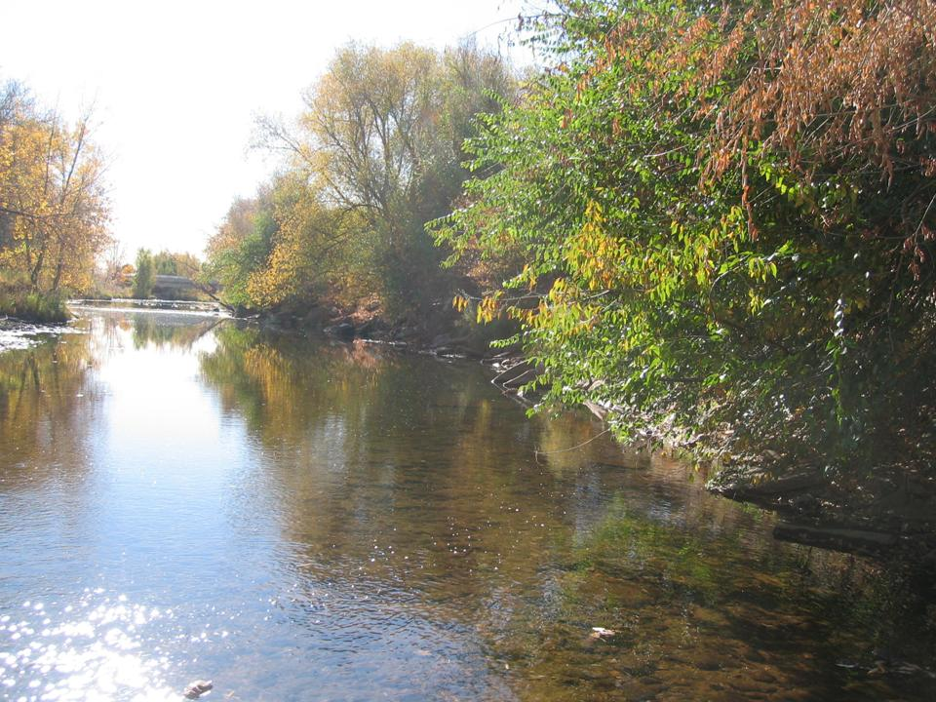
Cache La Poudre River
Fort Collins, Colorado
Case Study

Slide 60
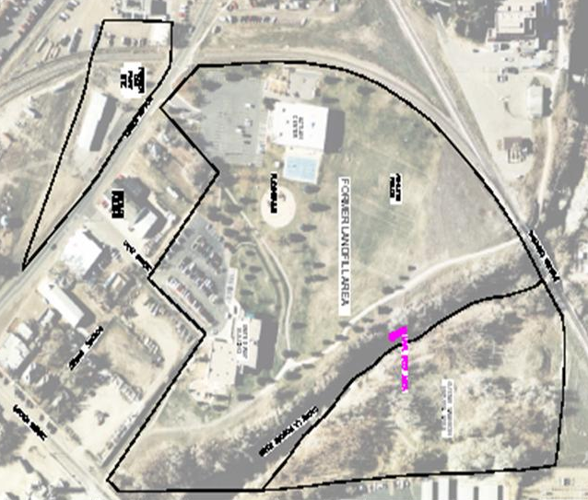
Site History and Background
City of Fort Collins awarded a brownfields grant in 2001
  Expand existing community
  center over old city landfill
  Initiated investigation targeting
  the potential impacts of the
  landfill and the surrounding area
  on indoor air quality of the
  proposed building

Slide 61
Brownfields Investigation
Landfill operated from late 1930s until 1963
A MGP operated from 1904 until 1927 immediately across the street
Post 1927, a gasoline distribution business (including a gas station) operated on the MGP parcel
Machine shop operated to the immediate southwest of the landfill
Sites adjacent to major recreational use river
Varying stakeholder views on sources and causes – managed through use of evolving CSM

Slide 62


NAPL Discovery
October 2002, NAPL liquid (previously not observed on-site) discovered in the river
Subsequent investigation by Brownfields Program indicated it to be fairly substantial
October 2003, site referred to the removal program and site assessment performed by the Superfund Technical Assessment and Response Team 2 contract

Slide 63
Contaminants
Groundwater
  BTEX, MTBE plume
  PAH plume
  TPH
  Chlorinated solvent plume
Subsurface soil and river sediments
  NAPL containing PAHs
  BTEX
  TPH

Slide 64
Investigation Techniques
Conventional
  Exploratory trenches in the river
  Soil gas sampling over the entire landfill and river bank
  Soil borings and groundwater well installation
Innovative/Real-Time Measurement
  Direct-push groundwater sampling methods
  Electromagnetic geophysical methods
  High-resolution resistivity geophysical methods
  On-site GC/MS analysis of VOCs in groundwater
  Passive soil gas
  Passive diffusion bag groundwater sampling methods
  Open-path Fourier transform infrared spectroscopy

Slide 65

Baseline CSM

Slide 66

Characterization Stage CSM

Slide 67
Results of Investigation
NAPL = coal tar, likely mixed with gasoline and diesel components
NAPL sank down through the alluvium to the top of area bedrock and traverses toward the river
Near the landfill, NAPL moved entirely into fractures in the bedrock, eventually accumulating under river
NAPL in the river sediments over a 300’ stretch
Underneath the river in the bedrock over a 600’ stretch
NAPL migrated slightly past the river in deep bedrock (20-25’ bgs) fractures

Slide 68

Design Stage CSM

Slide 69
After Friendly Negotiations
Excavated the contaminated sediments and bedrock in and underneath the river
Installed a vertical sheet pile barrier with hydraulic controls to intercept the NAPL
Provided for long-term water treatment

Slide 70






Remediation in a Nutshell
Finished Product

Slide 71
Benefits of Triad BMPs for Characterization / Remediation
Estimated cost savings of ~30% compared with more traditional approach (multiple mobilizations, fixed-based analytical methods)
Increased size and quality of data set used to make decisions
Adequate characterization assured functional mitigation strategy was installed appropriately in first attempt
Difficult to evaluate cost savings associated with installation of poorly-designed initial remedy
  Remedy cost was ~$13 million
  Installation of poorly designed system would have been very expensive in long run

Slide 72

Award-winning site Brownfields Redevelopment Effort
First community center in the United States certified Leadership in Energy and Environmental Design (LEED®) Gold
North Aztlan Community Center

