Slide 1
Best Management and Technical Practices for Site Assessment and Remediation Question and Answer Webinar
CLUIN Studios
3/12/15
Stephen Dyment US EPA
Technical Support Program Manager
OSWER/OSRTI/TIFSD/TIIB

Slide 2
Q&A Session for Archived Webinars
Best Management and Technical Practices for Site Assessment and Remediation
Delivered at 2013 National Tanks Conference
CLUIN archive sessions in 2014
Links
http://www.clu-in.org/conf/tio/bmp/intro.cfm
http://www.clu-in.org/conf/tio/bmp/archive.cfm
http://www.clu-in.org/conf/tio/bmp/archive.cfm

Slide 3
Topic Review
BMPs for Characterization
Why?
Optimization history, common findings, pilots
Identification of BMPs
Systematic Planning
CSMs, lifecycle costs and scale for LUST sites
Collaborative data and high resolution tools
Geophysical, hydrostratigraphic, direct sensing
DMAs, monitoring wells, vertical profiling, transects, flux

Slide 4
Topic Review
BMPs for Remediation
Why?
Optimization history, common findings
Identification of BMPs
CSMs for design
Evolution of remedy implementation
Single, large scale, presumptive to targeted multi technology approaches
HRSC and completion strategies
Technologies
SVE, air sparging, ISCO, excavation, bio/ enhanced bio, MNA
Green remediation, sustainability considerations
Case Studies

Slide 5
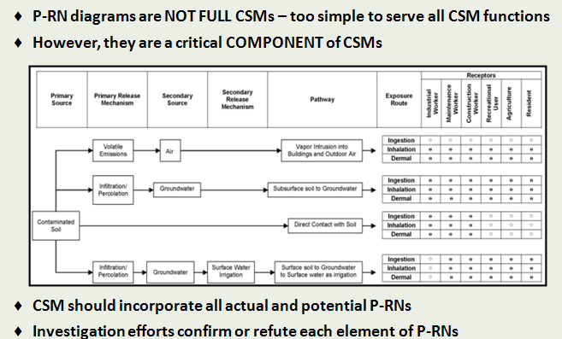
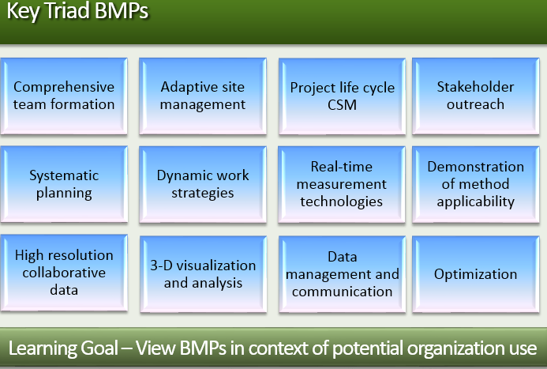
Submitted Questions Part 1
A set of methods or techniques found to be the most effective and practical means in achieving an objective while making the optimum use of resources
Are these BMPs codified anywhere? Are they part of EPA or state official guidance?
Notes:
Great question and one that I get a lot.
The short answer is no, there has been no effort to specifically codify these BMPs, nor has EPA developed a specific definition for BMPs. Here is the one we’ve been using.
The longer answer is that many of these BMPs are mentioned in various EPA guidance. The CSM for example is specifically mentioned in a number of EPA guidance documents. The example that comes to mind for me is the Superfund RI/FS guidance. Unfortunately that guidance also puts an example
“Collecting and analyzing existing data to develop a conceptual site model that can be used to assess both the nature and the extent of contamination and to identify potential exposure pathways and potential human health and/or environmental receptors” RI/FS guidance 1988
“The site conceptual model synthesizes data from historical information, site characterization, and remediation system operation……Like any theory or hypothesis it is a dynamic tool that should be tested and refined throughout the life of the project” Guidance for Evaluation of the Technical Impracticability of Ground-water Restoration. SF 1993
“All the important features relevant to characterization of a site should be included in a CSM….. essential tool to aid management decisions associated with the site and also serves as a valuable communication tool both internally with the “site team” and externally with the community.” Guidance for Evaluation of the Technical Impracticability of Ground-water Restoration. SF 1993
“The CSM documents current site conditions…” SF Soil screening guidance 1996.
“…it is important to keep in mind that remedial action costs are influenced, in general, by the quality of the conceptual site model (CSM), which is a three-dimensional “picture” of site conditions that illustrates contaminant distributions, release mechanisms, exposure pathways, migration routes, and potential receptors. The CSM documents current site conditions and is supported by maps, cross sections, and site diagrams…” The Role of Cost in Superfund Remedy Selection Process, 1996.
Finally, I would say that you have to remember that in the case of UST/LUST these are delegated programs whereby the states develop the regulatory frameworks to address these sites. I have been approached by a number of states who are re-vamping various guidances for examples of language to more clearly encourage the use of many of these BMPs. In particular real-time measurement tools and dynamic work strategies, HRSC, and 3D vis in support of a robust CSM. My group has done training for UST/LUST programs in a number of states and often as a precursor to conducting the training I will review their relevant guidance. I would say that in almost all cases if the BMPs are not explicitly stated as a requirement then they are most certainly not explicitly forbidden. In other words these things are BMPs precisely because they been found to be effective, efficient, and can be utilized in support of all of the programs I’ve worked in including: UST/LUST, brownfields, state voluntary cleanup, Superfund, RCRA, at federal facilities, internationally.
I know that many states and programs have specific analytical method requirements for example. And that’s great. We always want to obtain representative samples to meet those requirements. But that doesn’t mean we can’t use those analyses to develop a robust CSM, it does’t preclude the use of direct sensing tools as collaborative data, it doesn’t negate the need for comprehensive systematic planning, the use of adaptive strategies, or the use of optimization programs. At the end of the day these are strategies that most programs are either already using or would at least allow the exploration of use. What I’ve tried to do is bring these BMPs into programs and show practical applications. Ones that can show immediate benefit but really don’t require major guidance or policy changes. Those things tend to follow once we can show successful deployment of the BMPs and show tangible benefits like improved remedy performance, cost and time savings, more robust and statistically defensible and transparent decision making.
Optimization is a great example. We haven’t necessarily changed guidance (which can be a real challenge for us in the superfund program) but I would say that efforts in optimization have most certainly changed the way we think about characterization and remedy implementation and how we operate the program.

Slide 6
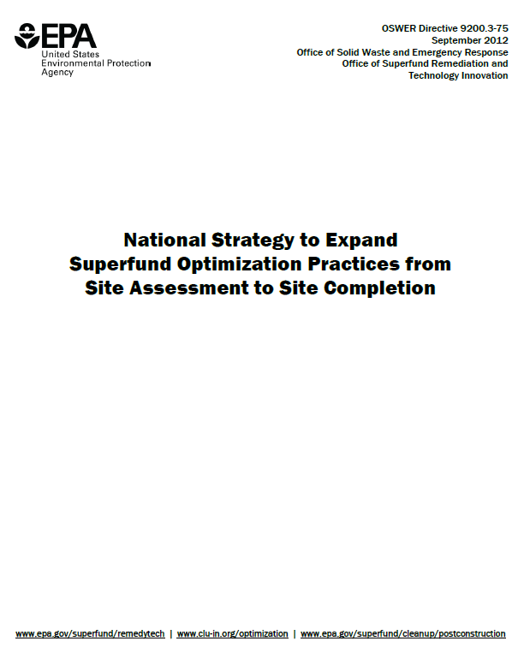
Submitted Questions Part 1
How long ago were you doing 10 sites per year compared to 30 per year now?
Is this increase mostly attributed to this optimization?
What is not included, specifically in this optimization?
Notes:
Optimization goes back to late 1990s early 2000s
This National Strategy (Strategy) 2012 institutes changes to Superfund remedial program business processes to take advantage of newer tools and strategies that promote more effective and efficient cleanups.
The Strategy identifies several objectives to achieve verifiably protective site cleanups faster, cleaner, greener and cheaper. When applied consistently and systemically to site management, these techniques and the decisions they generate show a significant return on investment. The U.S. Navy reports a return of greater than 6:1.
2 The Strategy envisions iterative efforts by regions to pursue cost-effective expenditure of Superfund dollars; lower energy use; reduce carbon footprint; improve remedy protectiveness; improve project and site decision making; and accelerate project and site completion.
This Strategy builds on a long history of successful practices and integrates different optimization technical support efforts. It capitalizes on the benefits of optimization through multiple processes including: work planning, communicating, training, implementing, measuring and cost accounting. As part of this Strategy, the Office of Solid Waste and Emergency Response (OSWER) expects regions to systemically apply optimization concepts throughout all phases of the remedial pipeline as a normal business practice.
Other programs using or exploring- Air Force, Navy, OUST/LUST, RCRA looking at incorporating optimization and BMPs into LEAN process.
What is included/not included- really a matter of scoping. Some projects allow the freedom to look holistically at the site, the process, milestones, endpoints etc. Others want very specific review. Really runs from value engineering (parts, components) to full optimization review (CSM, potential completion, ICs, remedy technology/implementation, sequencing) leading to adaptive management.
To the extent we can we prefer the project teams be allowed to explore all aspects of the site. What our clients get is a series of findings and recommendations. They are not required to take any specific action, however over the years and particularly with the national strategy we have formalized our tracking and follow up procedures. Which recommendations have been implemented? Which have not? Why?

Slide 7
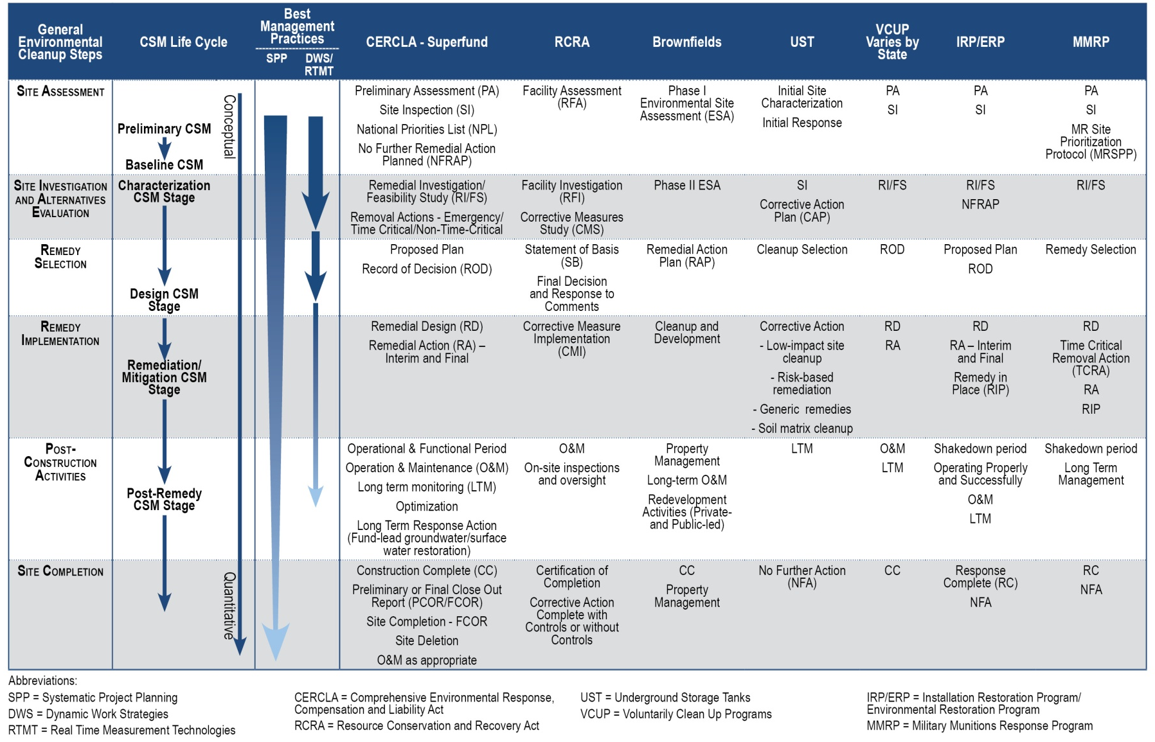
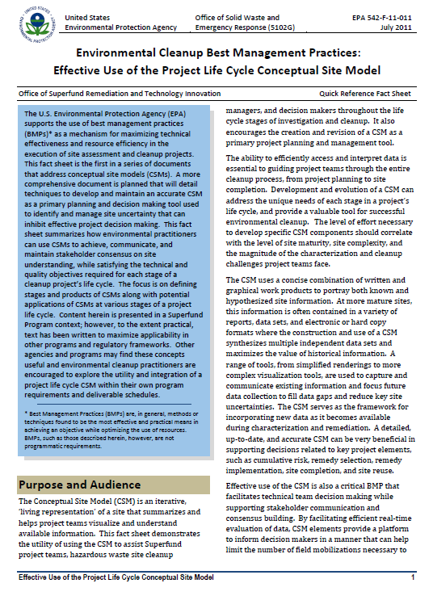
Submitted Questions Part 1
What’s an evolving Conceptual Site Model? Does this mean I need special software? Or need to recreate a CSM every month?
Notes:
We should all recognize the dynamic nature of any UST/LUST site. More importantly we should recognize the dynamic nature of our understanding of that site. In other words any data collection effort can impact our understanding (our CSM) of the processes controlling release, migration, attenuation, cleanup etc.
Documenting our understanding of the CSM as it relates to data collection both for characterization and to assess remediation performance is in essence documenting the evolving conceptual site model. Many reports and documents I see present recently collected data but few seek to draw conclusions from that data or illustrate changes in thinking, approaches, or understanding of the site as it relates to the data. Updating or evolving the CSM doesn’t require special software although 3D visualization tools are increasingly cost effective even at smaller tank sites. Please do your self a favor and at least consider interpreting data in 3D. Further consider geology, hydrogeology as much as chemical, biological data. In my opinion just crudely drawn plume maps with contours based solely on a few monitoring well data points provides limited value. Most consultants should be able to provide maps, cross sections, actual data interpretation.
We already collect that data as part of our various program guidance, procedures. The evolving CSM is simply documenting any changes from previous iterations or descriptions of the CSM, noting seasonal/temporal variations, noting changes to fate/transport processes, or cleanup processes (attenuation, active remediation).

Slide 8
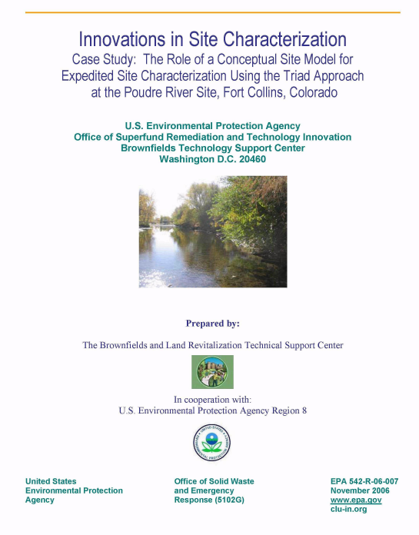
Submitted Questions Part 1
Do you have examples of CSMs you can share? What makes for a “good” CSM?
Notes:
What makes a good CSM, good characterization and actual data interpretation. What do we know, what are we less certain about, what do we need to know more about. Do we understand geology, hydrogeology, contaminant distribution, at scales appropriate for site heterogeneity? Where is the mass? Where is the source/dissolved plume in 3 dimensions etc. What to these issues mean in terms of risk, the need for remediation, potentially applicable technologies etc.
Talk to your colleagues. Do they have an example that was beneficial to them on a site?
CSM data needs for risk evaluation are likely different from those needed for remediation design.

Slide 9
Submitted Questions Part 1
Usually more data for a site means more time and/or more money. How can I balance the increased emphasis on characterization with costs?
Notes:
3 words- Return on investigation
The need for higher resolution characterization increases as the aggressiveness and expense of the remediation strategy increases.
I always find it interesting when one party is spending 100s of thousands of dollars in remediation but balks at spending 10, 20, even 50k to better characterize a site.
In my experience increased resolution (and therefore $$) of the characterization is accompanied by 1 of 3 scenarios
a more efficient and targeted remediation (save $) where the previous CSM was accurate
an improved CSM resulting in a smaller remediation footprint,
or identification of site realities which while more daunting then expected mean that we prevent application of technologies and therefore ($$) that will not address the contamination sufficiently to see a return on investigation.

Slide 10
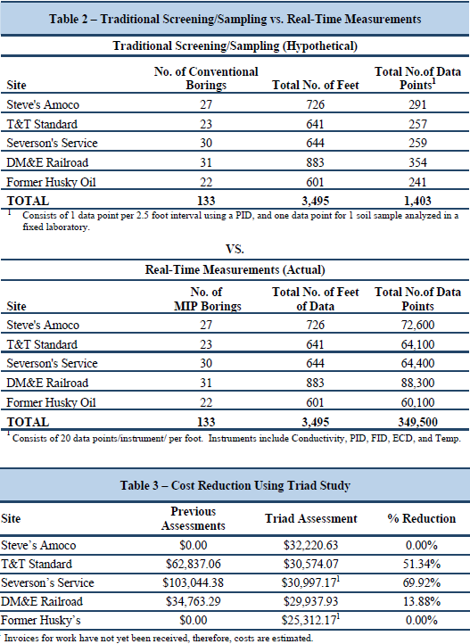
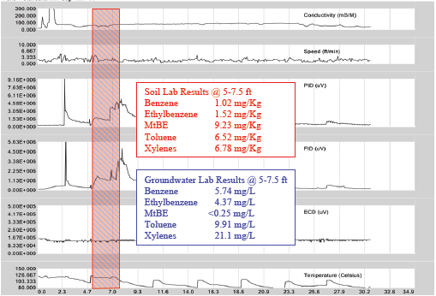
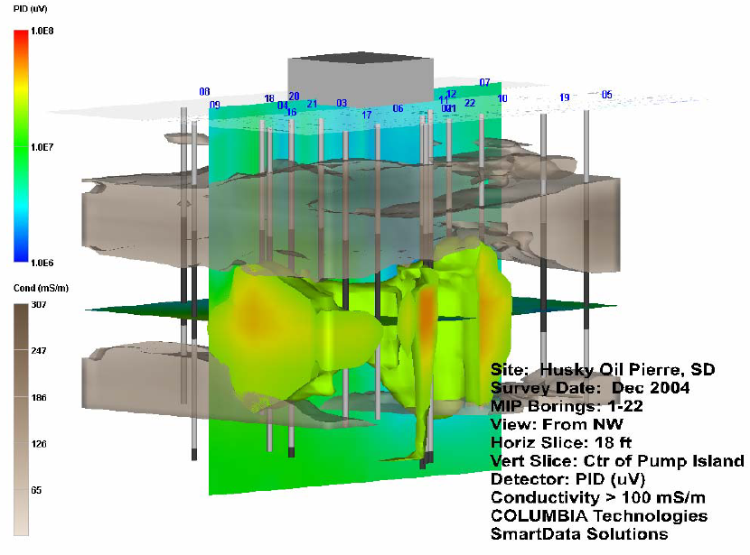
Example BTSC Technical Support Projects
South Dakota Triad- 2004/2005
5 “legacy” UST sites, 3 active gas stations, 1 closed gas station , 1 railroad fueling station
Stakeholders: South Dakota PRCF, State DENR, property owners/consultants, vendors
Goals: rapid characterization, accurate CSMs, establish clear cleanup goals, move to closure
Results
Elevated communication: PRCF and DENR
1 day systematic planning meeting, 2 week field effort
Corrective action plans for all 5 sites developed
3 previously unknown USTs located & removed
350,000 MIP data points
25 soil, 13 groundwater, 1 product lab samples analyzed
1 NFA, 2 additional remediation/vapor mitigation compliance monitoring, 2 MNA
Notes:
Legacy sites- Older sites not effectively moving toward closure, some had been in “assessment” phase for more than 10 years
Sites had been previously assessed, or were known release sites that had not had prior assessment activities preformed.
South Dakota Petroleum Release Compensation Fund (PRCF)
Department of Environment and Natural Resources (DENR)
rapidly
characterize the sites, develop accurate conceptual site models, establish clear cleanup goals and
move the languishing sites toward regulatory closure as rapidly as possible.
Steve’s Amoco Watertown, SD- 7 soil samples and 2 groundwater samples were collected
Former T&T Standard Platte, SD- 2 soil samples and 4 groundwater samples
Severson’s Service Platte, SD- 7 soil samples and 4 groundwater samples
DM&E Railroad Pierre, SD- 2 soil samples, 1 groundwater sample, 1 product sample
Former Husky Oil Pierre, SD-7 soil samples and 2 groundwater samples

Slide 11
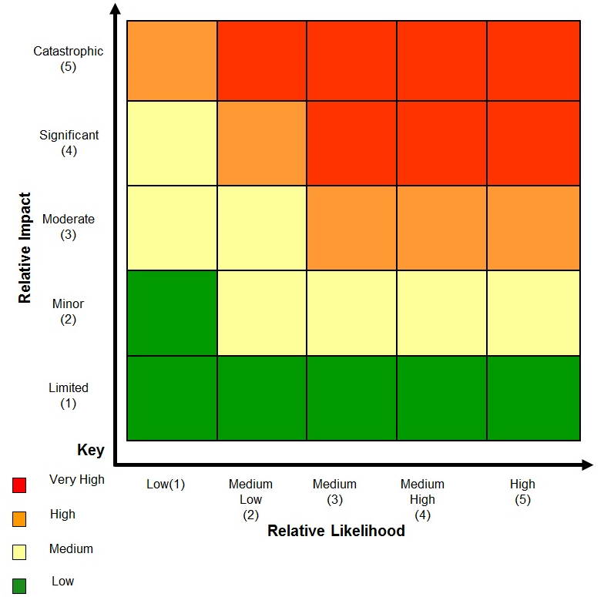
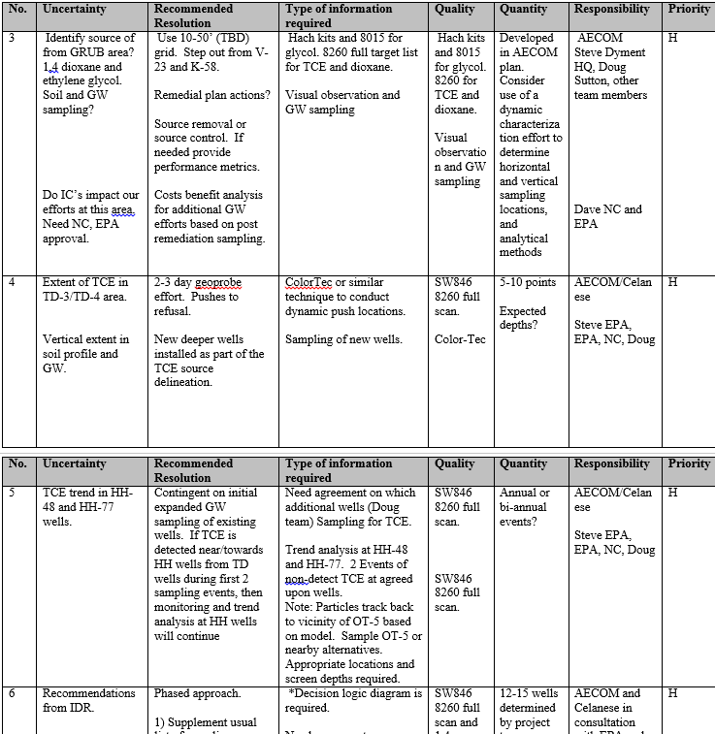
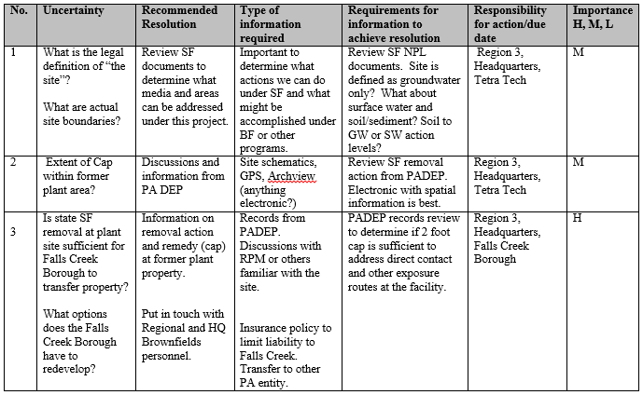
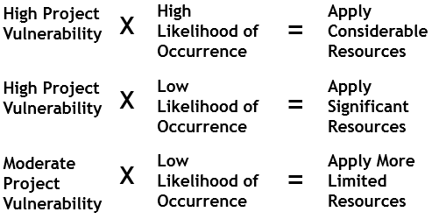
Submitted Questions Part 1
Can you give me examples of "non-technical uncertainties" you run into often when using systematic planning?
Notes:
Absolutely- let me start by saying that agreeing on technical uncertainties and the degree to which they need to be resolved can be a significant project challenge. Fortunately in most cases we either have or can access appropriate expertise to facilitate resolving these. Non- technical uncertainties can be harder to identify and quantify but can be more significant to manage than technical uncertainties.
Budget/ Funding
Schedule
Stakeholder input/requirements/needs/wants- team participation/changes/agreements/management buy in, development of trust- social capital
Access, boundaries
Reuse scenarios/ action levels
Well survey
Flow rates, tidal levels/impacts
Other program data and actions- what were tanks backfilled with, what is extent of cap,
Ics

Slide 12
Part 1 Live Session Questions

Slide 13
Submitted Questions Part 2
Everyone starts a site with the optimistic goal of cleaning it up… completely. After decades of remediating, we have contaminants that just won’t go away. How do you start the dialog to revisit your site goals to get to closure?
“Everybody has a plan… ‘till they get punched in the mouth.
-Mike Tyson
http://www.epa.gov/oust/cat/backlog.html
Notes:
I think this has to be asked of each organization some states have low risk closures, varying degrees of removing product the “maximum extent practical”
but also starts with a good CSM- if you don’t have that then it’s difficult to make any confident decisions on the likelihood of success for remediation.
The ITRC DNAPL strategy team uses the term “SMART” remediation objectives.
Specific
• e.g., TCE, cis-1,2 DCE
§▪ Measureable
• e.g., ppm, mg/kg, μg/kg, μg/l
§▪ Attainable
• e.g., Demonstrated ability to treat to a measureable level
§▪ Relevant
• e.g., reduces risk, meets drinking water standards (MCL)
§▪ Time-bound
• e. g., Performance toward objectives is based on days, months or
years (not centuries)
In the case of older sites with poorly defined remediation performance metrics, I would start by looking at the annual OM costs for system operation vs. what it might costs to conduct further investigation or address lingering questions. South Dakota Triad example (not really a remediation costs, really a legacy program cost to no close). OUST backlog reduction strategy
Look at OUST backlog study- >50% older than 10 years, >50% with groundwater issues-
State backlog reduction strategy may be a vehicle to begin discussing a path forward for complicated sites with lengthy history.

Slide 14
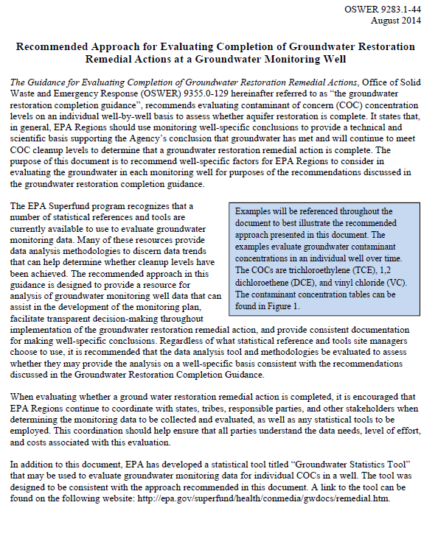
Submitted Questions Part 2
-Technology dependent
-Type and frequency of data
What would you say is the minimum time required to prepare reasonable performance metrics for a remediation system?
Would a three year clean up average allow for the time needed to make decisions based on performance metrics?
Notes:
You should have preliminary performance metrics as a result of design work- you know technology, locations, geology, mass distribution. I think what your asking is the minimum time required to assess preliminary design performance metrics and finalize system operation metrics?
SVE would have a very different time frame than a pump and treat system for example. SVE in months P&T in years
2) In general- yes. For a groundwater remedy for example quarterly sampling for 3 years would be 12 data points which would allow some level of statistical analysis, trend evaluation etc.
The remediation phase at a monitoring well typically is completed when the data collected and evaluated
demonstrate that the groundwater has reached the cleanup levels for all COCs set forth in the record of
decision (ROD). It is important to note that at any time during the groundwater remediation,
conclusions may be made to remove certain COCs from the monitoring program because the data
indicates that they have met their cleanup level before other, more recalcitrant COCs, in the well. This
conclusion should be documented in a monitoring report and used, in conjunction with the current well
data at the time of remedial action completion, to make the conclusion that all COCs have reached their
cleanup levels in a monitoring well.
The attainment monitoring phase typically occurs after a Region determines that the remediation
monitoring phase is complete. When the attainment monitoring phase begins, data typically are collected
to first evaluate whether the well has reached steady-state conditions where active remediation activities,
if employed, are no longer influencing the groundwater in the well. Once the groundwater is observed to
have reached steady-state conditions, data should be collected and evaluated to confirm the attainment
monitoring phase has been completed.
The attainment monitoring phase at a monitoring well typically is complete when contaminant-specific
data provide a technical and scientific basis that:
(1) The contaminant cleanup level for each COC has been met; and
(2) The groundwater will continue to meet the contaminant cleanup level for each COC in the
future.
Since the Groundwater Remediation Completion guidance recommends that completion of the
attainment monitoring phase be based on two lines of evidence, in general, a more robust data set using
a visual or statistical (trend test and mean test) evaluation is typically used to make the final attainment
determination. Therefore, it is recommended that a minimum of eight data points normally be used for
analysis done during
the attainment monitoring phase.

Slide 15
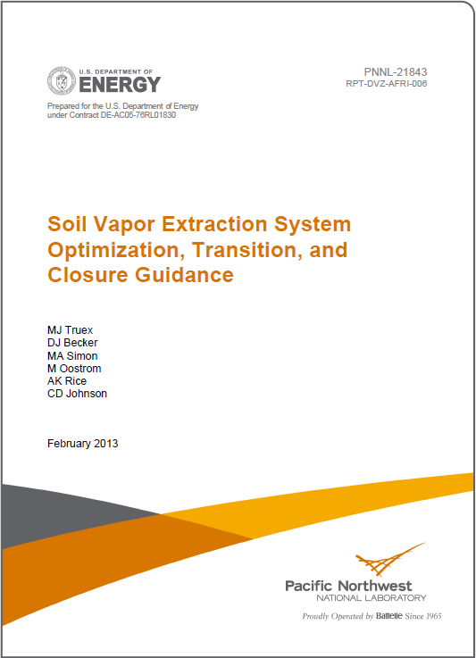
Submitted Questions Part 2
When is it time to consider pulsing an SVE system?
http://www.clu-in.org/download/techfocus/sve/PNNL-21843.pdf
Notes:
I would say certainly it’s a consideration when your removal rates go asymptotic.
Pulsing. As the remaining mass becomes more diffusion-limited, SVE operation can be transitioned to a periodic or “pulsed” operation such that active extraction occurs in intervals separated by periods of no extraction during which diffusion allows mass to re-enter permeable pathways. Pulsing can be done on a rotating basis at a large site such that active extraction is occurring at a subset of wells while other wells at the site are inactive. The period of inactivity depends on the rate of diffusion and can be determined based on monitoring of the rebound of concentrations following cessation of extraction. The length of the inactive period may represent the time to a rebound to some percentage (e.g., 60%) of a baseline concentration (USACE 2002).
Addendum to Appendix A Published Approaches to Assessing the Strength of Vadose Zone Sources
Output from the Approach. The primary output is the estimate of mass present in the subsurface. This mass estimate and the mass transfer coefficient may assist in modeling the impacts of the remaining mass on groundwater quality or vapor migration. The analysis also yields an estimate of the time to equilibrium during rebound periods that may assist in planning pulsed operations of the SVE system.
Method of USACE (2002). The approach presented in Appendix F of USACE (2002) is summarized below.
Purpose. The approach in USACE (2002), Appendix F, is intended to identify the mass remaining in the vadose zone following SVE application for significant duration. In particular, it attempts to quantify the mass remaining in a low permeability “immobile” zone that does not significantly participate in air flow under SVE conditions. Such air flow is concentrated in more permeable “mobile” zones. The approach relies on the behavior observed during rebound testing and provides guidance for conducting rebound testing.
Underlying Assumptions and Conceptual Site Model. This approach assumes the following:
The subsurface is heterogeneous with high permeability zones and low permeability zones; most of the contaminant mass resides in the low permeability zones.
There is no NAPL remaining; only vapor-phase, sorbed, and dissolved volatile organics.
The SVE system has been operated long enough to achieve a long-term asymptotic decline in mass removal rates.
The SVE system has been adequately designed and addresses the full volume of contaminated soil.
Equilibrium linear partitioning relationships apply for partitioning between gas and liquid (Henry’s Law) and between soil solids and dissolved contaminants in soil moisture.
Method of Brusseau et al. (2010). This approach—termed mass flux analysis—was published in Ground Water Monitoring and Remediation. The approach is summarized below.
Purpose. The approach is intended to provide an estimate of the magnitudes and time frames for mass flux from remaining vadose zone sources in low permeability zones following an extended history of SVE operational data. The magnitudes of mass flux from low air permeability zones under natural pressure and concentration gradients and under extraction-induced gradients are interpreted to assess SVE performance.
Underlying Assumptions and Conceptual Site Model. This approach, like the USACE (2002) method, uses concentration data collected from the extraction system during cyclic operation of the SVE. It is based on a conceptual model where the remaining mass lies within low permeability zones. It assumes the following:
The SVE extraction system encompasses the entire contaminated zone
Vapors extracted during the removal of the first pore volume of gas primarily represent the mass present in the permeable zones
There is minimal contaminant mass present in the permeable zones just before the start of the rebound period
During removal of the first pore volume, vapor removal is ideal (vapors are uniformly swept from the entire permeable domain).

Slide 16
Submitted Questions Part 2
These technologies are too expensive for my small UST site. How do I make them work for me?
-Good CSM
-Timely optimization
-Scalability of most cleanup technologies
Notes:
This question didn’t specify if the technologies they are referring to analytical tools or remediation technologies. To a certain extent I think the South Dakota Triad case study addresses the cost issue (at least for MIP) but it other direct push technologies are similar in cost 2500-5000/day.
So let’s focus on remediation costs. First I would say that- remediation is expensive. Its not uncommon for remediation costs to exceed characterization costs by an order of magnitude or more (SF experience).
One thing we preach in the HRSC course is that it’s dark down there. We really don’t know what going on at scales the affect contaminant fate and transport, mass transer/storage, etc. We’ve found good return on investigation by conducting higher resolution efforts to improve remedy performance. Source footprint reduction, small targeted aggressive actions in conjunction with passive techniques and attenuation.
SF has detailed cost and performance information for many of these remediation technologies but you also must consider the scale of most UST sites. ¼ acre to several acres maybe? If we characterize that multi acre site with 3 wells and assume everything in between is dirty remediation can get expensive quickly. However if we can define a much smaller source or NAPL zone along with the geologic/hydrogeologic context in which it resides then we may be able to take very surgical actions which will quickly and significantly affect the dissolved phase plume.
Most of the remediation technologies covered in Part 2 are cost effective for UST/LUST cleanup
Only 1 ERH tank project that I’m aware of.

Slide 17
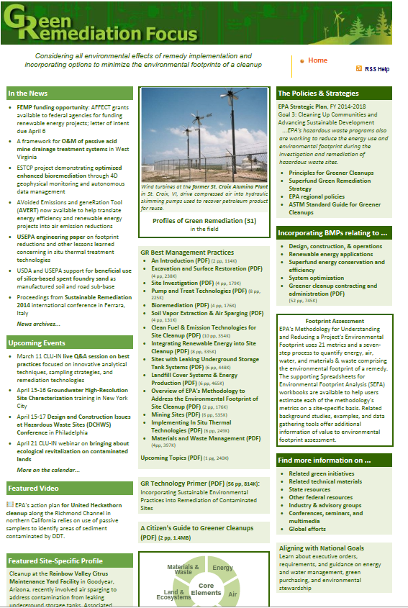
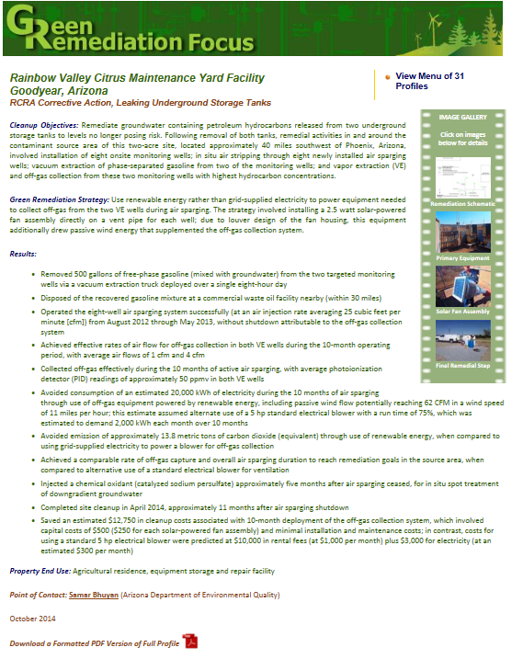
Submitted Questions Part 2
Have you used Green Remediation at an UST site?
http://www.clu-in.org/greenremediation/subtab_d38.cfm
Notes:
Yes.

Slide 18
Submitted Questions Part 2
Doesn’t bio take a while to develop the right bug communities? Seems like other technologies could clean up much faster at a small UST site
Notes:
Scale, sequencing,

Slide 19
Part 2 Live Session Questions

Slide 20
Summary & Wrap Up

Slide 21
UST Case Studies Sought
If you have an UST site that can serve as a case study, please share it with us!
Case studies can range from 1 page to 100+ pages depending on the site and resources
Typical elements of a case study include
Site Information
Contaminants and exposure pathways
Performance Data
Cost Data
Contact Queenie Mungin-Davis at Mungin-Davis.Queenie@epa.gov

Slide 22
25th National Tanks Conference and Expo
September 14 – 16, 2015 in Phoenix, AZ
Additional OUST training will be offered
Register at http://www.neiwpcc.org/tanksconference/

Slide 23
Online UST Forum Available
NEIWPCC (OUST Grantee) welcomes LUST/UST stakeholders to participate in the Corrective Action Planning Team and LUST Corrective Action Forum
http://www.neiwpcc.org/ust/caforum/index.php
For more info, contact JHarrison@neiwpcc.org or Queenie Mungin-Davis, mungin-davis.queenie@epa.gov

Slide 24
Thank you!
Steve Dyment, U.S. EPA Technology Innovation and Field Services Division (dyment.stephen@epa.gov)
Queenie Mungin-Davis, U.S. EPA OUST Coordinator (mungin-davis.queenie@epa.gov)

