Slide 1
ASTM’s Standard Guide for Greener Cleanups: Show me how it works!
Deb Goldblum, Region 3 RCRA
Clu-In Webinar
November 17, 2015

Slide 2
ASTM’s Standard Guide for Greener Cleanups
Supports the tenets of EPA’s Greener Cleanup Principles
Applicable to individual or multiple phases of a cleanup
Identifies and employs best management practices “BMPs”
Offers an option for a quantitative evaluation
Promotes transparency through a robust reporting structure

Slide 3
It Works at Any Site

Slide 4
Standard Structure
Scope
Referenced Documents
Terminology
Significance and Use
Planning and Scoping
BMP Process
Quantitative Evaluation
Documentation and Reporting
Keywords
Administrative
Protocol

Slide 5
Appendices
X1 Supporting Documentation
X2 Technical Summary Form
X3 BMP Table
X4 Supplemental Information for a Quantitative Evaluation
Adjuncts

Slide 6
Section 5: Planning and Scoping
Select lead environmental professional
Assemble project team
Identify the regulatory program
STEP 1
Compile site data
Identify key stakeholders
Develop a budget and schedule
STEP 2
Determine which cleanup phases
Choose to implement BMP process or QE
Plan for reporting results
STEP 3

Slide 7
Cleanup Phases
Site Assessment
Remedy Selection
Remedy Design/ Implementation
Operation, Maintenance and Monitoring
Remedy Optimization
No Further Cleanup

Slide 8
Cleanup Phases
Site Assessment
Remedy Selection
Remedy Design/ Implementation
Select new cleanup technology
Improve on-going cleanup technology
Operation, Maintenance and Monitoring
Remedy Optimization
No Further Cleanup

Slide 9
Cleanup Phases
BMPs
Site Assessment
Quantitative Evaluation
Remedy Selection
Quantitative Evaluation with BMPs
Remedy Design/ Implementation
BMPs
Select new cleanup technology
Quantitative Evaluation with BMPs
Operation, Maintenance and Monitoring
BMPs
Improve on-going cleanup technology
Remedy Optimization
No Further Cleanup

Slide 10
Section 6: Best Management Practice Process
Step 1: Opportunity Assessment
Step 2: BMP Prioritization
Step 3: BMP Selection
Step 4: BMP Implementation
Step 5: BMP Documentation
Particulate emissions may be important for a region in non-attainment
The water footprint may be important in arid lands
Waste generation may be important for a community with concerns regarding landfill space
GHG emissions may be important to a municipality with GHG reduction goals

Slide 11
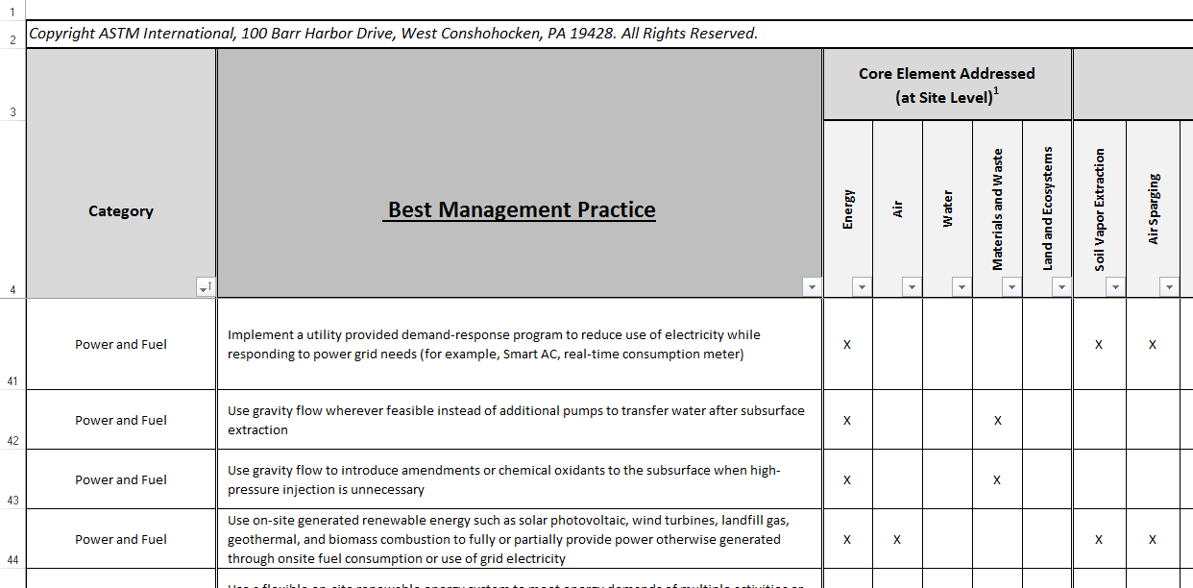
Step 1 BMP Opportunity Assessment Appendix X3 BMP Table

Slide 12
Step 1 BMP Opportunity Assessment
Best Management Practice | Applicable
BMP 1 | X
BMP 2 | X
BMP 3 | X
BMP 4 | X
BMP 5 | X
High
BMP 6
X

Slide 13
Step 2 BMP Prioritization
Best Management Practice | Priority
BMP 1
BMP 2
BMP 3
BMP 4
BMP 5
BMP 6
High
High
Med
High
Low
Low
Med

Slide 14
Step 2 BMP Prioritization
Best Management Practice | Priority
BMP 1 | High
BMP 3 | High
BMP 2 | Med
BMP 6 | Med
BMP 4 | Low
BMP 5 | Low
High

Slide 15
Step 3 BMP Selection
Best Management Practice | Priority | Select/Rationale
BMP 1 | High | X
BMP 3 | High
BMP 2 | Med | X
BMP 6 | Med | X
BMP 4 | Low | X – required by law
BMP 5 | Low
Cost
Effectiveness

Slide 16
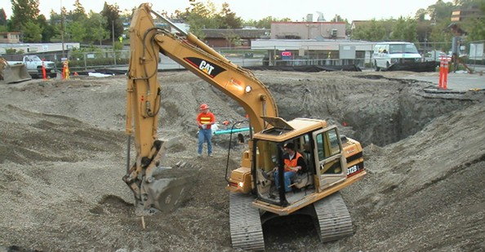
Step 4 BMP Implementation

Slide 17
Step 4 BMP Implementation
Best Management Practice | Priority | Select/Rationale
BMP 1 | High | X
BMP 3 | High
BMP 2 | Med | X
BMP 6 | Med
BMP 4 | Low | X – required by law
BMP 5 | Low
Cost
X
Effectiveness

Slide 18
Step 5 BMP Documentation
Best Management Practice | Priority | Select/Rationale
BMP 1 | High | X
BMP 3 | High
BMP 2 | Med | X
BMP 6 | Med
BMP 4 | Low | X – required by law
BMP 5 | Low
Cost
Stuff Happens
Effectiveness

Slide 19
Section 7: Quantitative Evaluation
Step 1: Goal and Scope
Step 2: Boundary Definition
Step 3: Core Elements and Contributors to the Core Elements
Step 4: Collection and Organization of Information
Step 5: Calculations for Quantitative Evaluation
Step 6: Sensitivity and Uncertainty Evaluation
Step 7: Documentation
Set Up
Numbers Crunch
Results

Slide 20
BMP Process
Planning and Scoping
BMP Process
Quantitative Evaluation
Documentation and Reporting
Protocol

Slide 21
Section 8: Documentation and Reporting
Step 1: Document BMP Tables for each phase
Remedy Design/Implementation
Best Management Practice | Priority | Select/Rationale
BMP 1 | High | X
BMP 3 | Med | Cost
BMP 2 | Med | X
BMP 6 | Med | implementability
BMP 4 | Low | X – required by law
BMP 5 | Low | Effectiveness
Operation Maintenance and Monitoring
Best Management Practice | Priority | Select/Rationale
BMP 1 | High | X
BMP 3 | High | X
BMP 9 | Med | X
BMP 8 | Med | Cost
BMP 7 | Low | Env. trade-offs
BMP 10 | Low | X

Slide 22
Section 8: Documentation and Reporting
Step 2: Report the information publicly
Best Management Practice | Priority | Select/Rationale
BMP 1 | High | X
BMP 3 | High | Cost
BMP 2 | Med | X
BMP 6 | Med | Stuff Happens
BMP 4 | Low | X – required by law
BMP 5 | Low | Effectiveness

Slide 23
Section 8: Documentation and Reporting Elements
BMP Summary Tables and Quantitative Evaluation Report, if applicable
Technical Summary (Appendix X2 form)
General Information
Environmental Footprint Reductions
Self-Declaration

Slide 24
Section 8: Documentation and Reporting Options for Public Availability
Public repository
Post on a website
Submit to a regulatory agency, with prior agency consent
ASTM will post on website. Contact Kate Chalfin at: kchalfin@astm.org

Slide 25
Section 8: Documentation and Reporting Timing for Reporting
Based on:
Needs of the user
Requirements or agreements with a regulatory program
Commitments through contractual agreements or with stakeholders
Recommends reporting results after implementation of cleanup activities

Slide 26
Uses
Protocol Tool Reference

Slide 27
Outcome
Defines greener cleanup
Provides a level playing field
Promotes culture change

