Slide 1

Public Building Commission of Chicago Case Studies-
Green Remediation
Implementing Greener Cleanups through ASTM's Standard Guide (E2893-13) Sponsored by: U.S. EPA Technology Innovation and Field Services Division

Slide 2
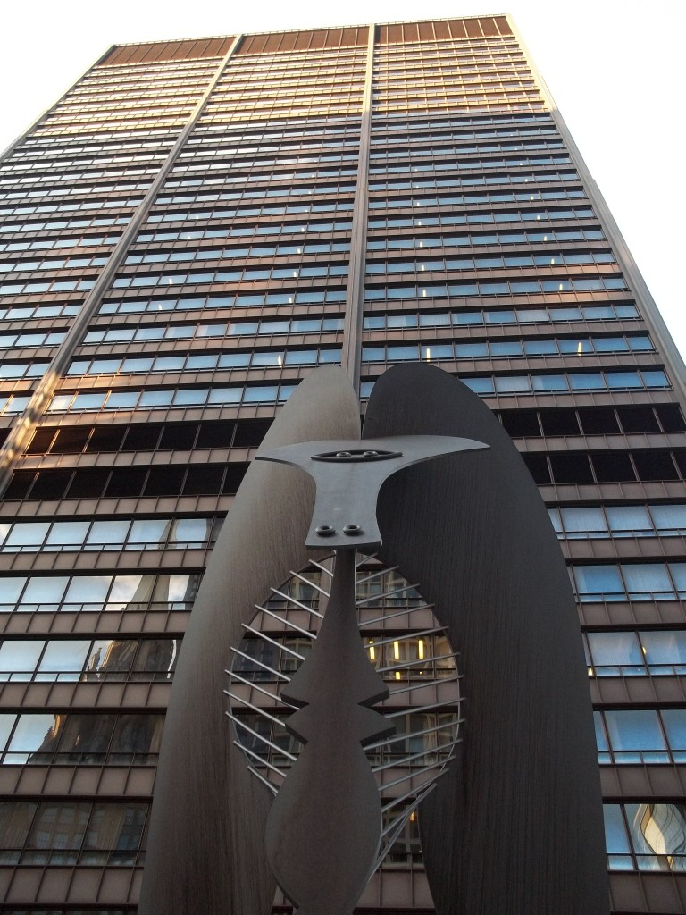
Case Study
An Integrated Development Program That Moves Beyond Dig and Haul
Mission
The Public Building Commission of Chicago (PBC) is committed to client service and strong stewardship of public resources. The PBC plans, designs and builds facilities that reflect the highest standards of Environmental and economic sustainability.
Vision
A built environment in which function, beauty and sustainability are inherent to every community; where physical surroundings inspire and support achievement of the individual goals of those who live, work and visit Chicago and Cook County; and, where people gather to share the common values that truly build our communities.
Notes:
Public Building Commission of Chicago’s capital development program, and 2 sample projects - really speak to the triple bottom line.
“developer” of public sector projects; ability to finance, acquire property, design and construct or renovate public facilities
Established 1956, PBC has been developing municipal projects for City of Chicago and sister agencies, Cook Co., with authority to work throughout state of IL.
2 main goals for PBC projects – that they be
-economic sustainability
-environmental sustainability
sustainability critical component of work –now built into Mission and Vision for organization
In year 8 of a multi-year capital development program - Over $2.6B in development authority –
Big opportunity to have impact in realm of sustainability in Chicago and region

Slide 3
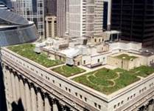
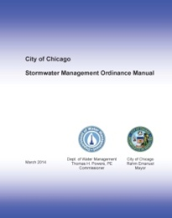
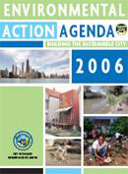

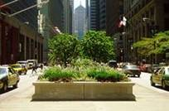
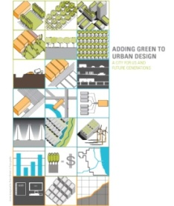

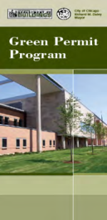


Sustainable Projects – Context
From Green Medians to Sustainable Chicago 2015
Brownfields2015
SUSTAINABLE COMMUNITIES START HERE
Green Alley Program
Stormwater Ordinance
-- 2000
-- 2002
-- 2004
-- 2006
-- 2008
-- 2010
-- 2012
-- 2014
-- 2015
Chicago Standard
Retrofit Chicago
Green Urban Design (2008)
2013
Notes:
PBC sustainability program developed in context of established culture in Chicago, of green development/
Aligned Goals / Shared Commitment
Green Remediation seemed natural “next step”, and a place we were already heading, driven by budget and logistical concerns as well as stringent regulatory environment – more than half of our projects are schools.

Slide 4
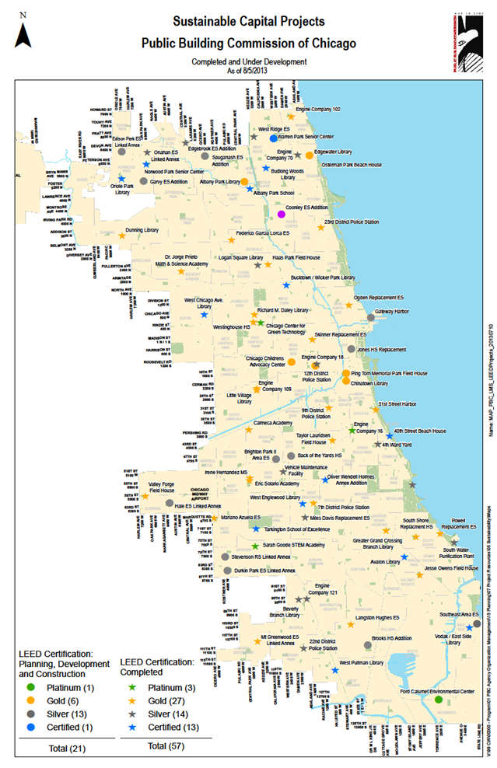
The Program – Economic and Environmental Sustainability
Economic Sustainability - Completed in 2013:
$32.9M, 6.02% under original budget.
Created 1,744 full-time equivalent (FTE) jobs
Inclusion:
  Construction - M/WBE work awarded: 39.93% or $144.7M
  Professional - M/WBE 70.25% or $11.34 M
  Community Hiring
Environmental Sustainability – Aggregate 2015:
LEED 88 targeted / 70 certified
Potable water savings: 23,883,929 gallons/year
Energy savings: $1.49 M / year
Recycled Materials: $67.6 M to date
Regional Materials: $117 M+ to date
Diverted from Landfill: 195,943 tons to date (94.9%)
Notes:
Economic Sustainability+ environmental sustainability = Responsible Development (positive impact on people.
As a SNAPSHOT –2013 (above metrics) - impact of the program even without considering environmental remediation as a separate component.
Sustainable goals enhanced and aligned with economic goals.
Goals –
durable as well as sustainable. We find that sustainability doesn’t add to costs since we are already looking at durable energy saving buildings.
long term benefit related to operations costs (energy savings). And benefits to the region and community

Slide 5
Grave to Cradle – Integrated Program Approach
One Goal: Repurpose Impacted sites to Sustainably designed new civic anchors. Save resources in the process.
  Integrated thinking starts in Planning
  Engage Stakeholders Early – Environmental, Design consultants
  Integrative Design + Environmental Remediation Best Practices => Synergies of site use, work effort, siting coordination
  Cost savings / impact
  Aligns with “green” agenda
  Equally protective remedies
Examples: Soil Management for site features and cap; Stormwater storage at remediation cut; Paved features (ie: tennis courts) as engineered barrier
Carry through into design and implementation
Notes:
MANY OF OUR SITES ARE ENVIRONMENTALLY IMPACTED – SO ONE OF OUR PROGRAM GOALS is to REPURPOSE IMPACTED SITES TO NEW CIVIC ANCHORS - (Grave to Cradle)
To do this, and also save resources, really requires integrative thought process.
Planning process – work together collaboratively – look at full life of a project; think in 3D
Resource savings as critical as effective remediation
Good sustainable design + remediation requirements + regulatory requirements + integrative process = > high performing building, cost savings

Slide 6
Environmental Sustainability AND Remediation – A Program Approach
Program-Level Standards
  Processes, Procedures, Standards
Contracts (consultants, contractors) and Contract Documents (specifications)
Reporting Tools and Metrics
Feedback / Lessons Learned
Goals
  Aligned Goals with Clients and Team
  Resource Savings/Reduce Environmental Impact
  Health and Quality of Life
  Track Metrics (LEED, SEFA)
  Generate Positive Messaging
Notes:
Program level standards were initially conceived separately for remediation and sustainable design, but quickly realized there were common threads:
Develop program level expectations and tools to meet the expectations.
Similar goals – internally and with client agencies:
energy and cost savings, quality of life and health benefits, clean (NFR, SRP) and “green” (LEED or sustainable) result. Meet or exceed quality, schedule and budget goals.
Health and Quality of Life ( for workers, the broader community, during the work, and after construction with finished product)
Track Metrics (LEED; starting to track for environmental remediation
Generate Positive Messaging – not wag the dog style, but we are cleaning sites and developing long term higher performing buildings and places to serve the community, and people should know.
Sometimes there is stigma associated with a site; we want community with us every step of the way through transformation of impacted site that noone wants to take on, to a green building or park or other

Slide 7
Case Studies:
Working Together to Get Beyond
“Dig and Haul”
Back of the Yards College Preparatory High School
Whitney Young Branch Library Adjacent Site
Notes:
2 case study projects – both use green remediation principles. 1st was done without knowledge of ASTM Guide, and the 2nd became ASTM Guide case study for IL EPA.
BOTY– massive env impact due to massiveness of the site – our first in situ that went through SRP; worked with IL EPA to do something innovative
WYBL– developed @ same time as IL EPA Greener Cleanup guidelines.
Opportunity to partner with IEPA in use of guide and to ACCESS FUNDING made available in support of Greener cleanups.
Subsequent project have been much smoother because of our earlier experiences in working together on a project all the way to the end, and PROUD to have helped formalize manual IEPA Greener Cleanup, and contribute to ASTM guide, which is now available “out of the gate” in planning phase.

Slide 8
Case Study:
Back of the Yards High School
Location: 2111 West 47th Street, Chicago
Completion: Summer 2013
Description: CPS Urban Model High School (UMHS) to serve 1,200 students. 212,285 SF. Three-story plus lower level. Steel frame and masonry construction
Property Size: 8.82 acres (374,572 SF)
Sustainability: LEED for Schools 2007 “Gold” certification.
Awards:
        2014 Good Neighbor Award - Commercial New Construction, Chicago Association of Realtors
        2014 Chicago Building Congress Merit Award Winner New Construction Chicago Over $55 Million
        2014 NAEP Environmental Excellence Award-Environmental Stewardship
Notes:
National Association of Environmental Professionals

Slide 9
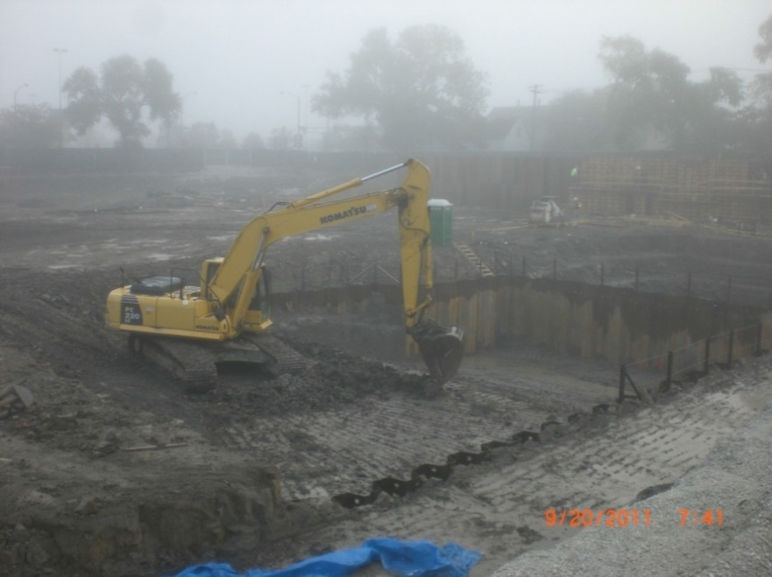
Case Study:
Back of the Yards College Preparatory High School
History
Green Remediation Strategies
    In-Situ Treatment of Hazardous Waste Lead
    Reuse of Pool Clay Spoils to Cap entire site
Funding
    No IEPA or US EPA $
    Green Remediation as cost saving strategy
Notes:
Auto salvage yard with earth floor.
13 tanks, several leaking
Buried auto parts;
PNA impacts including Vinyl Chloride to 10 ft
Hazardous Lead waste
Initially used BMP’s as cost saving strategy. Green in retrospect thru lens of ASTM standard.
In bid docs, gave GC leeway in the remediation design, including allowing reuse of materials on site, subject to PBC and regulatory body approval. (No lesser remedy)
Clean clay 14-20’ depth cut for pool used to cap the entire site ((except paved areas) And create landscape features

Slide 10
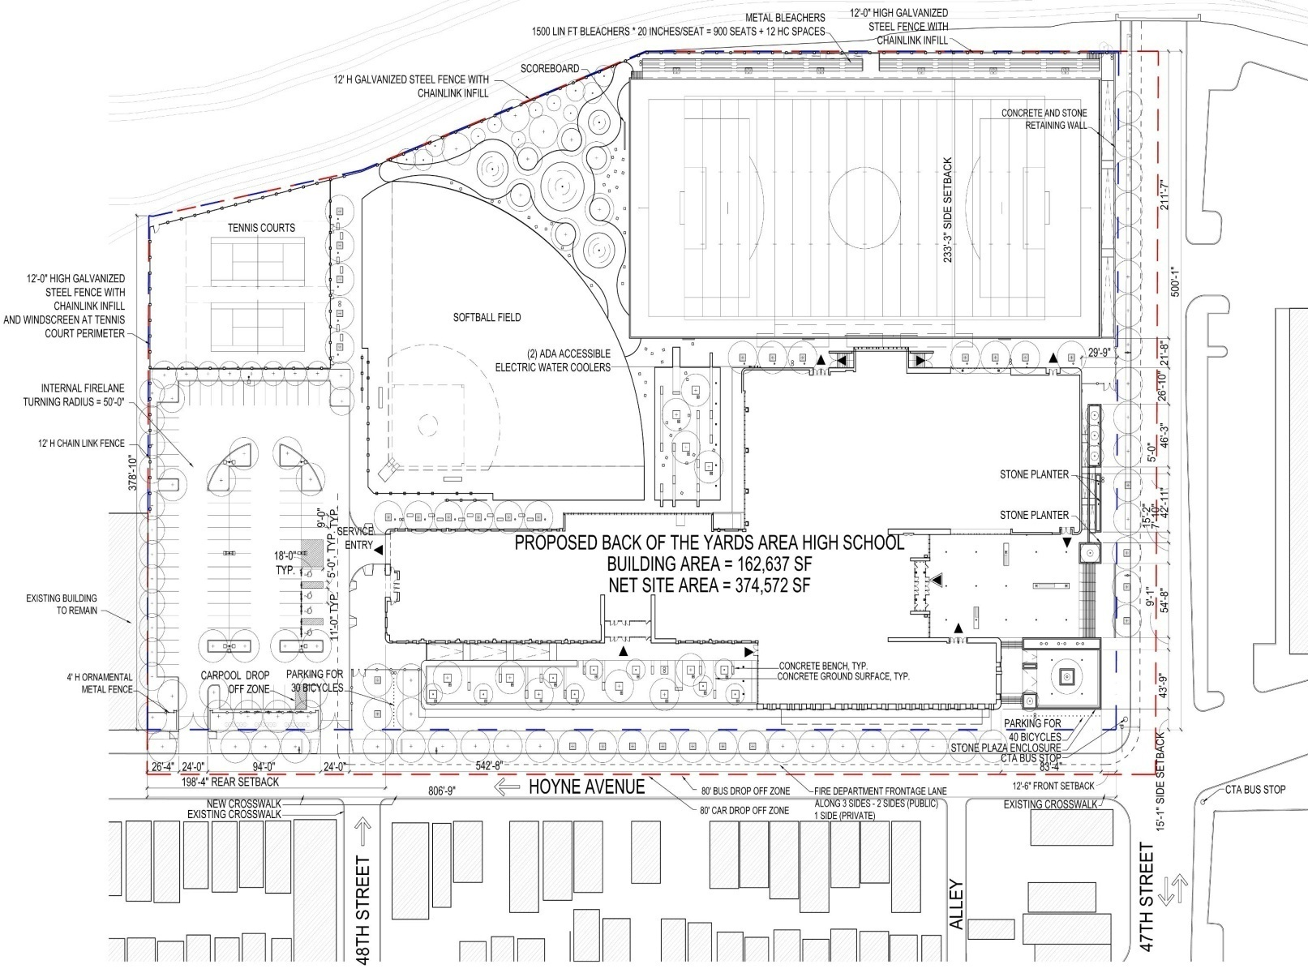
Case Study:
Back of the Yards High School
Notes:
Clay cap except where paving or building provides its own engineered barrier.

Slide 11
Case Study:
Back of the Yards College Preparatory High School
Green Remediation Strategies:
In-Situ Treatment of Hazardous Waste Lead
  Cost Savings: $ 33K
  Material Diverted from Hazardous Waste Landfill: ~355 cubic yards
  Strategies:
    In Situ treatment rendered material inert - lowered environmental burden and eliminated need to move hazardous materials
    Allowed use of local landfill (local Subtitle D vs. Subtitle C across country)
Reuse of Clay Spoils
  Cost Savings: $ 1.1M
  Material Diverted from Landfill: ~20,000 cubic yards
  Strategies :
    Materials and site / soil management reduced costs for disposal and importing of clean fill - 3,676 trucks eliminated
Notes:
$ savings in transport and tipping costs for Subtitle C&D Waste Diverted: 5,802 tons
Macetite
Lead stabilization medium. Binds lead to soil so it cannot leach or move in ground water.
Apply in 1 foot lifts; small turn of the material; sits for a day; test it. Once below 5 mg/ liter, can take off as material with lower environmental burden.
20’ diameter plume – only 1-1/2-2’ depth

Slide 12
Case Study:
Back of the Yards College Preparatory High School
Benefits:
Cost savings – reduced and no hazardous material landfill; reduced new materials
Community benefits
  Eliminated risks associated with moving hazardous materials
  Minimized traffic congestion, and community disruption
  New high performing school with co-located branch library
Reduced Energy Use and associated air pollutants, GHG’s from trucks
        Used local landfill (local Subtitle D vs. Subtitle C across country)
        Reduced haul-off and imported and virgin material use
        Used local laboratory for the frequent confirmation samples; local labor pool
Water – On site stormwater management; 1.4M g/yr
Waste/Materials Management
  Minimized imported and virgin material use
  Reduced landfill impact
Land/Ecosystem Management
  Lowered environmental burden – treatment rendered lead inert
  Soil management through reuse of clay and stone

Slide 13
Case Study:
Back of the Yards College Preparatory High School
Ancillary Benefits:
Informed / Helped Establish PBC’s Program Level Guidelines and BMP’s
  Environmental Design Guidelines
  Soil Management Plans
  Specifications
Integrative / Sitting Team Approach
  Bring on Environmental Design Team, engage stakeholders early
  Start thinking in 3D early
Alignment with IEPA Green Remediation Guideline
Notes:
Ancillary benefit – initiator for our Environmental standards
Take what we did here and establish Site Remediation Guidelines (this project as an example)
Soil Management Plans
Reduce waste and reuse on site

Slide 14
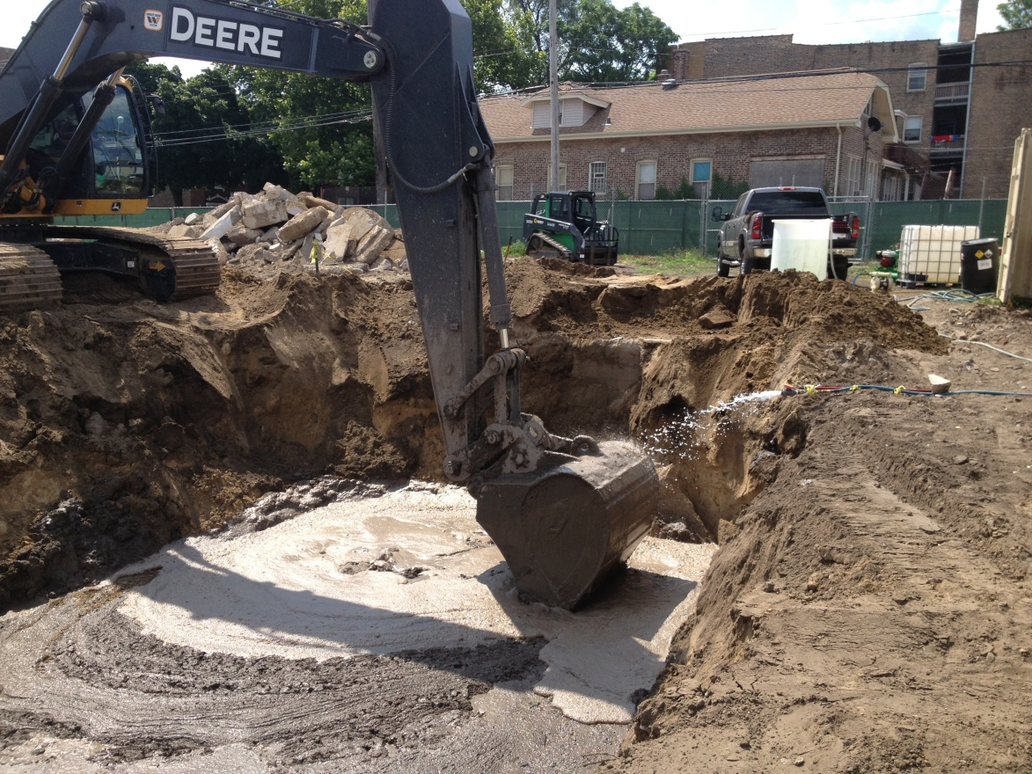
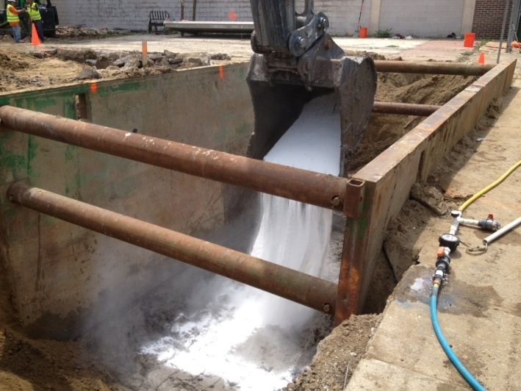

Case Study:
Whitney Young Branch Library
Location: 415-423 E. 79th Street, Chicago
Completion: Summer 2014
Description: Site clean-up of former drycleaners in preparation for future development
Property Size: 0.80 acres
Awards: 2014 NAEP Environmental Excellence Award - Environmental Stewardship

Slide 15
Case Study:
Whitney Young Library
History
Funding
IEPA Revolving Loan Funding-$ 436,000
    IEPA Green Remediation Evaluation (Study)
    In Situ Remediation +
  US EPA Brownfield Grant Funding - $600,000
    Pilot for In Situ +
Notes:
Former drycleaners and other buildings in disrepair
Clean site to make way for future development

Slide 16
Case Study:
Whitney Young Library

Slide 17
Case Study:
Whitney Young Library
Green Remediation Strategies:
Green Remediation Evaluation
    Funding from EPA
      Followed new ASTM Guidance for Greener Cleanups
      IEPA uses results as case study
In-Situ Treatment of Tetrachloroethene with Sodium Permanganate
  Cost Savings: $ 1.25 M
  Material Diverted from Subtitle D Landfill: ~22,000 cubic yards
  Strategies:
        In Situ treatment rendered material inert
        Allowed materials to be capped in place
        Plan for future site development (stormwater storage)
        Use direct push technologies
Notes:
Chlorinated solvent combined with an oxidizer – byproduct of the reaction is water + magnesium salt(?)
Cost savings determined by comparing cost for standard process – cut with 10’ across the site overall with 19’ in pockets; sheet piling – to other strategies
Engineering firm secured to come up with the ideas
First time this particular in in situ strategy approved in IL EPA and in US EPA Region 5 – and got funding – Fed Brownfield grants and IL EPA revolving loan fund

Slide 18
Case Study: Whitney Young Library
Benefits:
  Cost Savings / Additional Funding Streams
  Community Benefit
  Deactivated Tetrachloroethene plume
  Eliminated risks associated with moving hazardous materials
  Minimized traffic congestion, and community disruption
  Reduced Energy Use and associated Air Pollutants and Greenhouse Gas Emissions
    Used local landfill and laboratory, minimizing impacts from transportation
    Reduced haul-off and import of clean fill - Eliminated 4,043 trucks from streets
  Water Resource Impacts
    Integrated on-site stormwater management into final site design
  Waste/Materials Management
  Minimized imported and virgin material use
    Reduced landfill impact - Diverted 480 tons of concrete from landfill to recycling
  Land/Ecosystem Management
    Treatment rendered the material inert which has a lower environmental burden
    Site ready for development
Notes:
Total Energy Use
Total energy use reduced by linking remediation to site development, recycling concrete foundations, remediation of a TTZ
using direct push technologies
using local staff and laboratory
Greatest energy savings from minimizing energy required for excavation of soil off site with use of a TTZ, and minimizing future need to replace unsuitable backfill during construction of parking lot by using suitable construction backfill during remediation.
Air Pollutants and Greenhouse Gas Emissions
Air emissions will be reduced by
(see Total Energy Use)
Mixing amendments in-situ
using direct push technologies
using an idle reduction plan to reduce truck diesel emissions, and minimizing emissions from travel through use of local staff, local laboratory
Biggest CO2 / GHG reduction from:
reducing total diesel engine truck / excavator run time by minimizing excavation of soil off site with TTZ,
minimizing future need to replace unsuitable backfill during construction of parking lot, and
use of an idle reduction program.
Water Resource Impacts
Install stormwater management / storage system as part of the work.
Waste/Materials Management
Waste reduced by:
linking remediation to site development - minimizing future need to replace unsuitable backfill during construction of parking lot, and
Minimizing excavation of soil off site with TTZ,
Recycling concrete foundations instead of landfill disposal.
Land/Ecosystem Management
Because the site is located in a highly urbanized area, impacts to local land and ecosystems are of less significance as compared to a site in a rural setting. However, the BMPs identified above that would mitigate air emissions and stormwater runoff would also help mitigate impacts to offsite land and ecosystems.
Additionally, future plans for the currently-vacant site include the addition of landscaping and trees, enhancing the urban ecosystem.

Slide 19
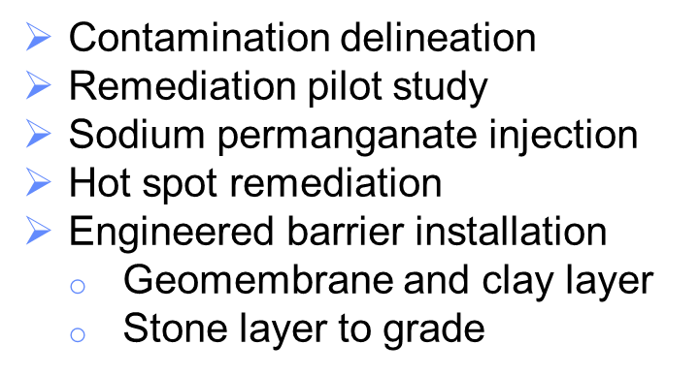
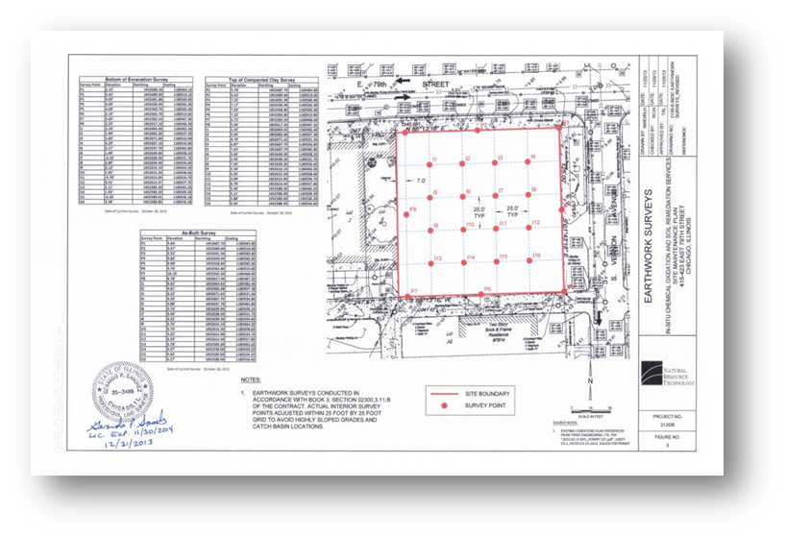
Case Study:
Whitney Young Library

Slide 20
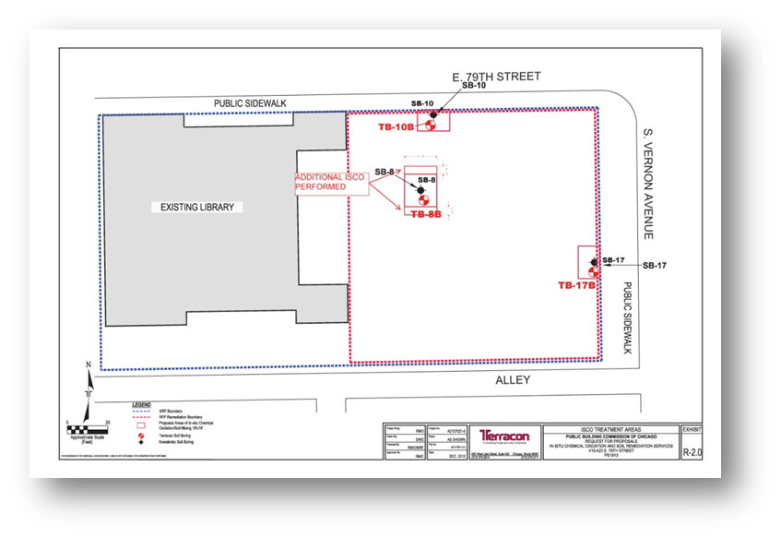
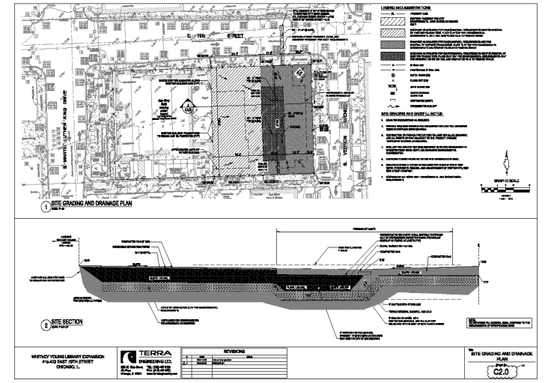
Case Study: Whitney Young Library

Slide 21
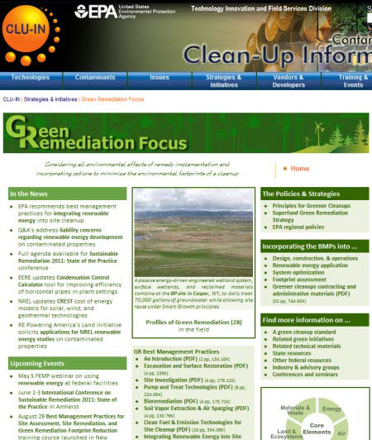
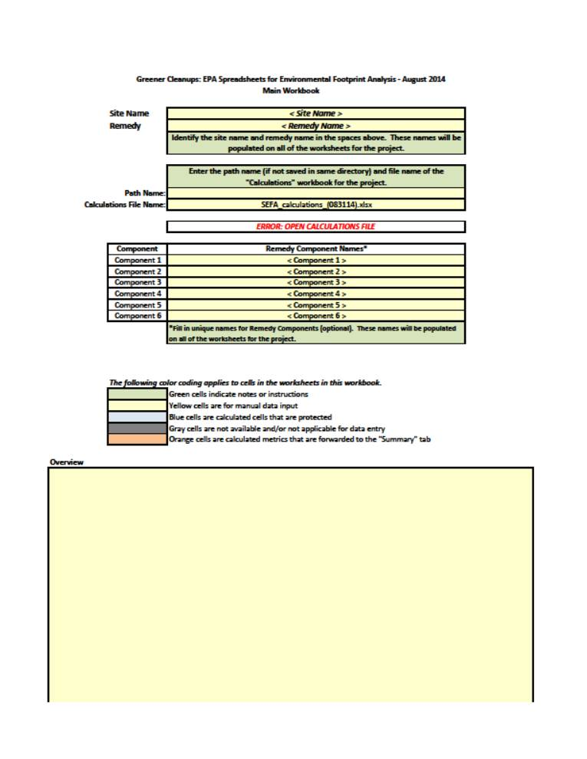
Environmental Footprint Analysis USEPA SEFA tool
Notes:
USEPA Spreadsheet for Environmental Footprint Analysis. (SEFA) tool to conduct analysis of impact
http://www.epa.gov/superfund/remedytech/tsp/download/2012_spring_meeting/eng_wed/1_footprint_methodology_042312.pdf
https://clu-in.org/greenremediation/methodology/

Slide 22
Green Remediation Outcome
PBC Conducted USEPA’s Spreadsheet for Environmental Footprint Analysis. Our goal was to utilize this document to show that green remediation does pay off environmentally as well as financially.
The second goal was to exemplify the PBC’s use of sustainable remediation at this project site and utilize this study to reduce the Revolving Loan principal by 30% of the initial loan. This clause was built into the Inter-governmental agreement between the IEPA and the PBC.
The Actual Greener Clean up vs traditional environmental remediation practices reduced:
  Total Energy usage in Million Btu by 56%
  Total Nitrogen Oxides by 59%
  Total Sulfur Oxides by 52%
  Total Particulate Matter by 60%
  Hazardous Pollutants by 61%
  Total Greenhouse gas Gasses by 55%

Slide 23
Applying Greener Cleanup to Your Projects
Next Steps – IEPA Goals:
Start applying the guideline to further validate the process
Develop a list of BMP's found to be effective and useful on different types of projects
Provide case studies and examples for others to follow
PBC program:
Case study / example / success story - pushing to deeper level of BMP's
Model for local government adoption of this process as standard
Provides precedent that others can access
  (ie: 4 reports posted on IEPA website -WYBL and 3 others)
Notes:
PBC next steps –
Follow IEPA guidelines –
IL EPA Goals include outreach to other municipalities: let them know they can also do this, save money, meet their green agenda - and here's how
For item 2., ie: Leaking underground storage tanks (LUST) are cookie cutter, but usually one-off for an individual owner.
LUST cleanup is reimbursable from State fund,
$ savings will mean savings to state funding pool.
looking for ways to engage and encourage individual Owners to make the small changes they can to collectively reduce impact on state fund.
List of tried and true LUST BMP's might help.

Slide 24
Greener Cleanup
User friendly “green” tools out there waiting to be used; BMPs already established:
  ASTM Standard Guide for Greener Cleanups
    Well vetted and finalized
    Process is transparent and defensible
    Not green-washing
Greener cleanup does NOT mean less protective cleanup – Can’t use greener cleanup to justify a lesser remedy
Small changes to thought process can have effective Green results, and can save money
Application is voluntary
Funding opportunities are available
Cost saving benefits are endless
Notes:
You wont be the first on your block – lots of precedent out there.
Can align with your client’s sustainability goals,
And there may even be some project savings and EPA funds that you can access.

Slide 25
Applying Greener Cleanup to Your Projects
It is a critical time in our lives and careers where we need to exercise our energies towards the sustainability of our planet.
What will YOU do?

Slide 26

Questions?
To waste, to destroy our natural resources, to skin and exhaust the land instead of using it so as to increase its usefulness, will result in undermining in the days of our children the very prosperity which we ought by right to hand down to them amplified and developed.”
        Theodore Roosevelt

Slide 27
Presenter Contact Information
LeeAnn Tomas-Foster
  LeeAnn.Tomas-Foster@CityofChicago.org

Slide 28
Helpful Links
http://www.sustainableremediation.org/
US EPA SEFA
https://clu-in.org/greenremediation/methodology/
http://www.epa.gov/superfund/remedytech/tsp/download/2012_spring_meeting/eng_wed/1_footprint_methodology_042312.pdf

