Slide 1
ASTM BMP Selection Case Study
John Simon, ASTM Task Group Lead
Gnarus Advisors LLC

Slide 2
Case Study Introduction
Project history and overview
Remedy discussion
BMP Evaluation Process
Notable environmental, social and economic BMPs
How green and sustainable remediation helped the overall project

Slide 3
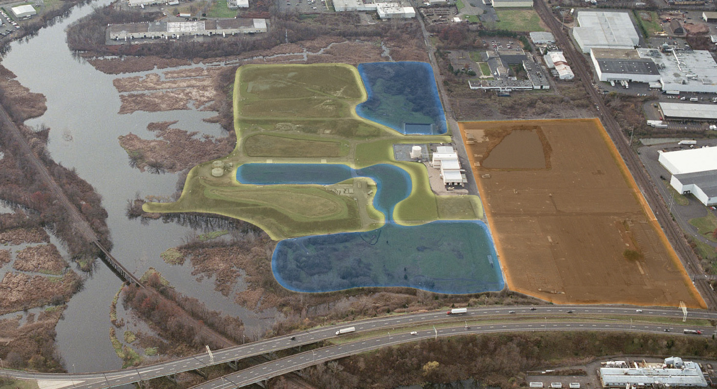
Project Overview
Notes:
Applied BMP Evaluation process to various remedies
Opportunity Assessment
Prioritization
Selection
Some BMPs already implemented others available for implementation
But, only if the BMPs are technically practicable and economically beneficial
x

Slide 4
Project Approach – Community Engagement
Developed project website
Worked with town council and a Community Advisory Panel
Involved community in remedy selection
EPA recognized community members with awards
Implemented community relations plan
Stakeholder-driven re-use planning process for both commercial and ecological areas

Slide 5
Remedial Strategy
ConsolidationCell #1
Low Perm. Wall
GW Treatment
Consolidation Cell #2
ISTT for DNAPLs
Protective Cover System
Sediment Removal
Notes:
Applied BMP Evaluation process to various remedies
Opportunity Assessment
Prioritization
Selection
Some BMPs already implemented others available for implementation
But, only if the BMPs are technically practicable and economically beneficial
x

Slide 6
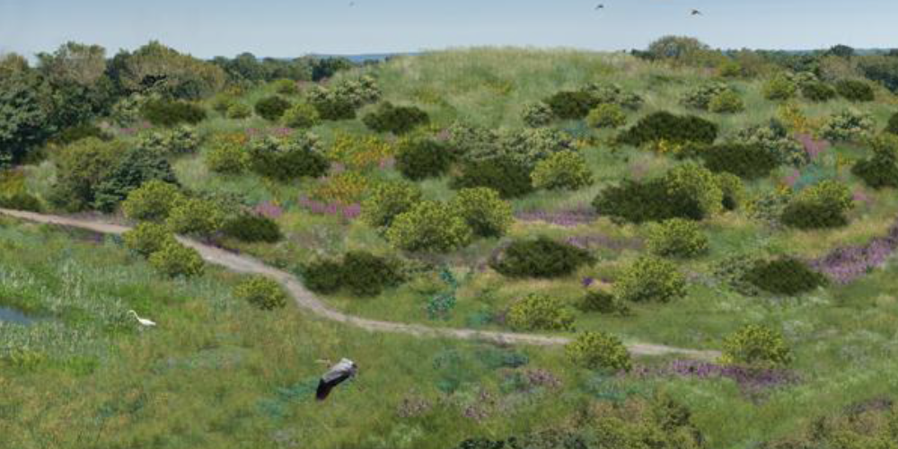
Vision for Ecological Enhancements
Notes:
Applied BMP Evaluation process to various remedies
Opportunity Assessment
Prioritization
Selection
Some BMPs already implemented others available for implementation
But, only if the BMPs are technically practicable and economically beneficial
x

Slide 7
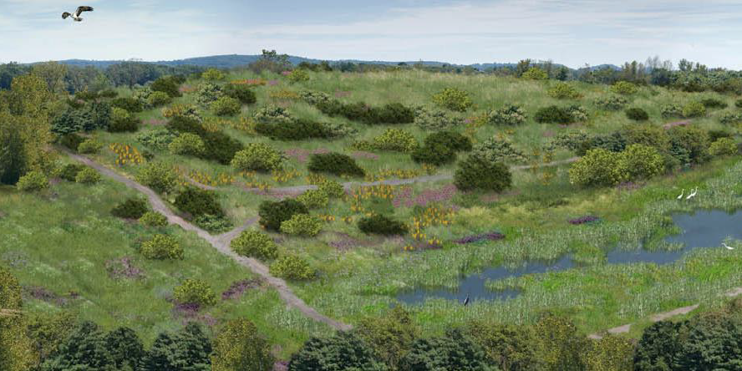
Vision for Ecological Enhancements

Slide 8
BMP Evaluation (Section 6)
Step 1 – BMP Opportunity Assessment
  Created BMP tables for each aspect of the remedy
    Sampling and Analysis
    Containment/Capping
    Groundwater Pump & Treat
    Dredging
    In-situ Thermal Treatment
    Social aspects
    Economic aspects
  Expanded table with BMPs not previously included
  Checked all BMPs that were potentially applicable

Slide 9
BMP Evaluation (Section 6)
Step 2 – BMP Prioritization
  Checked core elements, added columns for priority and retained
  Ranked BMPs as 3 (high), 2 (medium) or 1 (low)
  Sorted table
  Repeated for each aspect of the remedy

Slide 10
Applying BMP Table to the Site (Section 6)

Slide 11
BMP Evaluation (Section 6)
Step 3 – BMP Selection
  Added comments column and included explanation of why not retained
  Used professional judgment to identify BMPs
  Checked table with selected BMPs
  Sorted table
  Repeated for each aspect of the remedy

Slide 12
BMP Evaluation (Section 6)
Step 4 – BMP Implementation
  Determined which BMPs could be or were applied
  Documented why BMPs retained from Step 3 were not implemented
Step 5 – Prepared Report
  Followed ASTM Technical Summary Format
  Incorporated additional sections for social and economic BMPs

Slide 13
Environmental BMPs Implemented
Notable Environmental BMPs
Over 75 environmental BMPs
Remedy consolidated majority of contaminated materials under engineered caps
Creating on-site wetlands
Utilizing blast furnace slag for hydraulic barrier wall construction
Utilizing geotextile bags for dewatering contaminated sediments
Operating P&T in pulsed mode and adjusting pumping to match river’s tidal elevation changes
Selecting re-vegetation requiring minimal mowing
Managing drilling wastes on-site under caps
Used field screening DNAPL dyes to control investigation progress real-time

Slide 14
BMPs Implemented (cont.)
Environmental BMPs Identified for ISTT
15 BMPs for thermal treatment alone
Examples include:
  Insulating piping
  Recovering electrodes
  Using local labor and labs, when possible
  Employing variable frequency drives
  Segregating drilling waste and placing under caps (if possible)

Slide 15
Social BMPs
Developed project website
Worked with town council and Community Advisory Panel
Stakeholder-driven re-use planning process
Involved community in remedy selection
EPA recognized community members with awards
Provide nature trails
Maintained eco-diversity (yes, this is a social BMP because popular with community)

Slide 16
Economic BMPs
Local buying commitment, including web-based form on website
Created local jobs
Re-use planning included a market analysis
Providing redevelopment opportunities
Still a work in progress and re-development planning is in process

Slide 17
Examples of GSR Benefits
Promoting economical, yet green BMPs; many BMPs saved money
Shifted media and public perception from negative to positive – improved corporate social responsibility
Community is more supportive of the cleanup
Created local jobs
Community can utilize ecological resources
Enhanced regulatory acceptance of remedy
Stakeholders can showcase success

Slide 18
Questions?
John Simon, ASTM Task Group Lead, Gnarus Advisors LLC
  jsimon@gnarusllc.com

