Slide 1

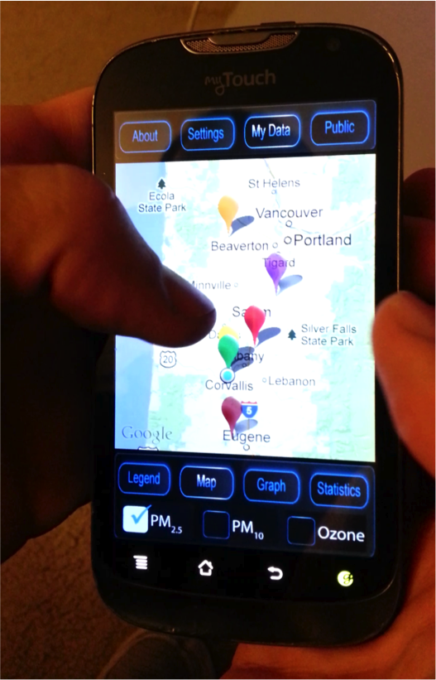
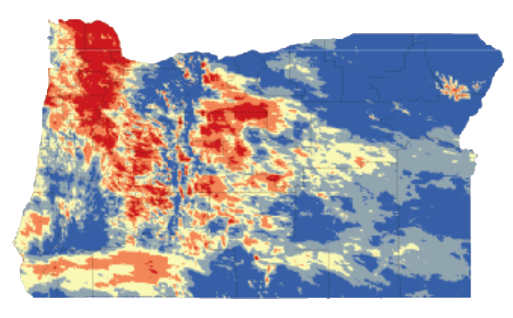
Making models personal
Notes:
Title: Making models personal
Presenter – Andrew Larkin, Oregon State University Department of Environmental Toxicology and Superfund Research Program Trainee
Co-authors: William M. Baird, Oregon State University Professor in the Department of Environmental Toxicology and Superfund Research Program investigator,
and David E. Williams, Oregon State University Professor in the Department of Environmental Toxicology, Director of the Oregon State Superfund Research Program, and Linus Pauling Institute Investigator.
Contact information:
e-mail address: larkinan@onid.orst.edu
phone number 1-541-737-5413
Address: Oregon State University, 1151 Ag Life Sciences Bldg, Corvallis, OR, 97333

Slide 2
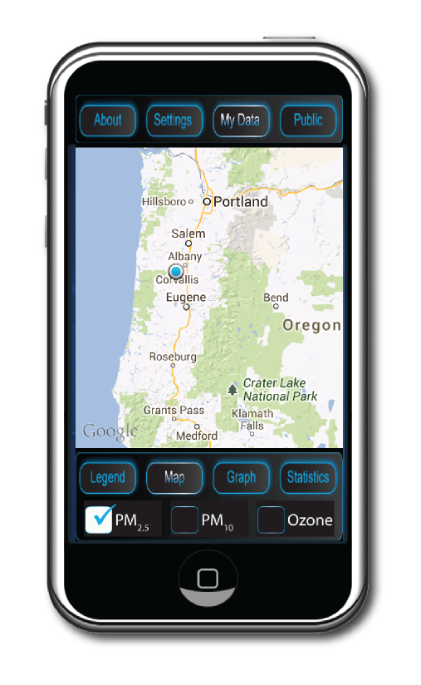
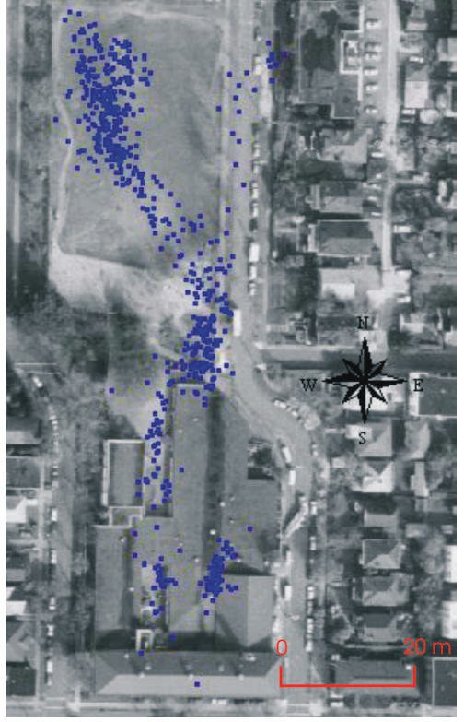
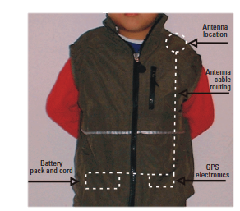
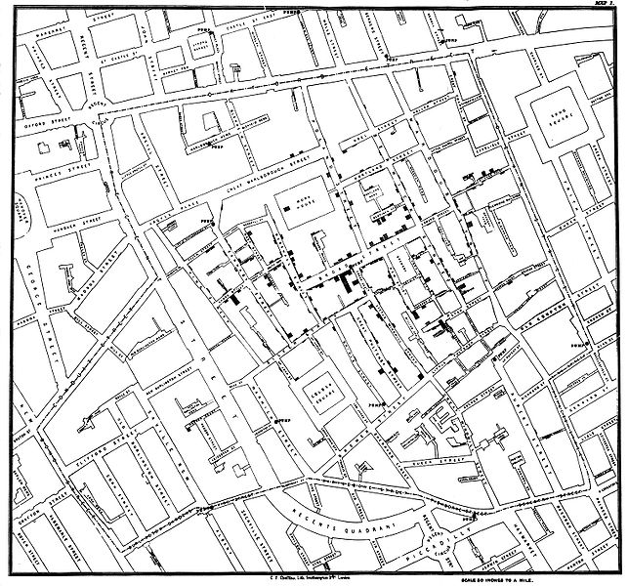
Location – old dog, new tricks
Elgethun et al.
Children’s Health
John Snow
1854
2003
2013
Notes:
Geographical location has been an essential component of the epidemiologist’s tool kit since the founding of epidemiology in 1854 by John Snow, who found a correlation between Cholera outbreak and the use of a community well in London. Methods of acquiring location information has been continually refined throughout the decades, including innovative applications of global positioning technology (GPS) to acquire precise information about an individual’s location. In 2003, Elgethun and associates successfully integrated GPS units into children’s clothing to accurately track children’s movements both indoors and outdoors. Smartphones are one of the newest methods available for collecting location-based information.

Slide 3
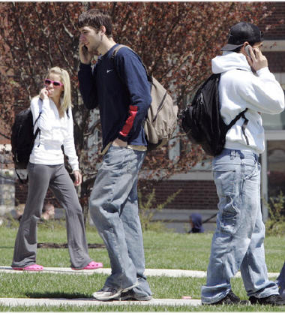
Smartphones are popular
1 billion smartphone users
  Teenagers, young adults
Vast majority include GPS chips
Many basic cell phones also have GPS
Notes:
There are currently more than 1 billion active smartphone users in the world (source: CBSNews.com). The largest demographics of smartphone users are teenagers and young adults: groups who are (arguably) old enough to start thinking about and understanding how the environment can affect their health, while at the same time young enough so that subtle changes in lifestyle and exposure can result in significant reductions in long term risk.
Most smartphones and many basic cell phones that are in the market today have embedded GPS chips, which utilizie the global positioning satellite system to determine the smartphone location anywhere (outdoors and weather permitting) on the surface of the earth. The majority of modern day phones use an advanced form of GPS called assisted GPS, which can use wifi networks and cell phone towers to determine indoor locations and increase the accuracy of location predictions.

Slide 4
Location based services
Services based on location
  Maps
  Directions
  Weather
Notes:
A number of services are available and popular on smartphones – Google maps, driving directions, directories to identify food services, gas stations, etc. nearby, weather predictions for the local area, and other programs that provide unique information for the smartphone location.

Slide 5
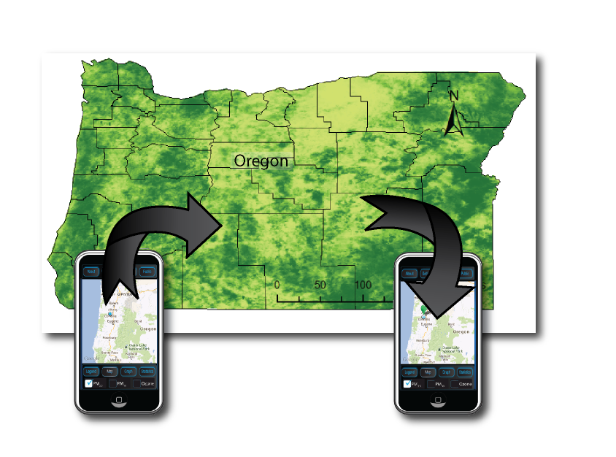
Link smartphones with pollution models
Multiple pollutants
  combination of pollutants
Multiple locations
Past, present, and future pollutant levels
Individual and population level
Notes:
Smartphones can identify a person’s location and pollutant models can predict pollution levels at a given location. By linking smartphones with pollutant models, we hypothesize that multiple pollutants can be predicted at smartphone locations. Geographical constraints are based on the constraint of the underlying pollutant models, and can conceivably cover the extent of the entire world. Sampling and retaining locations at regular intervals can provide a well documented past of predicted pollutant levels at smartphone locations, and input from the smartphone user about intended future locations can potentially be used to predict pollutant levels at future locations. Sampling data acquired from a group representative of the population can be used to make inferences about spatial and temporal trends regarding pollution level conditions for the entire population

Slide 6
Atmospheric pollution models
Hourly forecasts of PM_{2.5}, PM₁₀, and ozone
NASA, NOAA, and Oregon DEQ data sources
Seasonal Integrated Moving Average – Universal Kriging hybrid forecast model
Notes:
To test the proof of principle that smartphones can be linked with environmental maps, we created PM2.5, PM10, and ozone hourly forecast maps for the state of Oregon. Maps forecast predicted exposure levels at air monitoring stations using Seasonal Integrated Moving Average (SIMA) time series models. Forecasts at air monitoring stations are then interpolated to cover the entire state using universal Kriging for PM2.5 and PM10, and inverse distance weighing for ozone. These modeling methods were chosen because they can be validated and evaluated using prediction errors.

Slide 7
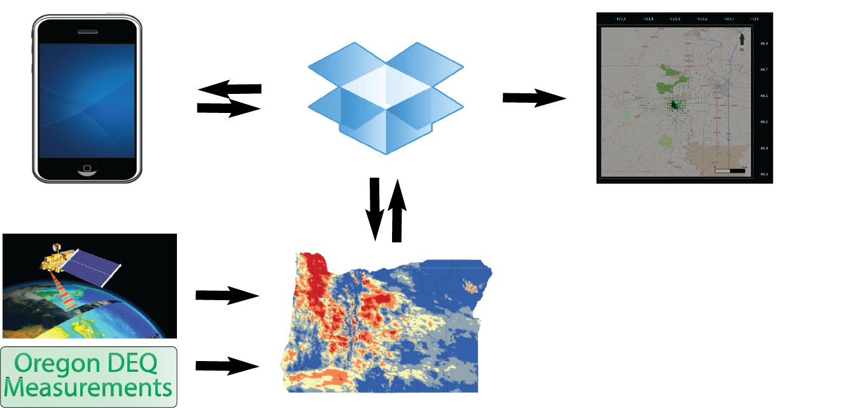
Method overview – step 1
Location and time is sent from smartphone to cloud storage database
Notes:
Step 1: The smartphone determines its location and current time, and sends the information to a cloud storage database as a .csv file

Slide 8
Method overview – step 2
Pollutant model predictions at latitude and longitude are determined
Notes:
Step 2: After location values are sent to the cloud storage database, the predicted pollutant concentrations for all models within the database are determined for the given latitude and longitude coordinates

Slide 9
Pollutant model folder
One georeferenced image (.tif file) for each modeled pollutant
Update file = update predictions
Any number of .tifs (and corresponding models) can be included in the database
Notes:
The pollutant folder is how the smartphone program accesses pollutants. Files with predicted pollutant values are georeferenced tif files. Switching pollutant models or updating predictions for existing pollutant models is as easy as replacing the corresponding .tif file. There can be any number of pollutants included in the database, with each modeled pollutant identified by it’s filename (ex. PM25.tif)

Slide 10
Method overview – step 3
Return values to smartphone
Notes:
Step 3: predicted pollutant values and the original information are then returned to the smartphone in a .csv file format

Slide 11
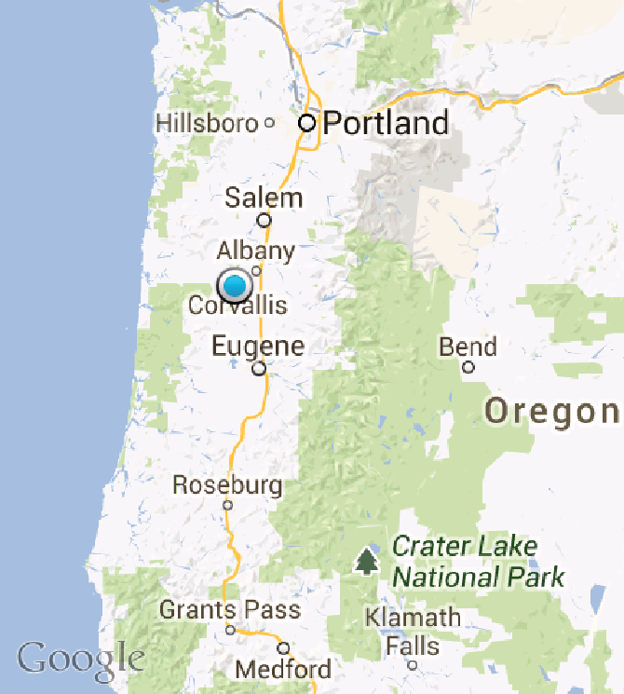

Smartphone display
Familiar symbols and software
  Google maps
  EPA air quality index (AQI) categories
Hazardous
Unhealthy
Unhealthy for sensitive individuals
Moderate
Good
Notes:
Step 3: predicted pollutant values and the original information are then returned to the smartphone in a .csv file format

Slide 12
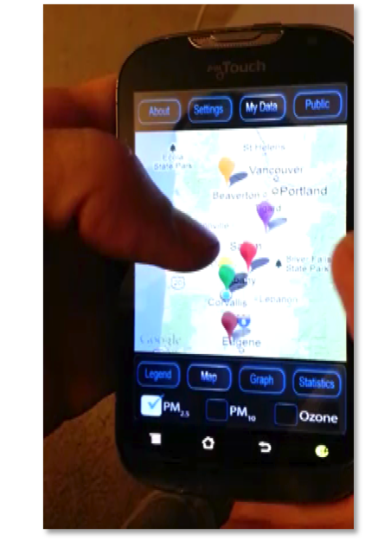
Google maps
Color coded according to AQI
Detailed sample information when point is clicked
Switch between pollutants
  Multicore processing for responsive feel
Notes:
Google maps are the gold standard for maps on mobile devices. Using the simplification model to drive our display design, we took advantage of the familiarity among the general public with Google maps and the EPA air quality index categories (AQI) to present predicted pollutant concentrations in a familiar and easy to learn and understand manner. Predicted concentrations are displayed as points on a Google map, color coded according to the EPA AQI. The default screen contains only color-coded points at the sampling location. The latitude, longitude, sampling time, and predicted concentration value for each point can be obtained by taping on the point on the map. Users can switch between pollutants using a check mark box system at the bottom of the screen. To keep the app responsive and improve user performance, multicore processing was developed in which one core handles the smartphone display and a second core handles database queries/processing.

Slide 13
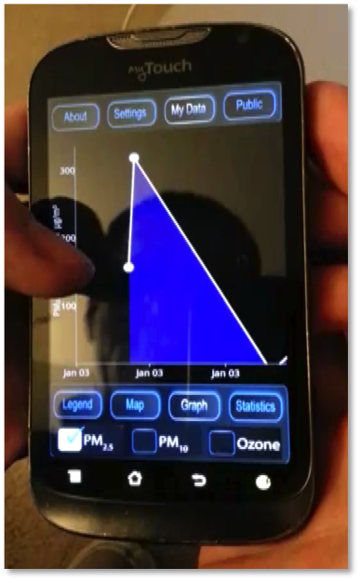
Time series graph
Pollutant levels as a function of time
Detailed sample information when point is clicked
Switch between pollutants
  Multicore processing for responsive feel
Notes:
Collected data can be viewed as points on a time series graph. Similar to the Google maps view, points are clickable to bring up specific sampling information and the graph can be panned or zoomed by the user.

Slide 14
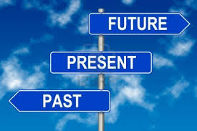
Informative, but is it useful?
Great for raising awareness, what about making informed decisions?
Include methods for minimizing risk from future exposures

Slide 15
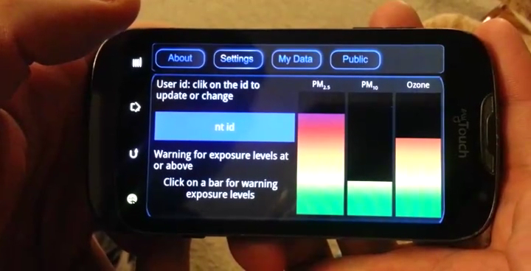
Warning bars

Slide 16
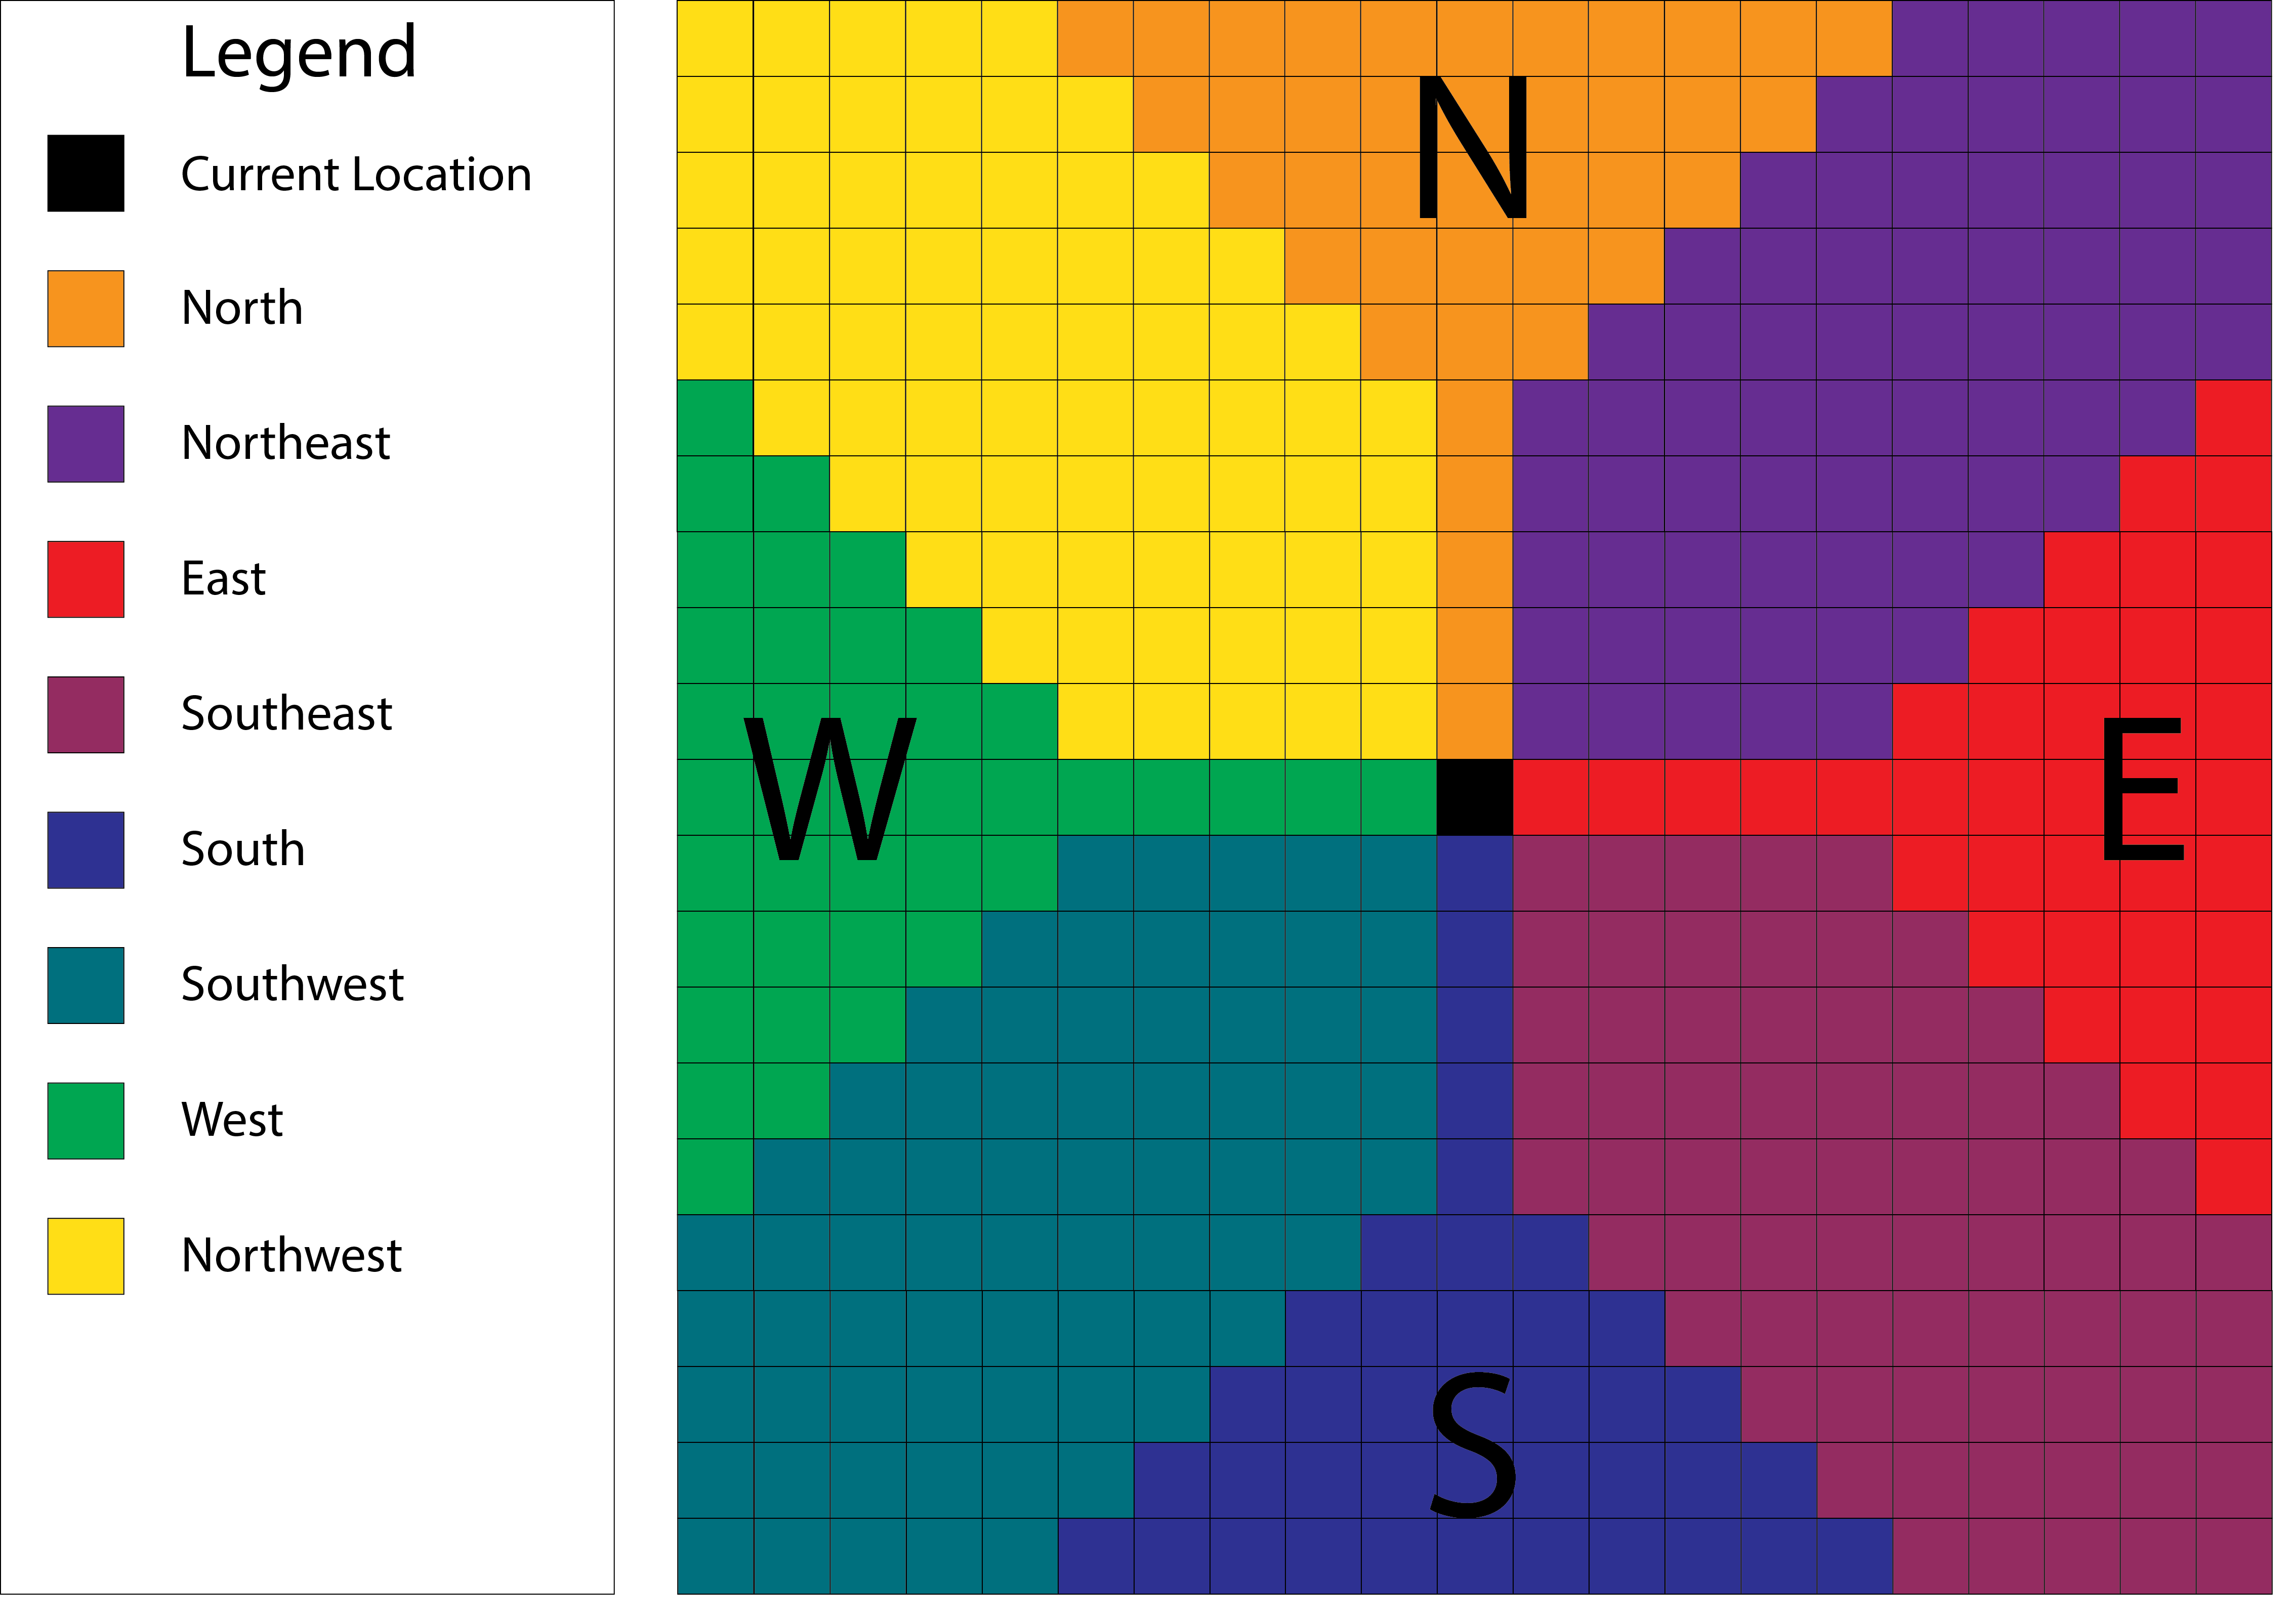

Warning bars

Slide 17
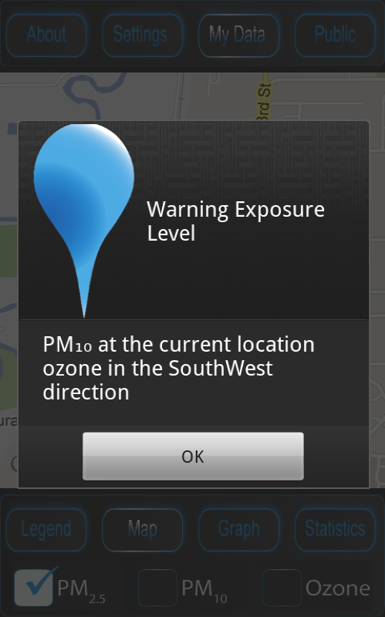

Warning bars
Foreground
Background

Slide 18
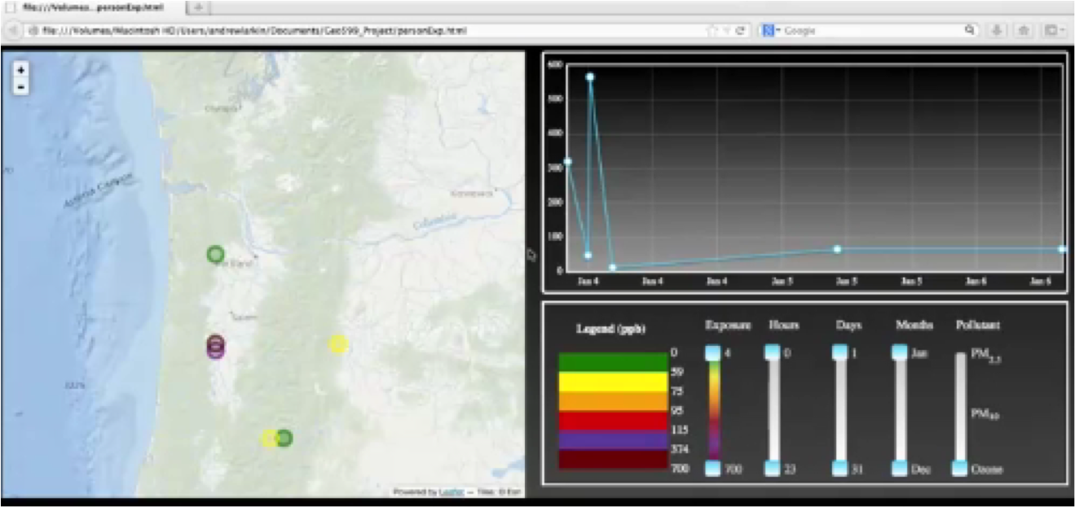
Sharing smartphone data
Smartphone
PC
personal website
Notes:
Share with medical, respiratory, air pollution experts
Upload data via bluetooth to pc, to website via pc
Send link, consult, identify pollutant combinations (multiple pollutants!) that are statistically significant at asthma attack sites
Then set warning levels to correspond with asthma attacks

Slide 19
Sample population analysis

Slide 20
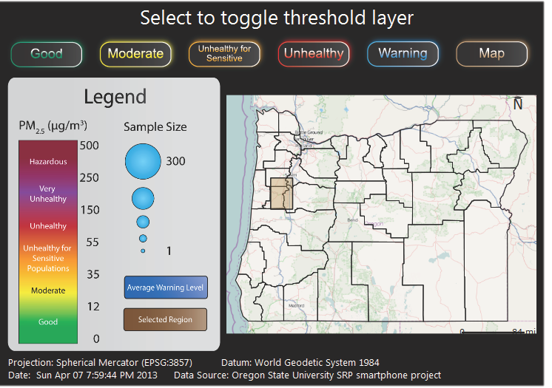
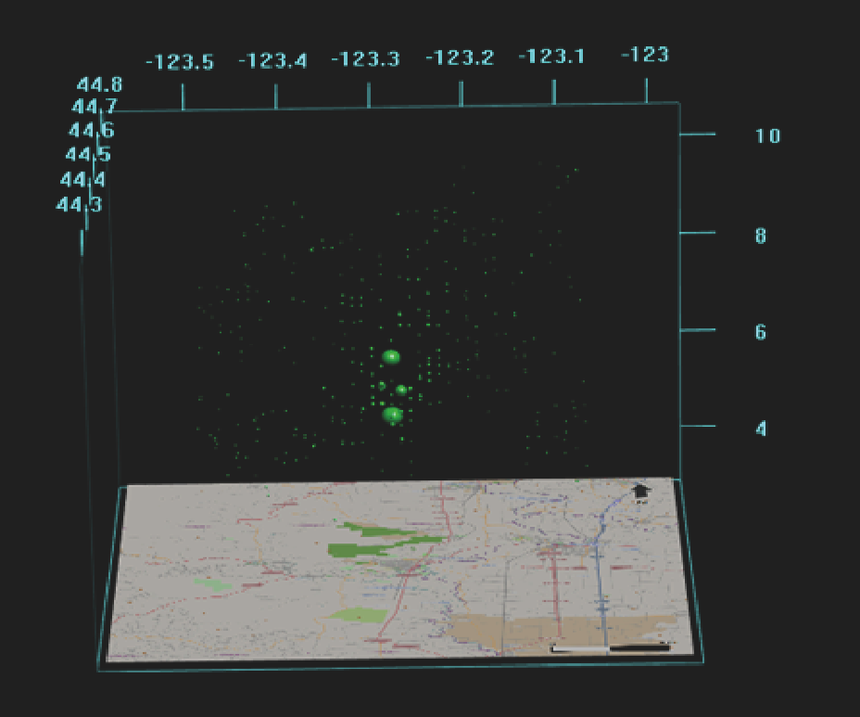
Sample population analysis

Slide 21
How adaptable is this software?
Any geographic region, any model, any pollutant, any media
Any sampling rate
  Currently 30 minutes due to GPS battery consumption in older phones
Any device with an operating system and GPS chip

Slide 22
Limitations
Predictions and resolutions (both temporal and spatial) are only as accurate and fine as the underlying models
Currently for outdoor air, will only work for indoor scenarios if better indoor pollutant models are developed

Slide 23
Complementary technologies

Slide 24
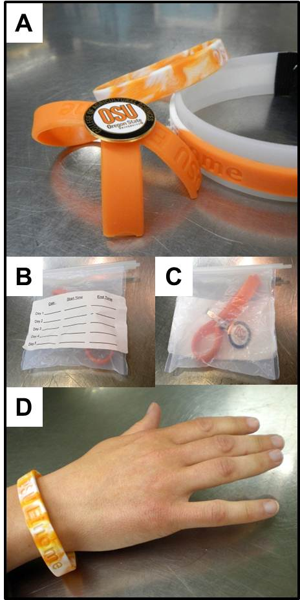
Chemical composition bracelets
Examples of personal sampling devices developed by Steven O’Connell and Kim Anderson, Oregon State University
A) Wristband configurations used in the study including a simple wristband, lapel, and double wristband attached with string and staples
B-C) Bags used for transport including labels that were attached to track participant ID and exposure time
D) Example of simple wristband deployment (“EINOME” – Environmental Integrated Organic Monitor of Exposure)

Slide 25
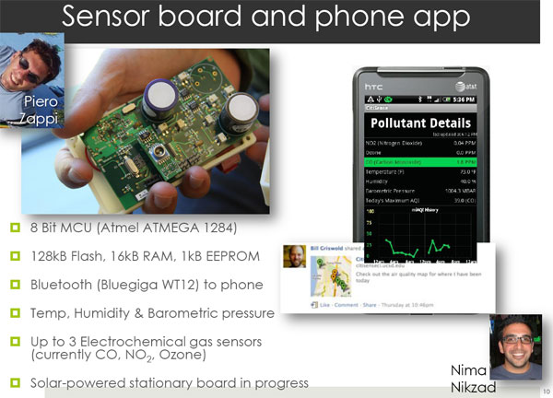
Integrated sensors
http://www.takingspace.org/epa-apps-sensors-for-air-pollution-workshop/

Slide 26
It’s all coming together
Foreground
Recent past
Present
Near Future

Slide 27
Conclusions
Smartphones been linked with pollutant models to predict pollutant concentrations at smartphone locations

Slide 28
Conclusions
This approach can be adapted to work with any pollutant model, any media, any device with an OS and GPS chip

Slide 29
Conclusions
The future in personal monitoring is combining complementary technologies

Slide 30





Acknowledgements
David Williams
William Baird
Lisbeth Siddens
Sharon Krueger
Data Sources
NASA NOAA Oregon DEQ
NIHP42ESO16465

Slide 31
References
Snow, J. On the mode of communication of cholera. John Churchill, 1855.
Elgethun, K, Fenske, RA, and Yost, MG. Time-location analysis for exposure assessment studies of children using a novel global positioning system instrument. Environmental Health Perspectives (2003). 111(1): 115-122.
Hazmat: New Jersey train derails, toxil spill reported in creek (PHOTOS) – http://www.rt.com/usa/train-vinyl chloride-njersey-980. Last accessed October 1, 2013.
Apps and sensors for air pollution - http://www.takingspace.org/epa-apps-sensors-for-air-pollution-workshop. Last accessed September 20, 2013.
Village green project – home –
Villagegreen.epa.gov. Last accessed October 1, 2013.
Kloog, I, Nordio, F., Coull, BA, and Schwartz, J. Incorporating local land use regression and satellite aerosol optical depth in a hybrid model of spatiotemporal PM_{2.5} exposures in the mid-Atlantic states. Environmental Sciences and Technology (2012). 46(21): 11913-11921.

