Slide 1
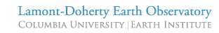
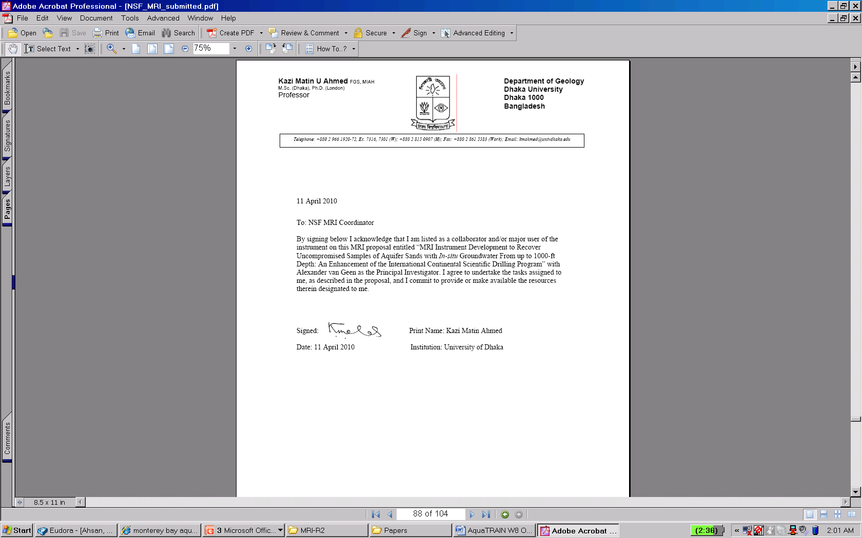



Superfund Research Program
“Using GIS Tools to Analyze, Compute, and Predict Pollution”
The unrealized potential of field kits to reduce toxic exposures:
Case-studies from Bangladesh (arsenic in groundwater)
and Peru (lead in mine tailings)
Alexander van Geen (avangeen@ldeo.columbia.edu)
Kazi Matin Ahmed
Joseph Graziano
Habibul Ahsan
Ershad Bin Shumon
Chander Kumar Singh
Carolina Bravo
Darby Jack
Vladimir Gil
Shaky Sherpa
Xiah Kragie

Slide 2
Outline
Health effects of lead (Pb) and arsenic (As) exposure
(2) Pb in mine tailings (Peru)
Mapping
Field-kit testing
(3) As in well water (Bangladesh)
Mapping
Field-kit testing
(4) Creating financial incentives for testing (India)

Slide 3
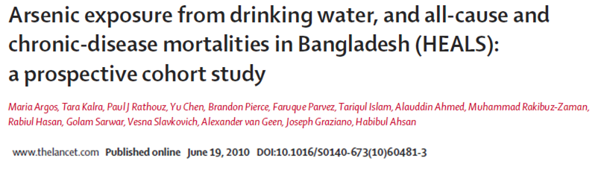
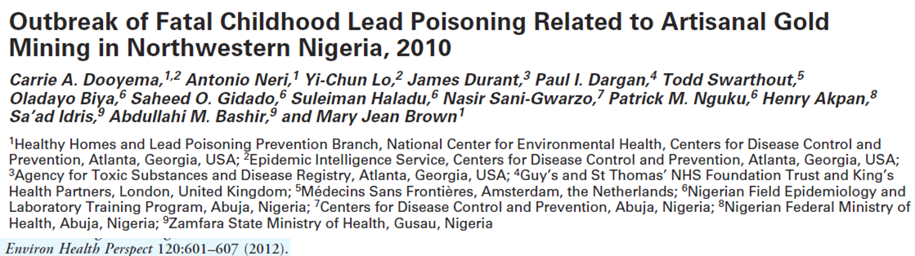
Health effects
Arsenic Lead
Cancers of lung, liver, bladder
Cardio-vascular disease Encephalopathy
Mental development in children Mental development in children
WHO guideline 10 ug/L in water 10 ug/dL in blood
Bangladesh 50 ug/L EPA soil screening
play area: 400 mg/kg
other:1200 mg/kg

Slide 4
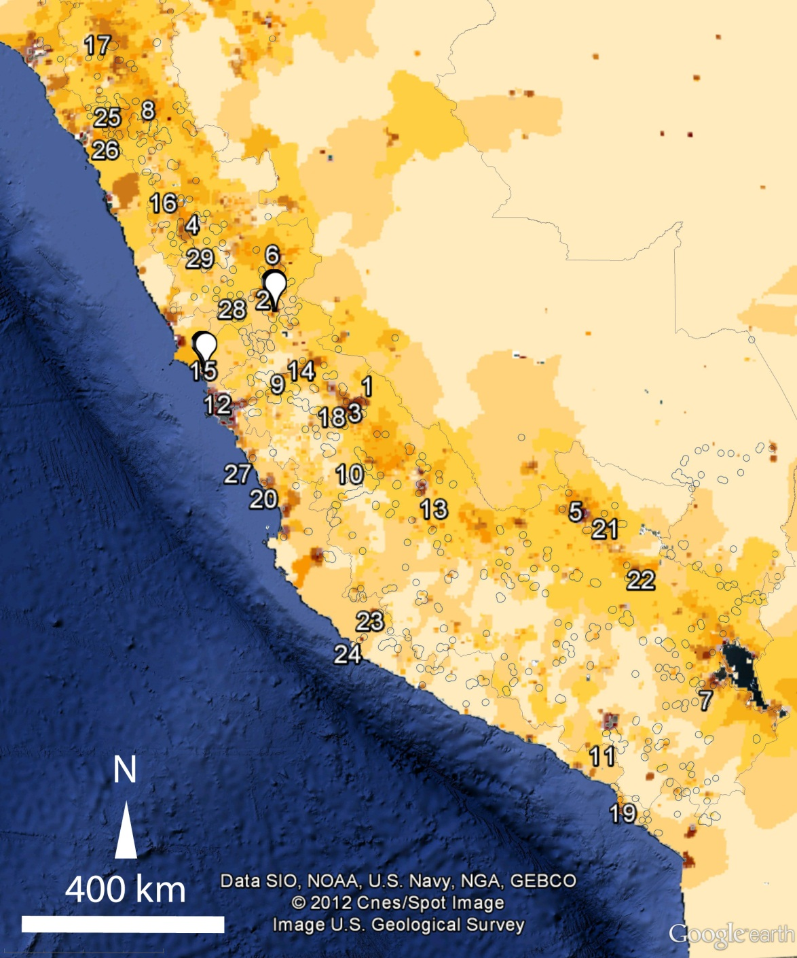
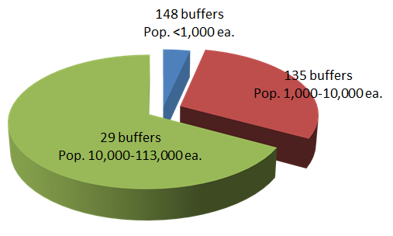
1.6 million in Peru within 5 km of mining-related activity
Population density from census
Government list of 113 mines
138 ore concentration plants
3 smelters
7,743 legacy sites
van Geen et al. Bull WHO, 2012

Slide 5
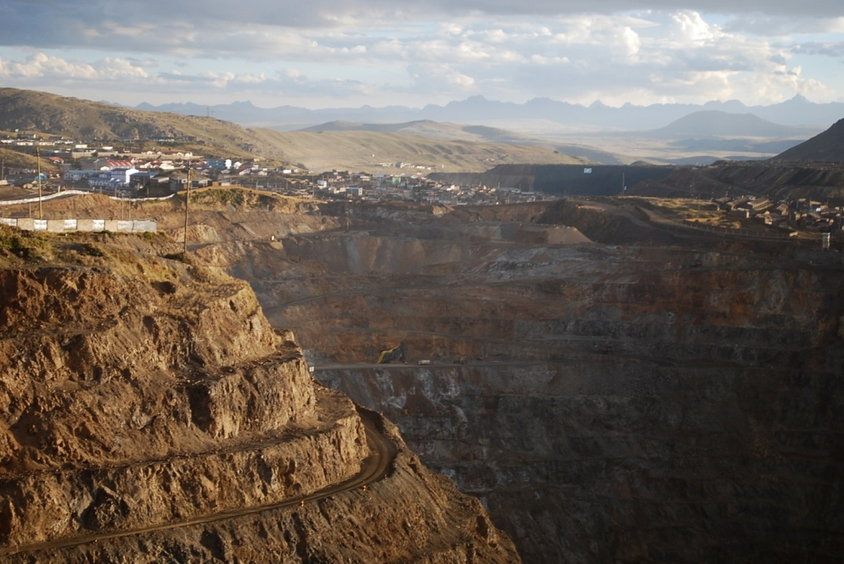
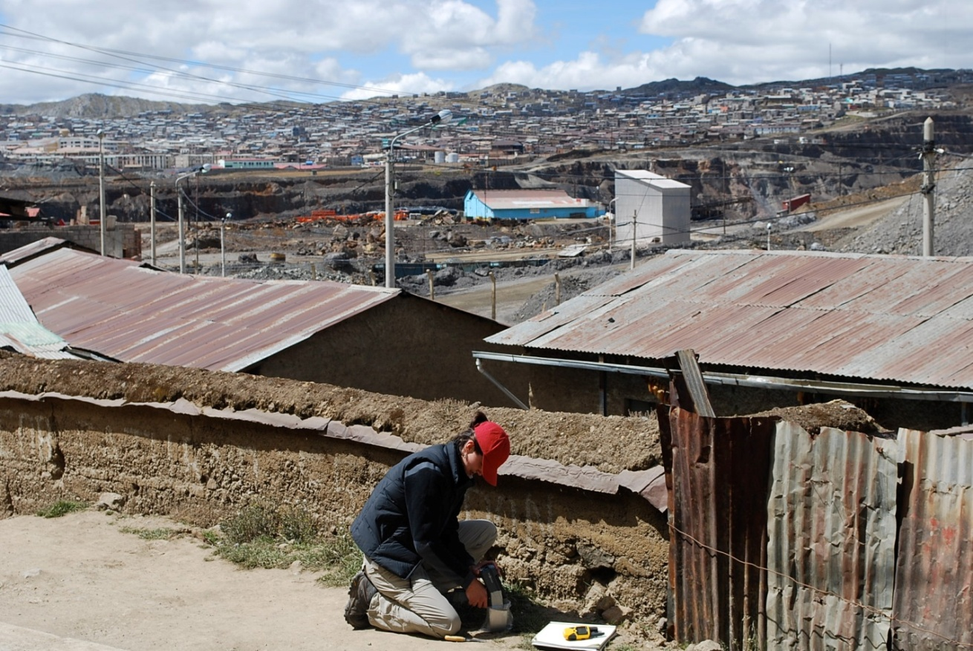
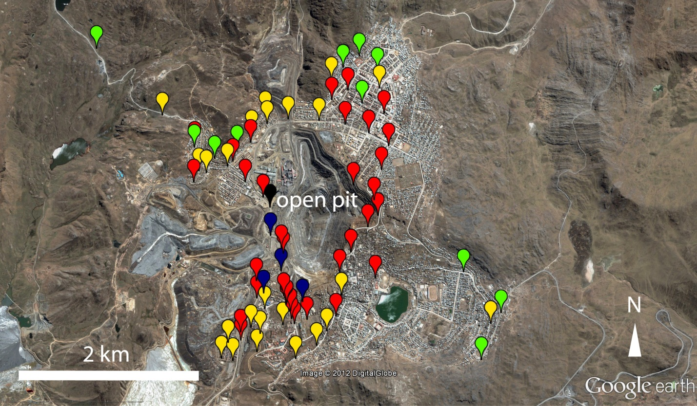

Long history of mining in Cerro de Pasco
(buffer ranked no. 2)
~US$20-40K
Soil Pb (mg/kg)
<400
400-1,200
1,200-5,000
5,000-10,000
>10,000

Slide 6
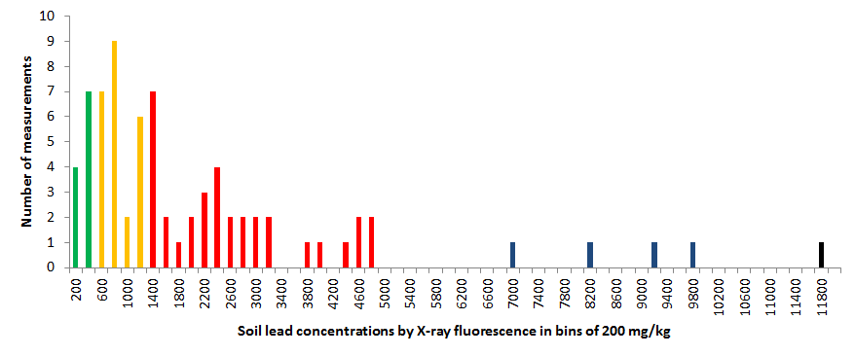
EPA residential
EPA play area
400 mg/kg x 30
Soil Pb (mg/kg)
<400
400-1,200
1,200-5,000
5,000-10,000
>10,000

Slide 7
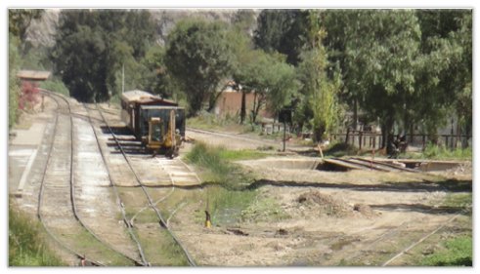
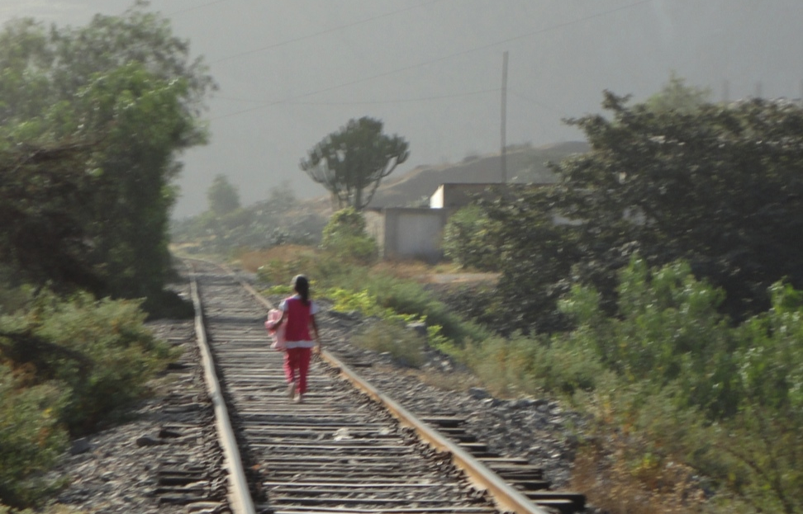
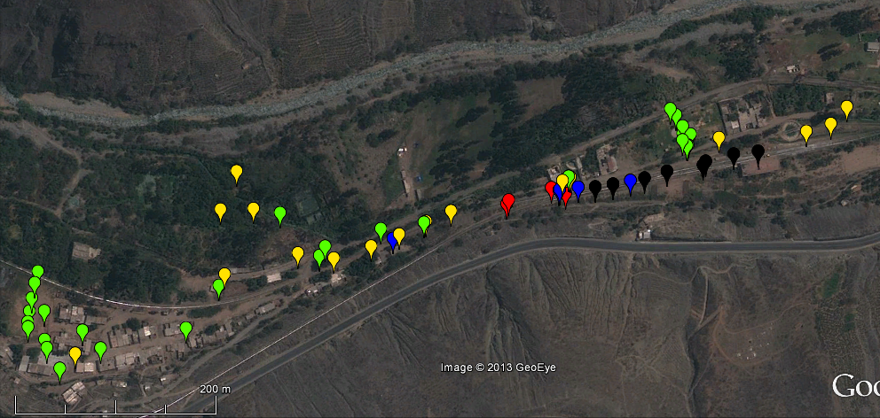
Open railroad cars in Tornamesa
(outside buffer ranked no. 38)
Soil Pb (mg/kg)
<400
400-1,200
1,200-5,000
5,000-10,000
>10,000
200 m

Slide 8
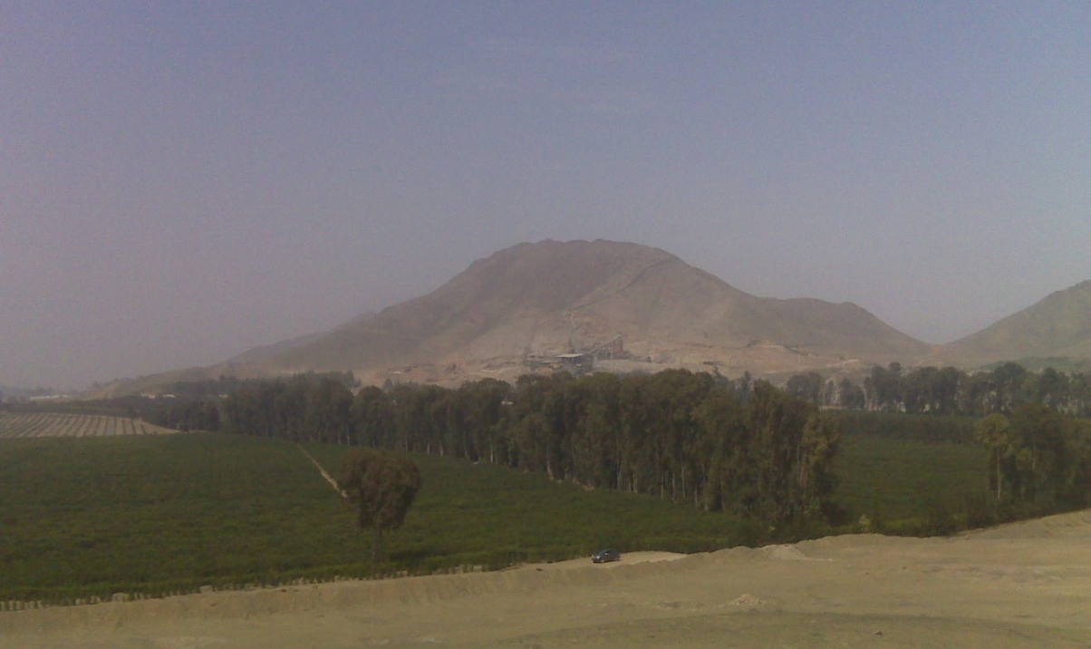
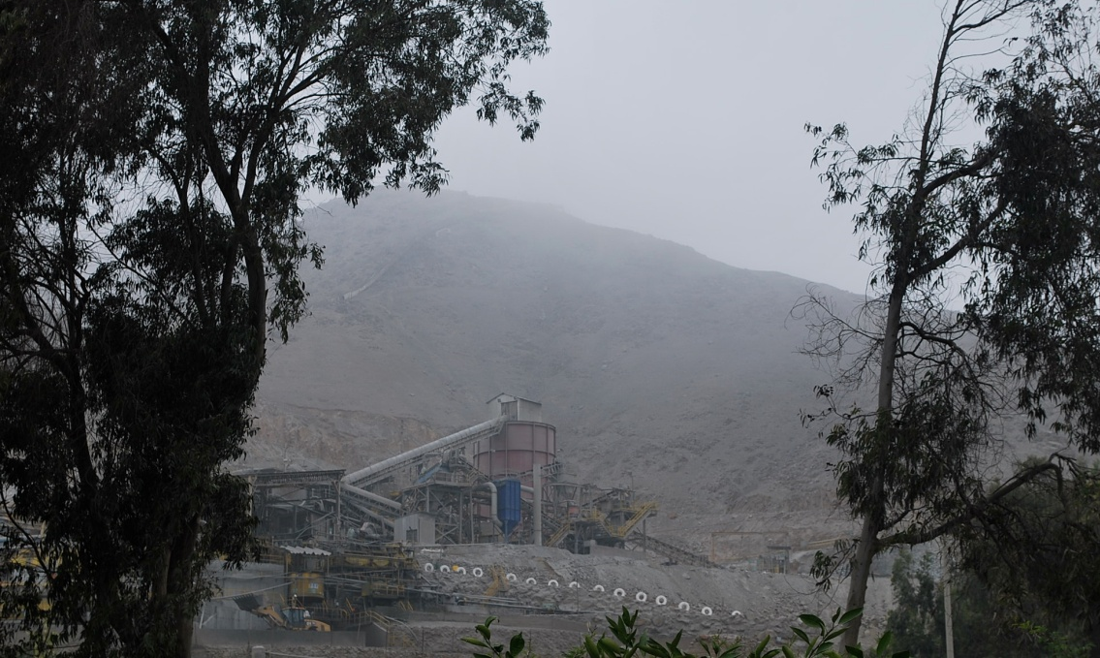
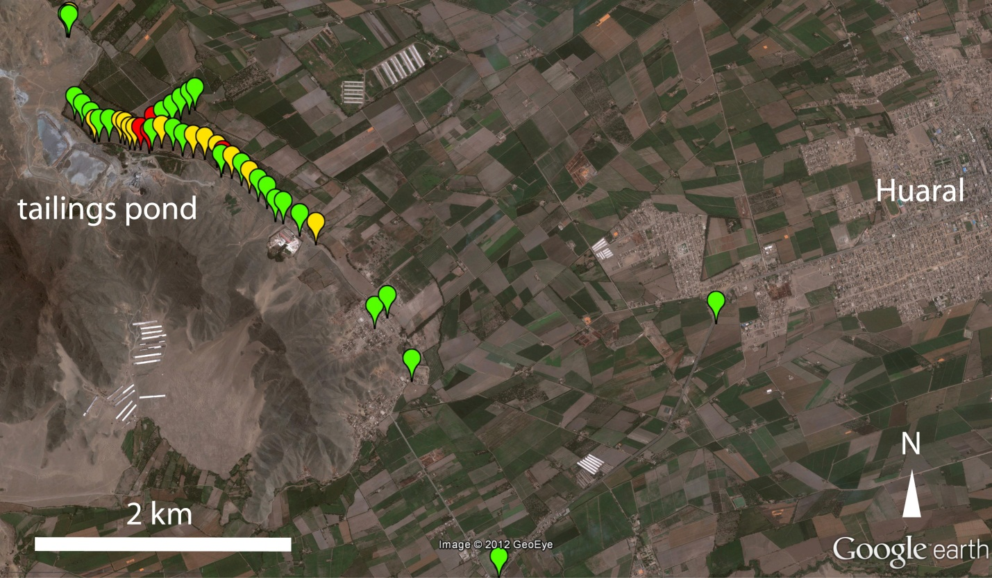
Recent mine and ore concentration plant near Huaral
(buffer ranked no. 15)
Soil Pb (mg/kg)
<400
400-1,200
1,200-5,000
5,000-10,000
>10,000

Slide 9
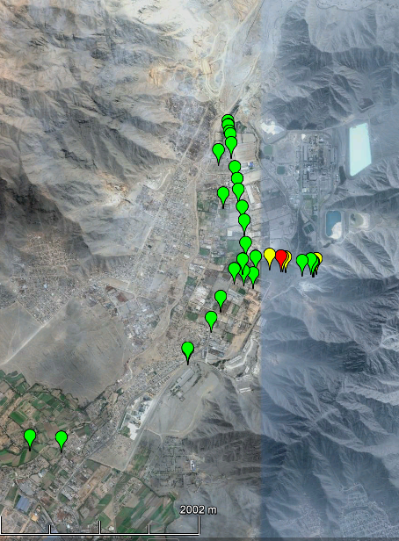
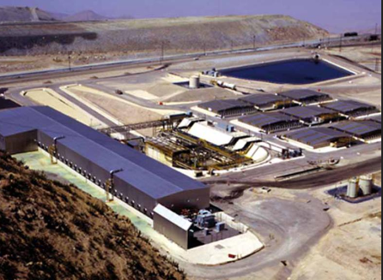
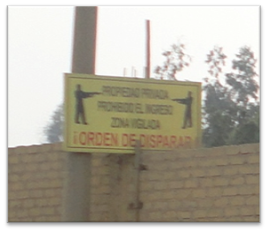
New smelter near Cajamarquilla
(buffer ranked no. 12)
http://noticiastiamaria.blogspot.com/2010/09/proyecto-tia-maria-generara-trabajo.html
Soil Pb (mg/kg)
<400
400-1,200
1,200-5,000
5,000-10,000
>10,000
2 km

Slide 10
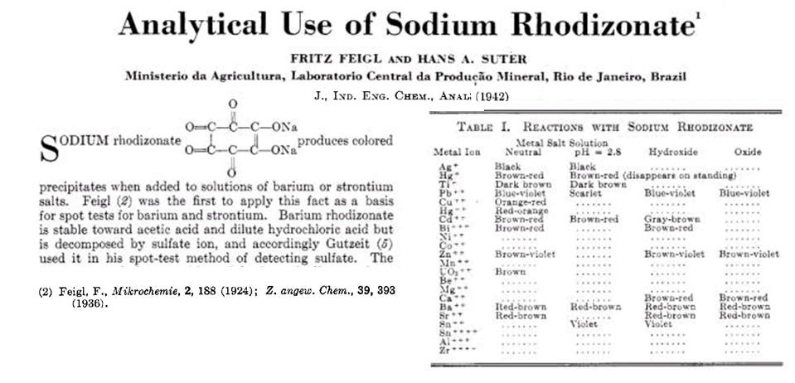
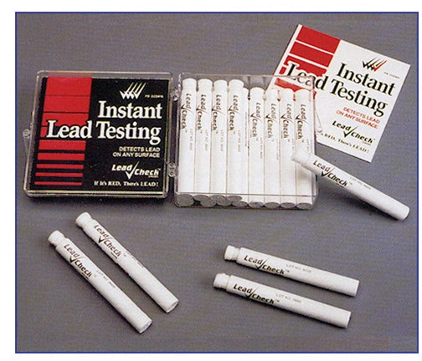
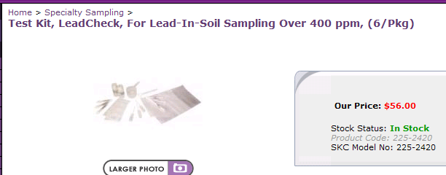
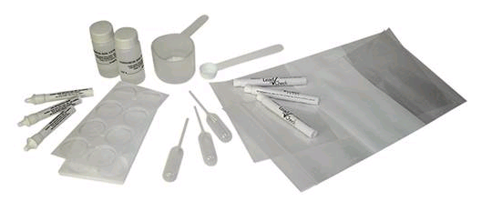
Modification of old colorimetric test to lower cost
http://www.skcinc.com/prod/225-2420.asp

Slide 11
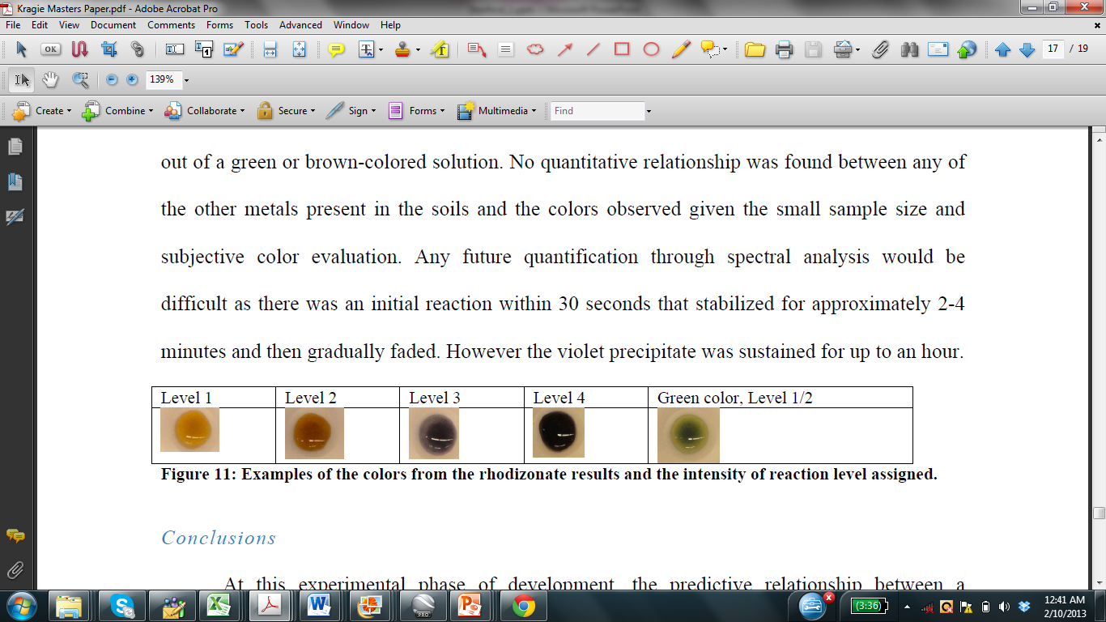
Performance of modified colorimetric test
0.5 M Na citrate @ pH 2
saturated Na rhodizonate
Extractable Pb in soil (mg/kg)

Slide 12
Outline
Health effects of lead (Pb) and arsenic (As) exposure
(2) Pb in mine tailings (Peru)
Mapping
Field-kit testing
(3) As in well water (Bangladesh)
Mapping
Field-kit testing
(4) Creating financial incentives for testing (India)

Slide 13
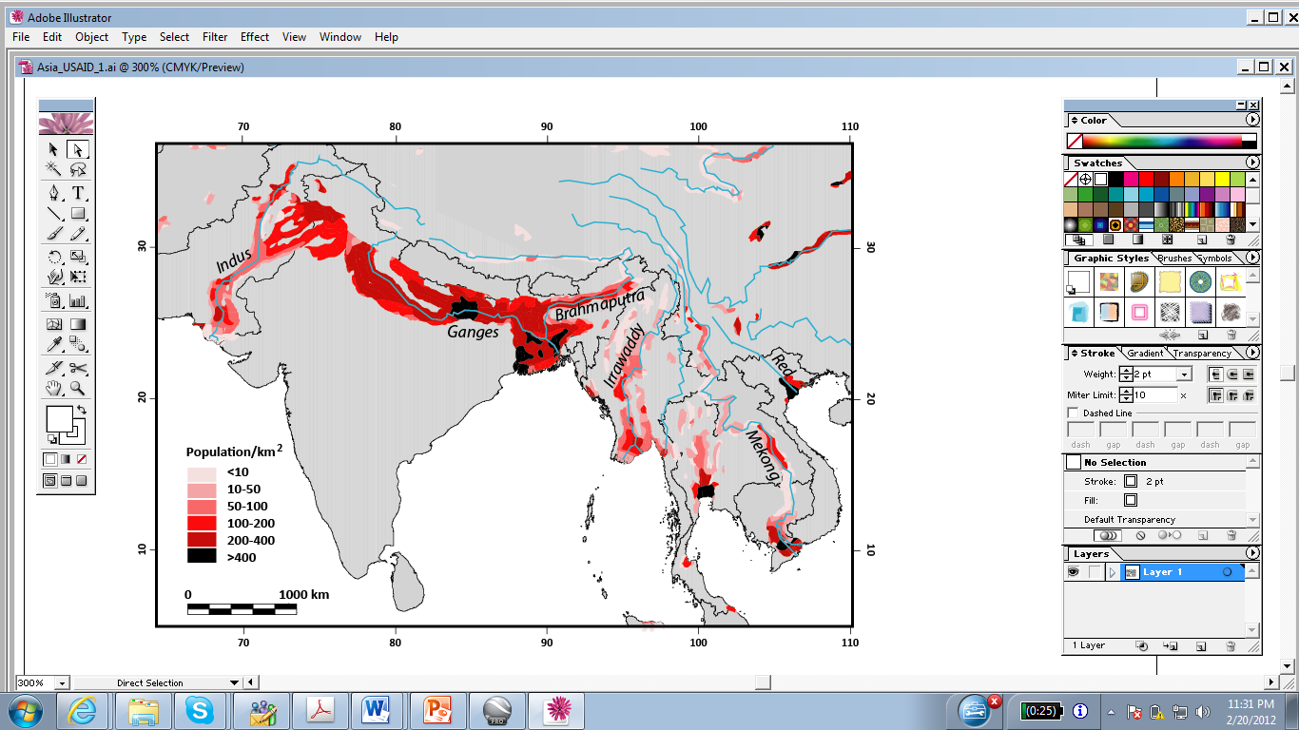
Potentially high-arsenic groundwater based on climate and geology
P. Ravenscroft for UNICEF, 2007

Slide 14
Bihar (India), Araihazar (Bangladesh), and Irrawaddy (Myanmar) in 2012
over 100 million affect across S/SE Asia

Slide 15
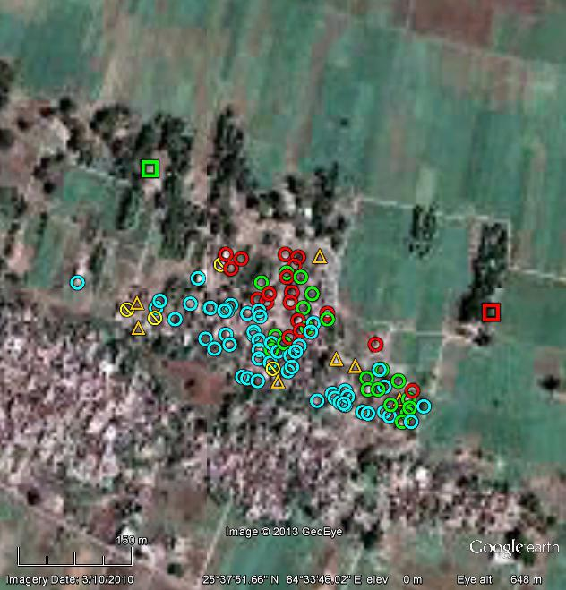
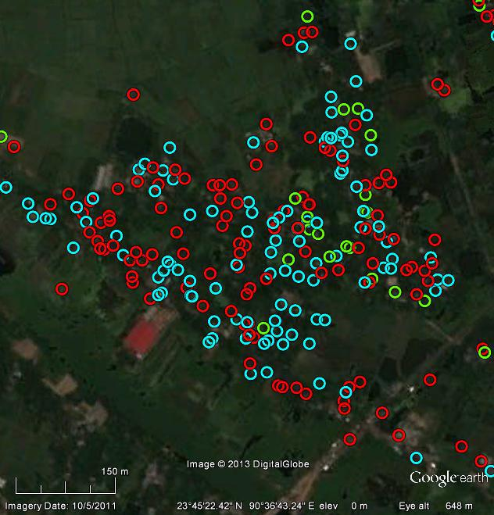
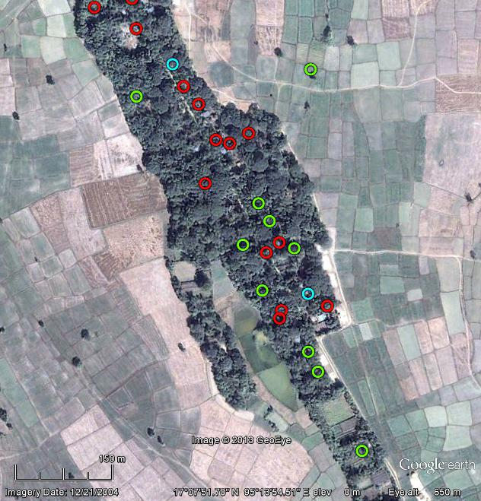
Field-kit arsenic results for 3 villages
Bihar Araihazar Irrawaddy
Spatial variability complicates prediction
but also provides opportunity for well-switching
Half the wells high in As, but >90% of households
within 100 m o f low-As well

Slide 16
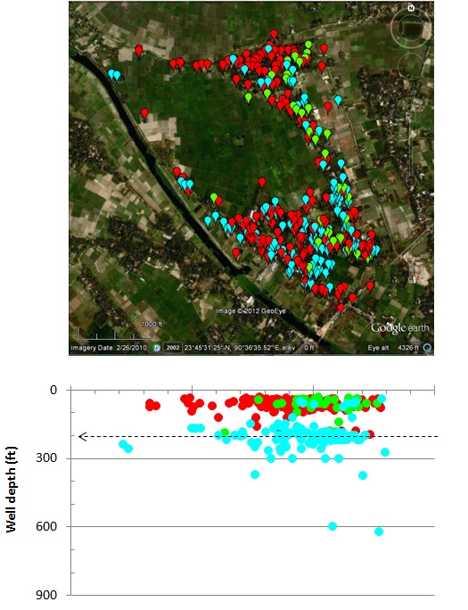
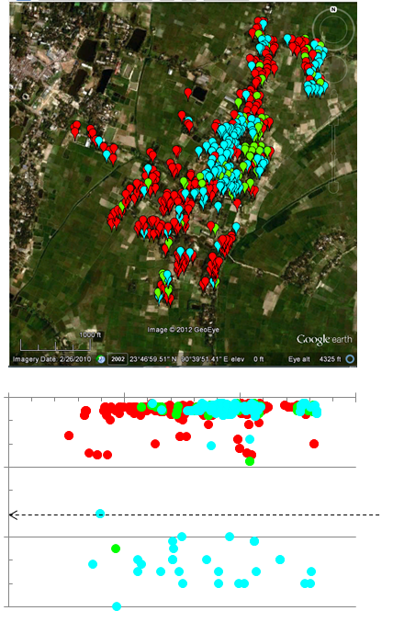
Depth to low-arsenic groundwater varies from one village to the next
200 ft
500 ft

Slide 17
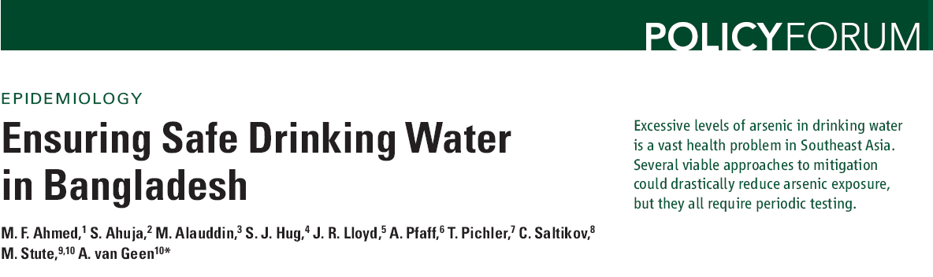
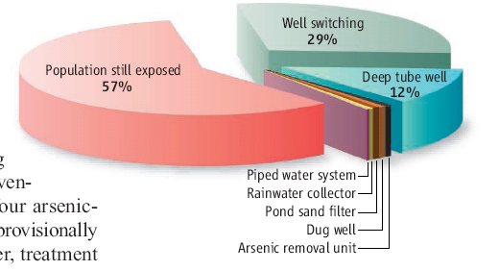
Two forms of exposure reduction dominate all others combined
Ahmed et al., Science, 2006

Slide 18
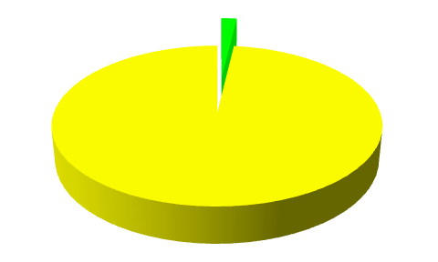
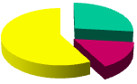
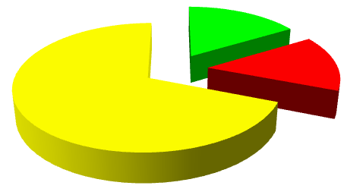
Well status according to households
Bihar Araihazar Irrawaddy
“safe”
unknown
“unsafe”
(n=1,224) (n=25,000) (n=55)

Slide 19
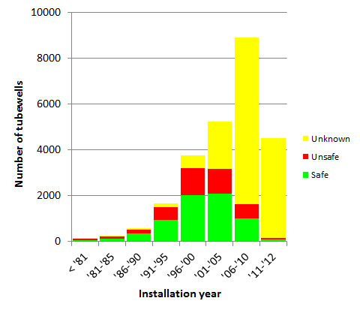
Wells continue to be installed but are not tested
Bihar Araihazar Irrawaddy
None 2000-01 and 2003 2004-11

Slide 20
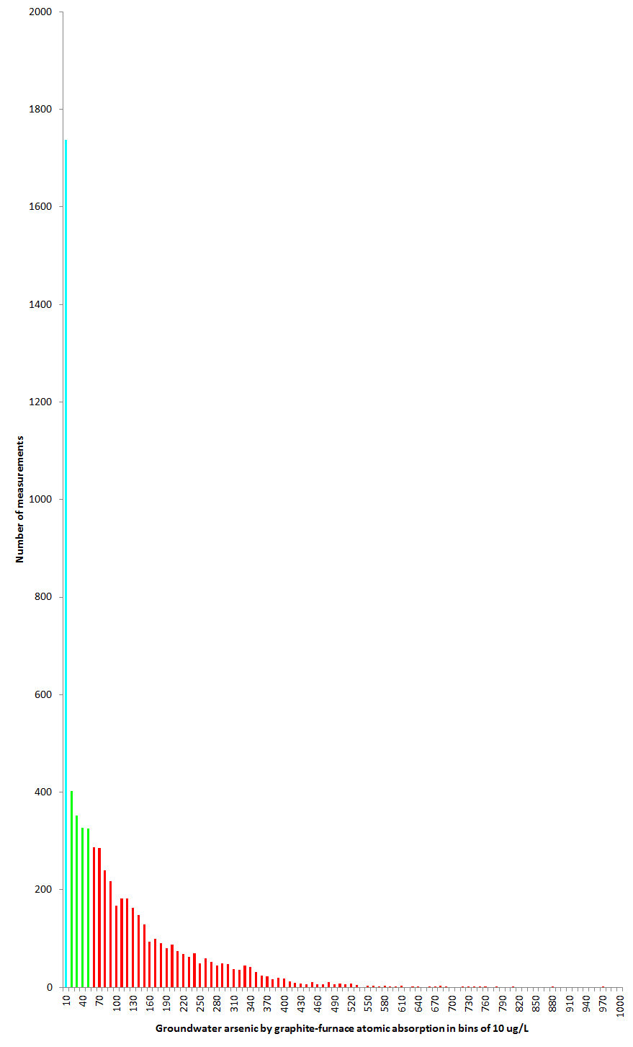
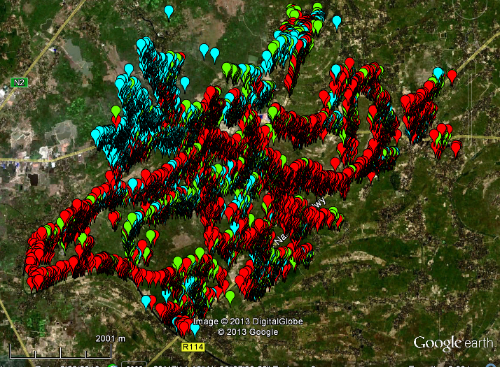
WHO guideline
Bangladesh standard
10 ug/L x 100

Slide 21
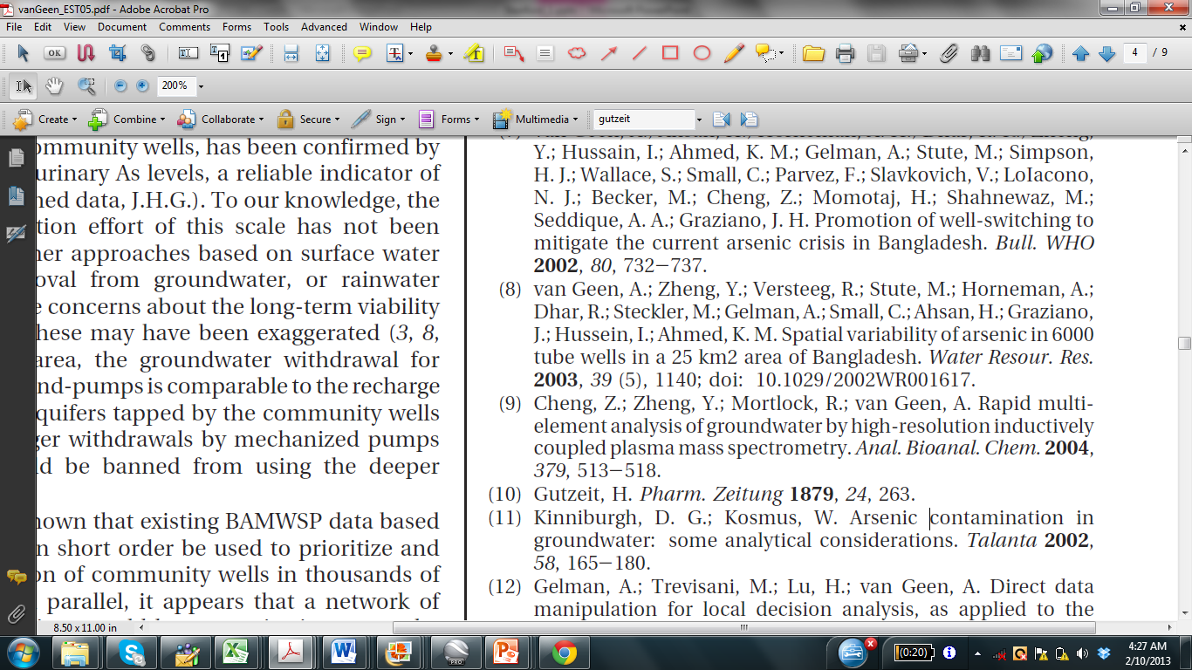
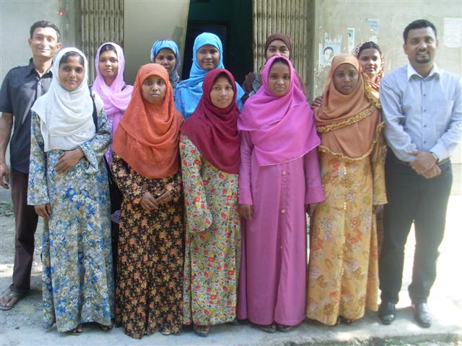
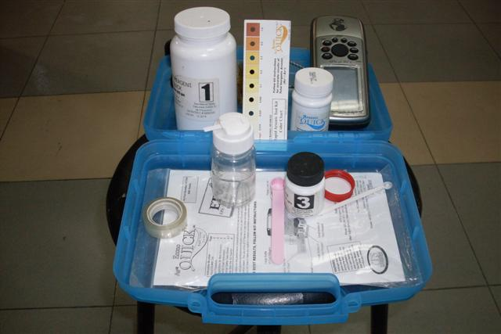
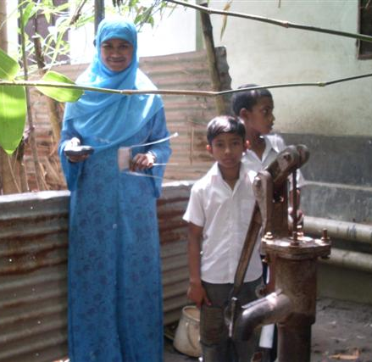
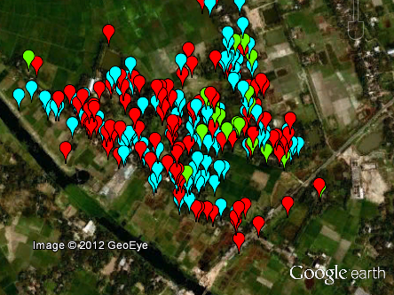
Priority no. 1 for exposure reduction: testing!
http://www.sensafe.com/481298.php
Tartaric acid + Zn => arsine

Slide 22
Results posted relative to WHO guideline AND national standard
0 to 10 ug/L 10-50 ug/L over 50 ug/L
George et al. Env. Sci. Technol. 2012

Slide 23
Outline
Health effects of lead (Pb) and arsenic (As) exposure
(2) Pb in mine tailings (Peru)
Mapping
Field-kit testing
(3) As in well water (Bangladesh)
Mapping
Field-kit testing
(4) Creating financial incentives for testing (India)

Slide 24
Cost of As testing in Bangladesh
GPS
unit
Field
supplies
US$2.40/test
Test kit
Metal placard
Supervision
VHW salary
Compare with US$100-300 paid by household for a 100-300 ft tubewell
US$22 million for testing 10 million tubewells vs. >US$1 billion spent by households

Slide 25
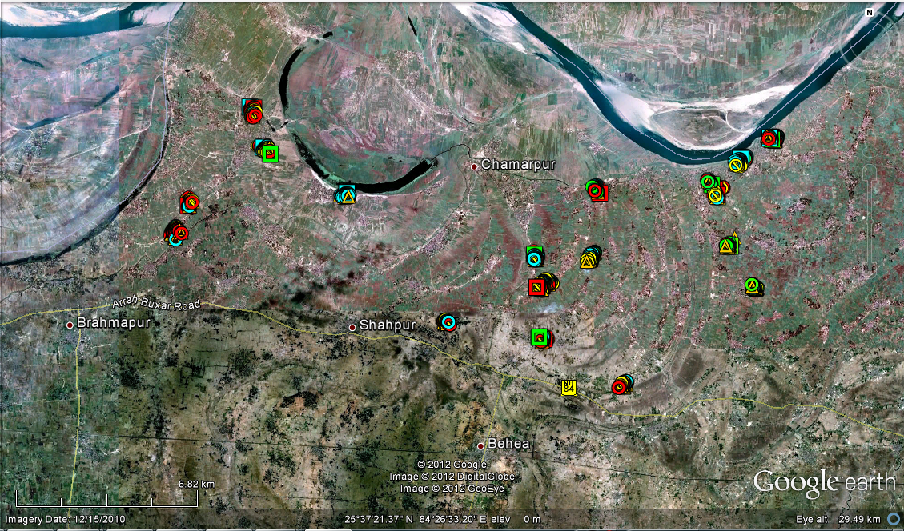
Covering tester salary with household contribution in Bihar
OJH40
KEW10
PRA50
CHN10
PIP20
DAL50
BHA30
HOR20
PIP40
CHA40
DHA30
PUR50
MED10
BAR20
SIN40
NAR30
NAW50
NRA30
1,500 households in 25 villages offered a test at 10, 20, 30, 40, 50 Rs.
(US$0.20-1.00)

Slide 26
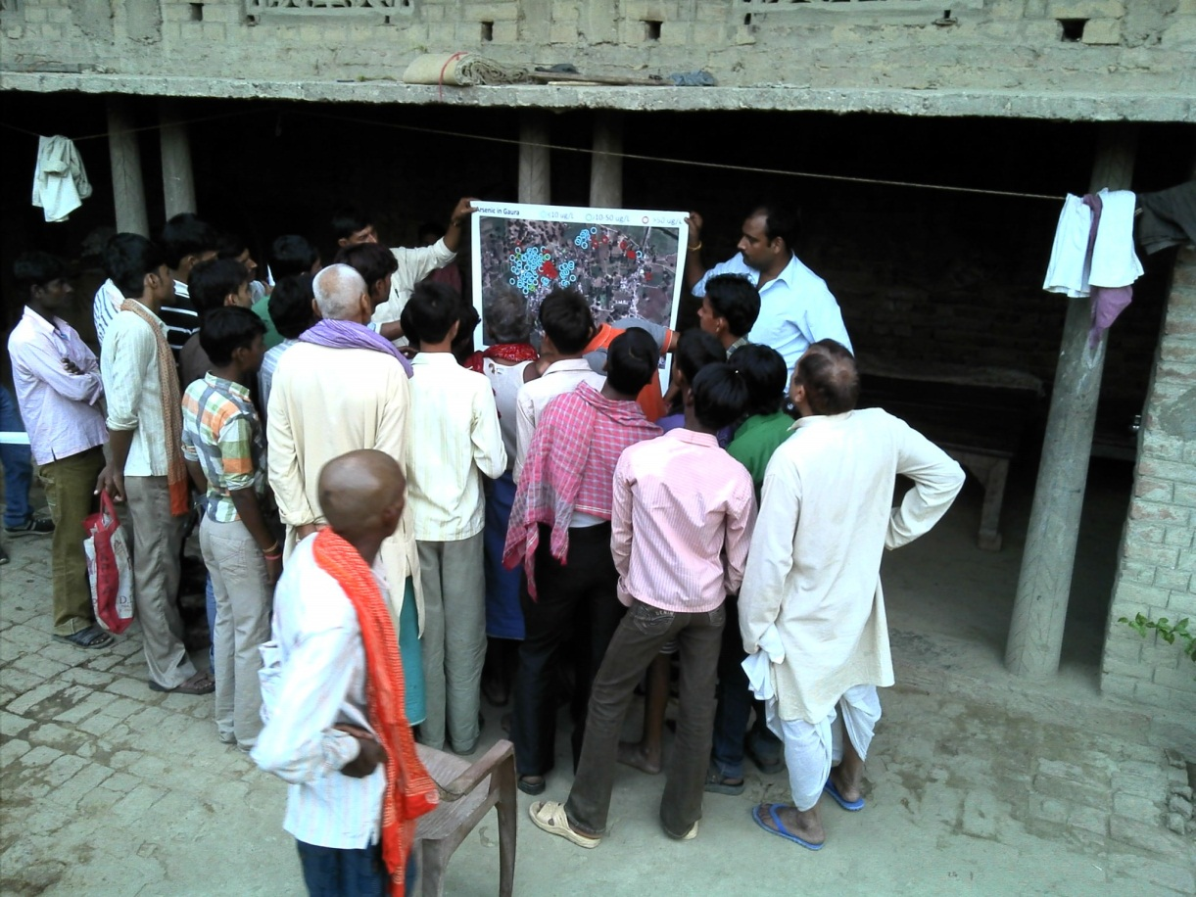
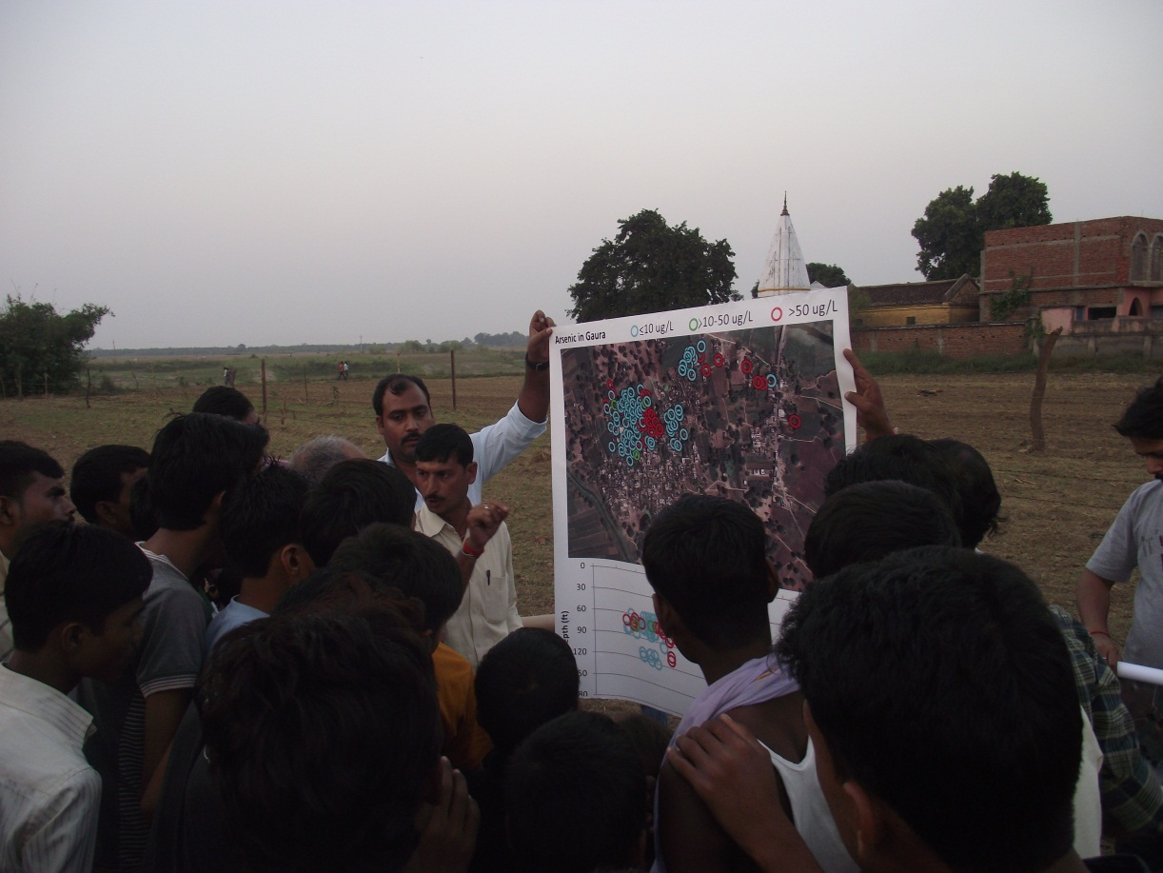
Google Earth map of villages to generate interest and convey health risks

Slide 27
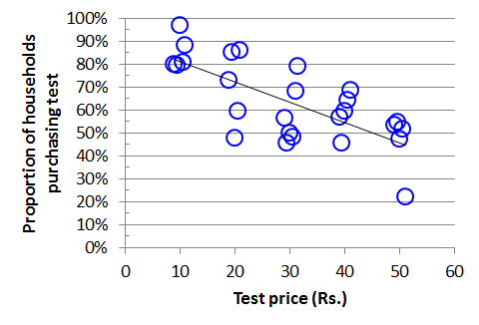
Gradual decline in uptake as price of testing increases
Testing 10-20 wells/day at 20 Rs ($0.40) ea. = 200-400 Rs/day ($4-8/day)
Need to subsidize ~80% of total cost, including quality control

Slide 28

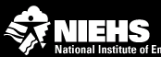

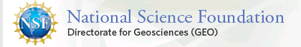

Outline
Health effects of lead (Pb) and arsenic (As) exposure
(2) Pb in mine tailings (Peru)
Mapping
Field-kit testing
(3) As in well water (Bangladesh)
Mapping
Field-kit testing
(4) Creating financial incentives for testing (India)

Slide 29
Outlook
Modification of arsenic kit to test urine and encourage well switching (arsine generation)
Test hair to measure exposure to mercury from artisanal gold mining (atomic fluorescence)
Test for microbial contamination of drinking water (rotavirus by hemagglutination)
Key: Someone needs to make a living from testing

