Slide 1





National Institute of Environmental Health Sciences
Application of the PROTECT Data Management System to Assess Relationships Between Environmental Chemical Exposure and Population Birth Outcomes in Northern Puerto Rico
Ingrid Padilla¹ & Dave Kaeli²
Luis O. Rivera-González³, Can Yegen², José F. Cordero⁴, John D. Meeker³, and Akram Alshawabkeh²
³University of Michigan ⁴University of Puerto Rico, Medical Campus
Civil Engineering and Surveying
¹University of Puerto Rico, Mayagüez
Electrical and Computer Engineering
²Northeastern University
EPA/NIEHS
Risk e Learning Webinar Series
February 6, 2014
Notes:
EPA e-SeminarUsing GIS Tools to Analyze, Compute, and Predict Pollution, Session I - Exposure Assessment in the Field and links to Human Health
Sponsored by: NIEHS Superfund Research Program

Slide 2
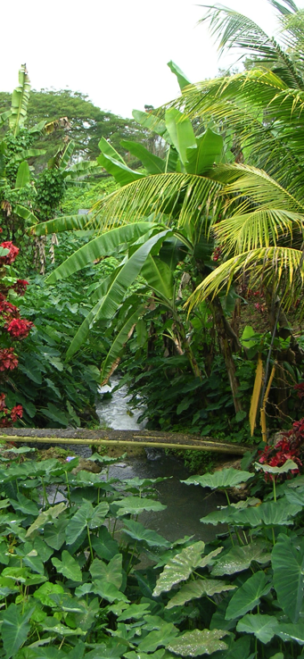
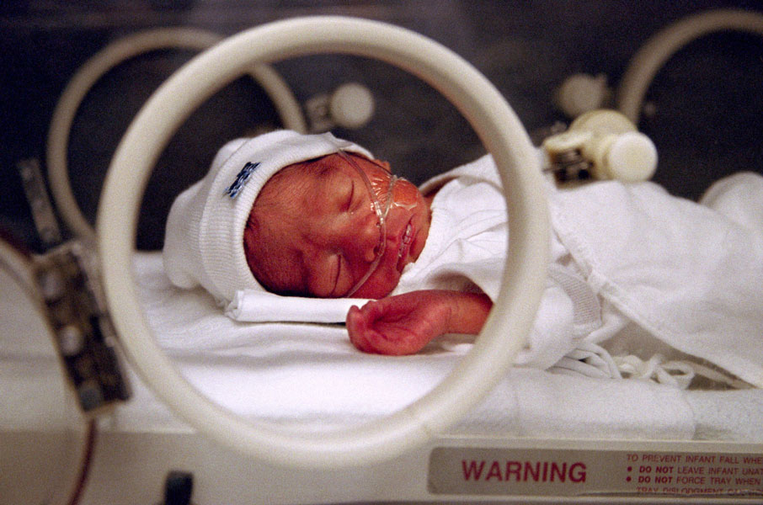
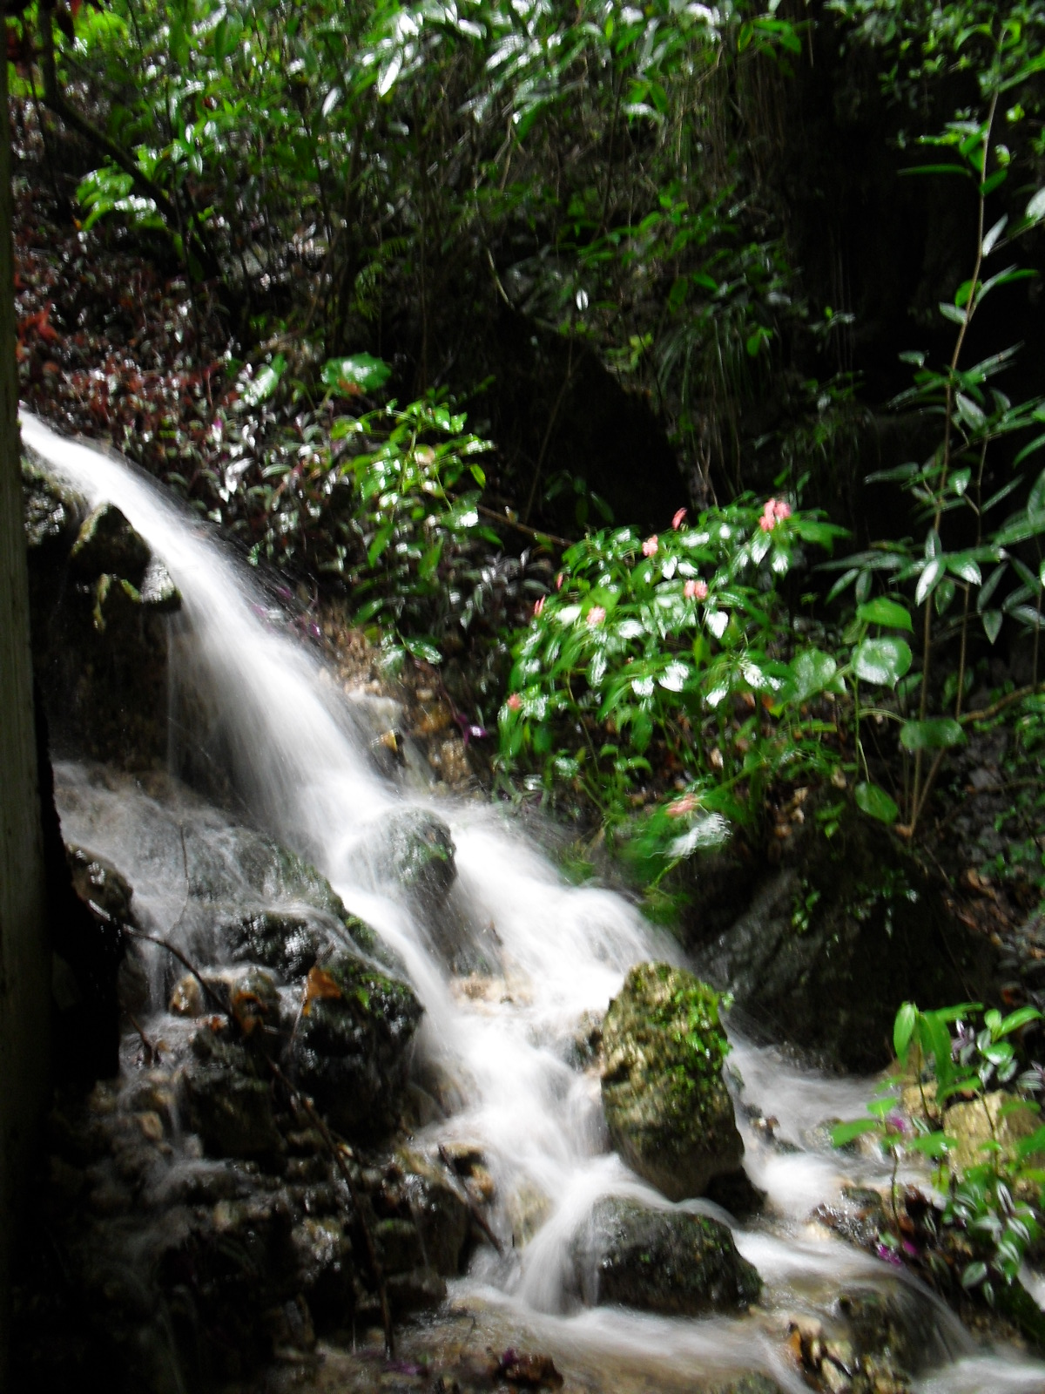
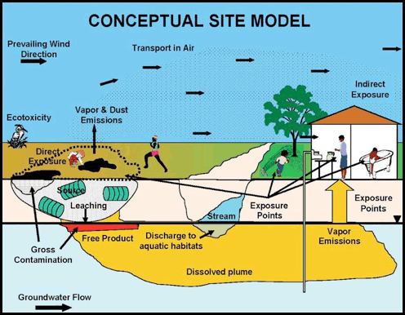
Overview
Background
PROTECT
Approach
Data Management & Analysis
Relationship Assessment Maps
  Examples
Concluding Remarks
Future Work
Acknowledgement
San Pedro and Camuy Springs, PR
ITRC, 2012

Slide 3
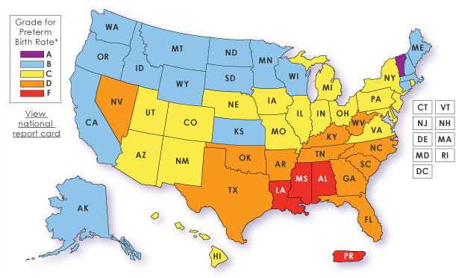

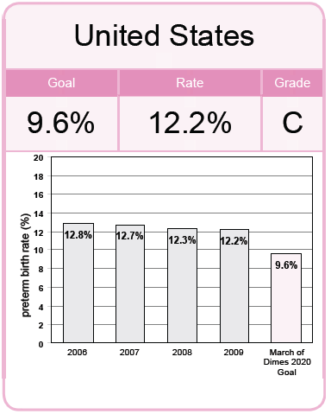
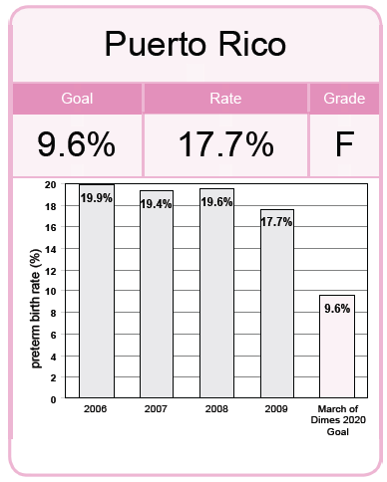
Motivation and Background
Puerto Rico has among the highest rates of preterm births in the United States and the world
Premature Babies are born before 37 completed weeks of gestation.

Slide 4
Preterm Birth
Preterm birth (PTB) is the leading cause of neonatal mortality in the US, contributing to over one-third of infant deaths (National Academies, 2007)
Results in high incidence of health complications that can lead to lifelong disabilities
Preterm birth is a major, costly health problem in the US, estimated (2005) to be at least $26 B
Source: Agency for Healthcare Research and Quality, 2003 Nationwide Inpatient Sample.
Prepared by March of Dimes Perinatal Data Center, 2006.
Known risk factors for prematurity do not explain the marked increase in preterm births in the US and Puerto Rico
Notes:
4
Results in high incidence of health complications
Acute respiratory, gastrointestinal, immunologic, central nervous system, hearing, and vision problems, hemolytic disease of the newborn (HBN), as well as longer-term motor, cognitive, visual, hearing, behavioral, social-emotional, health, and growth problems (Cordero 2009)
Preterm birth is a major, costly health problem in the US.
Premature infants accounted for half of the hospital charges for all infants in 2003 and cost $26 Billion according to a 2007 report
Los costos de tratamiento de bebés prematuros en Puerto Rico no están disponibles, pero sabemos que en los Estados Unidos en el 2003, los costos hospitalarios de bebés prematuros sumaron unos 18.1 billones de dólares. El costo hospitalario promedio de un bebé prematuro en los Estados Unidos en el 2003 fue de unos $77,000 comparado con $1,700 para bebés a término.
The known risk factors for prematurity do not explain the marked increase in preterm births in the US and Puerto Rico
Early prenatal care in Puerto Rico since 1990 has improved significantly (71% to 84%) and is now comparable to the US mainland
Tobacco use during pregnancy has decreased (14.5% to 12.2%) and is significantly less than what is reported in the US mainland (23.5% to 19.8%)
Maternal education has improved (67% to 78%)
Rate of multiple gestations did not significantly change (PR 2% US 3.5%).
The increase in preterm birth rates in Puerto Rico is not limited to certain educational backgrounds or maternal age ranges and is independent of the delivery method (C-section vs. vaginal)
The use of assisted reproductive technologies (ART) such as in vitro fertilization (IVF) are not as common in Puerto Rico and does not explain the overall increase in the number of preterm births

Slide 5
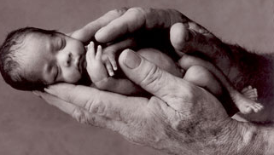
Motivation and Background
Several contaminants have been related to Adverse Reproductive Outcomes¹
  Phthalates
  Chlorinated Solvents
  Personal Care Products
  Pesticides
  Metals
http://www.australianbabyhands.com
Adverse Reproductive Outcomes¹
Reproductive damage
Decreased gestation length
Rise of preterm birth
Lower birth weights
Perinatal mortality
Increased risk for spontaneous abortion
All of which have been found in water in Puerto Rico
Ferguson KK, McElrath TF, Meeker JD. Environmental phthalate exposure and preterm birth. JAMA Pediatr, In Press.
¹Meeker et al. 2009; Meeker 2012; Sonnenfeld et al. 2001; Forand et al. 2012; ATSDR, 2007; CERHR, 2006; Latini et al., 2003; Ha and Cho 2002; Khattak, 1999.
Notes:
Several studies¹ have related CVOC and phthalate contaminats to adverse reproductive outcomes, including preterm birth contaminants

Slide 6
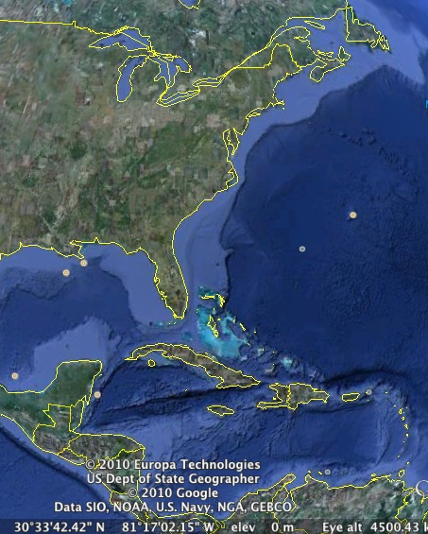
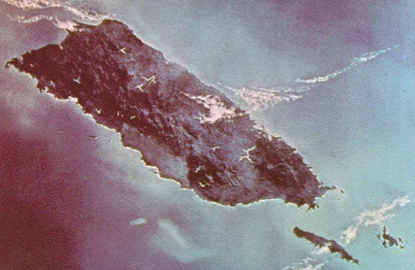
Motivation and Background
Contamination in Puerto Rico is extensive with 100s of polluted sites impacting water resources
W
N
S
E
Of particular concern is the karst region of northern Puerto Rico
Notes:
Most productive aquifer of the island¹
Significant source of water supply^{2,3}
Maintains ecological integrity
Over 40 years of contamination
12 Superfund Sites (other potential ones)
Several unlined landfills above aquifer
100s of other potential sources
Industrial waste injections before the 1970s
Highly vulnerable to contamination
This aquifer serves as a significant source of water for domestic, industrial, and agricultural uses (DNER, 2008). Groundwater in the region also discharges to surface water features, contributing to the ecological integrity of stream, wetlands, costal lagoons, and estuaries

Slide 7
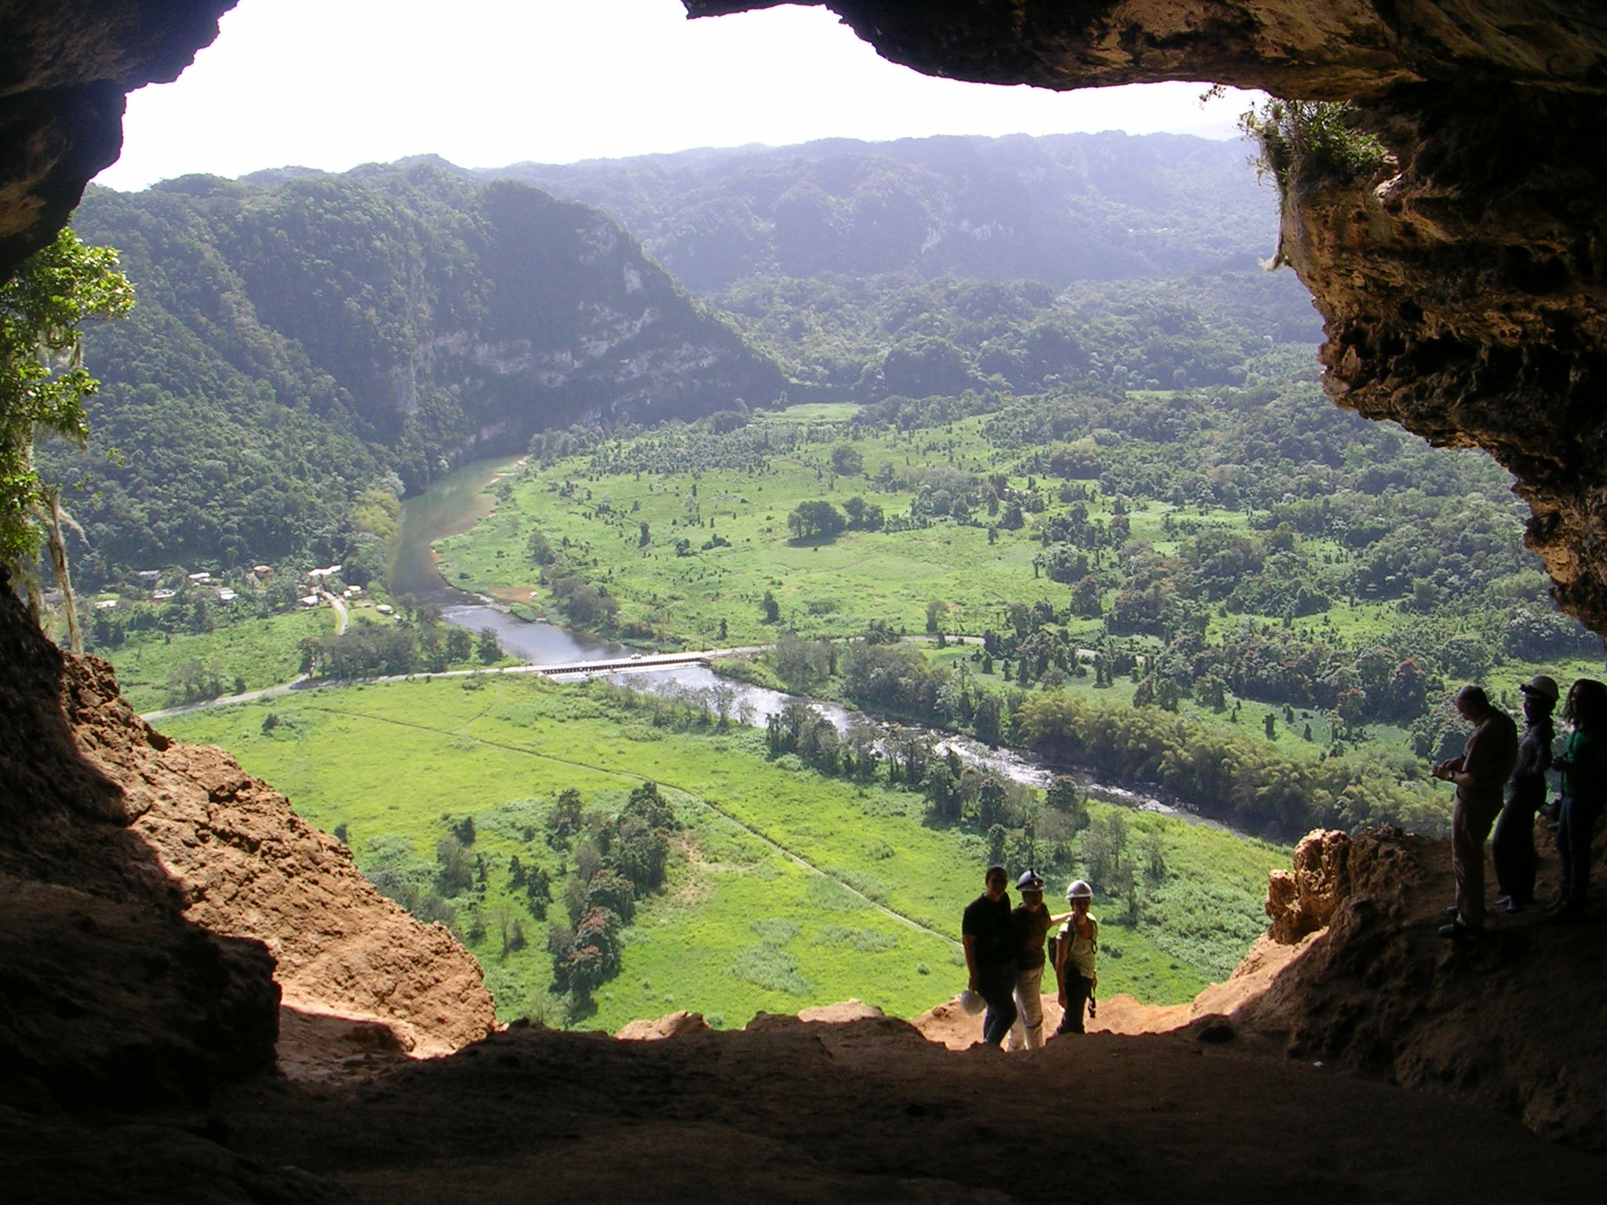
Karst Region of Northern Puerto Rico
Primarily limestone with highly permeable karst aquifers
○
    Most productive aquifer of the island¹
      Significant source of water supply^{2,3}
      Maintains ecological integrity
    Over 40 years of contamination
      12 Superfund Sites (other potential ones)
      Several unlined landfills above aquifer
      100s of other potential sources
      Industrial waste injections before the 1970s
  Highly vulnerable to contamination
Monte Encantado Cave and Wells, PR
  Could serve as an important route of contaminant exposure
¹Veve and Taggart, 1996 ²DNER, 2008 ³Molina, 2009
Notes:
Characterized by well-developed conduit porosity and high permeability zones. Highly heterogeneous.
This aquifer serves as a significant source of water for domestic, industrial, and agricultural uses (DNER, 2008). Groundwater in the region also discharges to surface water features, contributing to the ecological integrity of stream, wetlands, costal lagoons, and estuaries.
Extraction wells are used for domestic, industrial, and agricultural purposes, with the largest fraction used for public supply, followed by the industrial and agricultural sectors (Molina, 2009). Groundwater is, but several industrial wells (and a few public water supply) tap the lower aquifer.
Contamination in Puerto Rico is extensive with over 150 polluted sites impacting water resources and posing threats to the environment and public health
This aquifer is directly connected to surface contaminations sources.

Slide 8
Research Questions
What is the contribution of environmental contaminants to preterm birth in PR?
How significant is karst water as a mode of contaminant exposure?
Can we develop better strategies for detection and green remediation to minimize or prevent exposure to environmental contamination?
○
PROTECT

Slide 9
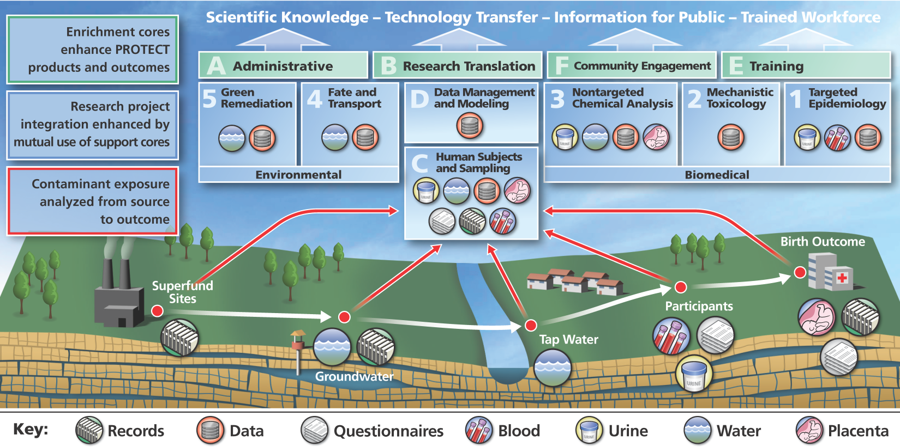
PRoTECT Goals and Approach
Goals
  Define the relationship between exposure to environmental contaminants and preterm birth
  Develop new technology for discovery, transport and exposure characterization, and green remediation of contaminants in karst systems
  Goal 3: Broader Impacts - support environmental public health practice, policy and awareness around our theme
Notes:
The program consist of 5 Research Projects and 5 cores
The team consists of biomedical and non-biomedical experts and scientists

Slide 10
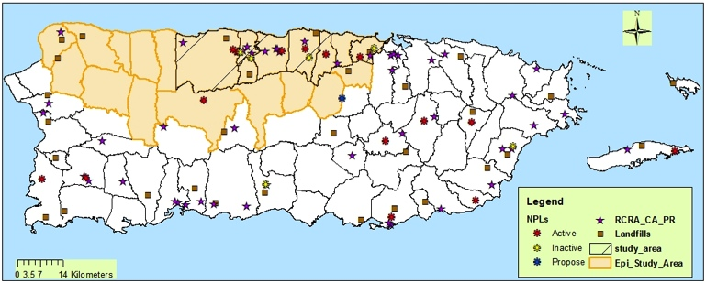
Study Area
  Karst Region of Northern Puerto Rico

Slide 11
PRoTECT Data
Environmental
Human Subject and Sampling
Epidemiologic/ Toxicologic
Urine
Blood
Groundwater
Tap Water
Recruitment of Pregnant Women
Hair
Placenta
Longitudinal Study
7 Clinics /3 Hospitals /In-House
Interviews and Surveys
  Demographic, medical, residential, product use, food intake
Medical Records Abstraction
Biological Samples
  Blood, Urine, Hair, Placenta
Birth Outcomes
WQ Parameters
  Temp, pH, ions, cond, NO₃⁻, etc.
Phthalates
  DEHP, DEP, DBP
Chlorinated VOCs
  TCE, PCE, CT, TCM, etc.
Non-Targeted
Metabolites
  Phthalates
  Parabens & Phenols
  Organo-phosphates
Metals
Hormones
Oxidative stress markers
Inflammatory markers
Other Non-Targeted
Historical
Historical
Current Field Measurement
Current Field Measurement
Notes:
Legacy Contaminants
Chlorinated Volatile Organic Compounds (CVOCs)
Among the most frequently contaminants found at superfund sites
Industrial use: solvents, dry/cleaning
Emergent Contaminants
Phthalates (DEHP, DEP, DBP)
Present in commonly used products that make their way to landfills and illegal dumps
DEHP – plasticizers
DEP, DBP – solvents : Fragrances, Cosmetics, shampoos, etc.
Other – phenols, PBA, Pharmaceuticals
CVOCs and Phthalates have been associated with Preterm Birth¹ (¹Meeker et al. 2009; Meeker 2012; Sonnenfeld et al. 2001; Forand et al. 2012)

Slide 12
PRoTECT Data
Environmental
Human Subject and Sampling
Epidemiologic/ Toxicologic
Urine
Blood
Groundwater
Tap Water
Recruitment of Pregnant Women
Hair
Placenta
Longitudinal Study
7 Clinics /3 Hospitals /In-House
Interviews and Surveys
  Demographic, medical, residential, product use, food intake
Medical Records Abstraction
Biological Samples
  Blood, Urine, Hair, Placenta
Birth Outcomes
WQ Parameters
  Temp, pH, ions, cond, NO₃⁻, etc.
Phthalates
  DEHP, DEP, DBP)
Chlorinated VOCs
  TCE, PCE, CT, TCM, etc.
Non-Targeted
Metabolites
  Phthalates
  Parabens & Phenols
  Organo-phosphates
Metals
Hormones
Oxidative stress markers
Inflammatory markers
Other Non-Targeted
Historical
Historical
Current Field Measurement
Current Field Measurement
Notes:
Legacy Contaminants
Chlorinated Volatile Organic Compounds (CVOCs)
Among the most frequently contaminants found at superfund sites
Industrial use: solvents, dry/cleaning
Emergent Contaminants
Phthalates (DEHP, DEP, DBP)
Present in commonly used products that make their way to landfills and illegal dumps
DEHP – plasticizers
DEP, DBP – solvents : Fragrances, Cosmetics, shampoos, etc.
Other – phenols, PBA, Pharmaceuticals
CVOCs and Phthalates have been associated with Preterm Birth¹ (¹Meeker et al. 2009; Meeker 2012; Sonnenfeld et al. 2001; Forand et al. 2012)

Slide 13
PRoTECT Data
Environmental
Human Subject and Sampling
Epidemiologic/ Toxicologic
Urine
Blood
Groundwater
Tap Water
Recruitment of Pregnant Women
Hair
Placenta
Longitudinal Study
7 Clinics /3 Hospitals /In-House
Interviews and Surveys
  Demographic, medical, residential, product use, food intake
Medical Records Abstraction
Biological Samples
  Blood, Urine, Hair, Placenta
Birth Outcomes
WQ Parameters
  Temp, pH, ions, cond, NO₃⁻, etc.
Phthalates
  DEHP, DEP, DBP)
Chlorinated VOCs
  TCE, PCE, CT, TCM, etc.
Non-Targeted
Metabolites
  Phthalates
  Parabens & Phenols
  Organo-phosphates
Metals
Hormones
Oxidative stress markers
Inflammatory markers
Other Non-Targeted
Historical
Historical
Current Field Measurement
Current Field Measurement

Slide 14
PRoTECT Data
Environmental
Human Subject and Sampling
Epidemiologic/ Toxicologic
Urine
Blood
Groundwater
Tap Water
Recruitment of Pregnant Women
Hair
Placenta
Longitudinal Study
7 Clinics /3 Hospitals /In-House
Interviews and Surveys
  Demographic, medical, residential, product use, food intake
Medical Records Abstraction
Biological Samples
  Blood, Urine, Hair, Placenta
Birth Outcomes
WQ Parameters
  Temp, pH, ions, cond, NO₃⁻, etc.
Phthalates
  DEHP, DEP, DBP)
Chlorinated VOCs
  TCE, PCE, CT, TCM, etc.
Non-Targeted
Metabolites
  Phthalates
  Parabens & Phenols
  Organo-phosphates
Metals
Hormones
Oxidative stress markers
Inflammatory markers
Other Non-Targeted
Historical
Historical
Current Field Measurement
Current Field Measurement
PROTECT generates an enormous amount of data records which are potentially related

Slide 15


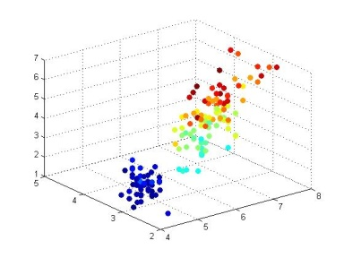
The PROTECT Data Management and Modeling Core
Building a customized process for each Core/Project to allow for the efficient cleaning and entry of the human subject, environmental, biological and chemical data
Delivering relational query and data export capabilities to support both program-based and broader communities
Providing for secure, confidential and reliable storage of all PROTECT data
Providing data modeling and data mining analytics for clustering analysis and pattern recognition

Slide 16
Data Management Challenges
  Manage a rich array of data provided by multiple Projects/Cores and disciplines:
    5 Research Project and 4 Cores
    Environmental, biological, chemical, biomedical, and demographic data
  Deliver an integrated data management system that can bridge disciplinary domains
  Support data de-identification and data privacy

Slide 17

Participant Data
  Recruitment of pregnant women from 7 clinics throughout the karst region
    Participant data includes:
      Interviews and surveys
        Demographic, medical, residential, product use, food intake
      Medical records
      Biological samples
        Blood, urine, hair, placenta
        Analyzed for phthalates, phenols, metals, metabolites, and other biomarkers

Slide 18

The PROTECT Database
We have leveraged Earthsoft’s Environmental Data Management Software
  Over 350 environmental firms use EQuIS™ Professional on tens of thousands of projects worldwide
We utilize the following EQuIS™ tools:
  Earthsoft EQuIS™ Professional 5.6
    EarthSoft EQuIS™ Data Processor (EDP)
    EarthSoft EQuIS™ ArcGIS Interface
Our database engine is:
  Microsoft SQLServer 2008 R2
We have extended the EQuIS™ schema to incorporate participant and biological/chemical data
Notes:
18
En resumen,..

Slide 19
The PROTECT Database
EarthSoft EQuIS™ Data Processor (EDP) 5.6
  Supports data cleaning conforming to the Electronic Data Deliverables (EDD) format
  EDDs have been developed for all program data
  Much of the participant data is recorded first in hand-written forms, entered into RedCap, and then exported to EQuIS™
EarthSoft ArcGIS Interface 5.6
  Extension for the ArcView, ArcEditor, and ArcInfo tools
  Allows users to query, report and map data managed by EDP
We have developed an online data dictionary for the entire PROTECT program to allow projects/cores to develop queries through EQuIS™ Pick Reports
Our database schema utilizes participant IDs and GIS coordinates to cross-index between projects/cores
Notes:
19
En resumen,..

Slide 20

The PROTECT Database
Participant Data – 14 different forms
  3,552 total fields/participant
    Consent, first visit, medical records visit 1, second visit, food frequency, third visit, medical records visit 3, product use
  1800 anticipated participants
  More than 6M records!
Environmental Data - >28K data points
  1048 wells (14 of them include water contaminant data)
  35 springs (3 of them include water contaminant data)
  24 rivers
  Field data measurements
    CVOC (133,139), Phthalates (4,330), Water Level (145,793), Discharge (181,839), Meteorological (670)
  GIS shape files for Northern Puerto Rico
Biological Data – 8733 data points to date
  Biological data - 19 analytes, 3 samples per participant
  Trace metals – 18 analytes, 2 samples per participant
Presently 1,065,600 cleaned data points available in our system
Notes:
20

Slide 21
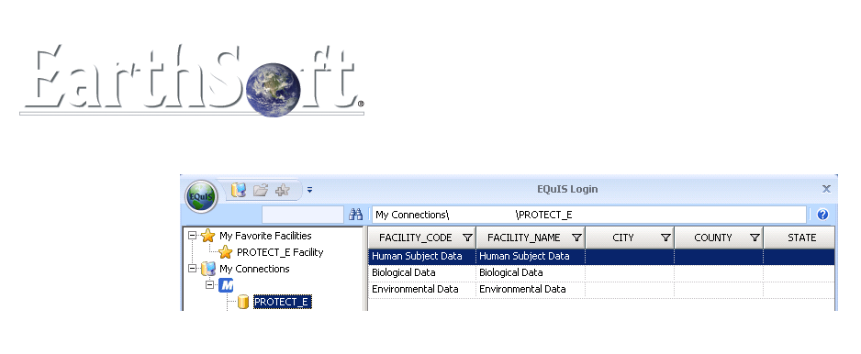


The PROTECT Database
Our system supports web-based authenticated login on a per-project per-user basis
Project/Core PI control access to their data – theme of the BRAID Center
Notes:
21

Slide 22

The PROTECT Database
Our system provides multiple export formats to support a range of analysis required by the PROTECT program
Notes:
22

Slide 23
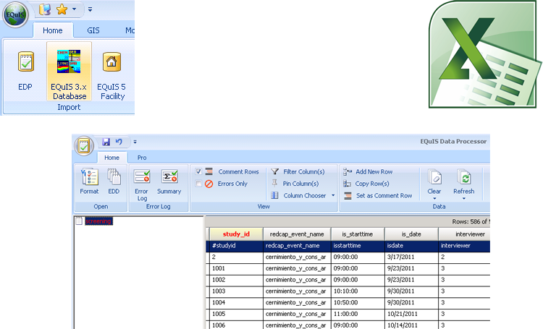
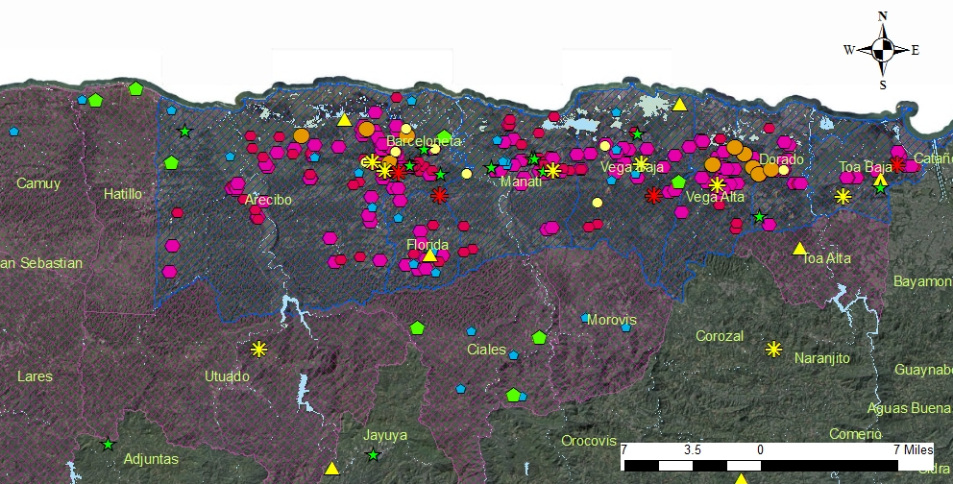
The PROTECT Database
    The EarthSoft EQuIS™ Data Processor (EDP) allows for significant online analysis of relational query results in an integrated and online environment
    Ongoing work will utilize EarthSoft EQuIS™ Enterprise to enable full online query capabilities
Notes:
23

Slide 24
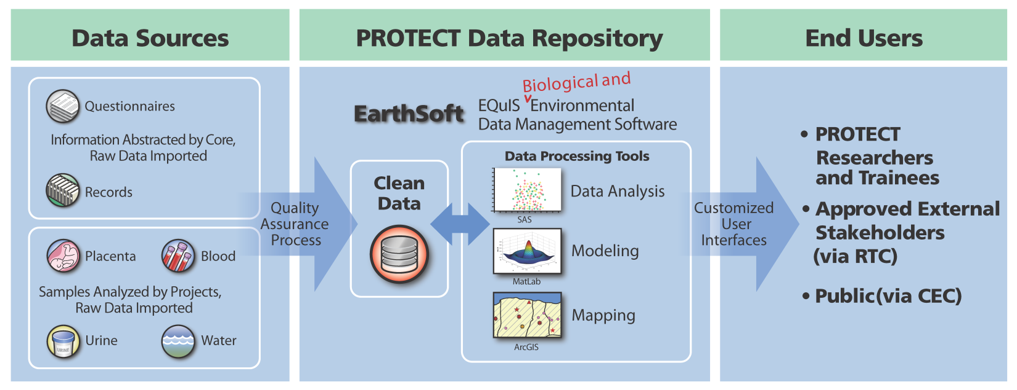
Knowledge Management (Data Core)
Notes:
24

Slide 25
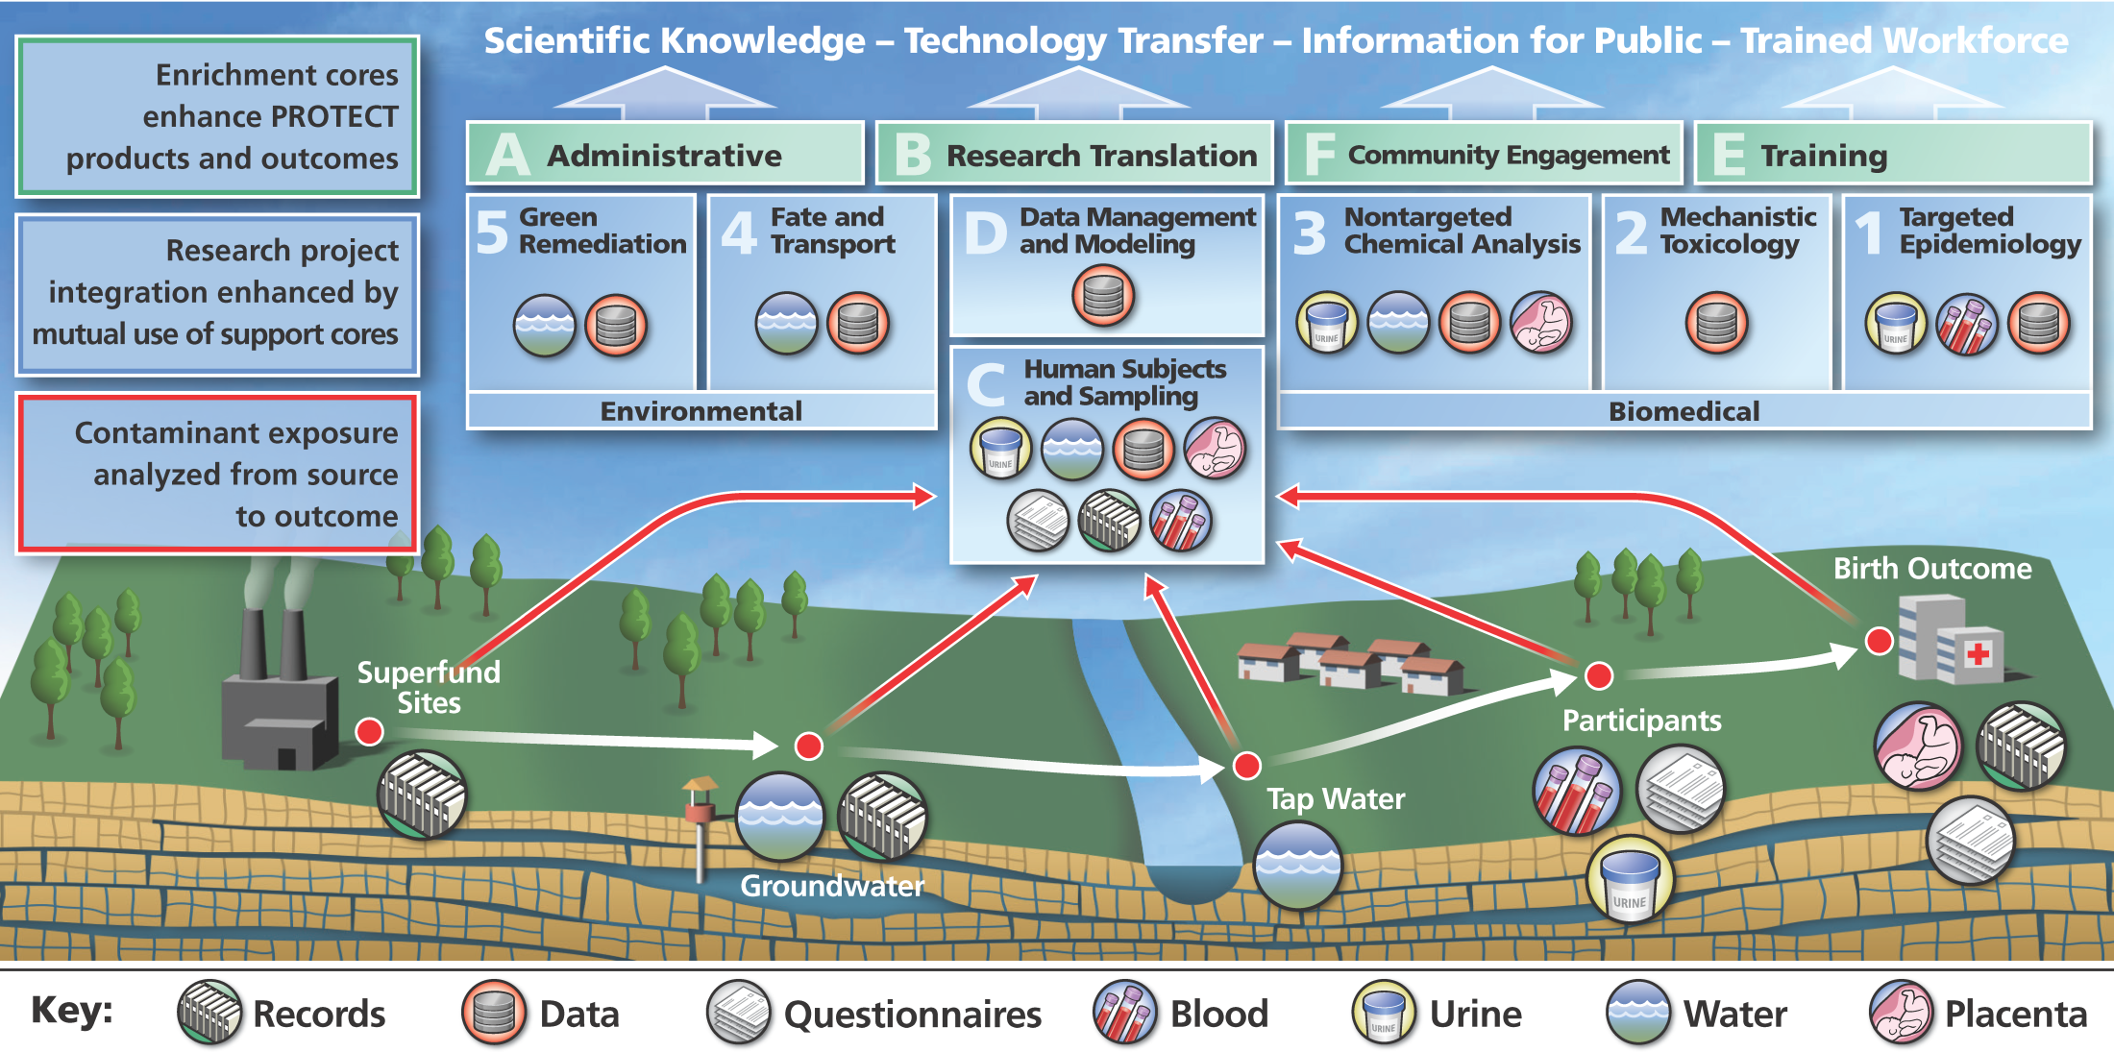
Application of GIS to Assess Spatial Relationships

Slide 26
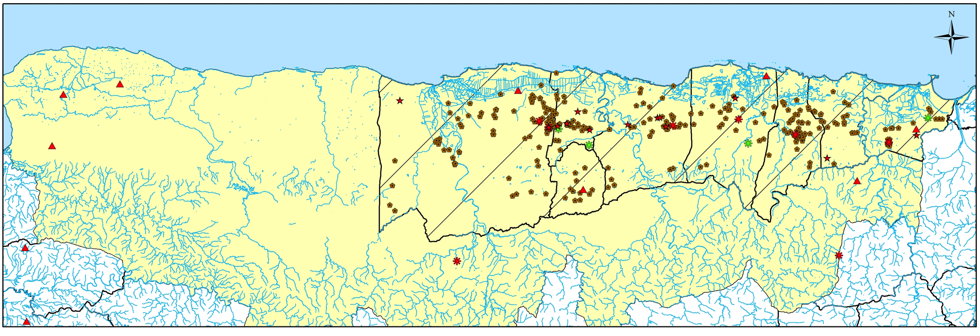
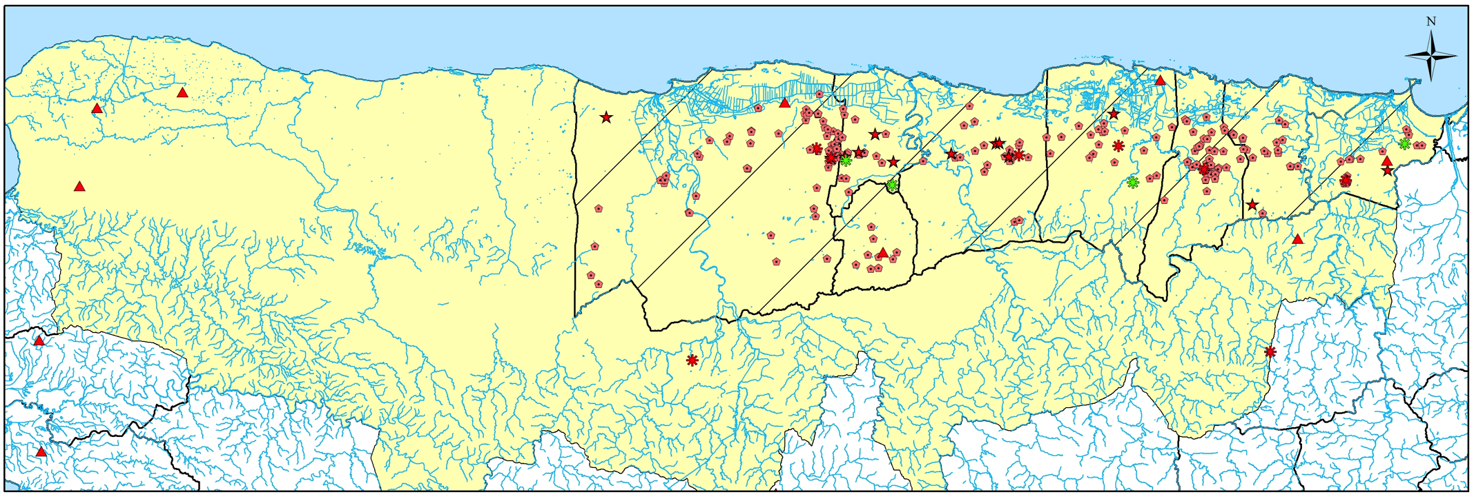
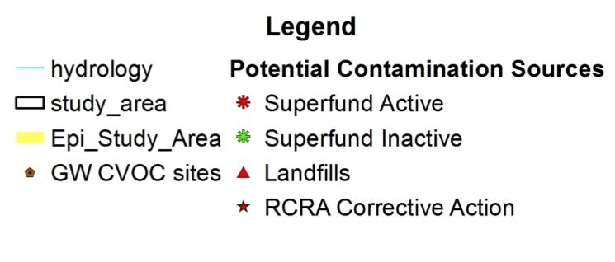


CVOC GW Sampling & Detection Sites
Sampling Sites
CVOC Detection

Slide 27
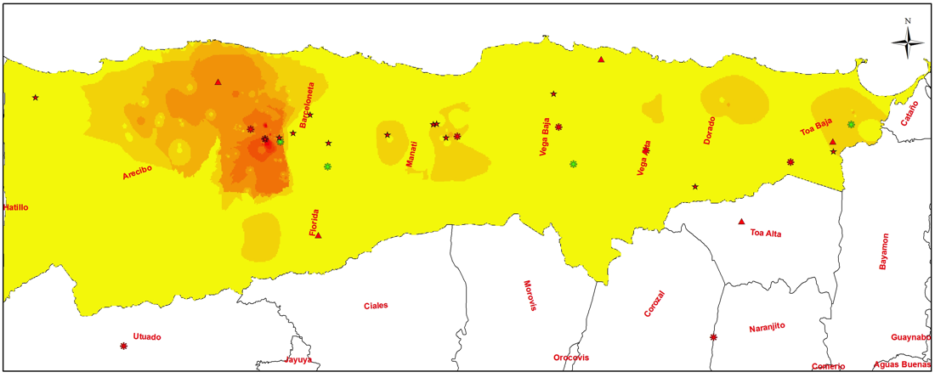
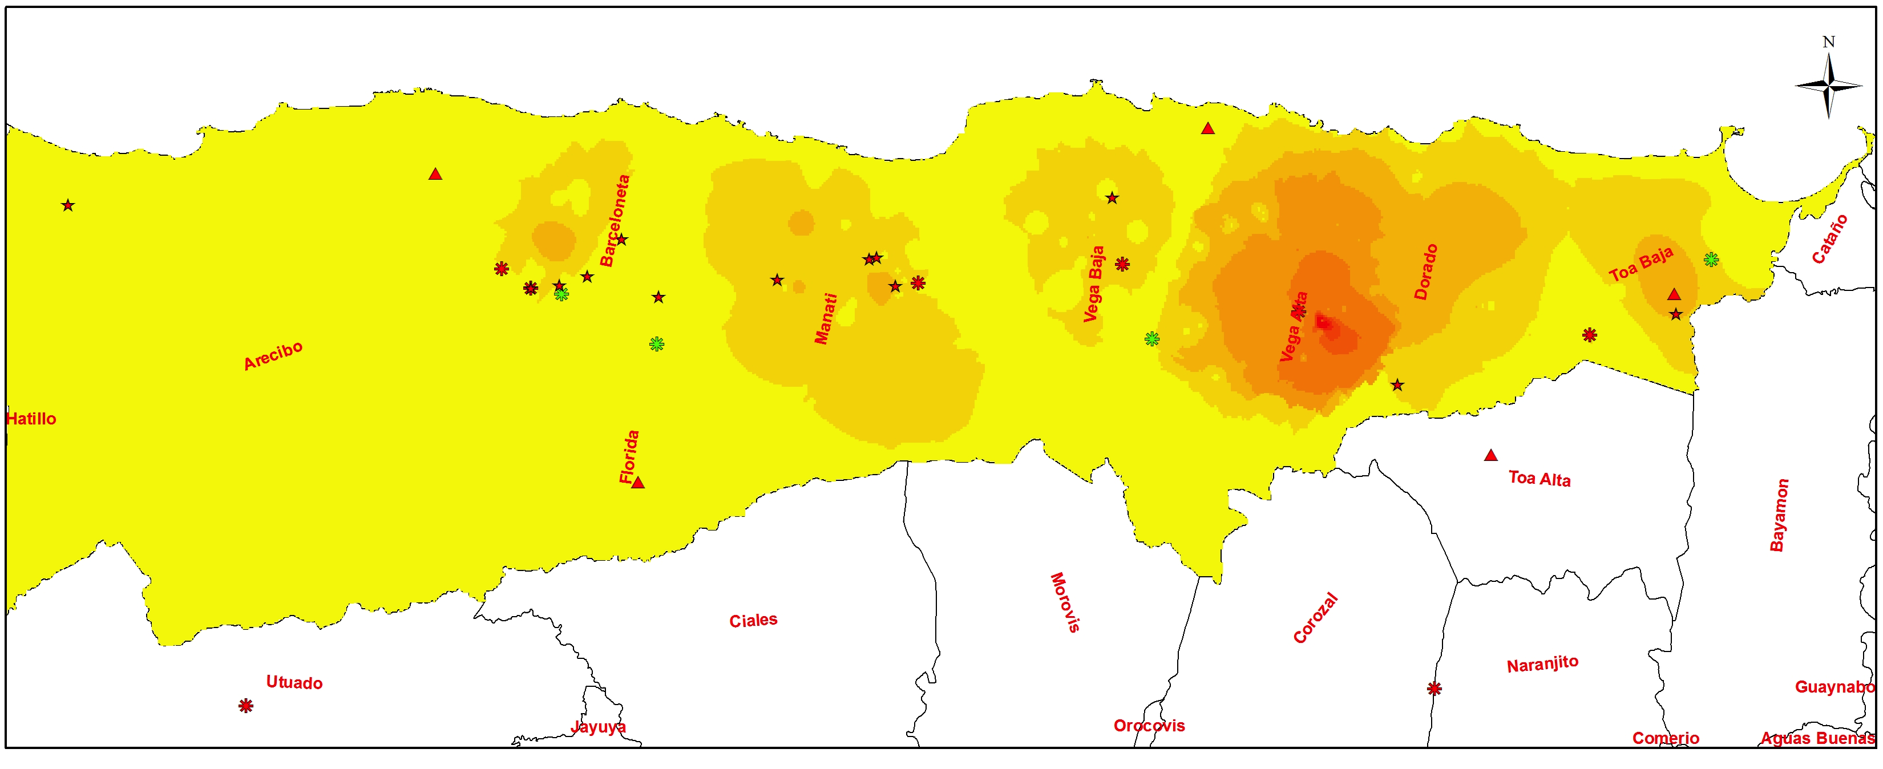
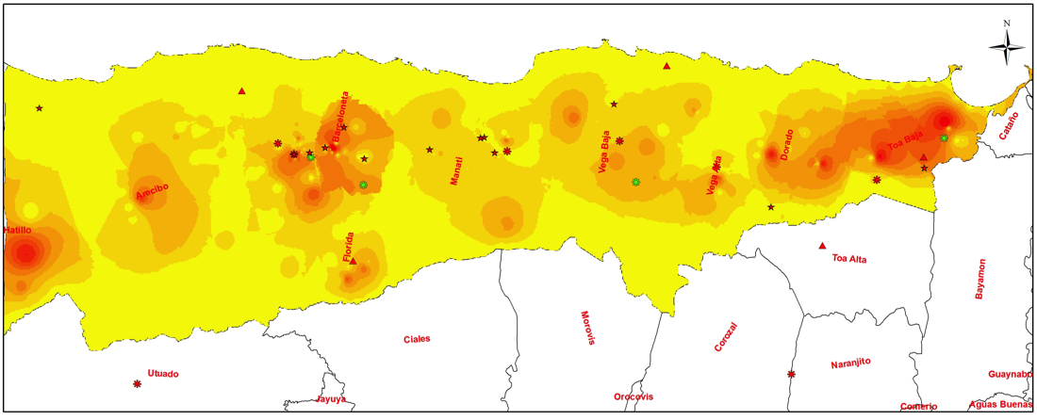
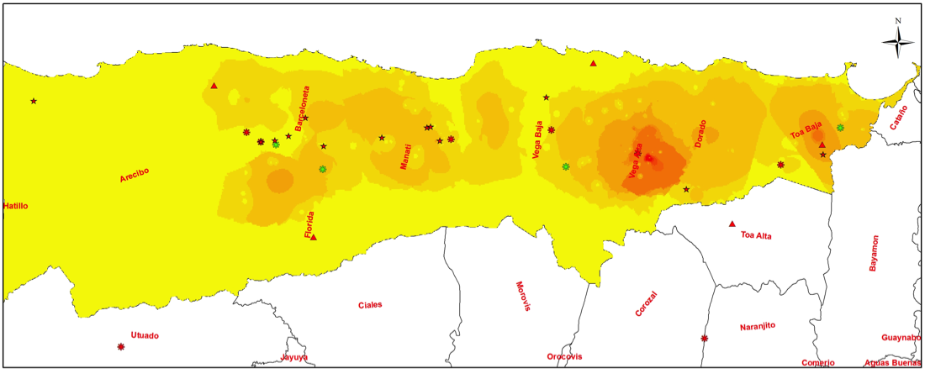
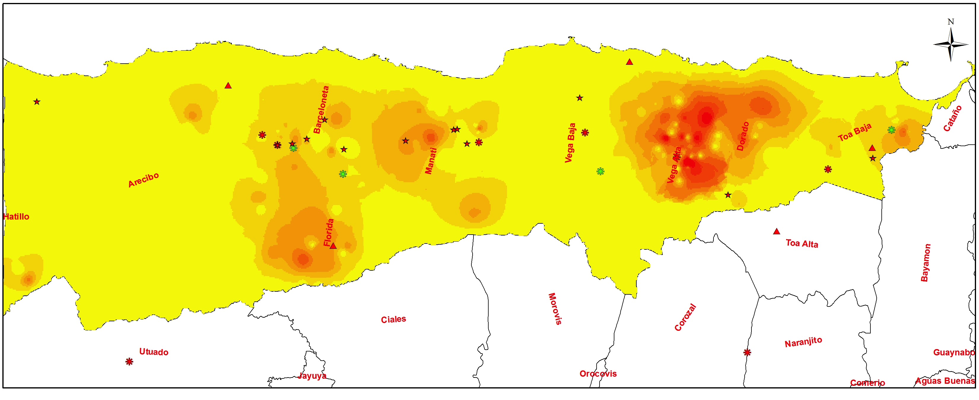
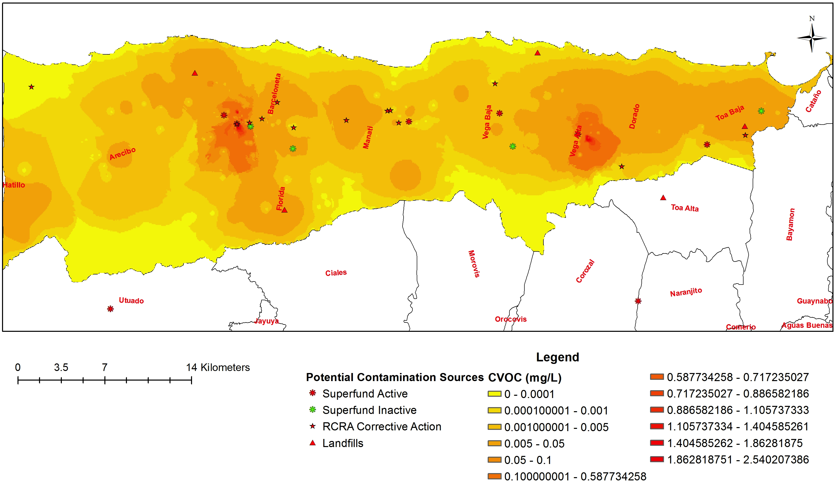
CVOCs GW Concentration Distributions
Carbon Tetrachloride (CT)
Max Range-0.494 mg/L
Trichloroethylene (TCE)
Max Range-0.498 mg/L
Chloroform (TCM)
Max Range-0.0.010 mg/L
Tetrachloroethylene (PCE)
Max Range-0.027 mg/L
Dichloroform (DCM)
Max Range-0.0.010 mg/L
Total CVOCs
Max Range-2.54 mg/L

Slide 28
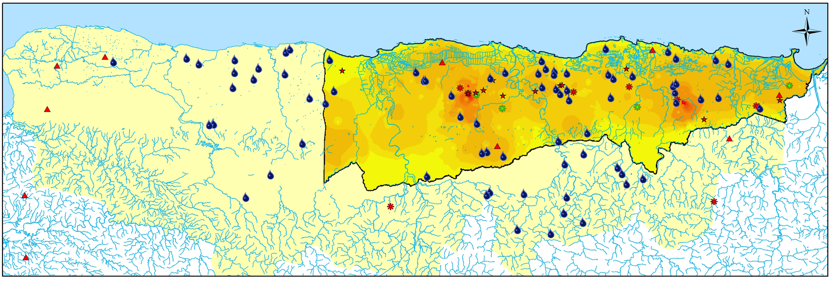
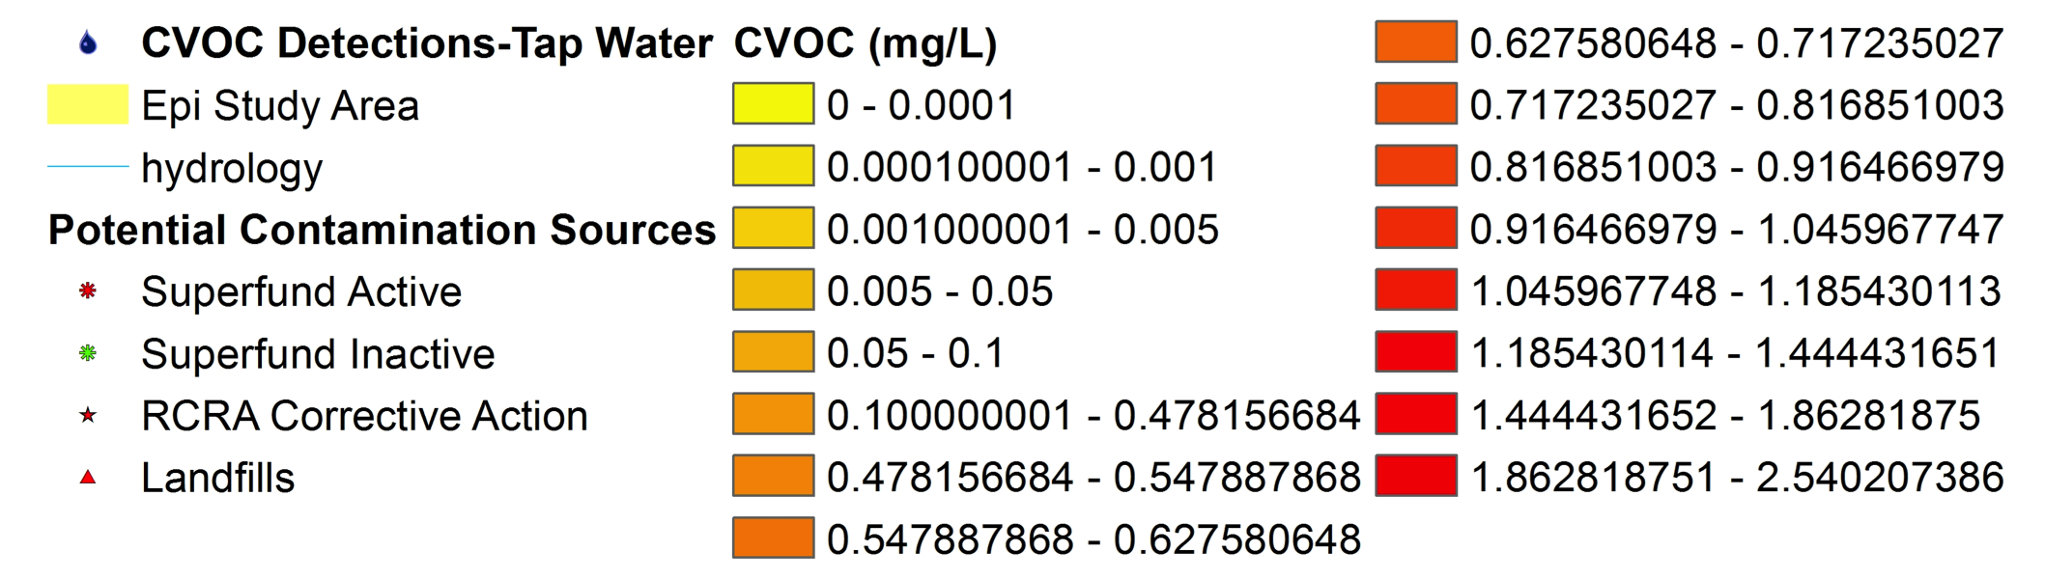

CVOC Concentration Distributions
& Tap Water Detections
Total CVOCs
Max Range: 2.54 mg/L
TCE 9%
PCE 1%
CT 3%

Slide 29
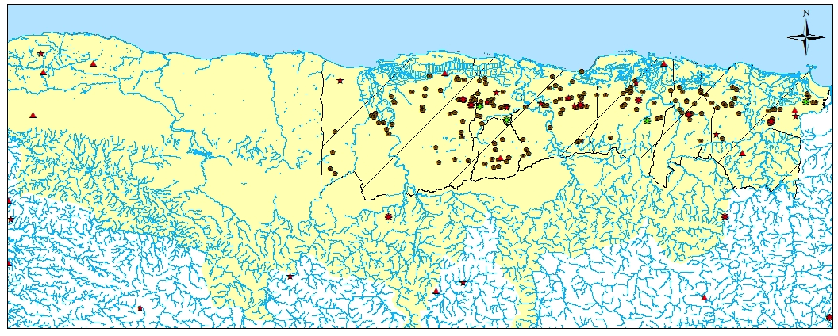
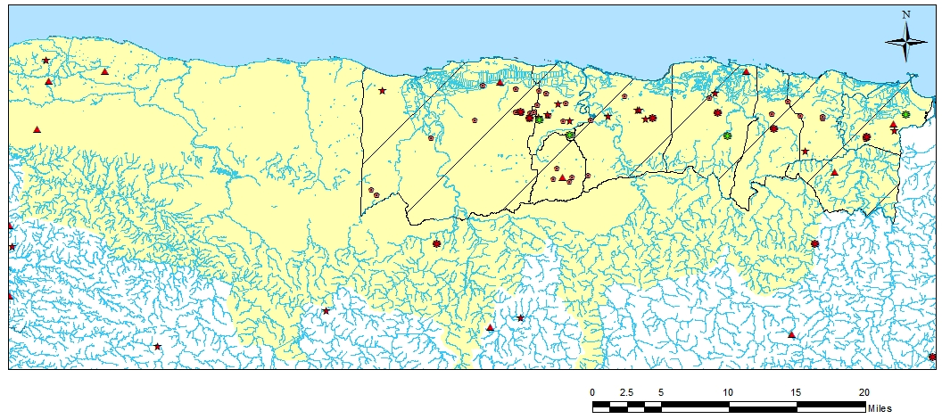
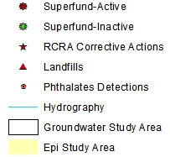
Phthalates GW Sampling & Detection Sites
Notes:
Extensive historical contamination of phthalates

Slide 30
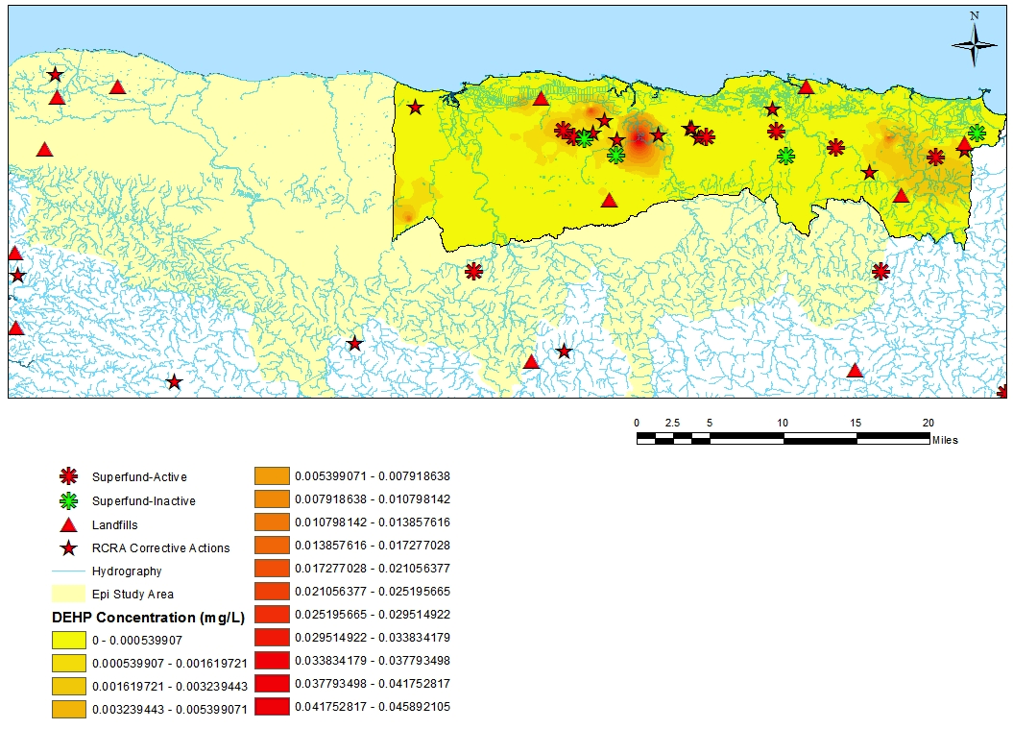
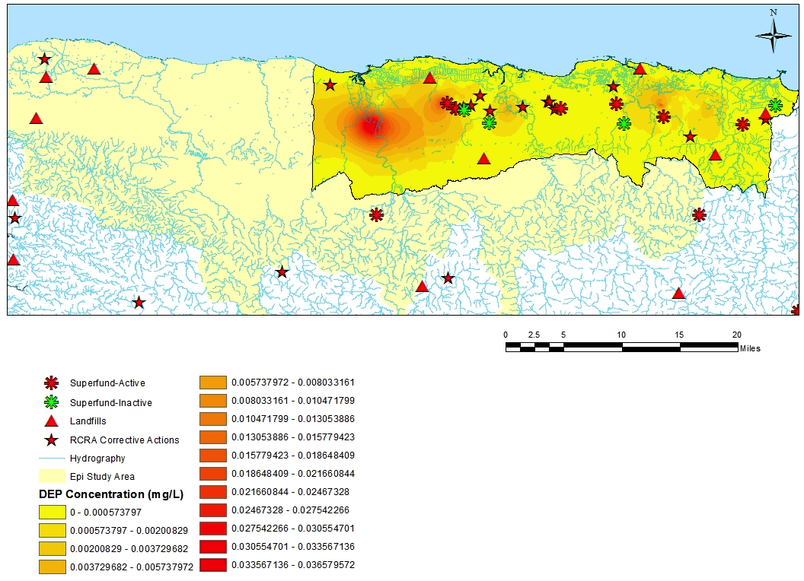
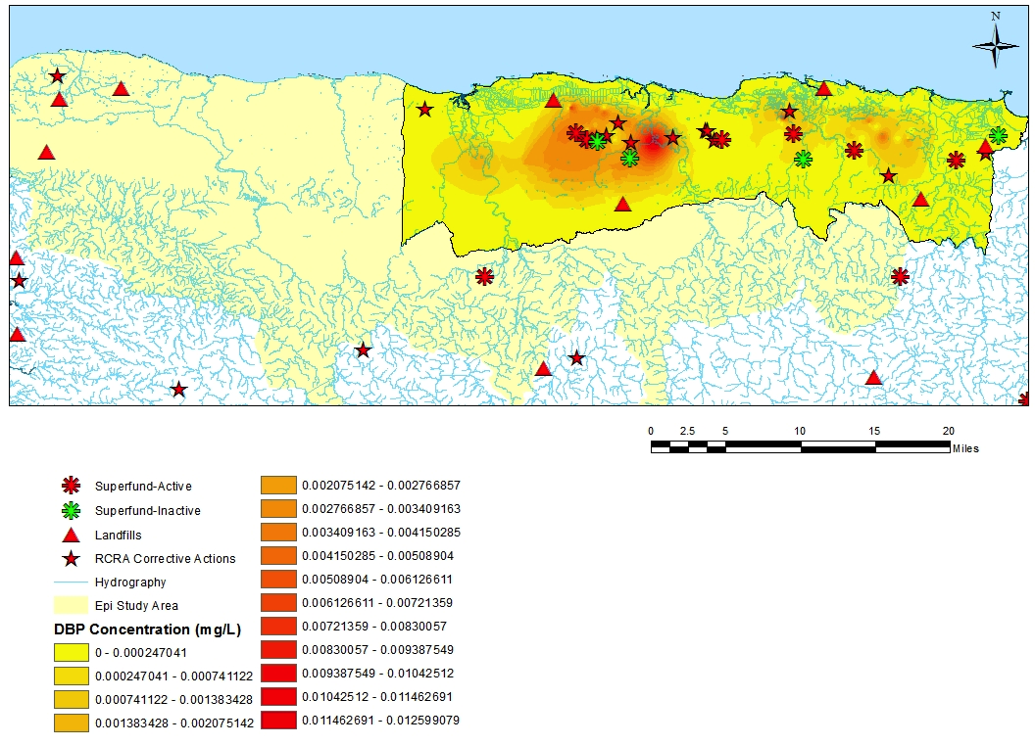
Phthalates GW Concentration Distributions
DEHP
Max Range: 0.038 mg/L
DEP
Max Range: 0.030 mg/L
DBP
Max Range: 0.010 mg/L

Slide 31
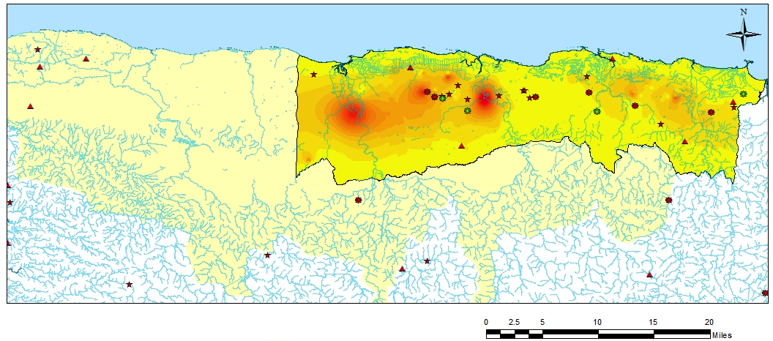
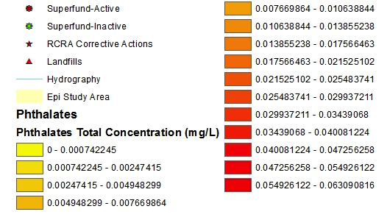
Phthalates GW Concentration Distribution
Total Phthalates Max Range: 0.063 mg/L

Slide 32
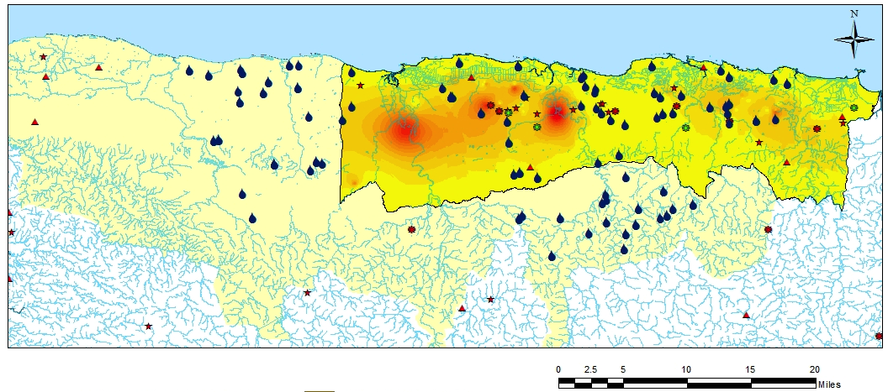
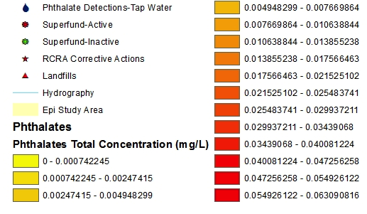
Phthalates GW Concentration Distribution & Tap Water Detection
Total Phthalates Max Range: 0.063 mg/L

Slide 33
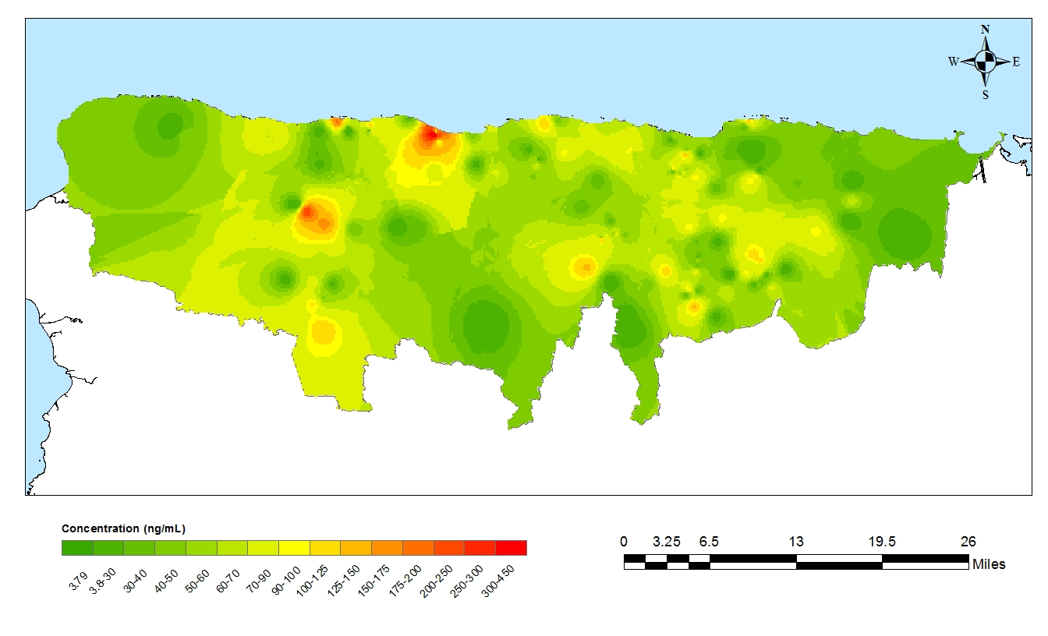
Total Average DEHP Metabolites* in Human Subjects
Total DEHP Metabolites* = MEHP+MECPP+MEOHP+MEHHP n=184
MEHP - Mono-2-ethylhexyl phthalate MECPP - Mono-2-ethyl-5-carboxypentyl phthalate
MEOHP – Mono-2-ethyl-5-oxohexyl phthalate MEHHP - Mono-2-ethyl-5-hydroxyhexyl phthalate

Slide 34
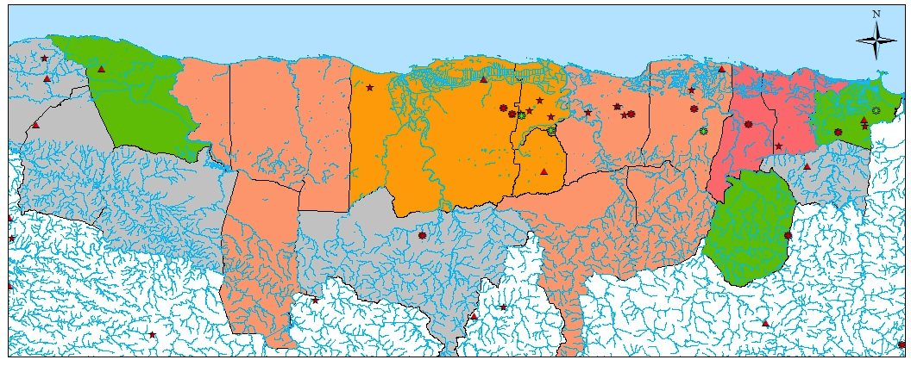

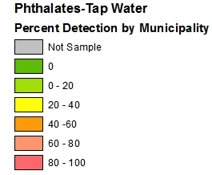
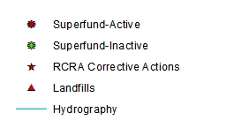
Phthalate %Detection in Tap Water & MEHP Metabolites by Municipality

Slide 35
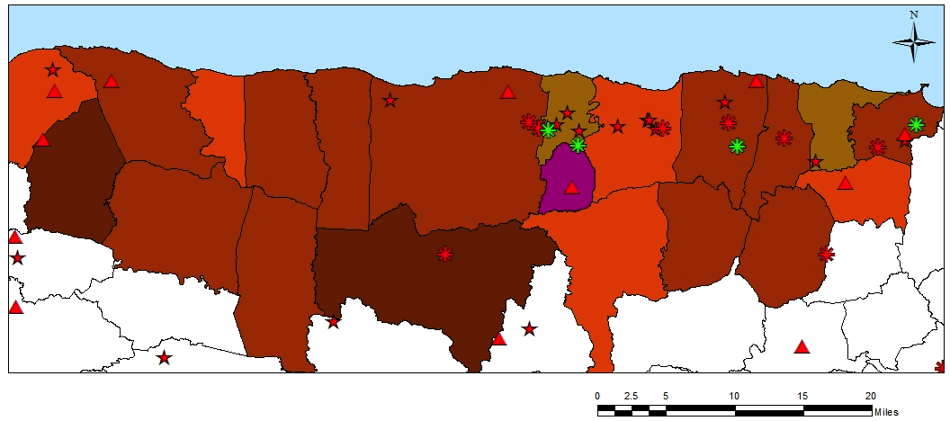
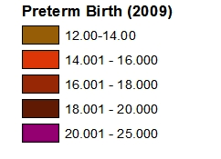
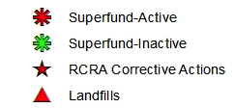
%PTB & Phthalate Tap Water Detection
by Municipality
Data Source: National Center for Health Statistics
%Preterm Birth (2009)
12.0 – 14.0
14.1 - 16.0
16.1 - 18.0
18.1 – 20.0
20.1 – 25.0

Slide 36
%PTB & MEHP Metabolite Detection
by Municipality
Data Source: National Center for Health Statistics
%Preterm Birth (2009)
12.0 – 14.0
14.1 - 16.0
16.1 - 18.0
18.1 – 20.0
20.1 – 25.0

Slide 37
%PTB & TW & MEHP Metabolite Detection
Data Source: National Center for Health Statistics
%Preterm Birth (2009)
%Preterm Birth (2009)
12.0 – 14.0
14.1 - 16.0
16.1 - 18.0
18.1 – 20.0
20.1 – 25.0

Slide 38
Concluding Remarks
  Puerto Rico has had a long history of groundwater contamination which may be associated with high preterm birth (PTB)
  A systematic methodology has been developed to:
    Assess the extent of groundwater contamination in the karst aquifer of northern Puerto Rico
    Relate contamination to drinking water and other modes of exposure
    Assess the presence of contaminants in a human pregnancy cohort
    Establish relationships between contamination and PTB
  Assessment of environmental, exposure, and birth outcome relationships requires collection, storage, and analysis of enormous amount of data
    Database and Data Management
    Spatiotemporal analysis applies GIS and Statistical Technologies

Slide 39
Concluding Remarks
  Preliminary finding
    Large temporal and spatial extent of groundwater contamination that may serve as route of exposure
    Presence of contaminants and metabolites in pregnant women (Cantonwine et al., 2013)
  Ongoing and Future studies
      Continue recruitment, data acquisition, data entry and analysis
        Pregnant women
        Environmental historical & current
        Biomarkers
        Birth Outcomes
      Continue developing tools for integration of projects and data across multidisciplinary fields

Slide 40
Concluding Remarks
  Ongoing and Future studies
      Continue Assessing Correlations
        Groundwater and tap water contamination
        Contaminant sources and presence in pregnant women
        Presence of contaminant/metabolite and PTB
    Exploit recent advances in machine learning and data mining to explore secondary pathways that impact human health
    Discuss with EPA how PROTECT can extend the current EDD standard to integrate human health data and biological data
    Extend the current online capabilities of the system to support integrated analysis/sharing across programs outside of PROTECT
    Develop additional capabilities to share PROTECT data utilizing privacy-preserving technologies - BRAID

Slide 41









Trainees & Staff Acknowledgements
Lisa Anzalota
(MD, UPR-MC)
Celys Irizarry
(GS, UPRM)
Reza Ghasemizadeh (GS, NEU)
Vilda Rivera
(GS, UPRM)
Luis Rivera (PD, UM)
Norma Torres
(GS, UPRM)
Can Yegen (DBA, NEU)
Leiming Yu (GS, NEU)
Xue Yu
(PD, NEU)

Slide 42





Acknowledgements
National Institute of Environmental Health Sciences
This project is supported by Grant Award Number P42ES017198 from the National Institute of Environmental Health Sciences. The content is solely the responsibility of the authors and does not necessarily represent the official views of the National Institute of Environmental Health Sciences or the National Institutes of Health.

